Slide 1
Smart Crop Disease Detection
Deep Learning Model for Crop Leaf Disease Identification
Manu John V S
Registration Number: 23BAI10838 | Application Number: IN26014237

Slide 2


CHALLENGE
Problem Statement
The Core Issue
Delayed Diagnosis
Farmers lack timely, accurate methods to identify crop diseases — manual diagnosis is slow, inconsistent, and demands expert knowledge.
Rapid disease spread before intervention is possible
Crop Loss
Significant yield reduction impacts farmer income
Food Security
Reduced agricultural output at scale threatens supply chains

Slide 3




GOALS
Objective
Automated Detection
High Accuracy
Deep learning model for disease identification from leaf images
Multi-class classification across multiple crop types
Treatment Advice
Deployable Tool
Actionable recommendations based on predicted disease class
Practical for resource-constrained agricultural settings

Slide 4

DATA
Dataset
Source
PlantVillage Dataset
Publicly available, large-scale leaf image collection stratified by crop type and disease class for balanced training.
Organize
Preprocess
Crop Types
Classes
Tomato · Potato · Corn · Apple · others
Healthy and diseased leaf categories per crop

Slide 5
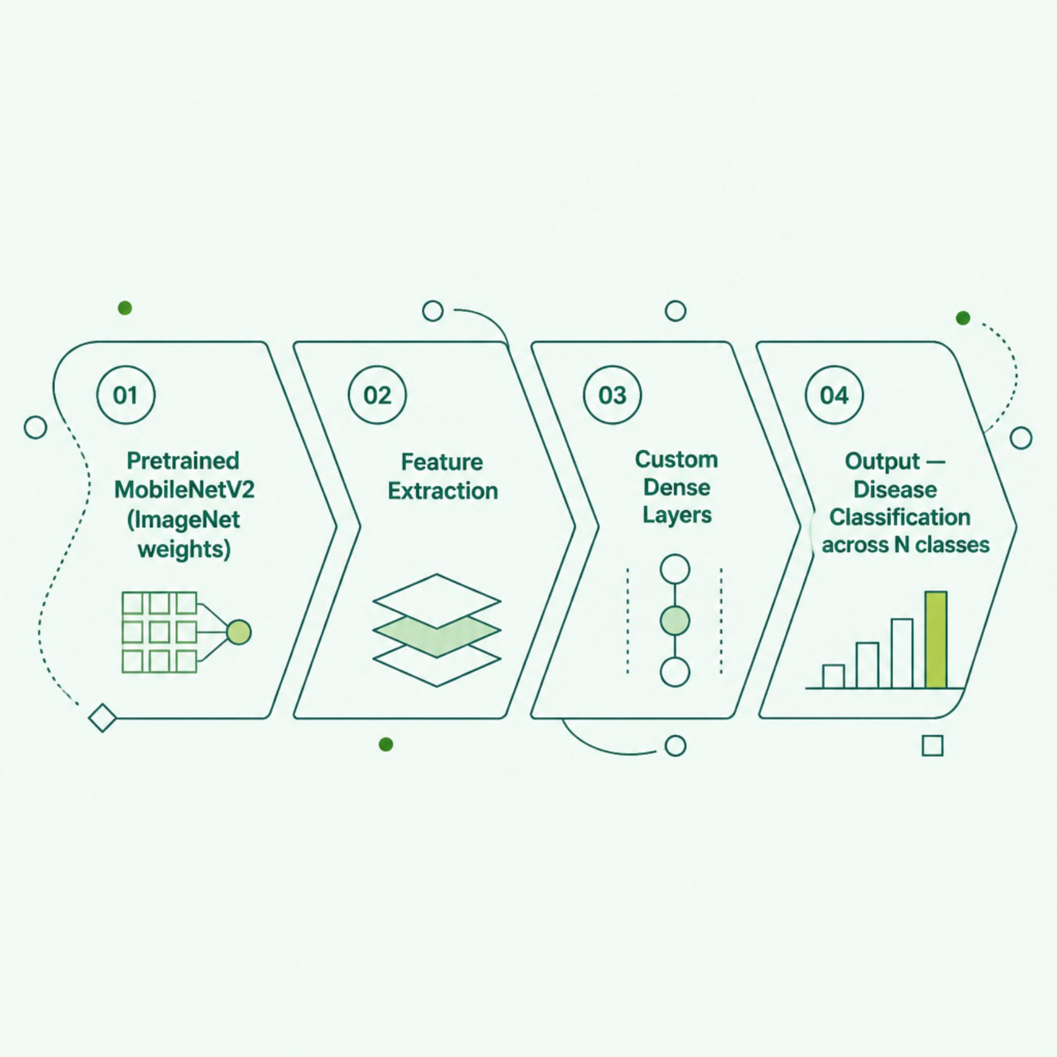
APPROACH
Methodology
Transfer Learning
Leverages feature representations learned from ImageNet — reducing training time and data requirements significantly.
Base Model: MobileNetV2 pretrained on ImageNet
Custom Head: Task-specific dense layers replacing final classification layer
Strategy: Two-phase training for optimal convergence

Slide 6

ARCHITECTURE
Model Architecture
MobileNetV2
GlobalAvgPool
Dense Layers
Softmax Output
Dropout 0.5
MobileNetV2 backbone extracts rich visual features; the custom head maps these to N disease classes + healthy across crop types via softmax probability distribution.

Slide 7

TRAINING
Training Process
Phase 1 — Classifier Head
Phase 2 — Fine-Tuning
Freeze MobileNetV2 base weights
Train custom dense layers only
Duration: 10–15 epochs
Unfreeze top base model layers
Low learning rate: 1e-5 to 1e-4
Duration: 10–20 epochs
Optimization: Adam optimizer with categorical cross-entropy loss function

Slide 8
INFERENCE
Prediction & Treatment Recommendation
01
02
03
Input
Preprocess
Inference
User uploads leaf image via application interface
Image resized and normalized to model input specifications
Model outputs probability distribution across disease classes
04
05
Predict
Recommend
Highest probability class selected as predicted disease
Disease name, confidence score, and treatment steps returned

Slide 9
RESULTS
Results
Key Metrics
Evaluation Breakdown
Training Metrics: Accuracy and loss curves across epochs
Validation Metrics: Generalization performance over held-out data
Per-Class Performance: Precision, recall, and F1-score per disease class
Confusion Matrix: Misclassification analysis — model strengths and weaknesses
Training Accuracy
Validation Accuracy
[Insert %]
[Insert %]
Convergence Epoch
[Insert number]

Slide 10

SUMMARY
Conclusion & Future Scope
Key Achievements
Future Improvements
Transfer learning model for automated crop disease detection
High accuracy multi-class classification
Practical tool for rapid field diagnosis
Expand dataset with field-collected images for robustness
Deploy as mobile application for offline field use
Integrate real-time camera feed for continuous monitoring
Extend to additional crop types and disease classes
Ensemble methods for increased prediction confidence

