Slide 1
Analysis & Prediction on Coronary Heart Disease
Presenter: Linghe Gong, Connor Parnau, John Biju Varghese
Dec 05, 2024

Slide 2
Outline
Data Cleaning
Preprocess
Factor & Correlation
Analysis
Further
Prediction
Notes:
3 main parts (introduction) – normal procedure of data analysis

Slide 3
Review & Introduction
Notes:
Brief review + introduction

Slide 4
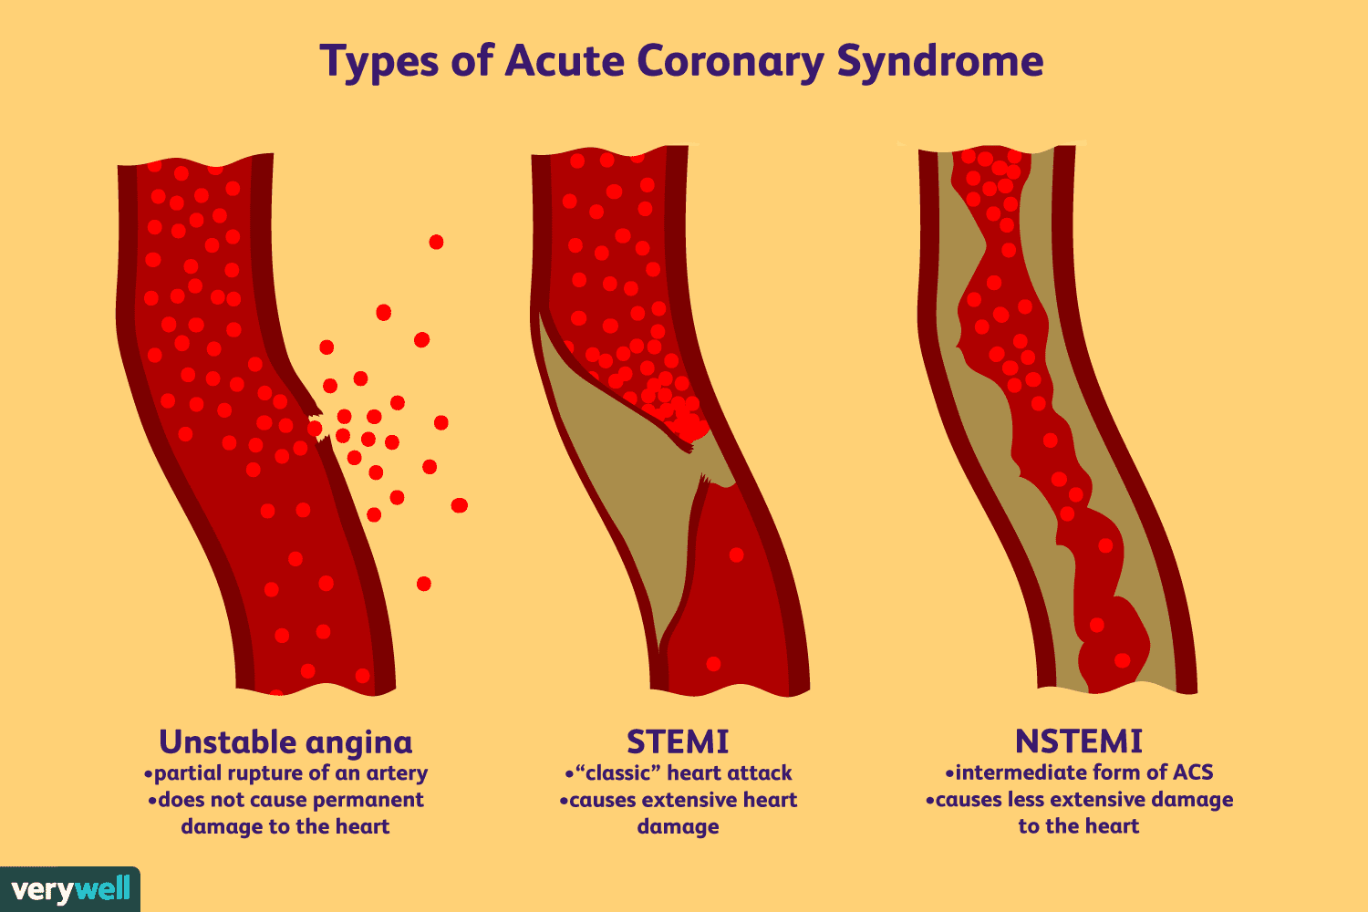
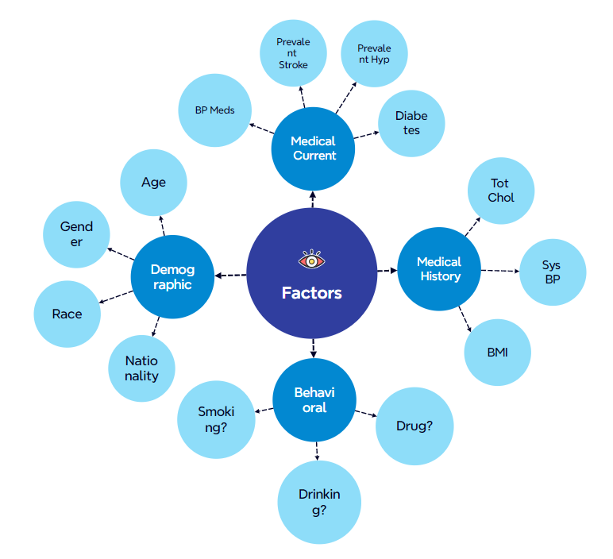
Review - Background
Facts about CHD
Factors inducing CHD
Most common type of heart disease
Leading cause of death
Huge estimated cost
Demographic
Behavioral
History medical risk
Current medical risk

Slide 5
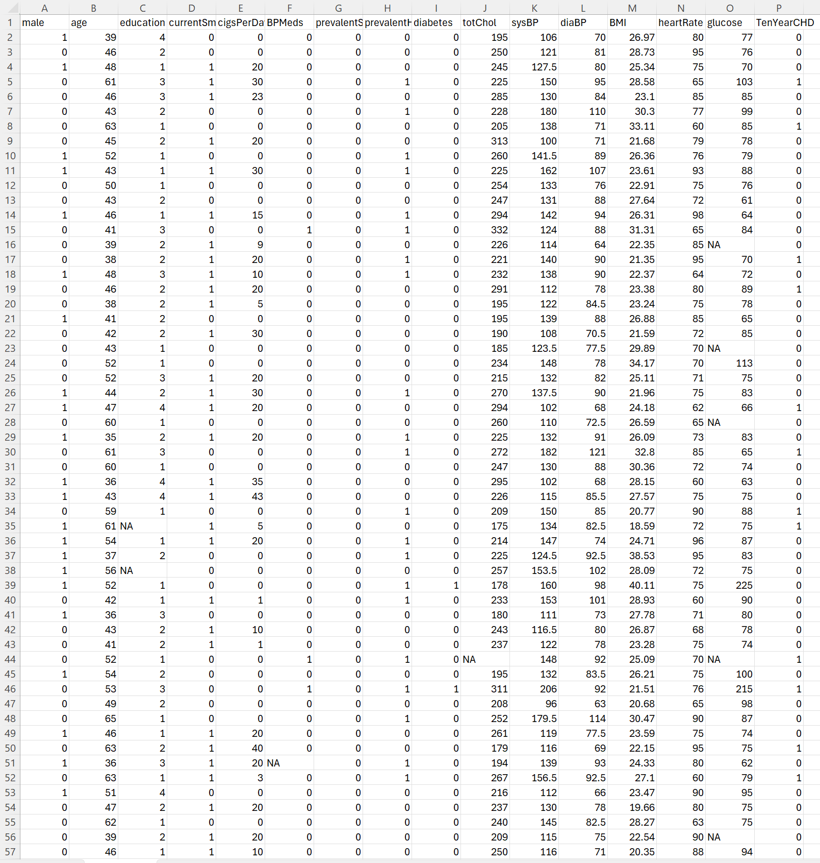
Review - Dataset
Content of dataset
Original Dataset
- Number: over 4000
- Attributes:16 (including target)
- Types: categorical & numerical
- Format: mostly clean

Slide 6
Core Questions
Descriptive questions
Technical questions
Do attributes have correlation between each other?
What are the principal components or latent factors underlying the dataset?
What will be the characteristics of people with high risk of getting disease?
If there exists a skewed or non-normal distribution in the data that requires transformation?
How does the predictive accuracy of machine learning models show?
What is the optimal level of data granularity for analysis?

Slide 7
Goal
Can we predict the 10-year risk of cardiovascular disease in individuals?

Slide 8
Data Preprocessing

Slide 9
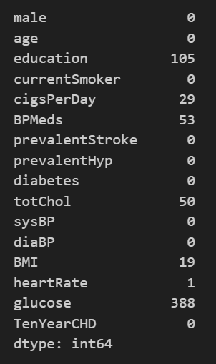
Data missing
1. education
2. cigsPerDay
3. BPMeds
4. totChol
5. BMI
6. heartrate
7. glucose

Slide 10
Preprocessing Tool
Straightforward Remove
Mean Interpolation
- ('education', 'BMI') : personal demographics could be removed
- ('cigsPerDay') : All NA values are not 0 since they are all current smokers
- ('heartRate') : only 1 record
- ('BPMeds') : based on the current blood pressure condition, will be 1 if urgent condition currently, else 0.
- ('totChol') : 3 ranges (underweight - normal - overweight) according to BMI
- ('glucose'): 2 fill-in number based on diabetes or not

Slide 11
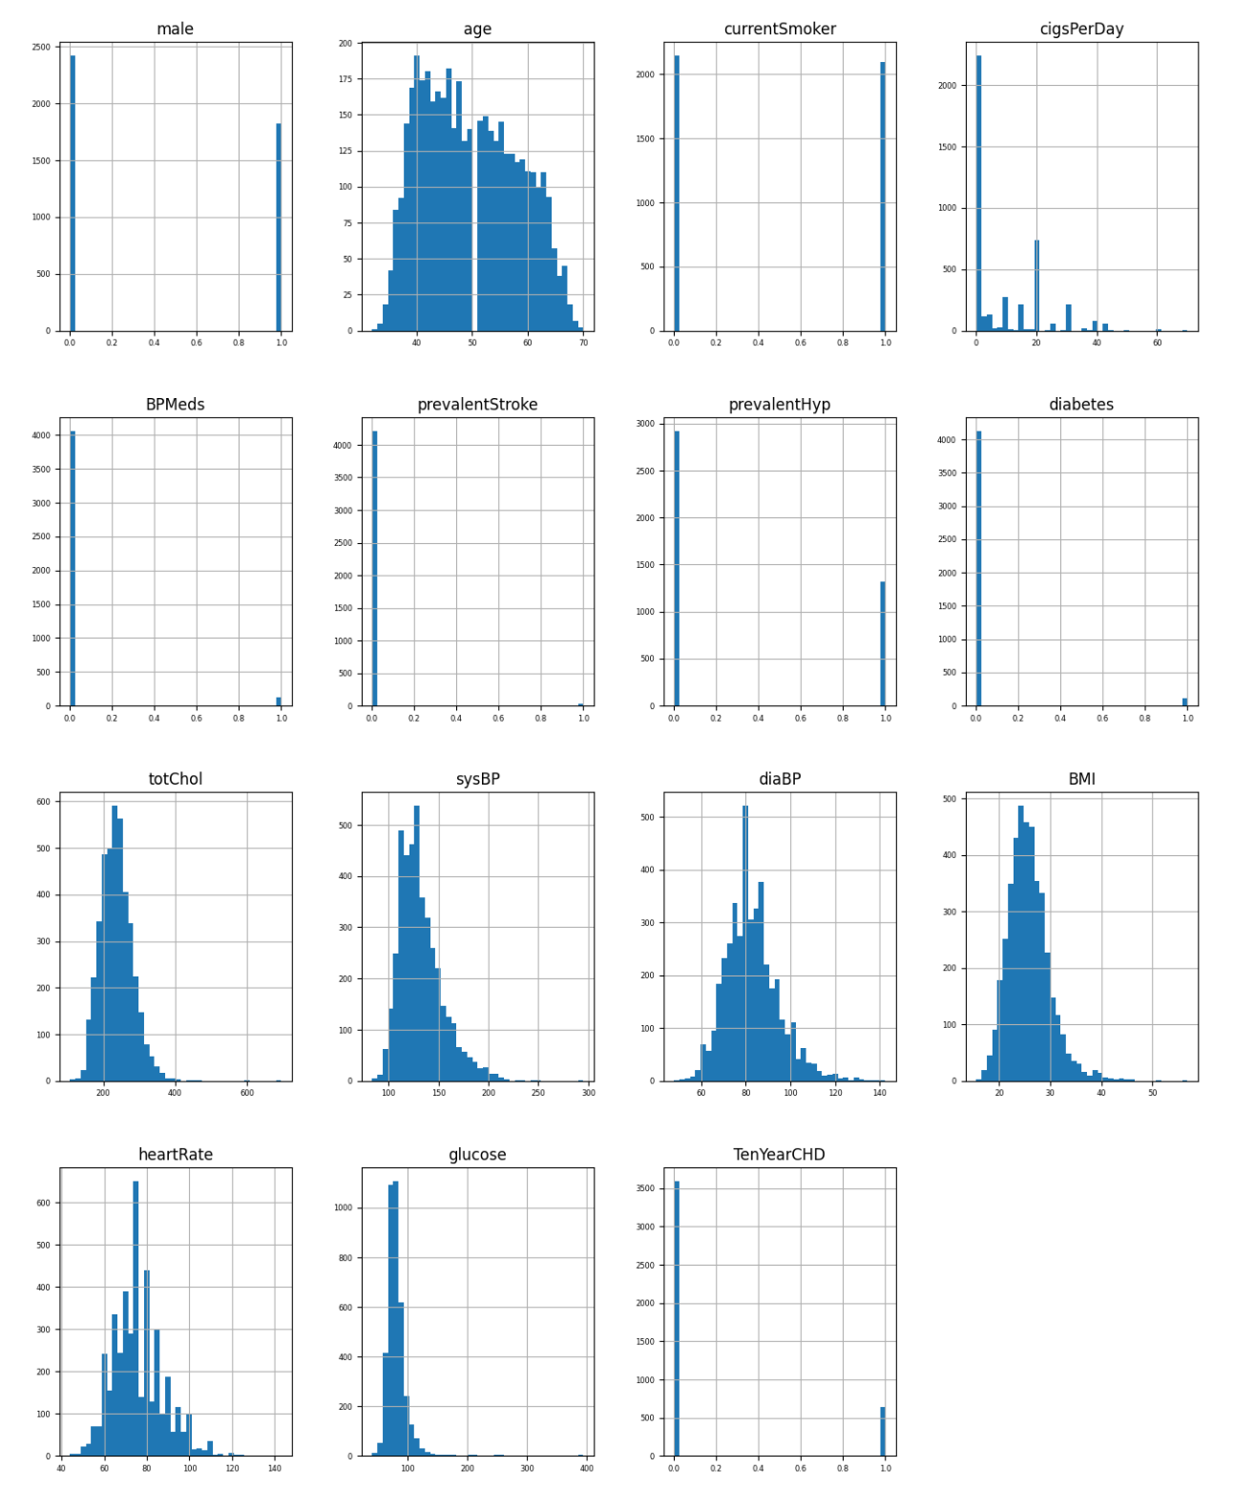
Data Overview
What is the distribution of TenYearCHD?
0 >> 1
Why Imbalanced data matters?
Biased Models: The model may predict the majority class more often, ignoring the minority class
Poor Performance Metrics: Accuracy may appear low if the model ignores the minority class.

Slide 12
EDA part 1. Overall Factor Analysis

Slide 13


Generalized Linear Model
Linear Model (lm)
Generalized Linear Model (glm)
Key Assumptions
Linearity
relationship between the predictors and the response
Normality
The residuals (errors) are normally distributed
Independence
Observations are independent of each other
extends the linear model to allow for:
Non-normal response distributions
The dependent variable can follow distributions like Binomial, Poisson, etc.
Nonlinear relationships
relationship between the predictors and the response

Slide 14
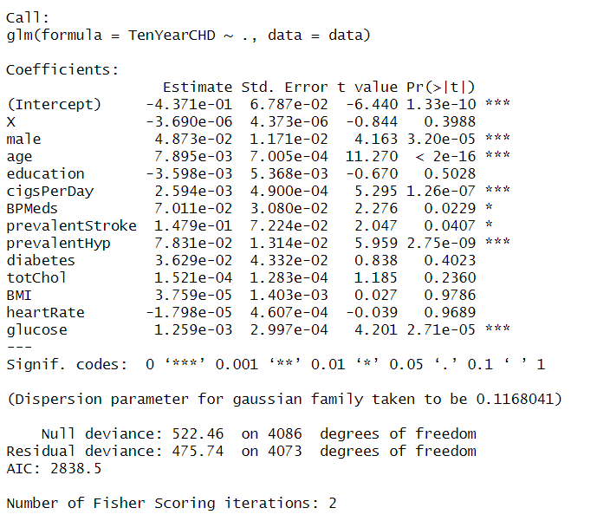
GLM Experiments
Results:
From the results:
Attributes: Male, age, cigsPerDay, BPMeds, prevalentStroke, prevalentHype, glucose
Can we use this result?
Flexibility
Interprebility
Diagnostic tools
But…
Collinearity
High dimensionality
Sensitivity to outliers

Slide 15
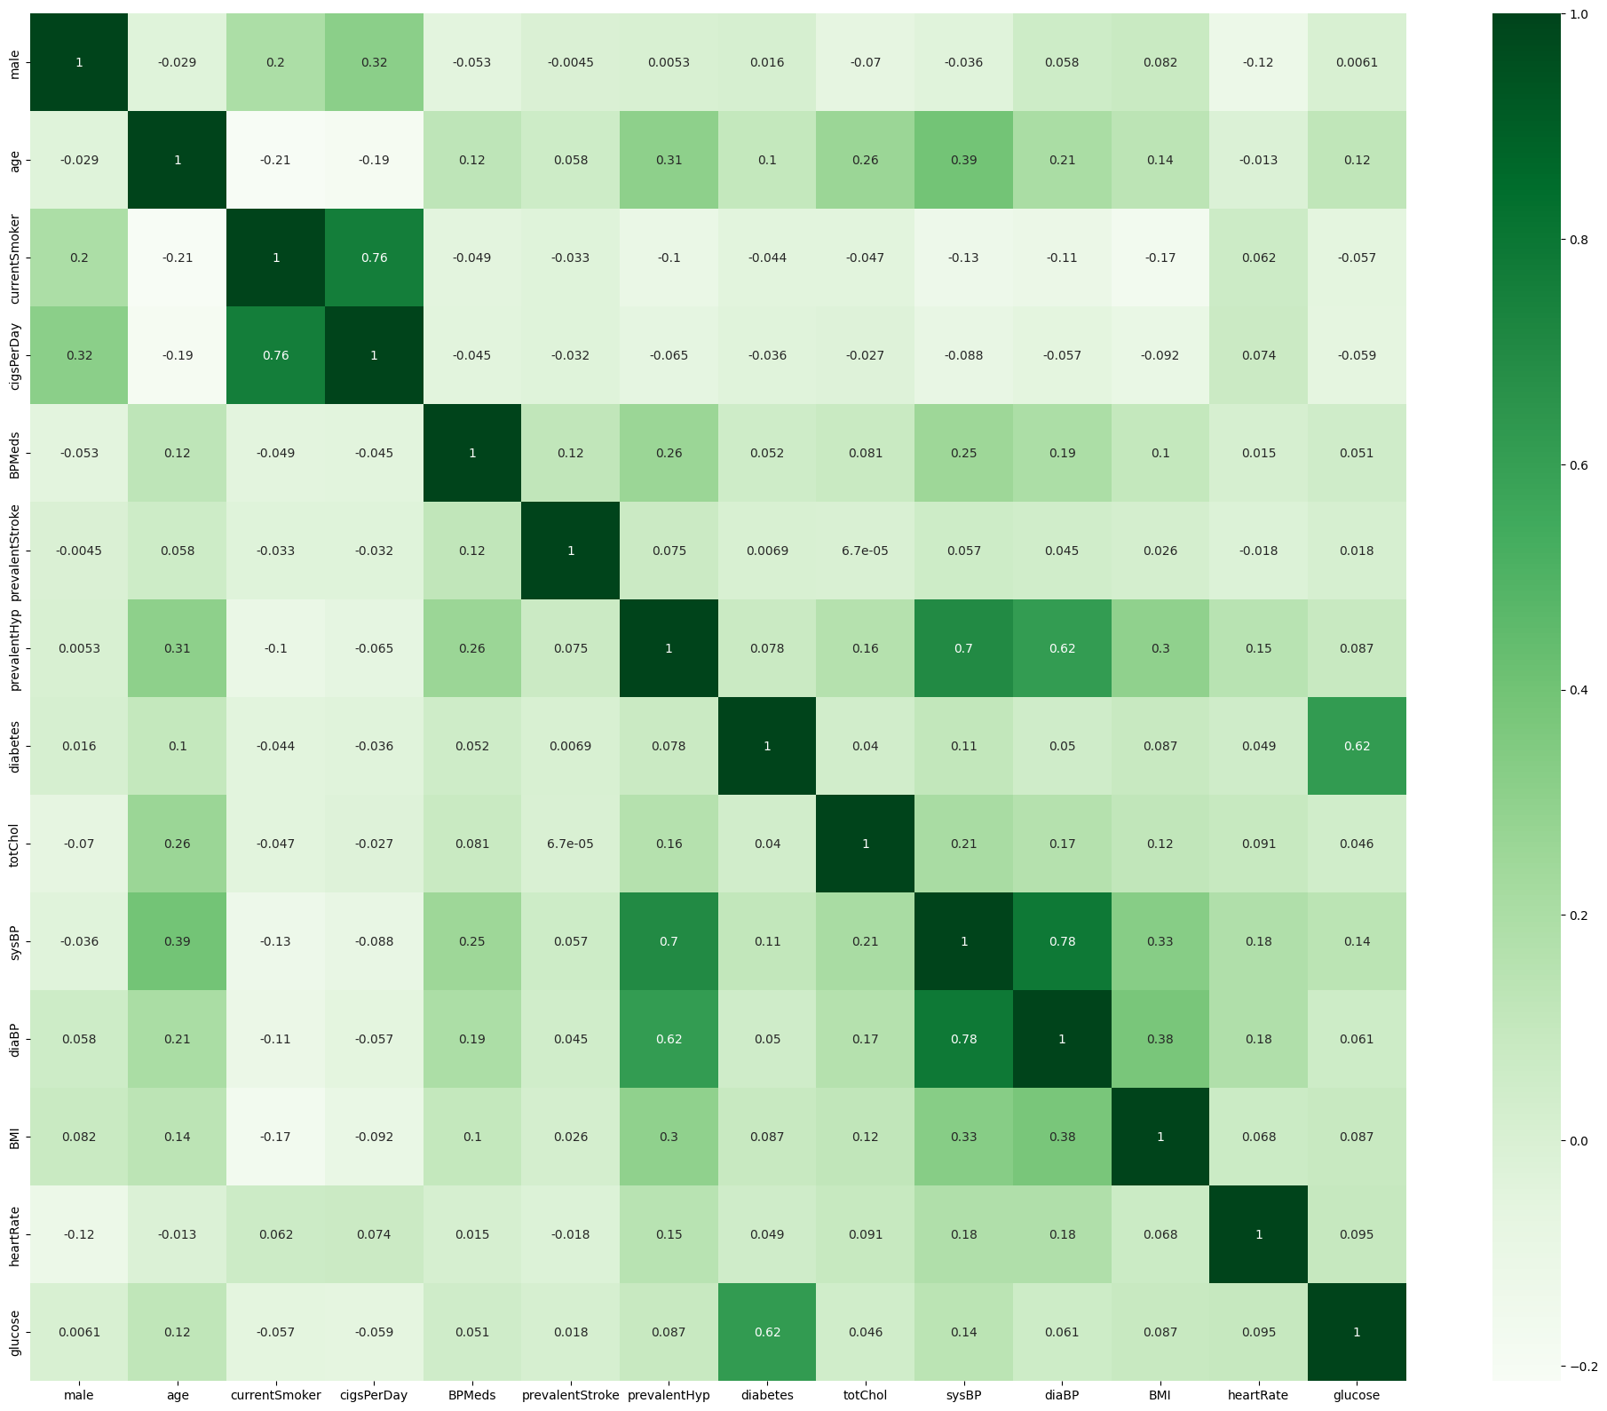
Collinearity From Correlation Heatmap
cigsPerDay and currentSmoker show a strong positive correlation (0.76)
This makes sense as smokers tend to smoke cigarettes daily.
sysBP and prevalentHyp have a strong correlation (~0.7)
likely because hypertension is related to higher systolic blood pressure

Slide 16

Principal Component Analysis (PCA)
Definition
Objective
PC_i​: Principal Component i
wij​: Loading (weight) of variable X_j​ in PC_i
Maximize Variance: Each PC explains the maximum possible variance, subject to being orthogonal to the previous PCs
Dimension Reduction
Collinearity Mitigation
Retain top PCs explaining >95 of variance.
Reduce p-dimensional data to k-dimensions.
High Correlation → Similar Loadings for PC1
Two measurements of the same phenomenon
Similar Loadings for PC1 → Similar direction
capture different aspects of the same underlying phenomenon

Slide 17
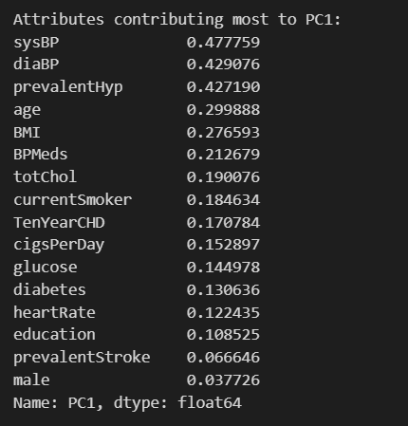
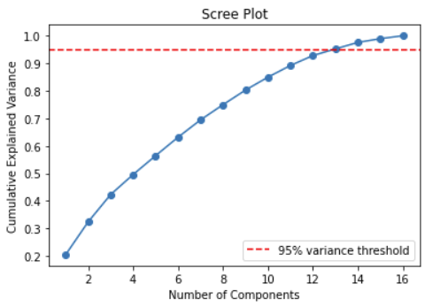
PCA Experiments
Dimensionality
Groups
1. sysBP/diaBP/prevalentHyp
2. totChol/currentSmoker
3. cigsPerDay/glucose
4. diabetes/heartRate
95% Variance threshold – 13 components

Slide 18



Risk-Adjusted Control Chart
Definition
How RACC works
A statistical tool used to monitor and assess performance or quality outcomes while accounting for the risk factors
Commonly used in fields like healthcare where variations in outcomes might be influenced by factors beyond direct control
The risk-adjusted control chart uses expected outcomes, adjusted for risk factors, to determine whether an observation is an outlier
Calculate Expected Outcomes
Compute Observed-to-Expected Ratios
Set Control Limits

Slide 19
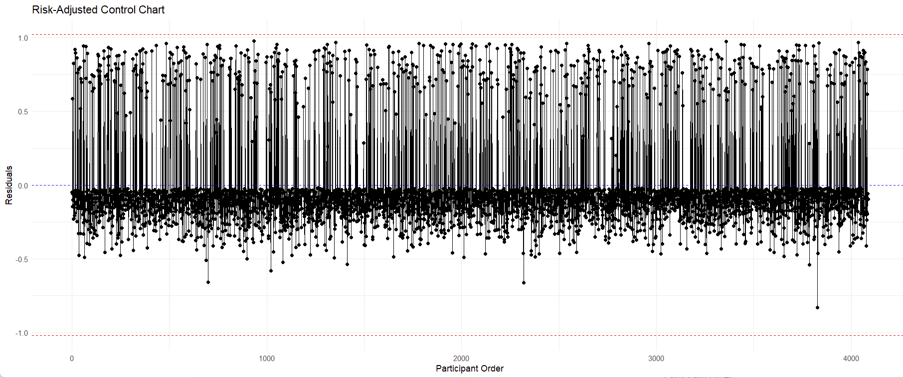
Outlier Check
Observations:
Cluster Around Zero:
Participants' outcomes align closely with their risk-adjusted expectations.
Asymmetry Between Positive and Negative Residuals:
Cases where the observed outcomes significantly exceed expectations (positive residuals).
More cases with small negative deviations, indicating underperformance but within an acceptable range.

Slide 20
XGBClassifier
Definition
Key Features
A machine learning model from the XGBoost library
designed for classification tasks.
XGBoost is an optimized and scalable implementation of gradient boosting
a machine learning technique that builds an ensemble of decision trees to improve model performance.
Support for Multi-Class and Binary Classification
Use for binary classification (e.g., spam vs. not spam) or multi-class classification tasks
Optimized Performance:
Known for its speed and efficiency, leveraging parallel processing, regularization (L1 and L2)
Flexible Parameters:
Provides extensive control over the training process, with parameters like learning rate, maximum tree depth, number of estimators

Slide 21
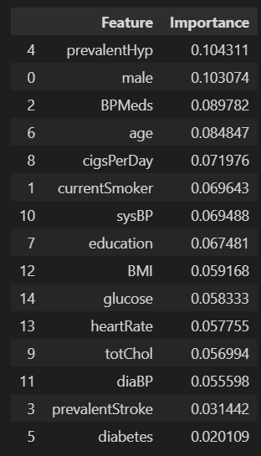
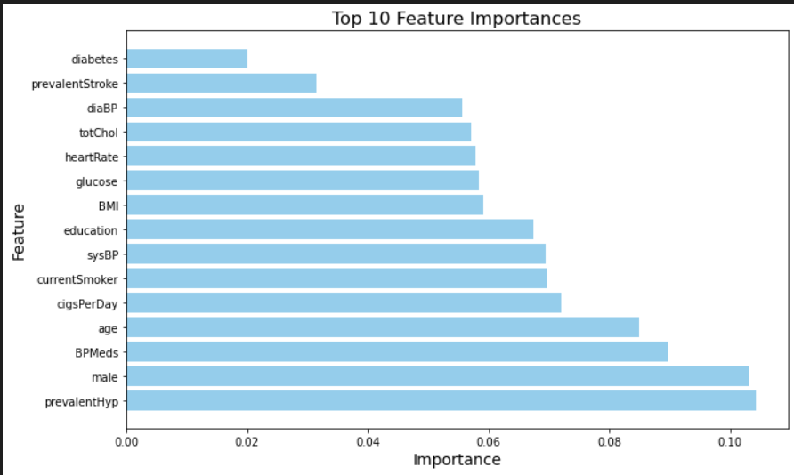
Factor importance
Most Important factors:
prevalentHyp
male
BPMeds
age

Slide 22
EDA part 2. Detailed Correlation & Clustering

Slide 23
EDA – High Level Analytics
Dependent
to
Independent
Dependent
To
Dependent
Statistical
Testing

Slide 24
Dependent to Independent

Slide 25
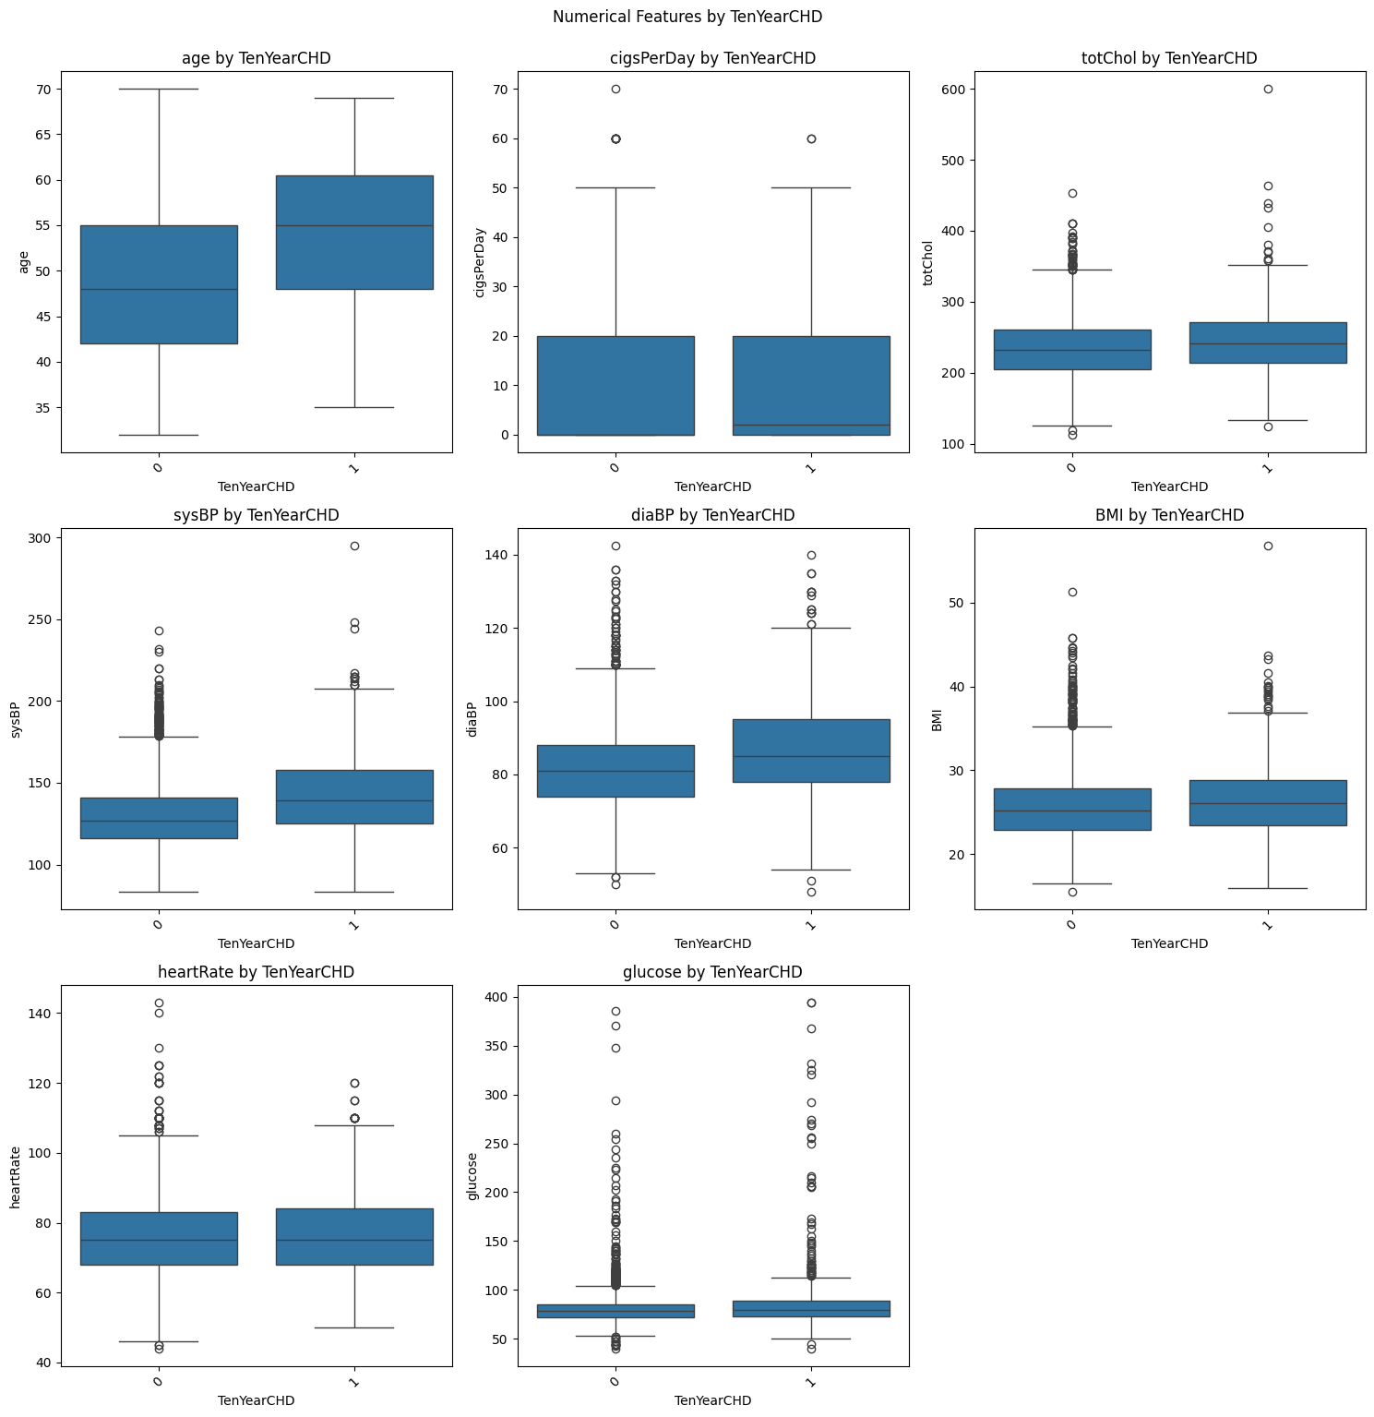
Numerical Feature Relationships with Dependent
Most Numerical Independent Features seem to share relationship with Dependent Feature

Slide 26
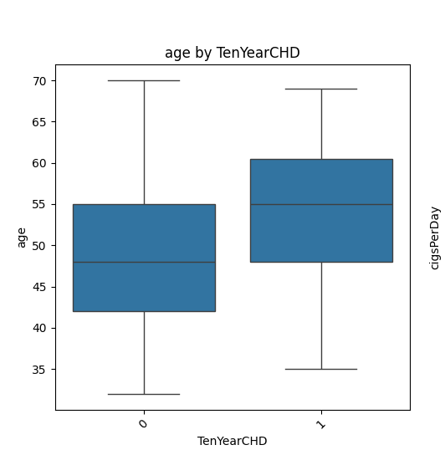
Numerical Feature Relationships with Dependent
Age clearly has a relationship with TenYearCHD

Slide 27
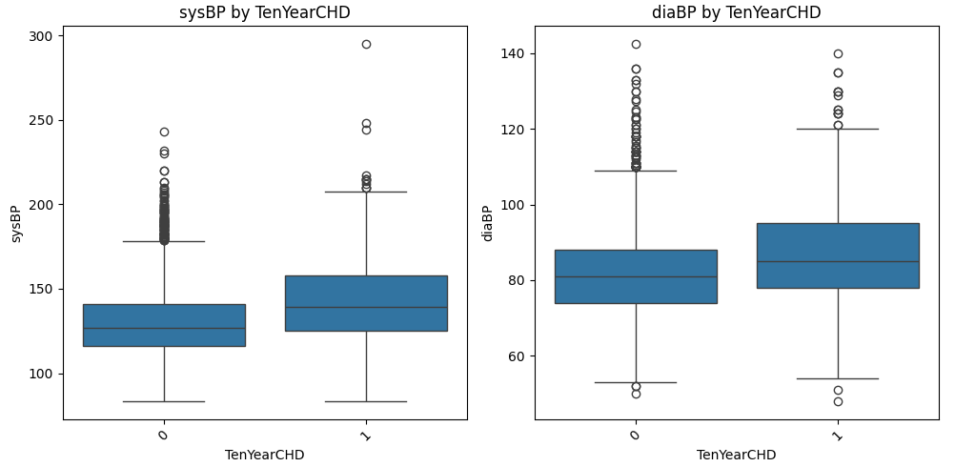
Numerical Feature Relationships with Dependent
Blood Pressure (both Diastolic and Systolic) has a relationship with TenYearCHD

Slide 28
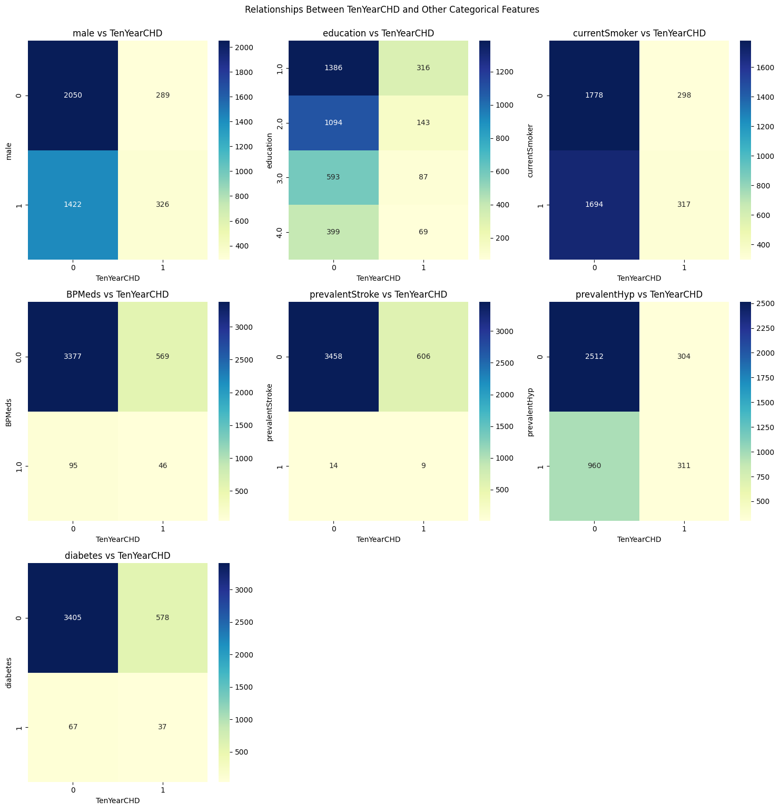
Categorical Feature Relationships with Dependent
Relationships between independent categorical features and dependent features not as clear from raw count visualizations

Slide 29
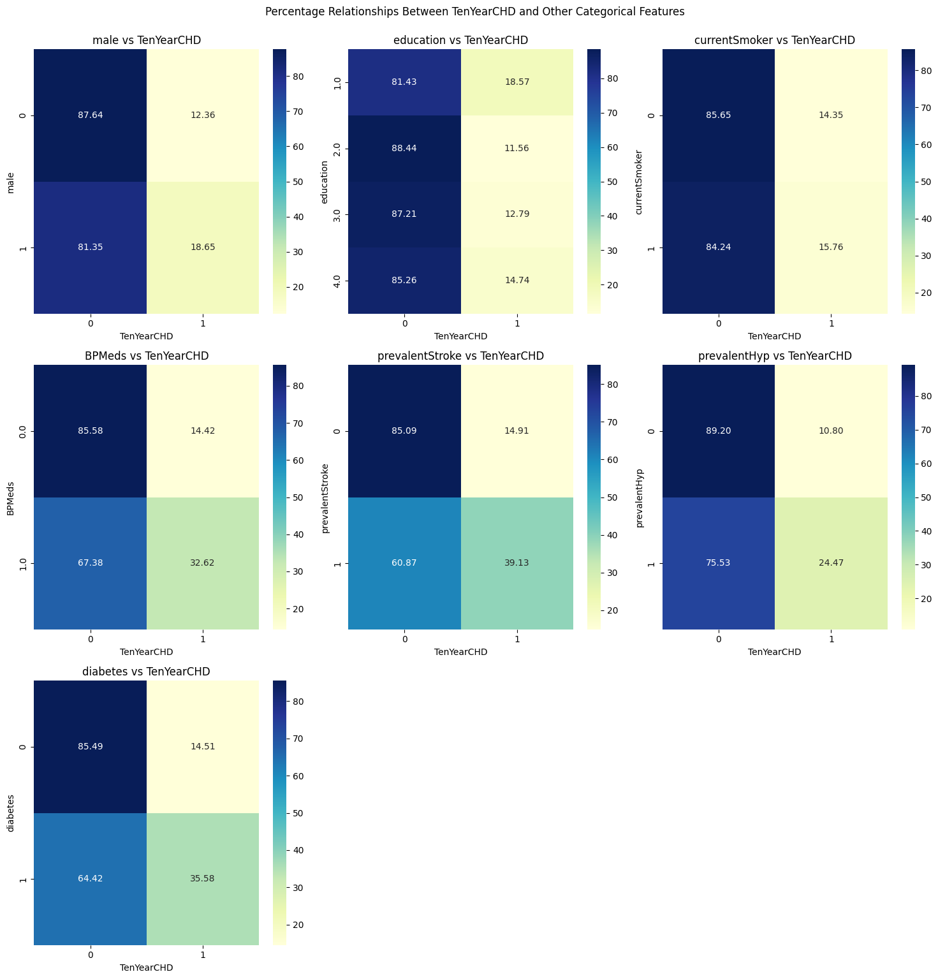
Categorical Feature Relationships with Dependent
Relationships much clearer when viewing percentages across rows

Slide 30
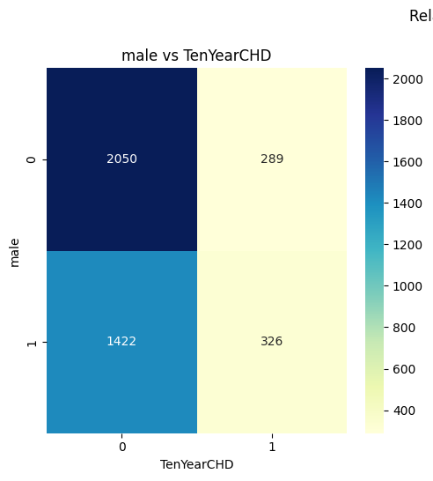
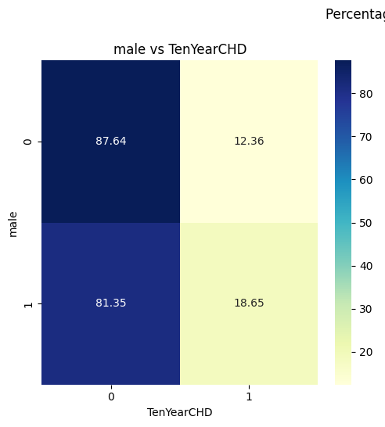
Categorical Feature Relationships with Dependent
Appears to be relationship between gender and CHD Diagnosis

Slide 31
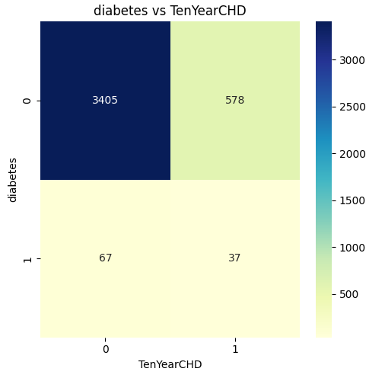
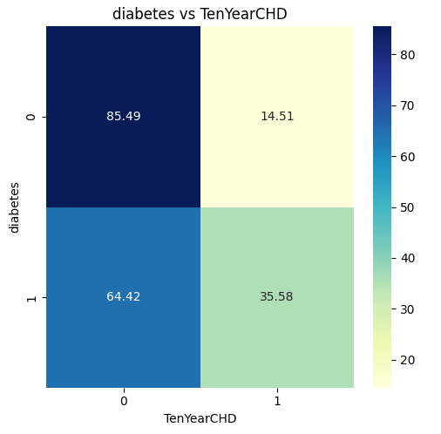
Categorical Feature Relationships with Dependent
Appears to be relationship between diabetes and CHD, however sample size is quite small

Slide 32
Statistical Testing
Methodologies
Findings
Numerical – Categorical Relationships:
ANOVA
Categorical – Categorical Relationship:
Chi-Squared Test
All features besides currentSmoker share a statistically significant relationship with TenYearCHD

Slide 33
Dependent to Dependent

Slide 34
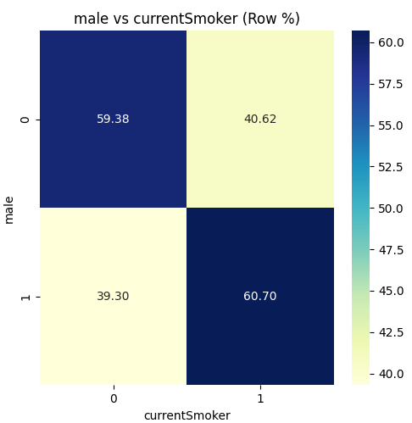
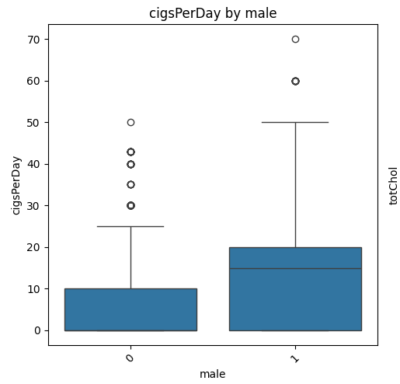
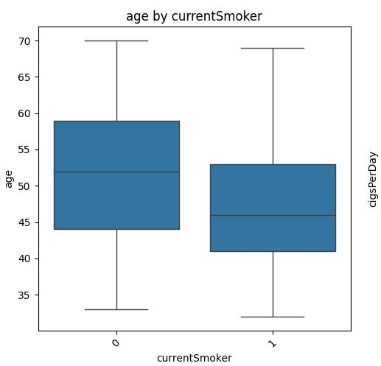
Smoker pictures
1. Males appear to be much more likely to smoke than females, as well as smoke many more cigarettes per day on average
2. Those who smoke are younger on average

Slide 35
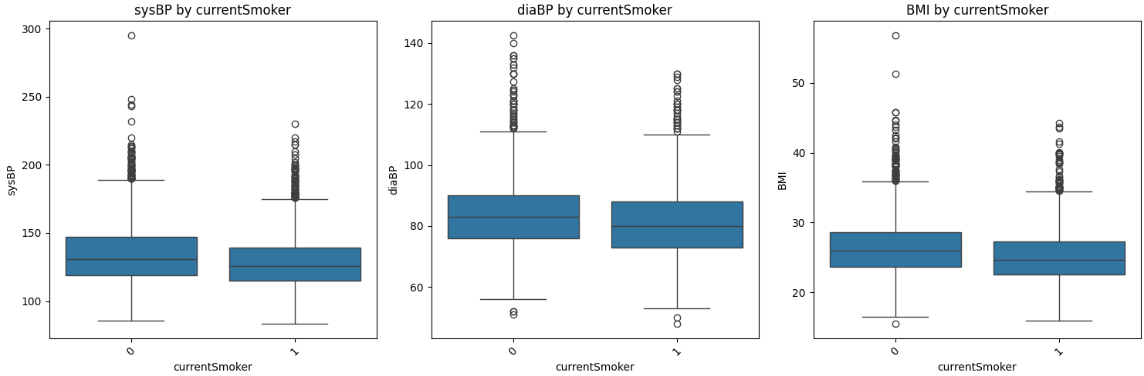
Are Smokers Healthier?
On average, smokers have lower blood pressure and BMI

Slide 36
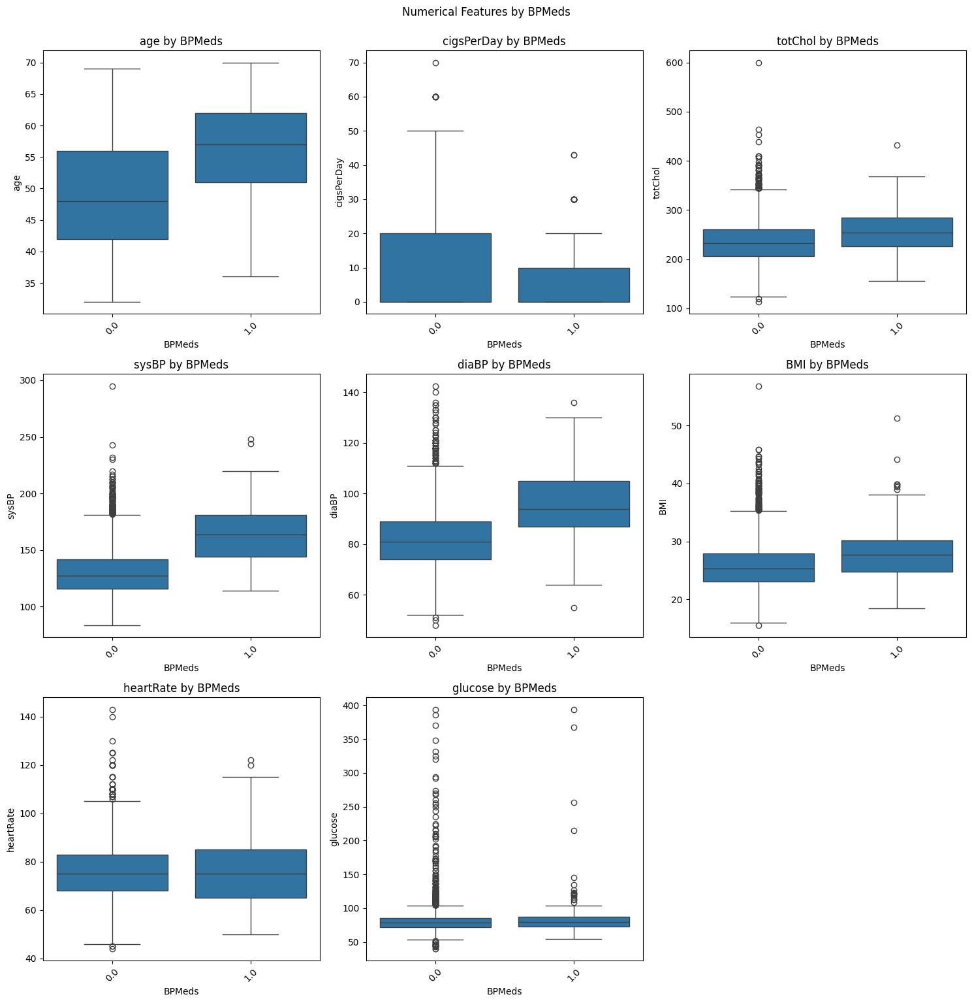
Blood Pressure Medication
Those on blood pressure medications are generally less healthy than those not
Older
Higher Cholesterol
Higher Blood Pressure
Higher BMI

Slide 37
Statistical Testing
Findings
Of all dependent – dependent relationships tested, the only statistically insignificant relationship is BMI - prevalentStroke
Methodologies
Numerical – Numerical Relationships
Pearson Correlation Test
Numerical – Categorical Relationships
ANOVA
Categorical – Categorical Relationship
Chi-Squared Test

Slide 38
Clustering
Method: K-Means clustering
Goal : to ID feature groups, gain insight into what characteristics “high-risk” individuals might have

Slide 39
Normalization
Data was normalized to remove potential outliers from skewing k-means algorithm
Numerical features were standardized using sklearn’s StandardScalar
Categorical Features were scaled using sklearn’s OneHotEncoder

Slide 40
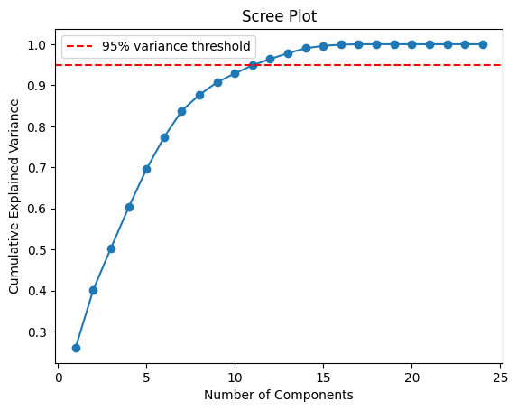
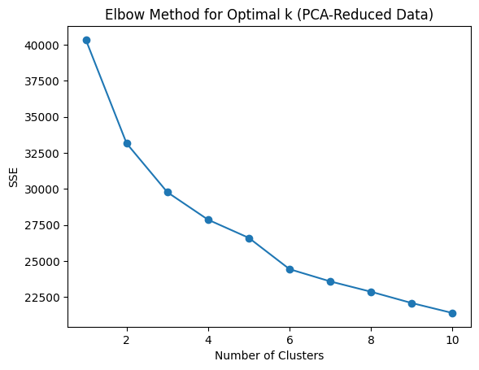
Dimensionality Reduction
Reduced dimensionality using PCA (former mentioned)
Elbow method for optimal number of clusters

Slide 41
Findings

Slide 42
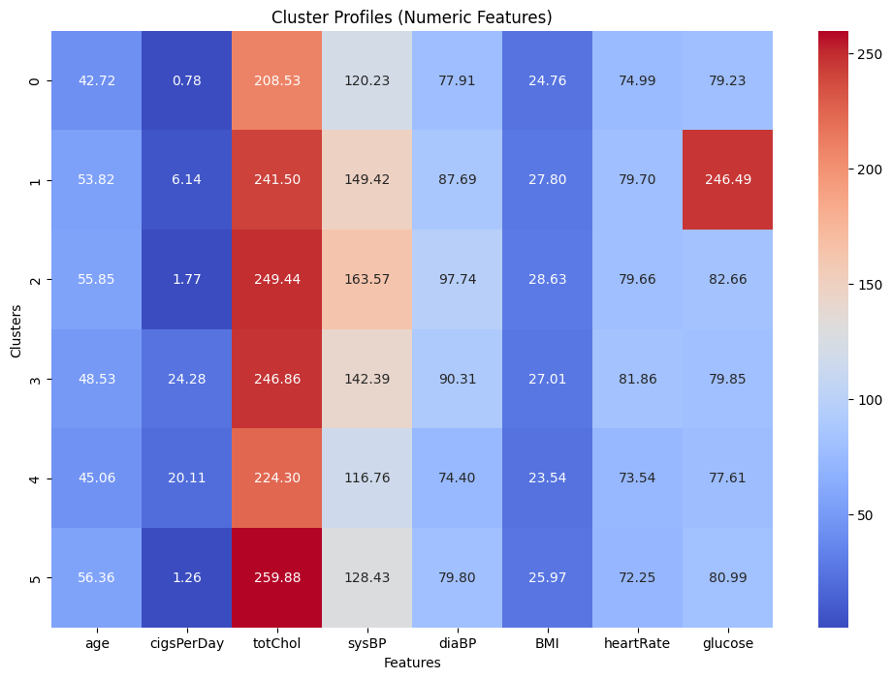
Findings – Numerical Features
High Risk
Slightly Older
Above Average BP
Higher BMI
High Glucose
Moderate Risk Groups
High Cholesterol
High BP
Low Risk Groups
Lower Blood Pressure
Lower BMI

Slide 43
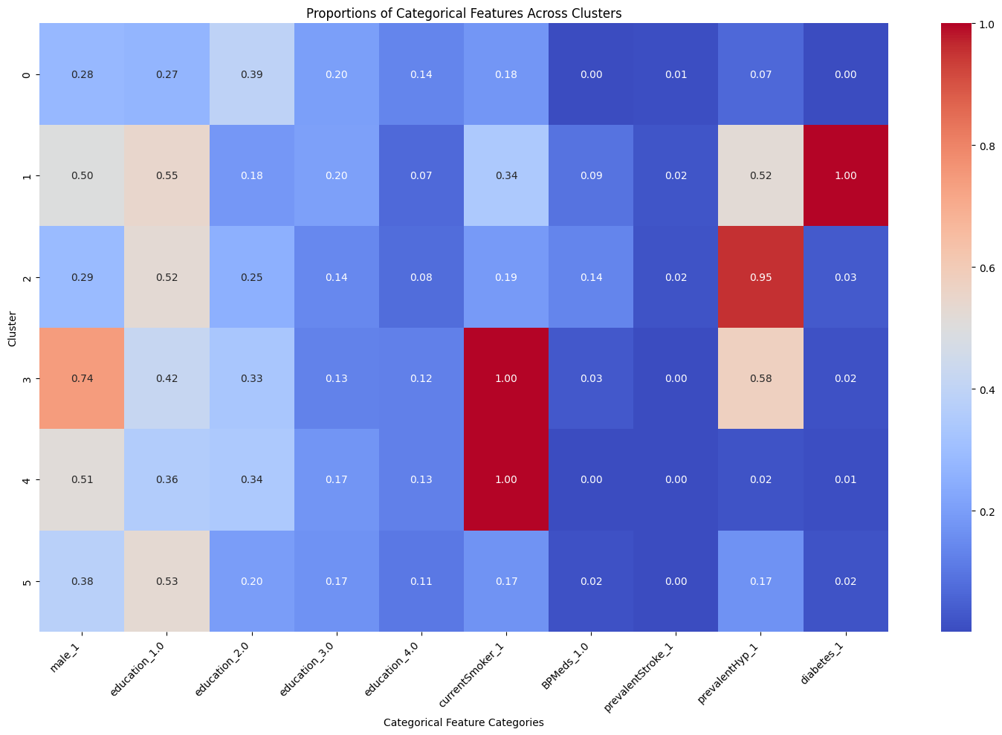
Findings – Categorical Features
High Risk
Often Male
Diabetic
Lower Education
Moderate Risk Groups
Often Hypertension
Lower Education
Low Risk Groups
Not often on Blood Pressure Medication

Slide 44
Prediction
Feature engineering – prediction models

Slide 45
Feature Engineering
Additional interaction
Transformation
Added interaction term such as age_cigs, bmi_glucose, mean arterial pressure (MAP)
Transformed systolic BP, diastolic BP, glucose and mean_MAP to reduce skewness.
Goal: Aimed to capture non-linear relationships and improve model interpretability.

Slide 46
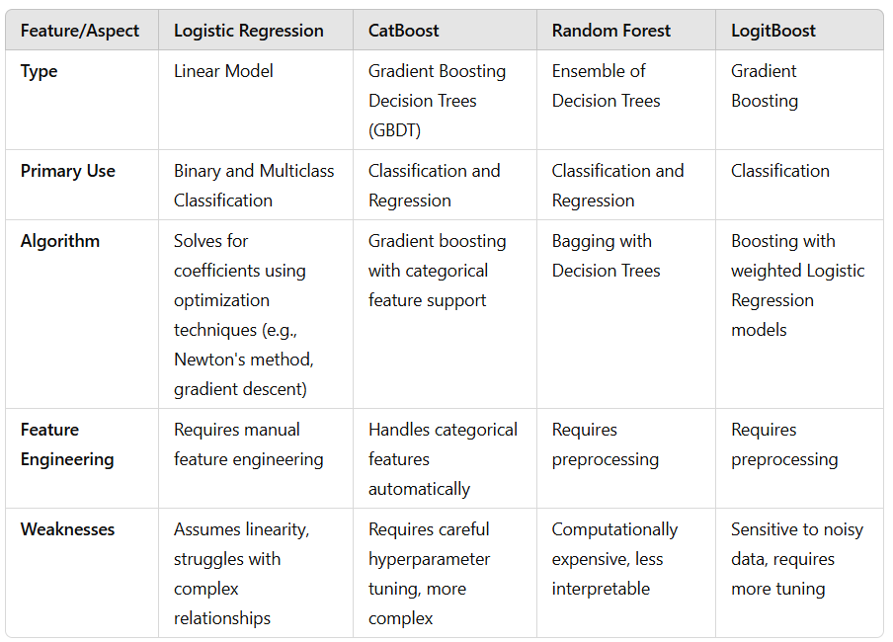
Models
Logistic Regression
CatBoost
Random Forest
LogitBoost

Slide 47

Model Selection Criteria
Models were evaluated based on:
Precision: To minimize false positives.
Recall: To maximize detection of positive cases.
ROC-AUC Score: To balance sensitivity and specificity.
Top 4 models were selected for further analysis.

Slide 48
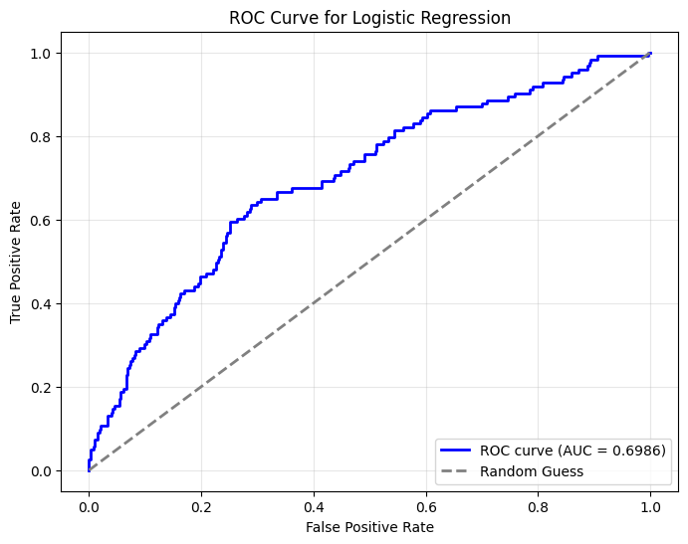
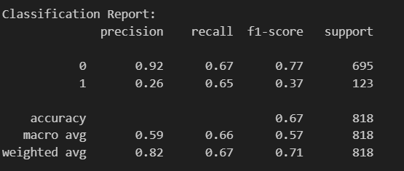
Logistic Regression
Logistic Regression Model Performance:
Accuracy: 0.6650 Precision: 0.2572 Recall: 0.6504 ROC AUC Score: 0.6986

Slide 49
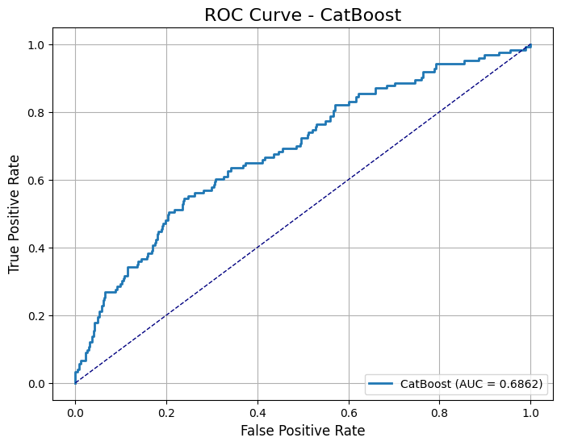
CatBoost
Tuned Model Performance:
Accuracy: 0.6650
Precision: 0.2492
Recall: 0.6098
F1 Score: 0.3538
ROC AUC Score: 0.6862

Slide 50
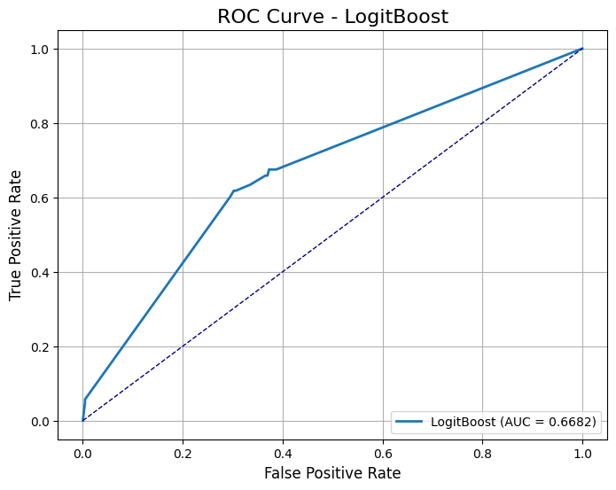
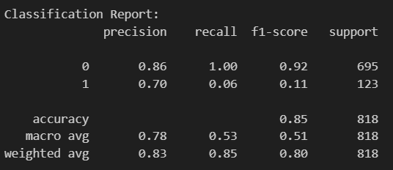
LogitBoost
Tuned LogitBoost Model Performance:
Accuracy: 0.8545
Precision: 0.7000
Recall: 0.0569
F1 Score: 0.1053
ROC AUC Score: 0.6682

Slide 51
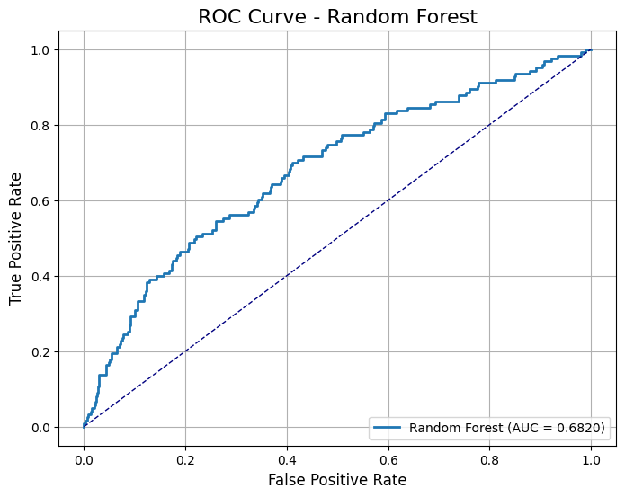
Random Forest
Performance after RandomizedSearch Tuning:
Accuracy: 0.8521
Precision: 0.6667
Recall: 0.0325
F1 Score: 0.0620
ROC-AUC Score: 0.6807

Slide 52
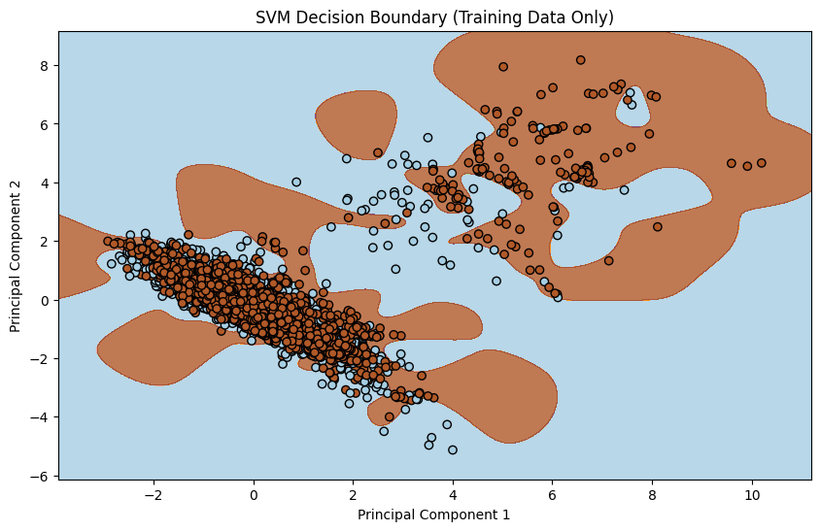
SVM Decision Boundary

Slide 53
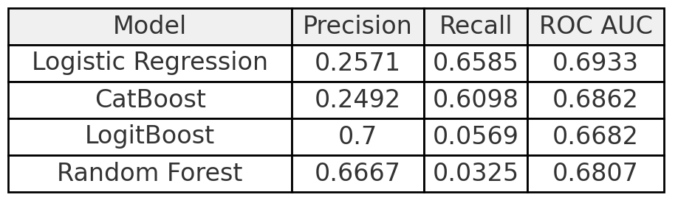
Key Metrics
Case 1: High Recall is Critical (e.g., detecting a life-threatening condition)
Preferred: Logistic Regression or CatBoost
Case 2: Require High Precision (e.g., avoiding unnecessary treatments)
Preferred: Random Forest
Suitable when false positives are costly
Case 3: Balance Between Precision & Recall Needed
Preferred: CatBoost
Trade-off between precision and recall
over-diagnosing and under-diagnosing
Case 4: Overall Performance Across Thresholds is Key
Preferred: LogitBoost
Flexibility in adjusting the sensitivity and specificity balance

Slide 54
Positive Case Recommendations
Maintain a healthy, balanced diet
Limit cholesterol intake (No dessert & Fried chicken ☹)
Lower drinking frequency (decrease Hypertension possibility)
Increase exercise (control your BMI)
Give up smoking (at least trying ☺)

Slide 55
Thank you!

