Slide 1
IBM Coursera Advanced Data Science Capstone Project - Predicting Defaulting on Credit Card Payments by Madhan Bose

Slide 2
OUTLINES
DOMAIN BACKGROUND
PROBLEM STATEMENT
DATA SET - USE CASE
DATA EXPLORATION
DATA CLEANSING - DATA AGGREGATION
MODEL DEFINITION AND TRAINING
MODEL EVALUATION - HYPER PARAMETER TUNING

Slide 3
DOMAIN BACKGROUND
Banks consider the denial of credit applications to risky customers an important priority in order to avoid undesirable decisions and consequences, like granting a customer a credit limit increase to risky customers. For example, a customer who has skipped making the minimum payment for several months. In such case, the credit card should be set to default after the customer has failed to make a payment for 6 months in a row. A credit default is a credit status applied when a customer fails to make the minimum payment for 6 months.
Risk Management is important field in Banking, and when we are talking about credit cards, credit risk management will be the first line of defense for any credit decision. Performing credit risk management correctly allows banks to minimize the risk associated with credit cards, such as avoiding the increase of credit limits for risky customers. For example: Helping a customer when a crisis or natural disaster occurred. The decision should go into Risk Analyst.
A research has been done by Department of Economics The Ohio State University that shows using data and machine learning will give ability to find complex pattern in the user behavior and find new aspects of credit card behavior(AN EMPIRICIAL INVESTIGATION OF CREDIT CARD DEFAULT)

Slide 4
PROBLEM STATEMENT
When customers come in financial difficulties, it usually does not happen at once. There are indicators which can be used to anticipate the final outcome, such as late payments, calls to the customer services, enquiries about the products, a different browsing pattern on the web or mobile app. By using such patterns it is possible to prevent, or at least guide the process and provide a better service for the customer as well as reduced risks for the bank.
In this presentation we will look at how to predict defaulting, using statistics, machine learning and deep learning. We also look at how to summarize the data using topological data analysis (TDA). Finally we will look at how to convert the model into an API and use it for account alerting.
The problem finding the patterns in customer behaviors that help predicting if a customer have a chance of getting his credit card defaulted before the 6 months period. By applying the right algorithm and parameters we can get a prediction on the 5th month or even 4th month to know if the customer have high chance of getting his credit card defaulted

Slide 5
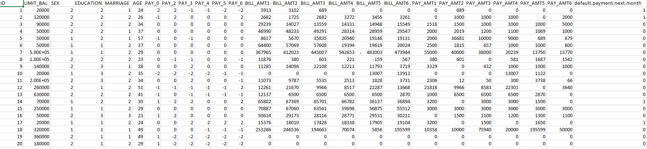
DATA SET
The dataset is available at the Center for Machine Learning and Intelligent Systems, Bren School of Information and Computer Science, University of California, Irvine: https://archive.ics.uci.edu/ml/datasets/default+of+credit+card+clients
And another data set is available in the following URL:
https://www.kaggle.com/lucabasa/credit-card-default-a-very-pedagogical-notebook/data
The data set contains 30000 user records and 26 features

Slide 6
USE CASE
The Goal is to train a model with the capability to minimize the risk by making predictions based on the dataset. The model predicts whether a late-paying customer will only be late for a limited duration (1 or 2 months), or if this customer is predicted not to make a payment at all. This makes it a classification problem.
Benchmark Model
The model that been developed by (Mahyar M. Moghadam) Payment Default Prediction is what been taking as Benchmark model. With the current model we will be aiming at 80% accuracy
Evaluation Metrics
To validate the model and determine its performance, the actual information from the data will be compared with the predictions, and the Recall and precision will be analyzed. Those two are calculated by looking at four things:
True positive : accounts got defaulted and model predict them as defaulted
False positive : accounts did not defaulted and model predict them as defaulted
True negative : accounts did not defaulted and model predict them as not defaulted
False negative : accounts got defaulted and model predict them as not defaulted

Slide 7
USE CASE (cont’d.)
Project Design
Data Preprocessing : Will check the data and prepare it by removing data input errors, missing values. Also checking for outliers and removing 10% - 25% or the leading and tailing data narrow the outliers
Data Processing : Will visualize the data and check the correlation and try to find pattern first visually. After that one of the supervised learning Algorithm will be use. It is yet uncertain whether supervised learning will be employed.
Training and Testing : will split the data and do 80% training and 20% for testing and to ensure the model is robust and we getting a result we can trust a cross validation will be applied.
Extract from the dataset information section : "This research aimed at the case of customers' default payments in Taiwan and compares the predictive accuracy of probability of default among six data mining methods. From the perspective of risk management, the result of predictive accuracy of the estimated probability of default will be more valuable than the binary result of classification - credible or not credible clients."

Slide 8
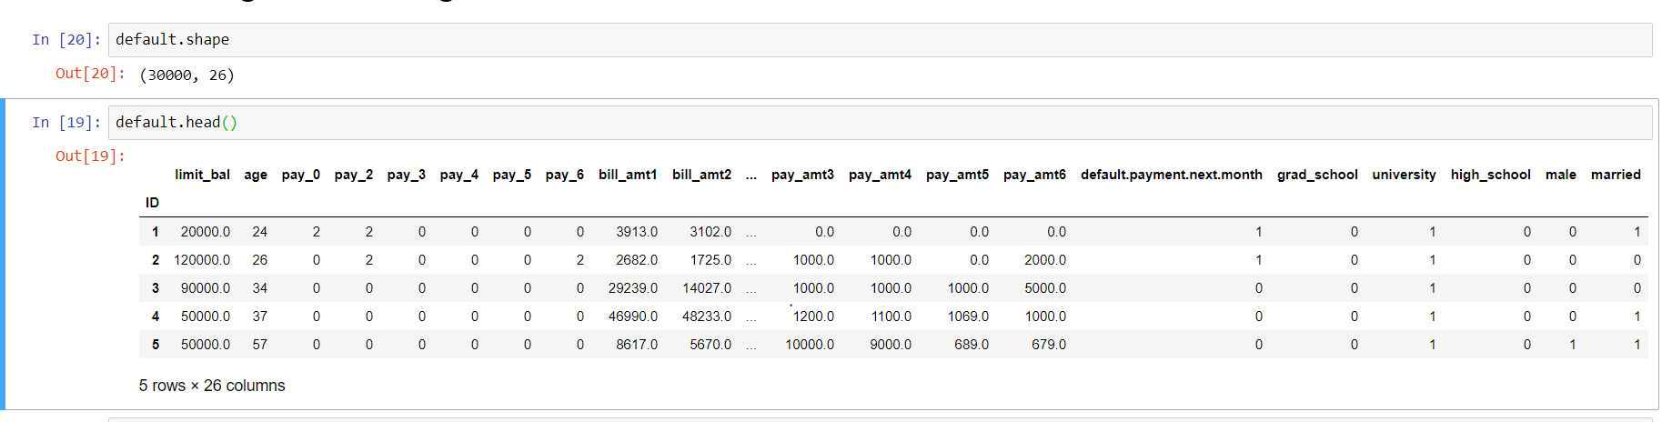
DATA EXPLORATION
There are 30000 user records and 26 features in the data set

Slide 9
DATA EXPLORATION
Features description:
LIMIT_BAL: Amount of the given credit (NT dollar): it includes both the individual consumer credit and his/her family (supplementary) credit.
SEX: Gender (1 = male; 2 = female).
EDUCATION: Education (1 = graduate school; 2 = university; 3 = high school; 4 = others).
MARRIAGE: Marital status (1 = married; 2 = single; 3 = others).
AGE: Age (year).
PAY_0 to PAY_6: History of past payment. We tracked the past monthly payment records (from April to September, 2005) as follows: 0 = the repayment status in September, 2005; 1 = the repayment status in August, 2005; . . .; 6 = the repayment status in April, 2005. The measurement scale for the repayment status is: -1 = pay duly; 1 = payment delay for one month; 2 = payment delay for two months; . . .; 8 = payment delay for eight months; 9 = payment delay for nine months and above.
BILL_AMT1 to BILL_AMT6: Amount of bill statement (NT dollar). X12 = amount of bill statement in September, 2005; X13 = amount of bill statement in August, 2005; . . .; X17 = amount of bill statement in April, 2005.
PAY_AMT1 to PAY_AMT6: Amount of previous payment (NT dollar).
default payment next month: positive class: default | negative class: pay

Slide 10
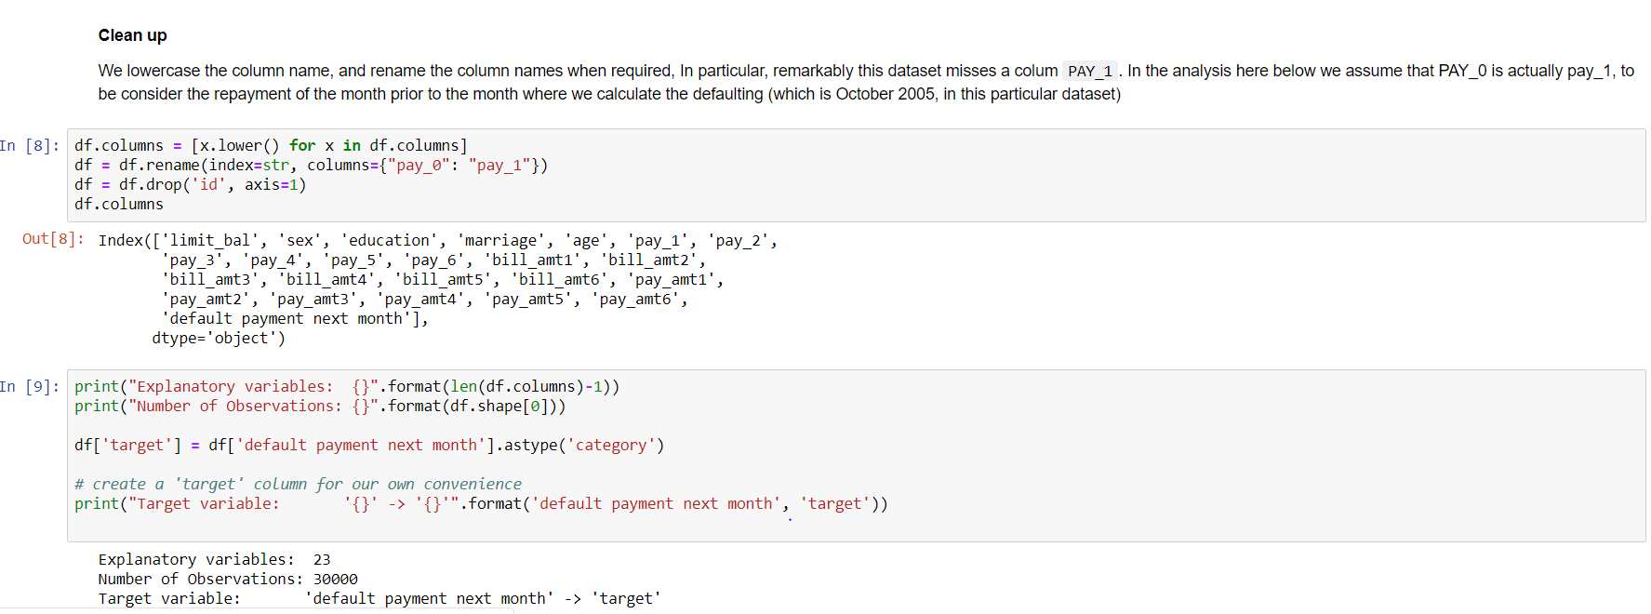
DATA CLEANING – FEATURE ENGINEERING
There are 24 features totally in the data set. We need only the features which are required for the analysis. We need PAY_1 to PAY_6 for the analysis. The target variable is ‘default payment next month’. We are using One hot encoding and sklearn.preprocessing.RobustScaler

Slide 11
MODEL SELECTION / DEFINITION
In Part-1 the following algorithms are explored
Logistic Regression
Decision Trees
Naive Bayes Classifier
In Part-2 we will compare the predictive power of four bespoken classes of algorithms
Logistic regression (scikit-learn)
Random Forests (scikit-learn)
Boosted Trees (xgboost)
Deep Learning (keras/tensorflow)
Explainability:
Understanding why a given model predicts the way it predicts, it probably just as important as achieving a good accuracy on the predicted results. I will present 3 methods which can be used to interpret and explain the result and gain a better understanding on the dataset and the various.
Extract activations from an inner layer of a neural network
Apply TSNE on the activation data
OPTICS for variable density clustering
TDA with a Kepler Mapper using the TSNE lens

Slide 12
MODEL DEFINITION
Training dataset:
A training dataset is a dataset of examples used for learning, that is to fit the parameters (e.g., weights) of, for example, a classifier.
Most approaches that search through training data for empirical relationships tend to overfit the data, meaning that they can identify and exploit apparent relationships in the training data that do not hold in general.
Validation dataset:
A validation dataset is a dataset of examples used to tune the hyperparameters (i.e. the architecture) of a classifier. It is sometimes also called the development set or the "dev set". In artificial neural networks, a hyperparameter is, for example, the number of hidden units. It, as well as the testing set (as mentioned above), should follow the same probability distribution as the training dataset.
In order to avoid overfitting, when any classification parameter needs to be adjusted, it is necessary to have a validation dataset in addition to the training and test datasets. For example, if the most suitable classifier for the problem is sought, the training dataset is used to train the candidate algorithms, the validation dataset is used to compare their performances and decide which one to take and, finally, the test dataset is used to obtain[citation needed] the performance characteristics such as accuracy, sensitivity, specificity, F-measure, and so on. The validation dataset functions as a hybrid: it is training data used by testing, but neither as part of the low-level training nor as part of the final testing[citation needed].

Slide 13
MODEL DEFINITION (cont’d)
The basic process of using a validation dataset for model selection (as part of training dataset, validation dataset, and test dataset) is:
An application of this process is in early stopping, where the candidate models are successive iterations of the same network, and training stops when the error on the validation set grows, choosing the previous model (the one with minimum error).
Test dataset:
A test dataset is a dataset that is independent of the training dataset, but that follows the same probability distribution as the training dataset. If a model fit to the training dataset also fits the test dataset well, minimal overfitting has taken place (see figure below). A better fitting of the training dataset as opposed to the test dataset usually points to overfitting.
A test set is therefore a set of examples used only to assess the performance (i.e. generalization) of a fully specified classifier.
In this Project the entire data set is split into 80% for training and 20% for testing

Slide 14
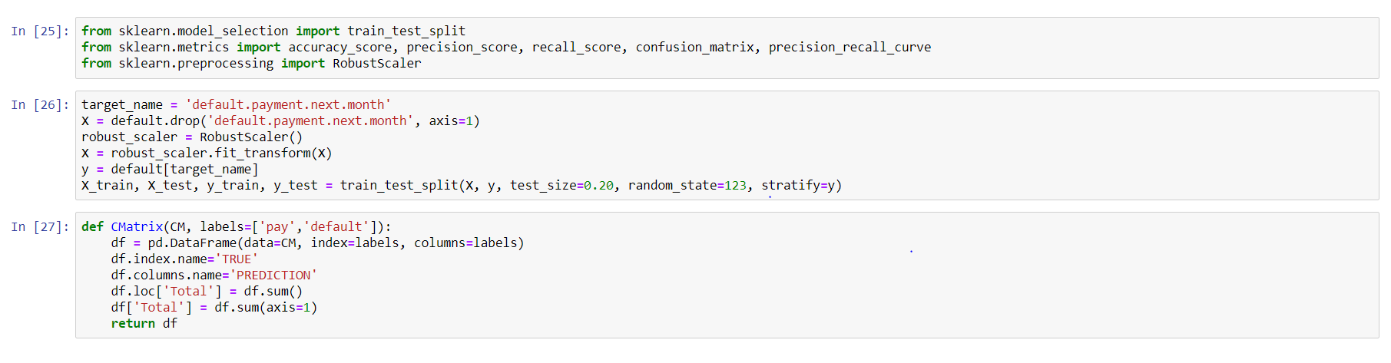
MODEL TRAINING
In the entire data set of 30000 user records, 80% of the data (24000 user records) is used for training the models.

Slide 15
MODEL EVALUATION (cont’d)
Performance Measures of the Models:
Accuracy: The proportion of the total number of predictions that are correct
Precision: The proportion of positive predictions that are actually correct
Recall: The proportion of positive observed values correctly predicted as such
ROC Curve and AUC : The relationship between True Positive Rate and the False Positive Rate and the area under the curve of ROC
In this application:
Accuracy: Overall how often the model predicts correctly defaulters and non-defaulters
Precision: When the model predicts default: how often is correct?
Recall: The proportion of actual defaulters that the model will correctly predict as such
AUC : Area under the ROC Curve
Which metric should I use?
False Positive: A person who will pay predicted as defaulter
False Negative: A person who default predicted as payer
False negatives are worse => look for a better recall

Slide 16
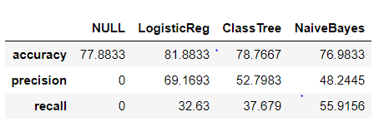
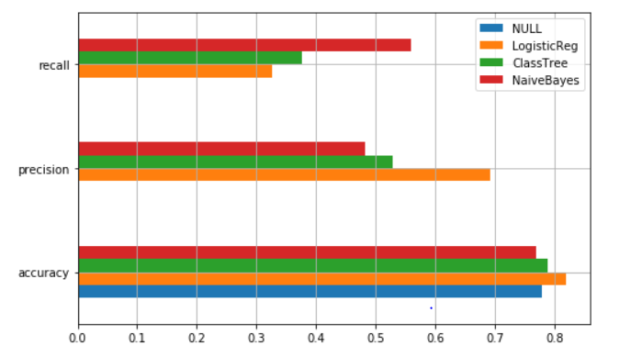
MODEL EVALUATION - PART 1

Slide 17
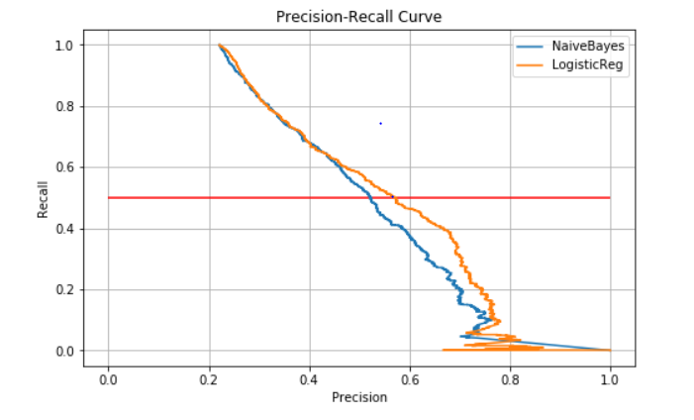
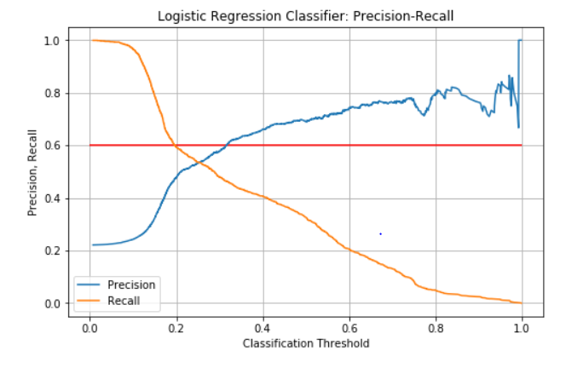
MODEL EVALUATION – PART 1

Slide 18
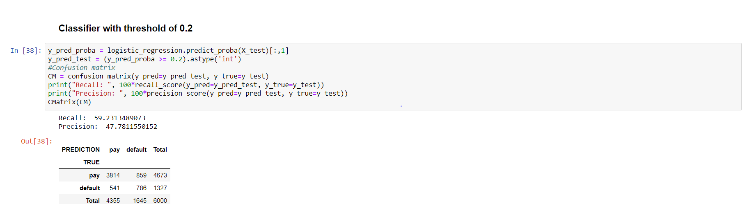
MODEL EVALUATION – PART 1
As per the PART-1 investigation Logistic Regression is performing well. We need to investigate more using some more Algorithms in PART-2

Slide 19
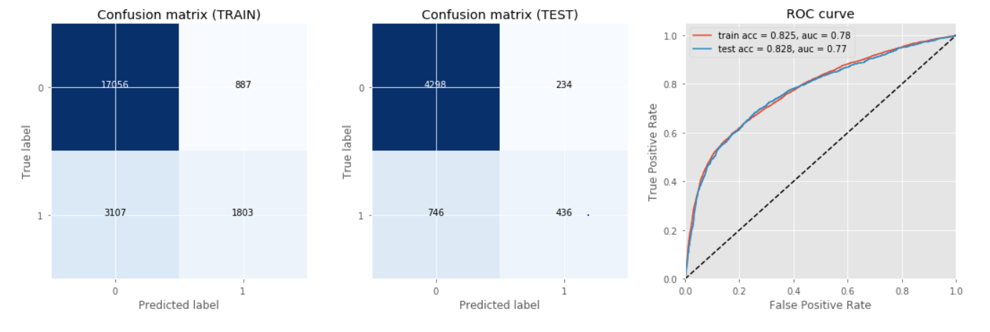
MODEL EVALUATION – PART 2
Model Evaluation of Logistic Regression:

Slide 20
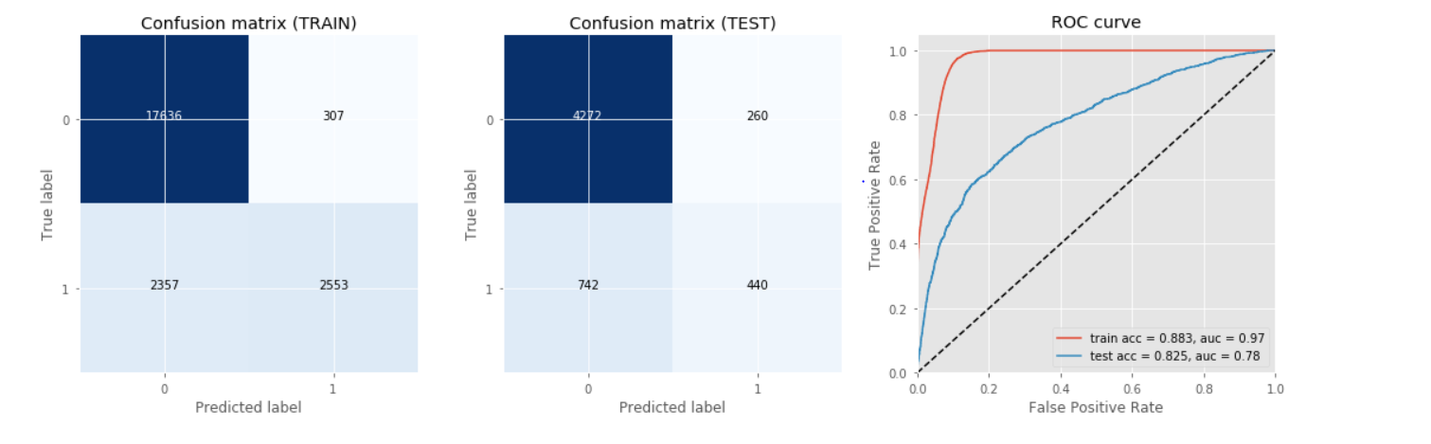
MODEL EVALUATION – PART 2
Model Evaluation of Random Forest:

Slide 21
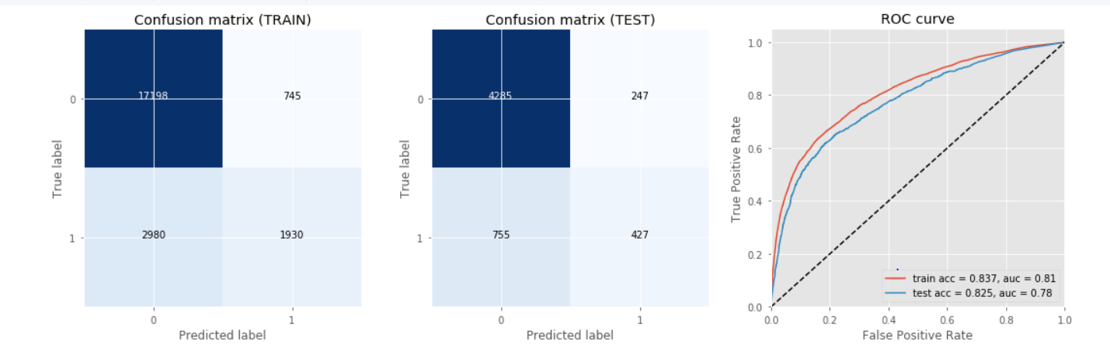
MODEL EVALUATION – PART 2
Model Evaluation of Boosted Decision Trees:

Slide 22
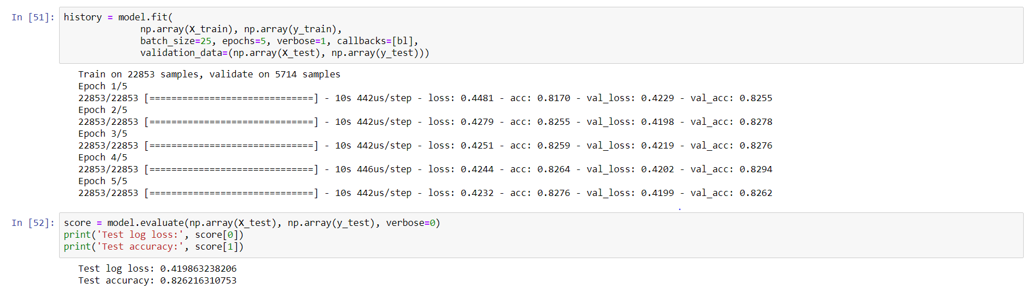
MODEL EVALUATION – PART 2
Model Evaluation of Feed Forward Neural Network using Tensor Flow and Keras:

Slide 23
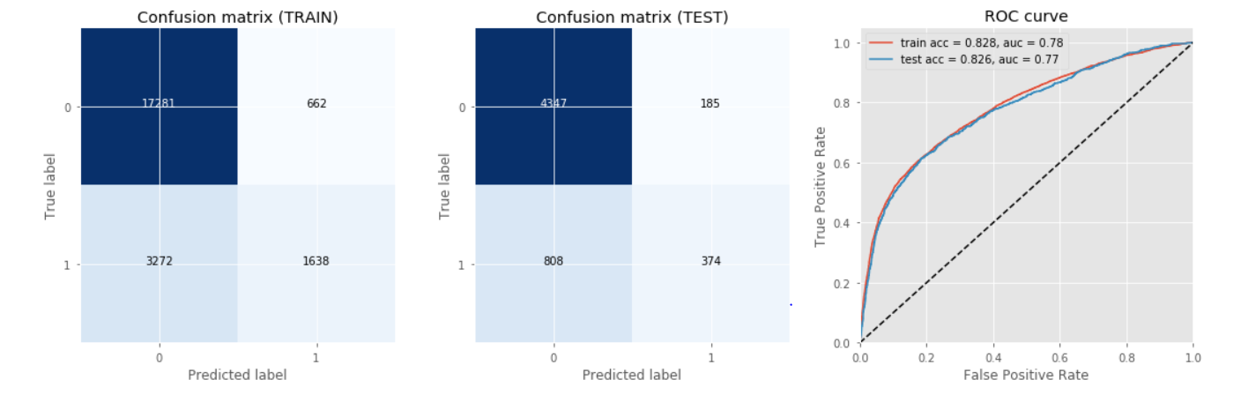
MODEL EVALUATION – PART 2
Model Evaluation of Feed Forward Neural Network using Tensor Flow and Keras:

Slide 24
CONCLUSION
Based on the above observations the Random Forest Model, Boosted Trees Model and the Feed Forward Neural Network Model with Tensor Flow and Keras are performing well and equally.
Model | Accuracy | AUC
Logistic Regression | 82.8000% | 0.77
Decision Trees | 78.7667% | NA
Naïve Bayes | 76.9833% | NA
Random Forest | 82.5000% | 0.78
Boosted Trees | 82.5000% | 0.78
Feed Forward Neural Network | 82.6300% | 0.78

Slide 25
LINKS
Git Hub URL: https://github.com/madhanbose99/Coursera_Advanced_Datascience_Capstone
Architecture Decision Document URL: https://github.com/madhanbose99/Coursera_Advanced_Datascience_Capstone/blob/master/IBM-Coursera-Capstone-Project-ADD.pdf
Data set URL: https://github.com/madhanbose99/Coursera_Advanced_Datascience_Capstone/blob/master/default%20of%20credit%20card%20clients.xls
Data set URL: https://github.com/madhanbose99/Coursera_Advanced_Datascience_Capstone/blob/master/UCI_Credit_Card.csv
Output URL: https://github.com/madhanbose99/Coursera_Advanced_Datascience_Capstone/blob/master/output.html

