Slide 1

Identifying Most Viable Neighborhood for Meal Kit Delivery Business in London

Slide 2
Introduction
Global Meal kit Delivery market is set to rise to USD 8.94 billion by 2025
London is one of the busiest cities in the world
London presents a market gap for Meal kit delivery business
This study identify best possible London neighborhoods to establish the business

Slide 3
Data
Data required entailed:
All London post codes and their names
Longitudes and latitudes of postal codes
Nearby neighborhoods of post codes using FourSquare API

Slide 4
Data Cleaning
Used BeautifulSoup to scrap data for the post codes and combined the post codes with the respective longitude and latitudes.
Used FourSquare API to get the most common neighborhoods
Used one hot encoding to get the top 10 venues close to each neighborhoods

Slide 5
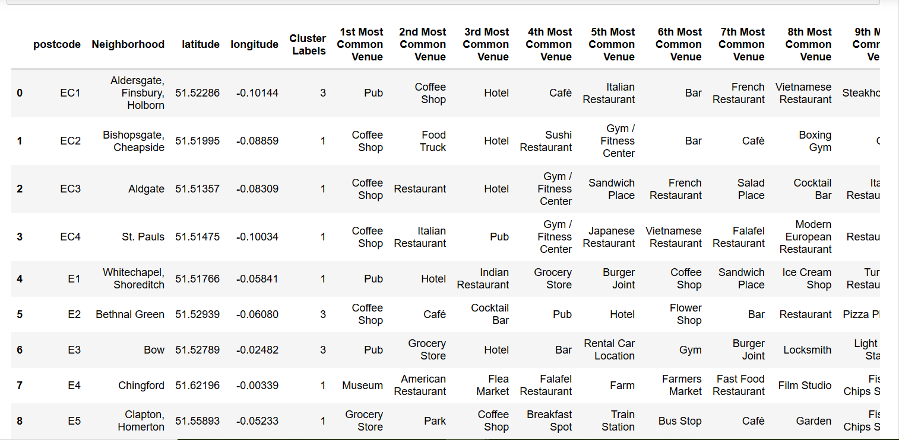
Clustered Neighborhoods

Slide 6
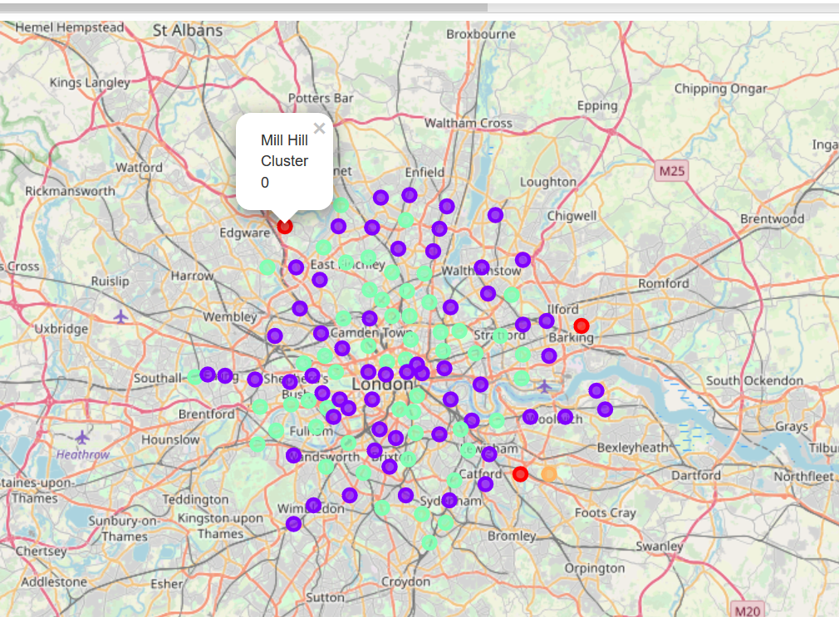
Mapping
Using folium maps, the clustered neighborhoods map is as follows:

Slide 7
Results
Cluster Number | Number of Postcodes | Most Notable Venues
1 | 3 | Park, Pharmacy, Fish Market, Restaurant
2 | 59 | Coffee Shop, Grocery Store, Pub, Pizza Place
3 | 0 | None
4 | 54 | Pub, Restaurant, Café, Bakery
5 | 1 | Golf Course, Farmers Market, Fish Market, Farm

Slide 8
Conclusion
Neighborhoods are concentrated in clusters 2 and 4
Most common venues for these clusters are restaurants, pubs, café, and other eateries
Other clusters have few neighborhoods with most common venues being parks, farms and restaurants

Slide 9
Concluson Cntd…
London has the majority of the population in clusters 2 and 4
A Meal Kit service business investor should consider clusters 2 and 4 because the market is huge

Slide 10

Thank you

