Slide 1
Apple Inc. (AAPL)
Full Company Breakdown — Products, Financials, Strategy & Outlook
Prepared September 2026 · Data: Apple FY2026 Q3 results (quarter ended June 27, 2026), company filings, market data

Slide 2
Company Overview
Who Apple is today — in numbers
$4.8–4.9T
Market capitalization
$451B
Trailing-12M revenue
$112B
Net income (TTM)
166,000
Employees worldwide
2.5B+
Active devices installed base
1976
Founded · Cupertino, CA
Apple is one of the largest companies in the world, designing its own hardware, software and semiconductors. The iPhone anchors an expansive ecosystem spanning Mac, iPad, Apple Watch, AirPods and Services (App Store, iCloud, Apple Music/TV+, Pay). Manufacturing is outsourced to partners such as Foxconn and TSMC; slightly less than half of sales go through Apple's own stores, with the rest via partners and distribution.

Slide 3
History & Milestones
From a garage startup to the world's most valuable company
1976
Founded by Steve Jobs, Steve Wozniak & Ronald Wayne; Apple I goes on sale
1984
Macintosh launches — the first mass-market GUI personal computer
2001
iPod debuts, beginning Apple's consumer-device transformation
2007
iPhone unveiled — redefines the smartphone industry
2010
iPad launches; Apple becomes the world's most valuable company (2011–12)
2015
Apple Watch — the best-selling watch in the world
2020
Apple Silicon: M1 chips replace Intel across the Mac lineup
2024
Apple Intelligence: privacy-focused AI across all platforms
2026
iPhone 18 Pro, first foldable (iPhone Duo), AirPods 5, Watch Series 12; CEO transition announced

Slide 4
Products & Services Portfolio
An ecosystem built around the iPhone
iPhone — $54.3B in Q3 FY26
· Flagship product: ~50% of revenue
· Q3 record: +22% YoY
· 2026 lineup: iPhone 18 Pro & first foldable (iPhone Duo)
Mac — $10.4B
· +29% YoY — best June quarter ever
· Driven by MacBook Neo & MacBook Pro
· 95% U.S. customer satisfaction
iPad — $6.2B
· -6% YoY on a tough prior-year compare
· A16-powered iPad cycle laps
· Education & creative segments
Wearables, Home & Accessories — $6.8B
· Apple Watch Series 12 / Ultra 4
· AirPods 5
· Home & accessories rounding out the home
Services — $30.7B
· +12% YoY; records in every category
· App Store, iCloud, Music, TV+, Pay
· Cloud & payment services hit all-time records
Software & AI
· iOS, macOS (Golden Gate at WWDC26)
· Apple Intelligence & Siri AI — privacy-first AI
· Designed chips: A-series & M-series silicon

Slide 5
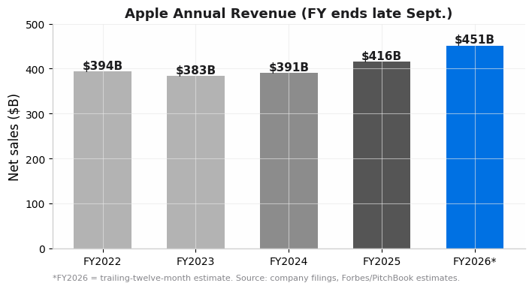
Financial Performance
Revenue re-accelerating — FY2026 tracking toward ~$451B
▸ Top line: FY2025 revenue $416.2B (+6.4%); trailing-12-month revenue now ~$451B
▸ Profitability: TTM net income ~$112B; net margin ~27%
▸ Efficiency: ROE ~141–171% — among the highest of any large company, driven by share buybacks
▸ Cash generation: Operating cash flow $34.4B in Q3 FY26 alone (June-quarter record)
▸ Capital returns: Dividend $0.27/share declared Aug 2026, plus one of the largest buyback programs in history
▸ Balance sheet: ~$33B debt to EV of only 3% — minimal leverage

Slide 6
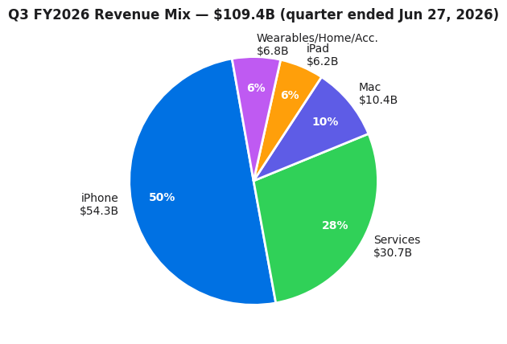
Latest Quarter — Q3 FY2026
Quarter ended June 27, 2026 — records across iPhone, Mac and Services
$109.4B
Revenue · +16% YoY · June-quarter record
$29.8B
Net income · EPS $2.02 (+29% YoY)
50.1%
Gross margin (incl. ~2pts tariff-refund benefit)
$78.7B
Products revenue · +18% YoY
$30.7B
Services revenue · +12% YoY · June-quarter record
Geography: double-digit growth in every segment — records in the U.S., Latin America, Western Europe, India, Mainland China, Japan and Southeast Asia. Guidance: Sept-quarter revenue +9–11% YoY; gross margin 47–48%.

Slide 7
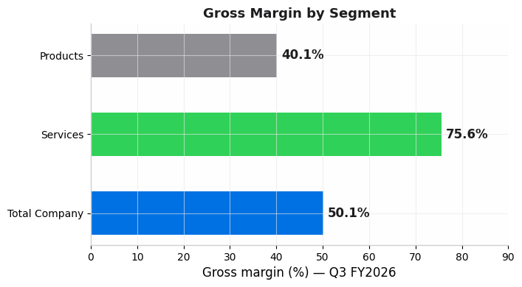
Business Model Economics
Services is the margin engine; hardware drives scale
▸ Services margin: 75.6% gross margin — nearly double the company average
▸ Products margin: 40.1% gross margin (incl. tariff-refund benefit)
▸ The mix shift: Services is ~28% of revenue but a much larger share of profit — every point of Services growth lifts blended margin
▸ R&D investment: OpEx $19.1B, +23% YoY, driven by AI and silicon development
▸ Watch item: Rising memory (DRAM/NAND) costs pressured margins into Q4; FX a secondary factor
▸ Long-term: Installed base of 2.5B+ active devices keeps Services compounding

Slide 8
Leadership & Market Position
▸ CEO: Tim Cook — led Apple since 2011; a CEO transition was announced alongside Q2 FY26 results
▸ CFO: Kevan Parekh — oversees record capital-return program
▸ Board/Founders: Co-founded by Steve Jobs & Steve Wozniak (1976); headquarters in Cupertino, California (Apple Park)
▸ Workforce: 166,000 employees; ~$2.5M revenue per employee
▸ Manufacturing: Outsourced to Foxconn, TSMC and other partners; Apple designs its own silicon
Market Position
▸ World's most valuable company (~$4.9T market cap) — competing with NVIDIA and Microsoft at the top of global rankings
▸ iPhone: dominant premium smartphone franchise, with record demand in China, India and emerging markets
▸ Mac: best quarter ever for new-to-Mac customers, incl. U.S., China Mainland and India
▸ Apple TV+ won the industry's top honors (Emmy, Grammy, Oscar, Tony) faster than any streamer in history
▸ Apple Music, iCloud, Pay and the App Store form a subscription annuity on top of hardware

Slide 9
Strategy, Outlook & Key Risks
Where Apple goes from here
Growth Strategy
Key Risks & Watch Items
▸ AI: Rollout of Apple Intelligence & Siri AI — approved for initial features in China; EU negotiations ongoing
▸ New categories: First foldable (iPhone Duo), MacBook Neo, and annual silicon upgrades
▸ Services annuity: 2.5B-device installed base converting to subscriptions
▸ Emerging markets: Record growth in India, Latin America and Southeast Asia
▸ Supply constraints: Component shortages capped Q3 and are expected to increase
▸ Memory costs: DRAM/NAND inflation drove ~160bps of sequential gross-margin pressure into Q4
▸ Regulation: EU Digital Markets Act limits feature rollouts; App Store rules under scrutiny worldwide
▸ China: Competition from domestic brands and geopolitical/tariff uncertainty
▸ Growth deceleration: Sept-quarter guide of +9–11% vs +16% in June — the market is watching the AI payoff

Slide 10
Summary — Apple at a Glance
Scale
~$451B revenue, ~$112B net income, $4.9T market cap — one of the three most valuable companies on Earth
Moat
2.5B active devices, 75%+ Services margins, proprietary silicon, and best-in-class brand loyalty
Momentum
Q3 FY26: +16% revenue, +29% EPS — records in every geography and every Services category
Catalysts
Foldable iPhone, Apple Intelligence / Siri AI, India & emerging-market expansion
Challenges
Memory-cost inflation, supply constraints, EU/China regulation, and decelerating growth guidance
Sources: Apple FY2026 Q3 earnings release & call (Jul 30, 2026), Yahoo Finance, Forbes, PitchBook, StockAnalysis. Figures as of September 2026.

