Slide 1
Touchless A webcam multi-touch SDK http://www.codeplex.com/touchless e-mail: mtless@microsoft.com
Michael Wasserman,
Isabel Mattos, Gary Caldwell,
Nicole Steinbok, Quinn Hawkins

Slide 2
Agenda
What is Touchless?
What can you do with it?
Play with our demo!
See the API class diagram!
Learn how the demo was built!
Get involved!

Slide 3
What is Touchless?
We love multi-touch interfaces! And we want you to be just as excited as we are! More than that, we want you to be able to build your own multi-touch applications!
That’s when Touchless comes in: a Software Developer Kit that will provide you with the APIs needed to create multi-touch interfaces.
You only need our two binaries, a webcam, and a passion for innovation!

Slide 4
What can we do with it?
Simple API for colored marker tracking:
TouchlessLib.dll &
WebCamLib.dll
Leverage CPU processing power (real-time vision-based processes are computationally expensive)
Easily create multi-touch applications for anyone with a camera!
Compliment or replace mouse-based interaction.
Simple demos can be made in less than one hour!
Employ direct manipulation interaction techniques with custom gestures.
(gesture coding is entirely client-side)
Cheap & ubiquitous webcams and markers (a marker can be almost anything brightly colored).

Slide 5
Play with our demo! And learn how it was built.
Go to http://www.codeplex.com/touchless & download a binary release.
Connect your webcam, run TouchlessDemo.exe and enjoy!
The C# source code for TouchlessDemo is also posted on CodePlex.
Prerequisites for compiling the demo (and building your own Touchless applications) are:
Visual Studio 2005/2008 *OR* Visual C# Express Edition
.NET 3.0+
See the next slide (or Touchless.jpg) for the API class diagram
See Touchless.chm for our xml-generated documentation

Slide 6
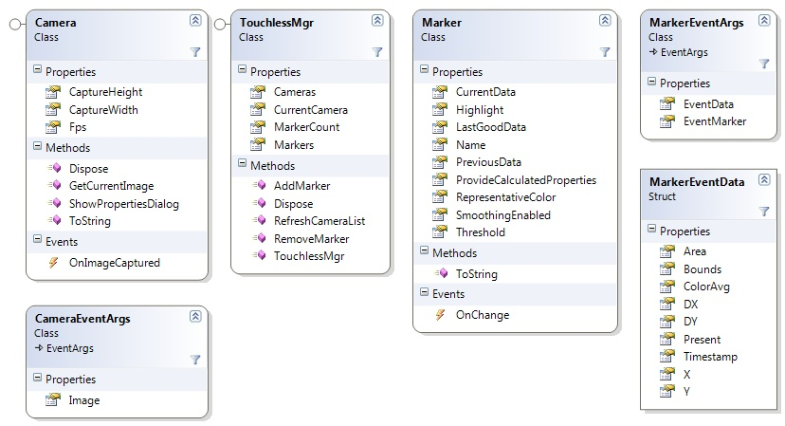
See the API class diagram!

Slide 7
Help us improve
Visit our homepage: www.codeplex.com/touchless
You feedback and contributions are highly appreciated!
Ask questions and make comments on our discussion board
Send e-mail to mtless@microsoft.com
Improve our demo or suggest other uses for Touchless
Show off your own .NET applications and XNA games built with Touchless
Contribute to the openly available project source code
Thanks for checking out Touchless… Unleash the power of your webcam!

