Slide 1
Technology: Professionalised From the Reach of Ordinary People
Talk by John Morrice

Slide 2
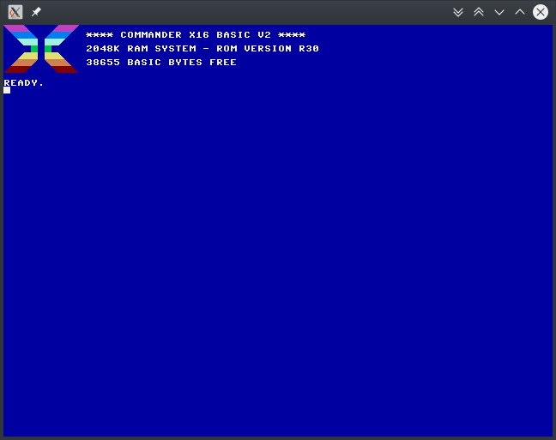
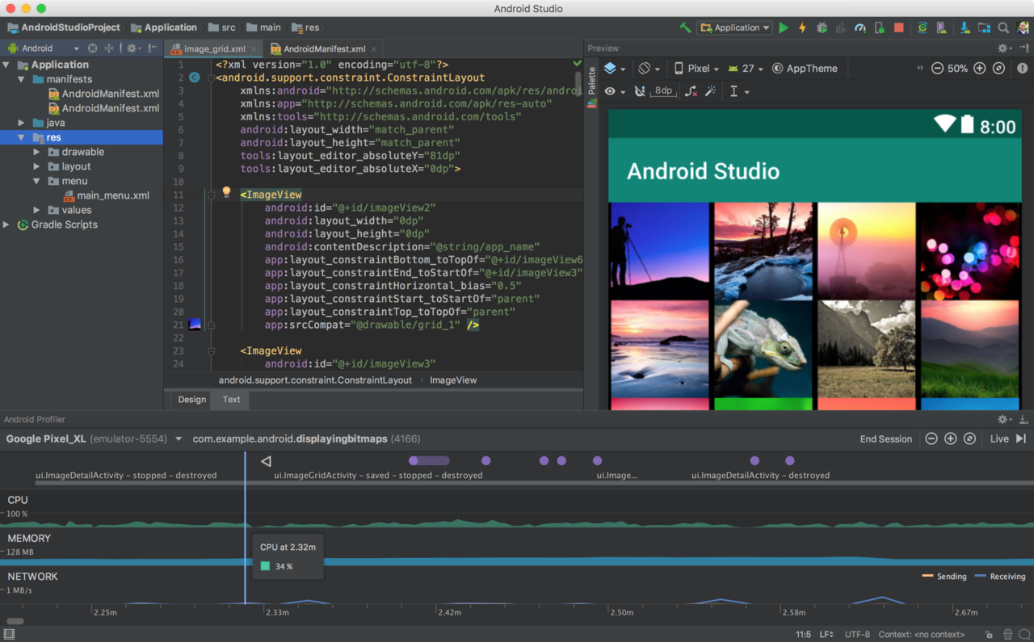

Slide 3
The modern web allows us to communicate more conveniently than ever before
But I believe we’ve lost something in the process
We’re going to have a look at a website to explore this idea from the perspective of end-users
We’re also going to look at the modern development experience and ask if it is over complicated
And finally we’re going to look at some projects that are exploring concepts of radical simplicity

Slide 4
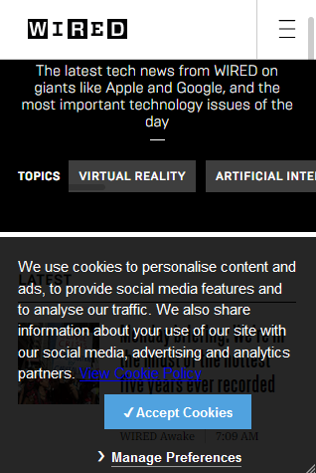
Overcomplicated UI design
Virtually every web site has a business requirement for branding
Virtually every element must be styled
There is a risk that doing so will create bugs
Let’s look at a site that behaves rather better

Slide 5
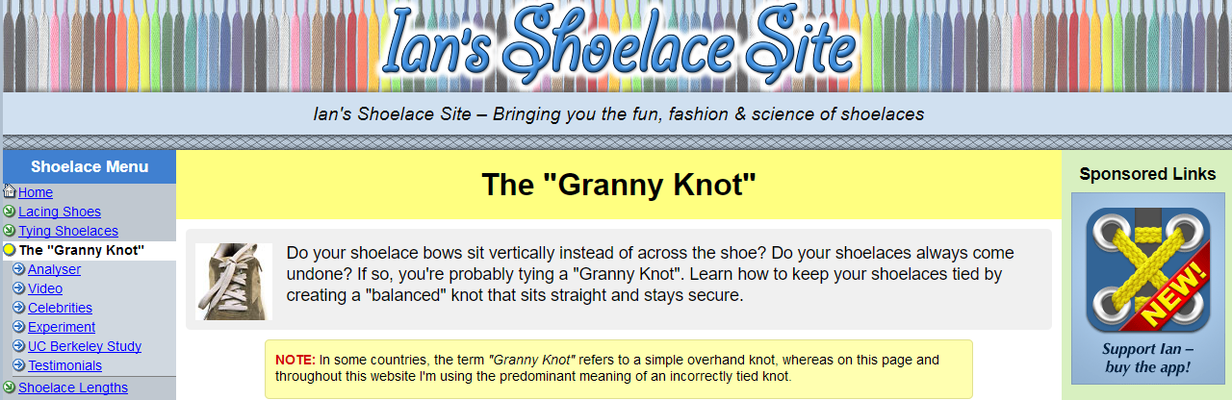
Ian’s Shoelace Site:
The web’s premier source of information on tying your shoelaces
https://www.fieggen.com/shoelace/

Slide 6
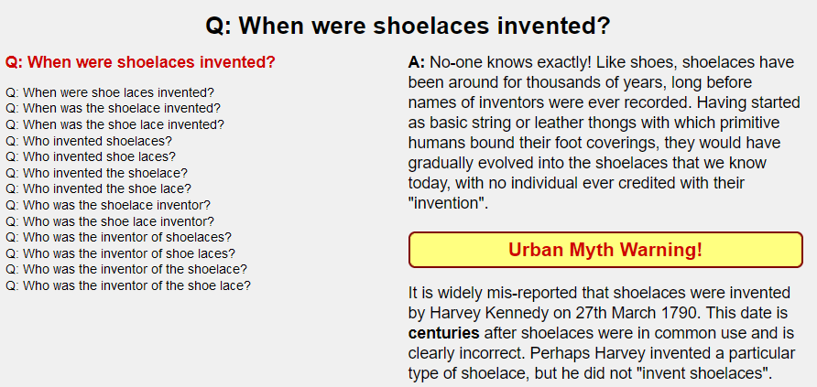
Really Basic HTML
There is no magic here
There doesn’t need to be magic here
The text is perfectly clear
We can all learn better shoelace knots

Slide 7
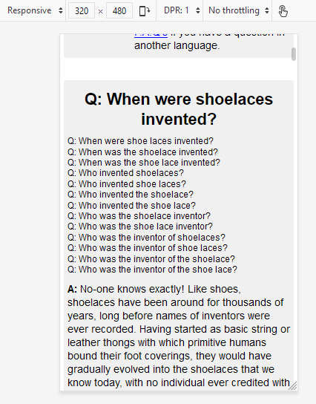
Works well on mobile!

Slide 8
Mobile support: wow! Isn’t that hard to do without a expensive development team that hold PhDs in HCI?
Ian is using the principal of KISS
He has utilised web technology in direct concordance with the WW3 spec without creating layers of abstractions and complications
When it comes to making his site responsive for mobiles, it’s remarkably easy
He doesn’t have complicated layouts and widgets that require huge amounts of fiddly CSS to get right

Slide 9
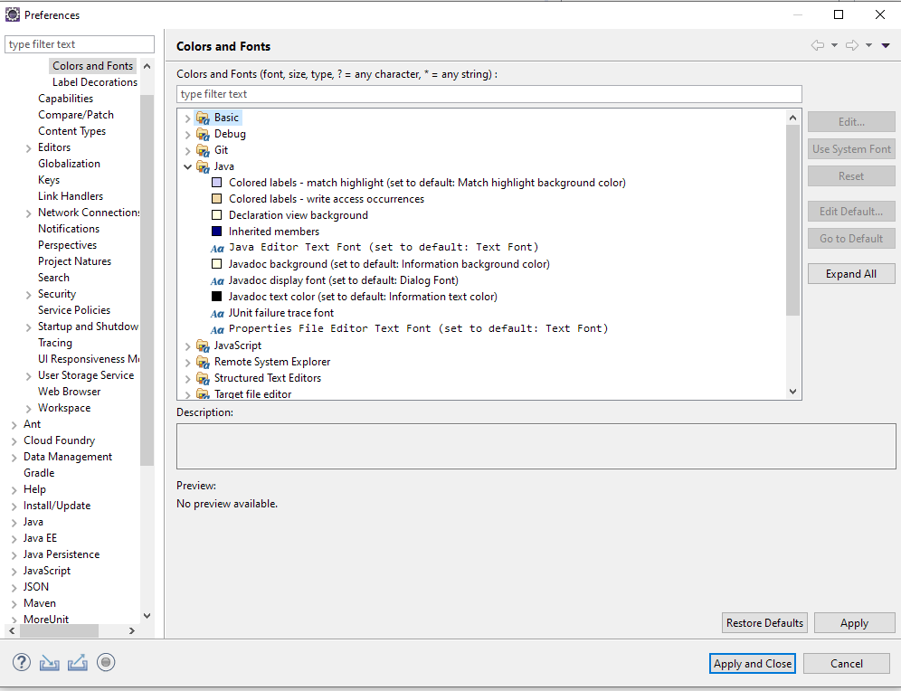
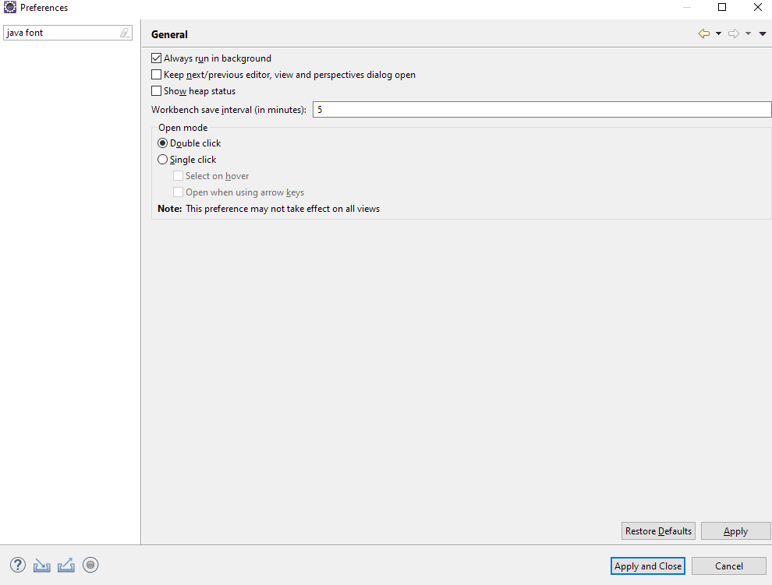
Overcomplicated IDEs

Slide 10
Mainstream IDEs: legacy of 90s software engineering practices
All I want is to run my code, which is usually a web app
I don’t really care about the details of how that happens
I would rather not have to know about all the configuration options available
For example, I would rather not have to configure complicated Maven files just to make basic things happen
But that’s not what I get
Antipattern: configuration over convention
Can be difficult to integrate with modern container technologies (e.g. Docker, kubernates)
Some common programming tasks are faster to do with text munging rather than a transform based on language analysis, but this is not well supported in Eclipse, Visual Studio

Slide 11
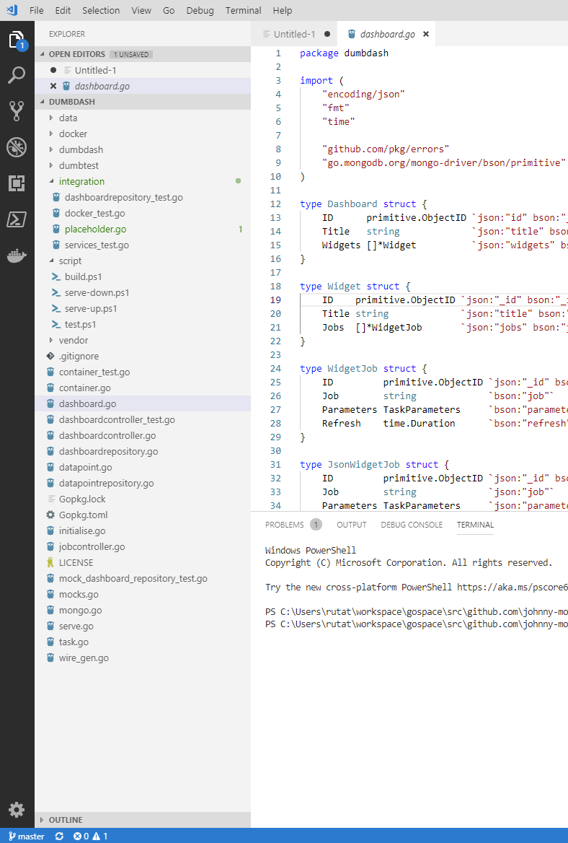
The Push Back: less weird stuff
Developers unsatisfied with IDE experience turning to simpler languages and powerful text editors
VS Studio Code, Sublime Text, Atom
Languages like Golang, Python, Ruby that don’t require an IDE to make the best usage
The Golang toolchain has a single coherent opinion on both testing and compilation. Your only option is to set up your code in the format expected. This is a good thing because no config is required.

Slide 12
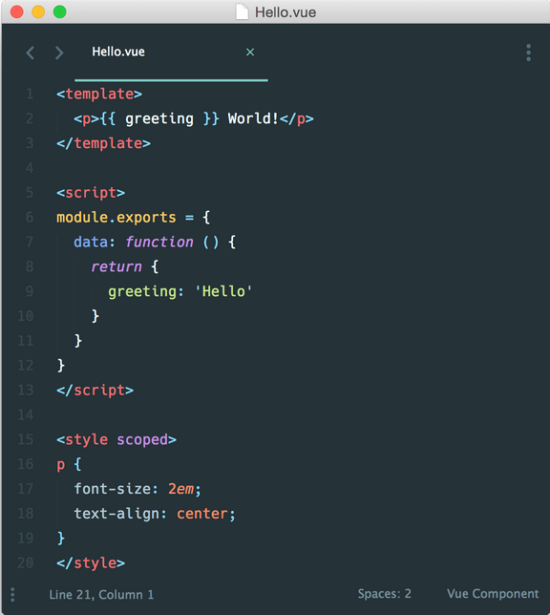
Aside, Vue.js
I’ve been playing with Vue.js
The HTML, Javascript, and CSS are held in a single file
Your component becomes a standalone widget
It’s remarkably simple
Allows design of consistent, well-behaved widgets

Slide 13
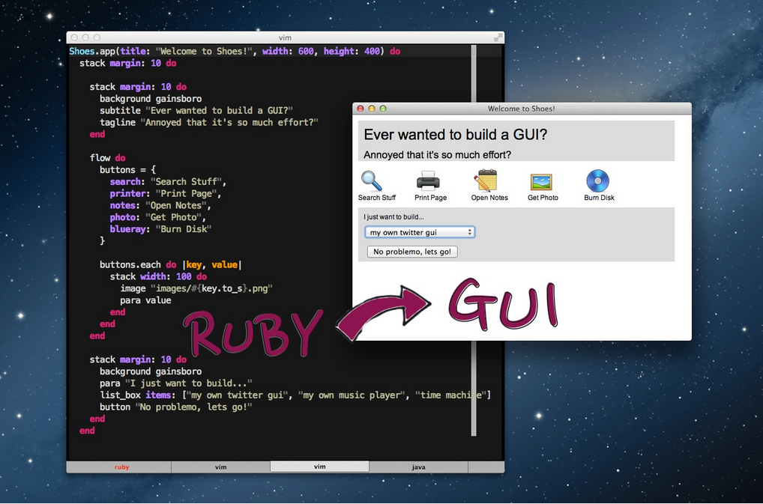
The Weirder Push Back: Shoes!
https://shoesrb.com/
For avoidance of doubt, not related to Ian’s shoelaces
An attempt to bring that early web magic into the world of desktop GUI programming

Slide 14
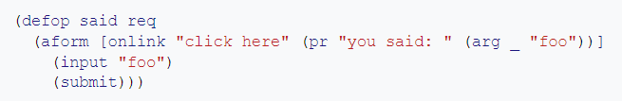
The Weirder Push Back: Arc Lisp
Arc Lisp is Paul Graham’s lisp dialect for the web
This project was definitely a flop but it’s very interesting regardless
Enabled the creation of zero configuration web applications with a few lines of code
The following program creates a web app with two pages

Slide 15
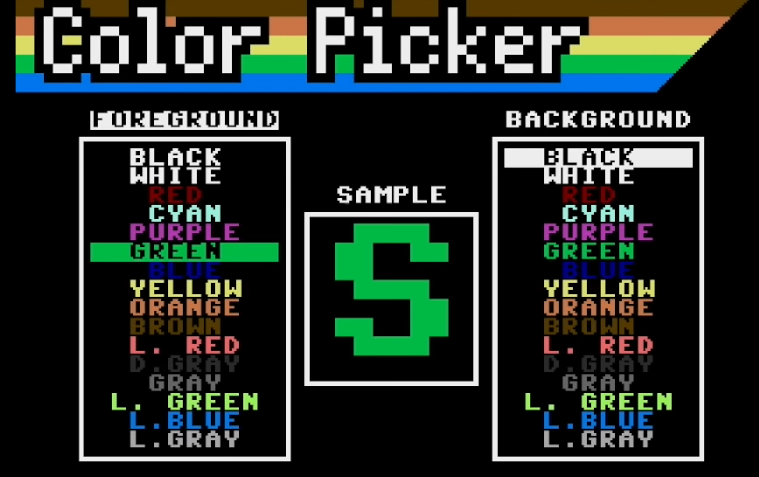
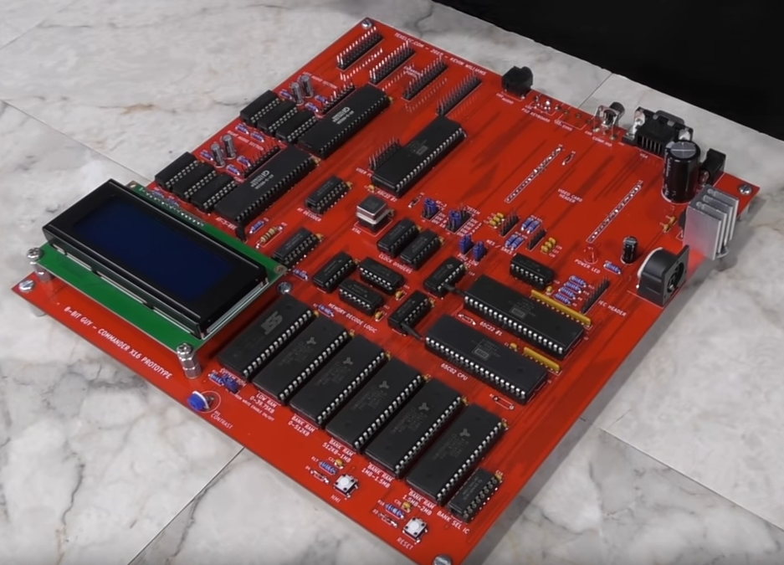
The Weirder Push Back: Commander X16
A modern 8-bit computer in development
Designed to be easy to program in assembler
Goal is to capture the things about old computers that made them easy to program while eliminating those things that were terrible e.g. cassette tapes, floppy disks
Plays a sound with one assembly instruction
By youtuber “The 8-Bit Guy”

Slide 16
Conclusion
Technology has become so complex that it’s very hard for ordinary people to understand how any part of it works
The complication isn’t good for professionals either
There is a movement concerned with simplicity, but there are differences in what people consider to be simple
Radical experimentation is very welcome to me, because I hope it will move the baseline for what is considered “too complicated” in our interactions with computers
My hope is that in future, standards bodies such as IETF and W3 committees will put more thought into making platforms that are simple yet support the kind of features end-users want
HTML5 video support was a good example of this

