Slide 1
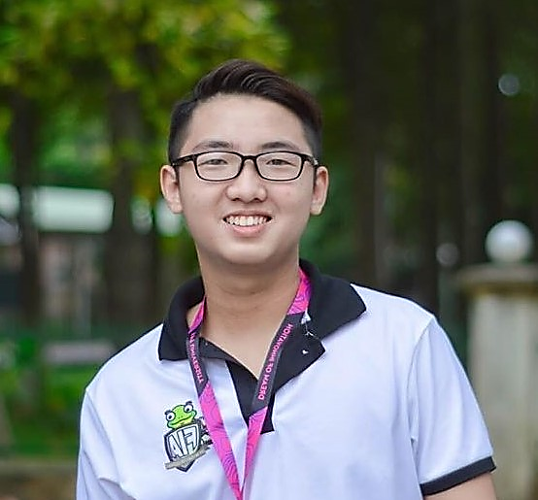
Tran Duy Hoang
ABOUT ME
Shortcut: Johnny
Hi there, I’m looking for challenging career opportunities in software engineering at a well-established organization to improve my knowledge and skills. I want to become a full-stack .NET Developer.
.Net Intern
Address: 94 street 2, Go Vap Dist., Ho Chi Minh City, Viet Nam
Mobile: (+84) 901 462 546
Email: duyhoangtran.johnny@gmail.com
Working Experiences
Languages
10/2019 – 2/2020 ( 4 months )
Fontend Internship in LIGV
Developed front-end using Angular. Created and maintained Angular component, implement login redirection routes, centralized fragmented code into one service
Improved teamwork soft-skill
Working with Scrum
English
(Rated IELTS 5.5 by Yola English Center)
My Skills
C#
5 months
Java
16 months
3/2020-now
Iphone Store Webapp
Using Angular to build fontend
Using WebAPI by ASP.NET CORE
Techs: SQL Server, Bootstrap, HTML5, CSS3, Auth0
IDE: Visual Studio Code, Visual Studio
Source: https://github.com/johnny-tran211/DHStore
Shopping online WebApp
Using design pattern: MVC
Build App by ASP.NET CORE
Techs: SQL Server, Bootstrap
IDE: Visual Studio
Source: https://github.com/johnny-tran211/Device_Management
MVC2
8 months
Angular
8 months
HTML5 CSS3
12 months
SQL Server
12 months
Git
8 months
Extra-curriculums
Play football in Gia Dinh church team.
Lead activities for youth in Go Vap Church
Statistics of activities in FPT Information Assurance Club. Source: https://github.com/johnny-tran211/Certificates/blob/master/FPT%20Information%20Assurance%20Club/activity.jpg
Certificates
Certificated OOP-Red YDeveloper in FPTU
Source: https://github.com/johnny-tran211/Certificates/blob/master/OOP-Red%20YDeveloper/OOP-certificate.jpg

