Slide 1
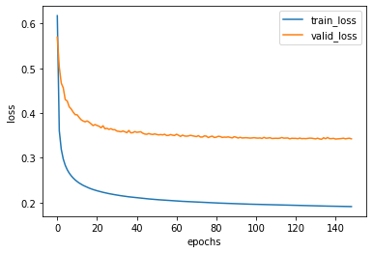
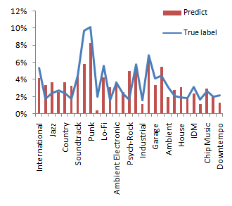

Music Genres Classification and Recommendation System
Jo-Chen Ma, Ting-Yu Wong, Kai-Ting Tsao, Kuan Lin Mentor:Ting-Wei Su
Introduction
Methodology and Results
Discussion and Conclusion
Classifying the multi-type of the audio-recordings and build up the recommendation model to generate the list of songs with similar genres.
We aim to accurate distinguish the genres of the songs and customize optimal playlist recommendation.
While user input a single song, we can provide three songs that includes high-related genres.
Data Preprocessing
Split and shuffle the data into train, valid , and test set (70%, 20%, and 10%)
We choose 32 genres^{[1]} that accounted for the greatest proportion of the dataset as the multi true label of our model.
Balance the amount of songs for different genres so that the weight of each genre can be more easier to learn.
There are more than 32 genres in our data set, but the rest of the genres can not accurately predict due to insufficient numbers of tracks.
Because of a large amount of audio features(518), the genres can be more precise with more variety of tracks.
Hip-Hop
Rock
Electronic
Algorithm and Training
We choose deep neural network (DNN) as our model with Keras.
By monitoring val_loss and val_auc, we use EarlyStopping and ModelCheckpoint to prevent our model from overfitting.
We got 79% accuracy by applying Adagrad optimizer (learning_rate= 5e-4, epsilon= 1e-6)
[173] [255] [1689]
Future Work
We can includes more type of genres to neural network by enhancing the data set.
Let our recommendation learn user’s preference by the feedback of songs it recommends to them.
Dataset
The datasets used in our project were collected International by Society for Music Information Retrieval Conference (ISMIR) and are available at https://github.com/mdeff/fma .
tracks.csv: per track metadata such as ID, title, artist, genres, tags and play counts, for all 106,574 tracks.
genres.csv: all 163 genres with name and parent (used to infer the genre hierarchy and top-level genres).
features.csv: common features extracted with librosa.
echonest.csv: audio features provided Spotify for a subset of 13,129 tracks.
Testing and Recommendation System
By using the train model, we could give our test data predicted multi-label.
A song could be successfully tagging with its genres, and our recommendation system will use set to match top three highest related songs to the users.
References
FMA: A Dataset For Music Analysis
Michaël Defferrard, Kirell Benzi, Pierre Vandergheynst, Xavier Bresson. International Society for Music Information Retrieval Conference (ISMIR), 2017.
[1] International, Blues, Jazz, Classical, Country, Experimental Pop, Synth Pop, Punk, Post-Rock, Lo-Fi, Loud-Rock, Noise-Rock, Psych-Rock, Indie-Rock, Industrial, Garage, Post-Punk, Hardcore, Soul-RnB, Ambient Electronic, Techno, House, Glitch, IDM, Trip-Hop, Chip Music, Downtempo, Psych-Folk, Singer-Songwriter, Hip-Hop, Soundtrack, Ambient.
Notes:
準確率
label

