Slide 1
BERT VS. RoBERTA VS. ALBERT VS. XLNet

Slide 2
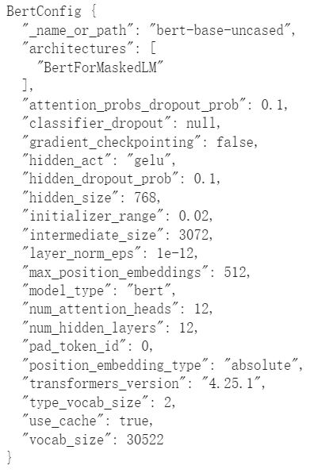
BERT模型

Slide 3
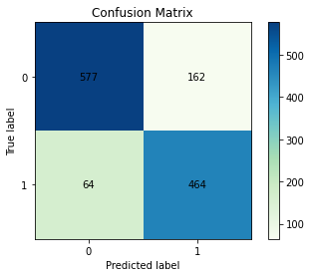
BERT混淆矩陣

Slide 4
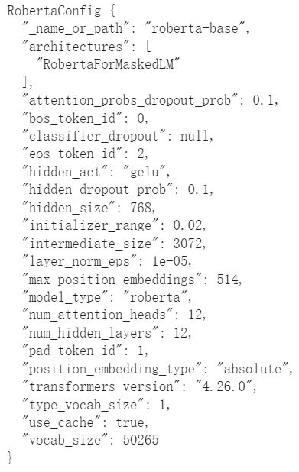
RoBERTa模型

Slide 5
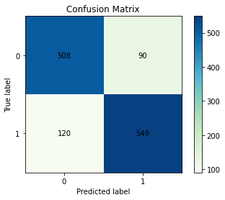
RoBERTa混淆矩陣

Slide 6
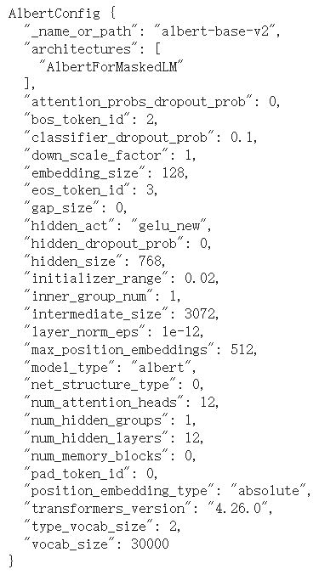
ALBERT模型

Slide 7
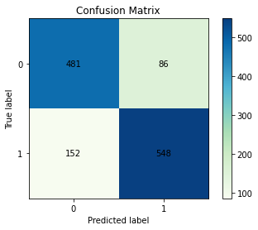
ALBERT混淆矩陣

Slide 8
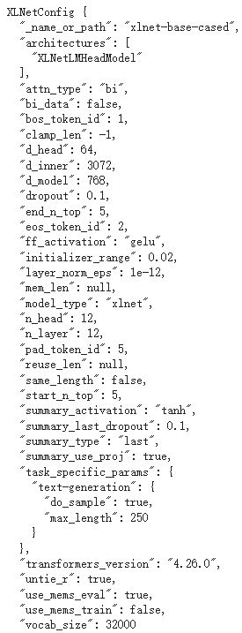
XLNet模型

Slide 9
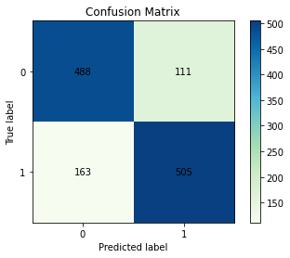
XLNet混淆矩陣

Slide 10
研究方法 | Accuracy | Precision | Recall | F1-Score
BERT | 82.16% | 82.92% | 82.16% | 82.04%
RoBERTa | 83.43% | 83.49% | 83.43% | 83.41%
ALBERT | 81.22% | 81.56% | 81.22% | 81.16%
XLNet | 78.37% | 78.62% | 78.37% | 78.36%

