Slide 1
RaspberryRemote
A web-based universal remote using LIRC

Slide 2
Tech Stack
ASP.NET Core
SignalR Core
LIRC

Slide 3
.NET Core
.NET Core is the open-source successor to the .NET Framework
Introduced in 2016
Implements .NET Standard
Can be compiled and executed on Windows, macOS, or Linux
Can run on top of the .NET Framework or as native code

Slide 4
SignalR
Simplifies real-time communication between server and clients
Allows messages to be pushed to clients without a request
Utilizes:
WebSockets (Latest versions of major browsers)
Server Sent Events (All recent browser versions except IE)
Forever Frame (IE only)
AJAX long polling (older browsers)

Slide 5
LIRC
Linux Infared Remote Control
Package which allows sending and receiving of infared signals
Large database of thousands of pre-configured remotes available at http://lirc.sourceforge.net/remotes/
Also supports training custom devices
Control computer with remote, or remote devices with computer

Slide 6
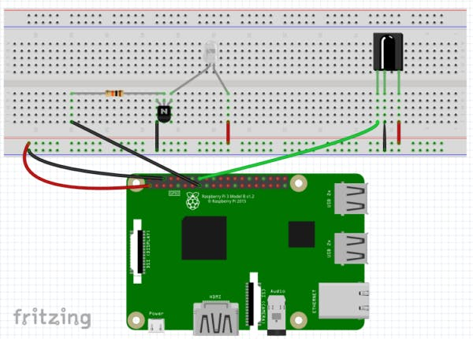
Circuit

Slide 7
Circuit
I used a 220 ohm resistor instead of a 10k ohm resistor – this will depend on your infared LED
These LEDs and receivers worked great for me: https://www.amazon.com/gp/product/B00EFOQEUM/ref=ppx_yo_dt_b_asin_title_o00_s00?ie=UTF8&psc=1
I also added an extra LED in parallel with the infared LED for debugging purposes

Slide 8
Interaction between .NET Core and LIRC
I use the Process class to interact with the LIRC CLI
Get a list of valid commands
Send commands from the webserver to the infared LED
Listen for infared signals from a configured remote

Slide 9

Disclaimer
This is a proof-of-concept and the architecture is not designed using industry best practices
Expect bugs ☺

Slide 10
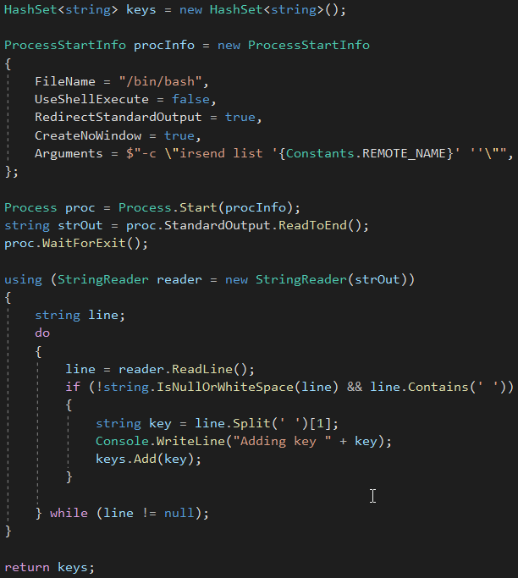
Getting valid commands
irsend list “remote_name” “”

Slide 11
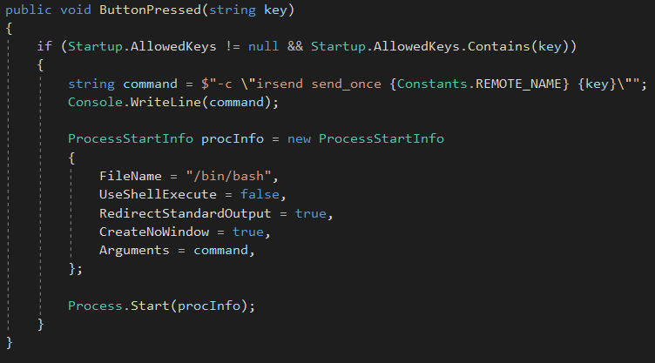
Send commands
irsend send_once “remote_name” “key”

Slide 12
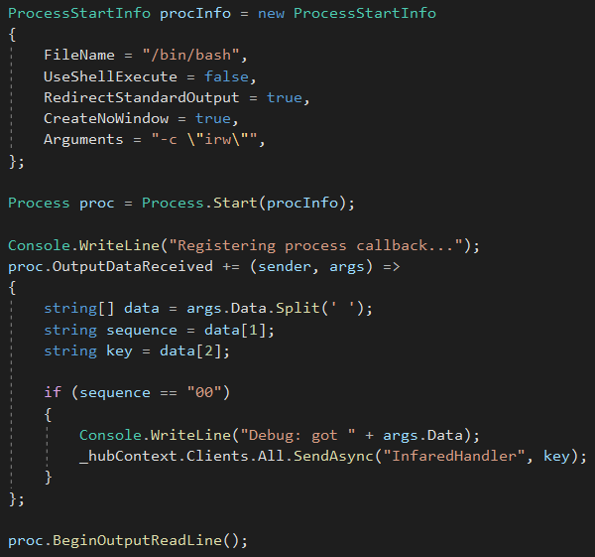
Listen for signals
irw

Slide 13
Resources
Proof-of-concept repository here: https://github.com/johnnyRose/RaspberryRemote
Tutorials:
https://www.hackster.io/austin-stanton/creating-a-raspberry-pi-universal-remote-with-lirc-2fd581
https://raspberrypi.stackexchange.com/a/70946/98721
Other helpful resources:
http://www.lirc.org/
https://raspberrypi.stackexchange.com/a/73070/98721
https://www.instructables.com/id/Verify-and-Debug-Linux-Infrared-Remote-Control-LIR/
Getting started with .NET Core: https://docs.microsoft.com/en-us/dotnet/core/get-started?tabs=windows
Getting started with SignalR Core: https://docs.microsoft.com/en-us/aspnet/core/tutorials/signalr?view=aspnetcore-2.2&tabs=visual-studio

Slide 14
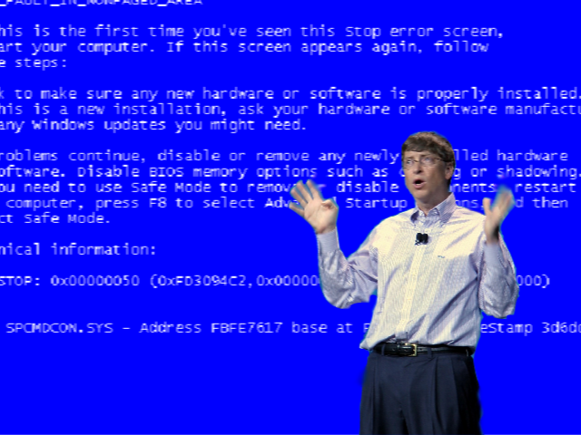
Demo?

