Slide 1
Blinker Tutorial
A simple blinking LED tutorial for the Raspberry Pi
John Rosewicz

Slide 2


Slide 3
  https://www.raspinews.com/blinking-led-on-raspberry-pi-using-python/
  https://github.com/johnnyRose/blinker

Slide 4
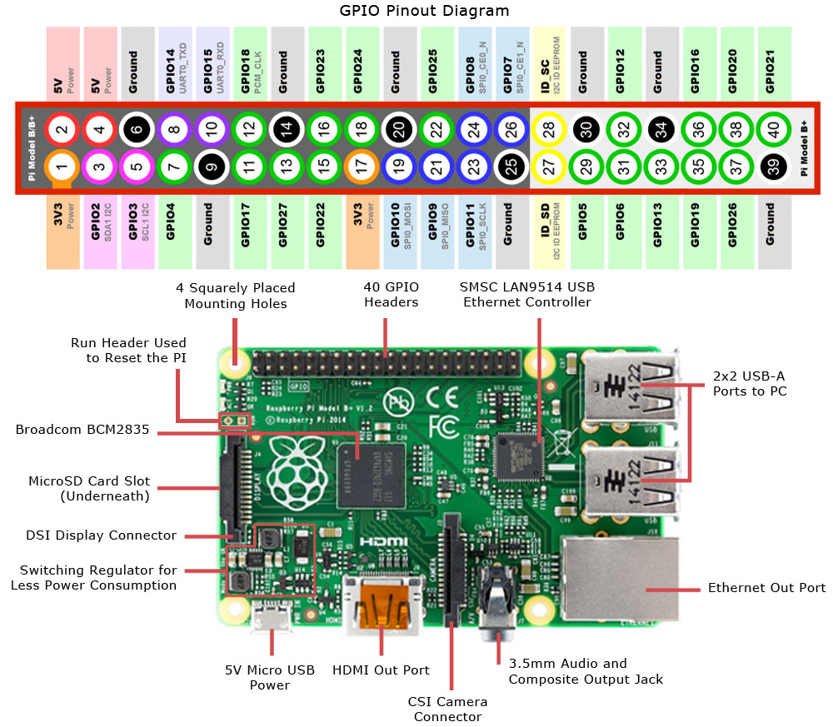

Slide 6
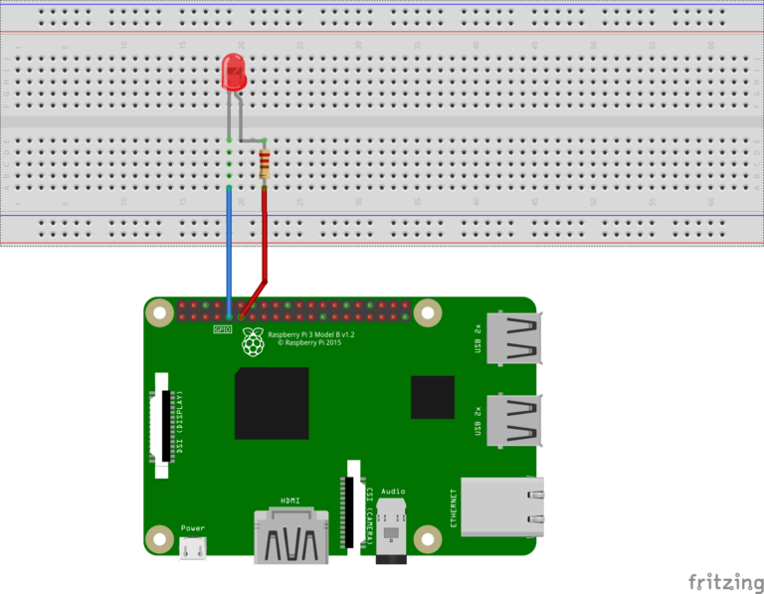

Slide 7
Ohm’s Law
R = V / I
Ohms, Volts, and Amps
LED has max of 20 mA
3.3 V out, need to reduce current to 20mA (0.020A)
R = 3.3V / 0.02 == 165 Ohms necessary

Slide 8


Slide 9
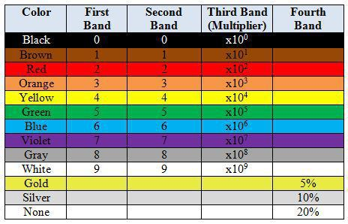

Slide 10
“2” + “2” * 10 == 22 * 10 == 220 Ohms

Slide 11

Demo

