Slide 1

Data-Driven Solutions for Enhancing Hospital Observation Units
John Pole Madhu

Slide 2

Project Overview
This project focuses on Efficient hospital observation unit operations play a crucial role in enhancing patient care and optimizing hospital resources.
As patient volumes increase, current workflows may become ineffective, requiring a reassessment of operational strategies.
Delays and inefficiencies in these units contribute to overcrowding, negatively affecting both patient outcomes and overall hospital functionality.
Optimizing workflows can significantly reduce patient wait times, leading to an improved healthcare experience.
A well-structured resource management system ensures better staff allocation and enhances cost efficiency for hospitals.
Addressing bottlenecks in hospital observation units can lead to substantial financial savings while maintaining high-quality care standards.

Slide 3

Objective
Primary Objective: Detect operational inefficiencies and implement data-driven strategies to ensure patients are placed in the most appropriate care setting. Right Patient-Right Bed.
Utilizing Data: Evaluate patient flow, staffing levels, and healthcare outcomes to enhance hospital operations.
Expected Benefits: Improve staff allocation and eliminate workflow bottlenecks, especially during high-demand periods.
Outlook: Develop a sustainable, data-informed approach for continuous hospital process optimization.

Slide 4
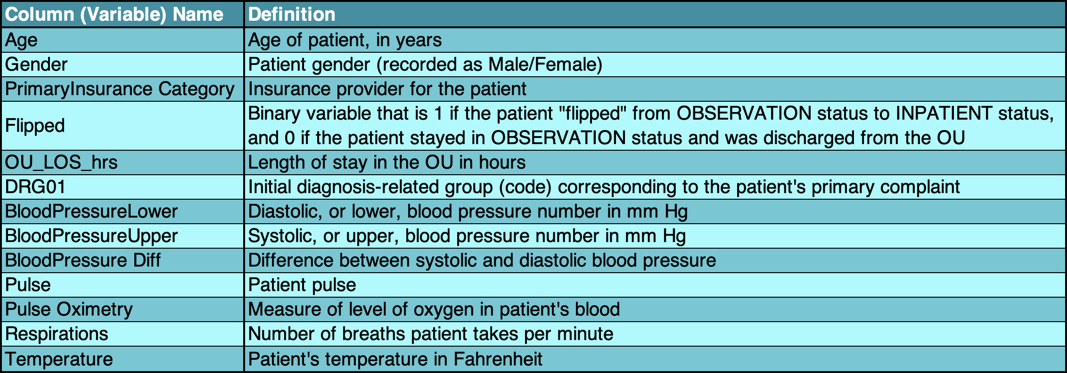
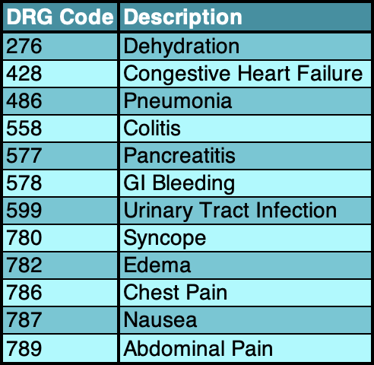

Data Dictionary & Data Description
Dataset: Hospital records from time-period 2019-2020, with 1111 patient entries.
Key Variables: Flipped, DRG01, PrimaryInsuranceCategory
Preprocessing: Handled missing data using median value, standardized variables.

Slide 5
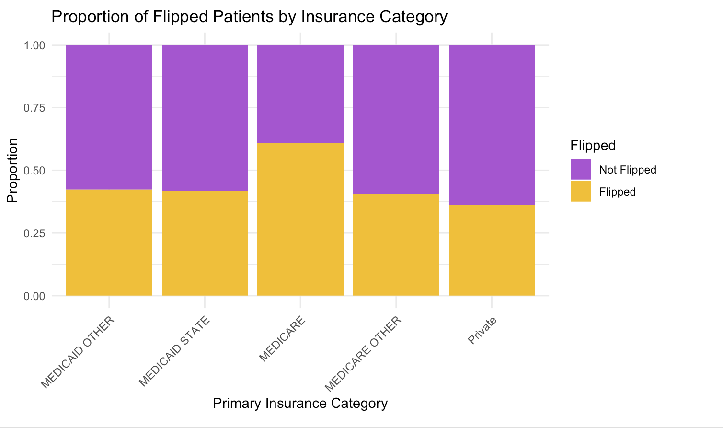
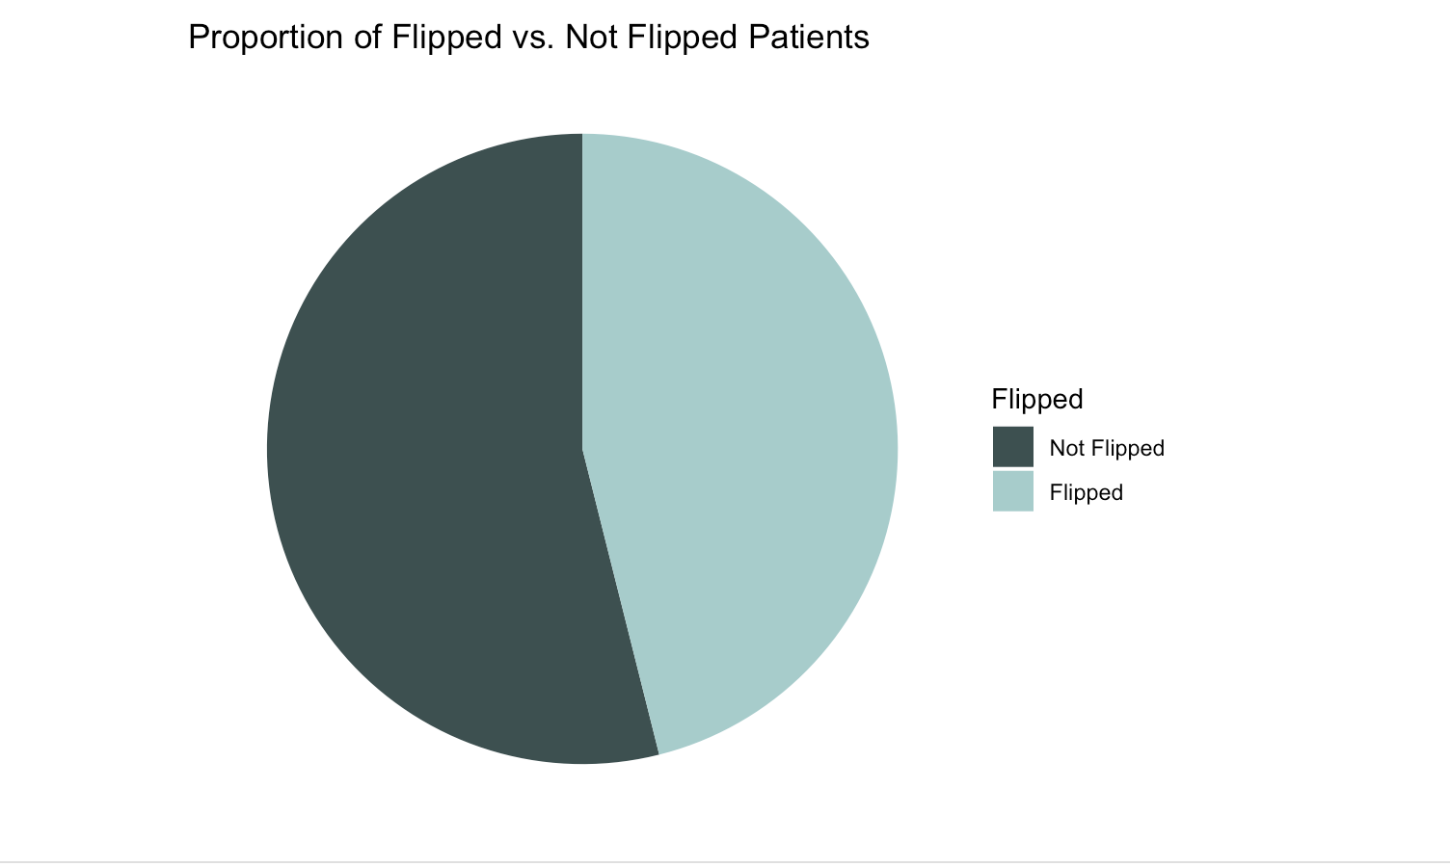
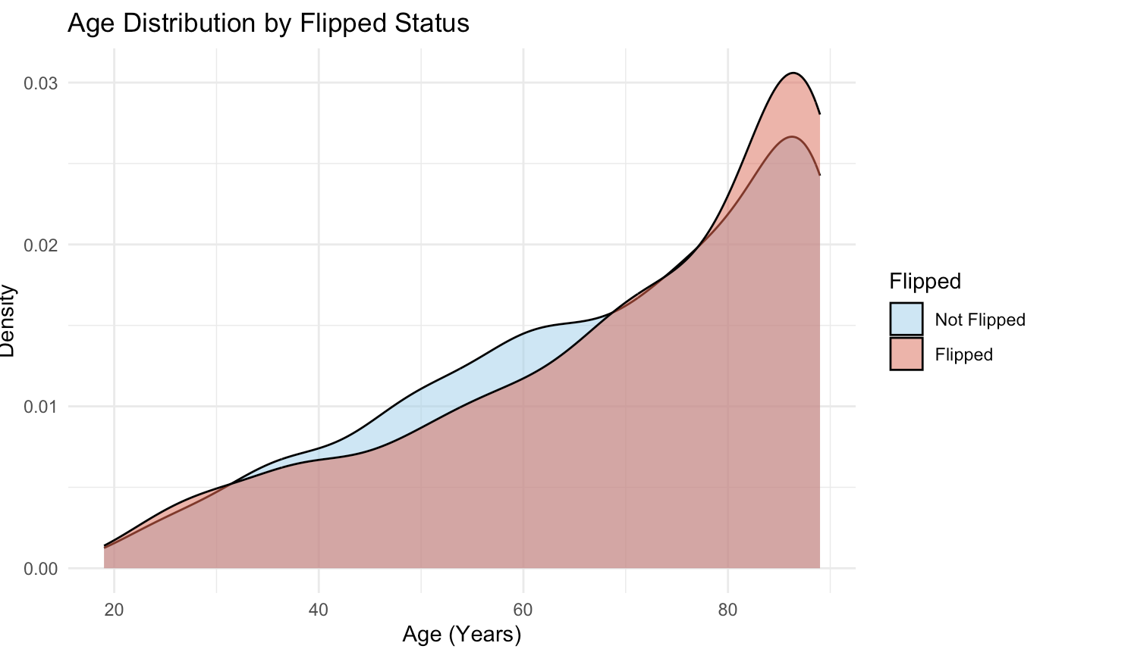
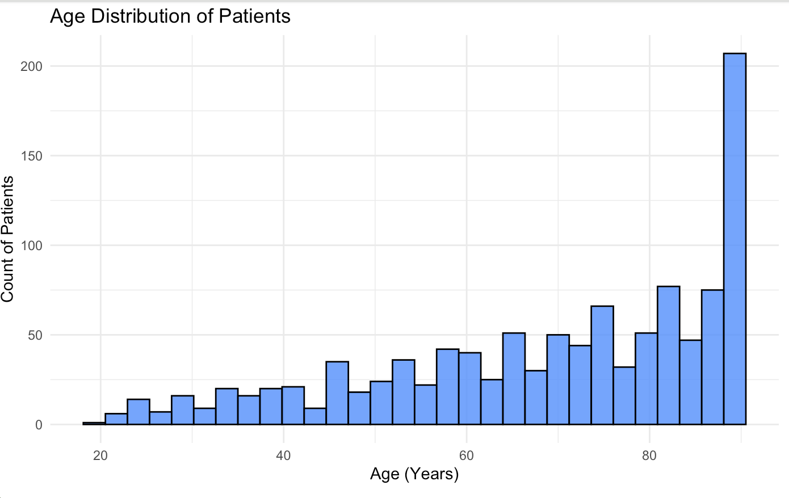
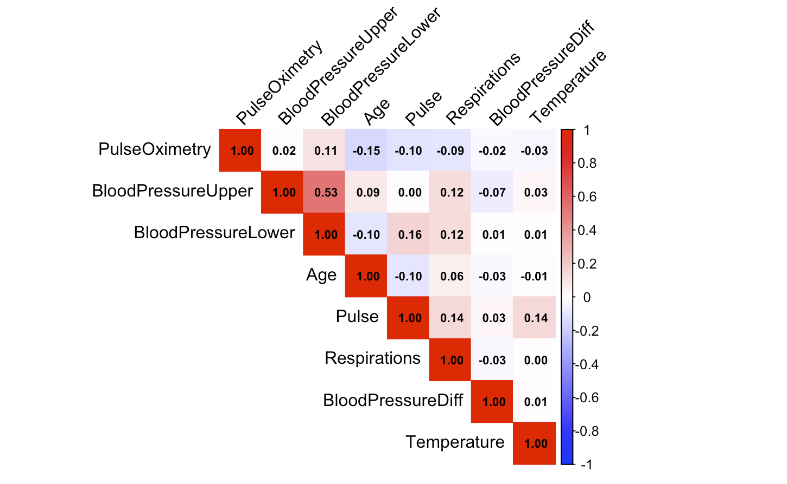
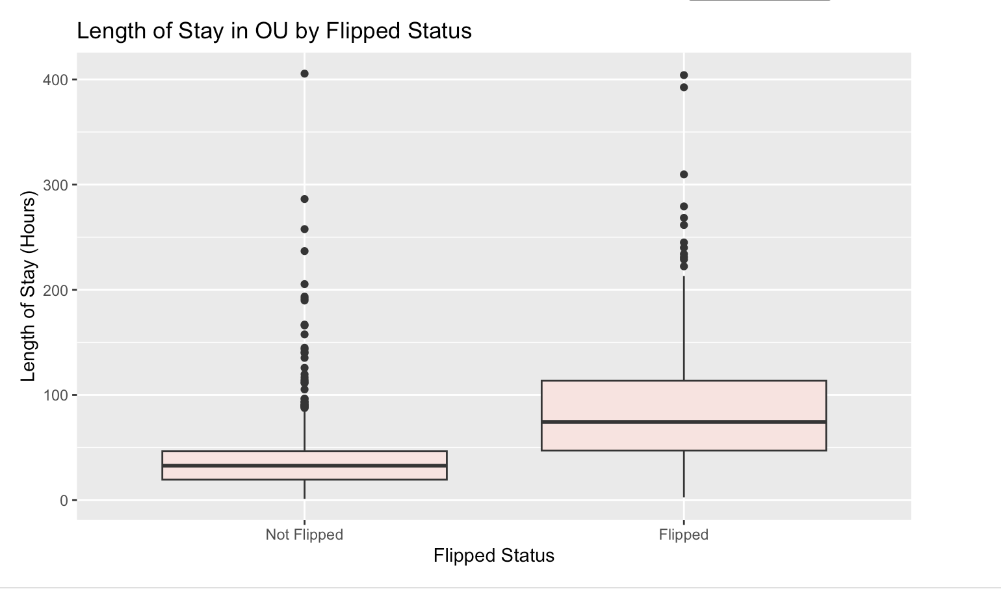
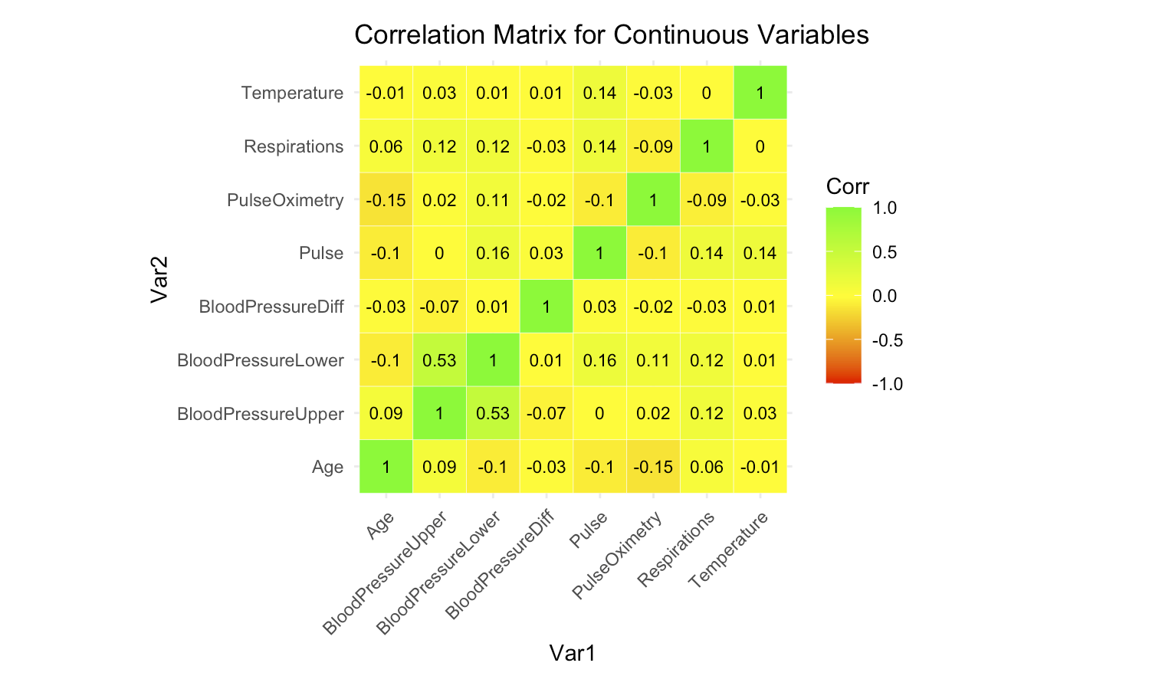
Introductory Tasks
Data Collection
Data Preparation
Exploratory Data Analysis (EDA)

Slide 6

Methodology
We employed three types of models in our analysis:
Logistic Regressions
Random Forests
Decision Trees
We tested these model’s multiple times—initially incorporating all variables and later refining the analysis by selecting only the most significant ones.

Slide 7
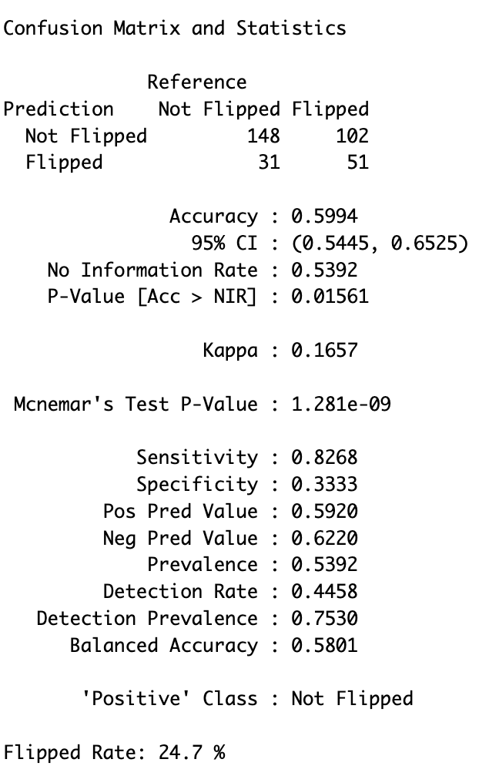

Model Results
The final model: The initial logistic regression, utilizing Flipped as the target variable and incorporating all predictor variables, demonstrated the highest performance.
Model accuracy was 59.94%
Flipped rate was 24.7%
0.6 threshold was found to be optimal
Adjusting thresholds and using higher-accuracy models increased the flip rate, leading to unintended consequences.

Slide 8
Key Metrics
Current Flipped Rate: Dr. Kelly's observation unit (OU) has a 45% flipped rate, leading to longer stays and reduced hospital resources
Impact of lower flipped rate: reducing flipped rate from 45% to 20 % increases patients treated from 44 to 55 per week
- New patients = 44 + (44 x (0.45 - 0.20)) = 55 patients
Annual patient Impact: 572 additional patients
- 11 extra patients per week x 52 weeks = 572 patients
Notes:
New Patients = Current Patients + (Current Patients × (Old Flipped Rate − New Flipped Rate))

Slide 9
Profit and Bed Utilization
Profit increase: Hospital could earn $400,400 extra per year
- 572 patients x $ 700 per visit = $400,400
Bed Utilization: Reduced flipped rate lowers patients in inpatient beds from 115 to 51 per week
- 115 x (0.20/0.45) = 51 patients
Annual Bed Utilization Impact: This results in 3,328 fewer patients in inpatient beds
- 64 fewer patients per week x 52 weeks = 3,328 patients
Notes:
New Patients in Beds = Current Patients in Beds × (New Flipped Rate/Old Flipped Rate)
115 is an example # for OU patients are occupying Inpatient beds

Slide 10
Recommendations and Conclusion
Optimized Patient Placement: Implementing the logistic regression model with key variables enhances patient assignment accuracy.
Improved Efficiency: This approach is expected to reduce the flipped rate by 25%, leading to better resource utilization and higher hospital revenue.

Slide 11

THANK YOU!

