Slide 1

UNDERSTANDING KOREAN ECONOMIC CONDITIONS.

Slide 2

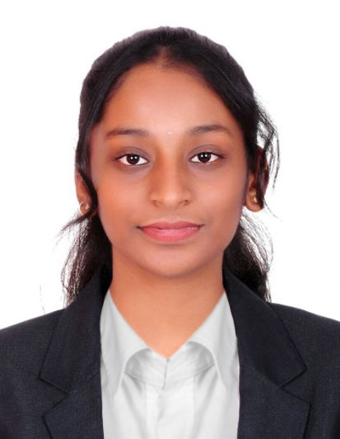

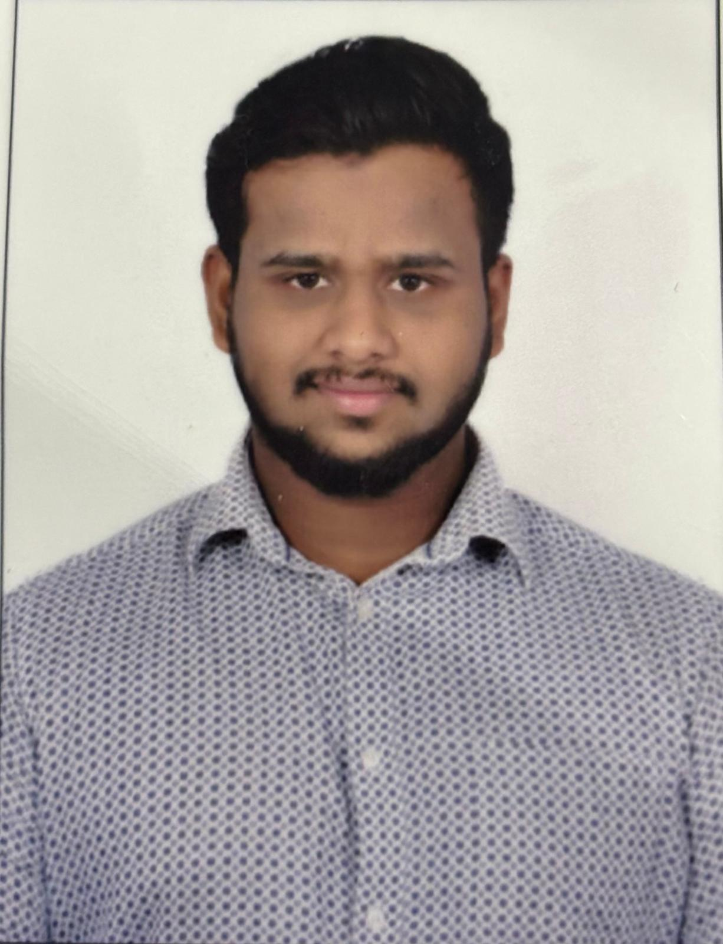
Team members
Rajivini T Prabhu Shankar
John Pole Madhu Mohammed Akbar Ali

Slide 3
Background
Understand and analyze economic conditions
Make a decision if it is profitable to start an apparel business in South Korea
Analyze the existing Fashion and Apparel industry and draw conclusions.

Slide 4
Problem Statement
Analyze the below points to make a decision:
Demographic shifts
Youth unemployment
Income inequality
Geopolitical tensions
Environmental sustainability
Depending on this, we need to specify whether or not to invest in the apparel industry.

Slide 5
Data
International Monetary Fund - The International Monetary Fund, or IMF, works to achieve sustainable growth and prosperity for all of its 190 member countries.
The World Bank - The Data Catalog is designed to make World Bank's development data easy to find, download, use, and share.
World wealth and income databases - an extensive, open and accessible database on the historical evolution of the world distribution of income and wealth, both within countries and between countries.

Slide 6
Descriptive statistics of the data sets
Mean: | Minimum value: | Median: | Maximum value: | Standard deviation: | Interquartile range(IQR):
33243.001 | 25459.168 | 33447.155 | 42326.204 | 8105.687 | 8134.609
GDP :
Retail sector market share:
Inflation rate analysis:
Unemployment rate:
Net wealth to income ratio:
Mean: | Minimum value: | Median: | Maximum value: | Standard deviation: | Interquartile range(IQR):
14.29 | 5.50 | 12.60 | 36 | 7.9 | 6.40
Mean: | Minimum value: | Median: | Maximum value: | Standard deviation: | Interquartile range(IQR):
1.608 | 0.38 | 1.48 | 5.09 | 1.22 | 0.79
Mean: | Minimum value: | Median: | Maximum value: | Standard deviation: | Interquartile range(IQR):
3.47 | 2.75 | 3.64 | 3.93 | 0.52 | 0.84
Mean: | Minimum value: | Median: | Maximum value: | Standard deviation: | Interquartile range(IQR):
8.58 | 7.85 | 8 | 9.34 | 0.476 | 1.15

Slide 7
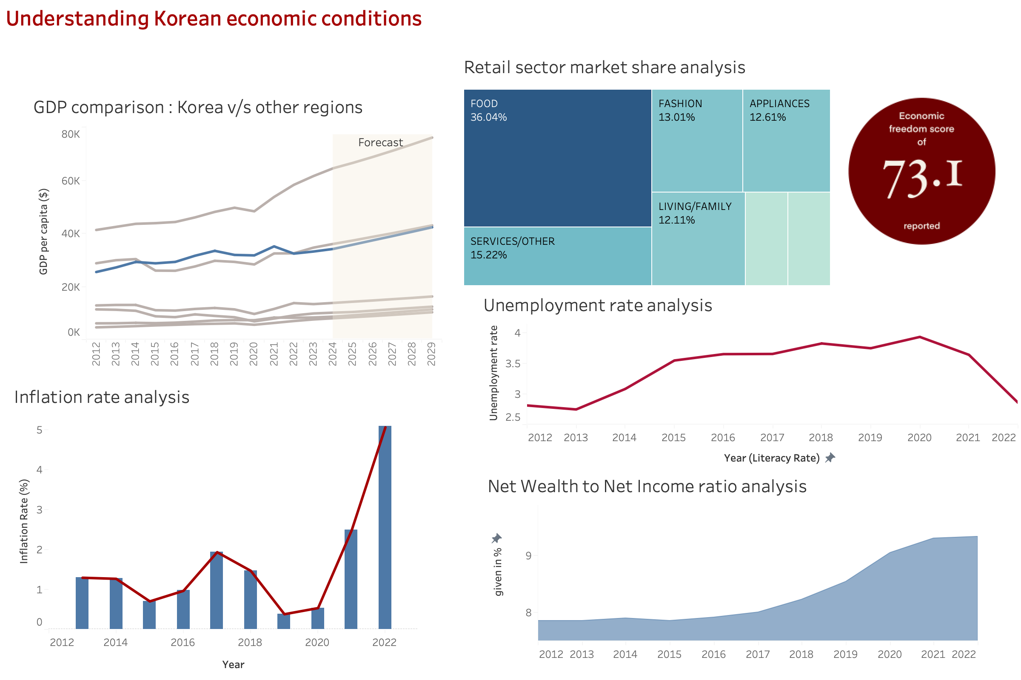
Dashboard

Slide 8
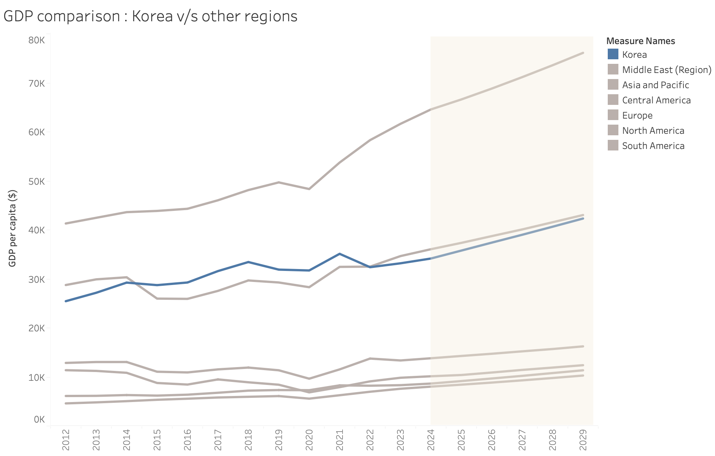
GDP comparison : Korea v/s other regions
The graph above shows the GDP per capita (represented in $) for Korea, which is our target market and all other countries, which have been categorized into regions.
South Korea's GDP per capita has shown steady growth over the past decade, reaching approximately $2,200 in 2023. This places South Korea among the high-income countries globally.

Slide 9
Inflation Rate Analysis
The inflation rate in South Korea has generally remained low and stable over the past 10 years, averaging around 1-2%. This indicates a relatively stable pricing environment for businesses.
We can also see a steep rise between the years 2020 and 2023. This is due to the COVID-19 pandemic, which had an adverse impact on the economic conditions of Korea.

Slide 10
Unemployment rate
Korea has maintained a relatively low unemployment rate, averaging around 3-4% over the past decade.
This suggests a stable labour market with ample opportunities for skilled workers.

Slide 11
Net wealth to Net income Ratio Analysis
The net wealth to net income ratio has showed a constant increase over the last 10 year. This means that the earnings have also grown with time.
As mentioned above, an increase in income will allow people to purchase more.

Slide 12
Retail sector market share analysis
As we can see, apart from food and services which are the main sectors, the next biggest sector is Fashion.
From this analysis, we can say that the fashion and apparel industry occupies a majority of the share

Slide 13
Recommendations
Based on the retail sector research chart, it's evident that the fashion and clothing business holds a substantial market share, suggesting promising growth potential.
Make a thorough budget and financial strategy for your clothing company, considering projected income, recurring costs, and start-up costs.
With a 3-4% unemployment rate, South Korea presents a chance for us to hire experts with training.

Slide 14
Thank you

