Slide 1

Team Details
Team name: SKUdesk
Team leader name: Mr. Chonlarnatt Poonchattakarn
Team member: Ms. Ploypitcha Boontavipitak
Problem statement: Shoppers and small resellers cannot tell whether a cheaper listing is the identical product, so a “deal” is often a different model, a case or a clone. SKUdesk finds the cheapest landed cost, prices a resale and checks arbitrage only on provably identical products.
Notes:
SKUdesk: one agent that finds the cheapest landed cost, prices a resale and checks arbitrage, only on identical products.

Slide 2
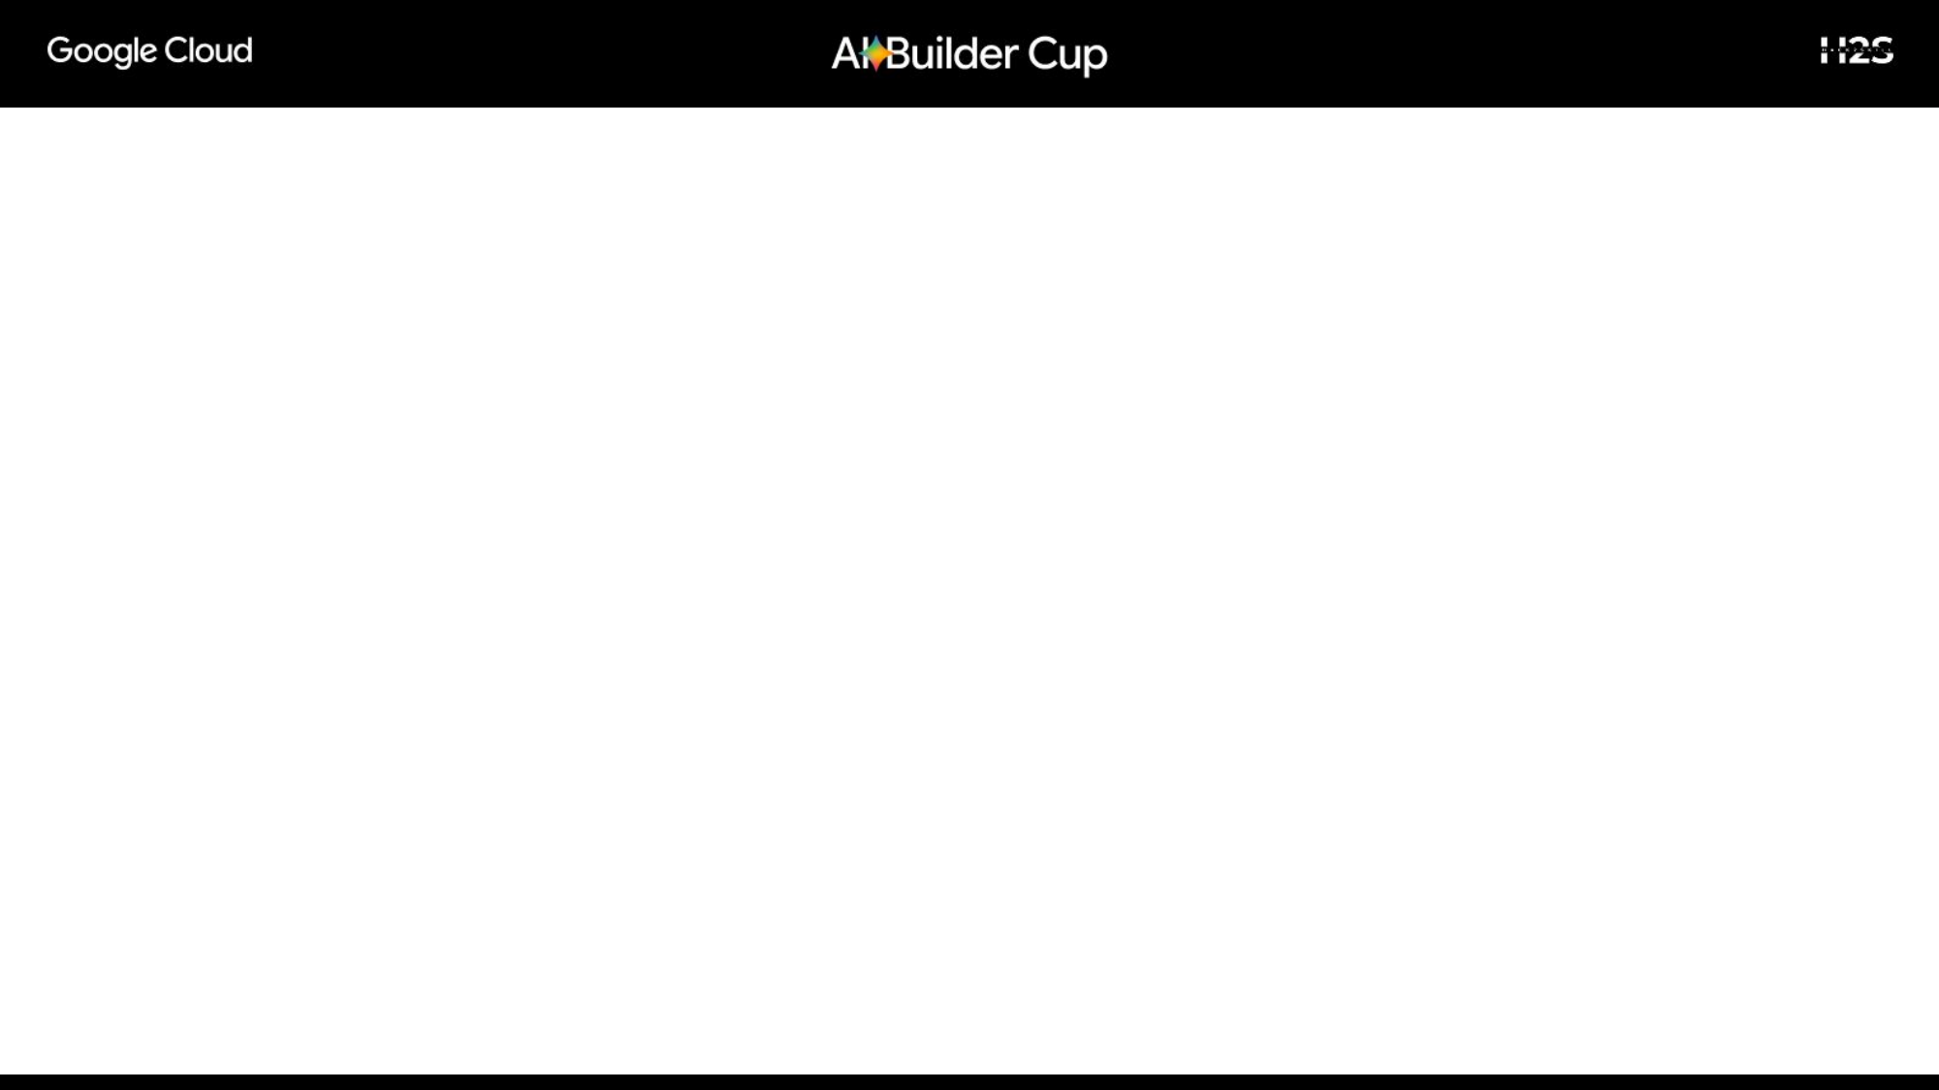
Brief about the idea
• One agent, three jobs. It finds the cheapest landed cost, prices a resale and checks arbitrage, but only when two listings are the identical product.
• Gemini is the identity gate. It must quote the brand and model it relied on, and our code checks that the quotes really appear in the listing. A second Gemini step looks at the photo and can only take a match away.
• The honest “no” is the product. No identical product, or no gap left after fees, returns and postage: the agent says so and shows every listing it turned down. A wrong “yes” loses money.
• A person approves every spend. The agent never buys anything itself. Each buy is a proposal; an approved resale can then be listed in Google Merchant Center by the owner.
• Real services, live now. Google Shopping results, Gemini, Cloud Run, Firestore, Cloud Scheduler, Secret Manager and the Merchant API, at skudesk.lol.

Slide 3
Opportunities
• How different is it? Price trackers compare titles and show a “lowest price” that is often another model, an accessory or a clone. SKUdesk makes identity the first gate and shows every listing it turned down and why.
• How does it solve the problem? A two-step identity check (text with quoted evidence, then the photo), a price-sanity filter for impossible prices, and a cost model in integer cents: landed cost, 13% marketplace fee, 2% returns reserve, outbound postage and a margin floor.
• USP The honest “no”. 67 labelled product pairs ran against the real model with zero wrong matches, and a person approves every spend. A market view shows asks, four buyer policies’ bids and the spread, so the reason for a “no” is visible.
Measured on the live service (18 Oct 2026, 12 products watched)
249
listings screened by the identity gate
201
turned down: not the same product (81%)
14
impossible prices set aside as bad data
$6,995
of fake discounts the agent refused to trade on
Figures come from the run-metrics page at skudesk.lol and keep growing as the scheduler checks the watchlist.

Slide 4
List of features offered by the solution
• Identity gate Gemini quotes brand and model; code verifies the quotes and reads storage size and model tier itself.
• Photo check Gemini compares each matching photo with the requested product and can only take a match away.
• Price sanity Prices far below the median or recalled retail are set aside as bad data.
• Economics Landed cost, fees, returns, postage and margin floor, in integer cents.
• Approval Every buy is a proposal; only the requester or the owner decides.
• Market page Order book of identical asks, four buyer-policy bids, spread, history chart, 3D product view.
• Watchlist and scheduler Up to 12 products checked on a schedule, longest-waiting first.
• Live agent view A graph that lights up as the agent searches, judges, looks and prices.
• Resale listings Preview and send an approved resale to Google Merchant Center (owner only).
• Owner controls Per-buy limit, margin floor, kill switch, audit log.

Slide 5
Process flow diagram
1 Search
Google Shopping listings
2 Identity gate
Gemini quotes evidence, code verifies
3 Photo check
Gemini looks at each photo
4 Price sanity
Impossible prices set aside
5 Economics
Landed cost, fees, margin
6 Proposal
Buy, or an honest “no”
A person approves
Only the requester or the owner
Merchant Center listing
Owner previews, then sends the resale
Nothing identical, or no gap after costs: the agent says no and shows what it turned down. The scheduler runs the same flow on the watchlist.

Slide 6
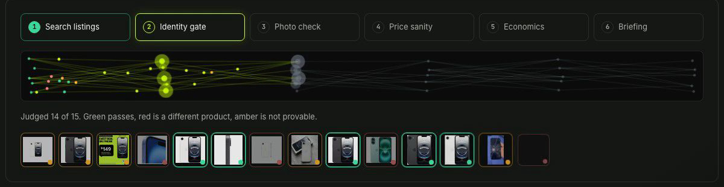
The agent at work: one real check
LEGO Technic Ferrari Daytona SP3 (42143), checked on skudesk.lol with real Google Shopping listings and real Gemini verdicts.
40
listings found
30
judged by Gemini
6
identical
20
different product
4
not provable
3
bad prices set aside
Live agent graph, from the demo recording (a check of an iPhone 16e). Every dot is one listing moving through six stages: green = identical, red = a different product, amber = not provable.
Of the 6 identical, 3 had prices that cannot be real ($5.83, $29.00 and $200.00 for a set that retails near $449.99), so only 3 were priced.
Five listings the agent did not trade on, and why
Buy BrickFever $525.00 landed ($515.00 + $10.00 assumed shipping)
Resell at $700.42 (next cheapest identical ask)
Costs 13% fee $91.05, 2% returns $14.01, postage $15.00
Net +$55.36 (10.5%), above the 10% margin floor
A proposal now waits for a person. The agent does not buy.
Asking prices, not sold prices. Checked 16 Oct 2026.
Listing | Verdict | Why
Ferrari Daytona SP3 “The Sense of Perfection” book | Different | A book, not the set
Brickshell Cases Wall Display Frame | Different | An accessory, not the set
“KING 8888 compatible 42143” building blocks | Different | Other brand: a clone
eBay 42143 “Collectible Supercar Building Kit” | Not provable | Brand not found in the listing
eBay LEGO Ferrari 42143 at $5.83 | Set aside | Impossible next to $449.99 retail

Slide 7
Architecture diagram of the proposed solution
Gemini API
Identity, photos, retail recall, note
Cloud Run
Node agent, API, identity gate, scheduler endpoint
Browser
Astro site, 3D view
Cloudflare edge
skudesk.lol
Google Shopping
via SerpApi: live listings
Merchant API
Resale listings
Firestore
Checks, history, proposals, audit
Secret Manager
Keys and owner key
Cloud Scheduler
Scans the watchlist on a schedule
The edge worker adds a shared secret so the service only answers traffic that came through it. The page content policy allows scripts from the site only.

Slide 8
Technologies used in the solution
• Google Cloud Cloud Run, Firestore, Cloud Scheduler, Secret Manager, Merchant API
• Gemini Google Gen AI SDK: structured identity verdicts, image understanding, grounded retail recall
• Google Shopping Live listings through SerpApi
• Backend Node.js with native TypeScript, no framework, node:test
• Frontend Astro, vanilla TypeScript, WebGL 3D view, canvas
• Quality 136 unit tests, 21 browser end-to-end tests (Playwright), a labelled evaluation set, a smoke test for the deployed service

Slide 9
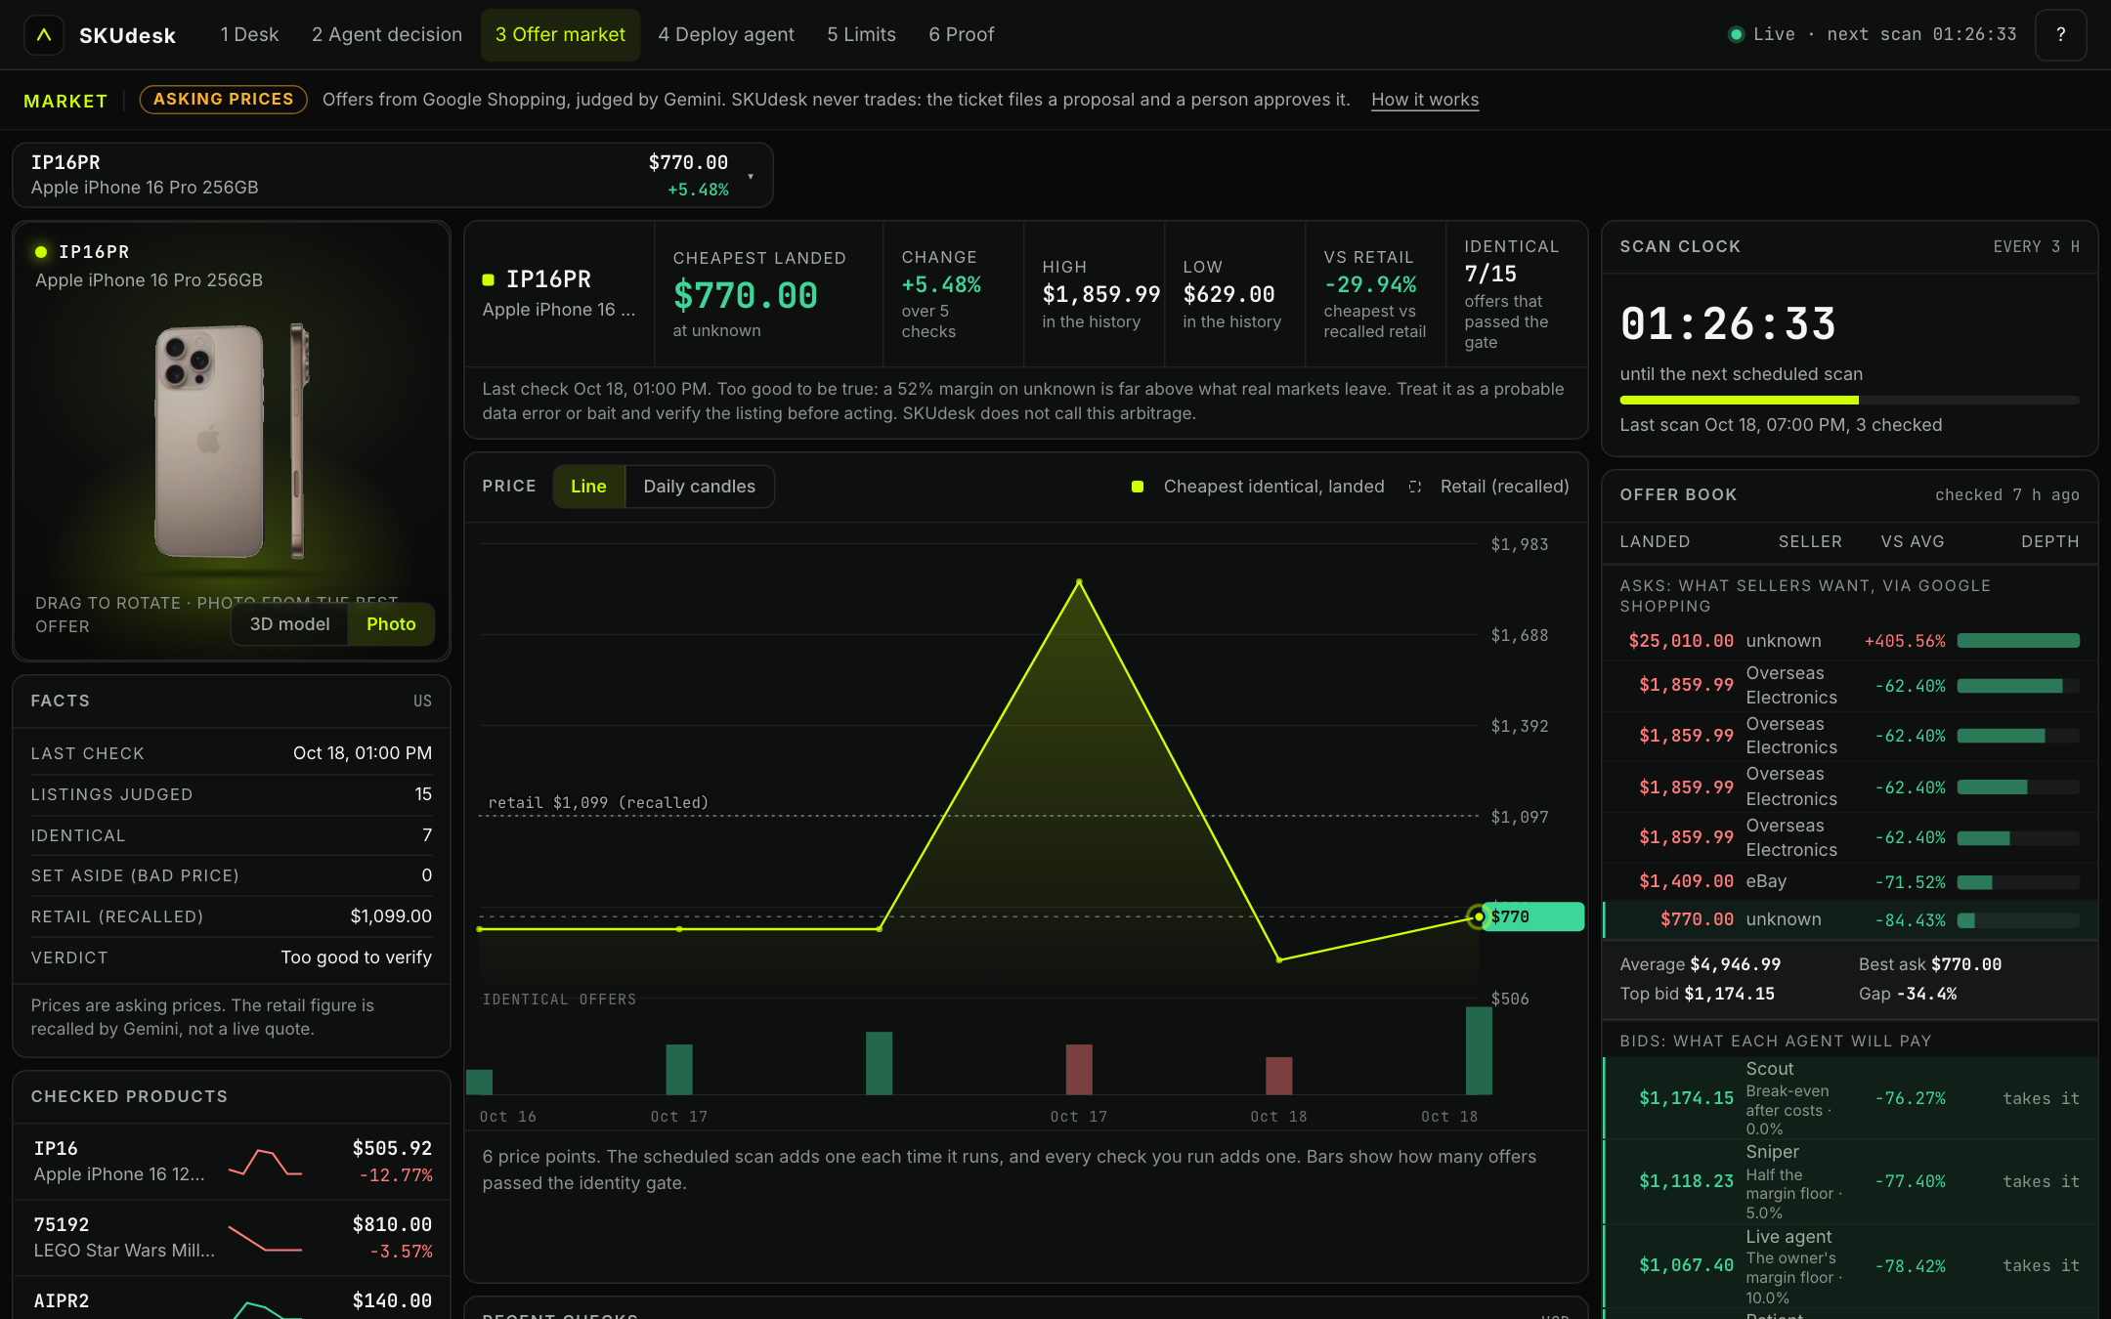
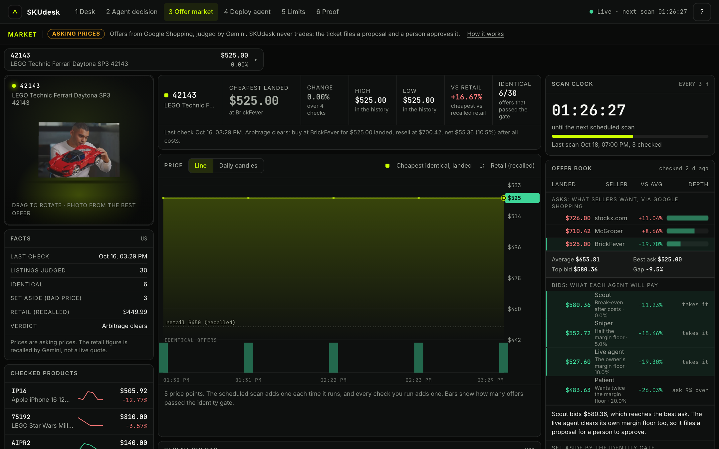
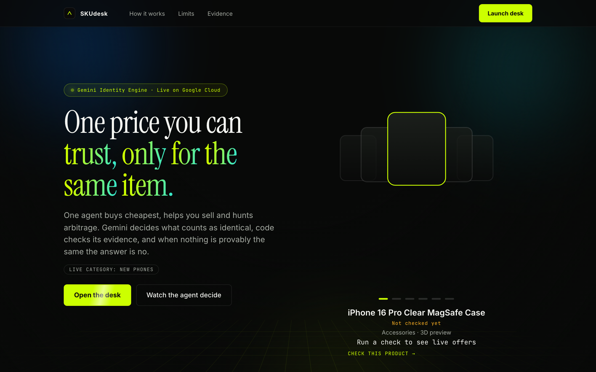
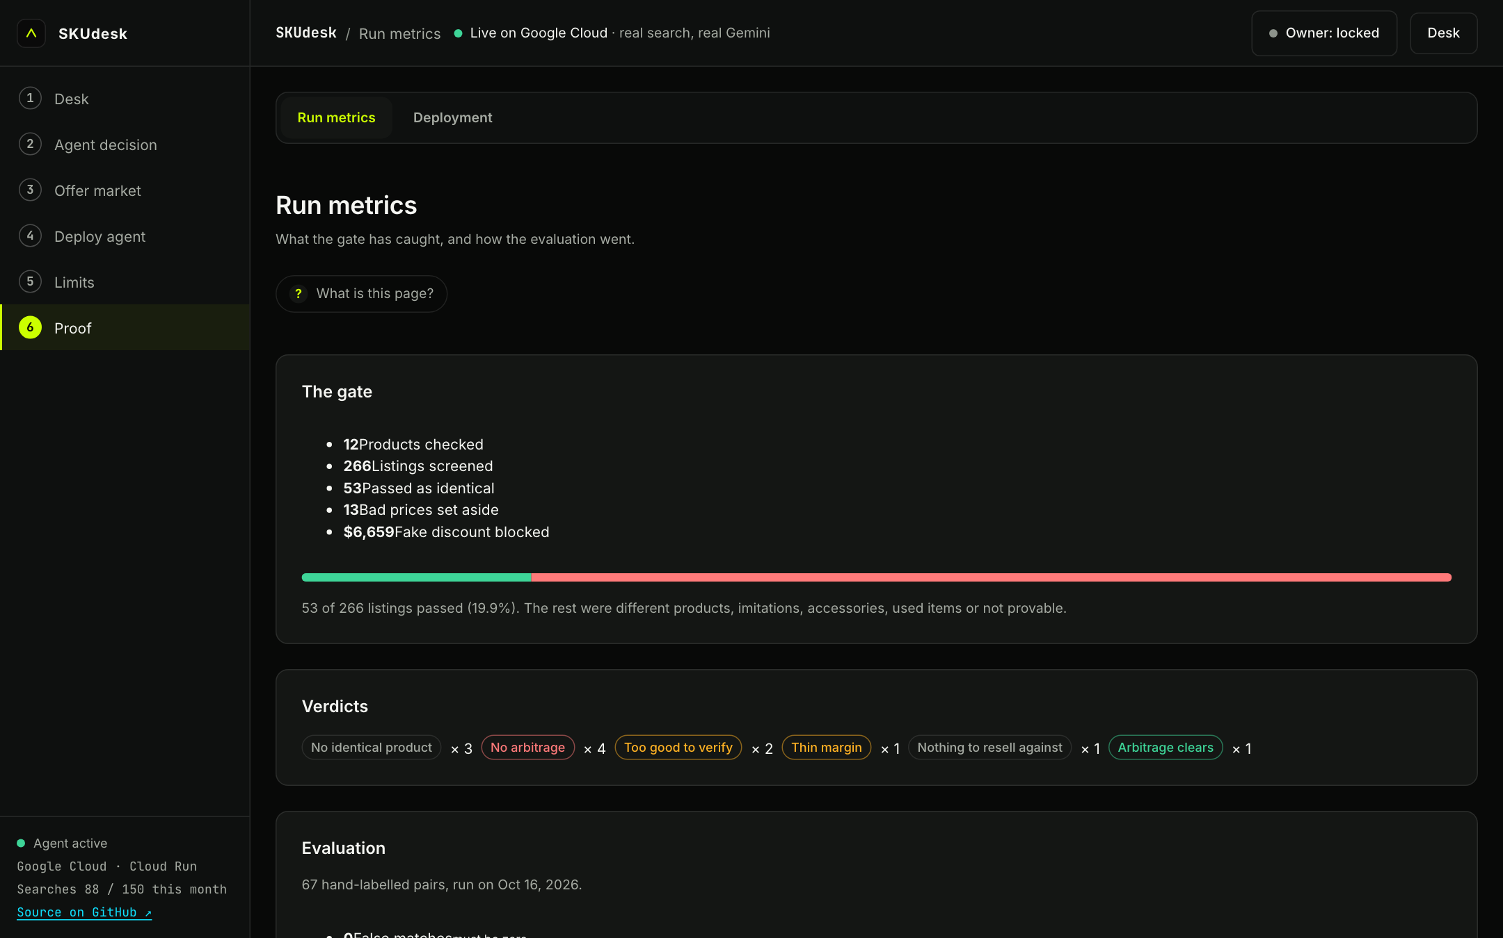
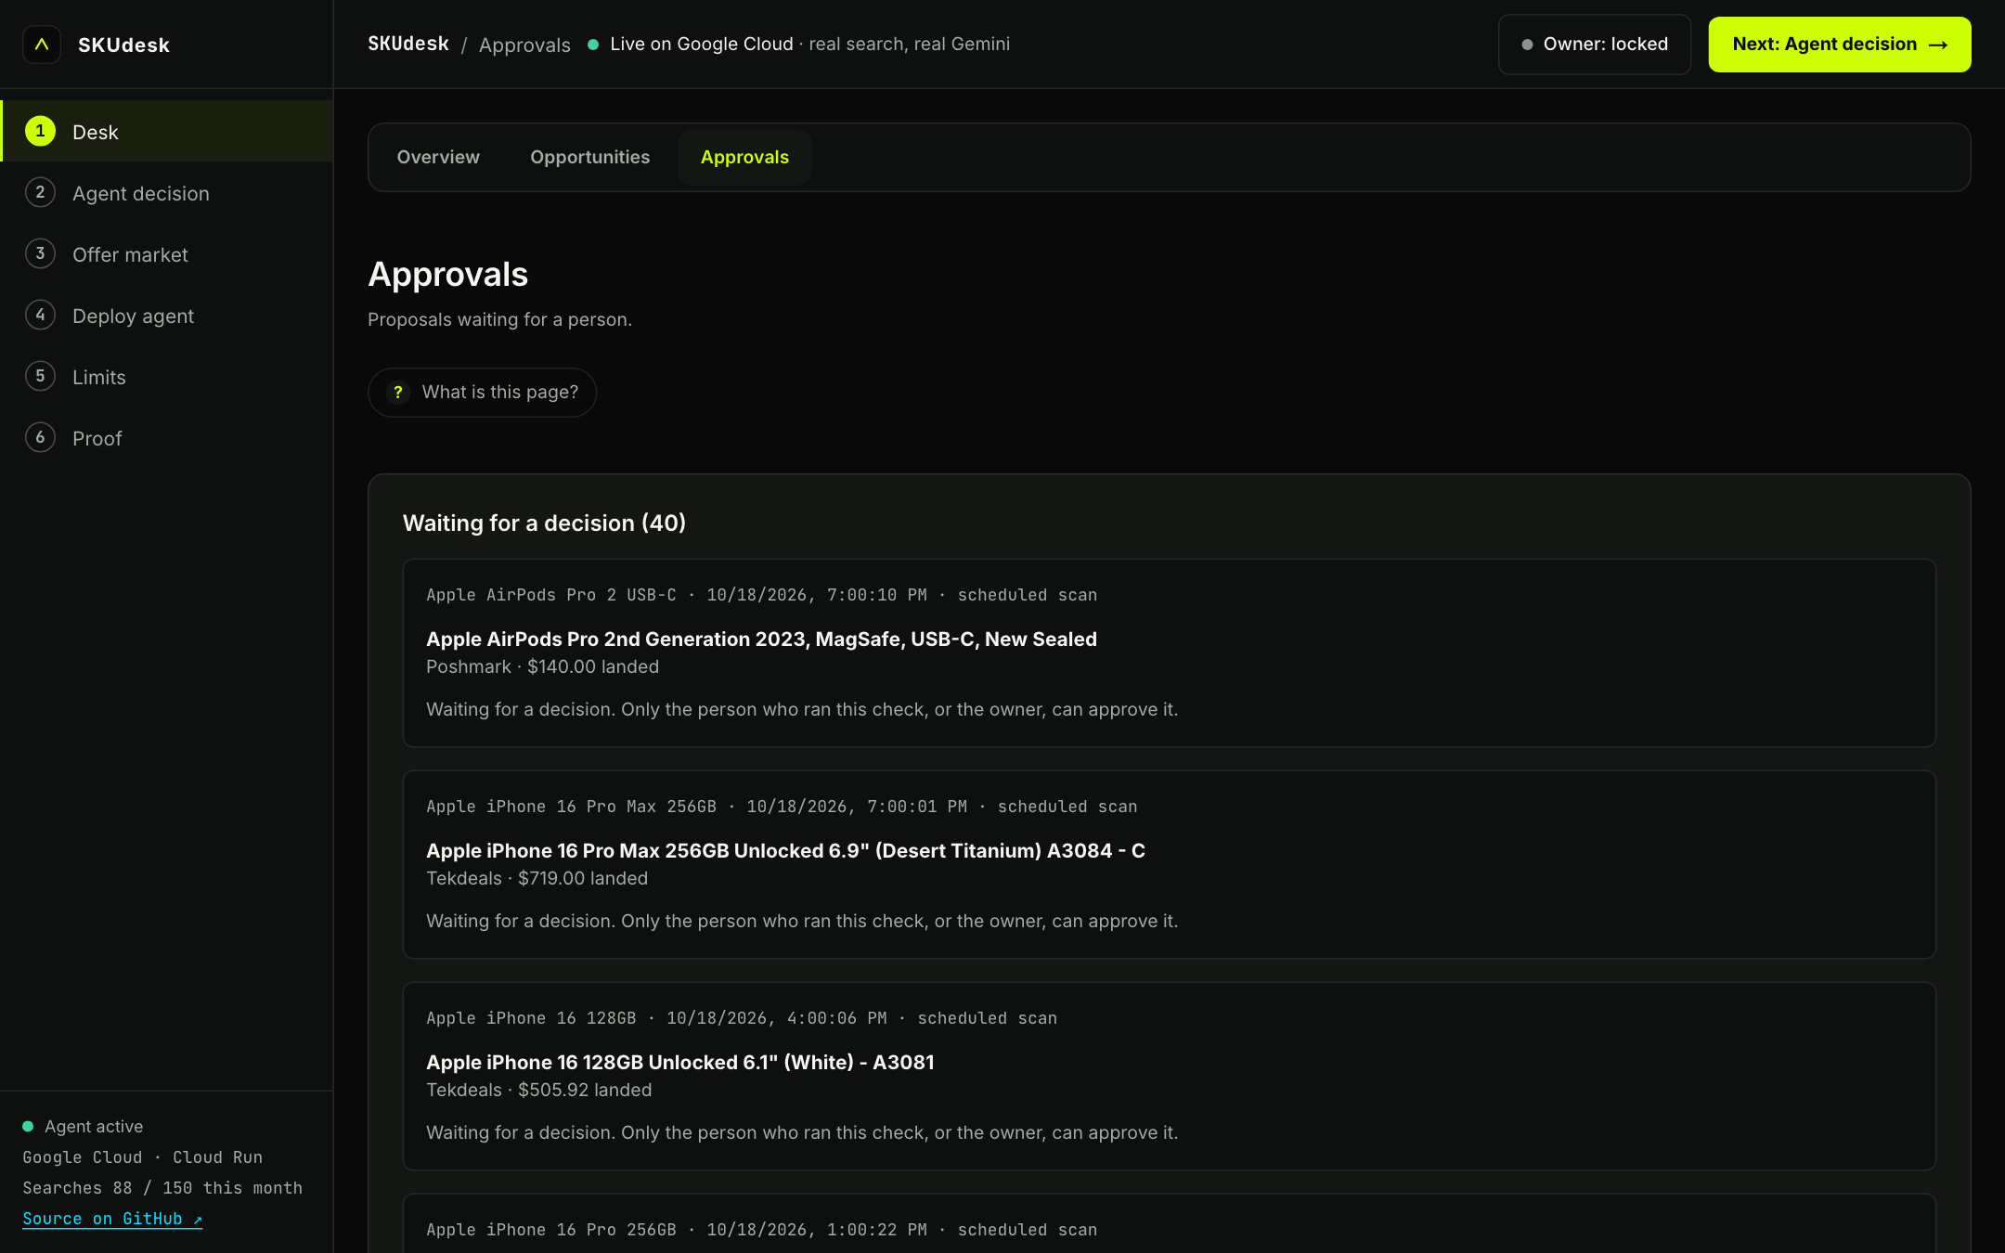
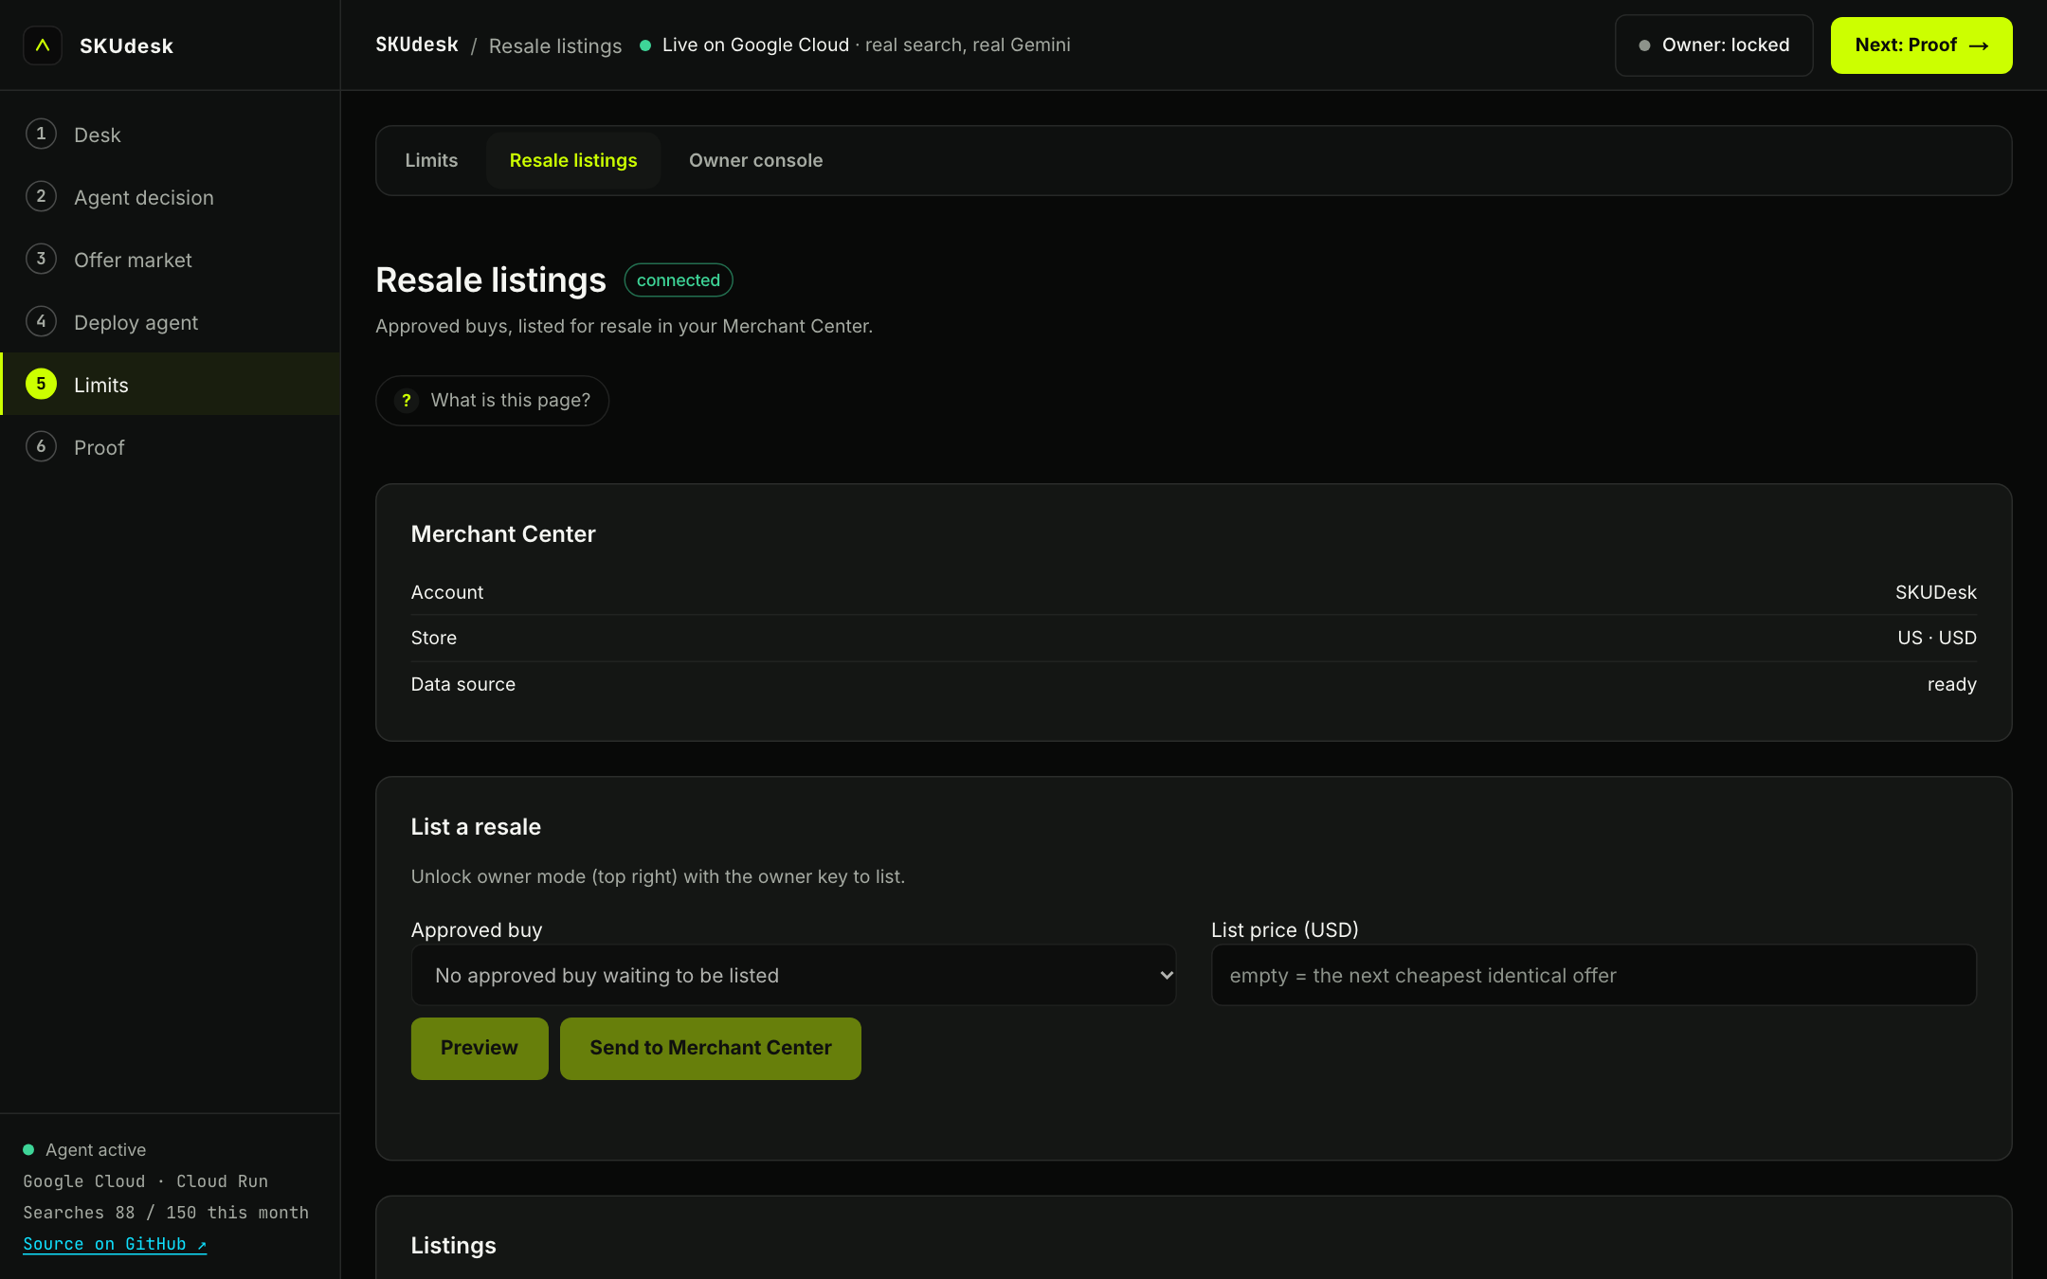
Snapshots of the prototype
Market page (iPhone 16 Pro, LEGO Ferrari) · Resale listings · Run metrics · Landing · Approvals — live at skudesk.lol

Slide 10
Prototype performance report / benchmarking
67 hand-labelled product pairs run against the real model: phones, LEGO sets, game consoles, accessories, clones, bundles, regional variants, injected instructions, Thai-language listings.
0 wrong matches (a different product called identical).
0 missed identical products.
64 of 67 exact on the verdict; the other three are “not provable”, which is the safe side.
Live Every check on the site adds to the run metrics: listings screened, passed as identical, bad prices set aside.
Notes:
Evaluation file: eval/pairs.json, results eval/summary.json. Prices are asking prices from Google Shopping, not sold prices.

Slide 11
Additional details / future development
• Add eBay Browse as a second source (the adapter is built and joins when its key is added).
• Sold-price data for resale pricing, in place of asking prices.
• More categories beyond phones, devices and LEGO, each with its own identity rules and labelled pairs.
• Seller-side agents that bid with their own cost models on the order book.
• Alerts when a watched product opens a gap, with the approval link in the message.

Slide 12
Provide links to your:
• GitHub public repository https://github.com/johnnyduo/SKUdesk_
• Demo video link (3 minutes) https://youtu.be/DgpX9r0xt9Y
• Final product link https://skudesk.lol

Slide 13


