Slide 1
The Latest and Greatest in Java
Features, Bells and Whistles from Java 8 and beyond...

Slide 2

Who am I
Johnny Egeland – Senior Developer
Work at Storebrand – Doing the Taxes
Have worked in Software Development for
21 years
10+ years of experience in C# and .Net
… and only 4+ years of experience in
Java :-O

Slide 3

What will we look into
The most useful new Java features, introduced after Java 8… (and some future stuff as well)

Slide 4
Moving forward from Java 8
What version of Java are you currently using?
I assume Java 8 features is familiar stuff?
  Lambda functions, Stream API, Optional, etc…
XML processing and Old libs where migration pain points
  All built in XML stuff is dropped after Java 8
  Hard to find the correct replacements. But doable…
  Hint! Jakarta and Glassfish has compatible API and Implementation
Getting up to 11 was tedious… Moving on from there was simple.

Slide 5

New stuff Java 9 to 17 (current LTS)
Interface default, static and private methods (8 - 9)
Try-with-resources (9)
Local Variable type inference (11)
Files.readString and Files.writeString (11)
Collectors.Teeing (12)
Switch Expressions (14)
Text Blocks (15)
InstanceOf pattern matching, Records (16)
Sealed Classes (17)

Slide 6

Beyond Java 17 ...
Switch Pattern Matching
(Preview from 18)
Project Loom
(Preview in Custom build of JDK 19)

Slide 7

Honorable mention...
Project Jigsaw, aka. Java modules (9)

Slide 8
01. Interface default, static and private methods
default and static methods introduced in Java 8
Use of private keyword allowed since Java 9
Place functionality related to the Interface, in the interface itself.
Allows for code re-use without exposing internal details
… live demo ...

Slide 9
02. Try-with-resources
Introduced in Java 9
Automatic closing of opened resources
Reduce verboseness and “ugly” code
… live demo ...

Slide 10
03. Local Variable Type inference
Introduced in Java 11
Reduced typing – less repetition of types
  Useful for long class names or verbose generics
Can only be used “locally” (for variables in methods)
Frowned upon by some Java devs
  Automatic -2 on reviews in Storebrand
… live heresy ...

Slide 11
04. Files.readString / .writeString
Files API additions added in Java 11
Old method was tedious and verbose
Reduces code complexity for handling text IO
… live demo ...

Slide 12
05. Collectors.teeing()
Introduced in Java 12
Splits a stream and provides it to two Collectors
… and then you must merge the results at the end
I believed I would use this a lot, but I really haven’t
… live demo ...

Slide 13
06. Switch expressions
Introduced in Java 14
Simplifies switch expression that produce values
Enables you to assign or return the result without a variable
The basis for the upcoming switch pattern matching features
… live demo ...

Slide 14
07. Text blocks
Introduced in Java 15
Makes it much cleaner to embed multi-line text in Java code
Removes the need for concatenation operators (+)
Removes the need for newline chars in strings (\n)
… live demo …
AdHoc Bonus example: informative NullPointerException

Slide 15
08. InstanceOf pattern matching
Introduced in Java 16
Removes the need for type casts after type check
Properties of objects can be used immediately
… live demo …

Slide 16
09. Records
Introduced in Java 16
Create fully featured Data objects with very little code
Are immutable and auto implements “getters”, equals() and hashCode()
Provides default toString() that describes the contained data
Can implement Interfaces, but not extend other classes
Be careful with Records containing Mutable objects, Lists, Maps etc.
… live demo …

Slide 17
10. Sealed Classes
Introduced in Java 17
Specify who is allowed to extend or implement
Similar to final class/interface, with
Sub-classes must be either also be Sealed or Final
… live demo …

Slide 18
Next – To the future...
The following features are Preview features available from Java 18 and beyond

Slide 19
11. Extended switch expressions
In preview from Java 17
Makes it possible to match types in Switch
Makes it possible to add expressions in Switch
… live demo …

Slide 20

Project Loom
Experimental release of Java 19
  https://jdk.java.net/loom/
In short: async/await (co-routines) for Java
… but much easier to use (transparent)
… and with more concurrency features
Avoid blocking of Platform threads, and instead re-purpose the thread for other tasks
We will just scratch the surface...

Slide 21
Traditional Java Thread model
Java
Thread
Java
Thread
Java
Thread
Java
Thread
Operating
System
Platform
Thread
Platform
Thread
Platform
Thread
Platform
Thread

Slide 22
Traditional Java Thread model
Java
Thread
Java
Thread
Java
Thread
Java
Thread
Operating
System
Platform
Thread
Platform
Thread
Platform
Thread
Platform
Thread

Slide 23
Loom Virtual Threads
Virtual
Thread
Virtual
Thread
Virtual
Thread
Virtual
Thread
Virtual
Thread
Virtual
Thread
Virtual
Thread
Virtual
Thread
Virtual
Thread
Virtual
Thread
Virtual
Thread
Virtual
Thread
Operating
System
Platform
Thread
Platform
Thread
Platform
Thread
Platform
Thread
“Carrier”
Threads

Slide 24
Loom Virtual Threads
Virtual
Thread
Virtual
Thread
Virtual
Thread
Virtual
Thread
Virtual
Thread
Virtual
Thread
Virtual
Thread
Virtual
Thread
Virtual
Thread
Virtual
Thread
Virtual
Thread
Virtual
Thread
Operating
System
Platform
Thread
Platform
Thread
Platform
Thread
Platform
Thread
“Carrier”
Threads

Slide 25
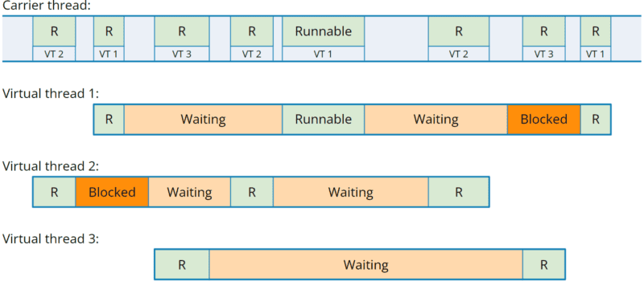
Loom Virtual Threads

Slide 26
Loom 01 and 02: Virtual Threads
Prevents Platform Threads from being blocked
Light weight context switching at JVM level
Java IO rewritten to take advantage automatically
Go from Thousands of threads to Millions of threads
… let’s scratch the surface ...

Slide 27
Loom 03: Async programming
Sequential code is easy and readable. But…
Blocking calls (I/O) blocks the thread down to OS
Solvable using CompletableFuture. But…
Async code is hard to write and to read. Bad stack traces.
Virtual Threads makes sequential code behave as async.
  No async / await keywords needed
  Completely transparent (as long as API supports Virtual Threads)
Sadly, hard to actually demonstrate effect of Virtual Thread blocking.
But here is an example anyway...

Slide 28
Loom 03: Gotchas...
There is no such thing as Magic!
APIs must be “Virtual Thread Aware” and explicitly yield control instead of blocking
Existing blocking code _can_ still block OS threads, unless…
… they rely on java.io or other built in Java functionality, as...
All built in Java APIs will be updated to be Virtual Thread aware (which should automatically make most libraries take advantage of Loom :-D)

Slide 29
Loom 04: Structured Concurrency
Using Thread.ofVirtual() is low level and tedious
New API for running Async Tasks
Progression from the old Executor Service APIs
Provide functionality where async sub-tasks are dependent
For instance a parent task can only complete once a set of sub-tasks are all complete
… one final example ...

