Slide 1
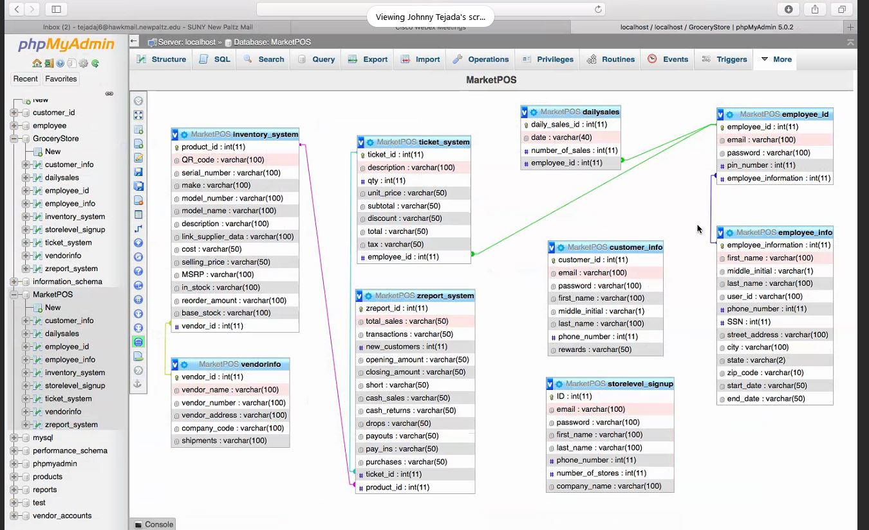

tax_table
TTID(int AI)
tax_year(date)
state_rate(float)
county_rate(float)
city_rate(float)
tax_rate(float)
inventory_sales
ISID
ticket_id
product_id
qty
unit_price
discount
add tax_rate(float)

Slide 2
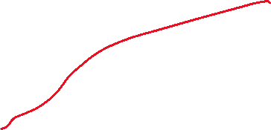

Slide 3
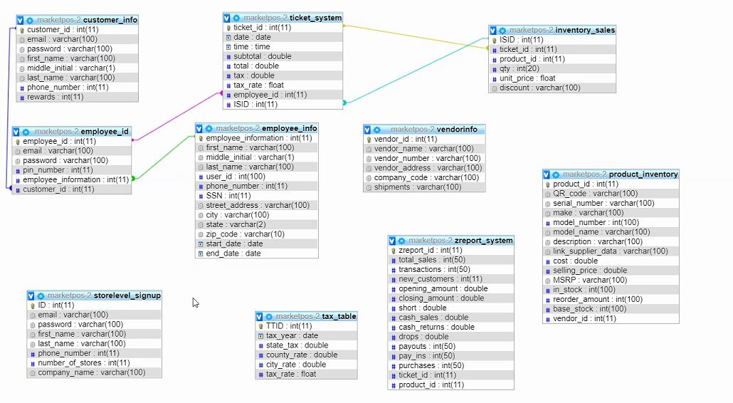
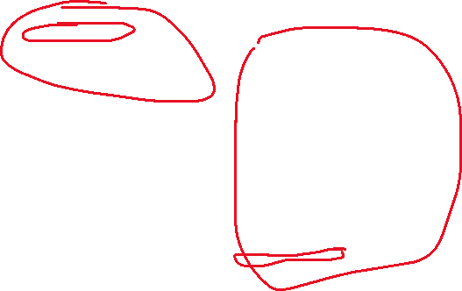
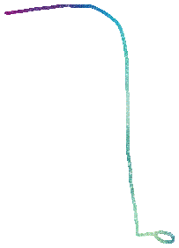
Things must happen in a certain order.
PEMDAS
X = 1
Y= (2x^2) + (4 * 3x) +15
Y= (2 * x^2)…

Slide 4

