Slide 1
Learning the K in K-means
Presentation by :
Mihir – Joyce - Jack

Slide 2
Summary of the Paper

Slide 3
G-means:
A method to determine k in k-means;
Basic assumption:each cluster adheres to Gaussian distribution;
Main idea: if the cluster appear to be in Gaussian distribution，no more centers should be added; otherwise the subset should be furtherly split

Slide 4
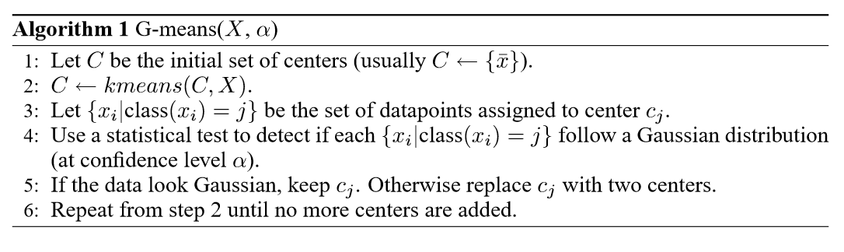
Algorithm:

Slide 5
Anderson-Darling Test
Given a subset of data X in d dimensions that belongs to center c:
H0: The data around the center are sampled from a Gaussian.
H1: The data around the center are not sampled from a Gaussian.

Slide 6
Anderson-Darling Test
1. Choose a signiﬁcance level α for the test.
2. Initialize two centers, called “children” of c.
3. Run k-means on these two centers in X to choose c1,c2 as the child centers.

Slide 7
Anderson-Darling Test
4. Let v=c1−c2 be a d-dimensional vector that connects the two centers. Then project X onto v a 1-dimensional representation of the data projected onto v. Transform X to X0 that have mean 0 and variance 1.
5. Calculate the Anderson-Darling Test Statistics A2∗(Z). And accordingly decide whether to keep the original center or the child centers.

Slide 8


Anderson-Darling Test
where n is the number of dataset, zi is the converted xi to have mean 0 and variance 1

Slide 9

X-means
searches over many values of k and scores each clustering model using Bayesian Information Criterion
is the log-likelihood of the dataset X according to model C,
p = k(d +1) is the number of parameters in the model C with dimensionality d and k cluster centers, and n is the number of points in the dataset.

Slide 10
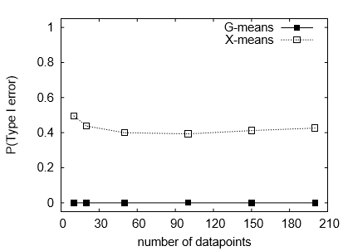
G-means VS X-means
Statistical power test: BIC tends to overﬁt by choosing too many centers when the data is not strictly spherical, while G-means does not.

Slide 11
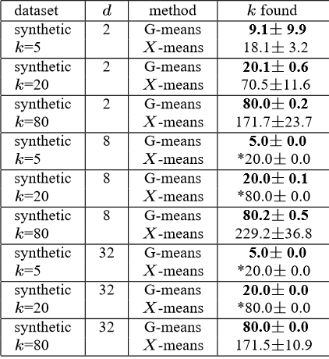
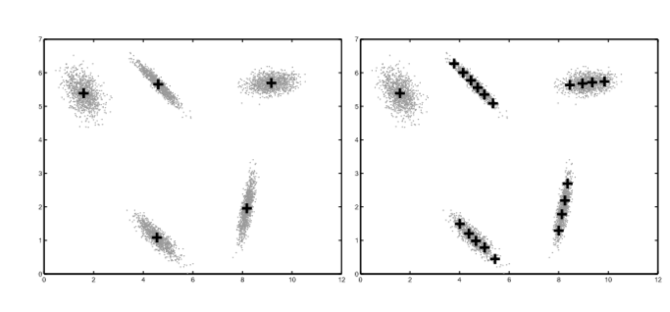
G-means VS X-means

Slide 12
Conclusion
G-means algorithm does better at ﬁnding the correct k on non-spherical data.
X-means tends to overestimates the number of true clusters in non-spherical data, especially when the number of points per cluster is small, as in datasets with 80 true clusters. The reason is BIC statistic that X-means uses has been formulated to maximize the likelihood for spherically-distributed data.

Slide 13
Implementation on Synthetic Dataset

Slide 14
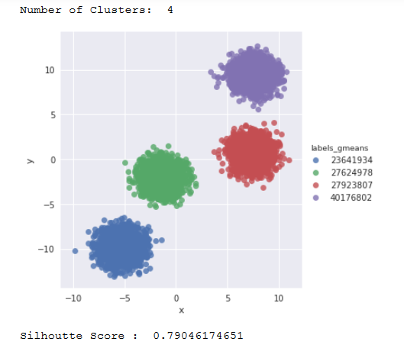
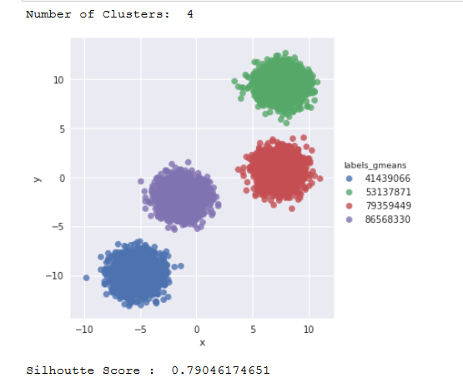
Strict vs Non-Strict Spherical Dataset

Slide 15
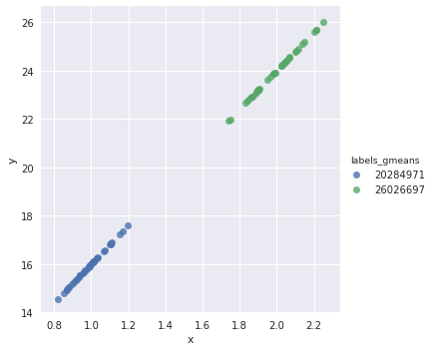
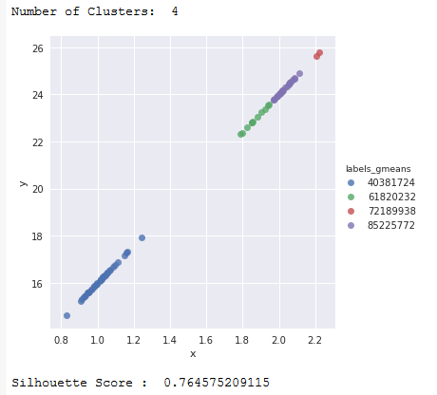
Strict vs Non-Strict Non-Spherical Dataset

Slide 16
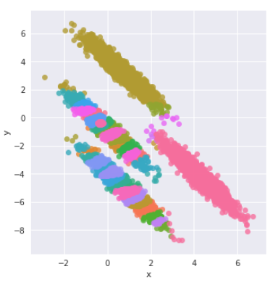
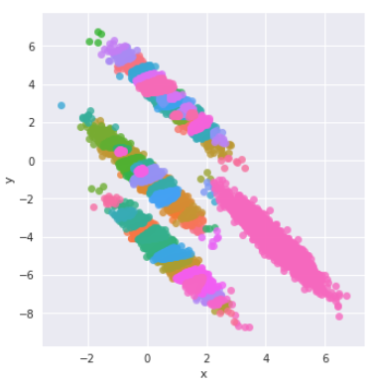
Strict vs Non-strict Non-spherical and close dataset

Slide 17
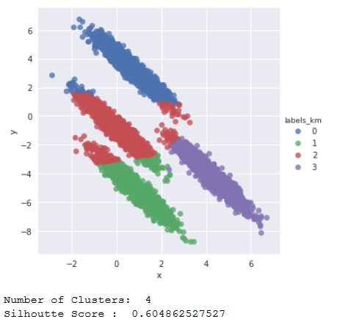
K-means with K=4 With Non-spherical, close dataset

Slide 18
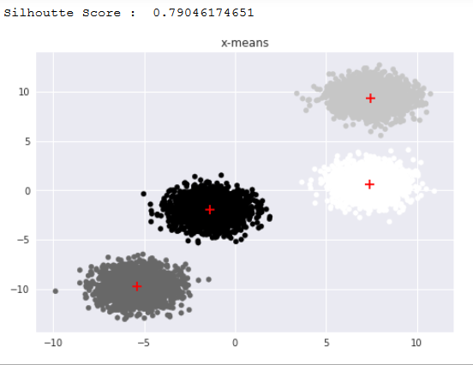
G-Means vs X-Means Spherical Dataset

Slide 19
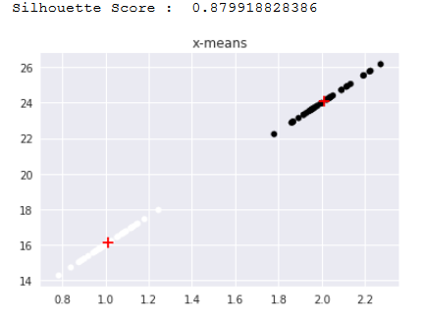
G-means vs X-Means Non-Spherical Dataset

Slide 20
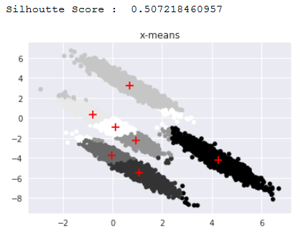
G-Means vs X-Means Difficult Dataset

Slide 21
Implementation on Benchmark Dataset

Slide 22
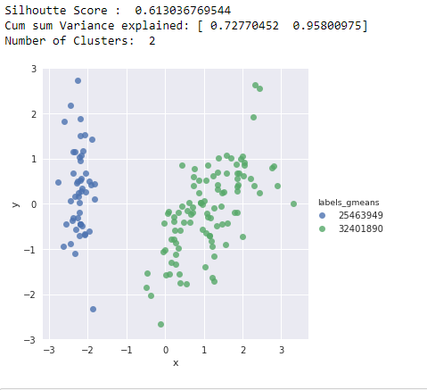
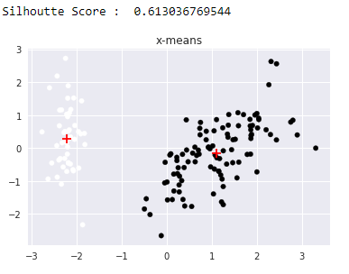
G-means Vs X-means on Iris Dataset

Slide 23
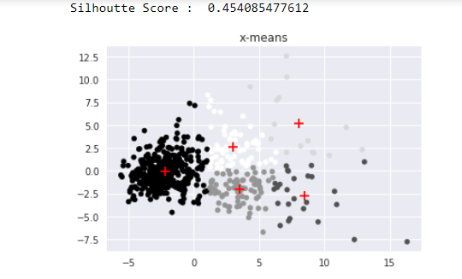
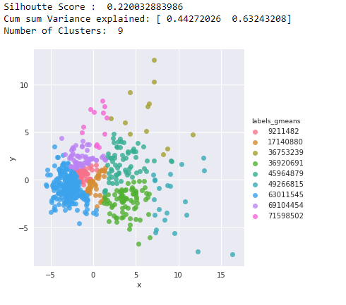
G-means Vs X-means Breast Cancer Dataset

Slide 24
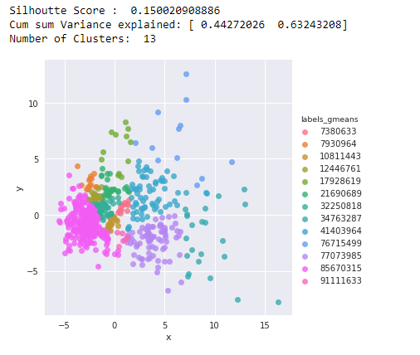
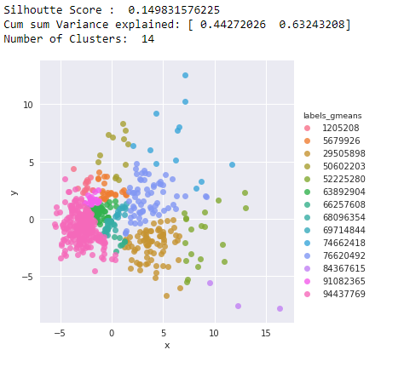
Strict vs Non-Strict Breast Cancer Dataset

Slide 25
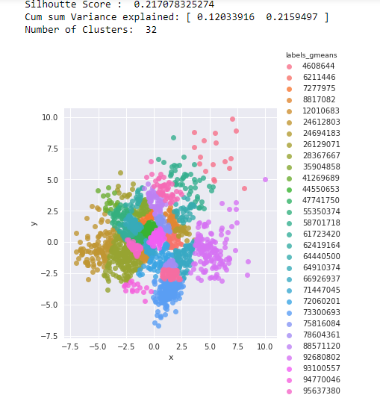
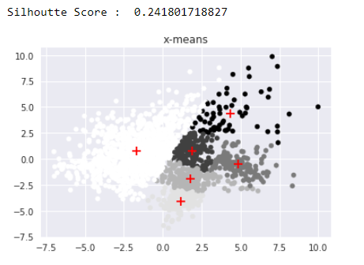
Gmeans vs Xmeans Digits Dataset

Slide 26
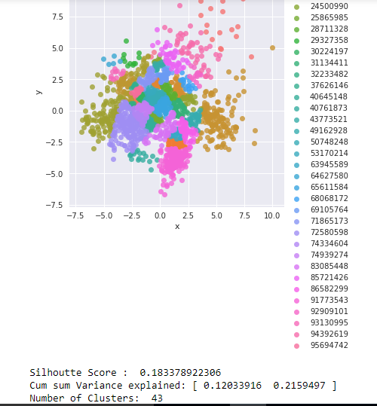
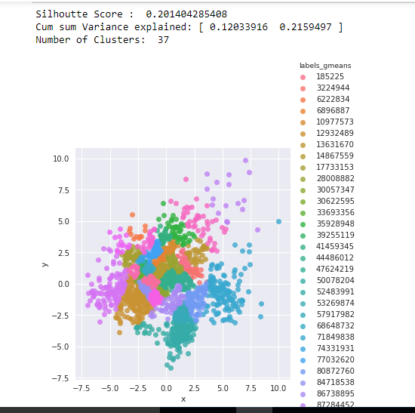
Strict vs Non-Strict Digits Dataset

