Slide 1
Predicting Ocean Temperature Using Water Depth
DS210 Final Project
John Griffith DS210 – Introduction to Data Science Instructor: Mihir, Kiranmay July 2026

Slide 2
Dataset used
For this presentation, I will be using the “bottles” dataset.
This dataset contains oceanographic data measured from seawater samples collected at CalCOFI stations.
What I want to know is can ocean temperature be predicted based on water depth? I’m curious to see if this can be predicted accurately.

Slide 3
Dataset used continued
Dataset Overview
Source: CalCOFI Bottle Database
Records: 1000
Features: 6 rows of variables
Measurements collected from seawater samples off the California coast.
Used to study ocean conditions over time.

Slide 4
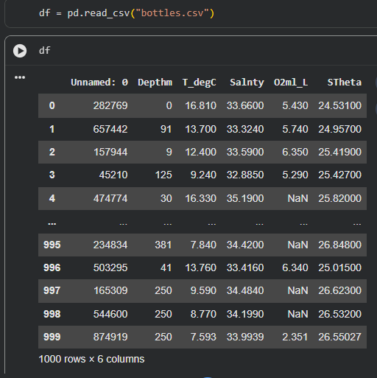
My understanding of this dataset
From this review of the data, we have the following columns:
Unnamed
Depthm
T_degC
Salnty
O2ml_L
STheta

Slide 5
My understanding of this dataset continued.
The dataset provided contains some areas to be researched further.
First there is Unnamed, after verifying from the original dataset provided on Calcofi’s website, this field is actually Btl_Cnt, or Bottle Count - All CalCOFI bottles ever sampled, consecutively numbered.

Slide 6
My understanding of this dataset continued.
Depthm, this is the Bottle depth in meters
T_degC, this is the Water temperature in degrees Celsius
Salnty, this is the Salinity (Practical Salinity Scale 1978)
O2ml_L, this is the Milliliters oxygen per liter of seawater
Stheta, this is the Potential Density (Sigma Theta), Kg/M³

Slide 7
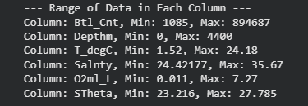
Exploratory Data Analysis
Here is the range of data in each column, this will give me an idea of how much variance each contains and if there could be outliers.

Slide 8
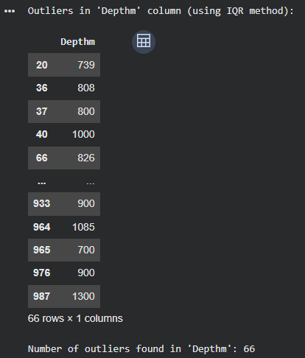
Exploratory Data Analysis continued
I am using the IQR (Interquartile Range ) method to find the outliers.
For this example, I’m using depthm.

Slide 9
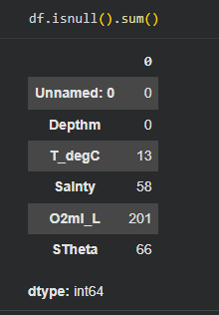
Exploratory Data Analysis continued
Now I want to address missing values in the data.
Using the df.isnull().sum() command will show how many rows in each column are blank

Slide 10
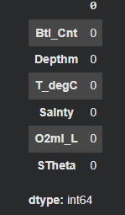
Exploratory Data Analysis continued
I’m going to use mean Imputation, this will replace missing values with the column's mean or media.
Here is what it looks like now, no more missing values.

Slide 11
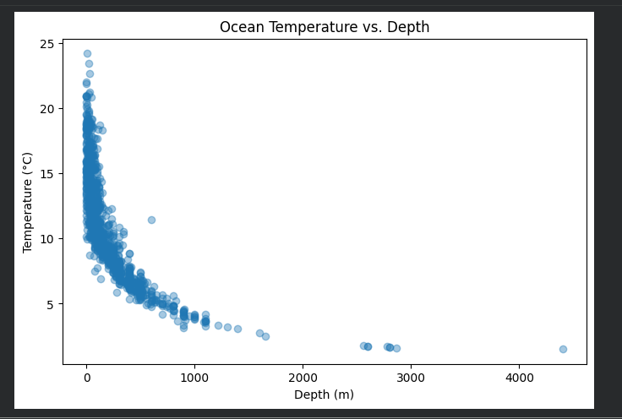
Exploratory Data Analysis continued
Now I want to run a scatter plot to show a visual of the difference.

Slide 12
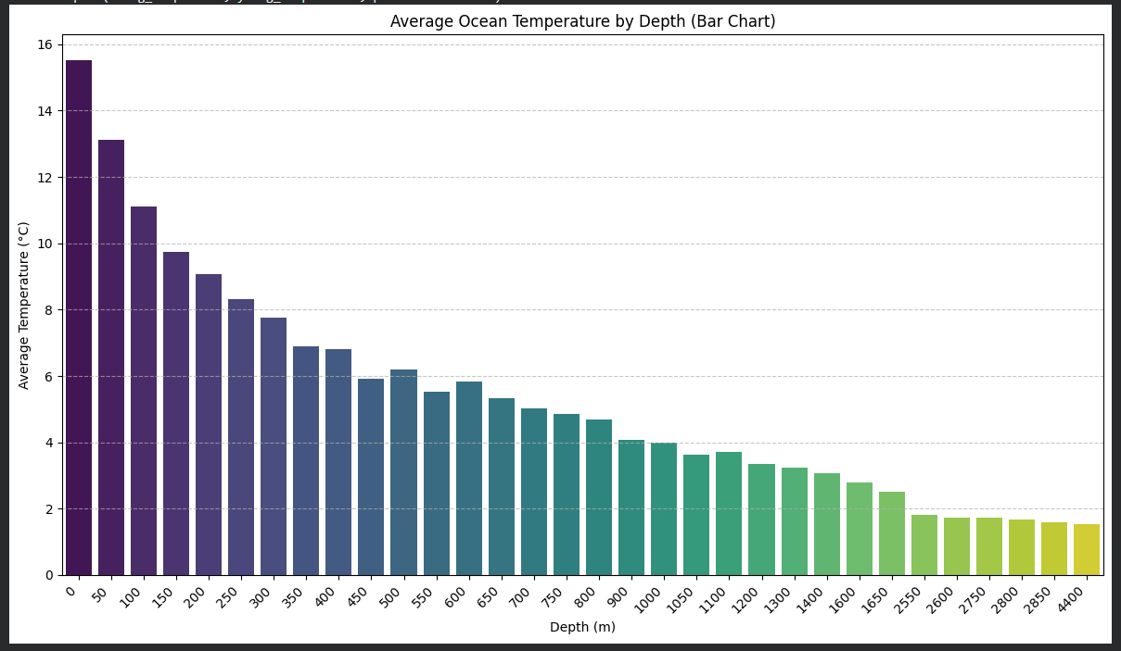
Exploratory Data Analysis continued
The scatterplot shows a clear inverse relationship between depth and temperature.
For fun, I also created a bar chart.

Slide 13
Refining the Question
My original question was “can ocean temperature be predicted based on water depth?”
So far that appears to be the case.
But now I want to refine my question to “where does the temperature drop more rapidly?”

Slide 14
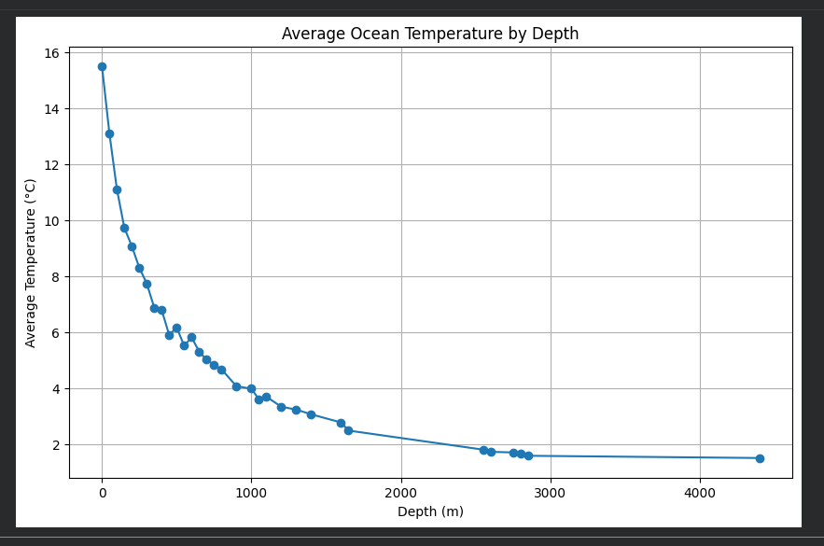
Refining the Question continued
In order to answer this question, I’m going to use a line chart.

Slide 15
Refining the Question continued
As you can see, the line chart makes it easier to see where the slope is the steepest.
The temperature drops rapidly near the surface (approximately the first 100–300 meters), then the temperature decreases more slowly and eventually levels off.

Slide 16
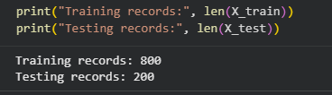
Model Building
For this project, I used Linear Regression to predict water temperature based on bottle depth.
It’s supervised because the dataset contains known values.
I used the variables Depthm and T_degC.
I used 800 of the observations to train the model, and 200 for testing.

Slide 17
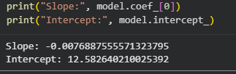
Model Building continued
Here’s the regression equation
This shows the Predicted temperature = intercept + slope × depth.
The slope is negative because temperatures generally fall as the depth increases.

Slide 18
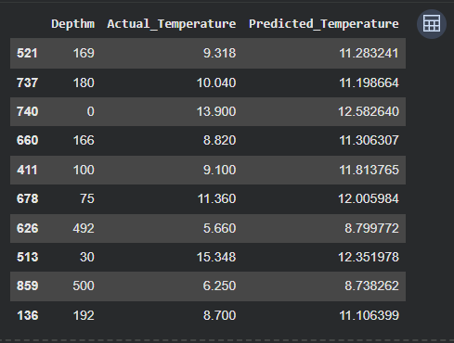
Model Building continued
Now I’m going to make predictions.
You can see the difference between actual and predicted temperatures.

Slide 19
Model Building continued
This confirms that the predicted temperature decreases as depth increases.

Slide 20
Interpretation & Conclusion
I successfully answered my question through linear regression, and my own analysis.
I found that ocean temperature can be predicted from water depth with reasonable accuracy.
The visualizations made these findings much easier to see.
After refining my question, I discovered that temperature drops rapidly with the first few hundred meters.

Slide 21
Interpretation & Conclusion
If I had more time, I would expand and include more variables to see if I could get my predictions more accurate.
My original question focused on prediction, but exploratory analysis revealed another pattern which led to me to refine my question.
Overall, I feel I could keep refining every question in order to develop a more meaningful analysis.

