Slide 1

Entry Manager
John L. Thow
Supervised by Dr David Manlove

Slide 2
Contents
Motivation and Background
Requirements
Design and Implementation
Concurrent Access
Testing and Evaluation
Future Work and Conclusion
Questions and Answers

Slide 3
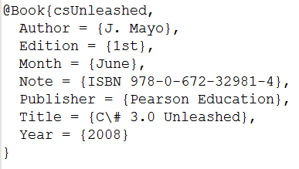
Motivation & Background
Overview of BibTeX
Potentially vast library of references
Collaborating authors & sharing of libraries
Builds on previous projects
Need to avoid:
Clashing entries
Invalid entries
Broad aims:
Provide a usable and useful solution to these problems
Focus on good software engineering practice

Slide 4
Requirements
Functional
Add, Edit, Delete & Restore Entries
Search, Import & Export Entries
Duplicate Entry Management & Revision
Non-Functional
Centrally stored in a database
Web-based: Multi-OS & Multi-Browser
Usable by target audience
Facilitate concurrent user access

Slide 5
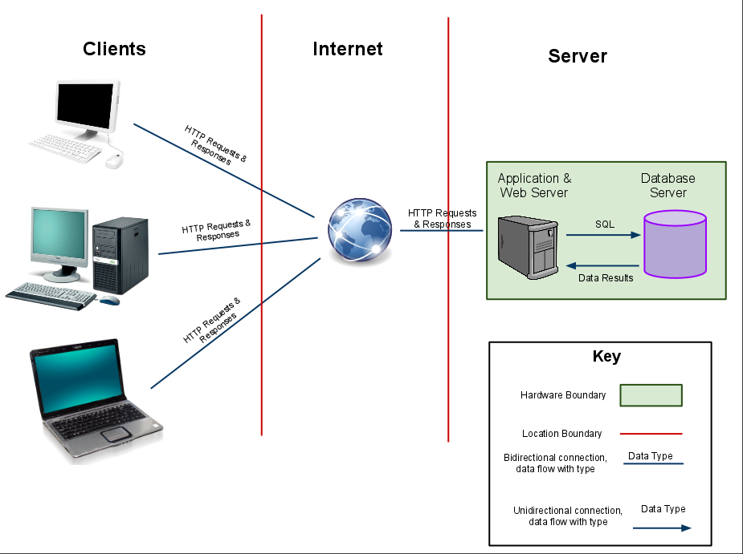
Design and Implementation
Focus on consistent, clean, intuitive interface
C# under the Microsoft.NET framework
Wide array of languages & technologies encountered:
ASP.NET / HTML, C#, CSS, JavaScript and SQL
Model-View-Controller
NHibernate
Implementation focussed on software engineering practice

Slide 6
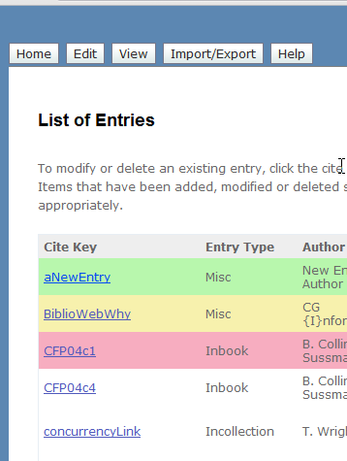
Concurrent Access (1)
Implemented by web services and AJAX
List of entries
Notification when entries are:
Added
Modified
Deleted

Slide 7
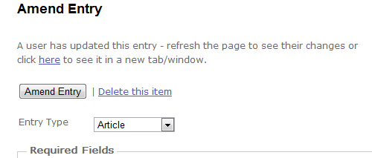
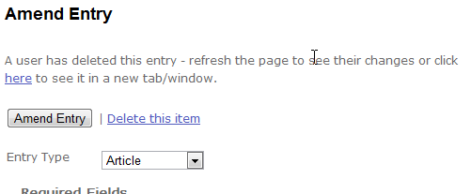
Concurrent Access (2)
Facilitated by web service
AJAX calls web service every 3 seconds
Clear feedback
Allows viewing of changes in new tab

Slide 8
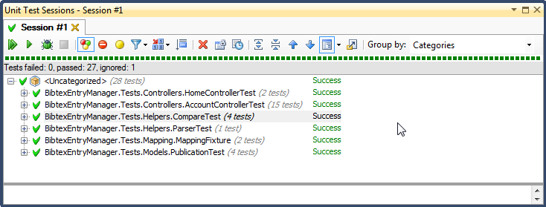
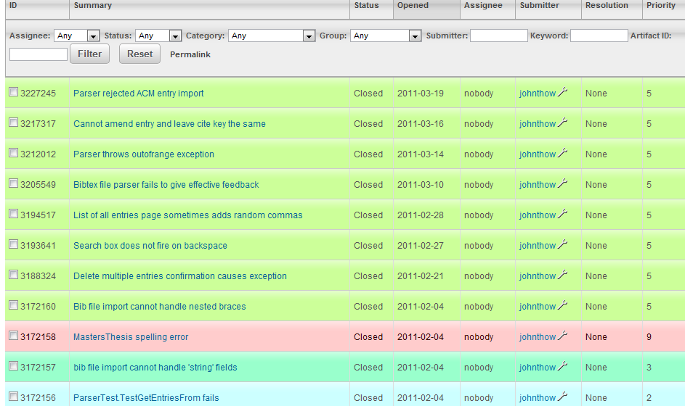
Testing
Unit tests
NUnit
1-click runs
Bug Tracking
SourceForge hosted
Bugs not forgotten

Slide 9
Evaluation
Task List and Questionnaire
Basic – tests usability of User Interface
Single user
Observation
Extended – tests concurrent access features
Multiple users
Very positive results in participants’ questionnaires
Could improve by sample more authors that use BibTeX

Slide 10
Future Work
With further time, the project would have:
Supported more file formats
Supported “tagging” of entries for categorisation
Taken a more rigorous approach to user authentication
Covered more of the code with unit tests

Slide 11
Conclusion
Successful in terms of:
Technology knowledge gained
Practice in software engineering
Positive user experience
Personal development
Could have been more productive with:
Team work
Reduced bureaucracy

Slide 12
Acknowledgements
Dr David Manlove
Mr Gregg O'Malley
Dr Colin Perkins
Mr Graham Mooney
Mr Thomas Anderson
My family, friends and classmates
Volunteers who took part in my evaluation
Staff in the School, both retired and active

Slide 13
Questions and Answers

