Slide 1
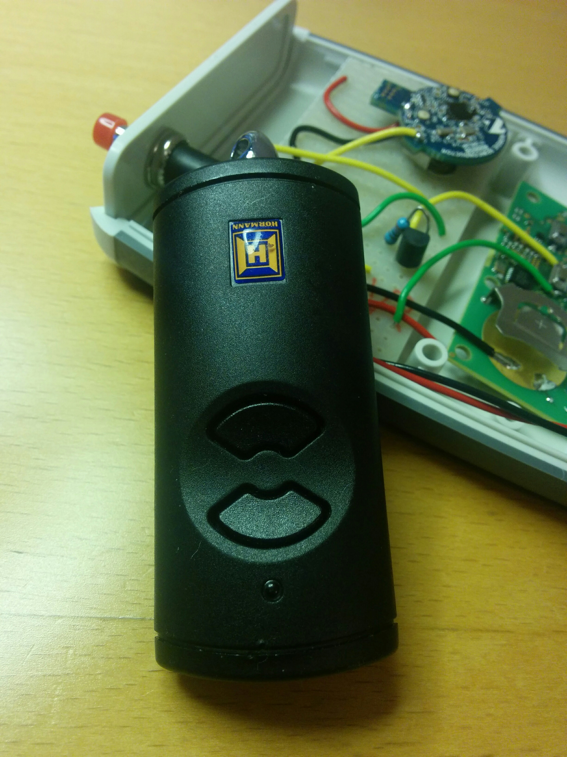
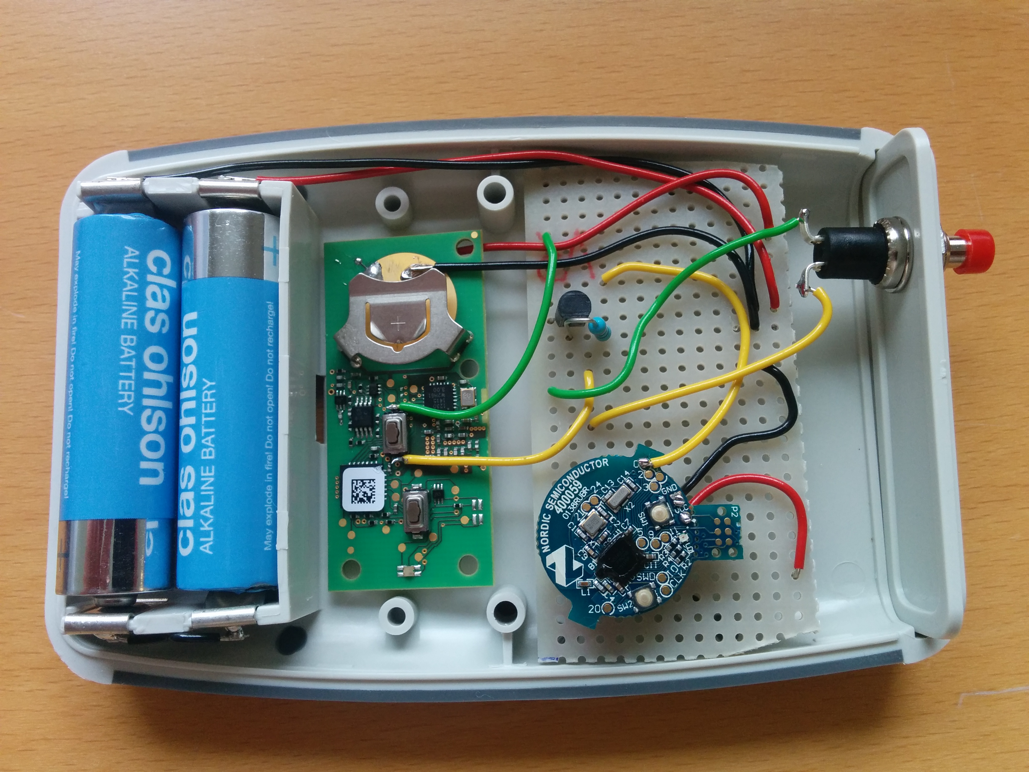
Convert your regular garage remote into a Bluetooth Low Energy Peripheral for using your smartphone as garage remote instead. In this project the NRF51 beacon from Nordic Semiconductor has been used for Bluetooth radio and as a platform for the needed software. Android software in project GarageControl and NRF51 software in GarageBase.

Slide 2
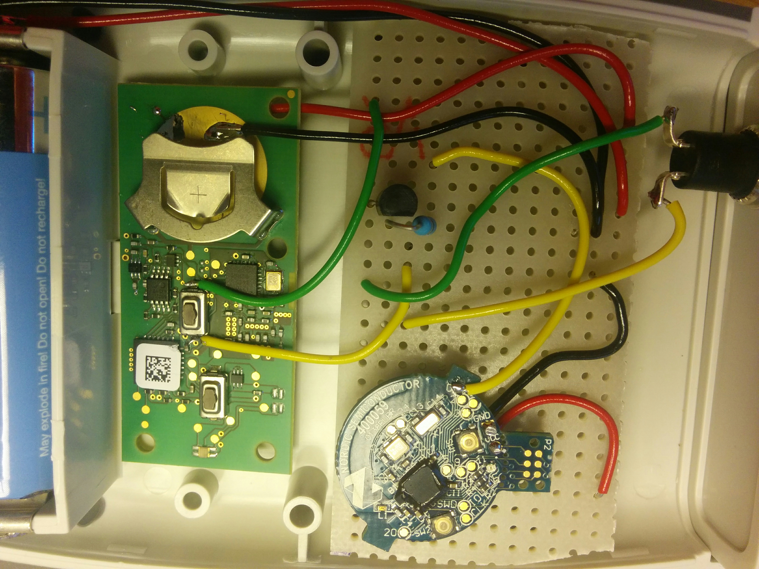
Remote switch
Interface between nrf51 and remote
High potential side
2.2K
GPIO pin on nrf51
e.g. BC547
Every remote may be different, in this case non of the sides of the switch were grounded so a transistor was used to shortcut the switch. All device parts could be run from two AA in series.

