Slide 1

Test case ranking
Results

Slide 2
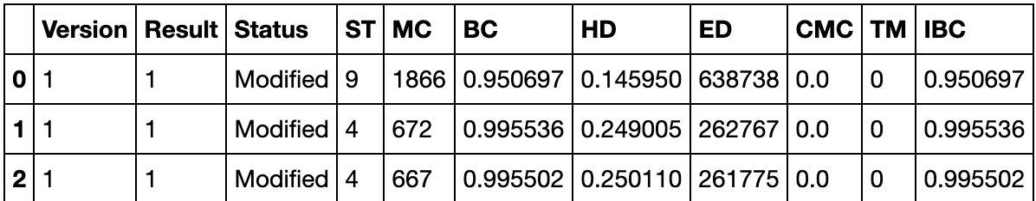
Data set Description – Palma et al (2018):
Version: version under test.
Status: test case status - Modified/New
ST: Size of tests. Number of lines of code.
MC: Method Coverage, the ratio of the nr. of methods called by a test case from the previous version and the total number of methods in the source code.
BC: Basic Counting, the nr. of unique method calls in the test trace from the current release that also appear in the previous failing sequences for that test case.
HD: Hamming distance, min nr. of edit operations (insertios, deletions and substitutions) required to convert a sequence into another.
ED: Edit distance, Levenshtein distance.
CMC: Changed Method Coverage, ratio between the nr. of changed methods from the previous version and the total nr. of methods in the source code.
TM: Traditional Historical Fault Detection Metric, obtained by counting the nr. of versions for which a test case has failed previously.
IBC: Improved Basic Counting, combination of BC and HD.

Slide 3
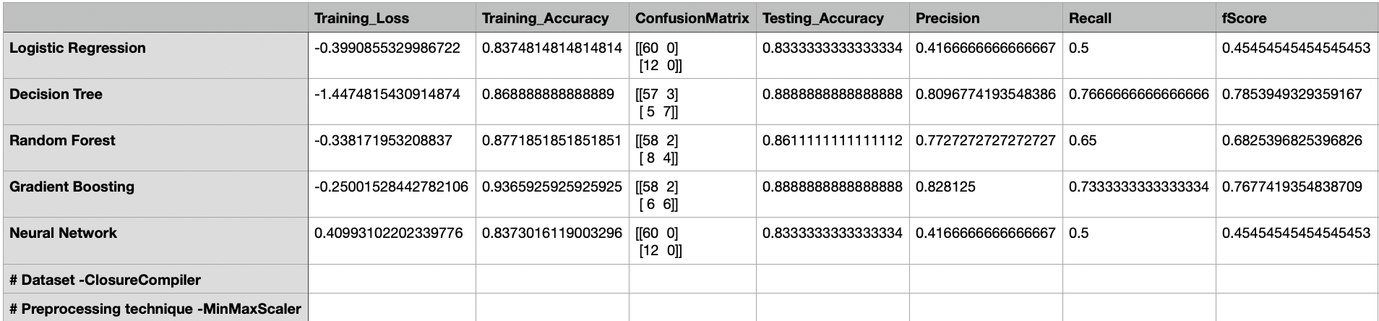
Classification Metrics

Slide 4
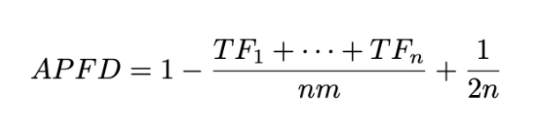
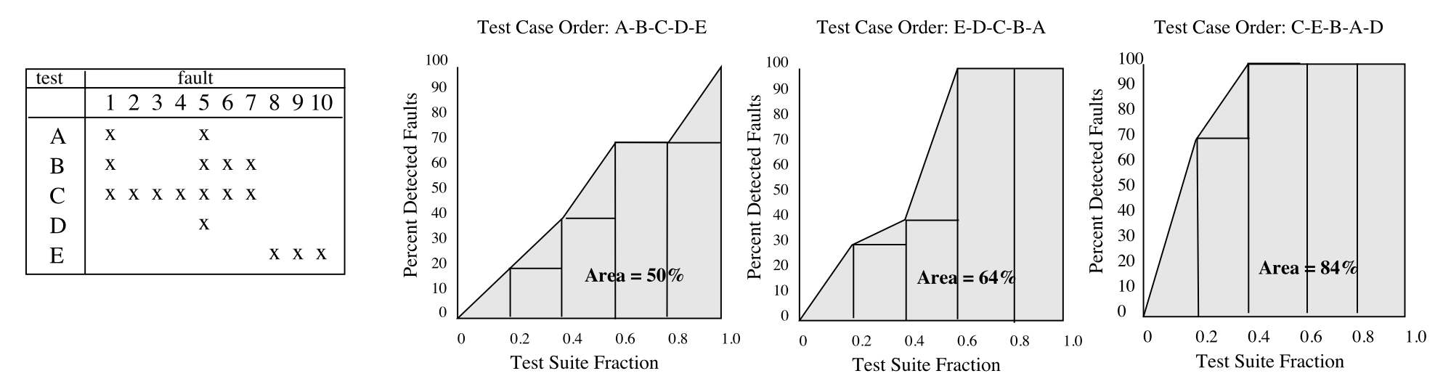
APFD
n – number of test cases
m – total number of faults
TF_{i} - position of the first test case that reveales the i^{th} fault
Average Percentage of Fault Detection

Slide 5
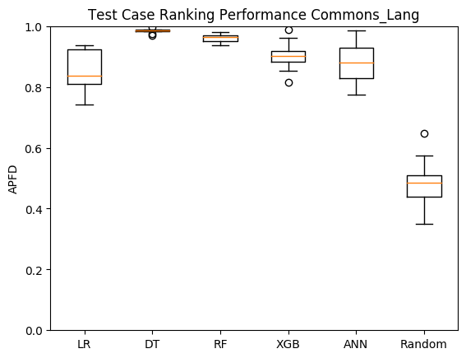
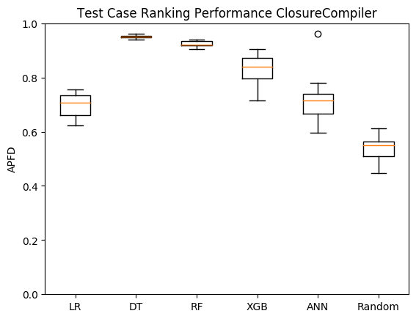
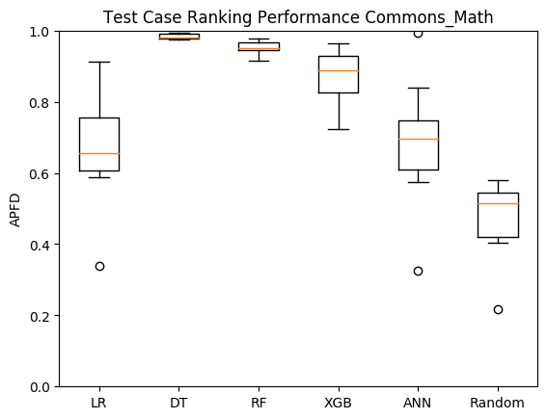
APFD
Palma et al (2018)

Slide 6
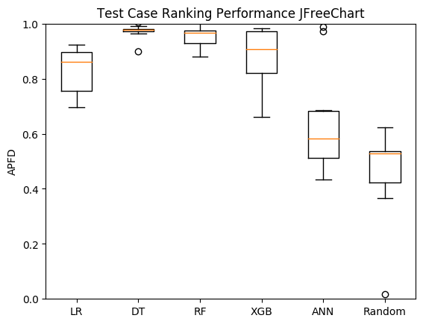
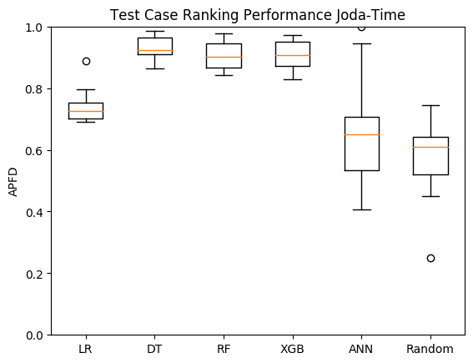
APFD
Palma et al (2018)

Slide 7
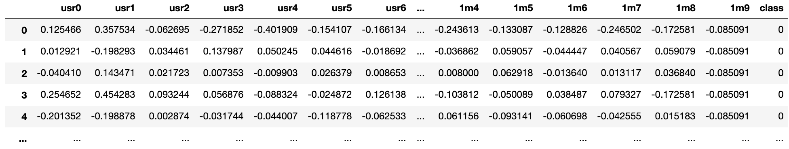
Data set Description - tempest-full:
Dstat * - versatile tool for generating system resource statistics.
Features :
(usr|m)
cpu usage by a user (usr) processes
memory stats

Slide 8
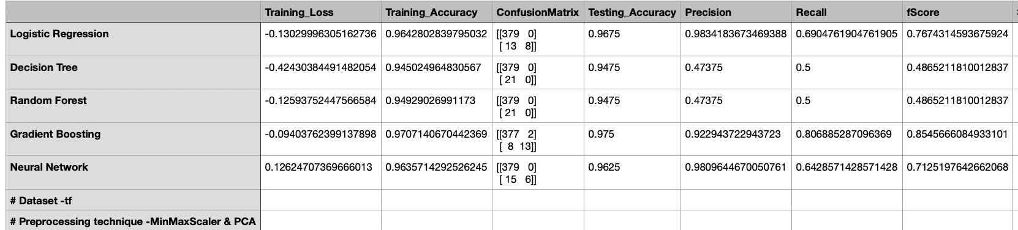
Classification Metrics

Slide 9
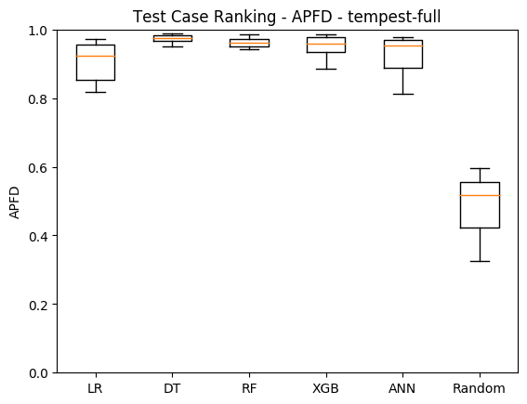
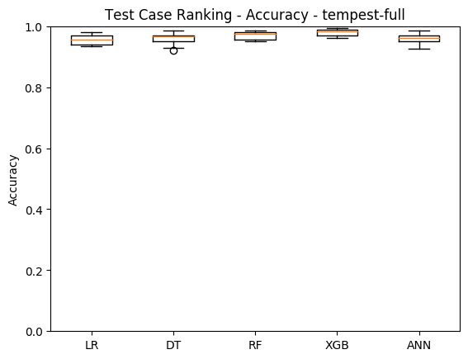
APFD Accuracy
Tempest-full dataset

