Slide 1
BASIC
PRESENTATION
On
Abstract class & interface

Slide 2
Agenda
Introduction
Abstract Class
Interface
Uses
Real Time Examples
Conclusion

Slide 3
What is an
Abstract class

Slide 4
Abstract class
An abstract class is a class that cannot be instantiated directly. It may contain abstract methods as well as concrete methods. Abstract classes allow us to define a common base for other classes, promoting code reuse and structure.
  Cannot be instantiated
  Can have fields and constructors
  Method Implementation

Slide 5
Abstract class
abstract Class Class_Name {
public string prop { get; set; }
protected Class_Name(){} //constructor
// Abstract method
public abstract void MethodName1();
// Concrete method
public void MethodName2(){
-------------
}
}

Slide 6

When we
use

Slide 7
Uses
  When we want to define a base class that provides some shared functionality or properties to the sub classes.
  When we want to enforce a certain structure on subclasses while allowing them to implement specific behaviors.

Slide 8
What is an
Interface

Slide 9
Interface
An interface is a contract that defines a set of methods and properties that implementing classes must provide. Interfaces cannot contain any implementation.
  No implementation
  Multiple implementation
  Only method signatures and properties

Slide 10
Interface
interface IClass
{
void Method1();
void Method2();
}

Slide 11
Uses
  When we want to define a set of behaviors that can be implemented by any class, regardless of its position in the class hierarchy.
  When we need to allow for flexible and decoupled designs.

Slide 12
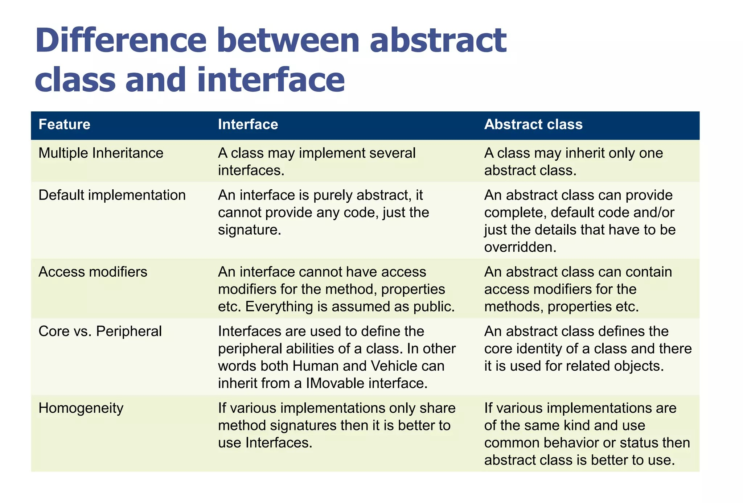

Slide 13
Conclusion
  Abstract classes and Interfaces are crucial components of object-oriented programming in C#. Use an abstract class when we want to provide a base class with some shared implementation and state, and use an interface when we want to define a contract for behaviors that multiple classes can implement, allowing for greater flexibility and decoupling.

Slide 14
THANK YOU
Johnny Naorem​
Johnny.Naorem@celsiortech.com

