Slide 1

M5 – Visual Recognition
Project: Cross-modal Retrieval
Week 1: Introduction to Pytorch
​
Group 3: Guillem Capellera, Abel García, Johnny Nuñez and Anna Oliveras
Notes:
My name is
What?
My name is
Who?
My name is
Chika-chika
Slim Shady

Slide 2
Tasks
Week 1: Introduction to Pytorch
Form groups.
Install and setup the development framework.
Set Up collaborative tools.
Understand Pytorch framework.
Implement Image Classification network from M3 in Pytorch
Compute loss graphs and compare them with yours from Keras
Compute accuracy graphs and compare them with yours from Keras
Extras

Slide 3
M3 Network
Our best network, in terms of accuracy/number of parameters ratio was a ResNet with 4 blocks of 2 convolutional layers followed by a Batch Normalization layer.
Then it has a Global average pooling layer followed by a dense layer and drop out, finishing with a softmax layer.
Params | Accuracy
68k | 0.82
Add, (64,64,32)
GAP 2D, 32
Dropout, 64
BatchNorm, (64,64,32)
Add, (64,64,32)
Dense, 64
Softmax, 8
Conv2D, (64,64,32)
BatchNorm, (64,64,32)
BatchNorm, (64,64,32)
BatchNorm, (64,64,32)
Conv2D, (64,64,32)
Conv2D, (64,64,32)
Conv2D, (64,64,32)
Conv2D, (64,64,32)
Conv2D, (64,64,32)
Conv2D, (64,64,32)
INPUT (64,64,3)
Add, (64,64,32)
Conv2D, (64,64,32)

Slide 4
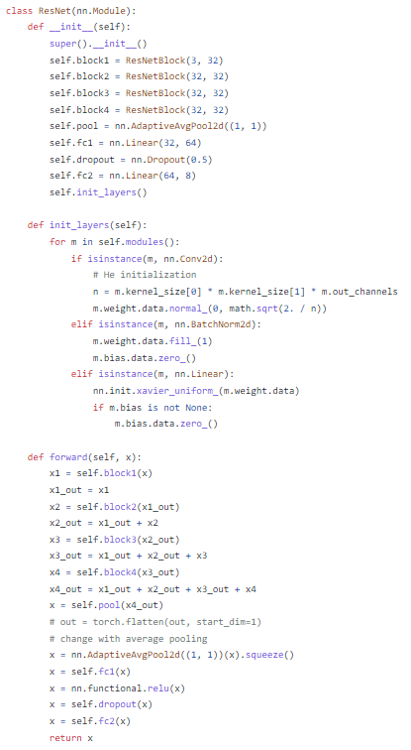
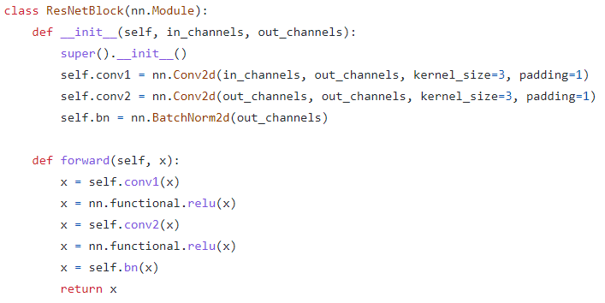
M3 Network
In Pytorch we defined the class ResNetBlock to later use it in the ResNet class.
Differently from Keras, when using Pytorch we had to explicitly define the forward pass.
We also noticed that Keras is more readable and easy to use when coding the model’s architecture. However, Pytorch is more flexible.

Slide 5


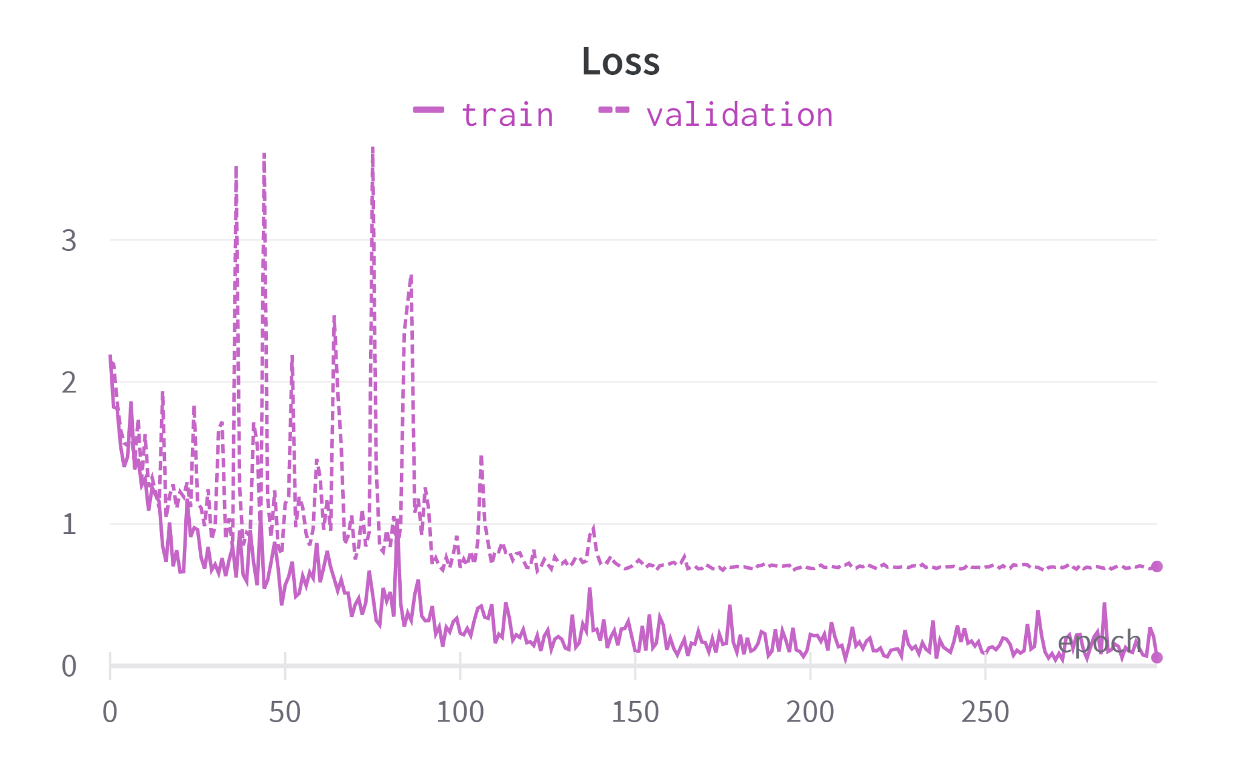
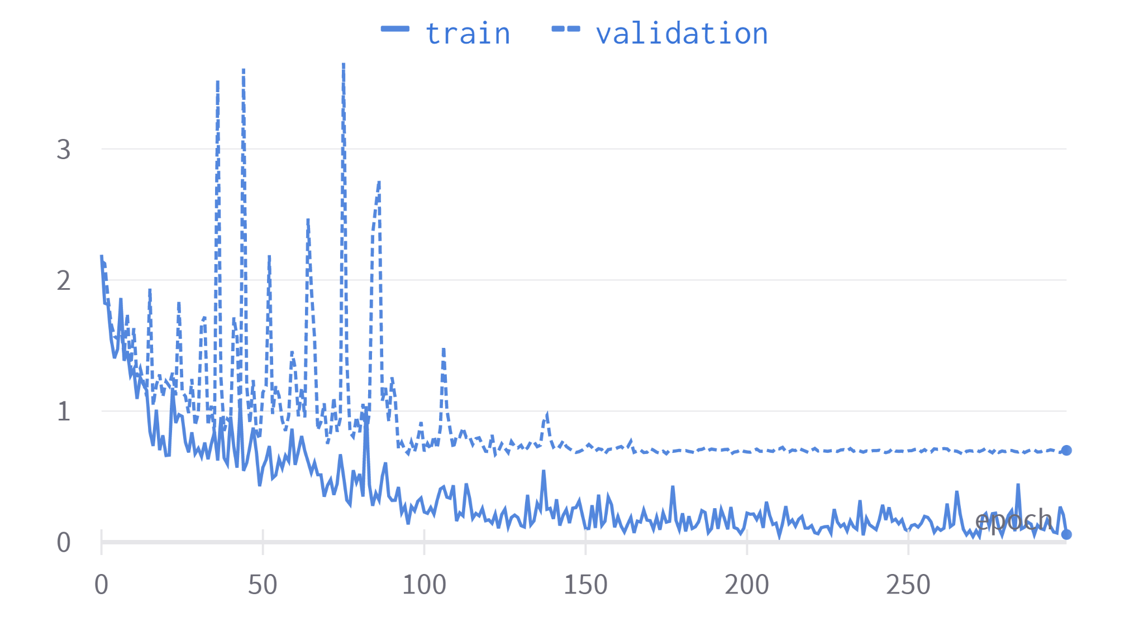
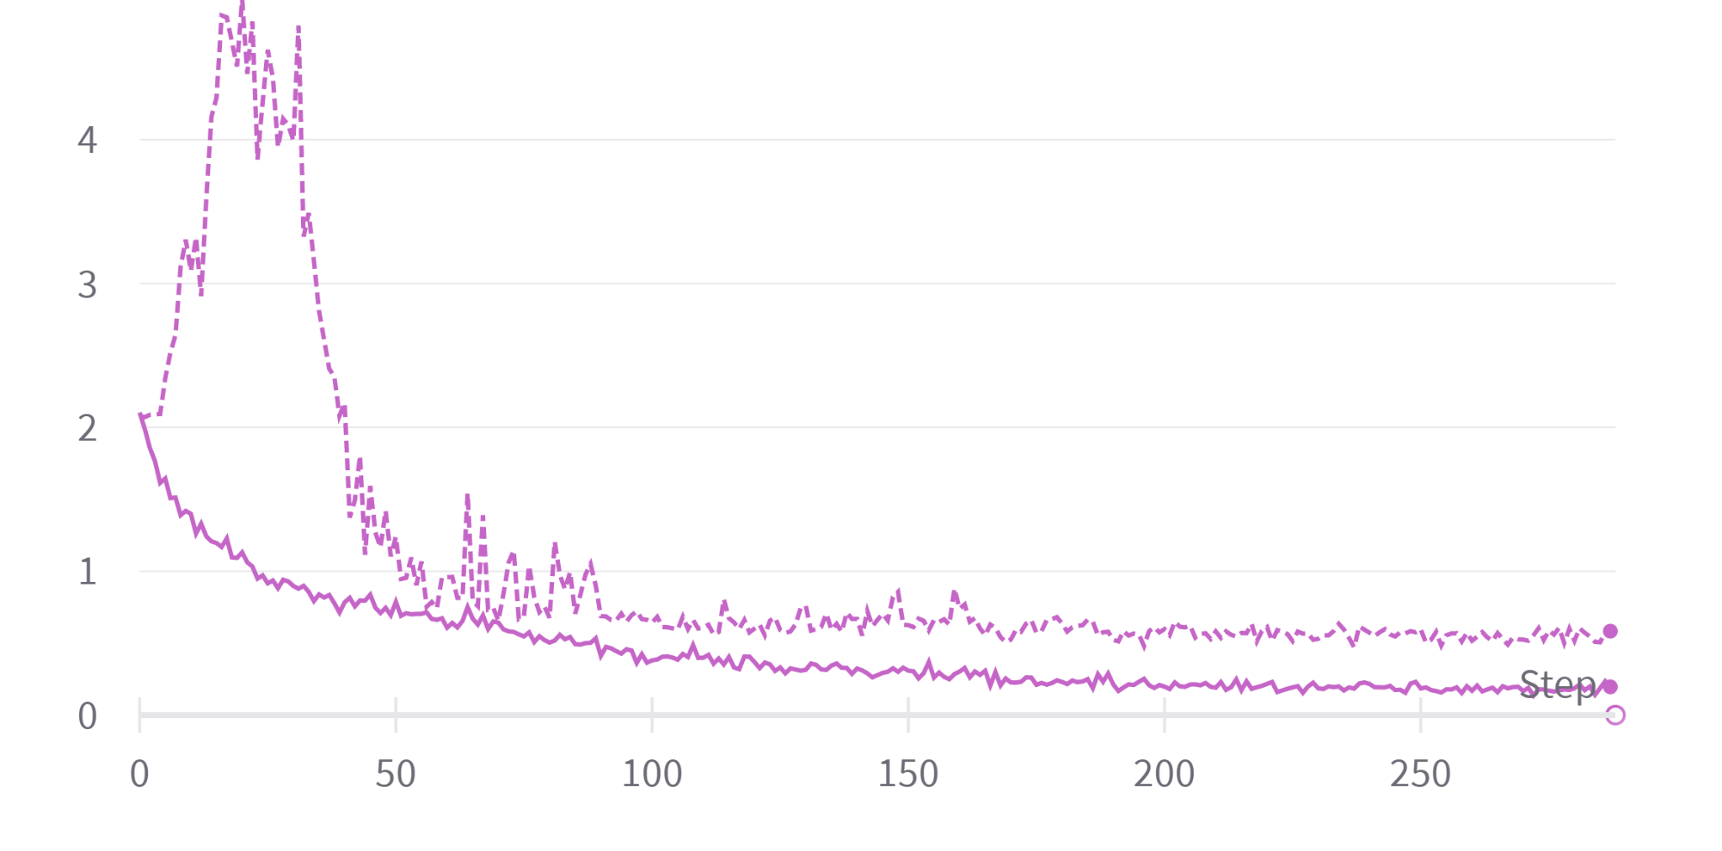
Keras vs Pytorch: Loss comparison
0.6
0.2
0.7
When using Pytorch we noticed:
Slightly higher loss than with keras
More inestable validation loss during the first 100 epochs → peaks due to the LR and validation randomness
More inestable training loss

Slide 6

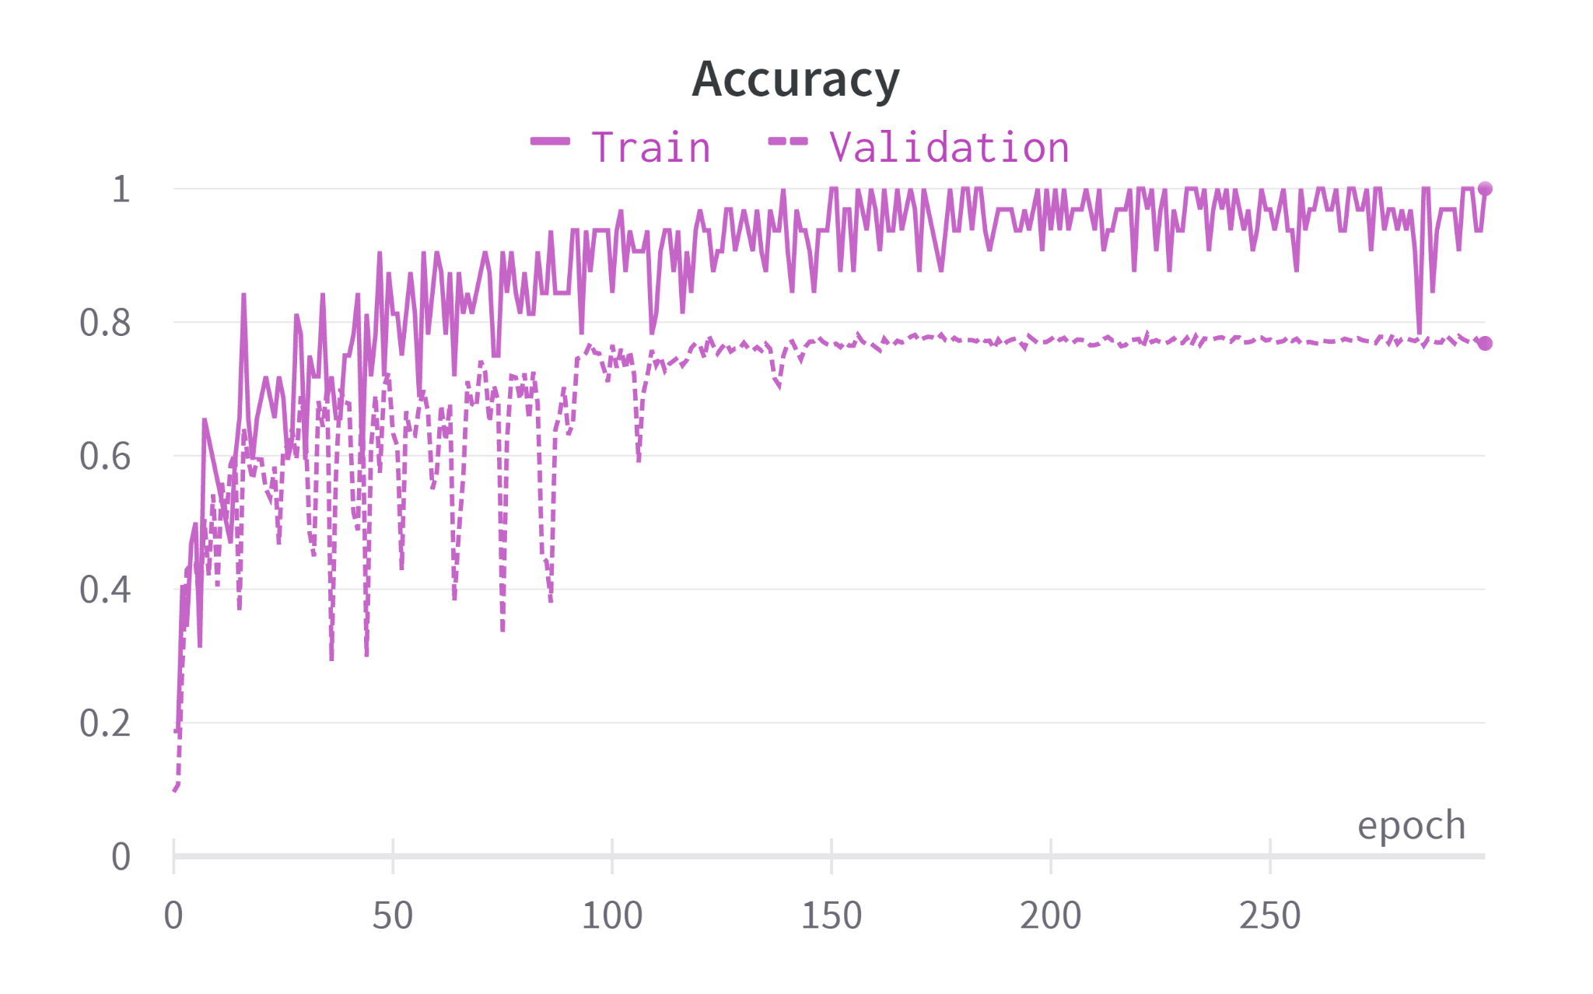
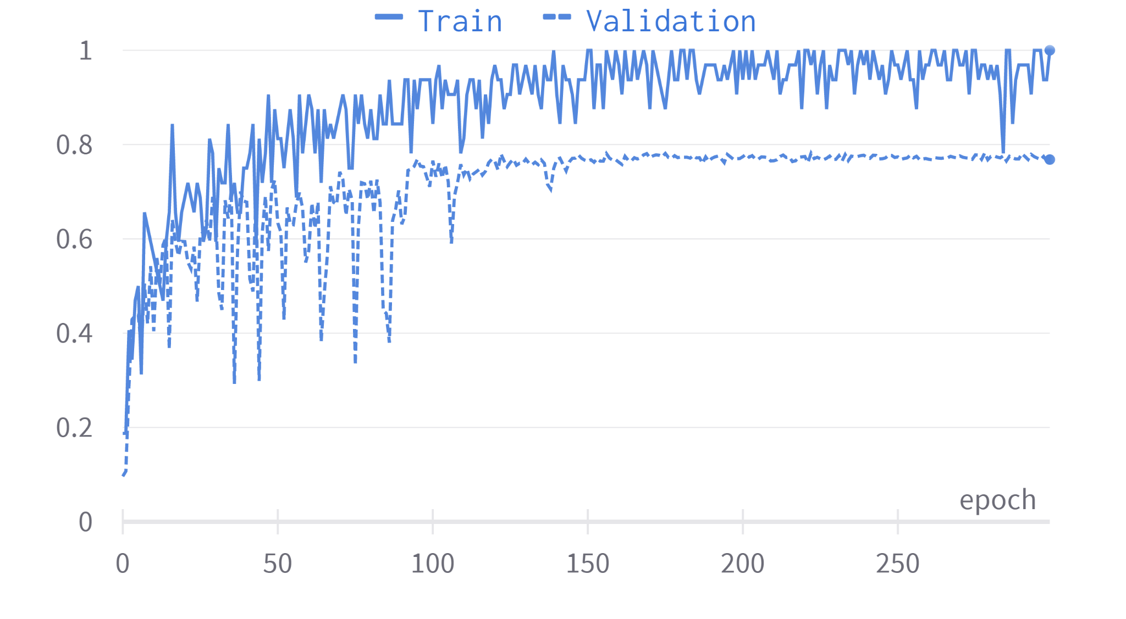
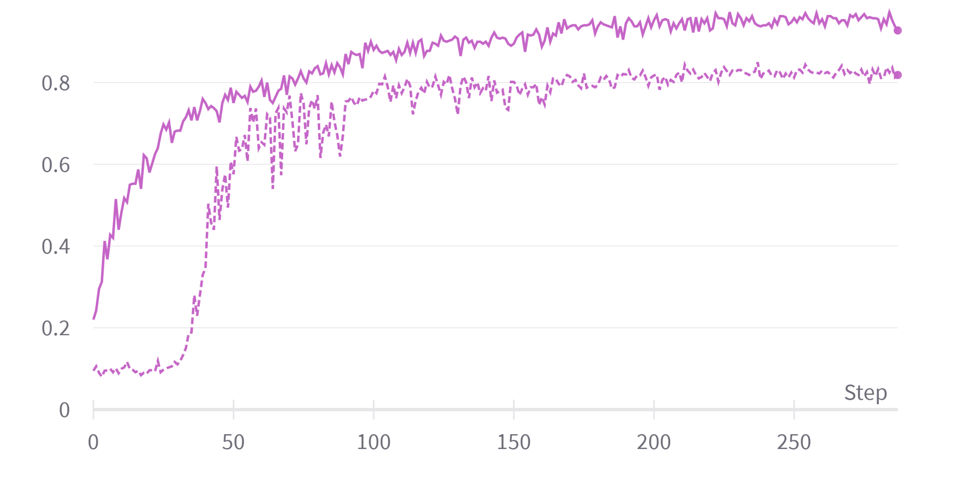
Keras vs Pytorch: Accuracy comparison
0.82
0.78
When using Pytorch we noticed:
More unstable curves
Slightly less validation accuracy achieved

Slide 7


Encountered differences
When coding the model architecture we realized that some functions are different in Pytorch than in keras, like global average pooling.
Keras maintains the same padding, but in PyTorch you need to calculate dimensions.
The Renet Add layers are not necessary in PyTorch.
The forward pass has to be explicitly coded when using PyTorch

Slide 8
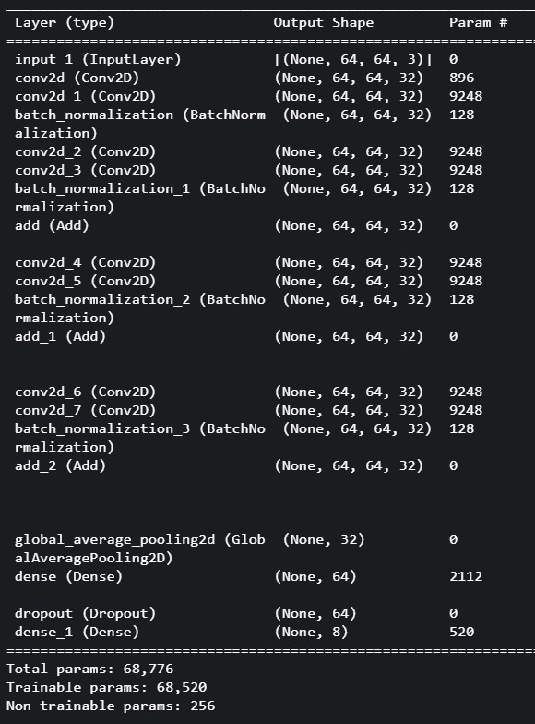
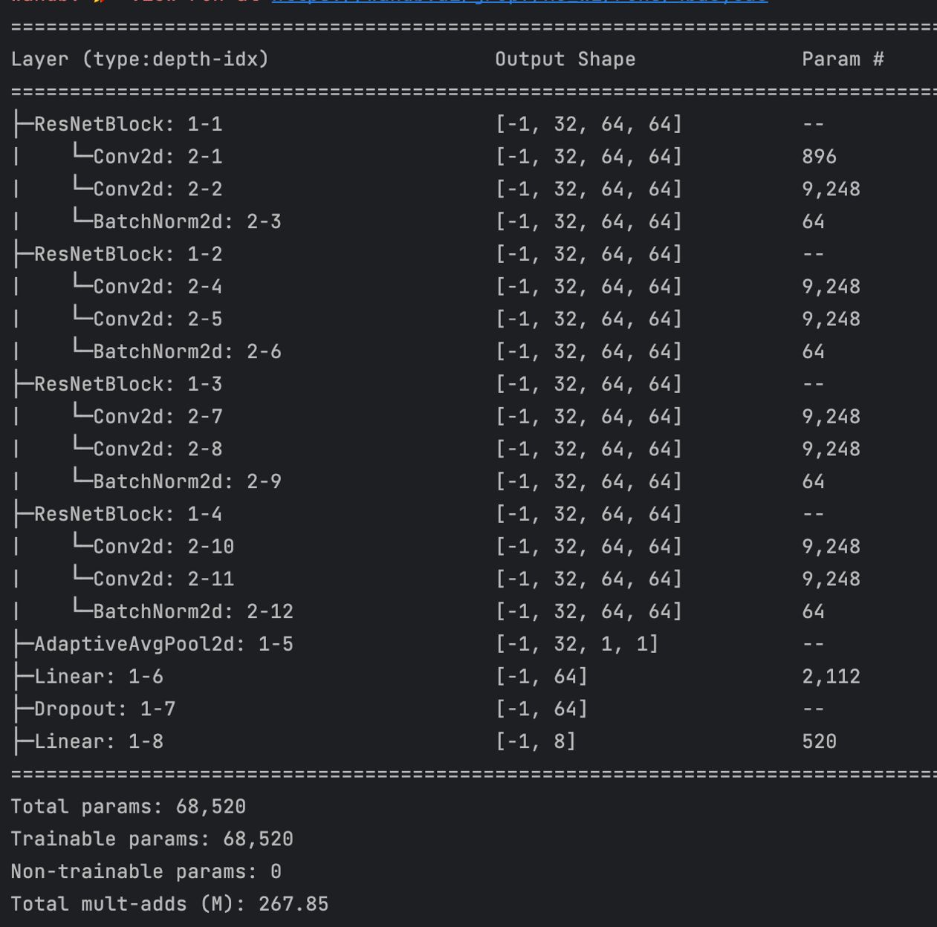
Encountered issues: Number of parameters
Keras Pytorch
The difference in the total number of parameters is due to the fact that Keras saves the accumulated mean and variance of the batches from the batch normalization layers including them as non trainable parameters!
Since we have 4 BatchNorm layers we have: 64*4 = 256 extra parameters in Keras.
Notice also the difference in the dimensions of the layers!

Slide 9
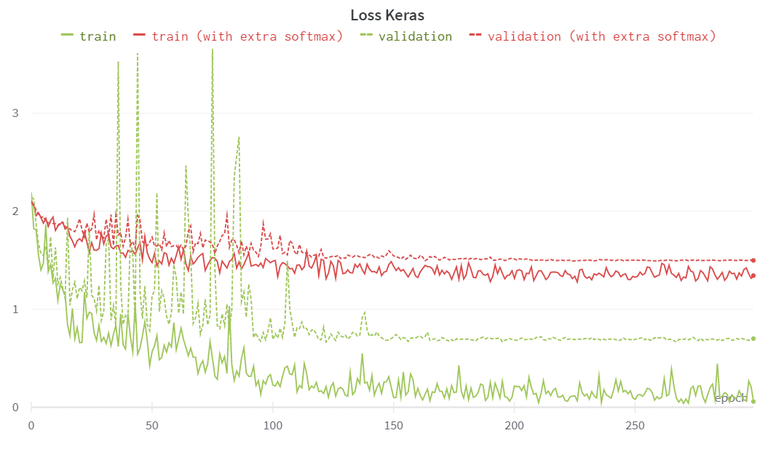
Encountered issues: using softmax
At the beginning, when moving from Keras to Pytorch we had higher losses than expected.
We realized that it was due to the use of the NN.CrossEntropyLoss, which combines the log_softmax and NLLLoss, so you don’t have to apply softmax at the end of the network since it is already implemented in the loss.
Removing the softmax that we had at the end of the network reduced our losses significantly

Slide 10
Conclusions
Keras (high-level neural network API) has a simple architecture → more readable and easy to use.
PyTorch provides a more low-level approach, we have more control of the network, training pipeline.
Change in the dimensions with respect to Keras.
We were able to replicate the same network successfully and similar results were achieved, although in our case Keras worked a bit better
Training may be slightly different and in Keras we optimized all the hyperparameters

