Slide 1
Bagging and Random Forests
Chapter 08 (part 02)

Slide 2
Outline
Bagging
Bootstrapping
Bagging for Regression Trees
Bagging for Classification Trees
Out-of-Bag Error Estimation
Variable Importance: Relative Influence Plots
Random Forests

Slide 3
bagging

Slide 4
Problem!
Decision trees discussed earlier suffer from high variance!
If we randomly split the training data into 2 parts, and fit decision trees on both parts, the results could be quite different
We would like to have models with low variance
To solve this problem, we can use bagging (bootstrap aggregating).

Slide 5
Bootstrapping is simple!
Resampling of the observed dataset (and of equal size to the observed dataset), each of which is obtained by random sampling with replacement from the original dataset.

Slide 6
What is bagging?
Repeat:
Take a bootstrap sample from the data
Fit a classification or regression method
Combine by
Voting (classification)
Averaging (Regression)

Slide 7
Importance of bagging?
Bagging is an extremely powerful idea based on two things:
Averaging: reduces variance!
Bootstrapping: plenty of training datasets!
Why does averaging reduces variance?
Averaging a set of observations reduces variance. Recall that given a set of n independent observations Z₁, …, Z_{n}, each with variance , the variance of the mean of the observations is given by

Slide 8
How does bagging work?
Generate B different bootstrapped training datasets
Train the statistical learning method on each of the B training datasets, and obtain the prediction
For prediction:
Regression: average all predictions from all B trees
Classification: majority vote among all B trees

Slide 9
Bagging for Regression Trees
Construct B regression trees using B bootstrapped training datasets
Average the resulting predictions
Note: These trees are not pruned, so each individual tree has high variance but low bias. Averaging these trees reduces variance, and thus we end up lowering both variance and bias ☺

Slide 10
Bagging for Classification Trees
Construct B regression trees using B bootstrapped training datasets
For prediction, there are two approaches:
Record the class that each bootstrapped data set predicts and provide an overall prediction to the most commonly occurring one (majority vote).
If our classifier produces probability estimates we can just average the probabilities and then predict to the class with the highest probability.
Both methods work well.

Slide 11
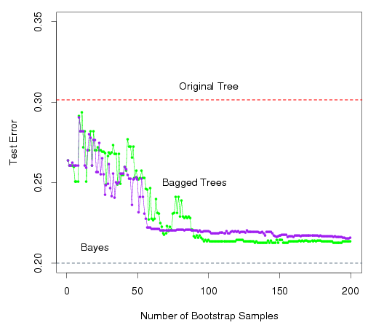
A Comparison of Error Rates
Here the green line represents a simple majority vote approach
The purple line corresponds to averaging the probability estimates.
Both do far better than a single tree (dashed red) and get close to the Bayes error rate (dashed grey).

Slide 12
Example: Housing Data
The red line represents the test mean sum of squares using a single tree.
The black line corresponds to the bagging error rate

Slide 13
Out-of-Bag Error Estimation
Since bootstrapping involves random selection of subsets of observations to build a training data set, then the remaining non-selected part could be the testing data.
On average, each bagged tree makes use of around 2/3 of the observations, so we end up having 1/3 of the observations used for testing

Slide 14
Variable Importance Measure
Bagging typically improves the accuracy over prediction using a single tree, but it is now hard to interpret the model!
We have hundreds of trees, and it is no longer clear which variables are most important to the procedure
Thus bagging improves prediction accuracy at the expense of interpretability
But, we can still get an overall summary of the importance of each predictor using Relative Influence Plots

Slide 15
Relative Influence Plots
How do we decide which variables are most useful in predicting the response?
We can compute something called relative influence plots.
These plots give a score for each variable.
These scores represents the decrease in MSE when splitting on a particular variable
A number close to zero indicates the variable is not important and could be dropped.
The larger the score the more influence the variable has.

Slide 16
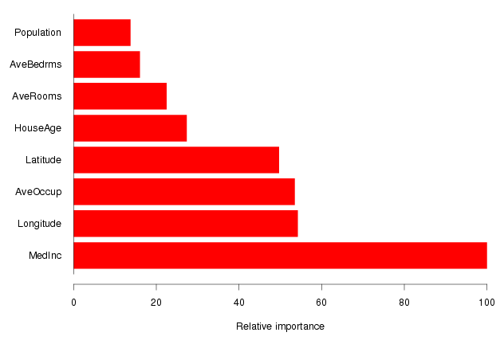
Example: Housing Data
Median Income is by far the most important variable.
Longitude, Latitude and Average occupancy are the next most important.

Slide 17
Random Forests

Slide 18
Random Forests

Slide 19
Random Forests
It is a very efficient statistical learning method
It builds on the idea of bagging, but it provides an improvement because it de-correlates the trees
How does it work?
Build a number of decision trees on bootstrapped training sample, but when building these trees, each time a split in a tree is considered, a random sample of m predictors is chosen as split candidates from the full set of p predictors (Usually )

Slide 20
Why are we considering a random sample of m predictors instead of all p predictors for splitting?
Suppose that we have a very strong predictor in the data set along with a number of other moderately strong predictor, then in the collection of bagged trees, most or all of them will use the very strong predictor for the first split!
All bagged trees will look similar. Hence all the predictions from the bagged trees will be highly correlated
Averaging many highly correlated quantities does not lead to a large variance reduction, and thus random forests “de-correlates” the bagged trees leading to more reduction in variance

Slide 21
Random Forest with different values of “m”
Notice when random forests are built using m = p, then this amounts simply to bagging.

Slide 22
Random Forests
Improve on Decision Tress with respect to:
Accuracy: Random Forests is competitive with the best known statistical learning methods
Instability: If we change the data a little, the individual trees will change but the forest is more stable because it is a combination of many trees

Slide 23
Hard Problem for a Single Tree

Slide 24
Single Tree

Slide 25
Random Forest: 25 Averaged Trees

