Slide 1
Data Science Study Case
Created By: Johnny Sin

Slide 2

Project Overview
Data Cleaning and Wrangling
Feature Engineering
Exploratory Data and Statistical Analysis
Model Evaluation
Hyperparameter Tuning
Feature Importance
Project Summary and Next Steps

Slide 3
About the Case Study
Client: Digital Transformation Managing Partner
Stakeholder: Director of VU University Medical Center
Task: Build an estimator that will predict the the positivity of stroke diagnosis in patients with various biometrics data recorded. Advancing technologies into more targeted treatments for stroke patients.
Subtask 1: Test out a couple different classification algorithms, evaluate them, and choose the best model.
Subtask 2: Summarize findings in a presentation for stakeholder.
Resources and Tool:
Programming Language: Python
IDE: Jupyter Notebook
Version Control: Git/ Github (link)

Slide 4
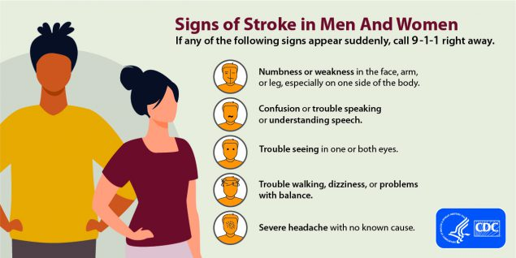
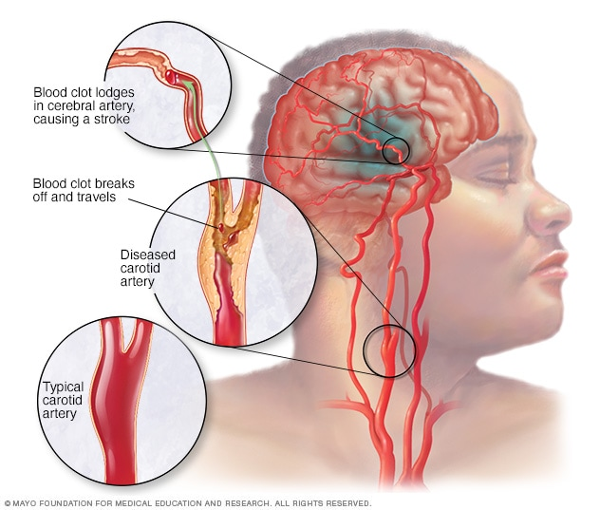
Overview of Stroke
What Is Stroke? – A medical condition that occurs when the blood supply to the brain is interrupted or even reduced leading to less oxygen and nutrient circulation in the brain.
Symptoms of Stroke? – There are very noticeable signs. Commonly the patient will have trouble speaking, show paralysis or numbness, and blurred vision. Although other signs are more subtle and often overlooked.
Risk factors for Stroke? – Hypertension, Diabetes, Heart/blood vessel diseases, smoking, age, sex, brain aneurysms, race and ethnicities, familial susceptibilities | anxiety, depression, stress, living / working conditions.
Why is this project important? – Every year around 800,000 people experience a stroke in the U.S. Therefore, an early diagnosis of stroke, or even a preventative treatment, for patients that might be at higher risk for stroke, is an unparalleled countermeasure, since the cognitive and systemic effects due to stroke might have long-lasting consequences
Notes:
Top image: cdc
Bottom image: mayoclinic.org

Slide 5
ML Workflow
Phase 2: Data exploration and processing
Phase 3: Modeling
Phase 1: Project planning and requirements
Highlighting the Client and Stakeholder requirements, and Outlining the tasks
Downloading the Data files and Getting an Overview of the Features.
Data wrangling and mining.Structure the Data: 1) Dealing with Missing Values 2) Encoding Categorical variables
Choice 1) Manually balance the classes (randomly sample 700 from the majority)
Choice 2) Use the Sklearn's class_weights parameters during modeling
(if more time)
Fitting the Model, Evaluating and Summarizing Predictions
Choice 3) Seive through the features and remove columns that might be also irrelevant to the model prediction
(if more time)
Includes:
Hyperparameter Tuning
Model Evaluation
Going back to Phase 2 for optimization

Slide 6
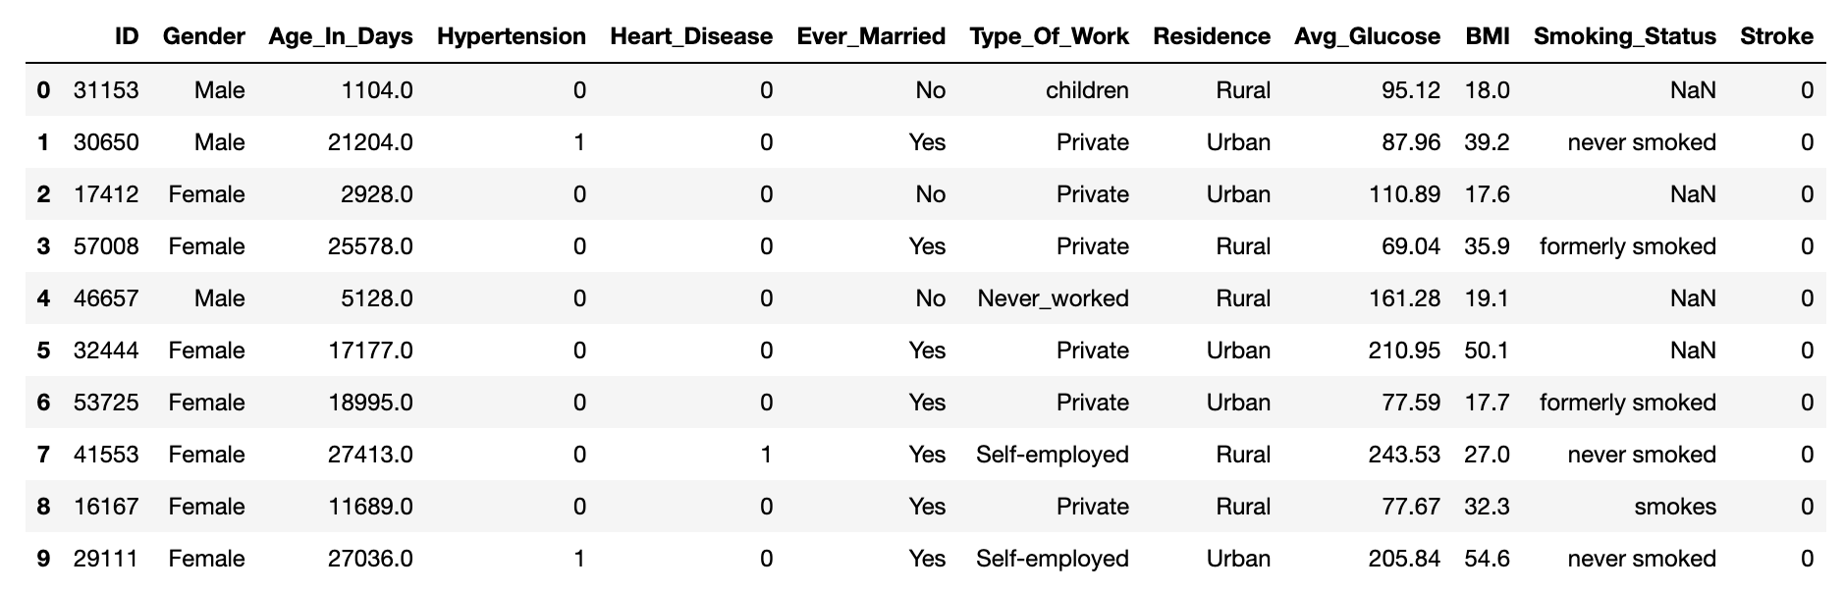
Information about the Dataset
Feature Name | Description | Type
ID | Unique Identification Number | ID
Gender | Male / Female / Other | Categorical
Age_In_Days | Indicates patient's age in days | Numerical
Hypertension | 1 - has hypertension | 0 - no hypertension | Binomial
Heart_Disease | 1 - has heart disease | 0 - no heart disease | Binomial
Ever_Married | Yes - patient is / was ever married | No - patient has never been married | Binomial
Type_Of_Work | working status, 'self-employed', 'works in private firm', 'government job’, ‘children’ | Categorical
Residence | Urban - patient currently lives in urban | Rural - patient lives in rural area | Binomial
Avg_Glucose | patient's average glucose level for the past 3 months | Numerical
BMI | patient's current BMI score | Numerical
Smoking_Status | indication of smoking habits | Categorical
Stroke | 1 - patient after stroke | 0 - no stroke (binomial variable) | TARGET
Figure 2. Original Data visualized as dataframe.
Note
There are two data files that were part of the case study.
Stroke_Prediction.csv
Stroke_Prediction.xlsx
Because the two files are the exact same with a different format, from here on out, I will be only using the .csv file.
Figure 1. Table overview of features

Slide 7
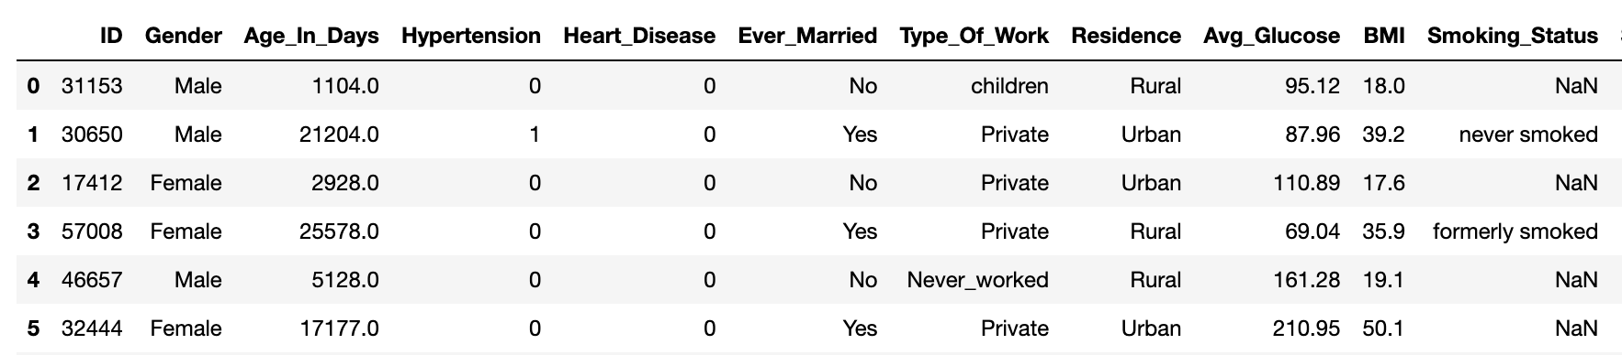
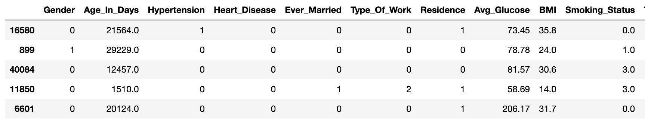
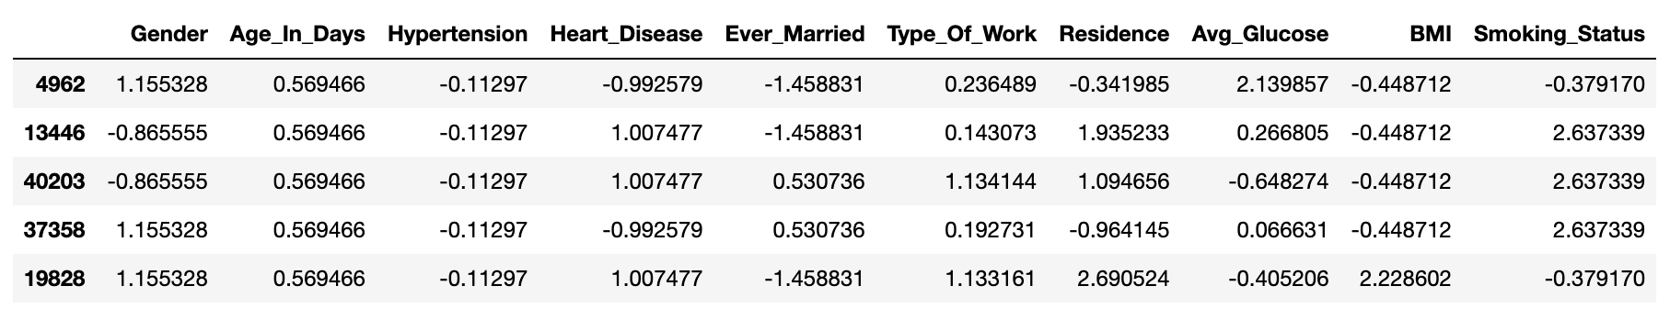
Manually Encoding Data for Visualization
The first step into making decisions about the data involves exploratory analysis and visualizations. In order to accomplish these tasks, the data needs to be imputed and encoded correctly into a numerical format.
Data encoding
Missing Values:
Column ‘BMI’ has 3% null values, which can be simply removed
Column ‘Smoking_Status’ has 30%, so those missing values were placed under a new category
Feature Engineering:
I assumed the ID column is a random value given to individuals. Since this column is irrelevant to the model, I removed this
This part can be part of the experimentation process, removing features that might be negatively impacting the success of the modeling process
Standardization of numerical values
Figure 3. Transforming and preprocessing the data

Slide 8
ML Workflow
Phase 2: Data exploration and processing
Phase 3: Modeling
Phase 1: Project planning and requirements
Highlighting the Client and Stakeholder requirements, and Outlining the tasks
Downloading the Data files and Getting an Overview of the Features.
Data wrangling and mining.Structure the Data: 1) Dealing with Missing Values 2) Encoding Categorical variables
Choice 1) Manually balance the classes (randomly sample 700 from the majority)
Choice 2) Use the Sklearn's class_weights parameters during modeling
(if more time)
Fitting the Model, Evaluating and Summarizing Predictions
Choice 3) Seive through the features and remove columns that might be also irrelevant to the model prediction
(if more time)
Includes:
Hyperparameter Tuning
Model Evaluation
Going back to Phase 2 for optimization

Slide 9
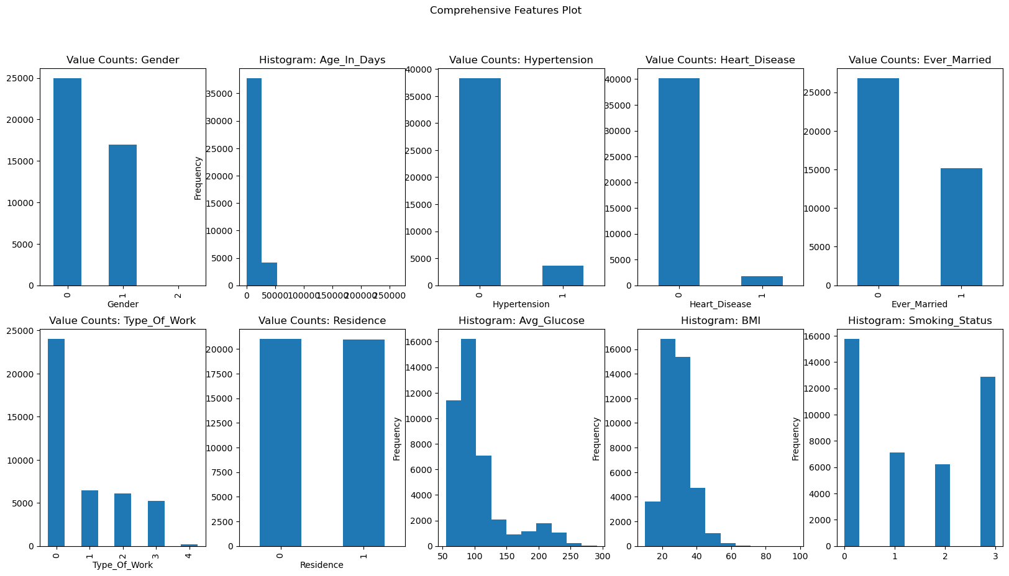
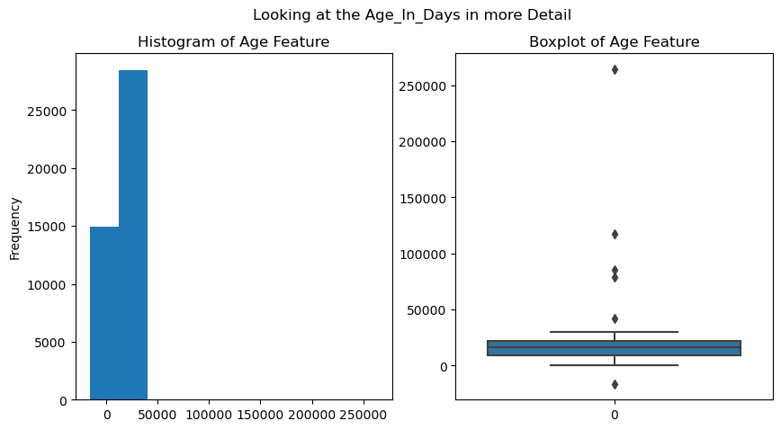
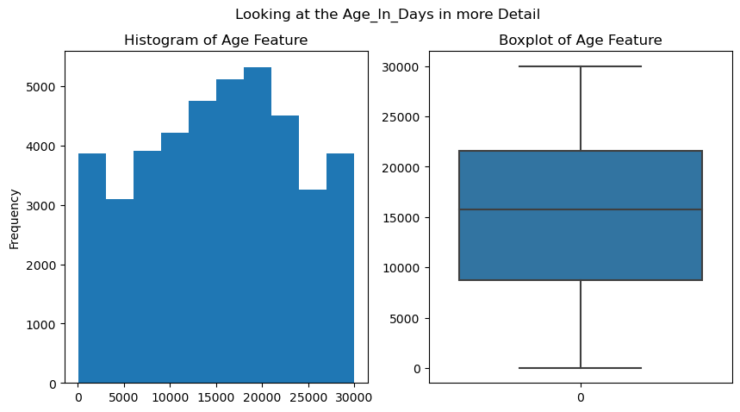
Statistical Analysis: Outlier Detection
Looking at this count plot (Fig.4) of each of the features, I noticed something slightly off about the ‘Age_In_Days’ feature:
The average Age of the patients in this sample is 41.9 years, however the max age is 724 years.
Figure 4. Detecting outliers in Age_In_Days column
Using the Tukey’s rule for outliers, I removed the outliers in this Age_In_Days column. Although converting this column into years might have been helpful, this column will be scaled later.
Figure 5. Change in histogram for the Age_In_Days column

Slide 10
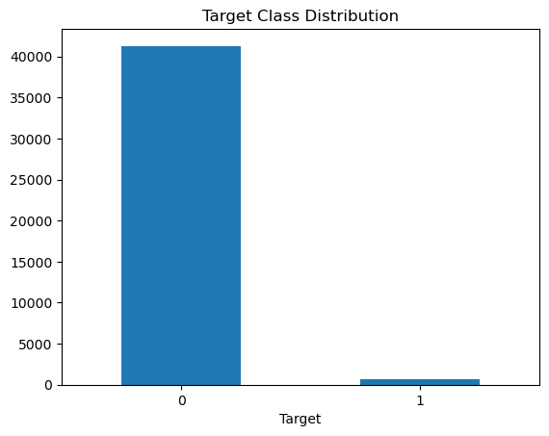
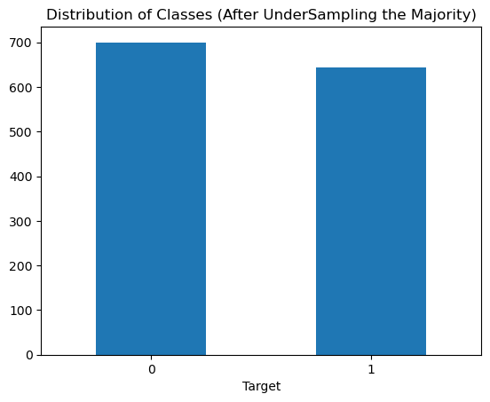
Statistical Analysis: Class Imbalance
The original data contains a heavily imbalanced Stroke (renamed to Target) class, with 41290 patients with a history of stroke and only 643 patients without stroke. Due to this imbalance, the model when trained on this data will have a huge decrease in true positive detection, and for an important classifier problem dealing with sick patients, we need to select a model that scores highly on the recall metric. (Where there is a high cost associated with false negative errors)
There are multiple ways to deal with this issue:
Use the parameter in sklearn’s model called `class_weights`
Randomly re-undersample the majority class (I will be using this because this is much faster for training models!)
Figure 6. Resampling to balance classes

Slide 11
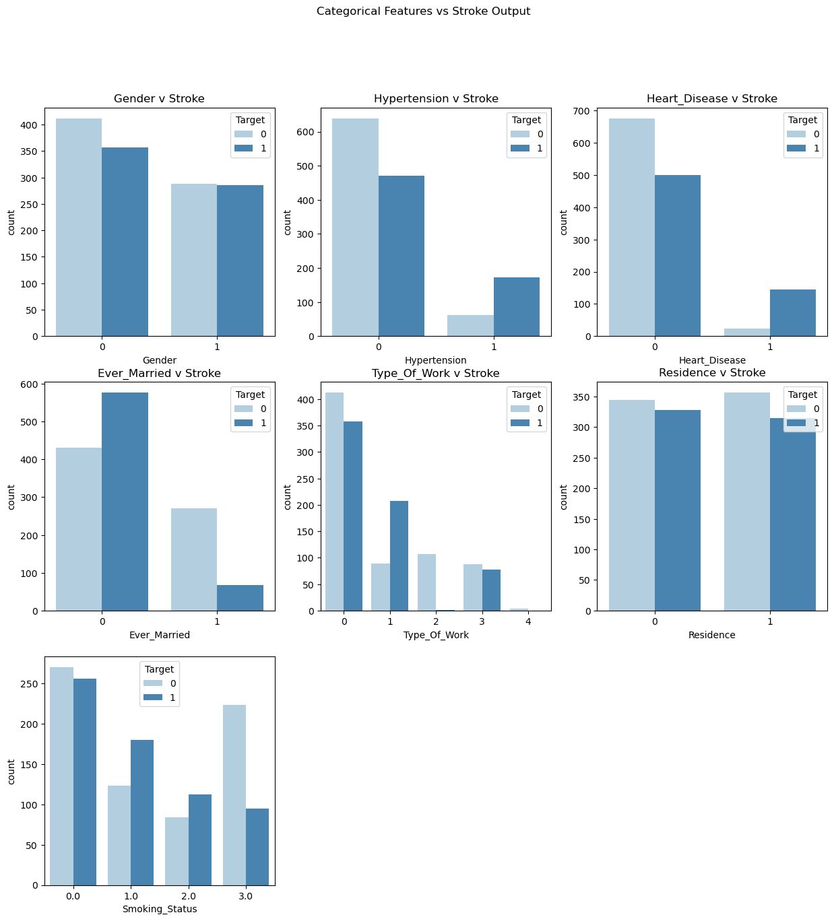
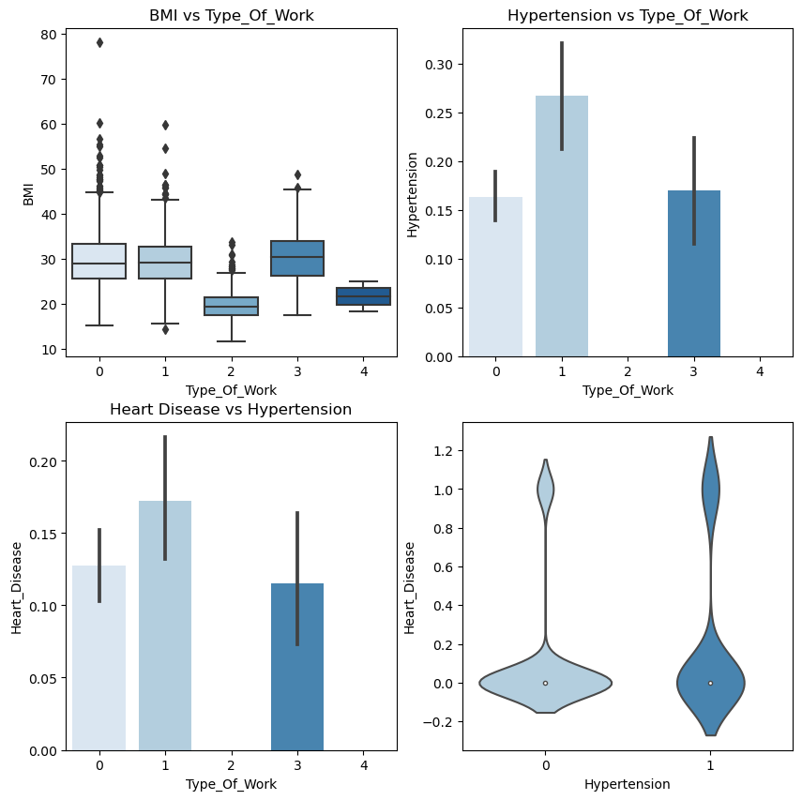
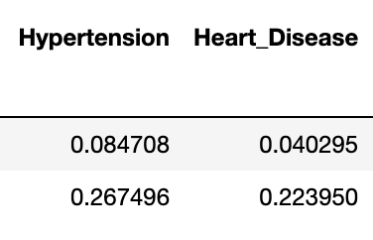
Statistical Analysis: Categorical Data
The majority of the features from this provided data is either categorical or binomial, which means the statistical analysis and visualizations must be carefully curated.
As mentioned in the Overview of Stroke slide before, work-life stress may be associated with higher levels of stroke incidence. So here I investigate the potential relationships that Type_Of_Work might have on Heart_Disease, BMI, and Hypertension features, all of which were associated with higher risk of stroke. **Jobs 2 and 4 seems to be less associated with hypertension and heart disease, both features have a higher mean of incidence in patients with stroke (Fig.7.2c )
Figure 7.1a Categorical variables and their distribution according to stroke outcome after resampling
Figure 7.2b. Categorical variables in related to Type_Of_Work.
* Private: 0
* Self-employed: 1
* children: 2
* Govt_job: 3
* Never_worked: 4
7.2c
Note: Here instead of using the randomly resampled data, l used the all the samples to capture a more comprehensive understanding of the patient mean.
no stroke
stroke

Slide 12
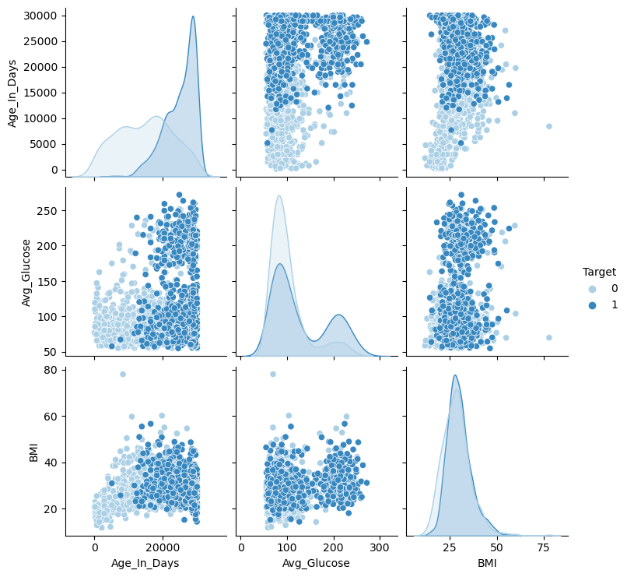
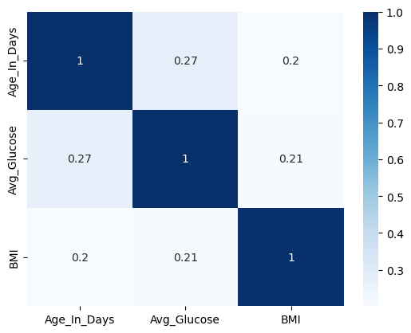
Statistical Analysis: Numerical Features
To get a high-level overview of the numerical features relationships, I used a combination of pairplot and a correlation matrix.
The pairplot is also colored by the Target column (where 1: Stroke, 0: absence of Stroke).
We can see that the Age_In_Days look interesting in that there is a clustering of stroke patients with a higher value of Age_In_Days. The other two numerical columns Avg_Glucose’ and ‘BMI do not display this similar clustering behavior.
The annotated correlation matrix shows low correlation between these variables.
Figure 7.3. High-level overview of numeric features using pairplot and correlation matrix

Slide 13
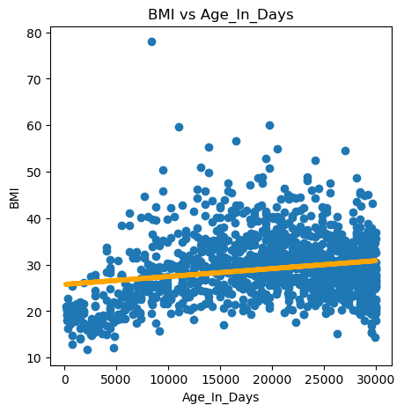
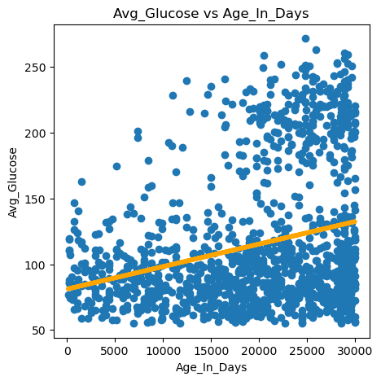
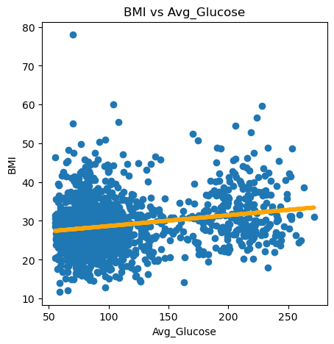
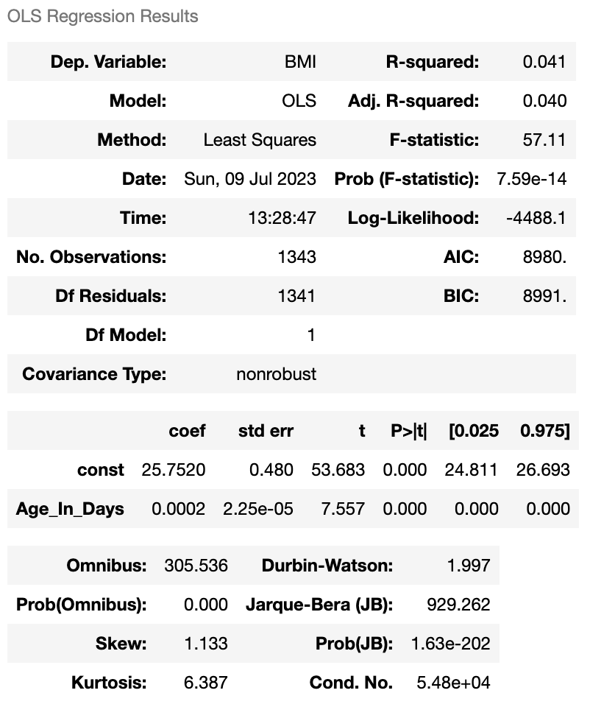
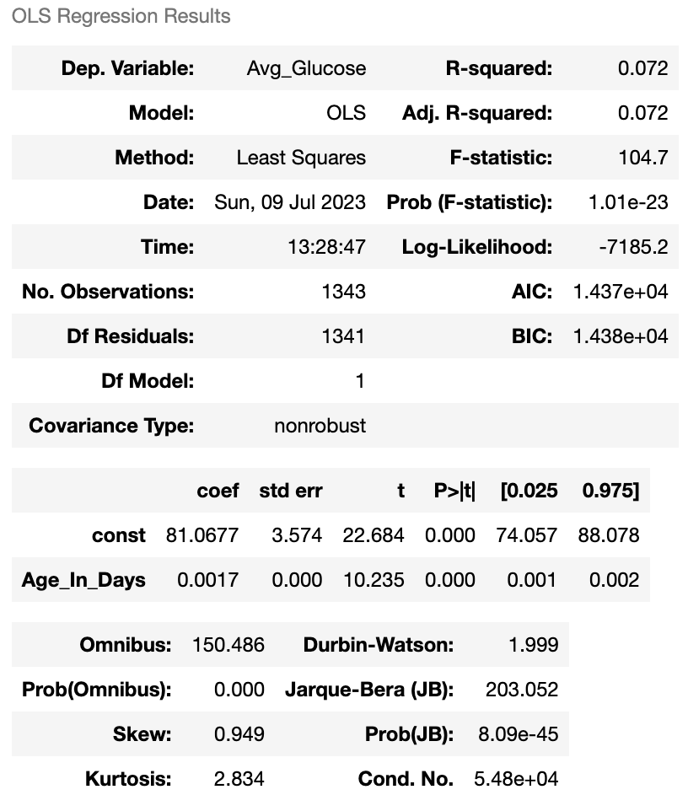

Statistical Analysis: Numerical Features – OLS
Performing an OLS regression between these numerical features, I found that there is a very low linear correlation between these variables along with a Durbin-Watson value ~2 which suggests a low probability of autocorrelation between these variables.
Figure 8. OLS results between the numerical features to find the autocorrelation

Slide 14
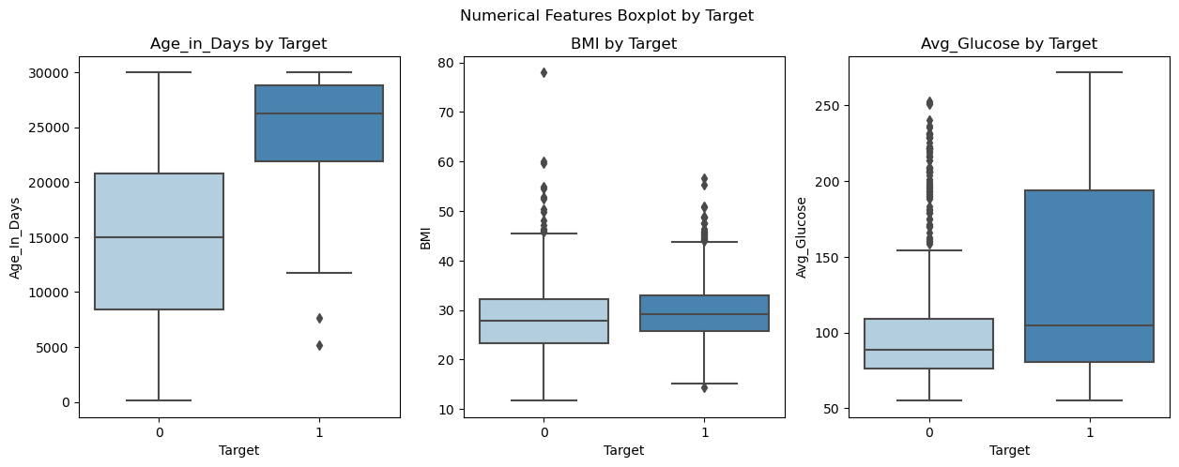
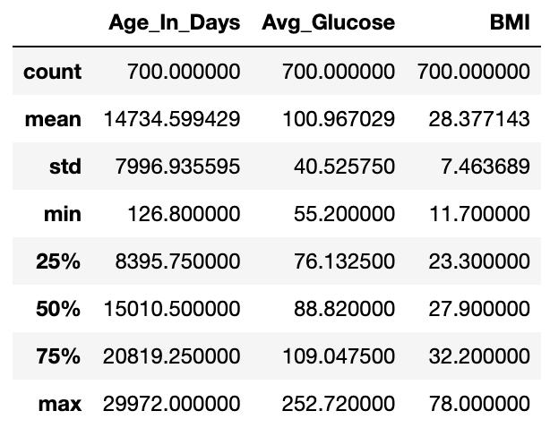
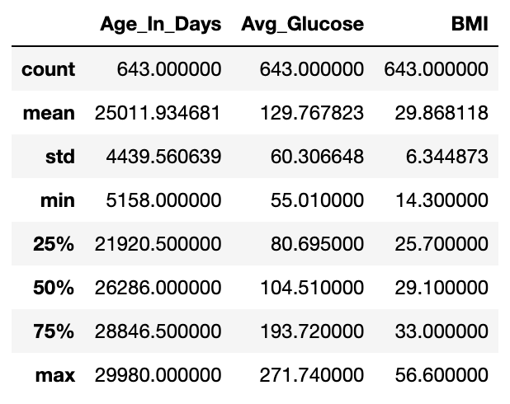
Statistical Analysis: Numerical Features – Hypothesis Testing
Numerical Features statistics with stroke
Numerical Features statistics without stroke
Figure 9. Comparison between the numerical features by stroke outcome
For the Age_In_Days column, there is a visually noticeable difference in the sample means between the two patient groups.
Hypothesis testing: After randomly sampling 50 from each group (outcome in the .ipynb file provided). The results from this test rules out our null hypothesis and shows a significant difference in the age in the stroke sample group.

Slide 15
ML Workflow
Phase 2: Data exploration and processing
Phase 3: Modeling
Phase 1: Project planning and requirements
Highlighting the Client and Stakeholder requirements, and Outlining the tasks
Downloading the Data files and Getting an Overview of the Features.
Data wrangling and mining.Structure the Data: 1) Dealing with Missing Values 2) Encoding Categorical variables
Choice 1) Manually balance the classes (randomly sample 700 from the majority)
Choice 2) Use the Sklearn's class_weights parameters during modeling
(if more time)
Fitting the Model, Evaluating and Summarizing Predictions
Choice 3) Seive through the features and remove columns that might be also irrelevant to the model prediction
(if more time)
Includes:
Hyperparameter Tuning
Model Evaluation
Going back to Phase 2 for optimization

Slide 16
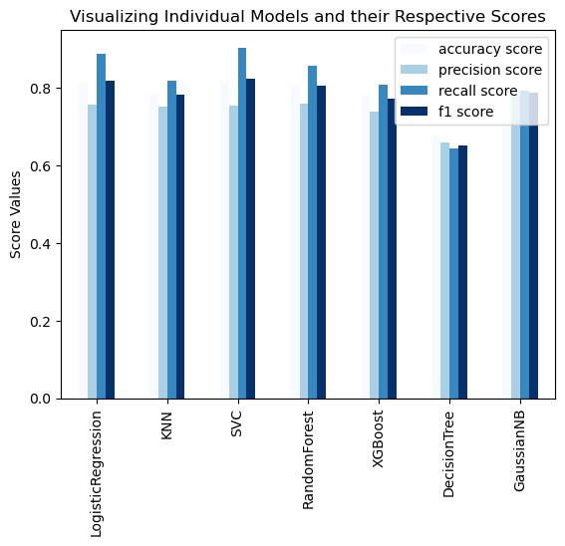
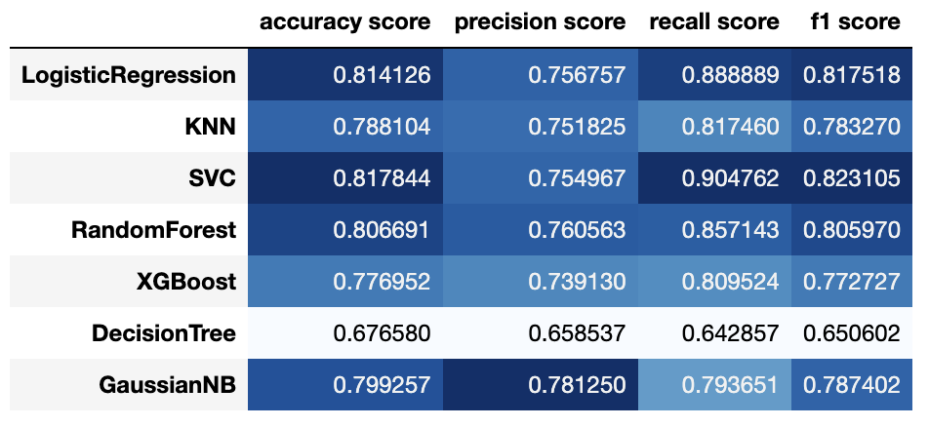
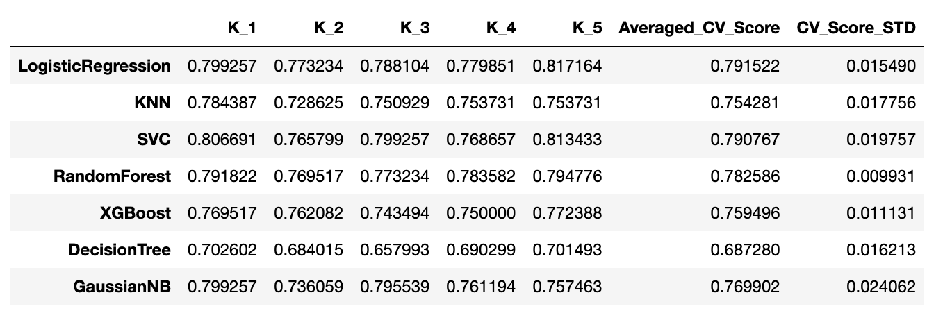
Evaluating Models of Interests
Figure 9. Evaluation metrics comparison between models
For this first pass of model evaluation, I decided to propose a handful of machine learning algorithms:
LogisticRegression
RandomForestClassifier
KNeighborsClassifier
SVC
XGBoostClassifier
DecisionTree
Naive Bayes
Classification report
Cross validation

Slide 17
Evaluating Models of Interests
Figure 9. Evaluation metrics comparison between models
For this first pass of model evaluation, I decided to propose a handful of machine learning algorithms to look at:
LogisticRegression
RandomForestClassifier
KNeighborsClassifier
SVC
XGBoostClassifier
DecisionTree
Naive Bayes
Classification report
Cross validation
I decided to focus on these three models (in bold) for now due to their metrics score such as: recall score (as previously mentioned) and F1 score

Slide 18
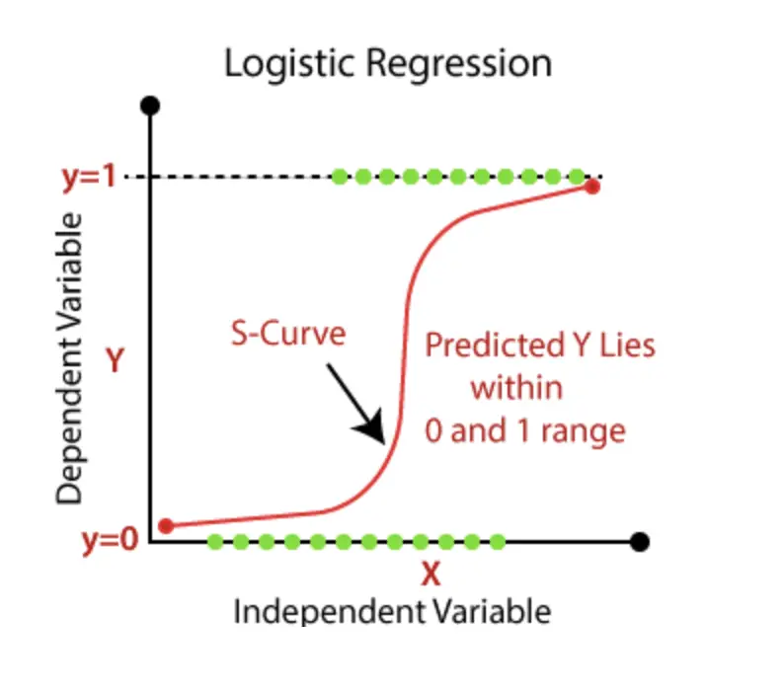
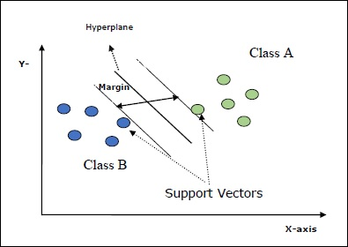
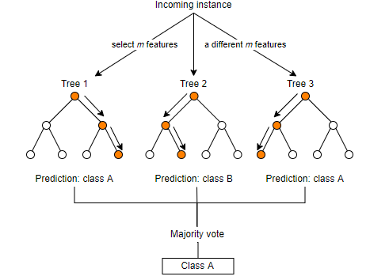
Quick Overview of the Selected Models
SVC
Logistic Regression
Random Forest
Abbreviated from ‘Support Vector Classifier’ which is a type of SVM or ‘Support Vector Machines’
It fits the data based on libsvm by providing a ‘best fit’ hyperplane, called the maximum marginal hyperplane, that divides and categorizes the data.
A supervised algorithm that is part of the sklearn.linear_model package
This model is most commonly known for its sigmoidal shape and widely used for classification problems.
Another popular choice for classification problems, the Random Forest uses decision trees, *many decision trees, to consolidate its results
It has great ability to mitigate overfitting and can handle complex datasets, making it a must option to test in predictive analytics.
Information compiled from scikit-learn.org
Notes:
Image 1: https://www.tutorialspoint.com/scikit_learn/scikit_learn_support_vector_machines.htm
Image 2: https://sparkbyexamples.com/machine-learning/logistic-regression-explained-with-examples/
Image 3: https://medium.com/cuny-csi-mth513/utilizing-models-to-predict-bacteria-species-a3e44954927e

Slide 19
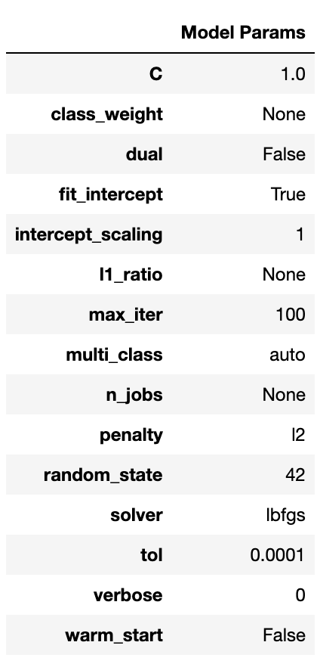
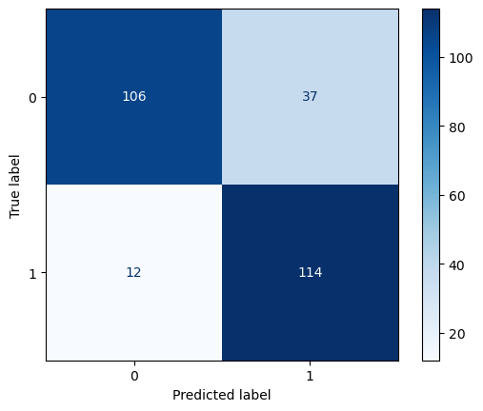

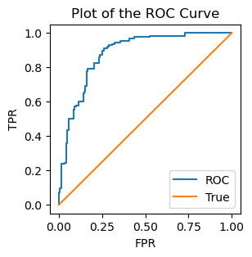
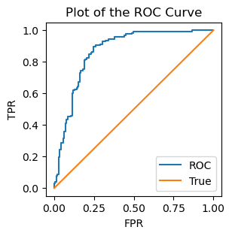
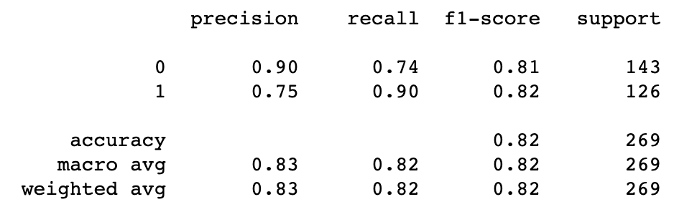
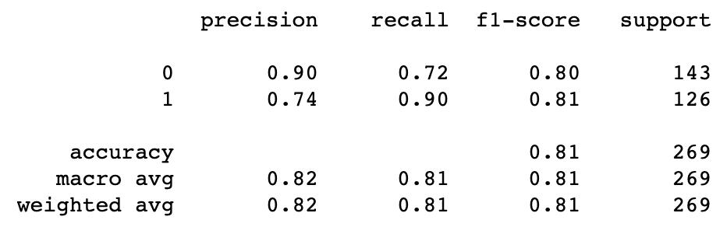
SVC: Hyperparameter Tuning
SVC Model: Pre-Grid Search Parameter Tuning
SVC Model: Grid Search Parameter Tuning
ROC AUC score: 0.88
ROC AUC score: 0.87

Slide 20
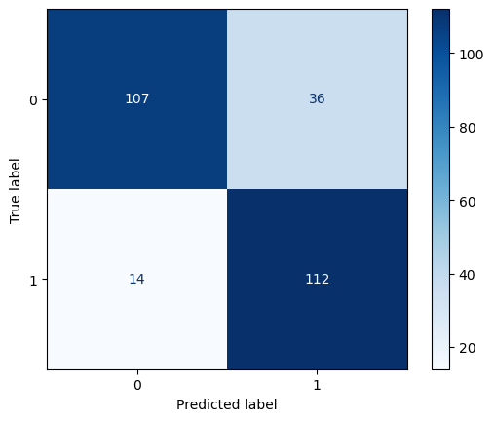


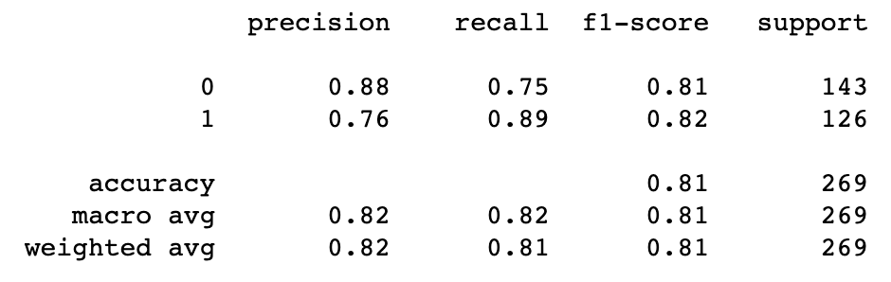
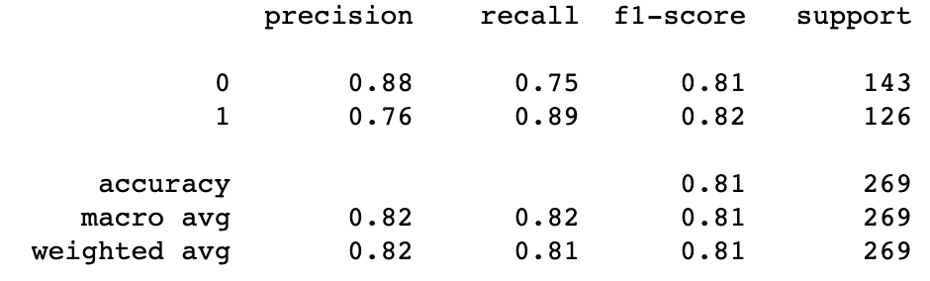
Logistic Regression: Hyperparameter Tuning
Log Model: Pre-Grid Search Parameter Tuning
Log Model: Grid Search Parameter Tuning
ROC AUC score: 0.87
ROC AUC score: 0.87

Slide 21
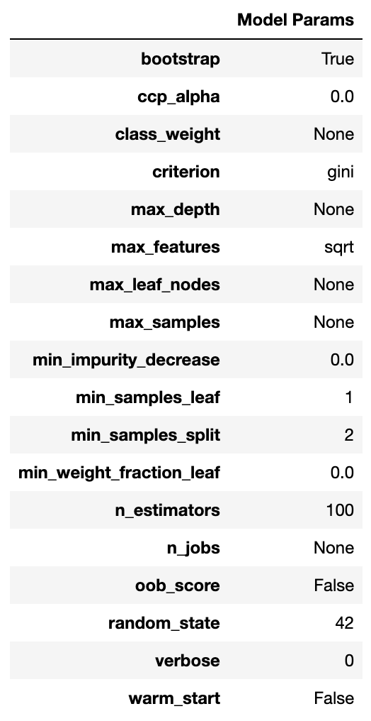
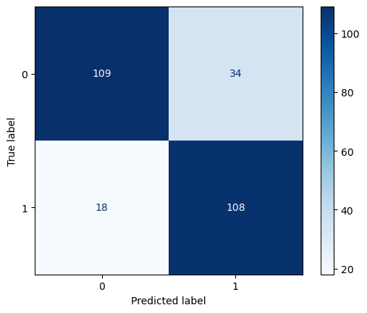
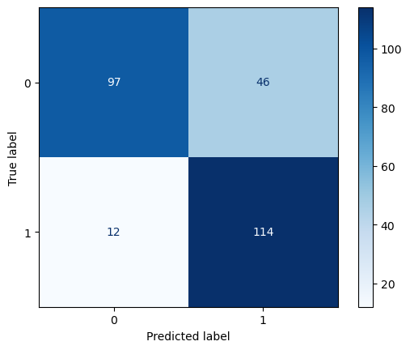
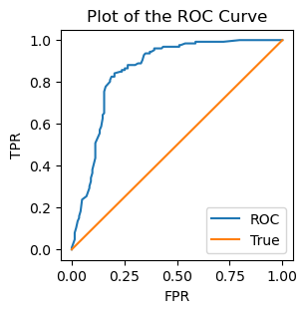
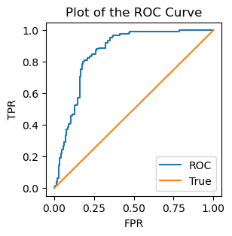
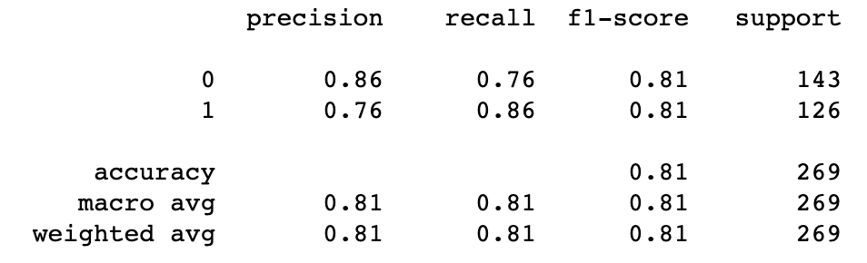
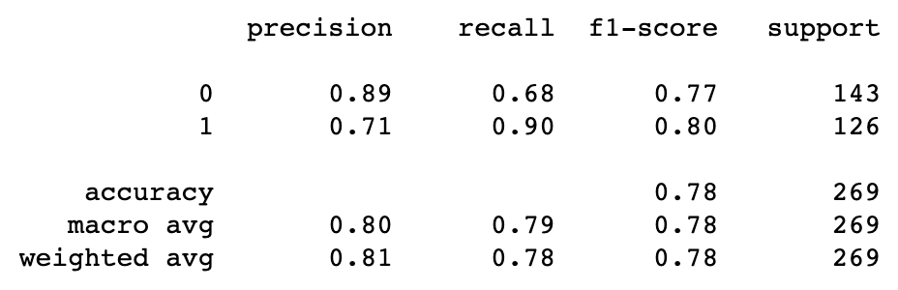
Random Forest: Hyperparameter Tuning
Forest Model: Pre-Grid Search Parameter Tuning
Forest Model: Grid Search Parameter Tuning
ROC AUC score: 0.86
ROC AUC score: 0.86
Recall score increased from 0.86 – 0.90!

Slide 22
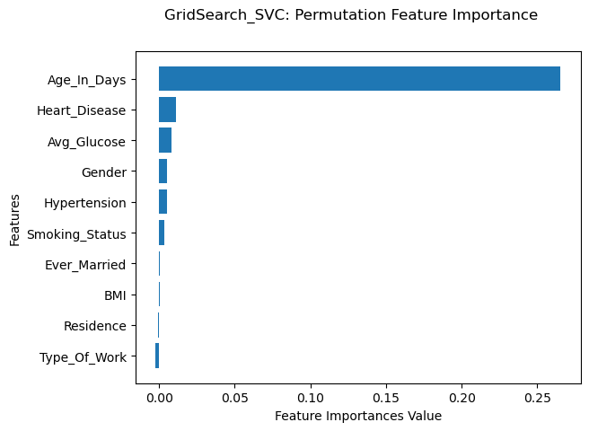
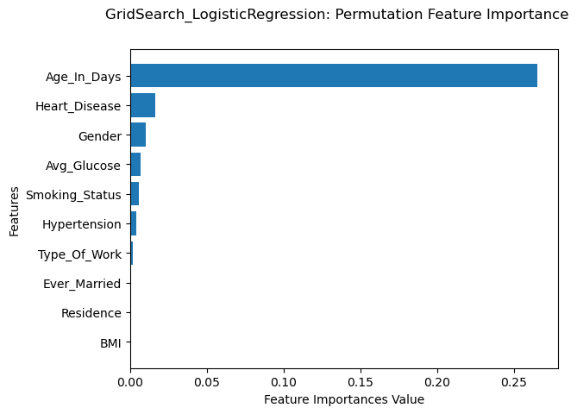
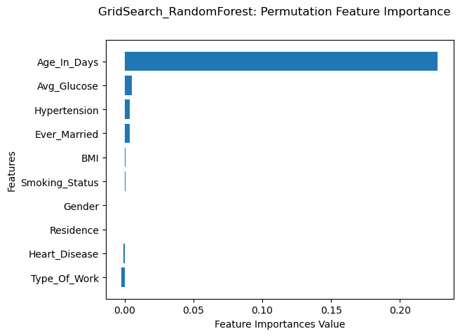
Model Evaluation: Feature Importance
Analyzing the feature importances of all three of the models evaluated so far using the permutation importance function yielded interesting results.
The feature with the most relevant and consistently high importance value is Age_In_Days. This isn’t surprising, considering that the hypothesis testing produced a significant difference in patients’ age with stroke.
The Logistic Regression and SVC classifiers produced similar importance values, however the RandomForestClassifier, which had the greatest improvement with Grid Search showed a different set of importance values.

Slide 23
Model Evaluation: Recommendations
Model Recommendation 1: Because the SVC model had the highest starting metrics (in recall particularly because this measures the ability to find all relevant instances of a class) it might be worthwhile to experiment with this model further and tune its hyperparameters.
Model Recommendation 2: However, if no improvement is seen with SVC, it might also be worthwhile to look at the RandomForestClassifier, because this model had the greatest change during the first phase of hyperparameter tuning (4% increase in recall)
Note to Stakeholder: Although the proposed models that were used in this preliminary investigation produce a ~90% outcome, further testing is necessary to increase their predictive capabilities. Perhaps one way to expedite this project is to improve the dataset by providing more ‘physiologically-relevant’ readouts such as plasma protein biomarkers from annual blood tests or cognitive testing and survey results during patient clinic visits.

Slide 24
If I had more time, what next?
Because the experimentation and machine learning optimization for classification problems portions of this assignment can be a cyclic process of repeated improving and tweaking, there are many steps that I have yet to explore due to the project time constraint.
Optimize the model further with a broader range of values for Grid Search to optimize these three models first, then potentially include the other models, as well as models that were not included in the list.
With the way this notebook is structured, it will be simple to go back and experiment with other choices (changing the way the unbalanced classes are handled and/or removing columns that are deemed irrelevant).
Consider even including new features (such as Race/Ethnicity or Family history) either through changing collection methods or feature engineering: ie. Considering that Type_Of_Work might be a variable that measure one modality of stress and use that information to either create a new feature or design a feature through merging multiple correlated columns.
In order to more accurately capture the distribution of class data it might be also important to optimize the model on the imbalanced class data (original) and emphasize the class_weights parameter for each model, since this more accurately resembles the real-world situation.
After optimizing the model further using the proposed methods, and perhaps after discussion with experts / client, it would be great to deploy this model using a web application framework such as Flask or Django or even in Shiny to make this model more accessible for hospital use during stroke treatment recommendation for patients.

Slide 25

Project Summary
Steps that I have completed for this project includes:
1. Data Cleaning and Wrangling ✓
2. Feature Engineering ✓
3. Exploratory Data and Statistical Analysis ✓
4. Model Evaluation ✓
5. Hyperparameter Tuning ✓
6. Feature Importance ✓
The modeling portion of this project was very exciting and fruitful. Having the opportunity to work with data for the proposed goal of stroke diagnosis and potentially improving health care was a rewarding experience.

Slide 26
Thank you

Slide 27
Supplementary Information

Slide 28
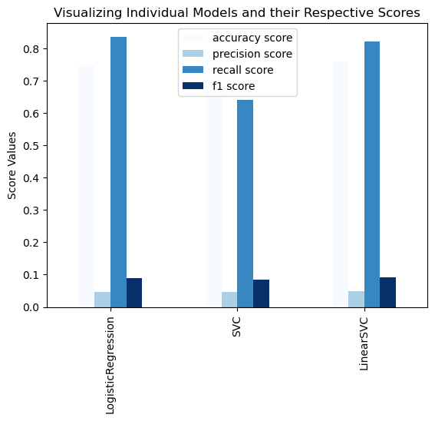


First look into: Using Class_weights parameter
Randomly resampling data manually
Using full dataset and the weighted model parameter

Slide 29



First look into: Filtering Out Selected Categorical Variables
Choice 1 scores: (manually random class-balancing)
Removing the ‘Type_Of_Work’ Column
2. Removing the ‘Ever_Married’ Column
3. Removing the ‘Residence’ Column

