Slide 1
Programs and Opportunities at the Summit Bechtel Reserve
Johnny Tracy, onsite programs and outreach manager

Slide 2
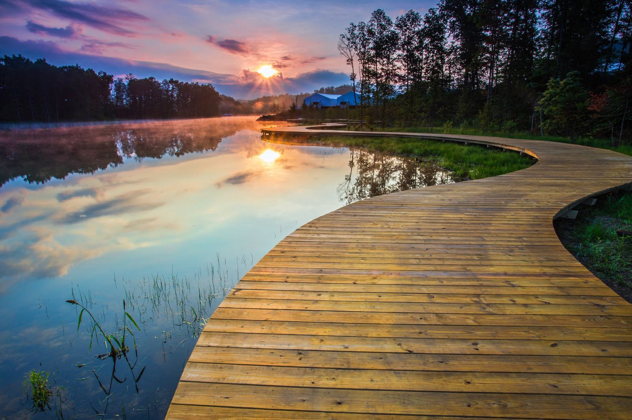

Slide 3
Welcome!

Slide 4
What is there to do?

Slide 5
The Summit Bechtel Reserve is the permanent home of the National Scout Jamboree and the occasional home of the World Scout Jamboree.
That’s it.

Slide 6


Slide 7
Just kidding!
The Summit, a National High Adventure Base of the Scouting America, is the home of the James C. Justice National Scout Camp, five incredible high-adventure experiences, and countless other opportunities for Scouts and the wider community!

Slide 8
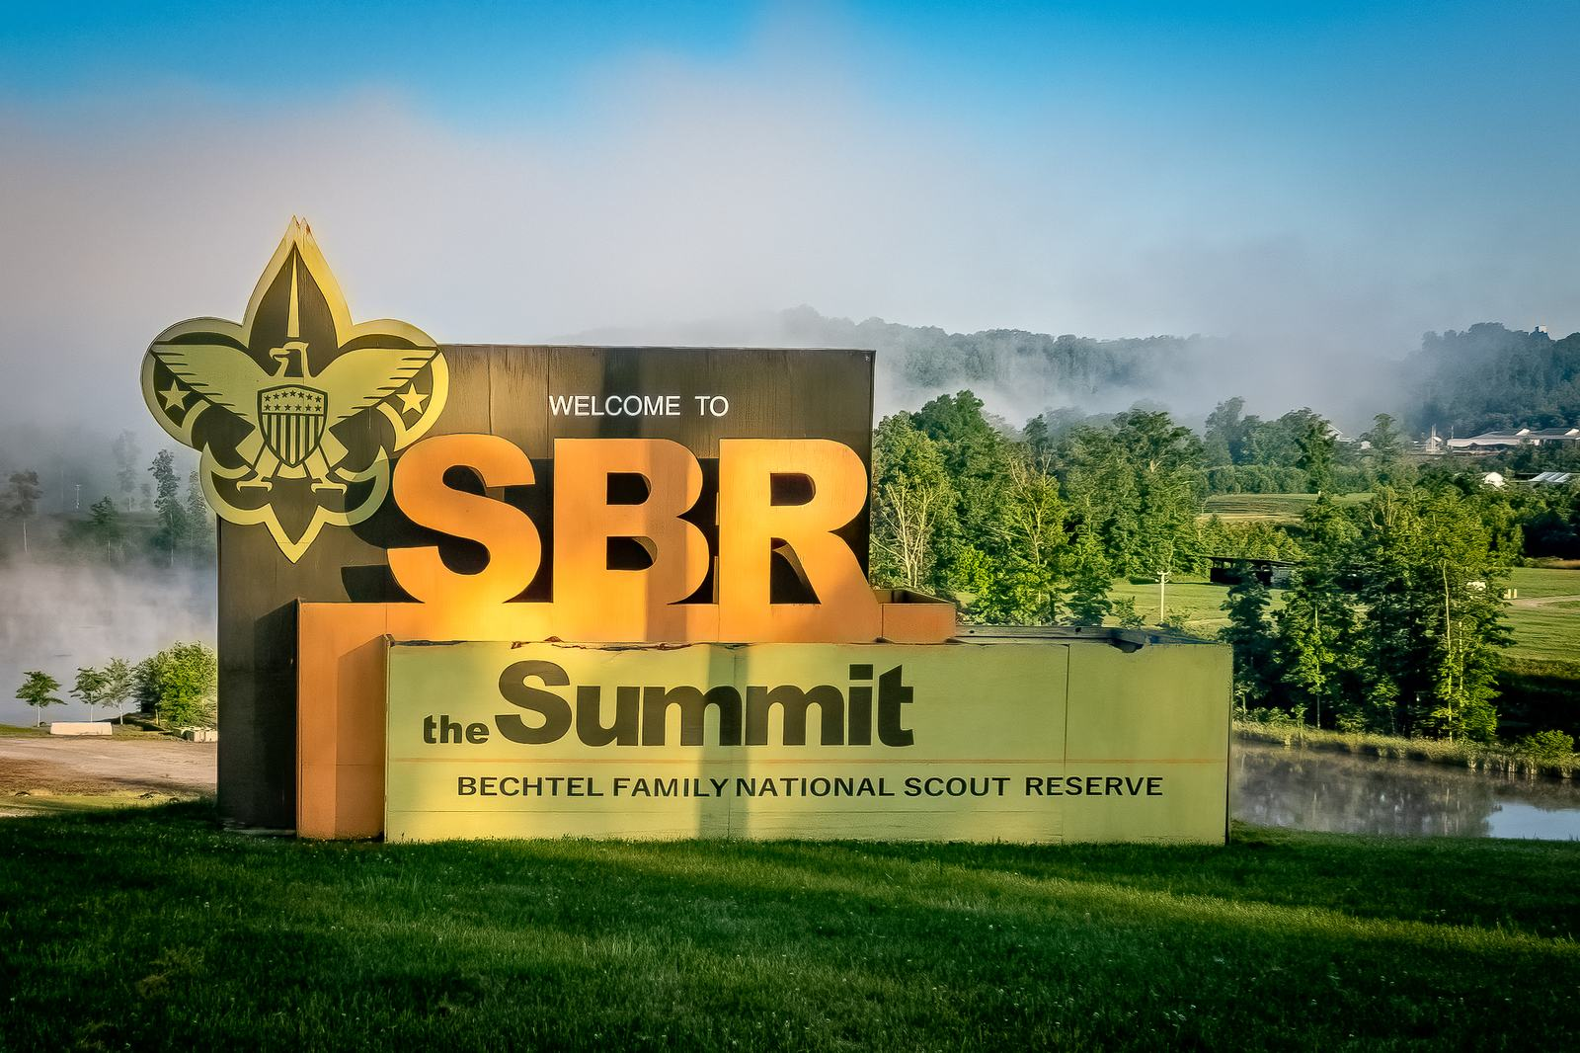
Adventure. Service. Leadership. Sustainability.

Slide 9
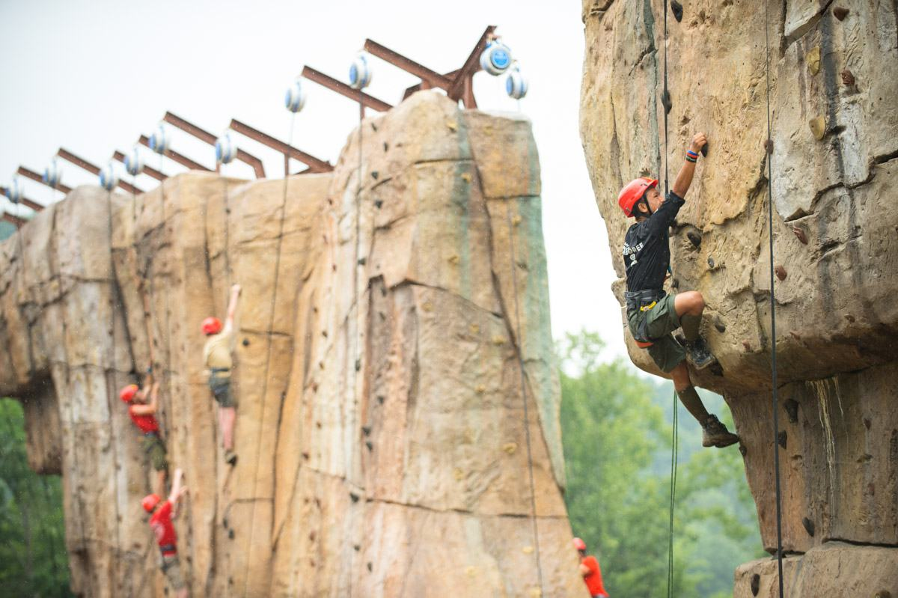

Slide 10
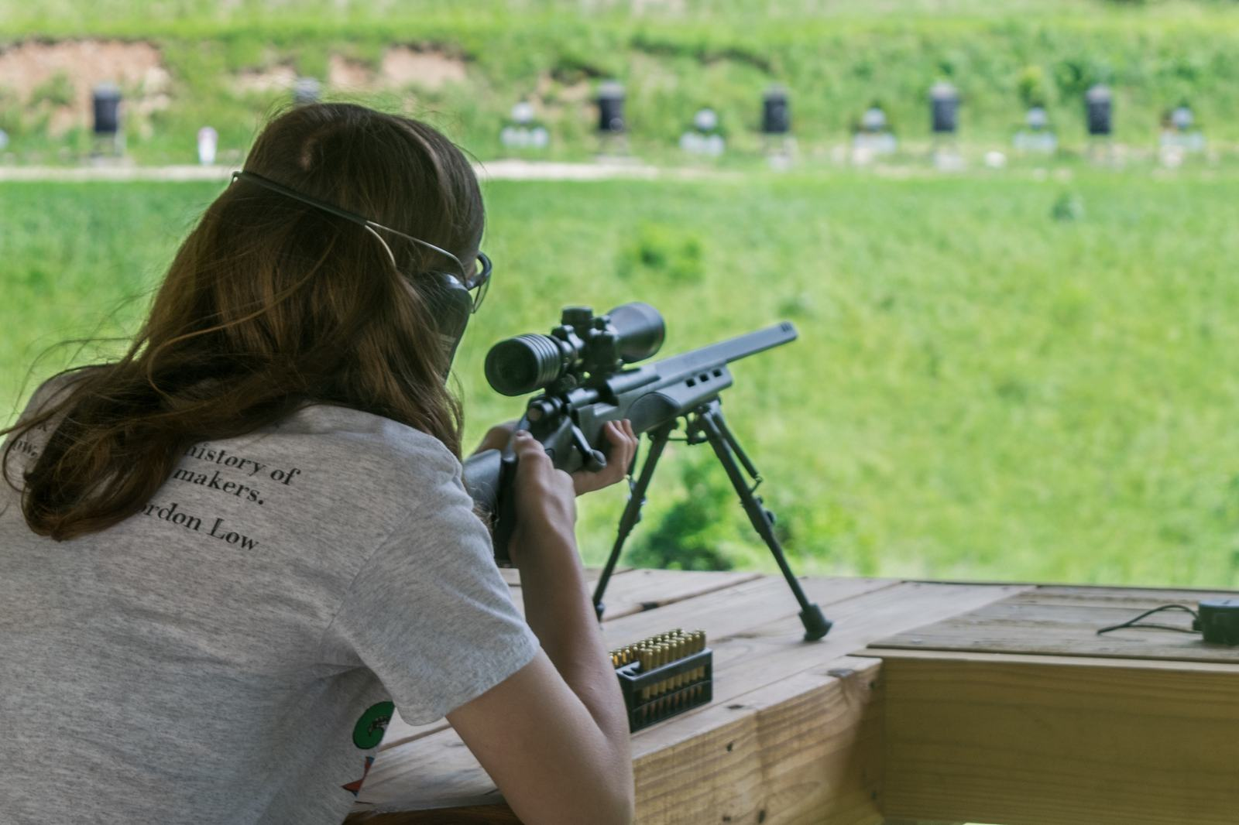

Slide 11
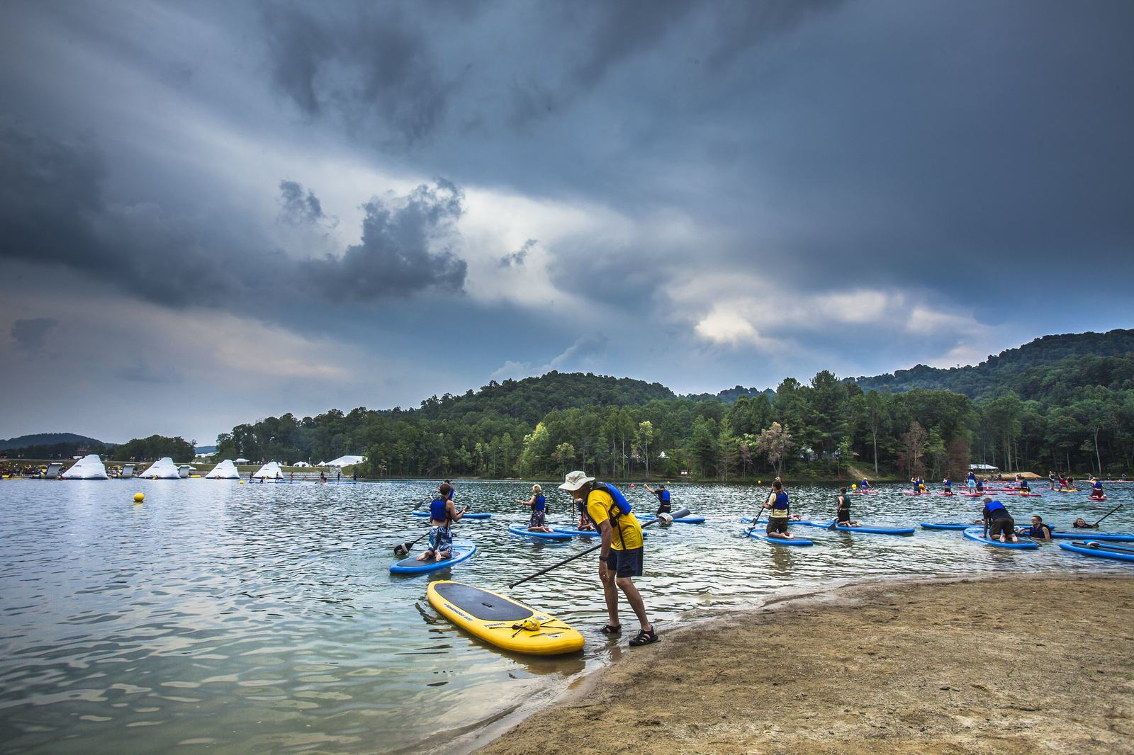

Slide 12
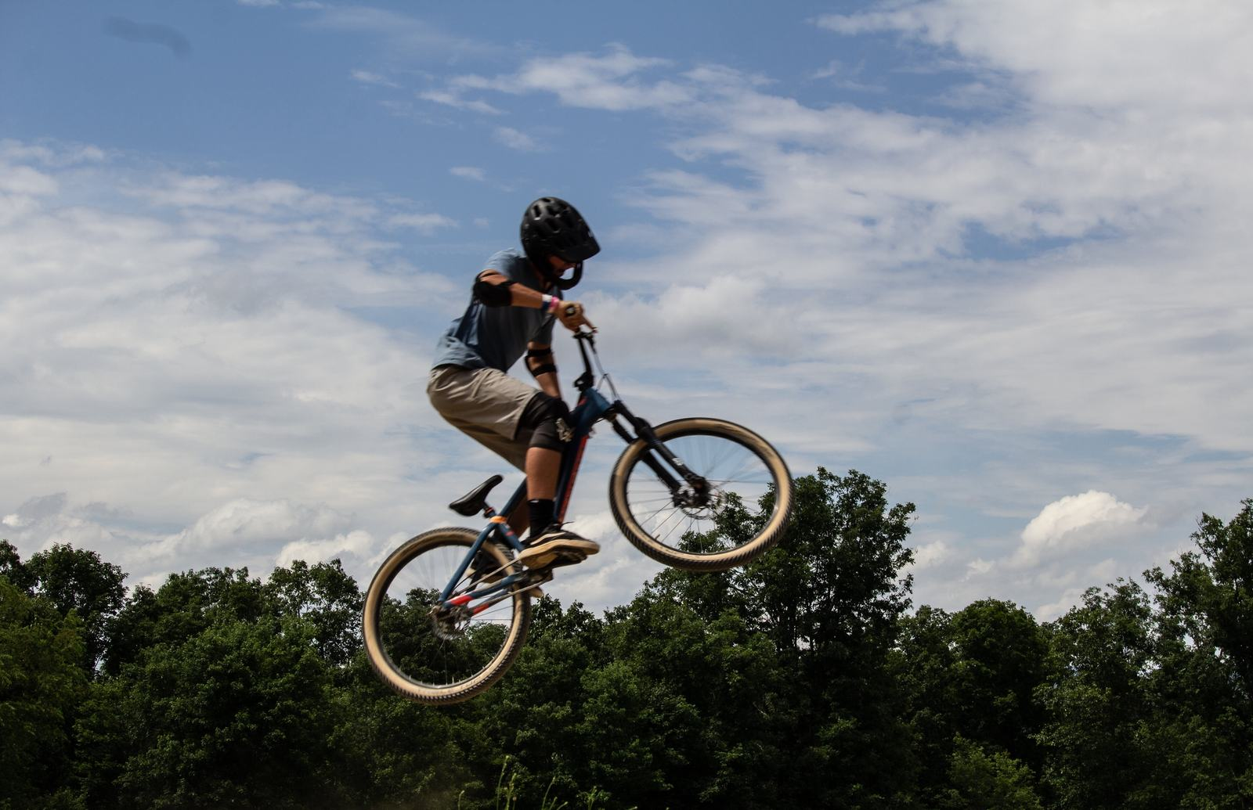

Slide 13
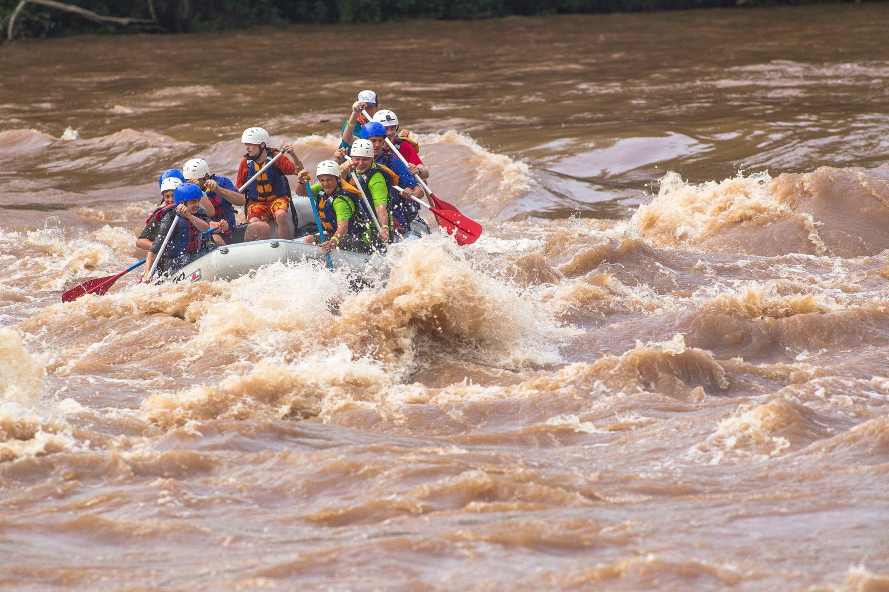

Slide 14
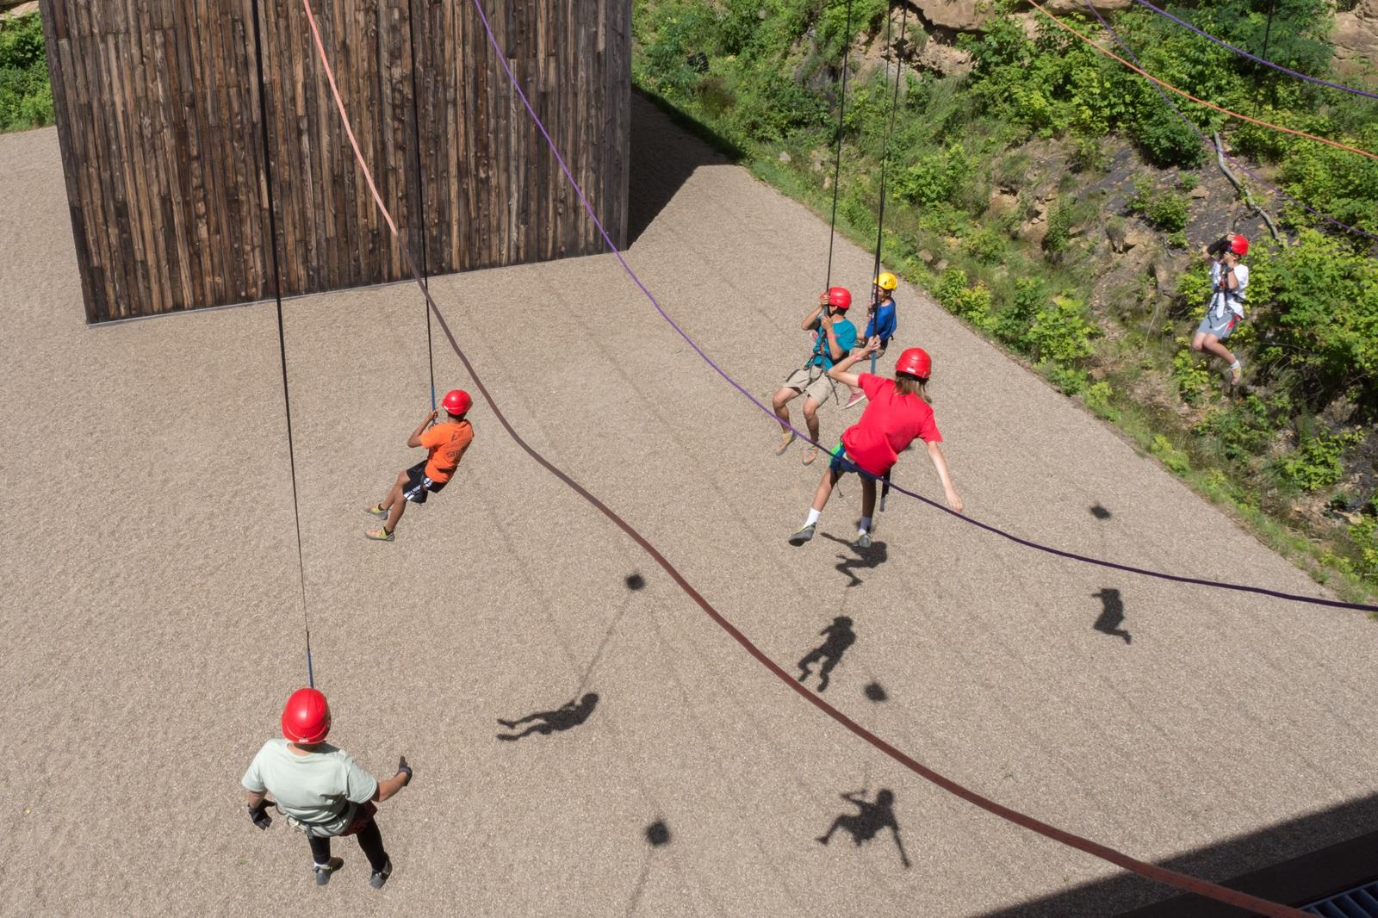

Slide 15
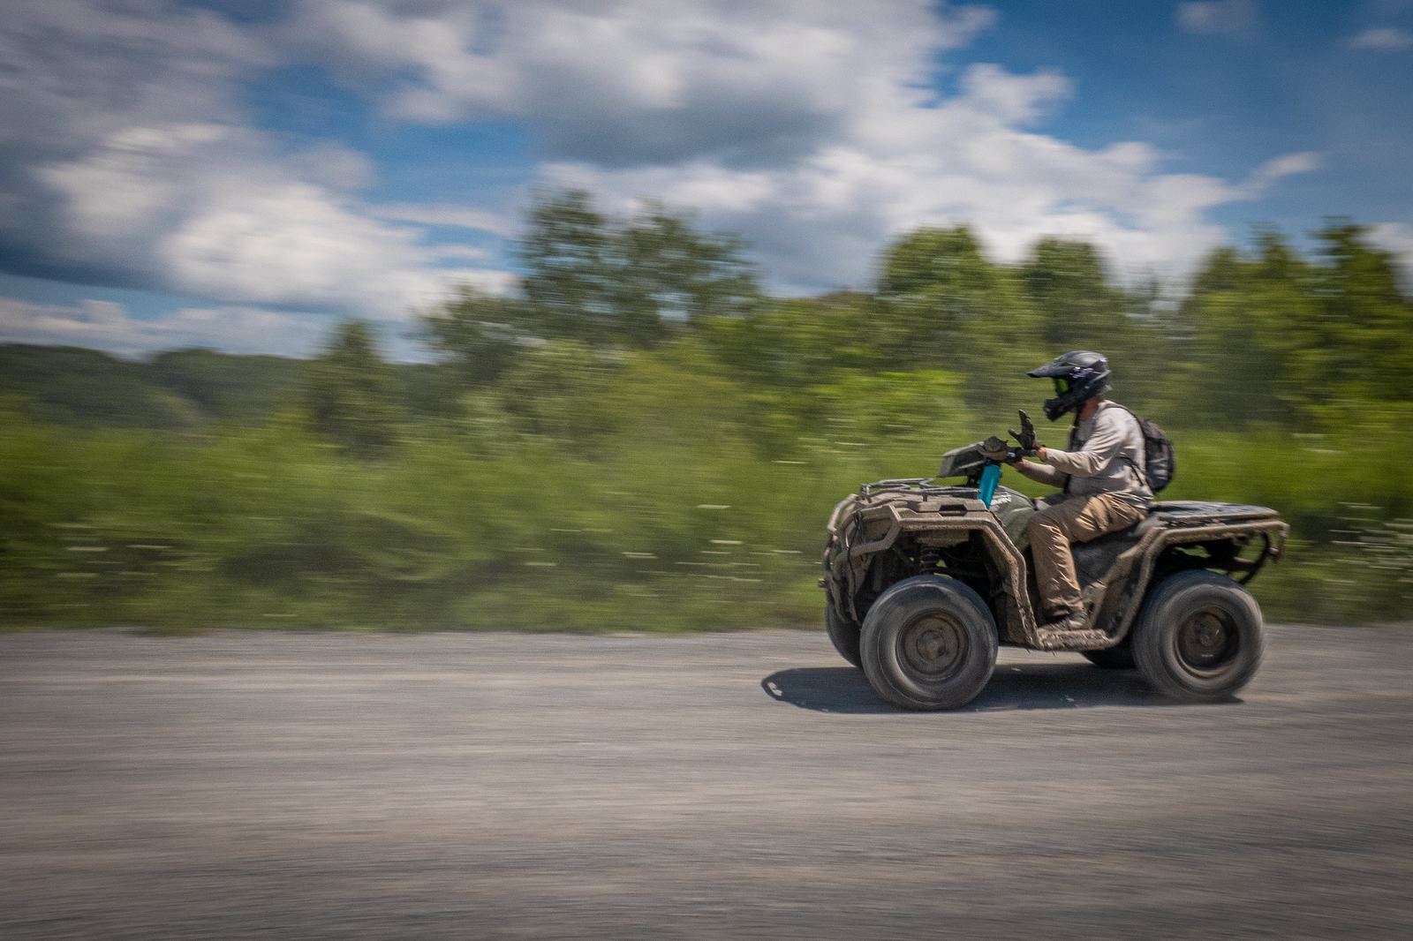

Slide 16
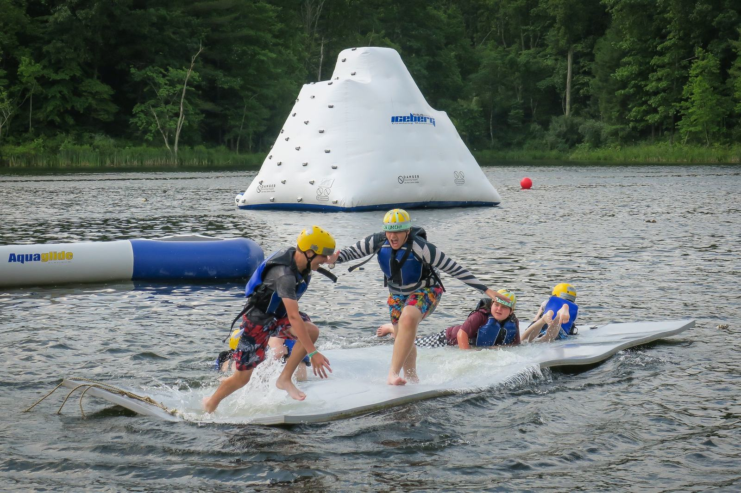

Slide 17
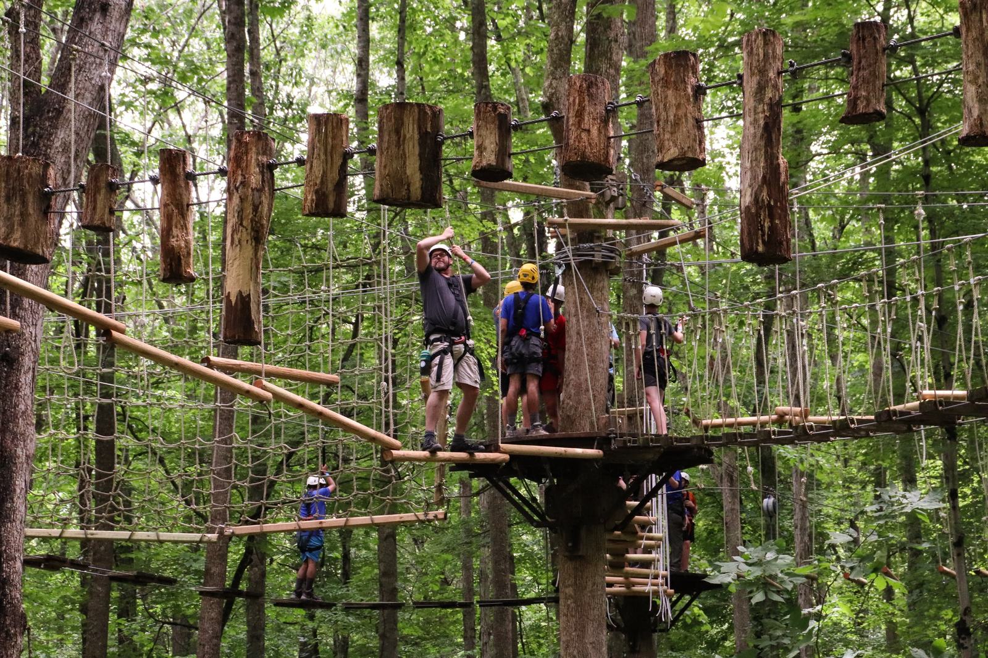

Slide 18
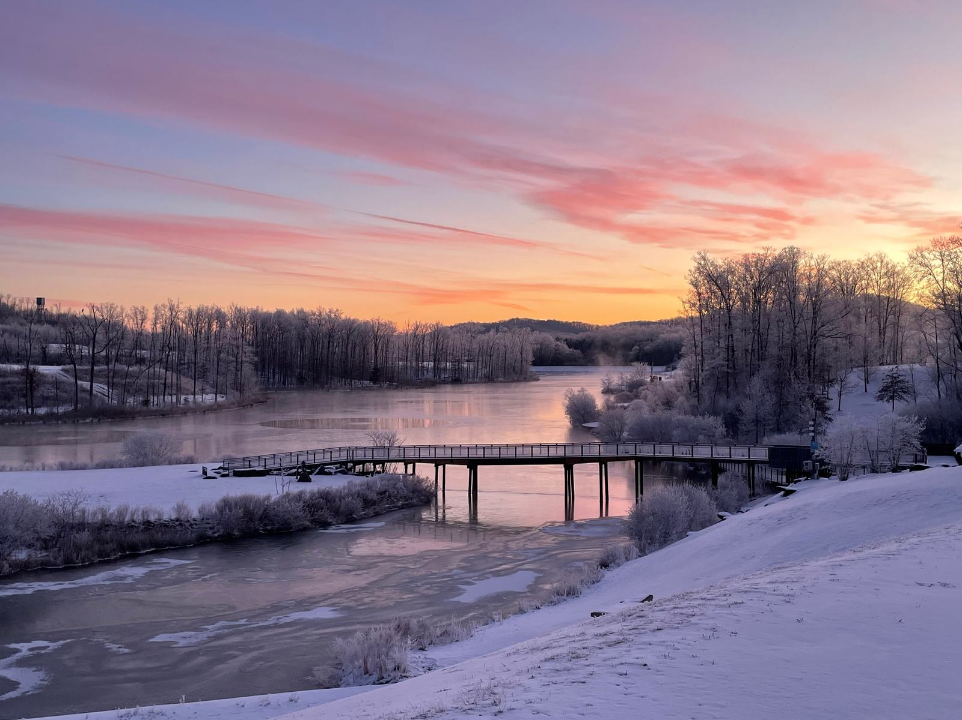

Slide 19
Where is the Summit?

Slide 20
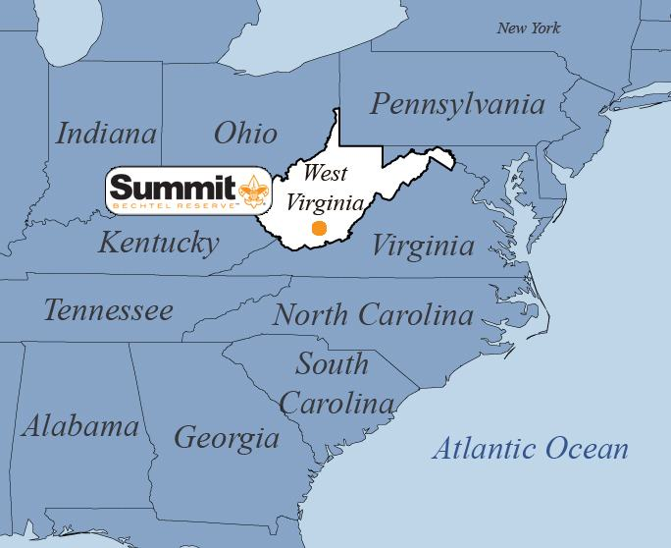

Slide 21
How big is the Summit?

Slide 22
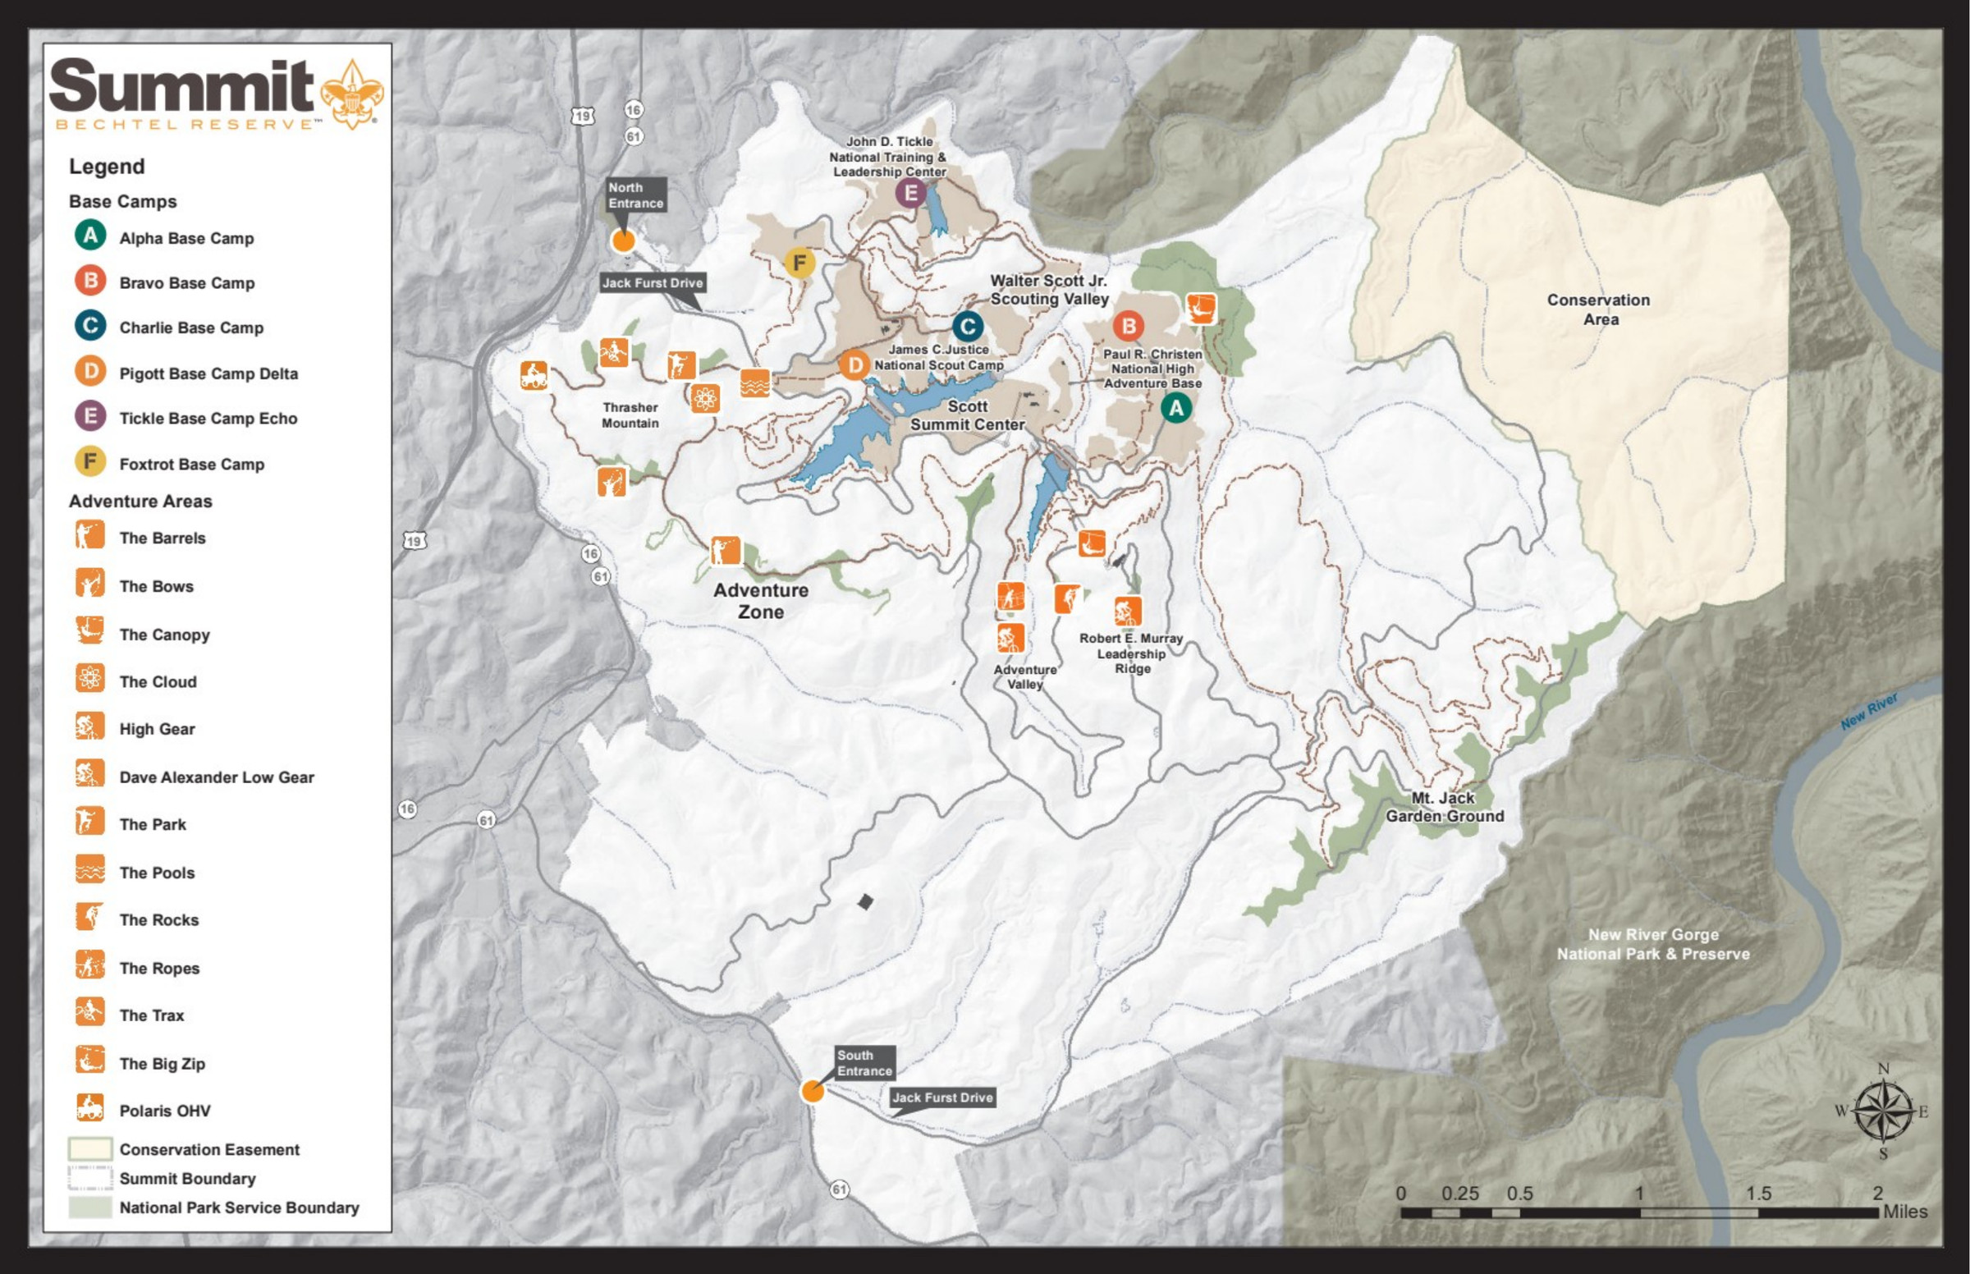
10,600 acres on the main site
+
More than 4,000 acres in the area!

Slide 23
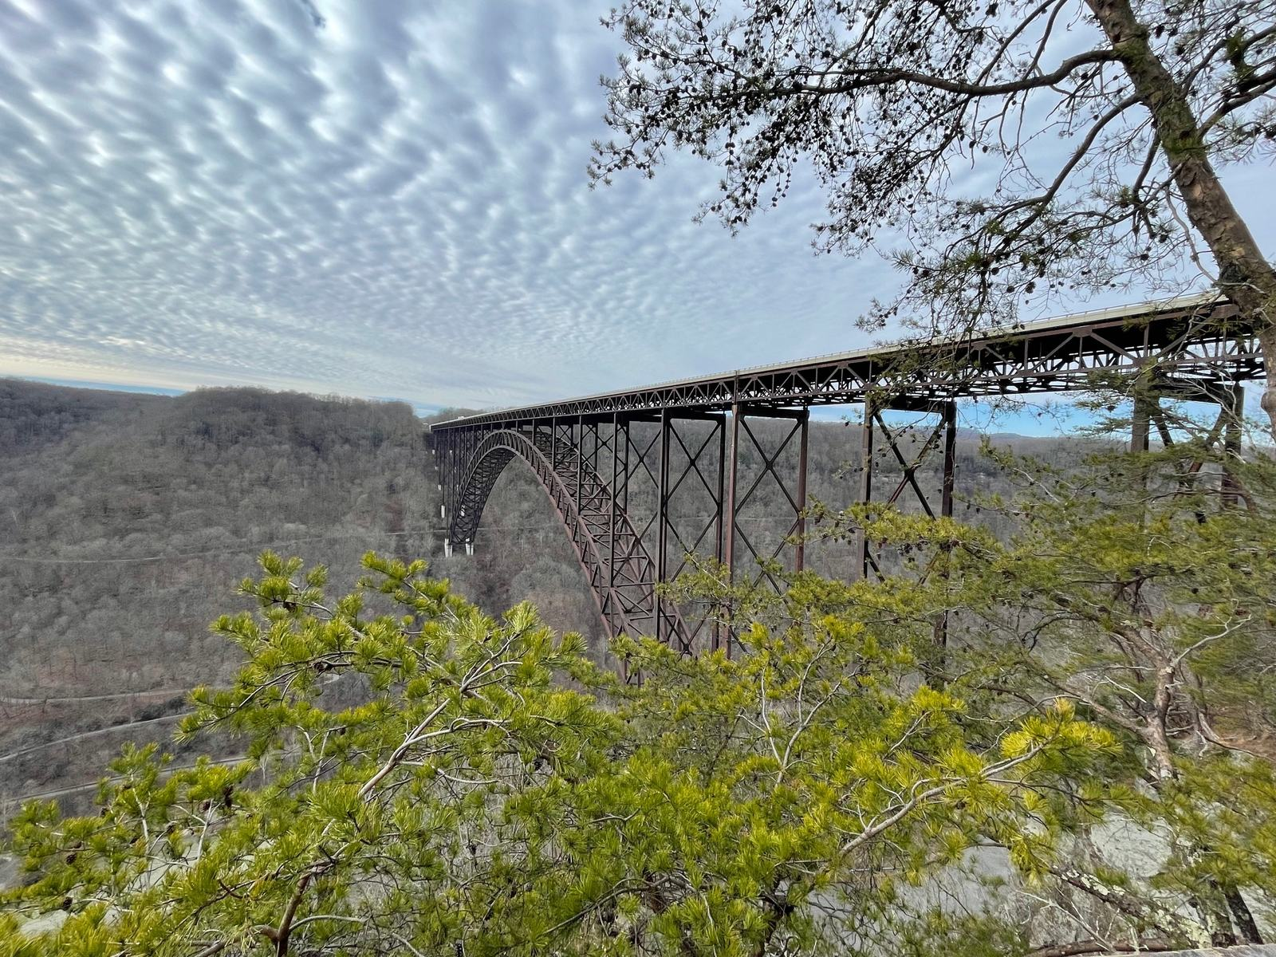

Slide 24
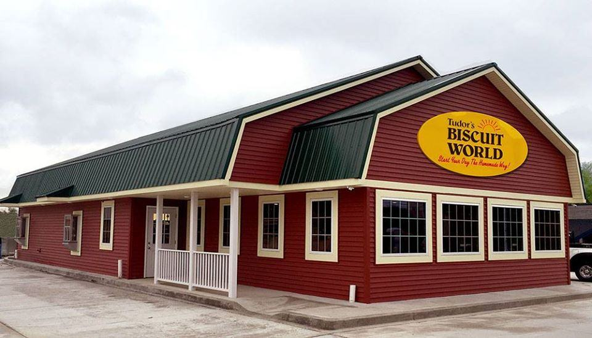

Slide 25
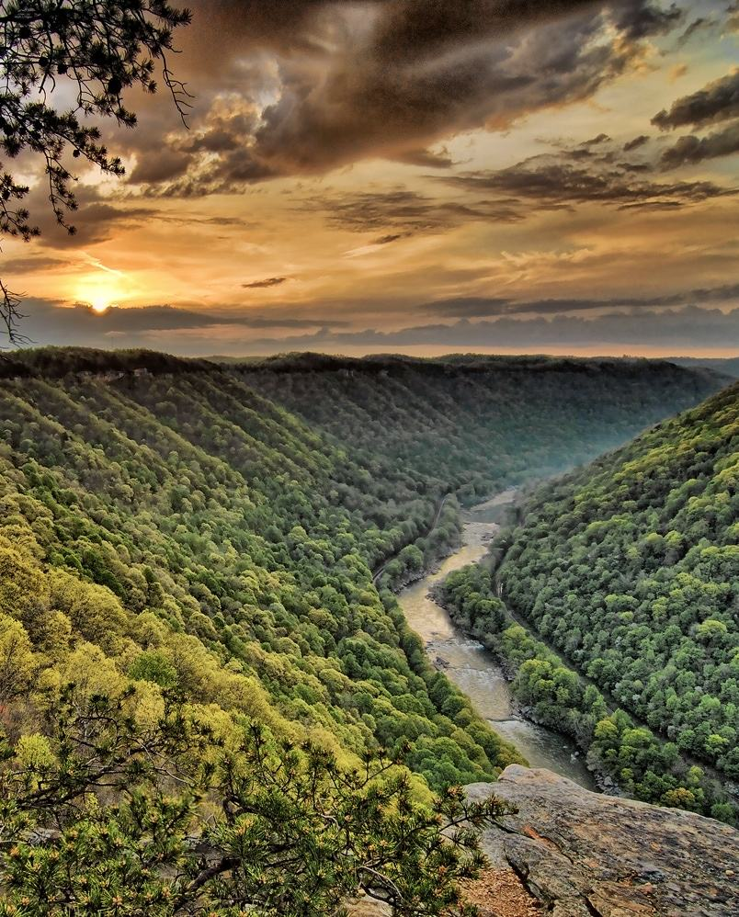

Slide 26
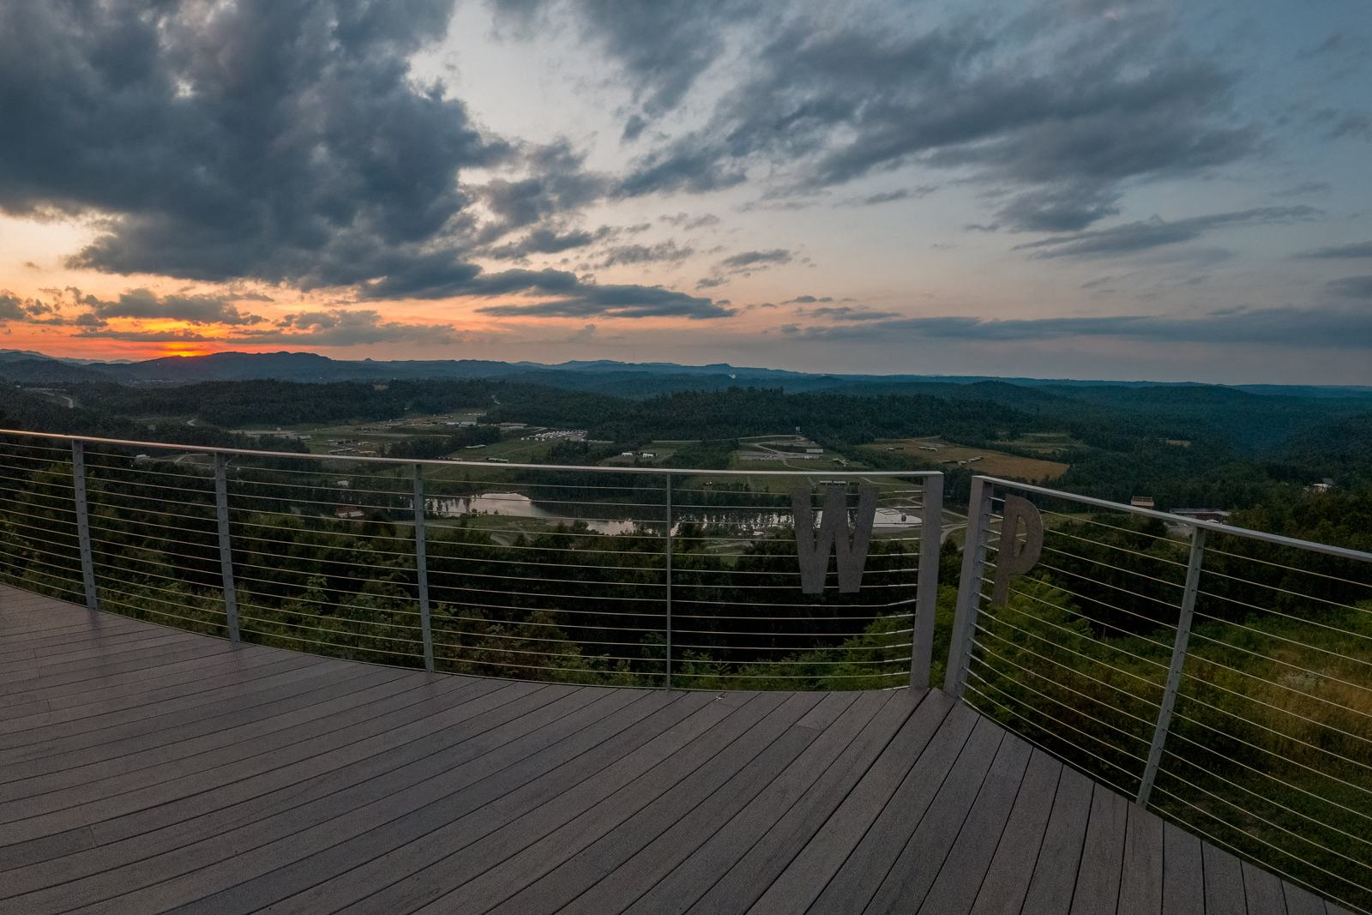

Slide 27
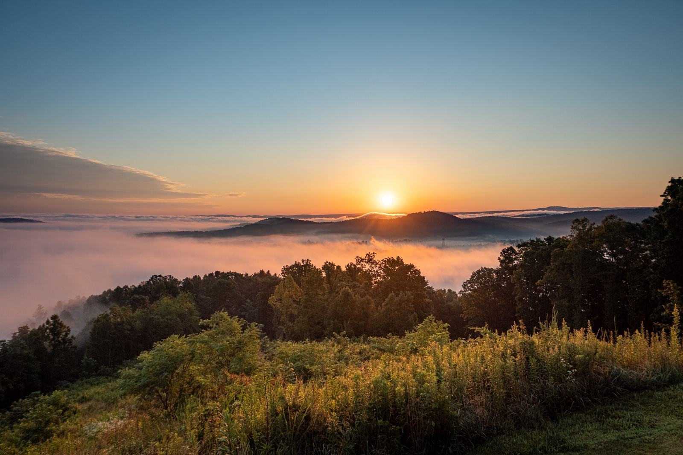

Slide 28
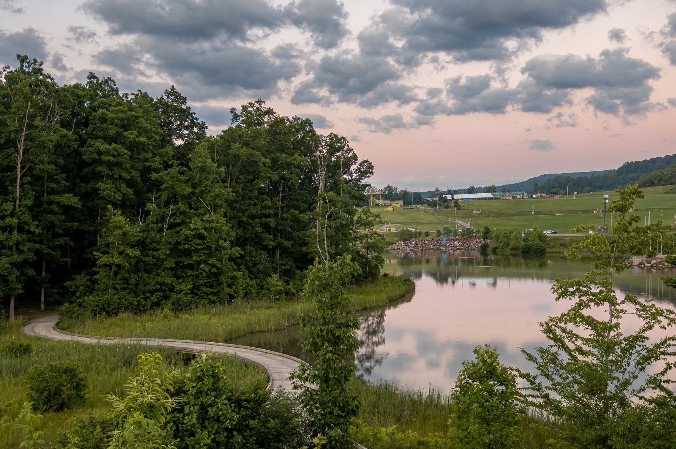

Slide 29
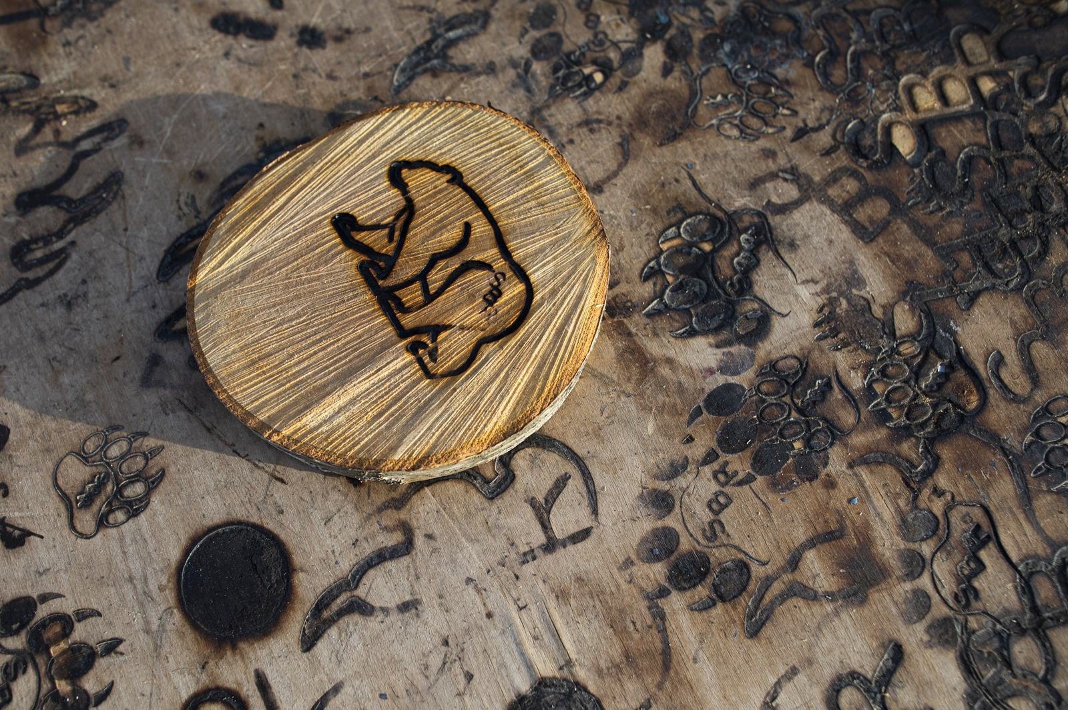

Slide 30
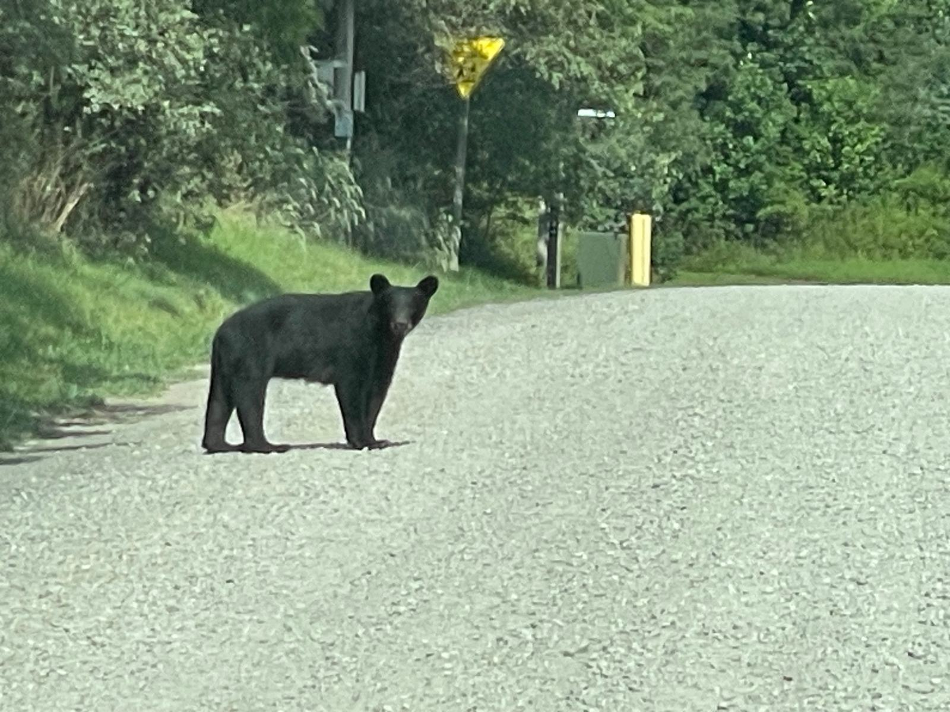

Slide 31
Summer Camp at the Summit

Slide 32
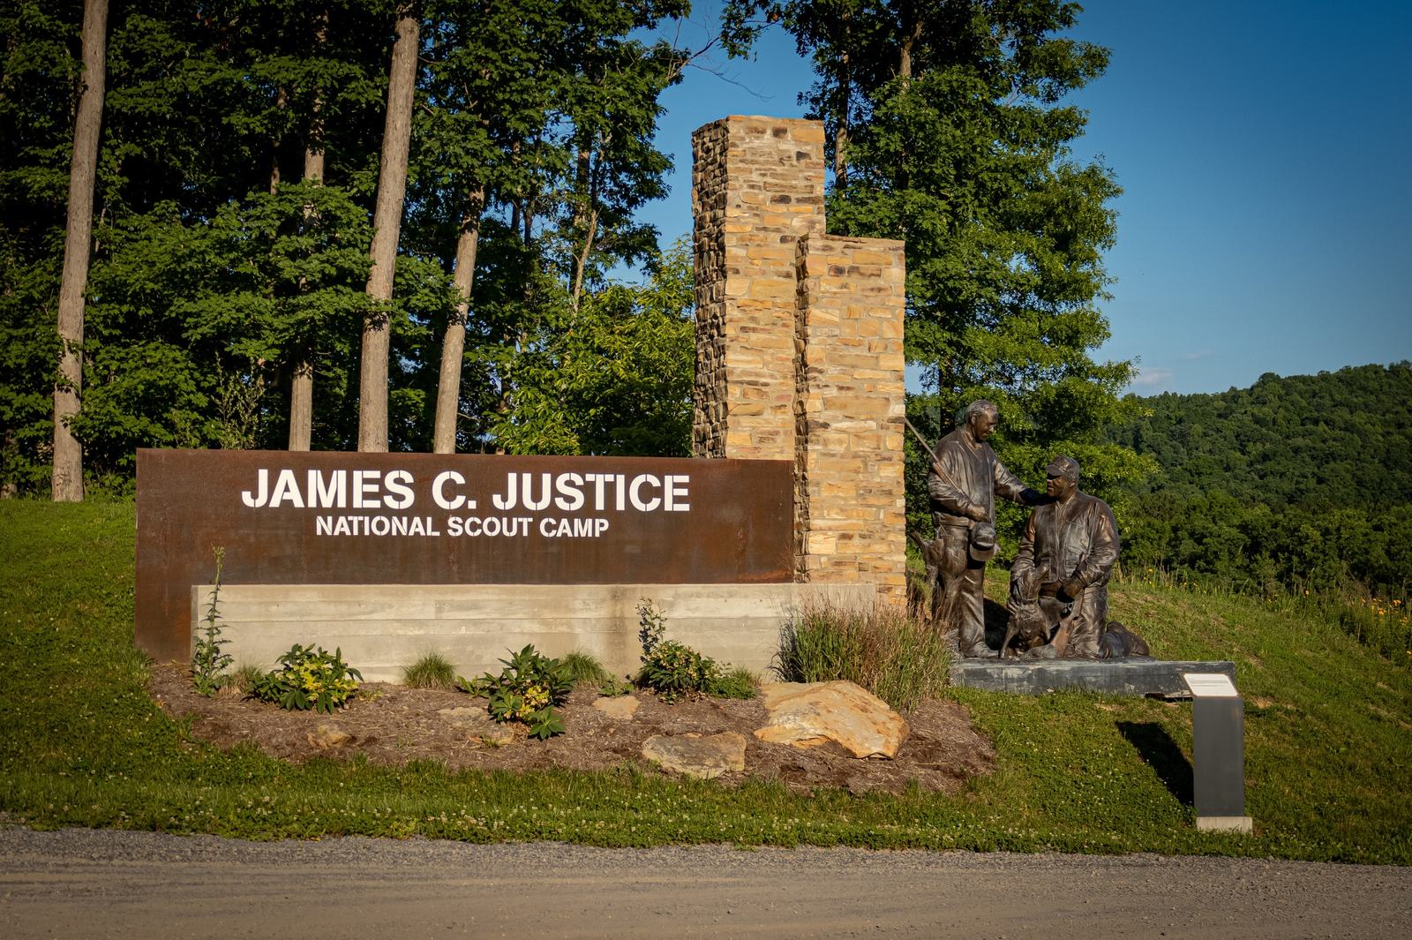

Slide 33
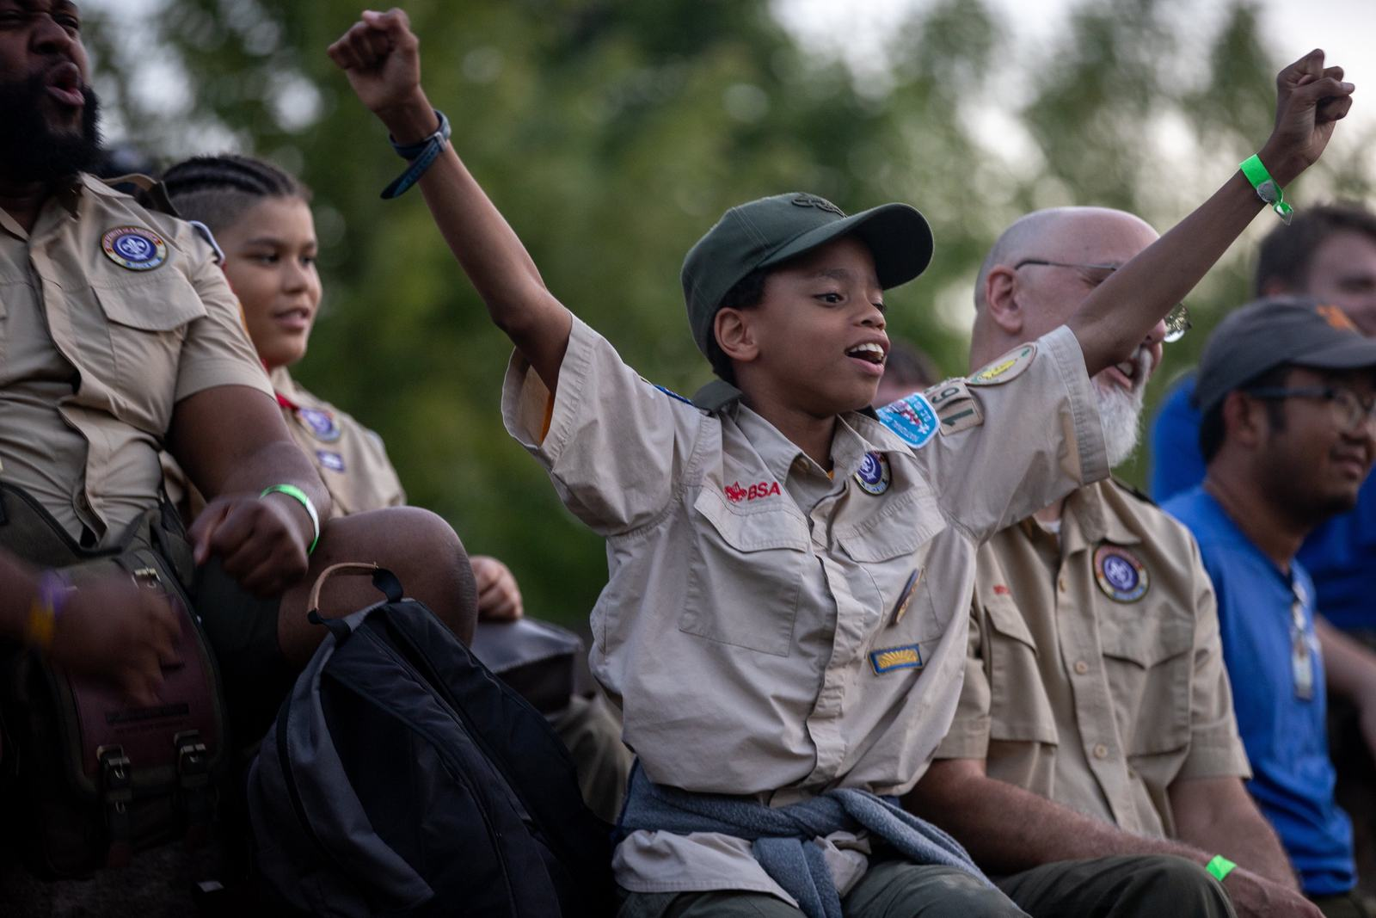

Slide 34
James C. Justice National Scout Camp
The James C. Justice National Scout Camp offers a robust Scout summer camp experience, primarily focused on advancement and enrichment
More than eighty merit badges are offered, across an array of program areas
Traditional programs include:
  Scoutcraft/outdoor skills + first-year camper program
  Ecology and conservation
  S.T.E.M. and arts, media, and handicrafts (S.T.E.A.M.)
  Citizenship/vocations
  Aquatics
  C.O.P.E. and climbing

Slide 35
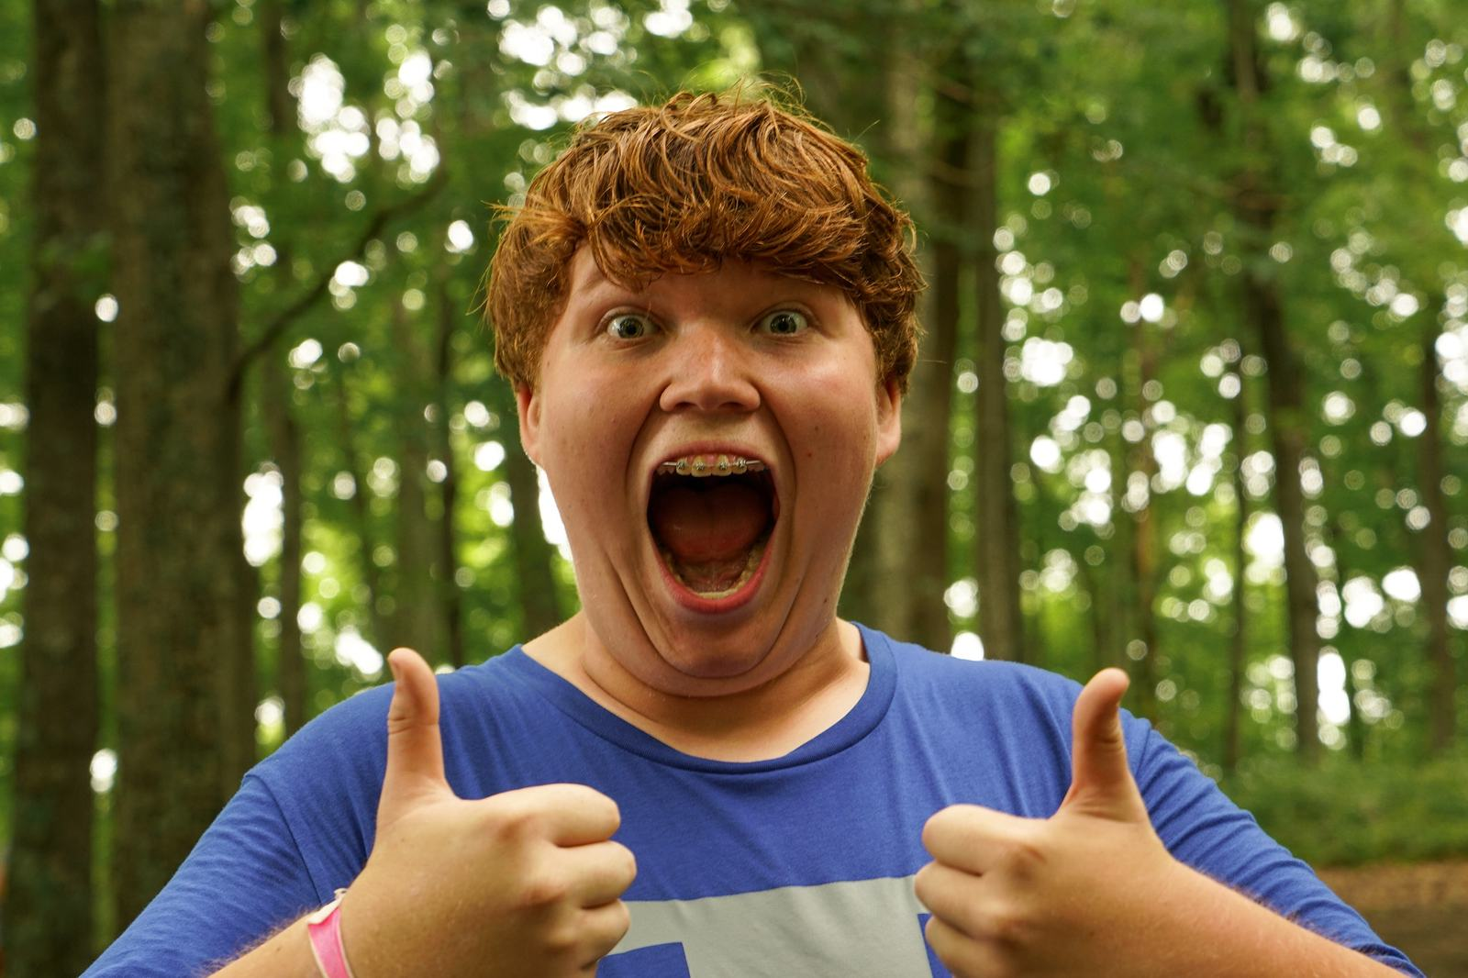

Slide 36
High-adventure Buy-up Programs
Scout camp participants have access to a variety of adventure-sports program venues and opportunities, including
  Alexander’s Eagle Flight (the Big Zip)
  Aerial sports (the Rocks, Alexander’s Eagle Flight, Action Point Canopy)
  Target sports at Bows and Barrels
  Skateboarding and B.M.X. at the Park and the Trax, on Thrasher Mountain
  Whitewater rafting on the New River (half-day program or merit badge)

Slide 37
Why Summer Camp at the Summit?
Summer camp at the James C. Justice National Scout Camp at the Summit is unlike any other
Huge menu of merit badge options from which to choose
Excellent first-year camper (Brownsea Island) program
Quality instruction provided by trained Scouters (eighteen or older)
Amazing high-adventure opportunities available through buy-up programs or available to participants throughout the week

Slide 38
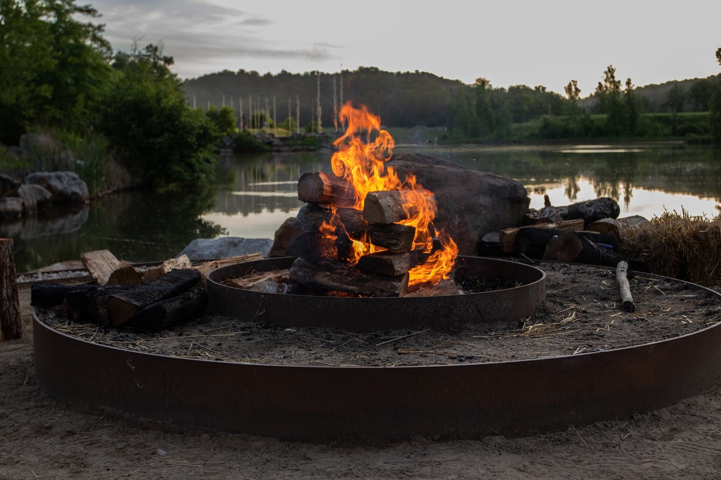

Slide 39
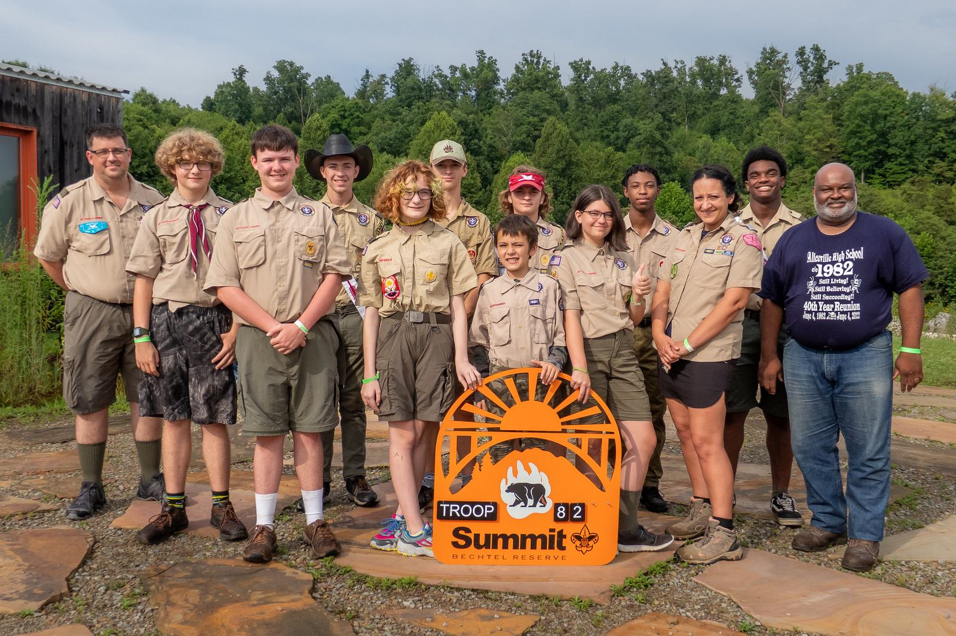

Slide 40
We own adventure!

Slide 41
High-adventure Programs
The Summit offers six different high-adventure programs, each of which focus on challenging outdoor adventure, application of Scout skills, fun and joy, and celebrating success
  Summit Experience (the high-adventure buffet—try everything!)
  New River Experience (rafting and river)
  Polaris A.T.V. Experience (Who doesn’t love A.T.V.s?)
  Marksman Experience (target sports emphasis)
  Pack n’ Paddle Experience (hiking and rafting)

Slide 42
Summit Experience
Includes all onsite high-adventure activities
  Aerial sports at the Rocks (climbing, rappelling, Leap of Faith)
  Big Zip (Alexander’s Eagle Flight)
  Canopy zipline tour
  Hunter education and laser shot
  Mountain biking
  Static, long-distance, target, and action archery
  Shotgun and rifle (.22, .223, .308)
  Skateboarding
  BMX
  Whitewater rafting
  Onsite aquatics

Slide 43
New River Experience
Fifty-mile paddle trek on the New River
Navigate the upper portion of the river in inflatable kayaks called “duckies”
  This portion of the river includes Class I to III rapids
The final whitewater day in the Lower Canyon is a rafting experience
  Includes Class III to IV rapids
Crews camp along the river through the New River Gorge
A gear boat (raft) accompanies the group to transport gear and food
Includes a ride on the Big Zip (Alexander’s Eagle Flight)
2026 (limited) and 2027 availability!

Slide 44
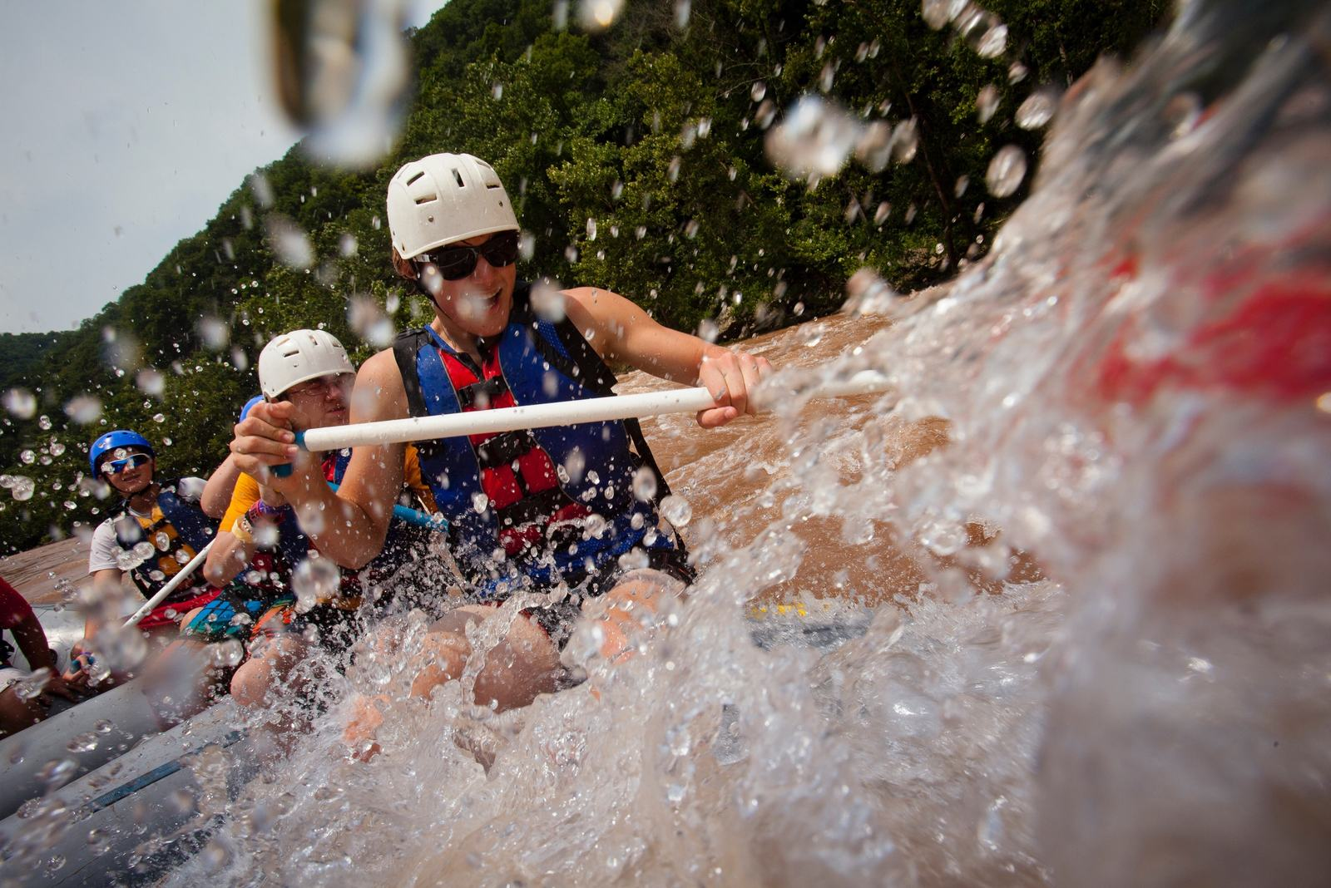

Slide 45
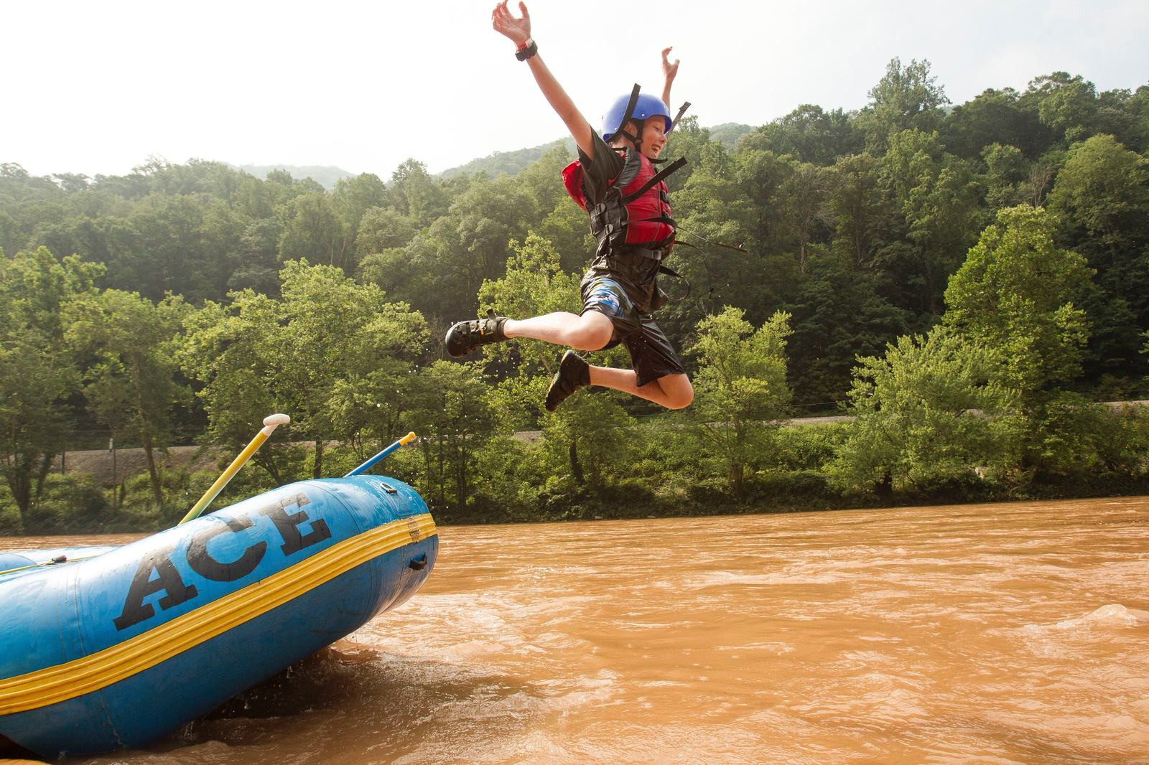

Slide 46
Polaris A.T.V. Experience
Sixty-mile, onsite A.T.V. trek
Includes A.S.I. training and extensive safety and handling instruction
Single-track, double-track, and gravel trails
Maintenance and repair training
Whitewater rafting
Alexander’s Eagle Flight (Big Zip)
2026 (limited) and 2027 (limited) availability!

Slide 47
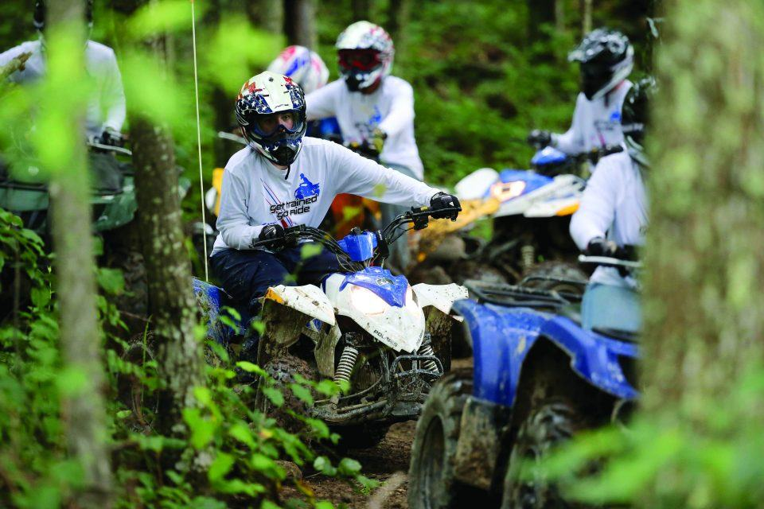

Slide 48
Marksman Experience
Five-stand shotgun
Sporting clays
.22 pistol, 9mm pistol
.22, .223, .308 rifle
.224 Valkyrie on thousand-yard range
Whitewater rafting
Alexander’s Eagle Flight (Big Zip)
2026 and 2027 availability!

Slide 49
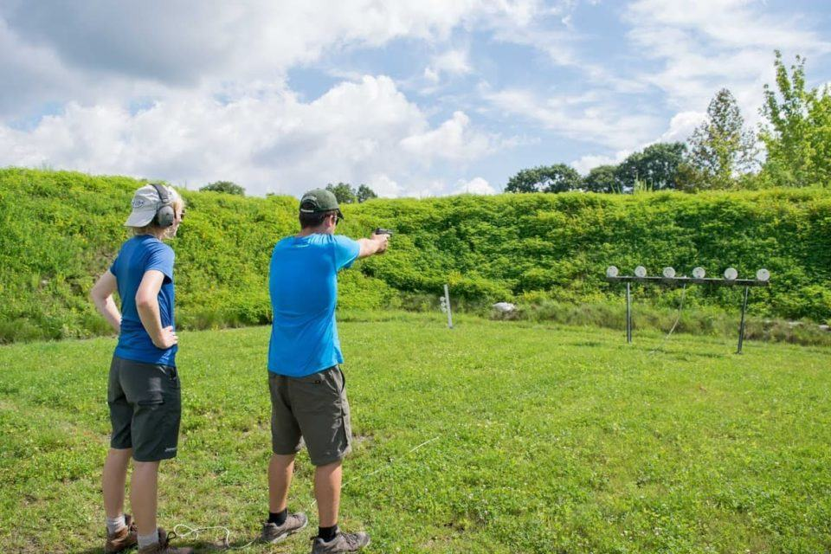

Slide 50
Pack n’ Paddle Experience
Forty-plus miles of hiking
  Introductory backpacking techniques
  Historical interpretation
  Walk through local history of southern West Virginia
Whitewater rafting
Opportunities for development and experience
  Teambuilding experiences
  Leave No Trace training and application
Alexander’s Eagle Flight (Big Zip)
2026 and 2027 availability!

Slide 51
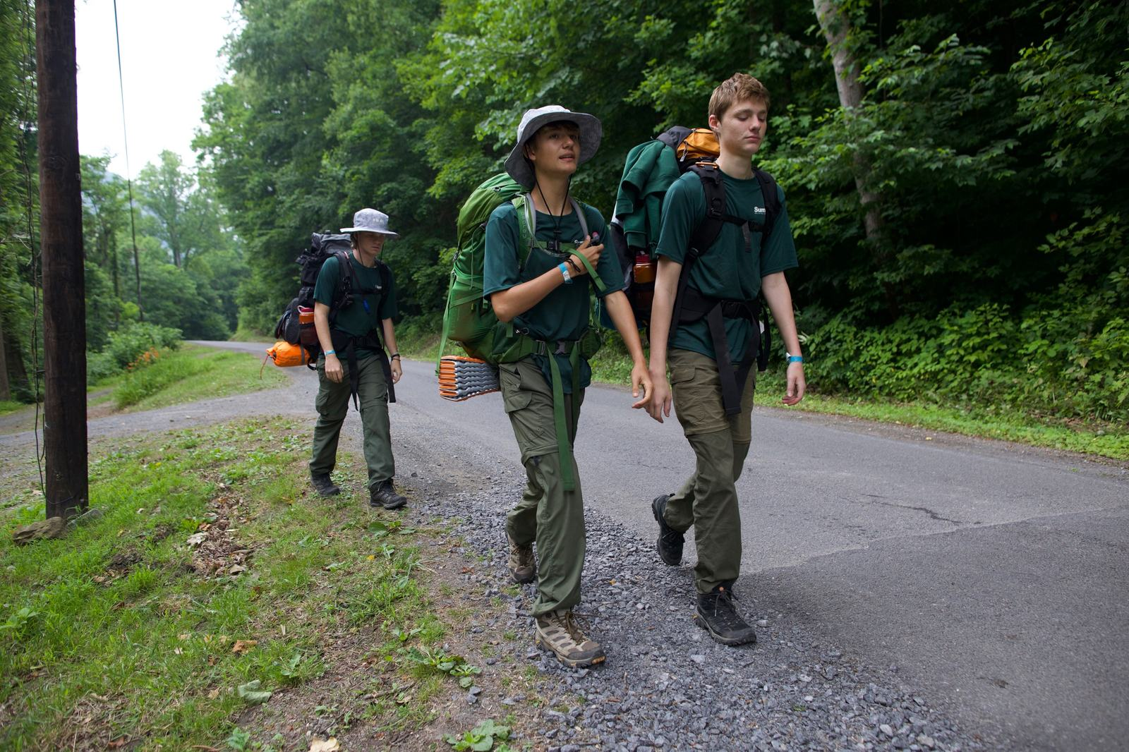

Slide 52
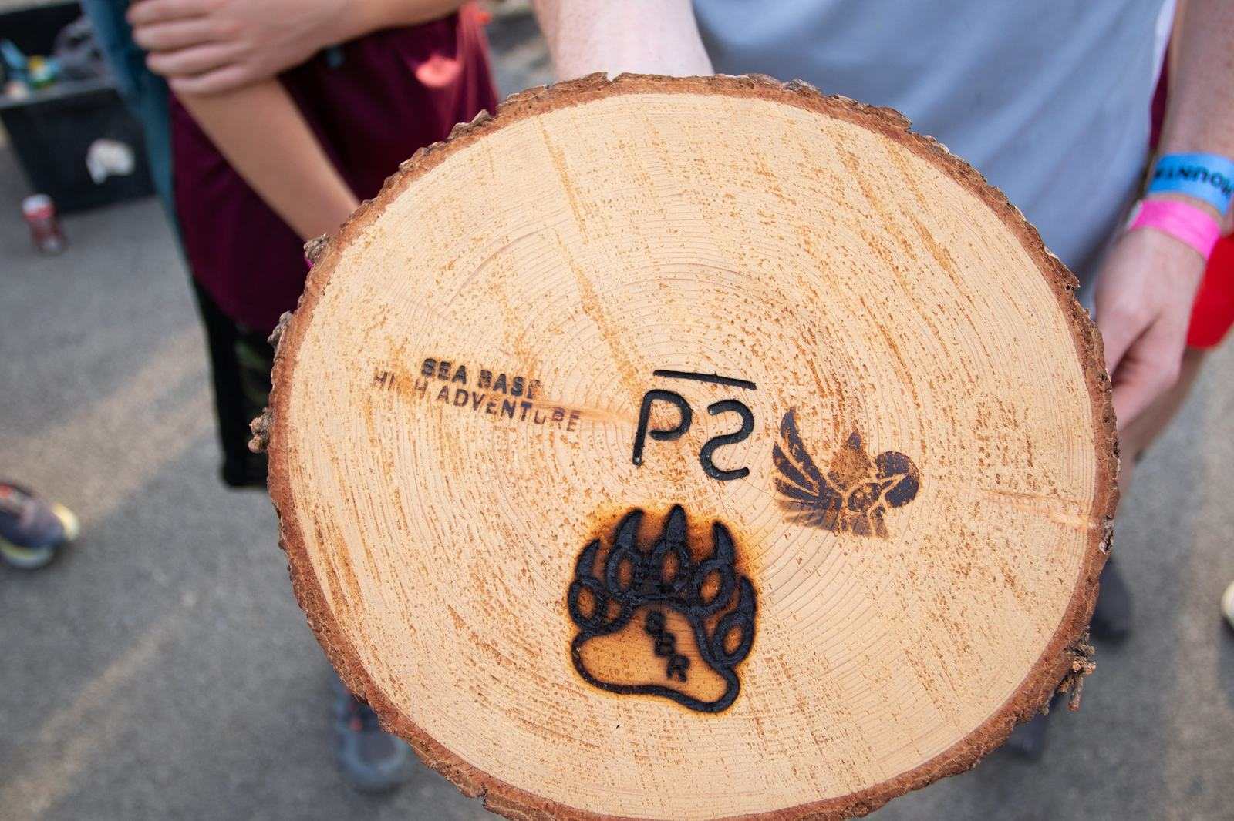

Slide 53
Evening Programs (open to all)
Appalachian Celebration (camp-wide program each Monday night)
Legacy and Gateway Zips
Laser shot in the Crafton Skills Center
Boulder Cove (climbing)
Boating and swimming (Goodrich Lake West)
Skateboarding
BMX
Mountain biking
Variety of Scout camp-specific open programs

Slide 54
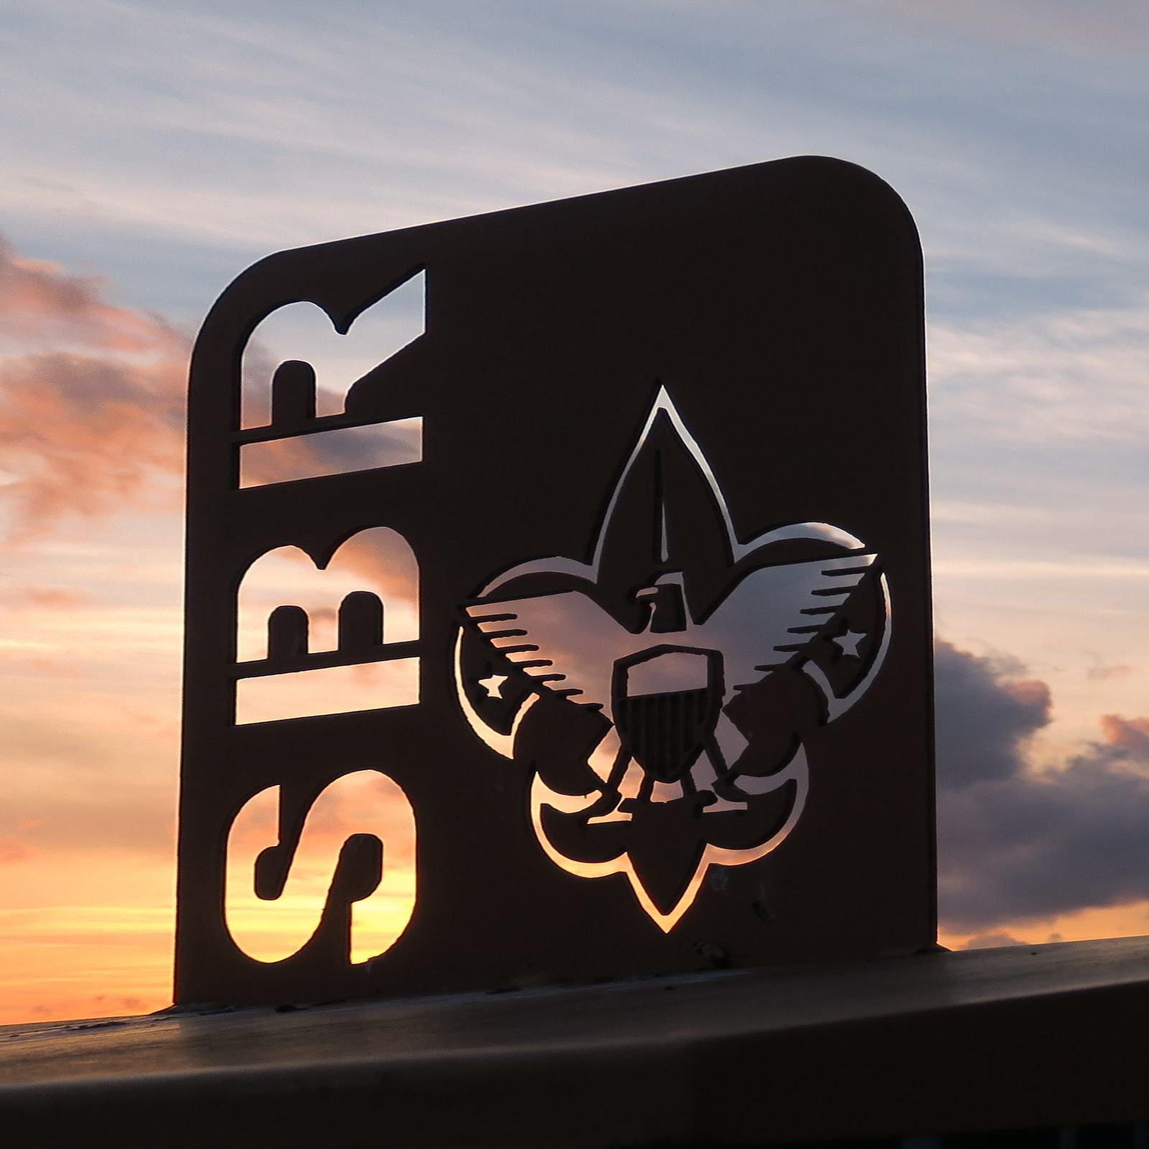

Slide 55
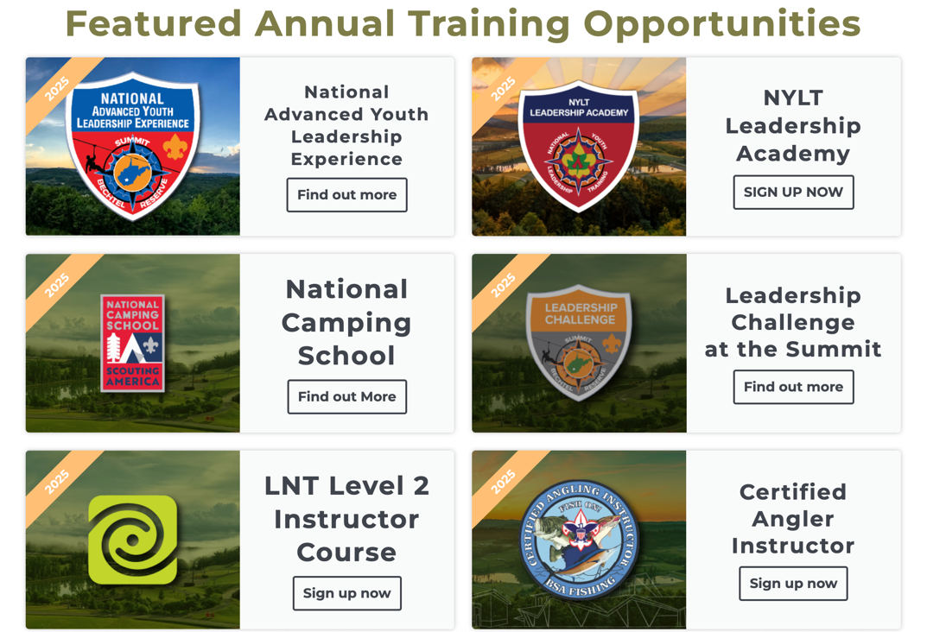
Other Amazing Opportunities
Trainings for youth and adults
  National Advanced Youth Leadership Experience (N.A.Y.L.E.)
  Leave No Trace Level II Trainer
  Certified Angler Instructor
  Linked Wood Badge Course
  Many others!
  Visit www.summitbsa.org/training to learn more about training
Have your next wedding, meeting, or conference at the Summit!
  Visit www.summiteventswv.com to learn about the many options

Slide 56
Summit Staff—Best Job Ever!
The Summit will welcome more than fifteen thousand guests this summer
To facilitate and support the programs we offer, we hire nearly three hundred seasonal staff members across a variety of program and operational areas
  Program (Scout camp, high adventure)
  Media and marketing
  Hospitality and foodservice
  Registration
Applicants must be eighteen or older
Great pay, housing in summer camp tents, and three hot meals per day provided
Internship credit available

Slide 57
Apply Today!
www.summitbsa.org/jobs

Slide 58
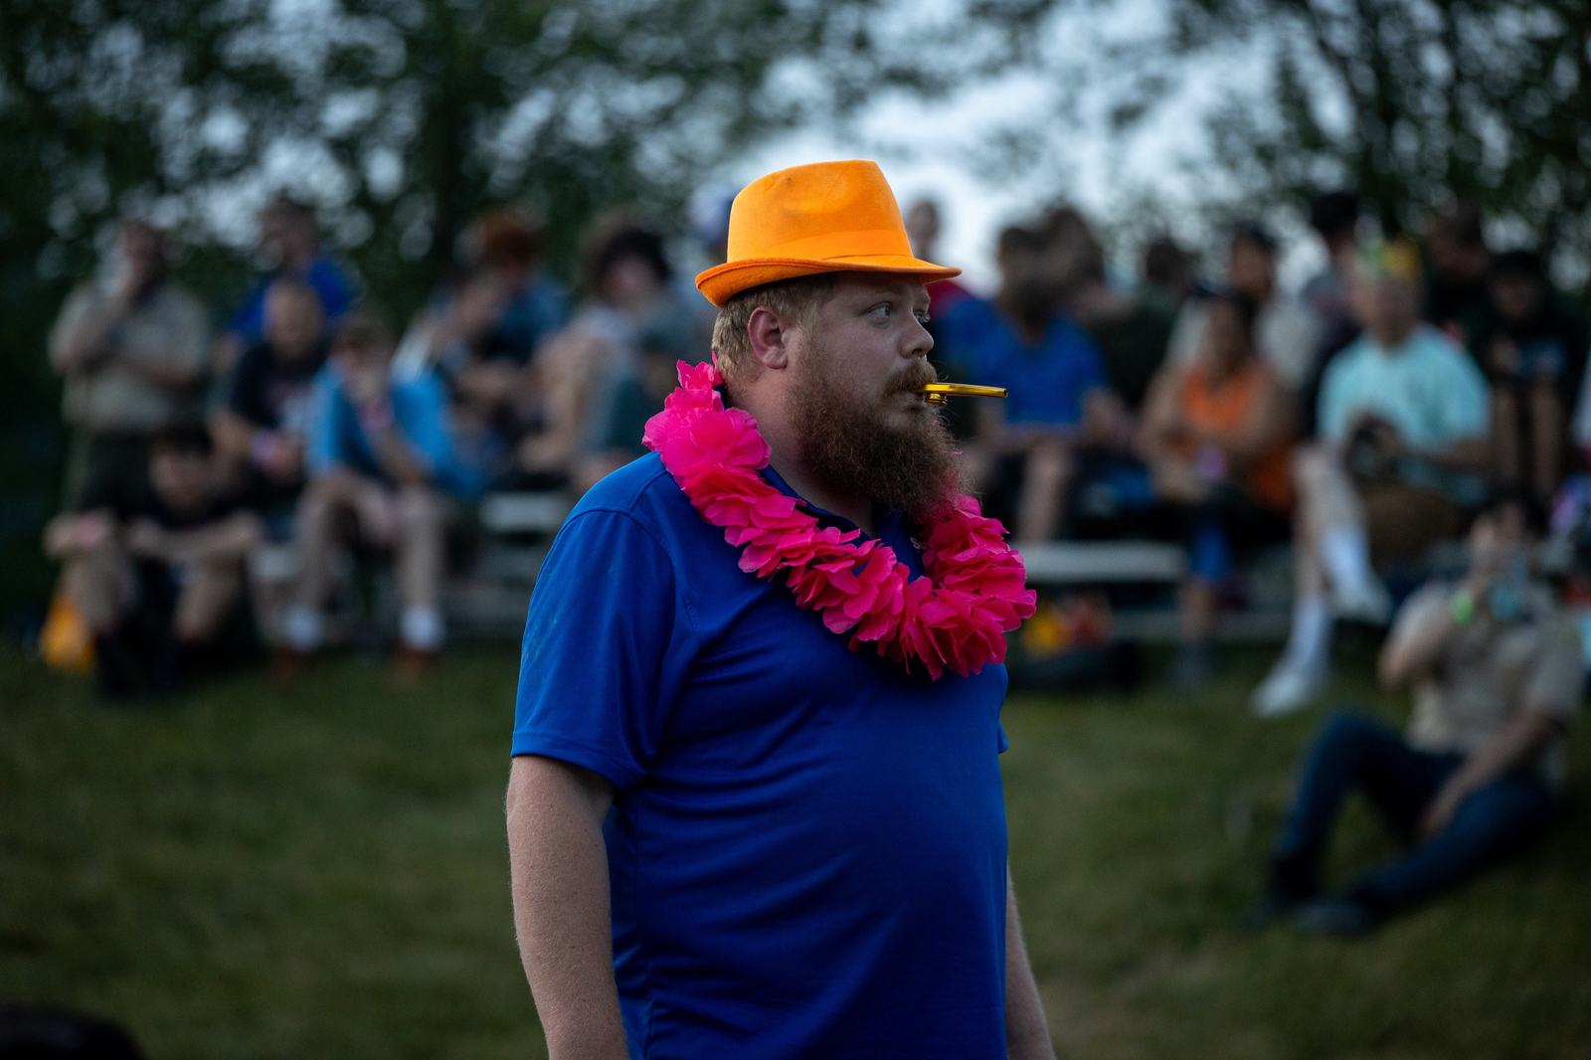

Slide 59
Visit Us/Stay in Touch!
Johnny Tracy, onsite programs/outreach
901-489-6027 (call or text)
Johnny.Tracy@scouting.org
www.summitbsa.org
Our team regularly visits council and district events in numerous councils. We can also visit district roundtables, unit meetings, and other events virtually or in person!

Slide 60
