Slide 1
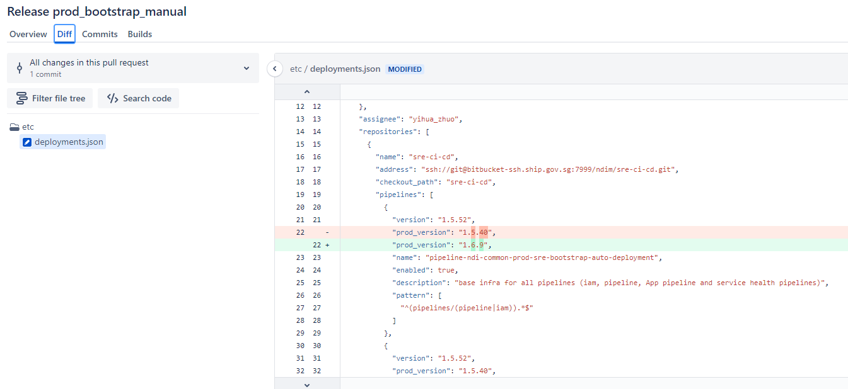
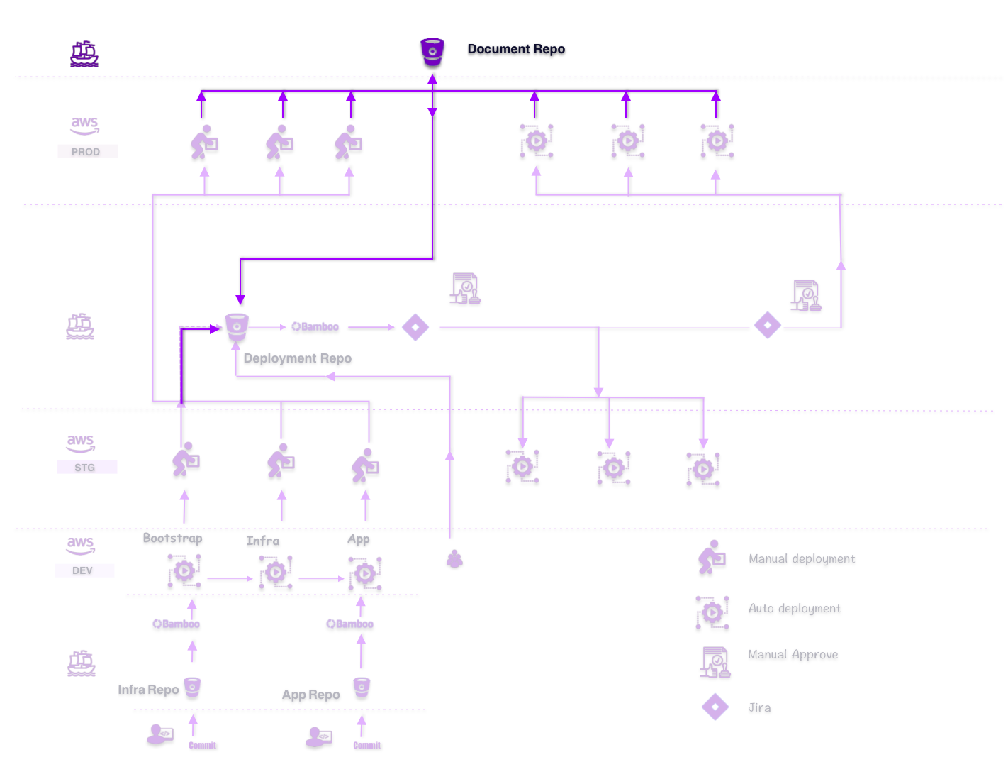
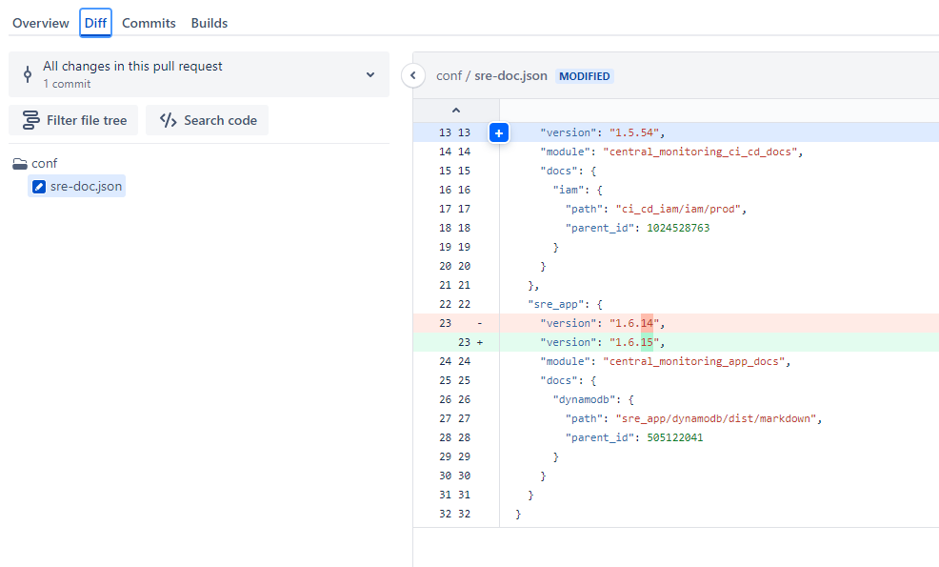
Pipeline enhancement (1)
auto pull request creation after deployment
Benefits
Ensure our documentation is up-to-date
Consistent with deployment version
Notes:
This is the requirement from SecOps to create auto flow to generate hash reports.
Since EDR is not supported on AL2, they request us to create the flow to run script inside instances.
The idea is we create shell script and run it from SSM to ec2 then send the reports to the centralized bucket
The report will show the value of each file path’s hashes in 3 options -
So Secops can easily download and check the report to see the hashes values.
So far we are done testing the script and SSM flow in ndi account and start onboarding the tenants to perform some requirements to include in the flow.

Slide 2
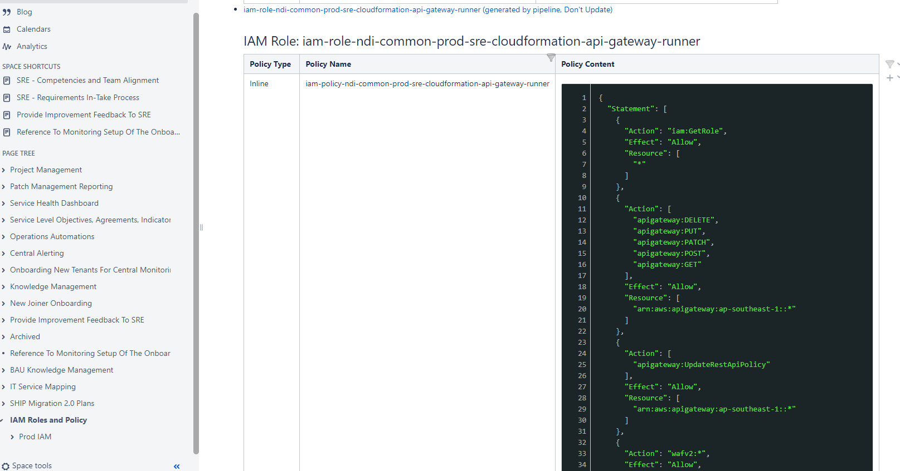
Pipeline enhancement (2)
Document published FOR iam
Benefits
Global view of infra roles
Up-to-date documentation
Notes:
This is the requirement from SecOps to create auto flow to generate hash reports.
Since EDR is not supported on AL2, they request us to create the flow to run script inside instances.
The idea is we create shell script and run it from SSM to ec2 then send the reports to the centralized bucket
The report will show the value of each file path’s hashes in 3 options -
So Secops can easily download and check the report to see the hashes values.
So far we are done testing the script and SSM flow in ndi account and start onboarding the tenants to perform some requirements to include in the flow.

Slide 3
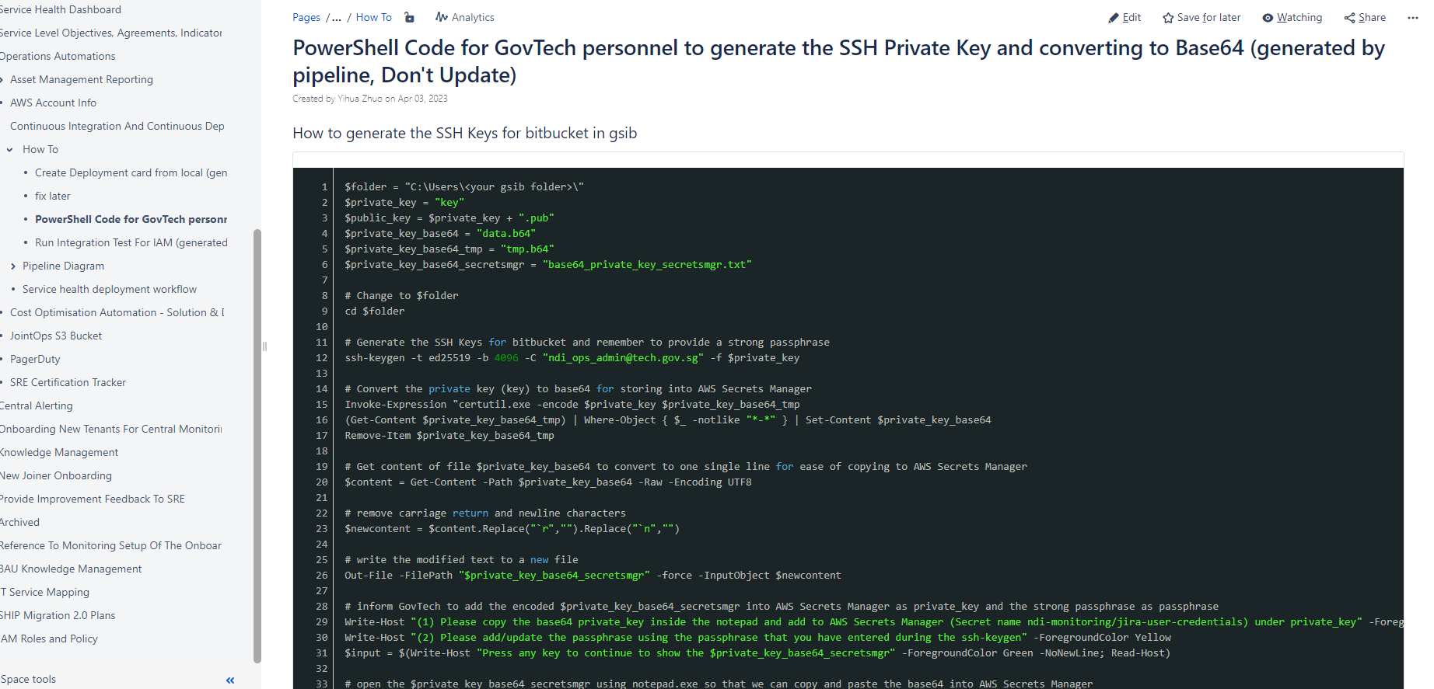
Pipeline enhancement (3)
Document publish repo how-to
Benefits
Version controlled documentation
Easy rollback
Notes:
This is the requirement from SecOps to create auto flow to generate hash reports.
Since EDR is not supported on AL2, they request us to create the flow to run script inside instances.
The idea is we create shell script and run it from SSM to ec2 then send the reports to the centralized bucket
The report will show the value of each file path’s hashes in 3 options -
So Secops can easily download and check the report to see the hashes values.
So far we are done testing the script and SSM flow in ndi account and start onboarding the tenants to perform some requirements to include in the flow.

Slide 4
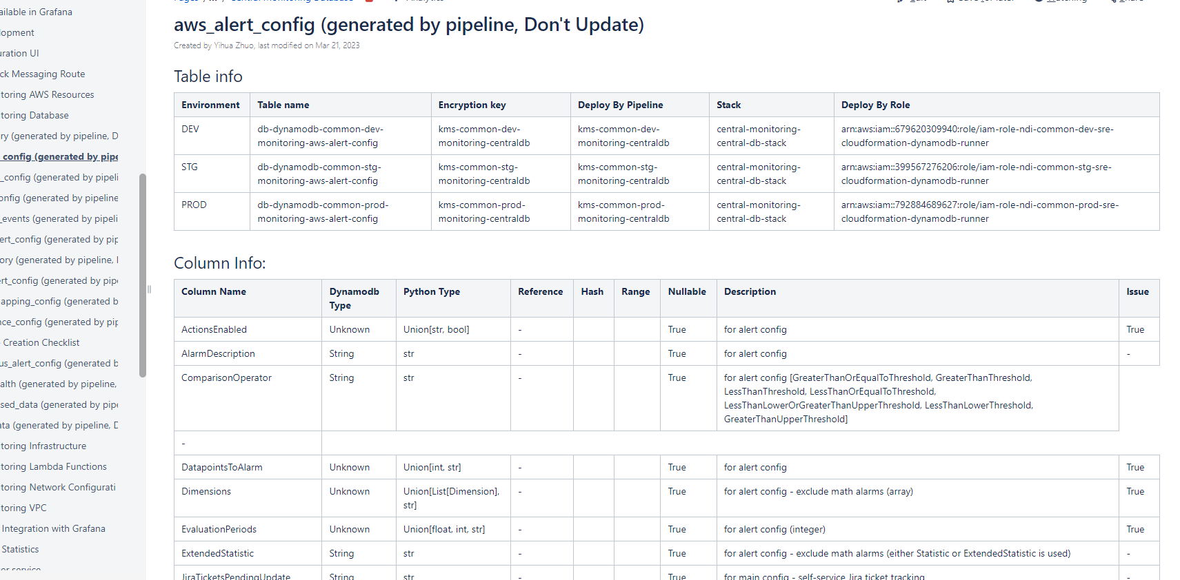
Pipeline enhancement (3)
Document publish repo db schema
Benefits
Automated error detection in table schema
Up-to-date documentation
Notes:
This is the requirement from SecOps to create auto flow to generate hash reports.
Since EDR is not supported on AL2, they request us to create the flow to run script inside instances.
The idea is we create shell script and run it from SSM to ec2 then send the reports to the centralized bucket
The report will show the value of each file path’s hashes in 3 options -
So Secops can easily download and check the report to see the hashes values.
So far we are done testing the script and SSM flow in ndi account and start onboarding the tenants to perform some requirements to include in the flow.

Slide 5
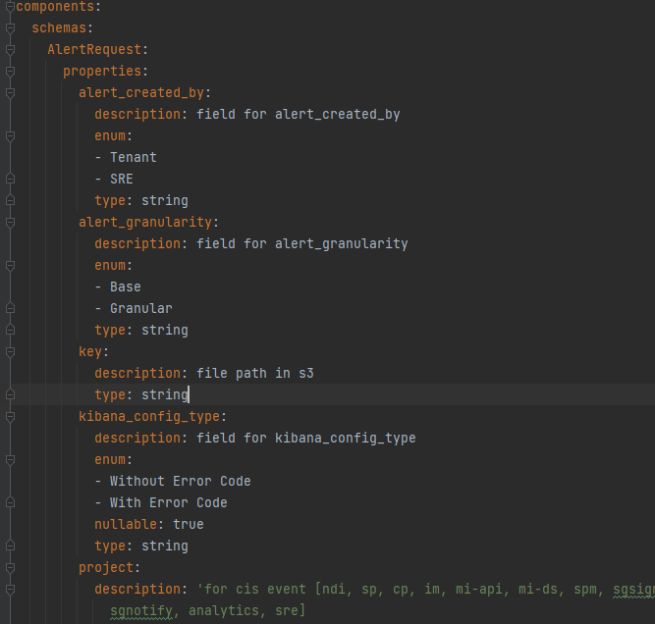
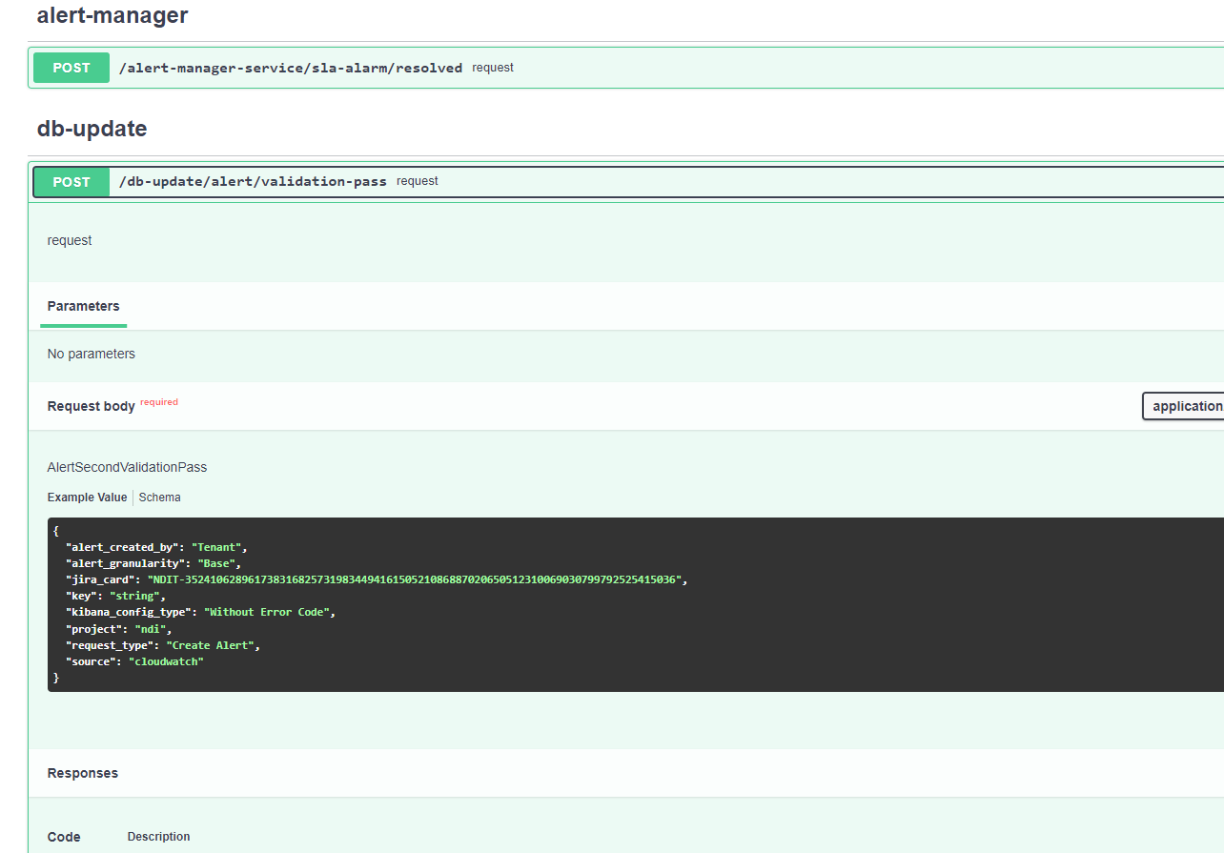
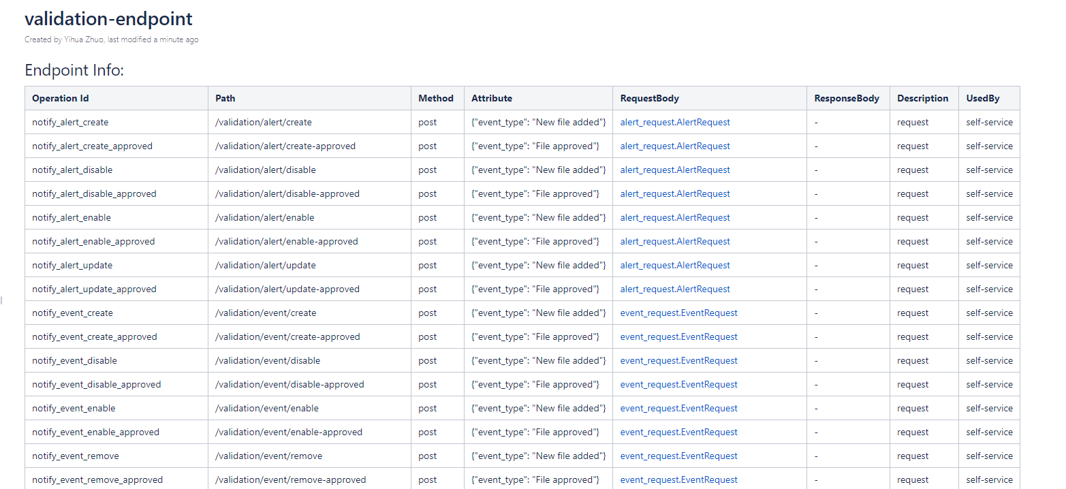
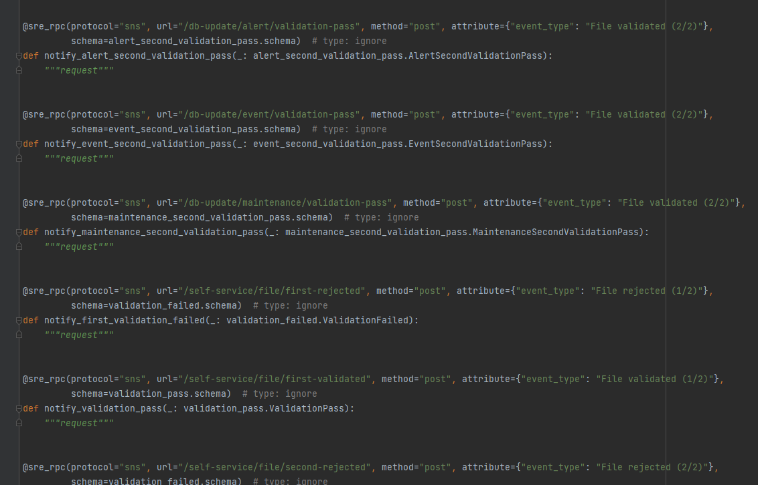
document first for integration layer
Convert each action to rest style API Definition
Use directly, decouple from SNS
Document first approach

Slide 6
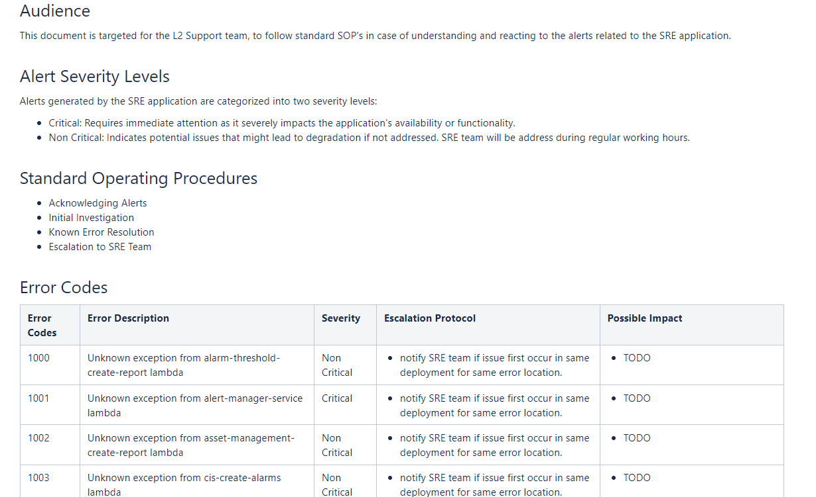
Document first for error handling

