Slide 1

Kings County Housing Market Analysis
John O’Donnell
June 2021
Notes:
My name is John ODonnell and over the course of this presentation I will speak to some of the relationships uncovered in an analysis completed on the housing market for Kings County. I will highlight some high-level trends, elaborate on a model created to predict the sale price of a home, and provide some recommendations on forward actions. I will end the presentation with some future work to be completed and answer and questions you might have.

Slide 2
Executive Summary
Review:
Purpose
Target Undervalues Homes for Purchase and Flip
Data and Visual
Sale Price has strong geographical trends that can be estimated
Recommendations:
Target most undervalues homes first
Avoid areas of uncertainty
Notes:
At a high level we can break this presentation into two parts:
In part 1 we will review the purpose of the work, which is to target undervalued homes for flipping, and we will take a look at what data we had to work with and explain the logic behind providing recommendations
Then we will get into the second part which are the recommendations themselves, where we will look at high-priority areas for targeting, as well as which area to avoid

Slide 3
Purpose Aim of the Project
Perform an analysis to assess home value
Visual inspection and due diligence
Create simple model
Use model to predict value, compare to actual value
Once undervalued homes are identified
Acquire them and flip
Notes:
The aim of this work is to better understand the relationships between the attributes of a home (such as square footage) and the value of the home
Using those relationships, we then predict what the value of each home should be
If there is a mismatch between our prediction and the actual value, and our interpreted relationships indicate that a home should be worth more than what it sold for, it present an opportunity for a buy-low-sell-high scenario

Slide 4
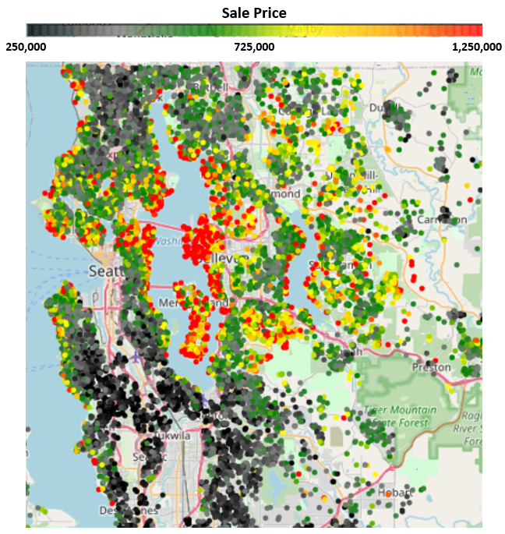
Data Review Variables Considered in the Analysis
22 variables considered
Important features include:
Prices of other houses in area
Size of lot
Year Built
Condition/Grade
Bedrooms
Location / Waterfront
Notes:
Here we will provide a brief overview of the data that went into this analysis
Some of the important qualities of a home are the
Prices of surrounding homes, or the “neighborhood value”
The size of the total lot
The year the home was built
The condition and grade, which are subjective measurements addressing the overall quality of the home
The number of bedrooms, and some location-based metrics such as if the property is waterfront
On the right you can see a map of Kings County with all of the homes represented as circles
They are colored by the sale price of the homes, and as you can see here there are systematic differences on the map, sale price does not appear to be randomly distributed
Next we will get into the logic behind some of the recommendations

Slide 5
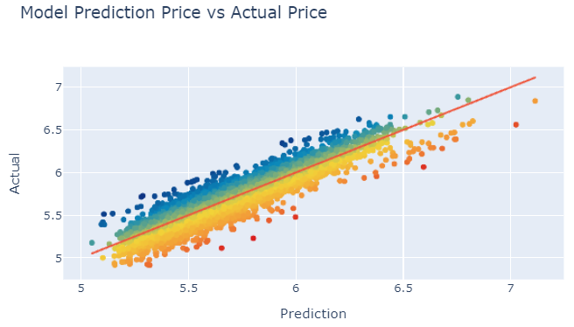
Recommendations Targeting Undervalued Homes
Overvalued
Undervalued
Notes:
A linear model was built, provided features such as the ones we just touched on with the intent or predicting sale price of the homes
Here we are looking at a simple scatterplot with the actual sale price of the home on the y-axis, and our models prediction on the x-axis
As you can see from the general trend, the model does a fairly good job, with the provided features it is able to explain nearly 90% of the variation in sale price
Each of these data points are a house, and houses that fall above the line of best fit are those which the actual price was higher than our prediction. These house are more likely to be overvalued, especially those farther from the line
The opposite can be said of the homes below the line, the model has predicted that these houses are worth more than what they sold for, and the further they are from the line the more they are undervalued
On the next slide we will take a look at the location of the homes that are most undervalued for the purpose of targeting for acquisition

Slide 6
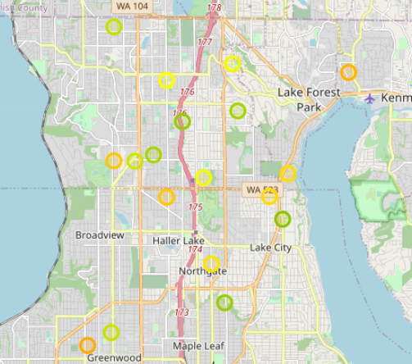
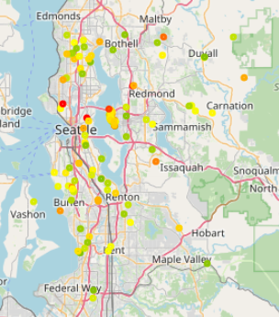
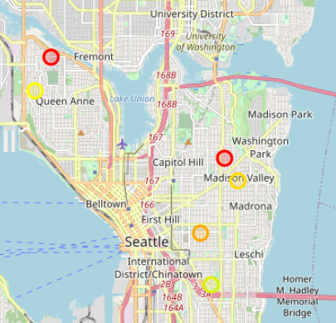
Recommendations Targeting Undervalued Homes
Notes:
Here we have a map on the left, similar to what we saw before but with far less data points
The houses shown on this map are colored by the amount the house is undervalued
We can think of this as a qualitative measure for this exercise, more of a heat map instead of getting into the details of the cutoff
On the right we have two subset maps highlighting two areas of interest that appear to have homes that are very undervalued
My recommendation here is to query the owner of homes in these two areas to see if they would be open to selling at a price below our models prediction
I would start with the houses in the red box, with the warmer colors first, then move into the blue box with the cooler colors.
This would have us targeting the most undervalues homes in the most undervalues areas
Next, we will take a look at what area we need to stay away from, which is arguably just as important

Slide 7
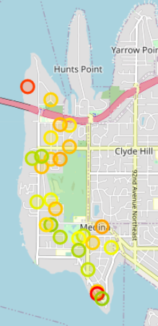
Recommendations Clustering of Residuals is Telling Avoid Medina: Gather More Data
Notes:
This slide has a similar format to the previous, with undervalued homes shown on the map, colored by this metric
The callout map in the right shows a dense clustering of undervalued homes in this “Medina” area
When we create plots like these, ideally we want to see an even distribution of errors around the map, when we see them cluster in an area like this we can reasonably conclude that this might not be due to the houses being undervalued, but that our model is “missing” something in this area
Due to the lingering uncertainty in this area, I do not recommend attempting to purchase homes in this area for flipping
This leads me into my final slide, which is what is to be done next in this project

Slide 8
Future Work
Gather more data on neighborhoods, suburbs, general location
Utilize other models such as polynomial regression or decision trees to capture non-linear relationships and increase predictive capability
Notes:
More data needs to be gathered, specifically data to represent what might be unique about the Medina area
This could be flags for neighborhoods, suburbs, or distance to public amenities like grocery stores or country clubs
There are also come relationships which might be better captures with a more complex model, such a polynomial regression or a decision tree
We would likely be able to achieve a higher model accuracy, however it might come at the cost of interpretability. This would need to be a team decision to see what our decision makers are most comfortable with moving forward. That being said, it might be a worthwhile pursuit to make several models and asses where some perform better and why.

Slide 9

Thank You Q&A
Notes:
- With that I would like to thank you for your time listening to my share the results of this analysis, and I will open it up for questions!

