Slide 1
What Makes for a Good Research Presentation?
CS185 Human Computer Interaction
Jun 5th 2018
Thanks to Tom Carsey (original author)
University of North Carolina Chapel Hill carsey@unc.edu

Slide 2
Preface
These slides provide an overview of giving an academic talk.
They are too wordy for a real talk, but I wanted to make them consumable on their own.
They are meant to offer general guidance. Individuals should tailor these suggestions to their own needs and situations. I generally have job talks in mind, but I hope the slides are helpful for conference presentations and even class lectures.

Slide 3
Three Stages of a Good Talk
Preparation Before the Talk
Giving the Talk
Q &A

Slide 4
Preparation Before the Talk
Ask about the room, allotted time, and “norms” for your talk
Consider the audience (general or not)
For job talks – no “works in progress”
  Generally, you need to present a solo-authored project (typically from the dissertation)
Never run long
Anticipate equipment problems
  Have a back-up plan in place
Practice, Practice, Practice!
  (seriously, practice several times)
  Even experienced presenters/instructors need to practice

Slide 5
Giving the Talk
Know your work inside and out
  Data, methods, measures, descriptive statistics, literature, etc. (Have backup slides)
Strive for clarity and avoid jargon
Don’t give handouts at the beginning
  People will read them rather than listen to you
Ask that questions be held until the end
Less important to hit a home run than it is to avoid striking out
Substance over Methods

Slide 6
Giving the Talk (cont.)
Get to the point
  (really nail that first 2-5 minutes)
Give them a road map and keep on it
  Avoid tangents, digressions, etc.
It is O.K. to preview the findings
  It’s not a murder mystery
Bad jokes are worse than no jokes

Slide 7
Giving the Talk (cont.)
The talk should make:
  An important theoretical contribution
  An important substantive contribution
Good talks begin with a puzzle, some tension, or a question that captures the attention of the audience.
Often nice to start with a political story/motivating example.
Good talks must answer the “So What?” question.

Slide 8
Giving the Talk (cont.)
A broad question should motivate the talk.
  Job talks might place that question in a broader research agenda (one or two sentences)
Your conclusion should return to your answer to that broad question
  Conclude with implications; don’t just rehash in summary
The middle 80% of your talk is a focused walk through your research.
  Think “Martini glass” as an outline.
Furthermore, 80% of your talk should be on your ideas, your work, your findings, etc. and NOT the work of others.

Slide 9
Giving the Talk (cont.)
Really explain your graphs, figures, and tables
  E.g. what is the x-axis? What does each number mean
In other words, really explain your results
  (don’t leave them guessing)
Do not read long wordy slides
  Don’t even have long wordy slides
  Long quotes are often a waste of time and space

Slide 10
Giving the Talk (cont.)
You can’t tell them everything.
  “Less is More” – save the rest for Q&A
Graphs often say more than tables
PowerPoint slides and/or overheads need to be readable
  Don’t do this (Table)
  Or this (Text)
  Or this (Graphics)

Slide 11
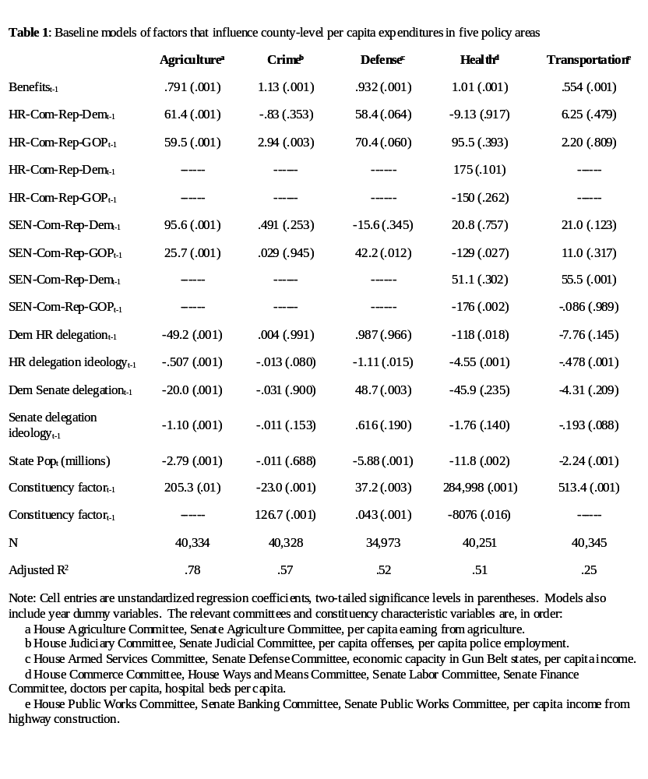

Slide 12
Giving the Talk (cont.)
Graphs often say more than tables
PowerPoint slides and/or overheads need to be readable
  Don’t do this (Table)
  Or this (Text)
  Or this (Graphics)

Slide 13
Hypotheses
The policy balancing theory generates two primary hypotheses:
  (1) that individuals who prefer that the President and the majority in Congress be from different parties are more likely than individuals who prefer that the President and the congressional majority be from the same party to cast split-ticket votes.
  (2) that individuals’ preferences for partisan control of government are shaped by their own ideological locations and their perceptions of the locations of the two parties

Slide 14
Giving the Talk (cont.)
Graphs often say more than tables
PowerPoint slides and/or overheads need to be readable
  Don’t do this (Table)
  Or this (Text)
  Or this (Graphics)

Slide 15

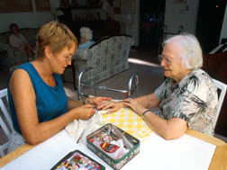
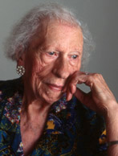
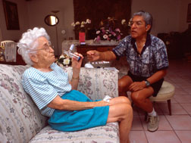


Politics of the Elderly
  Life-cycle versus cohort effects
  Do senior citizens really oppose public school funding?
  Mobilizing the senior vote

Slide 16
Giving the Talk (cont.)
People often spend too much time on:
  The general introduction
  Their methods
  The literature
And too little time on:
  Their theory
  Their own findings
  The important implications of their findings.

Slide 17
Q&A
Pay attention to the question
Let people finish their question before you start answering it
Give direct answers
Be complete, but don’t ramble
It is O.K. to:
  Pause
  Take notes
  Say “I don’t know” (once or twice anyway)
Keep your cool

Slide 18
Q&A (cont.)
Try to strike a balance:
  Defend without becoming defensive
  Be confident, but not arrogant
  Accept fair criticism, but don’t cave in
  Q&A should be a conversation among equals
    (Relax, keep your energy up, and stay cool)

Slide 19
You know something is wrong when questioners ask:
What is your research question?
What is your dependent variable?
What are your conclusions?
Why should political scientists care about this?
Nothing at all (at least at job talks)

Slide 20
Closing Thoughts
Be yourself, but . . .
Keep your energy up
  If you appear bored, the audience will be for sure
Stay positive
  It should be a conversation, not combat, and it takes two to fight
Strive for excellence, but remember that perfection is unattainable
Practice, Practice, Practice!
  We all have nervous ticks – discover yours and try to minimize them.
Relax: trust your preparation and your knowledge

Slide 21
For More Information
Navigating the Academic Job Market Minefield. Ralph G. Carter, James M. Scott. PS: Political Science and Politics, Vol. 31, No. 3. (Sep., 1998), pp. 615-622.
Government Job-Hunting in Washington. James P. McGregor PS, Vol. 11, No. 4. (Autumn, 1978), pp. 492-498.
So You Want to Get a Tenure-Track Job.... Daniel W. Drezner. PS: Political Science and Politics, Vol. 31, No. 3. (Sep., 1998), pp. 609-614.
Netting the Big One: Things Candidates (And Departments) Ought to Know. Deborah K. Furlong, Scott R. Furlong. PS: Political Science and Politics, Vol. 27, No. 1. (Mar., 1994), pp. 91-97.
Netting the Big One: Some Things Candidates (And Departments) Ought to Know... From the Hiring Department's Perspective. J. Theodore Anagnoson. PS: Political Science and Politics, Vol. 27, No. 3. (Sep., 1994), pp. 558-562.
The Long Voyage Home. Begun. Donald Chisholm. PS: Political Science and Politics, Vol. 21, No. 4. (Autumn, 1988), pp. 901-907.
The Long Voyage Home. Concluded. Donald Chisholm. PS: Political Science and Politics, Vol. 22, No. 1. (Mar., 1989), pp. 66-73.
Tips for an Academic Job Talk. Robert Axelrod. PS: Political Science and Politics, Vol. 18, Issue 1 (Summer, 1985), pp 612-613.

