Slide 1
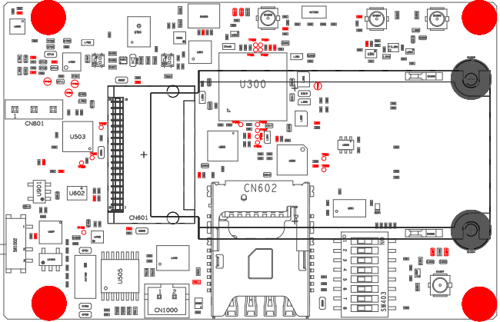
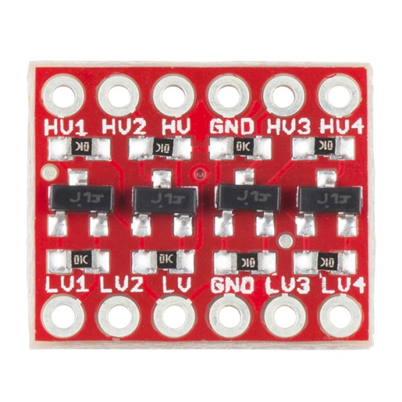
Arduino <-> mangOH example connections and settings
External GNSS antenna
ARDUINO Breakout
Custom Header
BOB-12009
Breakout Board
ARDUINO Mega2560
Standard 5V Header
IoT Expansion Board 1V8 logic
Jumper
30 GND
1 GND
5V
2
11 1V8 OUT
3 1V8 FROM mangOH
GND
12 1V8 < TX
4 < TX 1V8
TX2 PIN 16
13 1V8 > RX
5 > RX 1V8
RX2 PIN 17
External LTE antenna

