Slide 1
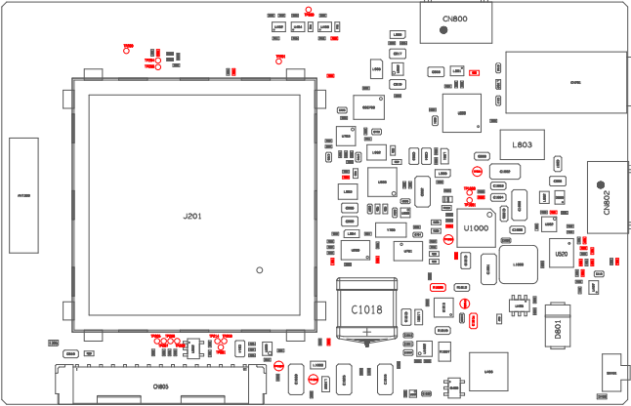
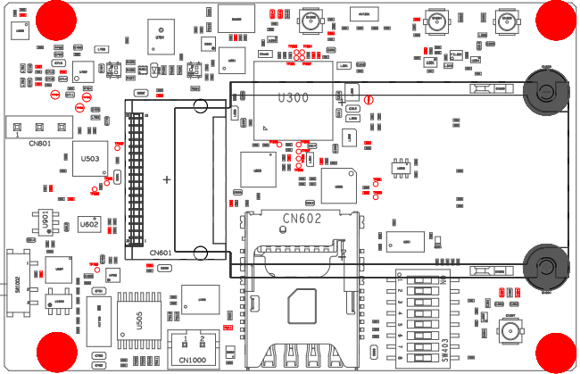
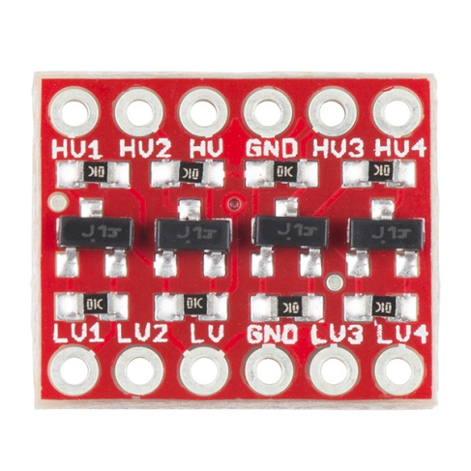
Arduino <-> mangOH example connections and settings
Change Jumper Position
Power from Arduino
External LTE antenna
External GNSS antenna
Jumper
1
15
15 <> GND
1 <> GND
Arduino
Standard Header
14 > 3V3 OUT
3 > 3V3 IN
8 > RX 3V3
5 > RX 3V3
5V
7 < TX 3V3
4 < TX 3V3
1 < 5V POWER INPUT
Warning - Disconnect
if using a USB serial convertor
6 < 5V POWER OUTPUT
GND
CN805
Arduino
Custom Header
TX2 16
Custom Cable
RX2 17

