Slide 1
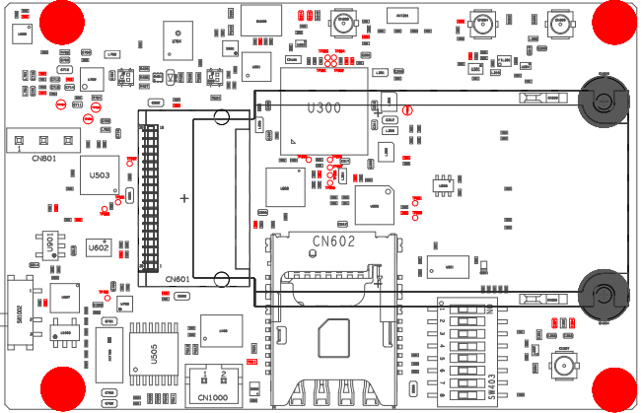
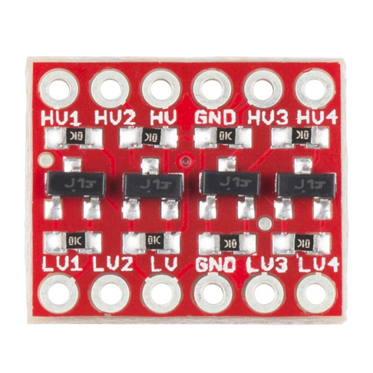
Arduino <-> mangOH example connections and settings
External GNSS antenna
IoT expansion board
1V8 logic
Jumper
BOB-12009
30 GND
1 GND
Arduino Mega2560
Standard Header
2
11 1V8 OUT
3 1V8 FROM mangOH
5V
12 < TX 3V3
4 < TX 3V3
13 > RX 3V3
5 > RX 3V3
GND
1 < 5V POWER INPUT
6 < 5V POWER OUTPUT
TX2 16
Custom Cable
Arduino breakout
Custom Header
RX2 17
External LTE antenna

