Slide 1
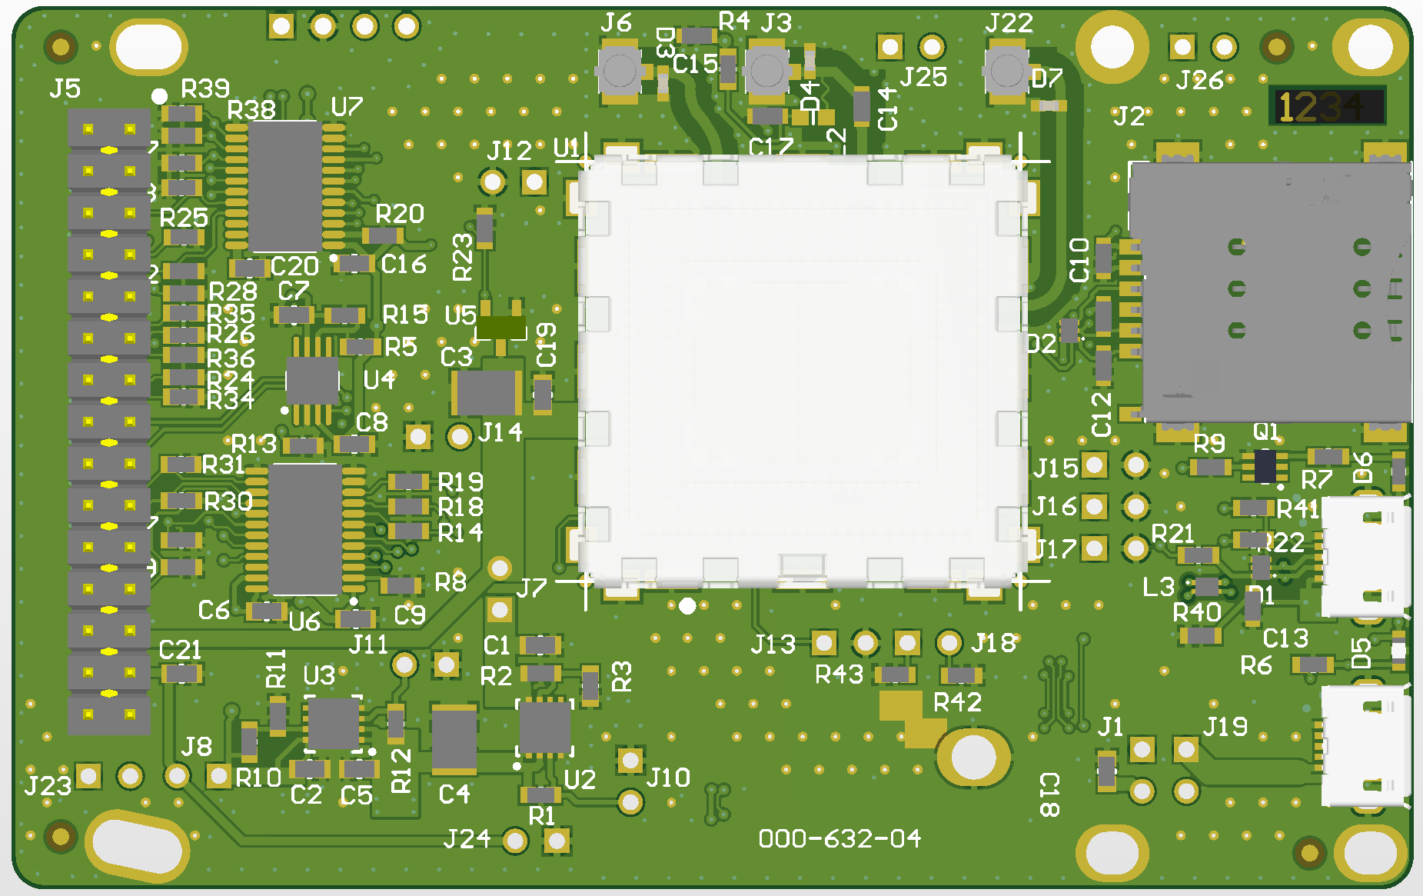
CELL MAIN
GNSS
CELL DIVERSITY
MICRO SIM
MICRO USB
SIGNAL
MICRO USB
POWER
LINK TO POWER FROM
MICRO USB SIGNAL
LINK TO POWER FROM
MICRO USB POWER

