Slide 1
DAY 2. A beginners guide to solving biological problems in R
Robert Stojnić (rs550), Laurent Gatto (lg390),
Rob Foy (raf51), John Davey (jd626) and Dávid Molnár (dm516)
Course material:
http://logic.sysbiol.cam.ac.uk/teaching/Rcourse/
Original slides by Ian Roberts and Robert Stojnić

Slide 2
Day 2
Schedule
Writing scripts
2. Writing functions
3. Data analysis examples
4. Graphics

Slide 3
Writing custom scripts for data analysis
1

Slide 4
The R scripting language
Scripting
A script is a series of instructions that when executed sequentially automates a task
  A script is a good solution to a repetitive problem
  The art of good script writing is
    understanding exactly what you want to do
    expressing the steps as concisely as possible
    making use of error checking
    including descriptive comments
R is a powerful scripting language, and embodies aspects found in most standard programming environments
  procedural statements
  loops
  functions
  conditional branching
Scripts may be written in any standard text editor, e.g. notepad, gedit, kate
  We will use RStudio

Slide 5
Colony forming experiment
We have been asked by some collaborators to analyse some trial data to see if an experiment will work.
We are interested in the behaviour of a gene, X, which is involved in a cell proliferation pathway.
This pathway causes cells to proliferate in the presence of a compound, Z.
Gene X turns the pathway off, reducing cell proliferation.
Our collaborators want to test what happens when we knock down X in the presence of Z.
To do this, they want to grow cell colonies in the presence of Z, with or without X, and count the number of colonies that result.

Slide 6
Initial trial
Our collaborators have sent us a first batch of test data, growing colonies in different concentrations of compound Z.
Does increasing concentration of Z have an effect on colony growth?
We want to do the following:
  Load the data into R
  Plot the data to inspect it
  Calculate an Analysis of Variance to see if growth is influenced by Z concentration
  Calculate the mean growth for each level of Z concentration, to see the direction of change
  (We will ignore full post hoc testing)

Slide 7
Initial trial exercise
The initial trial data is in the file 2.1_colony_trial.xls. This is an Excel file and the data is not in the right format for R. Enter the data into a plain text file in a data frame format, and load it into R.
Plot the data using a formula. Recall how we did this yesterday with linear modelling:
plot(y~x)
Calculate an analysis of variance for the data. The R function for ANOVA is aov(), which works like lm() for linear modelling – recall this from yesterday:
summary(lm(y~x))
There are four concentrations of Z, and each concentration has been replicated three times. What is the mean colony count for each concentration? See if you can figure out a way to calculate this with what we learned yesterday. You will need to use logical indexing and you may want to use a for loop.

Slide 8
Importing data
In the Excel file, the data has this format:
But this is not a data frame format,
where columns are variables and rows
are observations of those variables.
There are three variables, Z, Replicate, and Count. We need to reshape the data with these three columns.
We can do this in Excel, and then save the file in CSV format, or we can just type up the results in a CSV file ourselves.
Once we have a CSV file, we can load it with read.csv:
colony<-read.csv("2.1_colony_trial.csv”)

Slide 9
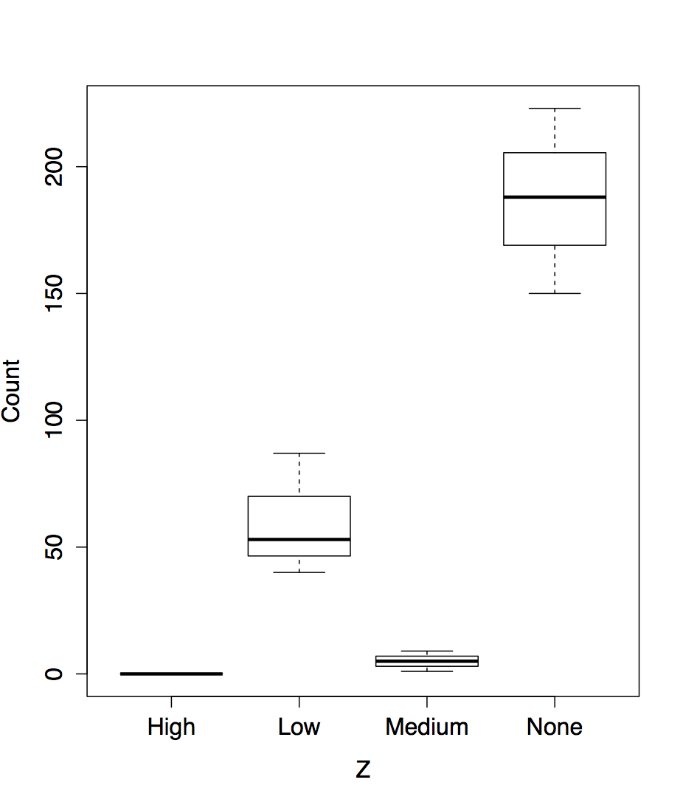
Plotting
We want to plot the colony growth in response to changing Z concentration.
Z is the explanatory variable, and Count is the response variable.
We don't want to plot replicates separately here, but get R to summarise each Z concentration over all replicates.
We can call plot using the same formula syntax we learnt yesterday:
plot(colony$Count~colony$Z)

Slide 10
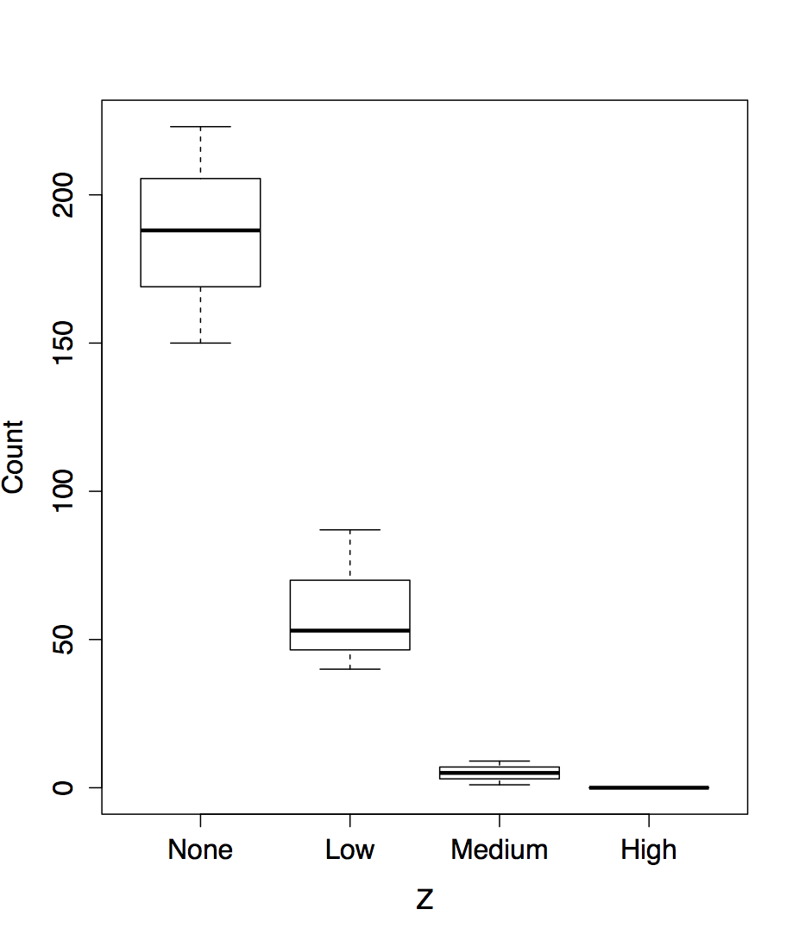
Plotting
We can improve on this. Firstly, we want to order the Z categories. Z is a factor, so we need to supply new levels to this factor in the colony data frame:
colony$Z<-factor(colony$Z, levels=c("None","Low","Medium","High"))
Second, we can tell the plot command which data frame to use, rather than using the dollar operator:
plot(Count~Z, data=colony)

Slide 11
Analysis of Variance
We can use the same formula syntax to calculate an analysis of variance:
colony.aov<-aov(Count~Z, colony)
summary(colony.aov)
Df Sum Sq Mean Sq F value Pr(>F)
Z 3 68154 22718 46.89 2.02e-05 ***
Residuals 8 3876 484
---
Signif. codes: 0 ‘***’ 0.001 ‘**’ 0.01 ‘*’ 0.05 ‘.’ 0.1 ‘ ’ 1
This tells us what we can already see from the plot, that there is a highly significant relationship between Z concentration and colony growth.
We would like to investigate this relationship. For example, we might want to calculate the mean colony count for each concentration of Z.

Slide 12
Calculating group means
We can calculate a mean for a particular group like this:
> mean(colony[colony$Z=="None",]$Count)
[1] 187
> mean(colony[colony$Z=="Low",]$Count)
[1] 60
> mean(colony[colony$Z=="Medium",]$Count)
[1] 5
> mean(colony[colony$Z=="High",]$Count)
[1] 0
We could generalise this with a for loop:
for (z in levels(colony$Z)) {
print(mean(colony[colony$Z==z,]$Count))
}
[1] 187
[1] 60
[1] 5
[1] 0
But there is a better way.

Slide 13
The tapply function
a brief digression
The apply family of functions allow us to group data by variable and calculate something for each group.
Assume we have the following data for heights of 5 males and females:
data <- data.frame(gender=c("Male", "Male", "Female",
"Female", "Female"), height=c(6, 6.1, 5.8, 6, 5.95))
gender height
1 Male 6.00
2 Male 6.10
3 Female 5.80
4 Female 6.00
5 Female 5.95
How can we get mean height of males and females separately?
  tapply() lets us do exactly this:
tapply( data$height, data$gender, mean )
data groups function

Slide 14
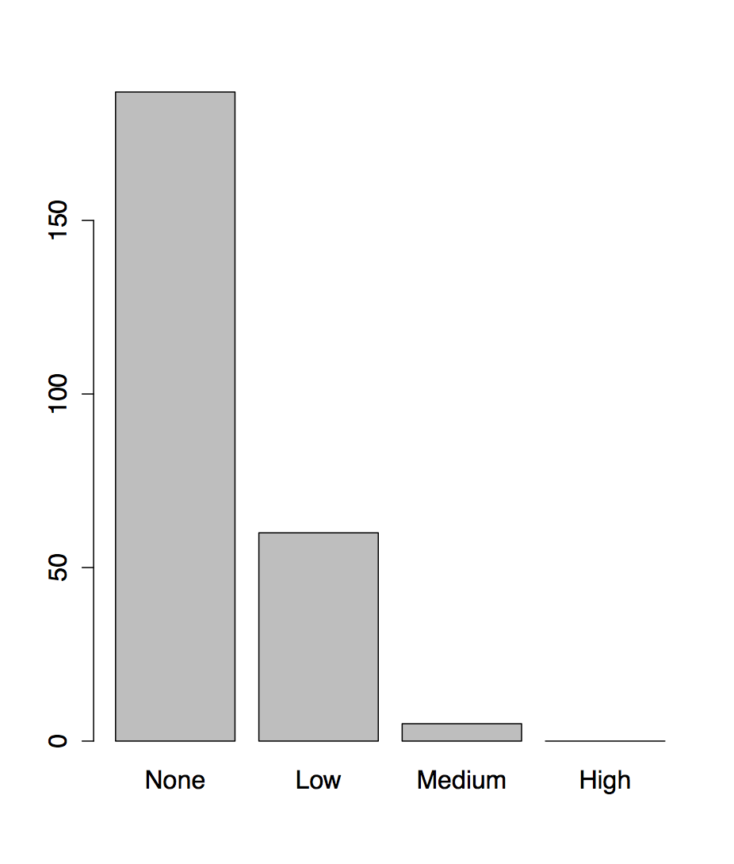
Using tapply on colony
We can use tapply to calculate group means on colony like this:
> colony.means<-tapply( colony$Count, colony$Z, mean )
> colony.means
None Low Medium High
187 60 5 0
> barplot(colony.means)

Slide 15
A complete script
We now have a complete script to analyse this data:
# Load data, order Z and plot
colony<-read.csv("2.1_colony_trial.csv")
colony$Z<-factor(colony$Z,c("None","Low","Medium","High"))
plot(Count~Z,colony)
# Analysis of Variance
colony.aov<-aov(Count~Z,colony)
print(summary(colony.aov))
# Calculate group means
colony.means<-tapply(colony$Count,colony$Z,mean)
print(colony.means)
barplot(colony.means)
We need to print the results we want to see on screen, otherwise they will not be output.
Make sure you can source your commands (or the file 2.1_colony_1.R) from Rstudio and generate the results and plot.

Slide 16
Knocking down gene X: revising the script
As the trial worked, our collaborators have gone ahead with an experiment to knock down gene X in the same concentrations of Z.
On our request, they have delivered the data in a data frame format in a CSV file: 2.1_colony_Run1Counts.csv.
They want us to see if knocking down X affects colony growth.
Because we saved our analysis in a script, we can rerun the same script to analyse the data, just by changing the name of the file we are loading.
Run your script on this new data file and confirm that you can calculate an ANOVA and group means for this new data set.

Slide 17
Knocking down gene X: revising the script
Our current script only analyses Z, not X. We need to modify it to include X and see how both X and Z influence colony growth.
1. We need to include X and the interaction between Z and X in our formulae for plotting and for ANOVA. Look up the 'Modelling formulae' slide from Day 1 to see how to do this.
2. What does plot do with a formula including both X and Z? Try using boxplot instead. What difference does it make if you change the order of X and Z?
3. We need to include both X and Z in our call to tapply. Modify the call to tapply by changing the second argument, which should be a list containing the data for both X and Z.
4. Plot the group means you calculated with tapply using barplot. Plot bars for different conditions beside each other, not on top of each other. Check the help page for an option to do this.

Slide 18
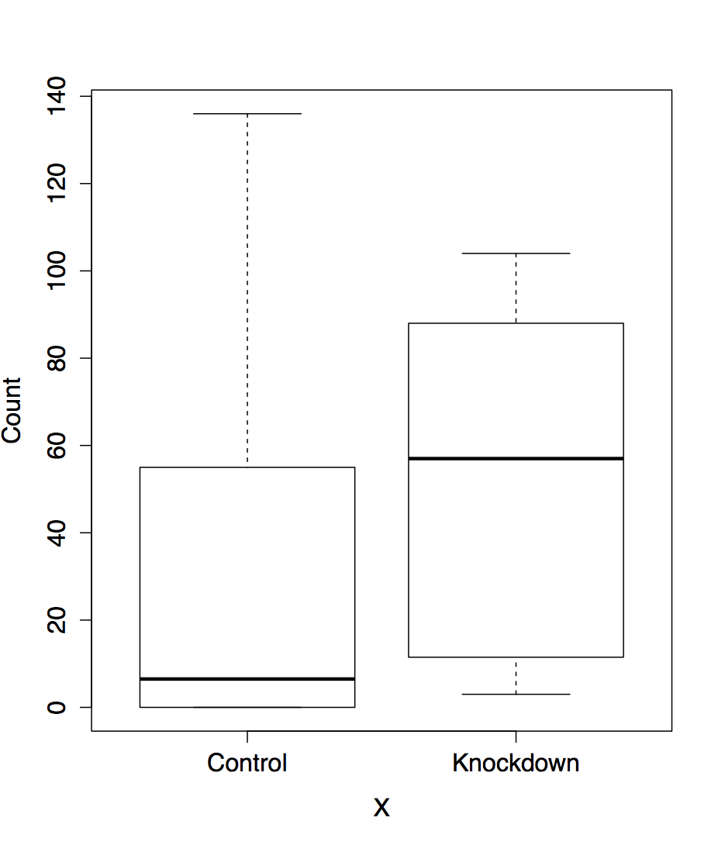
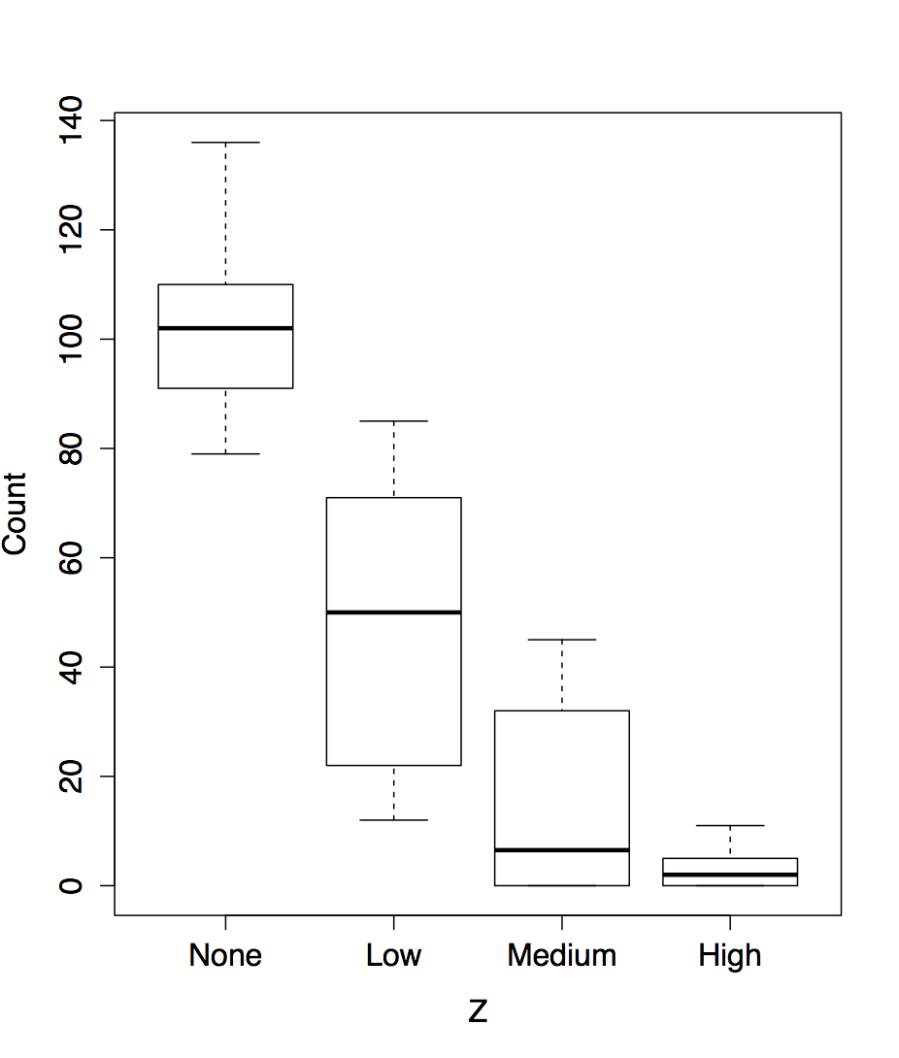
Plotting interactions
Including interactions in formulae is straightforward, but plot doesn't show us the interaction, only the main effects:
> plot(Count~X*Z,colony)

Slide 19
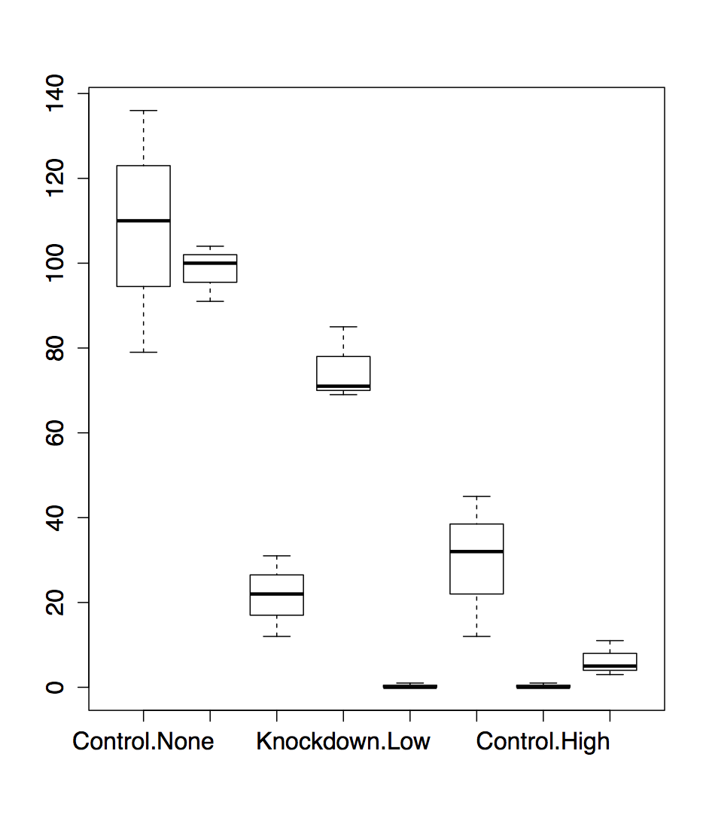
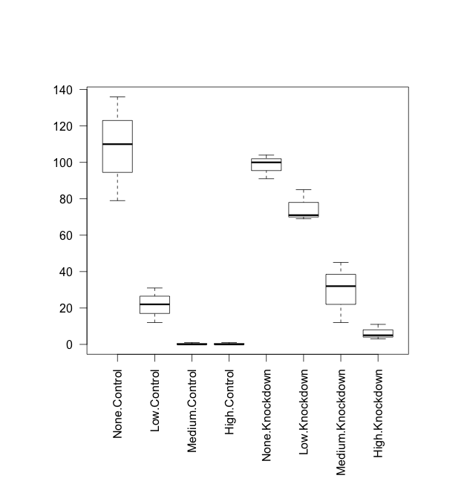
Plotting interactions
To get a sense of what's happening with the interactions, use boxplot:
> boxplot(Count~X*Z,colony)
To make the labels visible, we'll use some graphics commands to increase the size of the lower margin and make the x-axis labels vertical (full details on this this afternoon):
> par(oma=c(6,2,2,2))
> boxplot(Count~X*Z,colony,las=2)
It looks like knocking down X increases colony growth, except when Z is completely absent.

Slide 20
Analysis of variance with interactions
Including interactions in the analysis of variance is straightforward:
> colony.aov<-aov(Count~X*Z,colony)
> print(summary(colony.aov))
Df Sum Sq Mean Sq F value Pr(>F)
X 1 2321 2321 14.072 0.00174 **
Z 3 36150 12050 73.067 1.48e-09 ***
X:Z 3 3441 1147 6.954 0.00329 **
Residuals 16 2639 165
---
Signif. Codes: 0 ‘***’ 0.001 ‘**’ 0.01 ‘*’ 0.05 ‘.’ 0.1 ‘ ’ 1
Not only do X and Z have a significant effect on colony growth individually, but there is also a significant interaction between them.

Slide 21
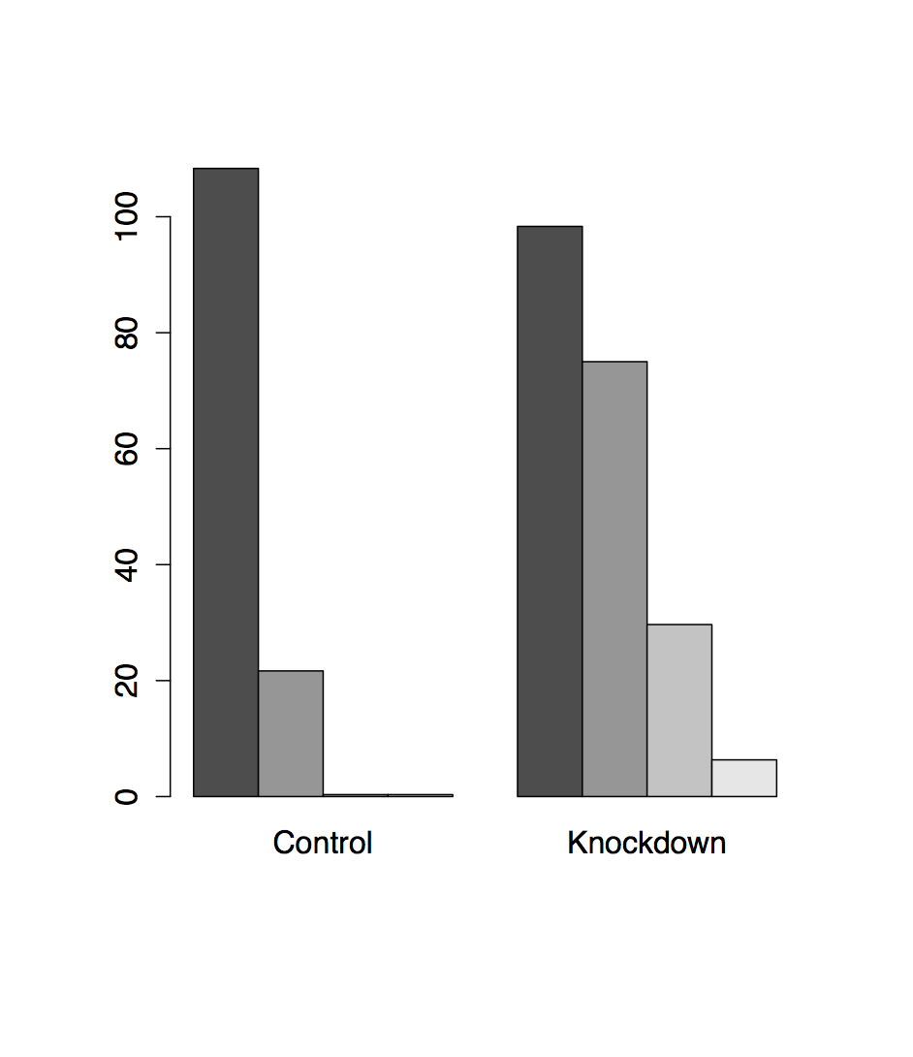
tapply with multiple variables
Including Z in the call to tapply is a little fiddly, but easy when you know how. Use the beside option in the call to barplot. (What happens if you put X first in the list?)
> colony.means<-tapply(colony$Count,list(colony$Z,colony$X),mean)
> print(colony.means)
Control Knockdown
None 108.3333333 98.333333
Low 21.6666667 75.000000
Medium 0.3333333 29.666667
High 0.3333333 6.333333
> barplot(colony.means,beside=TRUE)

Slide 22
Complete script: first revision
Our script now looks like this (see 2.1_colony_2.R):
# Load data, order Z and plot
colony<-read.csv("2.1_colony_Run1Counts.csv")
colony$Z<-factor(colony$Z,c("None","Low","Medium","High"))
par(oma=c(6,2,2,2))
boxplot(Count~Z*X,colony,las=2)
# Analysis of Variance
colony.aov<-aov(Count~X*Z,colony)
print(summary(colony.aov))
# Calculate group means
colony.means<-tapply(colony$Count,list(colony$Z,colony$X),mean)
print(colony.means)
barplot(colony.means,beside=TRUE)

Slide 23
Incorporating multiple runs: second revision
As it looks like there is an interaction between Z and X, our collaborators have repeated the experiment twice more, to increase the sample size. They have delivered two more data files, one for each extra run, in the files 2.1_colony_Run2Counts.csv and 2.1_colony_Run3Counts.csv.
1. Modify your script to load in the two new files. You may wish to use the looping code you wrote yesterday. Combine all three data sets into one colony data frame.
2. Now we have an additional variable, the Run each observation came from. Create a Run vector to record this, and add it to your colony data frame with cbind. You will need to use the rep function with its each argument – look it up to see what it does.
3. Modify your boxplot and analysis of variance to include Run. How does this data set look? Would you trust an analysis of it?

Slide 24
Loading multiple files
This should look familiar from yesterday:
# Load data
colony.files<-dir(pattern="Counts.csv")
colony<-data.frame()
for (cf in colony.files) {
colony<-rbind(colony,read.csv(cf))
}
We could just call read.csv three times, but this would be very brittle. What if we were given fifty more files? What if the filenames changed? This code will handle these cases – we would only have to change the pattern in the first line, not every call to read.csv.

Slide 25
Creating the Run variable
If we inspect the data files, we can see there are 24 observations in each file. So we can hardcode a Run variable like this:
Run<-rep(1:3,each=24)
colony<-cbind(Run,colony)
But this is brittle in the same way as calling read.csv three times is brittle. It would be better to get R to calculate Run from what it knows about the data.
We can count the observations in colony with nrow, and the number of runs (number of files) by getting the length of colony.files.
nruns<-length(colony.files)
Run<-rep(1:nruns,each=nrow(colony)/nruns)
colony<-cbind(Run,colony)

Slide 26
Analysis of variance with Run variable
Adding the Run variable to our analysis of variance is easy:
> colony.aov<-aov(Count~X*Z*Run,colony)
> print(summary(colony.aov))
Df Sum Sq Mean Sq F value Pr(>F)
X 1 24939 24939 32.454 4.71e-07 ***
Z 3 355524 118508 154.221 < 2e-16 ***
Run 1 48197 48197 62.721 1.05e-10 ***
X:Z 3 21967 7322 9.529 3.51e-05 ***
X:Run 1 3485 3485 4.535 0.0376 *
Z:Run 3 49513 16504 21.478 2.19e-09 ***
X:Z:Run 3 805 268 0.349 0.7897
Residuals 56 43032 768
---
Signif. codes: 0 ‘***’ 0.001 ‘**’ 0.01 ‘*’ 0.05 ‘.’ 0.1 ‘ ’ 1
But the result is troubling – why should Run be correlated with colony growth? Let's have a look at the plot.

Slide 27
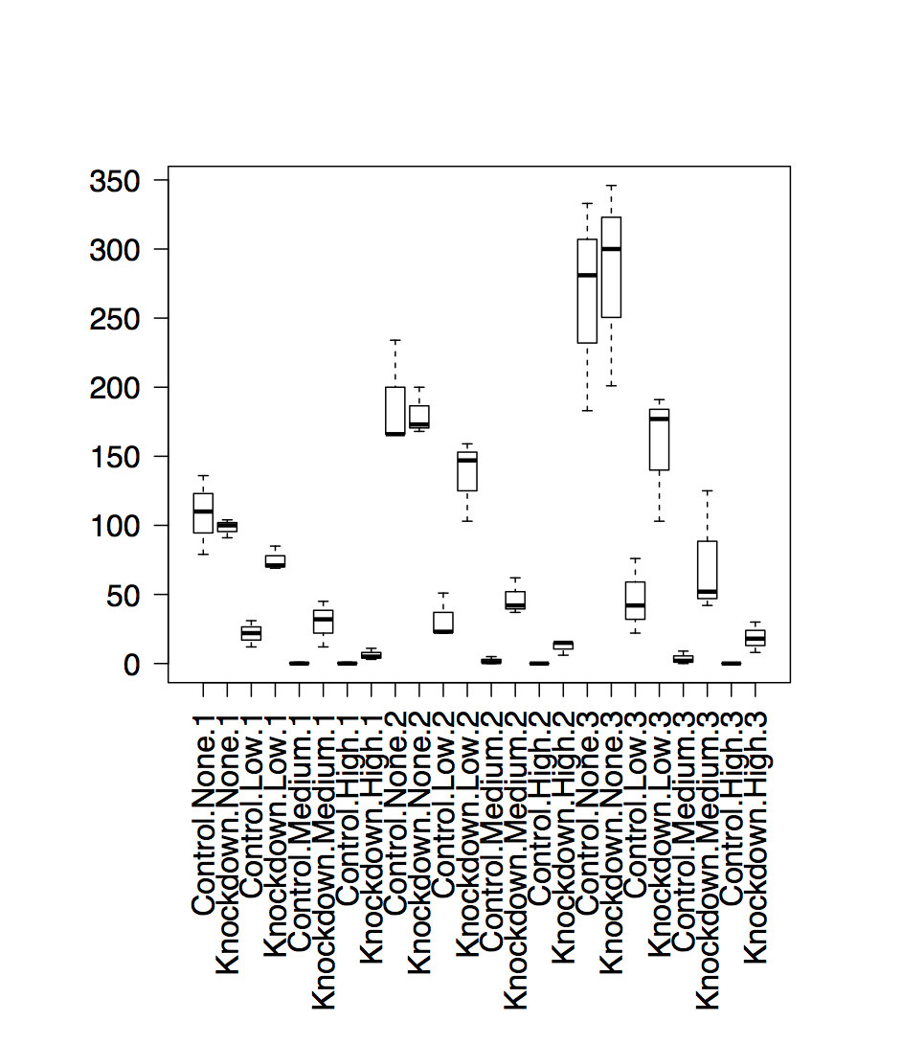
Plotting the Run variable
It is also easy to add Run to our boxplot:
boxplot(Count~X*Z*Run,colony,las=2)
Unfortunately, this shows that something has gone wrong during the experiments. The later runs have much higher colony growth than the first.
We probably can't rely on this data to tell us something about X and Z. At the very least, we will have to control for Run during the analysis.

Slide 28
Scripting summary
You can find the final version of the script in 2.1_colony_3.R.
We have seen the value of writing a reusable script, and how we can modify scripts as new data comes in.
We have also seen how easy it is to incorporate new variables into R, and to repeat complicated analyses with single commands.
Finally, we have learnt a little about generalising our code to cope with variations in current and future input. Now we'll go on to learn how to define our own functions in R, to help us to generalise even further.

Slide 29
User functions
2

Slide 30
Introducing ...
User functions
All R commands are functions.
Functions perform calculations, possibly involving several arguments, then return a value to the calling statement.
The calculation maybe any process, might or might not have return value
  It need not be arithmetic
User functions extend the capabilities of R by adapting or creating new tasks that are tailored to your specific requirements.
User functions are a special kind of object

Slide 31
Defining a new function
Parts of function definition: name, arguments, procedural steps, return value
sqXplusX <- function(x){
x^2 + x
}
sqXplusX is the function name
x is the single argument to this function and it exists only within the function
everything between brackets { } are procedural steps
the last calculated value is the function return value
after defining the function, we can use it:
> sqXplusX(10)
[1] 110

Slide 32
Named and default arguments
Example of function with more than one named argument:
powXplusX <- function(x, power=2){
x^power + x
}
Now we have two arguments. The second argument has a default value of 2.
Arguments without default value are required, those with default values are optional.
> powXplusX(10)
[1] 110
> powXplusX(10, 3)
[1] 1010
> powXplusX(x=10, power=3)
[1] 1010
arguments matched based on position
arguments matched based on name

Slide 33
Assignments with arguments
User functions
You can use a blank document in gedit, nedit or other text editor to hold these commands for you, then copy / paste the instructions into R
sqXplusX <- function(x){
x^2 + x
}
Now try this …
a <- matrix(1:100, ncol=10, byrow=T) # make some dummy data
b <- sqXplusX(a) # transform a by sqXplusX, assign result to b
b # to view the result
sqXplusX user function is now an R object, check its arguments and list it in the current workspace
> args(sqXplusX)
> ls()
> sqXplusX
Don’t add brackets to see the
definition of sqXplusX

Slide 34
Assigned or anonymous ...
User functions
Functions may be assigned a name, or anonymously created within an operation
  Anonymous functions are really useful in apply()style procedures
apply(object, margin, function)
  E.g. I have a 10 x 10 matrix and want to square each item, and add the item to itself
a<-matrix(1:100, ncol=10, byrow=T)
a # to view new object
apply(a, c(1,2), function(x) x^2+x)
x is transiently assigned each item of a, and this is passed as an argument to the anonymous function
1 means by rows, 2 means by columns [1st or 2nd margin]
c(1,2) means do both rows and columns

Slide 35
Functions occupy their own space
User functions
Objects created in functions are not available to the general environment unless returned.
  they are said to be out of scope
    Scope relates to the accessibility of an object.
A function can only return one object.
Custom functions disappear when R sessions end, unless the function object is saved in an Rdata file or sourced from a script.
  A really useful function could be added to your .Rprofile file, and would always be ready for you at launch
You could also make a package
  Beyond the scope of the beginners course!!!!

Slide 36
Script / function tips
User functions
If your script repeats the same style command more than twice, you should consider writing a function
Writing functions makes your code more easily understandable because they encapsulate a procedure into a well-defined boundary with consistent input/output
Functions should not be longer than one-to-two screens of code, keep functions clean and simple
Look at other functions to get ideas for how to write your own …
  Display function code by entering the function’s name without brackets.

Slide 37
File commands for extending
scripts & user functions
Generic file commands
dir(...,pattern="txt")
Retrieve working directory file listing filtered by pattern. Note pattern is a regular expression, not a shell wildcard
glob2rx("*.txt")
Changes wildcards to regular expressions!
unlink(...)
Remove (permanently) a file from system
system(...)
Execute a shell command from within R
Result can not be coerced to an object, only available to linux R
> glob2rx("*.txt")
[1] "^.*\\.txt$"

Slide 38
Text manipulation for extending
scripts & user functions
Text manipulation and file name mangling ... that's a technical term
grep( pattern, object )
    If pattern is not found, grep returns a 0 length object.
      Test for null with is.null()
sub( pattern, replacement, object )
gsub( pattern, replacement, object)
    Sub replaces first occurrence only, gsub does them all.
cat( "...", file=...)
    Outputs text to a file, or prints it on screen if file=""
      cat requires "\n" to be given for new lines ... try ...
cat("Hello World!") ; cat("Hello World!",sep="\n") ; cat("Hello World!",sep="\n",file="world.txt")
    cat is extremely useful for writing scripts or generating reports on-the-fly

Slide 39
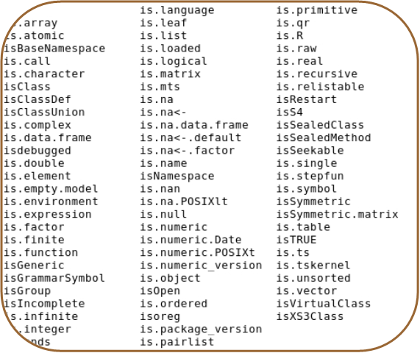
Error reporting for extending
scripts & user functions
Your code should report errors if inconsistency is detected.
stop(...)
  Stops execution of a function and reports a custom error message
is.family(...)
  Functions that can be used to test for a variety of conditions place them inside if structures to check that all is well
if( !is.numeric(x) ){ stop ("Non numeric value entered. Cannot continue.") }
If the object x is non numeric (e.g. Text has been entered when numbers were required), then stop execution and report message
The is.family

Slide 40
Temperature conversion exercise
User functions
Centigrade to Fahrenheit conversion is given by
  F = 9/5 C +32
    Write a function that converts between temperatures.
      The function will need two named arguments
        temperature (t) is numeric
        units (unit) is character
        They will need default values, e.g t=0, unit="c"
      The function should report an appropriate error if inappropriate values are given
if( !is.numeric(t) ) { .... }
if( !(unit %in% c("c","f")) ){...}
      The function should print out the temperature in F if given in C, and vica versa
Functions with named arguments are defined with the following syntax
myFunc<-function(arg=defaultValue,…)
Why not add a third scale?
K=C+273.15
Example code:
12_convTemp.R

Slide 41
Building the solution
It is difficult to write large chunks of code, instead start with something that works and build upon it
E.g. to solve the temperature conversion exercise:
  start with the function powXplusX (from some slides ago)
  modify the argument names
  delete the old code, for now just print out the input arguments
  save the function file, load it into R and try it out
  now add the two lines for input checking from the previous slide
  try it out, see if passing a character for temperature gives the expected error
  now try to convert C into F and print out the result
  when that works, add the conversion from F to C
If you get stuck, call us to help you !

Slide 42
Temperature conversion script
convTemp<-function(t=0,unit="c"){ # convTemp is defined as a new user function requiring two arguments, t and unit, the default values are 0 and "c", respectively.
if( !is.numeric(t) ){
stop("Non numeric temparture entered") # Exception error if character given for temperature
}
if(!(unit %in% c("c","f","k"))){
stop("Unrecognized temperature unit. \n Enter either (c)entigrade, (f)ahreneinheit or (k)elvin") # Exception error if unrecognized units entered
}
# Conversion for centigrade
if(unit=="c"){
fTemp <- 9/5 * t + 32
kTemp <- t + 273.15
output <- paste(t,"C is: \n",fTemp,"F \n",kTemp,"K \n")
cat(output)
}
# Conversion for Fahrenheit
if(unit=="f"){
cTemp <- 5/9 * (t-32)
kTemp <- cTemp + 273.15
output <- paste(t,"F is: \n",cTemp,"C \n",kTemp,"K \n")
cat(output)
}
# Conversion for Kelvin
if(unit=="k"){
cTemp <- t - 273.15
fTemp <- 9/5 * cTemp + 32
output <-paste(t,"K is: \n",cTemp,"C \n",fTemp,"F \n")
cat(output)
}
}
"\n" -> puts text on a new line
Units must be entered in quotes, as it’s a character object
> convTemp(t=-273,unit="c")
-273 C is:
-459.4 F
0.149999999999977 K
Example code:
12_convTemp.R

Slide 43
Advanced data processing
3

Slide 44
Combining data from multiple sources
Gene clustering example
R has powerful functions to combine heterogeneous data into a single data set
Gene clustering example data:
  five sets of differentially expressed genes from various experimental conditions
  file with names of experimentally verified genes
Gene clustering exercise:
  combine this dataset into a single table and cluster to see which conditions are similar
  repeat the clustering but only on a subset of experimentally verified genes

Slide 45
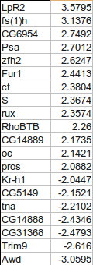
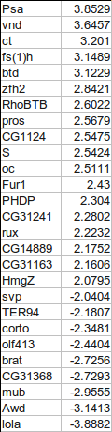
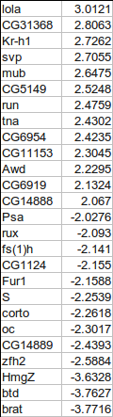
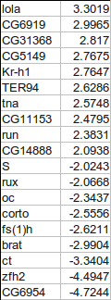
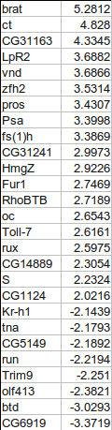
Combining gene tables
input files have two columns: gene names and fold change
we want to combine all five tables into a single table, with 0 for missing values
+
+
+
+

Slide 46
Gene clustering
Script walkthrough 1
To make the big table we first need to find out all the genes present in at least one of the files
Make sure not to use factors in read.delim()
# start with en empty collection of genes
genes <- c()
for( fileNum in 1:5 ){
# load in files 13_DiffGenes1.tsv ...
t <- read.delim(paste("13_DiffGenes", fileNum, ".tsv", sep=""),
as.is=TRUE, header=FALSE)
# label the input columns to help code readability
names(t) <- c("gene", "expression")
genes <- union(genes, t$gene)
}
# for tidiness order our genes by name
genes <- sort(genes)
genes # show all genes
when loading in character data
use as.is=T to prevent it being
converted to factors!
union() is a set operation, combines
two vectors by eliminating duplicates.
There are also intersect() and setdiff()
Example code:
13_geneClustering.R

Slide 47
Gene clustering
Script walkthrough 2
Using the complete list of genes, we can create the big table and fill in the values:
# make the destination table [rows = unique genes, cols = file numbers]
values <- matrix(0, nrow=length(genes), ncol=5)
rownames(values) <- genes # name the rows with the complete gene names
for(fileNum in 1:5){
# read in the file again
t <- read.delim(paste("13_DiffGenes", fileNum, ".tsv", sep=""),
as.is=T, header=F)
names(t) <- c("gene", "expression")
# match the names of the genes to the rows in our big table
index <- match(t$gene, rownames(values))
# copy the expression levels
values[index,fileNum] <- t$expression
}
match() returns the index of first argument in the second, i.e. index of input file genes in the big table
we use index to pick the rows in such way that they match the gene order in the input file

Slide 48
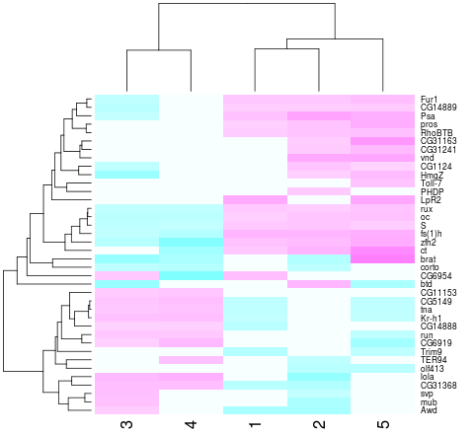
Gene clustering
Script walkthrough 3
Now we can do hierarchical clustering:
heatmap(values, scale="none", col = cm.colors(256))
Values from the matrix
are colour-coded.
Rows and columns
are re-arranged according to similarity

Slide 49
Gene clustering
Script walkthrough 4
In a second part of our analysis, we want to produce the same heatmap but only based on a list of experimentally verified genes
The problem is data is not formatted in the most convenient way:
genes | citation
oc,run,RhoBTB,CG5149,CG11153,S,Fur1 | Segal et al, Development 2001
tna,Kr-h1,rux | Krejci et al, Development 2002

Slide 50
Gene clustering
Script walkthrough 5
We load in this table, and only extract the gene names, then we use them to select a subset of values matrix
# load in the tab-delimited file with genes and citations
t.exp <- read.delim("13_ExperimentalGenes.tsv", as.is=T)
# split all gene names by "," and then flatten it out into a single vector
experim.genes <- unlist( strsplit(t.exp$genes, ",") )
# redo the heatmap by using just the genes in the experimentally verified set
is.experimental <- rownames(values) %in% experim.genes
heatmap(values[ is.experimental, ], scale="none", col = cm.colors(256))
unlist() flattens out a nested
list into a single vector
strsplit() splits a vector of strings by a custom
split character (","). The result is a list of split
values for each element of the input vector

Slide 51
Gene clustering review
We load in the five tables twice - first to collect gene names, then to load expression values
Based on expression table (values) we construct a clustered heatmap first on the whole set of genes, then on a selected subset
Go through the code, try it out it and understand it
Try answering the following questions:
  what is rownames(values) ?
  why is rownames(values)[index] and t$gene giving the same output?
  what is the difference between rownames(values) %in% experim.genes and experim.genes %in% rownames(values)
Example code:
13_geneClustering.R

Slide 52
Graphics
4

Slide 53
Starting out with R graphics
Graphics
R provides several mechanisms for producing graphical output
  Functionality depends on the level at which the user seeks interaction with R
    graphics systems, packages, devices & engines
High level graphics
  Functions compute an appropriate chart based up on the information provided. Optional arguments may tailor the chart as required
    Interaction is at traditional graphics system level. The user isn’t required to know much about anything
Low level graphics
  The user interacts with the drawing device to build up a picture of the chart piece by piece.
    This fine granular control is only required if you seek to do something exceptional
R graphics produces plots using a painter’s model
  Elements of the graph are added to the canvas one layer at a time, and the picture built up in levels. Lower levels are obscured by higher levels, allowing for blending, masking and overlaying of objects.

Slide 54
High level vs. Low level plotting
Graphics
High level plotting
example(plot)
Low level plotting
(Scotland by blighty package)

Slide 55
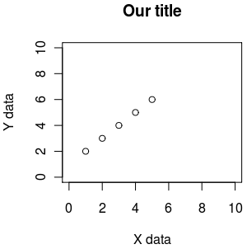
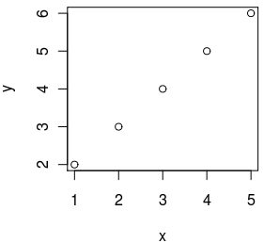
Essential plotting - plot()
plot() is the main function for plotting, it takes x,y values to plot and also lots of graphical parameters (see ?par for all of them)
default plotting
custom plotting
x <- 1:5
y <- 2:6
plot(x,y)
x <- 1:5
y <- 2:6
plot(x,y, xlab="X data", ylab="Y data", xlim=c(0,10), ylim=c(0,10), main="Our title")

Slide 56
R graphics uses a painter’s model
x <- seq(-2, 2, 0.1)
y <- sin(x)
1
2
3
plot(y~x, ylim=c(-1.5,1.5), xlim=c(-2.5,2.5), col="red" ,pch=16, cex=1.4)
lines(y~x, ylim=c(-1.5,1.5), xlim=c(-2.5,2.5), col="blue", lty=1,lwd=2)
rect(-2.5,0,2.5,-1.5, col="white", border="white")
xlim, ylim = axis limits
col = line colour
pch = plotting character [example(points)]
cex = character expansion [scaling factor]
lty = line type
lwd = line width
rect = rectangle
Example code:
14_painterModel.R

Slide 57
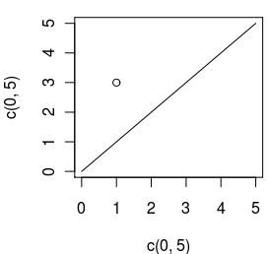
Plotting x,y data - plot(), points(), lines()
plot() is used to start a new plot, accepts x,y data, but also data from some objects (like linear regression). Use the parameter type to draw points, lines, etc (see ?plot)
points() is used to add points to an existing plot
lines() is used to add lines to an existing plot
plot(c(0, 5), c(0, 5), type="l") # draw as line from (0,0) to (5,5)
points(1, 3) # add a point at 1,3

Slide 58
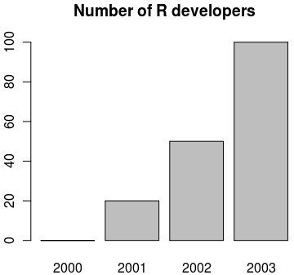
Making bar plots - barplot()
visualizing a vector of data can be done with bar plots, using function barplot()
data <- c("2000"=0, "2001"=20, "2002"=50, "2003"=100)
barplot(data, main="Number of R developers")

Slide 59
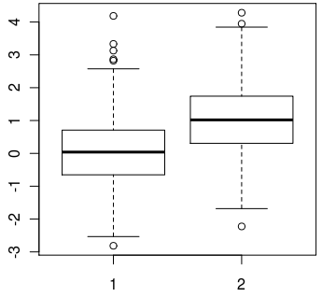
Making box plots - boxplot()
when a spread of data needs to be visualised, we can use boxplots with function boxplot()
data1 <- rnorm(1000, mean=0)
data2 <- rnorm(1000, mean=1)
boxplot(data1, data2)

Slide 60
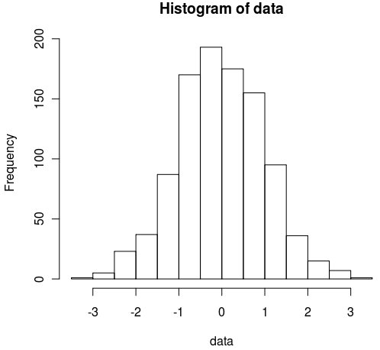
Making histograms - hist()
when we need to look at the distribution of data, we can visualize it using histograms with function hist()
data <- rnorm(1000)
hist(data)

Slide 61
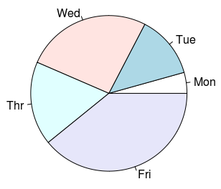
Pie charts - pie()
to visualise percentages or parts of a whole we can use pie charts with function pie()
data <- c("Mon"=1, "Tue"=3, "Wed"=6, "Thr"=4, "Fri"=9)
pie(data)

Slide 62
Typical plotting workflow
Set the plot layout and style - par()
  Set the number of plots you want per page
  Set the outer margins of the figure region
    The distance between the edge of the page and the figure region, or between adjacent plots if there are multiple figures per page
  Set the inner margins of the plot
    The distance between the plot axes and the labels & titles
  Set the styles for the plot
    Colours, fonts, line styles and weights
Draw the plot - plot(x,y, …)

Slide 63
Setting graphics layout and style - par()
par() Top level graphics function
  parameter specifies various page settings. These are inherited by subordinate functions, if no other styles are set.
    Specific colours and styles may be set globally with par, but changed ad hoc in plotting commands
    The global setting will remain unchanged, and reused in future plotting calls.
  par sets the size of page and figure margins
    Margin spacing is in ‘lines’
  par is responsible for controlling the number of figures that are plotted on a page
  par may set global colouring of axes, text, background, foreground, line styles (solid/dashed), if figures should be boxed or open etc. etc.
type par() to get a list of top down settings which may be set globally

Slide 64
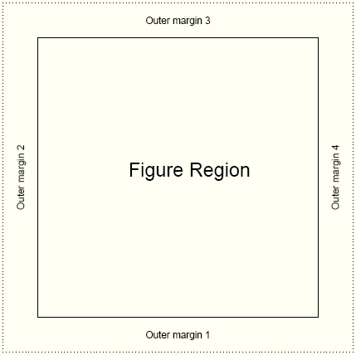
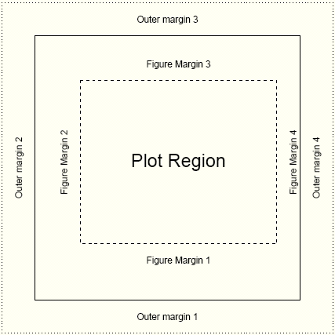
Page settings with par
Graphics
par(mfrow=c(1,1))
one figure on page
par(oma=c(2,2,2,2))
equal outer margins
par(mar=c(5,4,4,2))
Sets space for x & y labels, a main title, and a thin margin on the right
Numbering: bottom, left, top, right

Slide 65
Page layout plot exercise
Graphics
oma 1 line here
par(mfrow=c(2,2))
2 x 2 figures per page
par(oma=c(1,0,1,0)
1 line spacing top and bottom
par(mar=c(4,2,4,2))
4 lines at bottom & top
2 lines left & right
par(bg="lightblue",fg="darkgrey")
light blue background
dark grey spots
par(pch=16,cex=1.4)
Large circles for spots
Execute 4 times with different colors:
plot(1:10)
box("figure",lty=3,col="blue")
Draw a blue dashed line around plot
box("outer",lty=1,lwd=3,
col="green")
Draw a green solid line around figure
mar 4 lines here
mar 2 lines here
See how the figure margins overlap
Using painter’s model
15_parExample.R

Slide 66
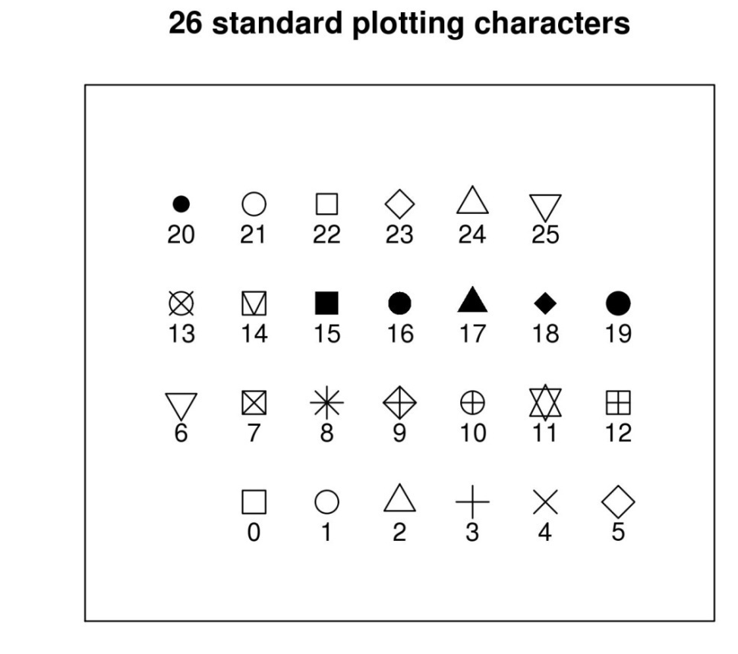
Plotting characters for plot()
size and orientation
pch= ...
Sets one of the 26 standard plotting character used.
Can also use characters, such as "."
cex= ...
Character expansion. Sets the scaling factor of the printing character
las= ...
Axes label style. 1 normal, 2 rotated 90º
4 styles (0-3)

Slide 67
Plotting characters exercise
Graphics
16_plottingChars.R
xCounter<-1
yCounter<-1
plotChar<-0
plot(NULL, xlim=c(0,8), ylim=c(0,5),xaxt="n",
yaxt="n",ylab="",xlab=""
,main="26 standard plotting characters")
while (plotChar < 26){
if(xCounter < 7){
xCounter <- xCounter+1
} else {
xCounter <- 1
yCounter <- yCounter+1
}
points(xCounter,yCounter,pch=plotChar, cex=2)
text(xCounter,(yCounter-0.3),plotChar)
plotChar <- plotChar+1
}
X-Y coordinates,
Plotting character index counter
Sets up an empty plotting area.
Axis scale limits, xlim, ylim
Don't draw axis ticks, xaxt, yaxt="n"
Don't annotate axis, xlab, ylab=""
Set a main title, main
We want to print the characters in a
7 x 4 grid. The if statement sets up the character plotting coordinates such that each time x =7, make it 1 again and increment the y axis by 1 at the same time
While loop counts up to 25
(0 to 25 = 26 iterations)
And cycles through each pch available

Slide 68
Annotating the plot
plot accepts main title, subtitle, X label, Y label as standard arguments
plot(x, y, main="...", sub="...", xlab="...", ylab="...")
mtext(text="…", side= …)
  allows text to be written directly into the margin of a plot
text(x,y,labels="…")
  allows text to be written in the plot at x,y
legend(x,y, legend=…)
  produces a legend for the plot

Slide 69
Appreciating drawing coordinates
How do we know where to place items within the plot region when building up our customized graphs?
Most of the time we can specify X,Y coordinates.
  R calculates sensible pixel coordinates of plots from the data we provide. We don’t need to worry about pixels, centimetre distances etc.
locator(…)
    Returns x,y coordinates from a mouse click within a plot
    good for working out where to place legend items
identify(…)
    provides an id tag for the closest plotted point to a mouse click
    useful if you want to label points on a chart
xy.coords(…)
    translates x,y coordinates into pixel coordinates
Margin spacing is in lines
  The exact distance is a factor of font family, style and size
    Text may appear bunched or squashed if sufficient distance is not left between the axes and the caption

Slide 70
Building up a plot
Graphics
Text
R code
par(mfrow=c(1,1))
par(bg="white",fg="black",cex=1)
par(oma=c(1,1,1,1))
par(mar=c(5,4,4,2)+0.1)
plot(1:10,main="The plot title", sub="A subtitle", xlab="Numbers",
ylab="More numbers")
mtext(c("Bottom", "Left", "Top", "Right"), c(1,2,3,4), line=.5)
text(2,10,"Text at X=2,Y=10")
legend(locator(1),"Some Legend",fill="red")
Adding legend ...
Don't forget to mouse click!
mtext
Xlab
Subtitle
align text left, right & centre with adj=(i,j) i.e centre is adj=(0.5,0.5), left is adj=(1,0) and right is adj=(0,1)
17_buildingAplot.R

Slide 71
Plots with custom axes
Graphics
R plot doesn’t support multiple Y axis by default
  You have to make additional axes yourself!
Adding custom axis
axis(side=, at=, labels=, …)
If you want to specify custom axes, make sure you turn off the automatic axes in the plot / points call
plot( …, axes=F)

Slide 72
Adding a second Y axis
Graphics
The trick
plot first Y series
use par(new=T) to overlay a second figure region
plot second series without axes
axis(side=4, …) to add second Y axis
mtext(side=4, …) to label second Y

Slide 73
Example: The second Y series
Graphics
18_secondYaxis.R
x1<-1:20
y1<-sample(1000,20)
y2<-runif(20)
y2axis<-seq(0,1,.2)
par(mar=c(4,4,4,4))
plot(x1,y1,type="p",pch=10,cex=2,col="red",
main="A second axis example",
ylab="Big values",ylim=c(0,1100),
xlab="Ordered units")
points(x1,y1,type="l",lty=3,lwd=2,col="green")
par(new=T)
plot(x1,y2,type="p",pch=20,cex=2,col="black",axes=FALSE,bty="n",xlab="",ylab="")
points(x1,y2,type="l",lty=2,lwd=2,col="grey")
axis(side=4,at=pretty(y2axis))
mtext("Little values",side=4,line=2.5)
legend(15,0.2,c("Big Y","Little Y"),lty=1,lwd=2,col=c("green","grey"))
Demo data
Set up equivalent figure margins
Plot and label first Y series
Connect dots with a line
Overlay a second plot region
Plot second Y series, but suppress labels
Anotate second Y axis
Add legend, note X,Y is on second Y axis scale

Slide 74
Use of colour in R
Graphics
Colour is usually expressed as a hexadecimal code of Red, Green, and Blue counterparts
  No good for humans.
R supports numerous colour palettes which are available through several "colour" functions.
  colours() # get inbuilt names of known colours
    RGB primaries may take on a decimal intensity value of 0 to 255
      255 is #FF in hexidecimal
        White is #FF FF FF
        Black is #00 00 00
  rgb() # converts red green blue intensities to colour
    Strangely, likes decimalized intensities (ie. 0 is black, 1 is white)
> rgb(1,1,1)
[1] "#FFFFFF"
> par(mfrow=c(2,2))
> plot(1:10,col="#FF00FF")
> plot(1:10,col=rgb(1,0,1))
> plot(1:10,col="magenta")

Slide 75
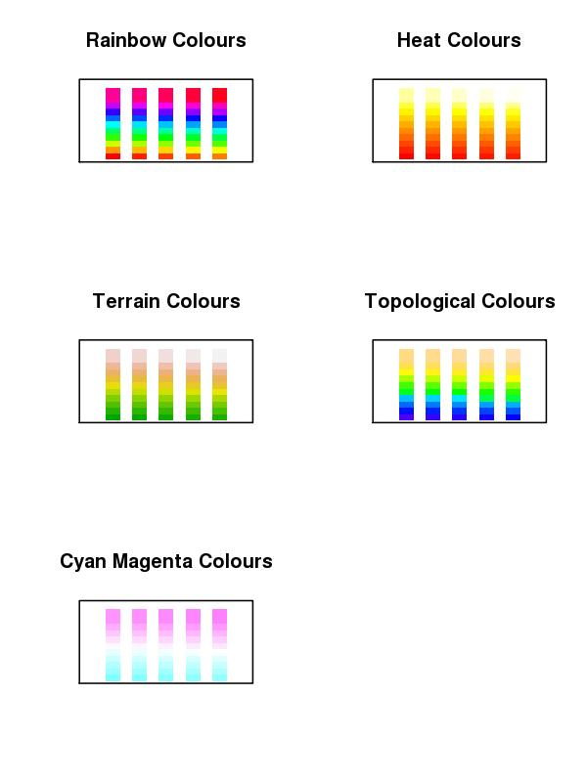
Colour Ramps & Palettes
Graphics
Heatmaps use colour depth to convey data values. Cold colours are typically low values, and light colours are high state values. This is a colour ramp.
R supports numerous graded colour charts. Specify n, to set the number of gradations required in the palette
rainbow(n)
heat.colors(n)
terrain.colors(n)
topo.colors(n)
cm.colors(n)
19_colourCharts.R
You can specify a user defined palette of indexed colours:
palette(rainbow(7)) # creates 7 indexed colours (1:7) based on # rainbow palette R O Y G B I V !!!

Slide 76
Colour packages: RColorBrewer
Graphics
This add on package provides a series of well defined colour palettes. The colours in these palettes are selected to permit maximum visual discrimination
Access the RColorBrewer library functions ...
library("RColorBrewer")
  Check out the available palettes
display.brewer.all(n=NULL, type="all", select=NULL, exact.n=TRUE)
  Define your own palette based on one of RColorBrewers'
myCol<-brewer.pal(n,"...") # n=number of colours, "..." is the palette name

Slide 77
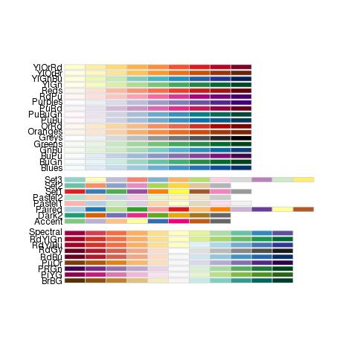
RColorBrewer named palettes
Graphics

Slide 78
Saving plots to files
Unless specified, R plots all graphics to the screen
To send plots to a file, you need to set up an appropriate graphics device …
postscript(file="a_name.ps", …)
pdf(file="…pdf", …)
jpeg(file=" …jpg", …)
png(file=" ….png", …)
    Each graphics device will have a specific set of arguments that dictate characteristics of the outputted file
      height=, width=, horizontal=, res=, paper=
        Top tip: jpg, A4 @ 300 dpi, portrait, size in pixels
        jpg(file="my_Figure.jpg", height=3510, width=2490, res=300)
        Postscript & pdf work in inches by default, A4 = 8.3" x 11.7"
Graphics devices need closing when printing is finished
dev.off()
for example:
png("tenPoints.png", width=300, height=300)
plot(1:10)
dev.off()

Slide 79
Thoughts when plotting to a file
Graphics
Its very tempting to send all graphical output to a pdf file. Caution!
  For high resolution publication quality images you need postscript. Set up postscript file capture with the following function
postscript("a_file.ps",paper="a4")
    postscript images can be converted to JPEG using ghostscript (free to download) for low resolution lab book photos and talks
  PDF images will grow too large for acrobat to render if plots contain many data points (e.g. Affymetrix MA plots)‏
  Automatically send multiple page outputs to separate image files using …file="somename%02d.jpg"
  Don’t forget to close graphics devices (i.e. the file) by using
    dev.off()

Slide 80
Plotting exercise
Graphics
Exercise:
  Make a full A4 page figure comprising of 6 plots: 2 each of XY plot (plot()), barchart (barplot()) and box plots (boxplot())
  The two version of each plots should consistent of: the default plot and a customised plot (change for instance colours, range, captions...)
  Output the completed 6-panel figure to: screen, jpeg, postscript and pdf file
Suggested route to solution:
1. Generate some plotting data appropriate for each type of plot
2. Write the code to produce the six plots, once plotting the data by using default plotting, one with some customisations you want
3. To output the plot to screen, jpeg, postscript and pdf you will need to redo the plot multiple times - create a function to do a plotting and call it by redirecting graphical output to screen, jpeg file, poscript file and pdf file
20_6PanelPlotScript.R

Slide 81
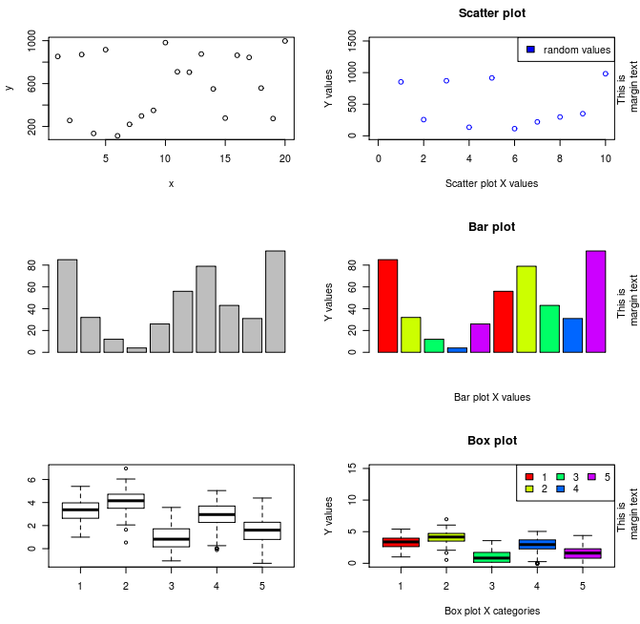
6 Panel plots exercise
Graphics

Slide 82
References
Official documentation on:
  http://cran.r-project.org/manuals.html
A good repository of R recipes:
  Quick-R: http://www.statmethods.net/
Don't forget that many packages come with tutorials (vignettes)
Website of this course:
  http://logic.sysbiol.cam.ac.uk/teaching/Rcourse/
R forums (stackoverflow & official):
  http://stackoverflow.com/questions/tagged/r
  http://news.gmane.org/gmane.comp.lang.r.general
Plenty of textbooks to choose from, comprehensive list + reviews:
  http://www.r-project.org/doc/bib/R-books.html

Slide 83
Thanks for your attention!
END OF COURSE

