Slide 1
Application UI Description Template
Instructions and examples are set in green text.
Enter information for all applicable items. If the application UI description is incomplete, the application can be rejected.
Before submitting the description file, delete the green instructions and examples. You must also delete this slide, and any unused slides.

Slide 3
Revision History
Version | Date | Description | Author | Related App Version
1.0 | 2012.01.01 | Change description | Author Name | 1.0

Slide 4
Contents
UI Structure
Use Cases
Menus and Functions
Remote Control Keys
Language Options

Slide 5
UI Structure
Illustrate the complete UI structure of your application.
  All application screens and navigation paths must be included.
Use a flow graph, tree structure, or depth navigation diagram.

Slide 6
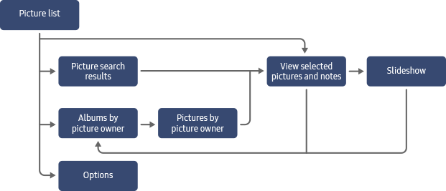
UI Structure
Flow Graph
The following diagram is an example only. After adding your own UI structure diagram, delete this slide.

Slide 7
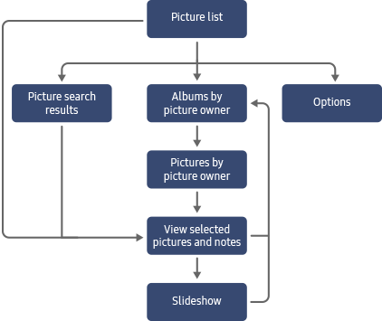
UI Structure
Tree Structure
The following diagram is an example only. After adding your own UI structure diagram, delete this slide.

Slide 8
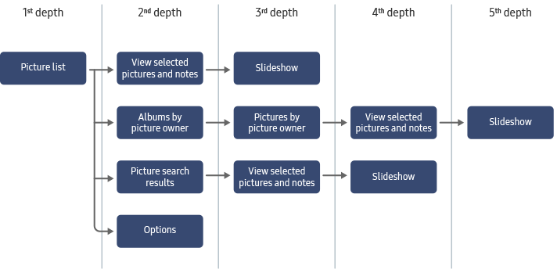
UI Structure
Depth Navigation
The following diagram is an example only. After adding your own UI structure diagram, delete this slide.

Slide 9
Contents
UI Structure
Use Cases
Menus and Functions
Remote Control Keys
Language Options

Slide 10
Use Cases
Describe the application functionality in detail, by dividing it into clear use cases. The use cases must cover the main functions or scenarios of the application.
You can use text, figures, and screenshots.
Label each use case with a title.
Create as many slides as you need.
In addition to application-specific features, you must also describe any general user login, menu browsing, and in-app purchase features.

Slide 11
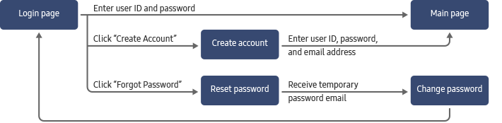
Use Cases – User Login
The following use case is an example only.
You must provide test account login and password info.
Login | Password
testaccount@example.com | MyTestAccount

Slide 12
Use Cases – Menu Browsing
The following use case is an example only.
To browse the video catalog:
  From the home page, click the “Menu” key. The application menu appears.
  Select “Explore” and click “OK”. The application moves to the “Explore” page, which shows a category list.
  Select a category and click “OK”. The application moves to the category page, which lists the videos in that category.
  You can select a video for playback from the video list, or click “Back” to return to the category list.

Slide 13
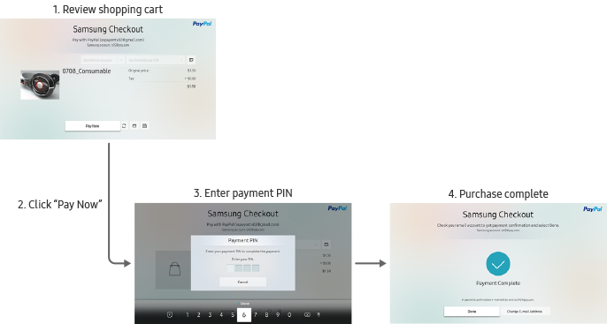
Use Cases – In-app Purchase
The following use case is an example only.

Slide 14
Contents
UI Structure
Use Cases
Menus and Functions
Remote Control Keys
Language Options

Slide 15
Menus and Functions
Use labeled screenshots to describe the UI elements on each application screen.
Create as many slides as you need.
Label the UI elements with numbers or text. If there are many elements, use number labels.
Describe the elements in a table.
If the screenshots are not in English, provide translations for titles, headings, and button labels.

Slide 16
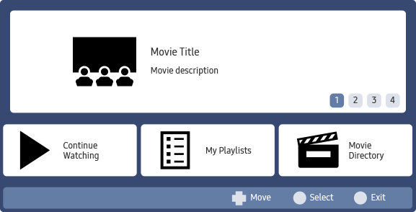
Menus and Functions
Example: Number Labels
The following illustration is an example only. You must use a screenshot.
No. | Description
1 | Banner slideshow linking to new movies
2 | Select the banner to display
3 | Continue playing a movie
4 | Move to the playlists page
5 | Move to the movie directory page
6 | Navigation help bar
1
2
3
4
5
6

Slide 17
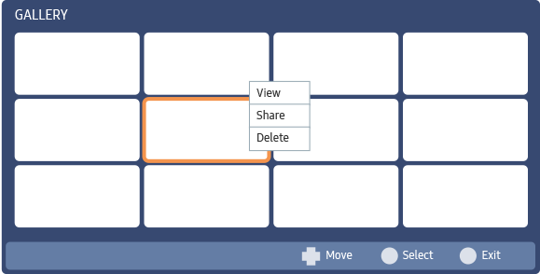
Menus and Functions
Example: Text Labels
The following illustration is an example only. You must use a screenshot.
Element | Description
Page title | Shows the page title.
Image grid | Shows the gallery images as a thumbnail grid. By default, the top-left image is selected.
Navigation help bar | Shows a guide to the remote control key functions.
Selected image | Shows the currently-selected image with a frame highlight. To change the selection, use the remote control arrow keys.
Popup menu | Shown by clicking “Select” on the selected image.
View image | Opens the image in fullscreen mode.
Share image | Opens the image sharing popup.
Delete image | Opens the delete image confirmation popup.
Page title
Image grid
Selected image
View image
Share image
Delete image
Navigation help bar
Popup menu

Slide 18
Contents
UI Structure
Use Cases
Menus and Functions
Remote Control Keys
Language Options

Slide 19
Remote Control Keys
If the application maps any remote control keys to custom functions, list the key mappings.
The “Return” and “Exit” key functions are mandatory and common to all applications. Do not modify them.
Key | Action | Remarks
RETURN | Move to previous page. Game applications must show a confirmation popup. | Mandatory. Do not modify.
EXIT | Close the application and show the TV broadcast channel. Game applications must show a confirmation popup. | Mandatory. Do not modify.
ENTER | Switch between full-screen and windowed mode
CHANNEL UP/DOWN | No action
UP/DOWN | No action
LEFT/RIGHT | Move highlight left/right
YELLOW | View information

Slide 20
Contents
UI Structure
Use Cases
Menus and Functions
Remote Control Keys
Language Options

Slide 21
Language Options
If the application supports multiple languages, describe how the user can switch the application language.
The following description is an example only.
To switch the application language:
  From the Picture List page, select “Options”.
  Select the language you want from the “Language” drop-down menu.
  Select “Save”.
  To use the application in the new language, exit and restart the application.
Otherwise, include the following text:
  The application does not support multiple languages.

