Slide 1
CCPlayTV
Application UI Description
Version 0.2.1 · Samsung Smart TV (Tizen)

Slide 2
Revision History
Version | Date | Description | Author | Related App Version
1.0 | 2026.10.17 | First UI description (first submission, commercial version) | John Costa | 0.2.1

Slide 3
Contents
UI Structure
Use Cases
Menus and Functions
Remote Control Keys
Language Options

Slide 4
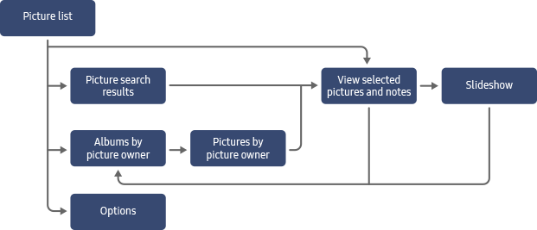
UI Structure
Flow Graph
All screens and navigation paths. RETURN always goes back one level; the list chip in the top bar goes back to the list selection.
Connect your playlist
On the website (QR) · Xtream Codes · M3U
Settings
Integrations · Playlists · Playback · Accessibility · About · Portal & license · Backup
Live TV
categories → channels + guide
Live player
CH +/- switches channel
Import progress
List actions
Resync · Edit · Delete · Configure
Movies
rows → category grid
Movie details
Watch → full-screen player
Splash
app launch
Select or Add your list
one card per playlist
Home
top bar + rows
Series
rows → category grid
Series details
season → episode → player
Radio
countries → stations
Now playing bar
station playing
Exit confirmation
RETURN on the list screen
License required
list opened after the 7-day trial
PIN prompt
locked category (Live TV, Movies, Series)
Pix purchase
R$35 · 12 months · one TV
Settings opens from the list screen or the gear in the top bar; Settings › Portal & license also opens the Pix purchase. List actions appear with DOWN on a list card; a locked category asks for the PIN. The website portal.ccplaytv.com (QR code on the TV) manages lists, license and settings from a phone or PC.

Slide 5
Contents
UI Structure
Use Cases
Menus and Functions
Remote Control Keys
Language Options

Slide 6
Use Cases
CCPlayTV organizes and plays the IPTV playlist (Xtream Codes or M3U) that the user already has. It does not provide or sell any content, channel or playlist.
No user account and no advertising. In-app purchase: a yearly license (R$35, 12 months, one TV) after a free 7-day trial, paid by Pix on the TV or by card on the website — one-time, no automatic renewal.
Use cases:
  1. Add a Playlist (Test Account)
  2. Trial and In-app Purchase
  3. Web Portal (Phone or PC)
  4. Watch Live TV
  5. Browse and Play Movies
  6. Watch a Series Episode
  7. Favorites, My List and History
  8. Listen to Radio
  9. Manage Lists, Categories and Parental Control

Slide 7
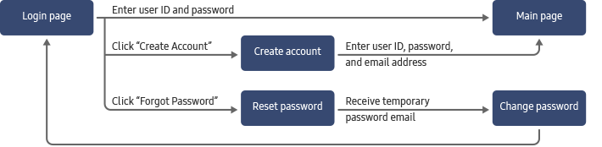
Use Cases – Add a Playlist
CCPlayTV has no user account and no login of its own. The only credential is the IPTV playlist the user already has (Xtream Codes or M3U). It is typed on the TV and stays on the TV.
1. On first launch the app opens "Connect your playlist". Otherwise, on "Select or Add your list", select "Add list" and press OK. The form opens on the "On the website" tab (see the portal use case).
2. Move to "Xtream Codes" (or "M3U list") and fill in Playlist name, Host, User name and Password with the on-screen keyboard.
3. Select "Connect and sync". The structure of the list is imported on the TV; when it finishes, select "Back".
4. Select the new list card and press OK: the Home screen opens.
Test playlist for the review (Xtream Codes):
Field | Value
Type | Xtream Codes
Host | <TEST_HOST>
User name | <TEST_USERNAME>
Password | <TEST_PASSWORD>

Slide 8
Use Cases – Trial and In-app Purchase
A new installation runs a free 7-day trial with every feature, counted on the TV — no account, voucher or payment needed. The reviewer tests the app inside this trial.
1. Settings › "Portal & license" shows the license status ("Trial"), its end date and the offer: R$35 for 12 months, for one TV, one-time purchase by Pix or card, no automatic renewal.
2. "Buy license" opens "Buy a license with Pix": price, QR code and copy-and-paste code for the bank app. Paying by card is done on the website portal.ccplaytv.com (same TV ID and key).
3. After paying, "Refresh" brings the license to the TV; the status changes to "Active" with the new end date.
4. When the trial (or the license) ends, opening a list shows "A license is required to open the list", with "Buy license", "Refresh" and "Back". Lists, favorites and settings are kept; the app itself keeps opening.
Payment is processed by Mercado Pago (Brazil). Nothing is charged automatically.

Slide 9
Use Cases – Web Portal (Phone or PC)
Optional: the TV works completely without the portal.
1. "Add list" › "On the website" (or Settings › "Portal & license") shows a QR code, the device ID and the device key.
2. On the phone, scan the QR code (or open portal.ccplaytv.com and type the ID and key). The website shows "Lists", "License" and "Settings" for this TV.
3. Add or edit a list on the website, then press "Reload"/"Refresh" on the TV: the list is imported on the TV.
4. The TV talks to the portal only when the user presses one of these buttons; nothing runs in the background.

Slide 10
Use Cases – Watch Live TV
1. On Home, move to "Live TV" in the top bar and press OK.
2. The left column lists the categories of the playlist. Select one and press OK to see its channels.
3. Each channel shows its number, logo and the current program when the playlist provides a guide (EPG). The right side shows the program now and the next ones.
4. Press OK on a channel to watch it in full screen. CHANNEL UP/DOWN switches to the previous/next channel.
5. RETURN closes the player and goes back to the channel, with the focus where it was.
Moving the focus never starts playback: only OK does.

Slide 11
Use Cases – Browse and Play Movies
1. On Home, select "Movies" in the top bar. Rows such as "Recently added" and "Top rated" are shown; LEFT opens the category list (★ Favorites, ↺ History, All and the categories of the playlist).
2. Press OK on a category or on "See all" to open the grid. The grid has "Search" and "Sort".
3. Press OK on a title to open its details: "Watch", "+ My List", "Similar", "Mark as watched", and the tabs Details / Cast / Similar.
4. "Watch" starts the movie. In the player, OK shows the controls: -10s, Pause, +10s, Audio, Quality, Aspect and Info.
5. A movie stopped in the middle shows "Resume from …" the next time.

Slide 12
Use Cases – Watch a Series Episode
1. On Home, select "Series" in the top bar and open a category, as for movies.
2. Press OK on a series. The details show the synopsis, "Watch T1:E1" (or "Continue" with progress), the season selector and the episode list.
3. Choose a season, move to an episode and press OK to play it.
4. RETURN goes back to the episode list, with the focus on the episode just watched.

Slide 13
Use Cases – Favorites, My List and History
1. Hold OK, or press the YELLOW key, on a channel, movie, series or radio station to add it to Favorites (the same gesture removes it).
2. Favorites appear in the "★ Favorites" category of each section and in the Home rows "My List" and "Favorite channels". Titles in progress appear in "Continue watching".
3. Titles already played appear in "↺ History". In the History grid, the RED key removes the focused title; the details screen also has "Remove from history".

Slide 14
Use Cases – Listen to Radio
1. Select "Radio" in the top bar. The left column has "★ Favorites", "Most played worldwide" and the countries.
2. Select a country to list its stations (public directory Radio Browser; it does not use the playlist).
3. Press OK on a station to play it; the "Now playing" bar shows it. STOP stops the radio.
4. Hold OK or press YELLOW to keep the station in Favorites.

Slide 15
Use Cases – Manage Lists, Categories and Parental Control
1. On "Select or Add your list", press DOWN on a list card: Resync, Edit, Delete and Configure.
2. "Configure" opens the settings of that list: Account & list, EPG, Categories & parental control, History.
3. In "Categories & parental control", categories can be hidden or locked with a PIN. Opening a locked category asks for the PIN (number keys or the on-screen keypad).
4. "Settings" (bottom right of the list screen, or the gear in the top bar) has: Integrations (optional TMDB key of the user, for synopses and images), Playlists, Playback, Accessibility (including Language), About & credits, Portal & license and Backup (encrypted backup of favorites, history and progress).

Slide 16
Contents
UI Structure
Use Cases
Menus and Functions
Remote Control Keys
Language Options

Slide 17
Menus and Functions
One slide per screen, with numbered labels on a real screenshot of this version.
Screenshots taken with the application in English and a fictional demo playlist (names, posters and logos invented for the demo). Content names come from the playlist and are not translated.
Every screen keeps one item focused (orange frame); the key guide at the bottom shows the keys of that screen.

Slide 18
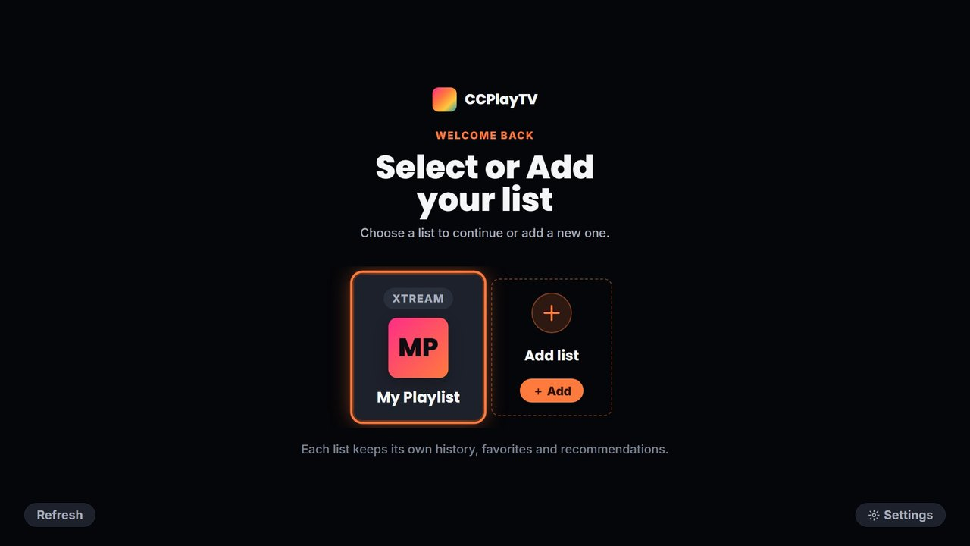
Menus and Functions
Select or Add your list
No. | Description
1 | List card (one per playlist). OK opens the list; DOWN shows Resync, Edit, Delete and Configure.
2 | "Add list": opens the playlist form.
3 | Settings for all lists.
4 | "Refresh": brings lists changed on the web portal.
1
2
4
3
RETURN on this screen shows the "Exit CCPlayTV?" confirmation.

Slide 19
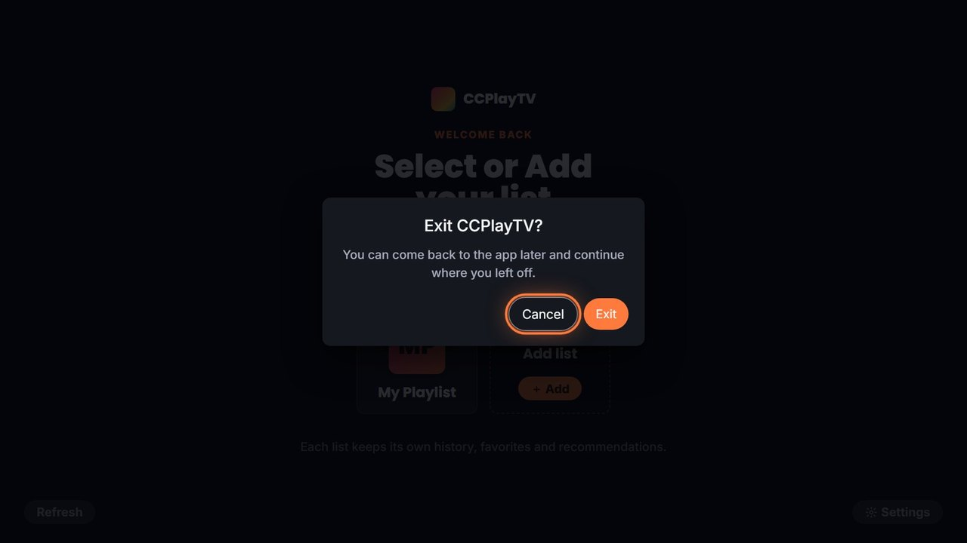
Menus and Functions
Exit confirmation
No. | Description
1 | "Cancel": closes the dialog (default focus).
2 | "Exit": closes the application.
1
2

Slide 20
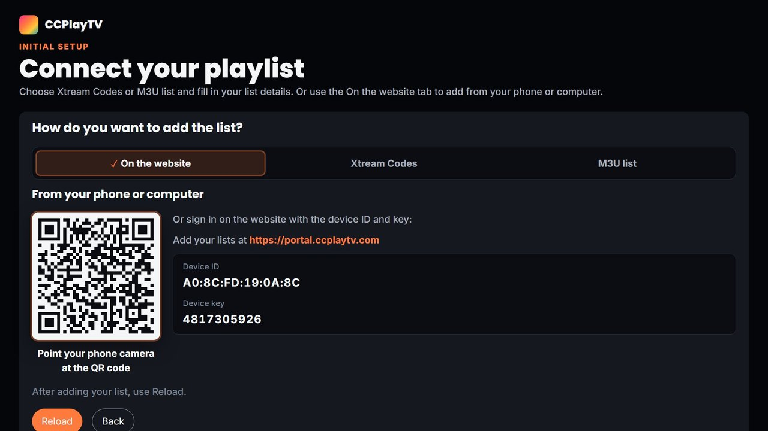
Menus and Functions
Connect your playlist › On the website
No. | Description
1 | Tabs: On the website (default), Xtream Codes, M3U list.
2 | QR code: opens the web portal for this TV on the phone.
3 | Portal address.
4 | Device ID and device key, to sign in on the website.
5 | "Reload": imports lists added on the website. "Back": returns.
1
3
2
4
5

Slide 21
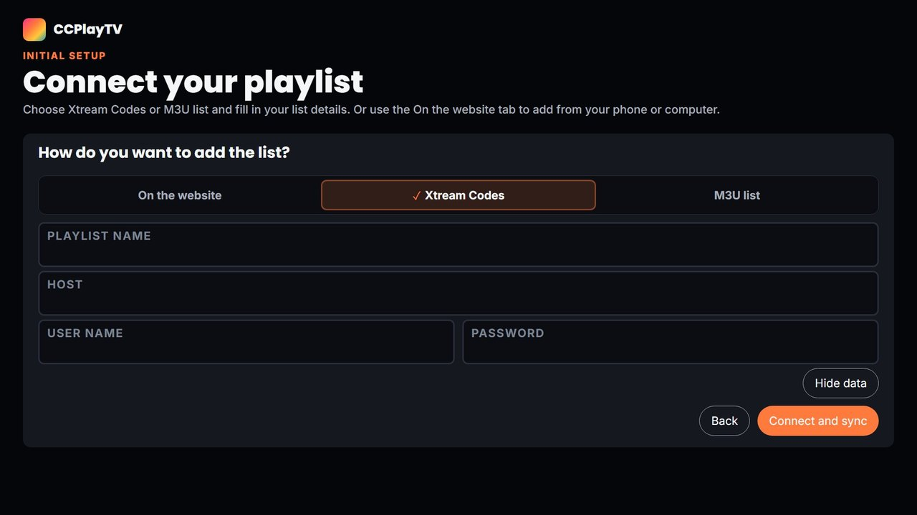
Menus and Functions
Connect your playlist › Xtream Codes
No. | Description
1 | Type of list: Xtream Codes or M3U list (M3U asks for the list URL).
2 | Playlist fields. OK on a field opens the on-screen keyboard.
3 | "Hide data": masks or shows the typed values.
4 | "Back": returns without saving.
5 | "Connect and sync": checks the list and imports it on the TV.
1
2
3
4
5

Slide 22
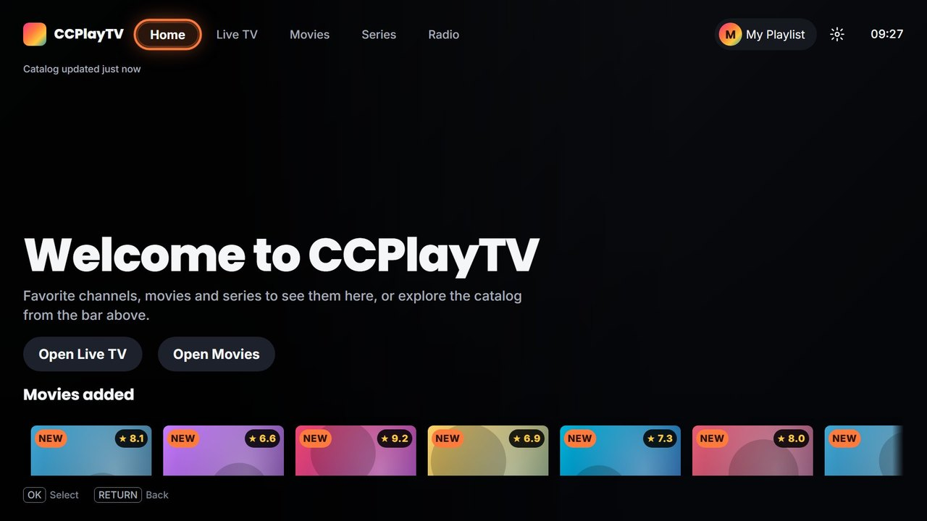
Menus and Functions
Home
1
No. | Description
1 | Top bar: Home, Live TV, Movies, Series and Radio.
2 | Active list: OK returns to the list selection.
3 | Settings.
4 | Catalog status (last update of the list).
5 | Shortcuts to Live TV and Movies.
6 | Rows: Continue watching, My List, Favorite channels, Movies added, Series added.
7 | Key guide of the current screen.
4
2
3
5
6
7

Slide 23
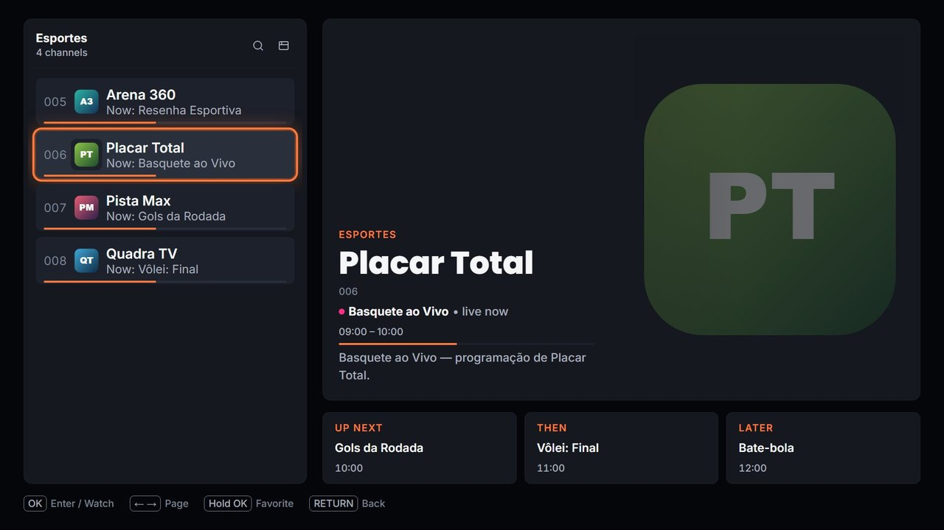
Menus and Functions
Live TV
No. | Description
1 | Current category and number of channels.
2 | Search this category and Full guide.
3 | Channel list: number, logo, name and program now (when the list has a guide).
4 | Focused channel: program now, time and progress.
5 | Next programs.
6 | Key guide.
1
2
3
4
5
6
OK on a channel plays it in full screen; hold OK or YELLOW adds it to Favorites.

Slide 24

Menus and Functions
Live TV player
No. | Description
1 | Channel banner: LIVE, number, logo, name and current program with progress.
1
CHANNEL UP/DOWN switches channel. No seek bar on live channels: controls follow what the stream supports.

Slide 25
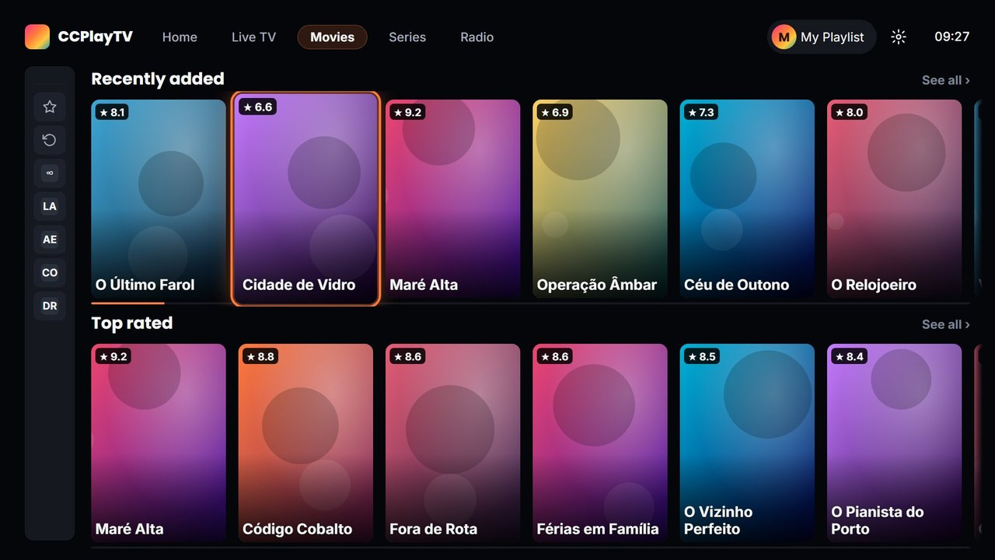
Menus and Functions
Movies (Series has the same layout)
1
No. | Description
1 | Top bar with the current section.
2 | Category list: ★ Favorites, ↺ History, All and the categories of the playlist.
3 | Rows: Recently added, Top rated and others.
4 | Focused title with rating.
5 | "See all": opens the grid of the row.
2
3
5
4

Slide 26
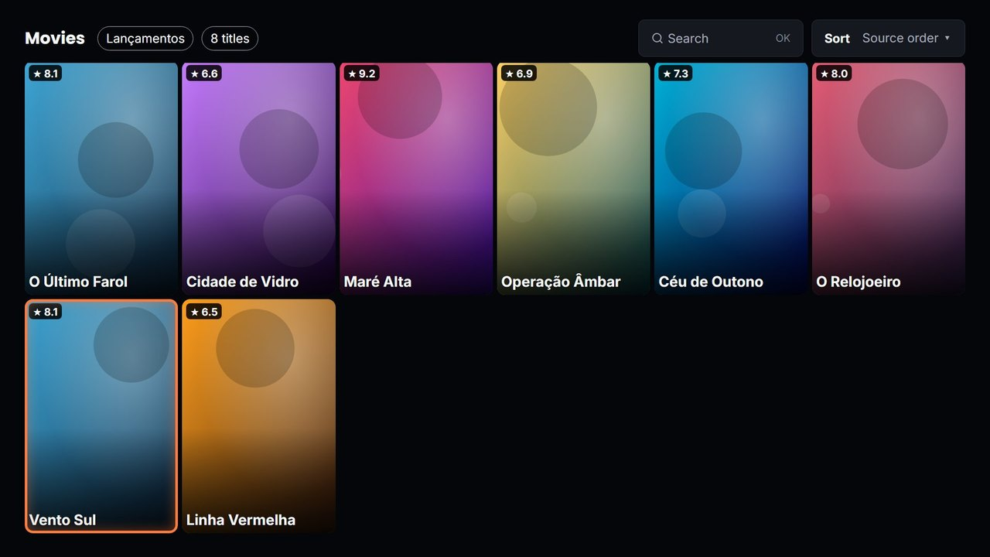
Menus and Functions
Category grid
1
2
3
No. | Description
1 | Section, category and number of titles.
2 | "Search" in this category.
3 | "Sort": source order, A–Z, year, recently added, rating.
4 | Grid of titles. OK opens the details.
4

Slide 27
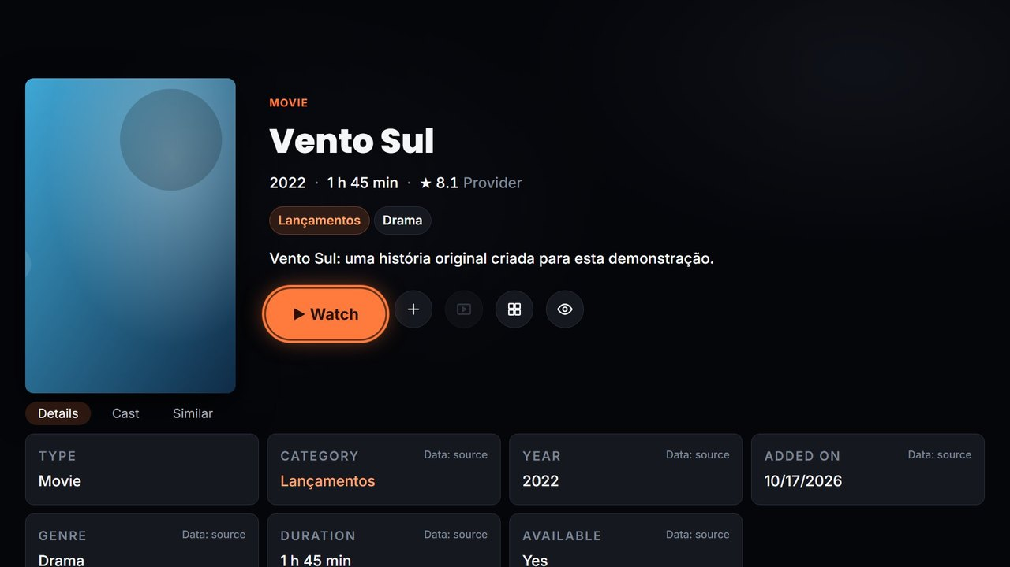
Menus and Functions
Movie details
No. | Description
1 | Title, year, duration and rating.
2 | Category and genres.
3 | "Watch" (or "Resume from …").
4 | "+ My List".
5 | Trailer (available with a TMDB key).
6 | "Similar" titles.
7 | "Mark as watched".
8 | Tabs: Details, Cast, Similar.
1
2
3
4
5
6
7
8

Slide 28
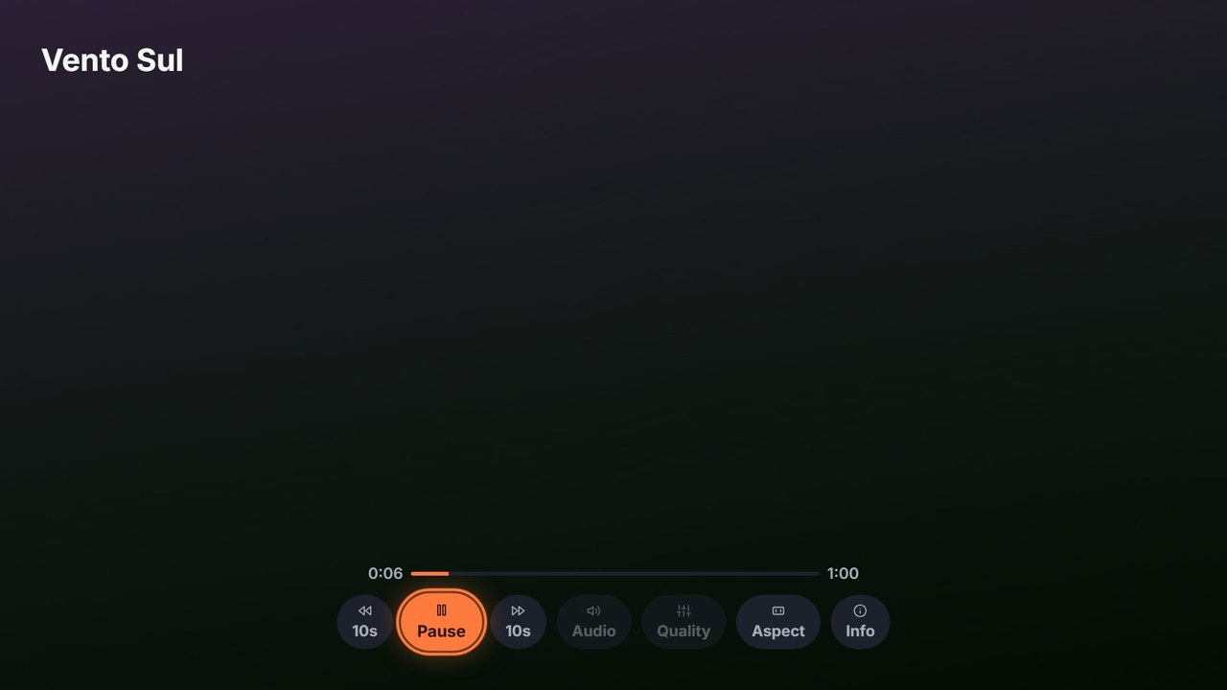
Menus and Functions
Movie / episode player
No. | Description
1 | Title.
2 | Position, progress and duration.
3 | -10s, Pause/Play, +10s.
4 | Audio and Quality (enabled when the stream has options).
5 | Aspect: Fit, Fill, Original, Zoom.
6 | Info about the title.
1
2
3
4
5
6

Slide 29
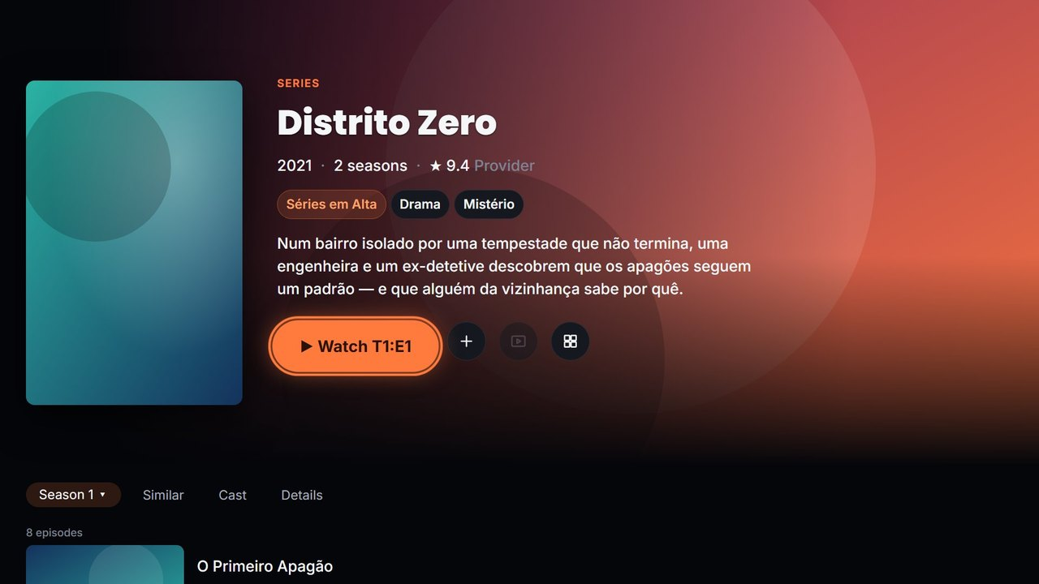
Menus and Functions
Series details
No. | Description
1 | Title, year, seasons and rating.
2 | "Watch T1:E1" (or "Continue" an episode in progress).
3 | "+ My List".
4 | "Similar" titles.
5 | Season selector.
6 | Tabs: Similar, Cast, Details.
7 | Episode list. OK plays the episode.
1
3
4
2
5
6
7

Slide 30
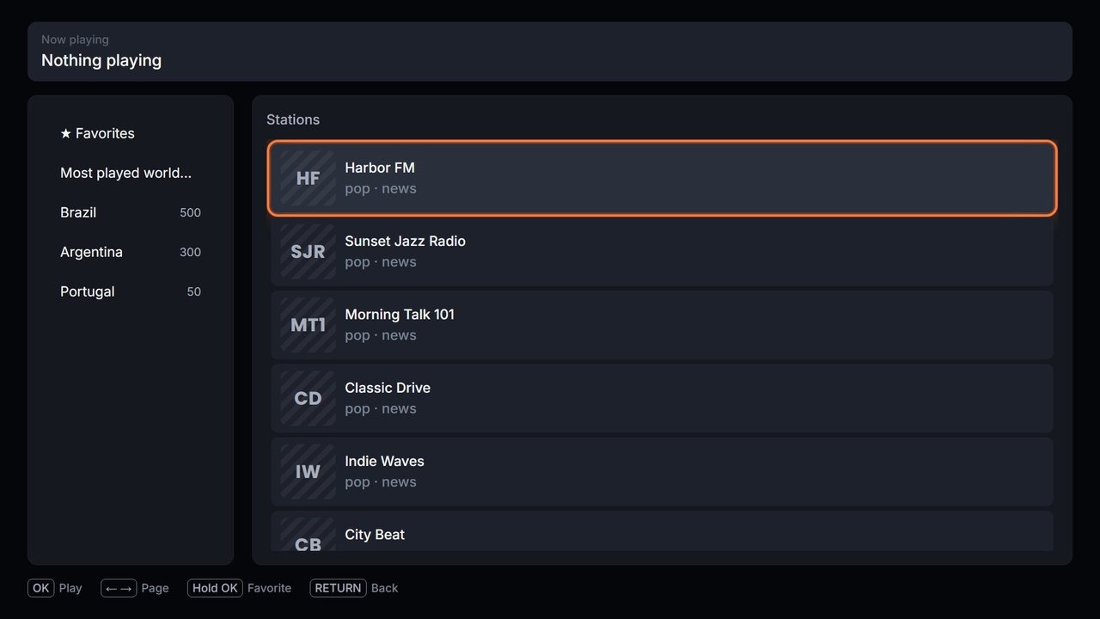
Menus and Functions
Radio
No. | Description
1 | "Now playing" bar.
2 | ★ Favorites, Most played worldwide and countries.
3 | Stations of the selected country. OK plays.
4 | Key guide.
1
2
3
4
Stations come from the public Radio Browser directory; STOP stops the radio.

Slide 31
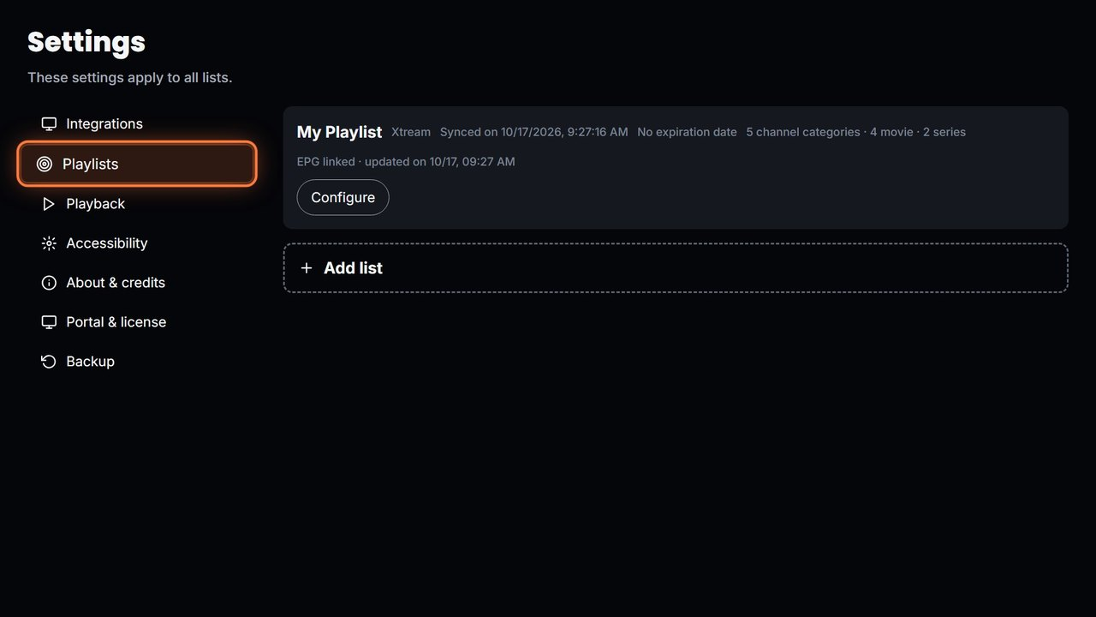
Menus and Functions
Settings
No. | Description
1 | Tabs: Integrations, Playlists, Playback, Accessibility, About & credits, Portal & license, Backup.
2 | A playlist: type, last sync, guide (EPG). "Configure" opens its settings.
3 | "Add list".
1
2
3
Integrations: optional TMDB key of the user. Accessibility: Reduce motion and Language.

Slide 32
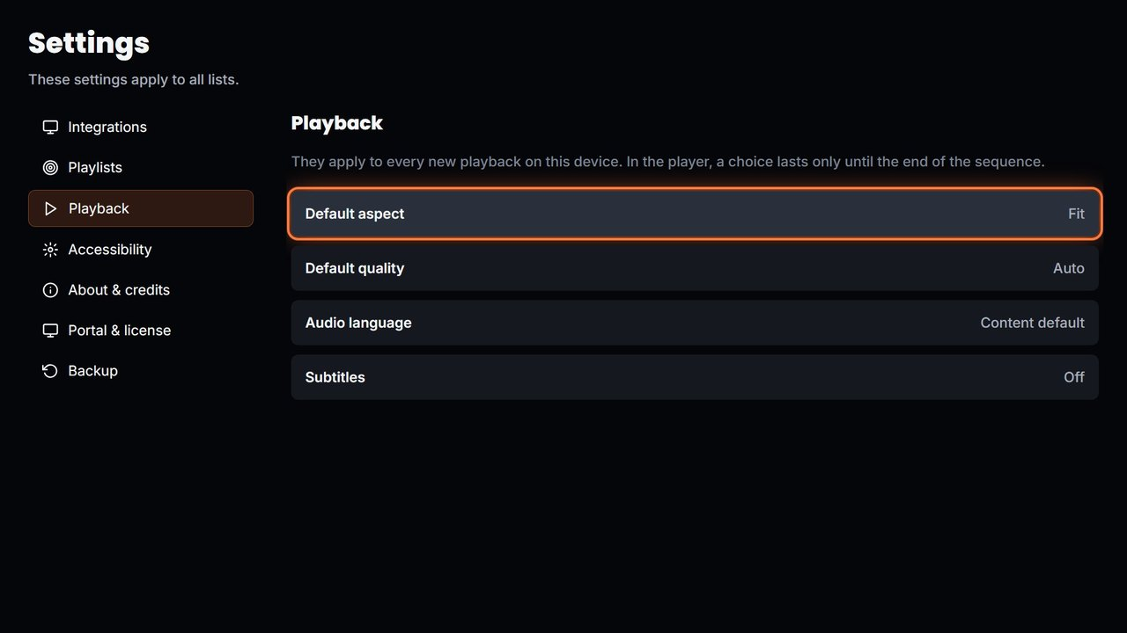
Menus and Functions
Settings › Playback
No. | Description
1 | Default aspect.
2 | Default quality.
3 | Audio language.
4 | Subtitles.
1
2
3
4

Slide 33
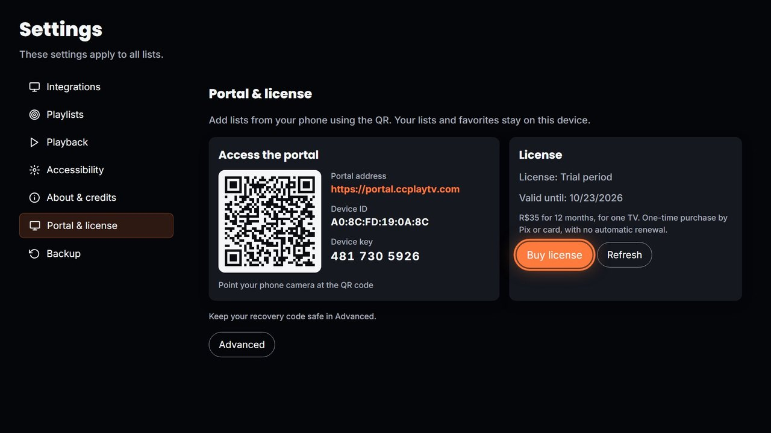
Menus and Functions
Settings › Portal & license
No. | Description
1 | Access the portal: QR code, portal address, device ID and device key.
2 | Portal & license and Backup tabs.
3 | License status ("Trial" or "Active"), end date and the offer: R$35 for 12 months.
4 | "Buy license" (Pix on the TV) and "Refresh" (brings the license after paying).
5 | "Advanced": recovery code, new key and Unlink.
1
3
2
4
5

Slide 34
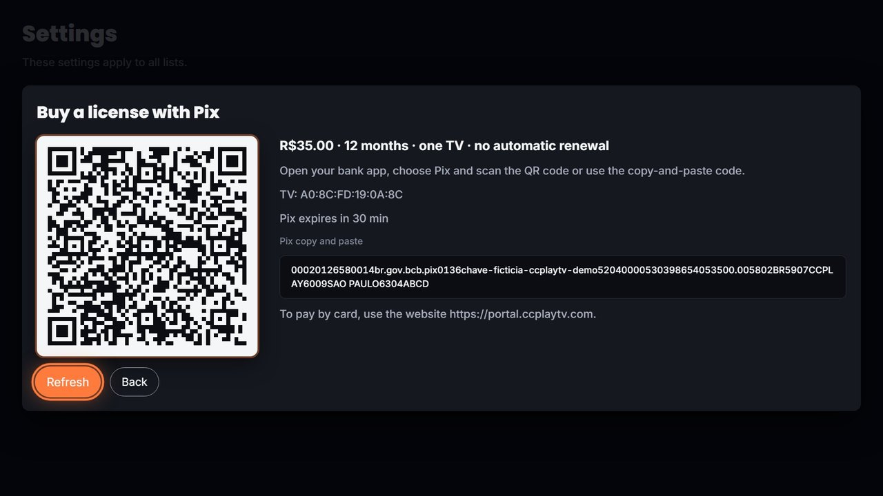
Menus and Functions
Buy a license with Pix
No. | Description
1 | Pix QR code for the bank app.
2 | Price and terms: R$35.00, 12 months, one TV, no automatic renewal.
3 | Pix copy-and-paste code.
4 | Card payment: on the website.
5 | "Refresh": checks the payment and activates the license.
6 | "Back": returns without paying.
2
1
3
4
6
5
Payment processed by Mercado Pago. Screenshot with a fictional Pix code.

Slide 35
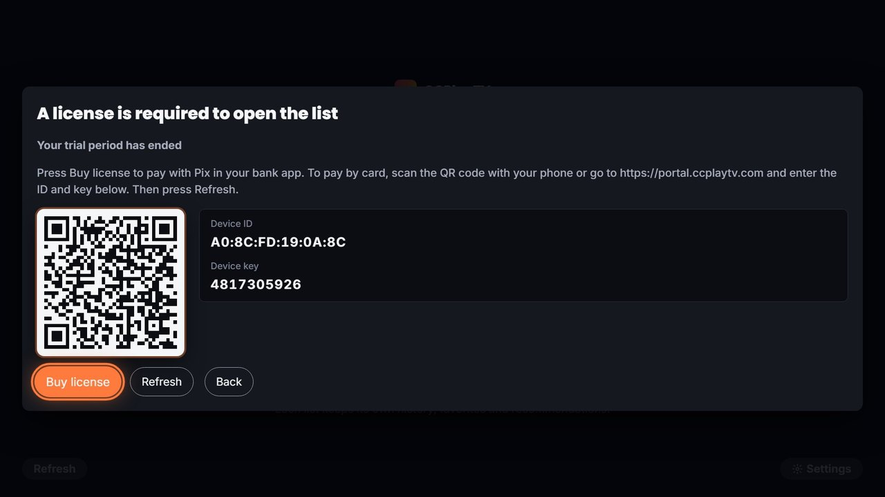
Menus and Functions
License required (after the trial)
No. | Description
1 | Shown when a list is opened after the 7-day trial (or the license) ends.
2 | QR code, device ID and key: pay by card on the website.
3 | "Buy license": Pix on the TV.
4 | "Refresh": brings a license paid on the website.
5 | "Back": returns to the list selection; lists and favorites are kept.
1
2
3
4
5

Slide 36
Contents
UI Structure
Use Cases
Menus and Functions
Remote Control Keys
Language Options

Slide 37
Remote Control Keys
Only the keys below are used. RETURN and EXIT keep their standard behavior.
Key | Action | Remarks
RETURN | Move to the previous screen; the focus goes back to the item you came from. On the list selection screen, shows the "Exit CCPlayTV?" confirmation. | Mandatory. Not modified.
EXIT | Close the application and show the TV broadcast channel. | Mandatory. Not modified.
UP / DOWN / LEFT / RIGHT | Move the focus between top bar, categories, rows, cards and buttons. Moving the focus never starts playback.
ENTER (OK) | Open the focused item or press the focused button. On a channel or episode, start playback. In the player, show the controls.
Hold ENTER (OK) | Add/remove the focused channel, movie, series or station to/from Favorites.
YELLOW | Same as holding OK: add/remove Favorites. | Where items can be favorited

Slide 38
Remote Control Keys
Key | Action | Remarks
RED | Remove the focused title from "↺ History". | History grid only
PLAY / PAUSE | Play or pause the movie or episode. | Player
STOP | Close the player. In Radio, stop the station. | Player, Radio
REW / FF | Jump 10 seconds back / forward. | Only when the stream can seek
CHANNEL UP / DOWN | Live TV player: previous / next channel. Live TV guide: previous / next page. | Live TV
0 – 9 | Type the parental-control PIN. | PIN prompt

Slide 39
Contents
UI Structure
Use Cases
Menus and Functions
Remote Control Keys
Language Options

Slide 40
Language Options
The application is available in English, Portuguese and Spanish.
By default it follows the TV language when it is one of these three (otherwise Portuguese).
To switch the application language:
  From "Select or Add your list", select "Settings" (or the gear in the top bar).
  Select "Accessibility", then "Language".
  Choose English, Português or Español. The new language applies immediately, no restart needed.
Names coming from the playlist (channels, categories, titles) are shown as the provider declares them and are not translated.

