Slide 1
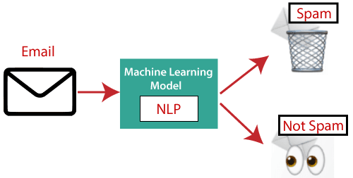
Email Spam Detection using NLP
The Email Spam Detection system employs Natural Language Processing (NLP) and Python's Machine Learning capabilities. By utilizing a dataset comprising numerous emails, the system extracts crucial words.
With the help of machine learning algorithms, it determines whether an email falls into the spam or non-spam category, providing an effective solution to identify and filter out unwanted emails.

Slide 2
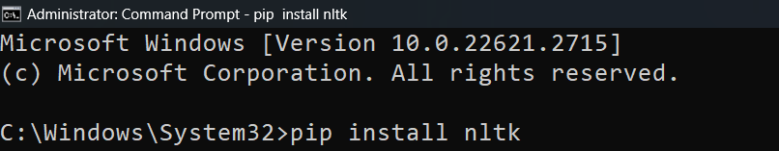
Installing Libraries
OpenCV-Contrib : pip install nltk

Slide 3


Email Spam Detection
using NLP

