Slide 1

SPARK STREAMING

Slide 2

Batch processing systems like Apache Hadoop have high latency that is not suitable for near real time processing requirements. Hadoop is used mostly for batch processing while Storm is used for stream processing. Storm guarantees a record if it hasn’t processed but can lead to inconsistency with repetition of record processing. The state is lost if a node running Storm goes down. Storm also causes an increase in code size, number of bugs to fix, development effort, and learning curve.

Slide 3
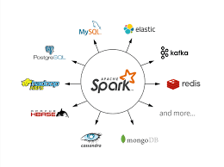
This creates differences between Hadoop and Spark. Spark Streaming helps in fixing these issues and provides a scalable, efficient, resilient, and integrated (with batch processing) system. Spark has provided a unified engine that natively supports both batch and streaming workloads. Spark’s single execution engine and unified Spark programming model for batch and streaming lead to some unique benefits over other traditional streaming systems. Spark Streaming has rapidly adopted disparate data processing capabilities in a unified way. Developers can use a single framework to satisfy their processing needs. Data from streaming sources can be combined with a range of static data sources via Apache Spark SQL.

Slide 4

Spark Streaming was added to Apache Spark in 2013, an extension of the core Spark API that provides scalable, high-throughput and fault-tolerant stream processing of live data streams. Data ingestion can be done from many sources like Kafka, Apache Flume, Amazon Kinesis and TCP sockets. Processing can be done with algorithms using high-level functions like map, reduce, join and window. The resulting processed data can be pushed out to filesystems, databases and live dashboards. Its internal working is as follows. Live input data streams is received and divided into batches by Spark streaming, these batches are then processed by the Spark engine to generate the final stream of results in batches.

Slide 5
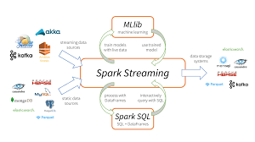
Instead of processing the streaming data one record at a time, Spark Streaming splits data into tiny batches called RDDs. Spark Streaming receivers accept data in parallel and buffer it in the memory of Spark’s workers nodes. Then the latency-optimized Spark engine runs short tasks to process the batches and output the results to other systems. Unlike a traditional continuous operator model, where the computation is statically allocated to a node, Spark tasks are assigned to the workers dynamically based on available resources and data locality. This enables better load balancing and faster fault recovery. Each batch of data is a Resilient Distributed Dataset in Spark. This allow them to function as an abstraction of a fault-tolerant dataset allowing streaming data to be processed using any Spark code or library.

Slide 6
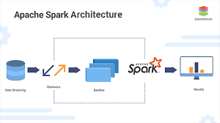
a) Dynamic load balancing allows for fine-grained allocation of computations to resources. b) Fast failure and straggler recovery small batch/small tasks that can run anywhere without affecting correctness. Failed tasks can distribute evenly on other nodes for recomp/recovery. c) Unification of batch, streaming and interactive analytics Batch and streaming interoperate seamlessly. Spark functions can be applied to each batch of streaming data. d) Advanced analytics like machine learning Spark works with libraries like: MLlib, SQL, DataFrames, GraphX.. e) Performance batch data leads higher throughput with latencies of a few hundred milliseconds.

Slide 7
Spark transformations allow modification of the data from streams. Streams support: map(), flatMap(), filter(), repartition(numPartitions), union(otherStream), count(), reduce(), countByValue(), reduceByKey(func, [numTasks]), join(otherStream, [numTasks]), cogroup(otherStream, [numTasks]), transform(), updateStateByKey(), Window() Output Operations in Apache Spark Stream data push out to external systems like a database or file systems using Output Operations. The following output operations define as: print(), saveAsTextFiles, saveAsObjectFiles, saveAsHadoopFiles, foreachRDD(func). By default, output operations execute one-at-a-time. And they executes in the order they are define in the Spark applications.

Slide 8
CODE
See R code examples on Github

