Slide 1

DEADLOCK
By :
S.Abarna

Slide 2
Deadlock
A process request the resources ,the resources are not available at that time , so that process enter into the waiting state .The requesting resources are held by another waiting process , both are in waiting state. This situation is said to be deadlock

Slide 3
Index
Introduction
Conditions for deadlock
Strategies
Deadlock issues
Deadlock detection
Recovery from deadlock
Deadlock prevention
Deadlock avoidance

Slide 4
Introduction
A deadlock occurs when two transactions wait indefinitely for each other to unlock data.
Occur In a multi-process system.
Either the transactions involved in deadlock are rolled back and restarted.

Slide 5
Example
For example, a deadlock occurs when two transactions, T1 and T2, exist in the following
mode:
T1 = access data items X and Y
T2 = access data items Y and X
If T1 has not unlocked data item Y, T2 cannot begin; if T2 has not unlocked data item X,
T1 cannot continue.

Slide 6
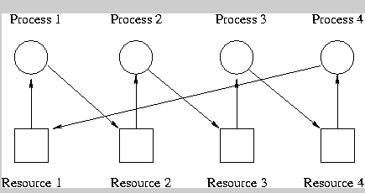

Slide 7
Conditions for deadlocks
1) Mutual exclusion
The resources involved must be unshareable
Each resource is either currently allocated to exactly one process or it is available. (Two processes cannot simultaneously control the same resource ).

Slide 8
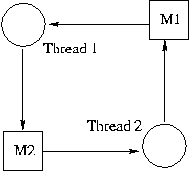
MUTUAL EXCLUSION

Slide 9
2. Hold and Wait Condition
There must exist a process that is holding at least one resource and is waiting to acquire additional resources that are currently being held by other processes.

Slide 10
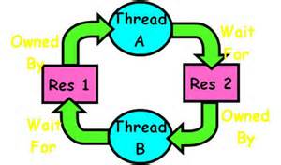
HOLD AND WAIT

Slide 11
3. No Preemption Condition
The processes must not have resources taken away while that resource is being used.

Slide 12
4. Circular Wait Condition
In circular wait a chain of processes exists in which each process waits for one or more resources held by the next process in the chain

Slide 13
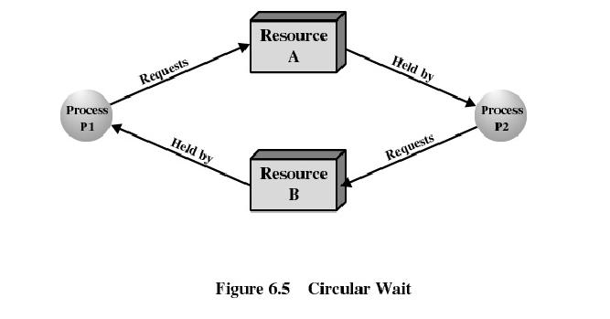

Slide 14
Strategies to deal with deadlock
In general, there are four strategies of dealing with deadlock problem:-
.Deadlock Detection and Recovery
.Deadlock Avoidance
.Deadlock Prevention

Slide 15
1. Deadlock Detection and Recovery
– The system lets deadlocks occur.
– The system tries to detect when a deadlock occurs
– When a deadlock is detected, some action is taken to try to recover from it

Slide 16
– One technique for detecting deadlocks is to build a resource graph
• A circle represents a process
• A square represents a resource
• A directed arc from a resource to a process denotes ownership of a resource
• A directed arc from a process to a resource denotes a request for a resource

Slide 17
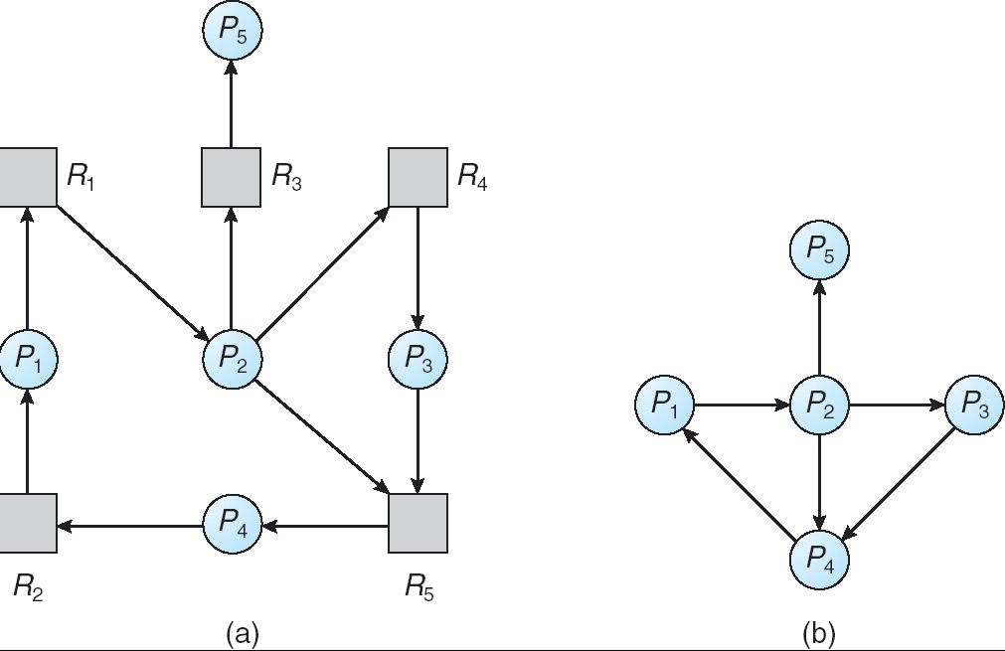

Slide 18
2) Deadlock Avoidance
Carefully analyze each resource request to see if it can be safely granted.
avoid deadlock by only granting resources if granting them cannot result in a deadlock situation later.
Need an algorithm that can always avoid deadlock by making right choice all the time.

Slide 19
3) Deadlock Prevention
– Try to eliminate one of the four conditions of deadlock
Relaxing mutual exclusion requires making all relevant resources sharable. Some resources can be made sharable
But it is not always possible. For ex-only one user can use a printer at a time and if more than one user will try access it then deadlock may occur

Slide 20
• Hold and wait condition
Only allocate all resources at once
Only allocate resource when process has none
This results in poor resource utilitization

Slide 21
3) No-Preemption
A process holding certain resources is denied a further request, that process must release its original resources.

Slide 22
4) Circular wait
Impose ordering on resources
• Give all resources a ranking; must acquire highest
ranked first
E.G. Always acquire resources in numerical order
• Need not acquire them all at once!
1) Image setter
2) Scanner Numerically ordered
3) Plotter resources
4) Tape Drive
5) CD Rom Drive

Slide 23
THANK YOU

