Slide 1
Tool Design
Geospatial Wetland Assessment Tool
“GeoWET”

Slide 2
Data Prep - Overview
Assemble stream/catchment data: NHD+/EPA StreamCat dataset
Download regional files and merge into single study-wide files
Attach catchment GRIDCODE, FEATUREID, and HUC12 values for joining
Prepare species occurrence data: Endries dataset
Identify indicator species for each ecoregions
Run Maxent models on all indicator species
Create Maxent input files (“SWD files”) for each from StreamCat + spp data
Run Maxent → Creates “lambda file”
Notes:
SWD involved
Identifying the HUC8s in which the species occurs
Removing HUCs with no data (where the species was not found)
Remove attributes with no data (where the species occurs)
Remove attributes not correlated with presence/absence
Remove attributes cross correlated with other attributes (selecting one with higher P/A correlation)

Slide 3
Project analysis workflow - 1
User draws boundary of proposed wetland
Model identifies the catchment in which the project as well as all downstream catchments
Model adjusts the area of each land cover type in the project catchment and cumulative areas in all downstream catchments
Overall land cover
Land cover in low/med/high slope categories
Land cover inside riparian areas

Slide 4
Project analysis workflow - 1
Model creates a Maxent projection files (SWD format) consisting of the project catchment and all downstream catchments
…under current/unmodified conditions (without wetland)
…under altered conditions (with wetland)
Both projection files are run against lambda file created in initial Maxent analysis
computes habitat likelihood under current and modified conditions
Compute uplift → Modified – Current habitat likelihoods
Computed for each indicator species and averaged

Slide 5
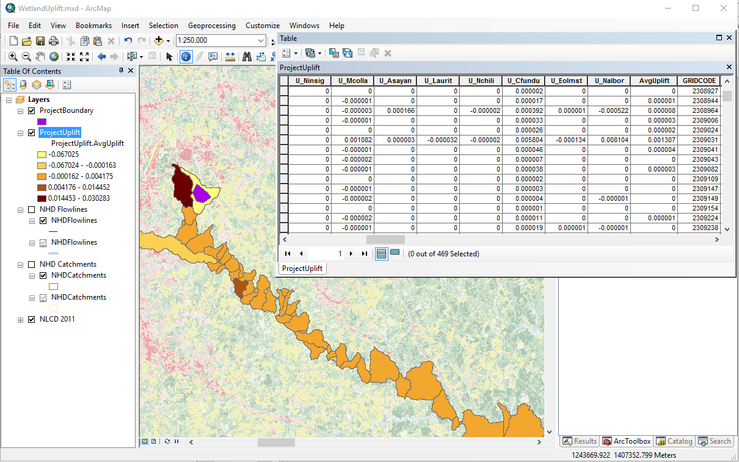
Demo

Slide 6
What’s next
Incorporate changes to other StreamCat attributes into contingent with wetland area
e.g., Use water models to estimate change in mean runoff, base flow, nutrients…
These revised conditions will go into Maxent projection models
Compare uplift with future uplift using FUTURES model outputs
Compute current and modified habitat likelihoods using 2030 NLCD
Link with terrestrial habitat uplift models/GeoHAT…

Slide 7
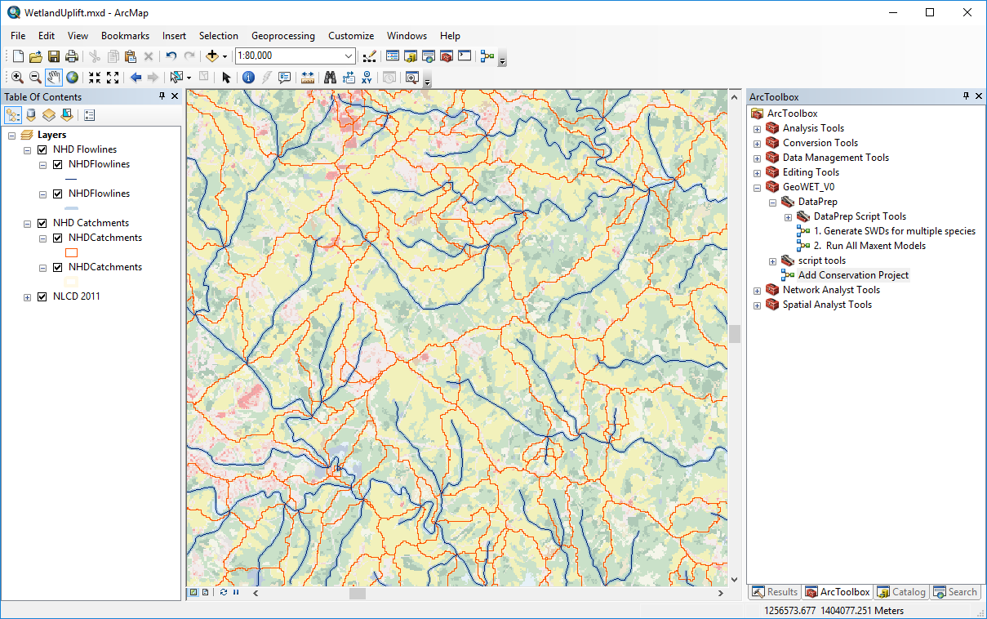
Demo

Slide 8
Data Prep: 1
Download regional StreamCat data files
ftp://newftp.epa.gov/EPADataCommons/ORD/NHDPlusLandscapeAttributes/StreamCat
Use MergeStreamCatCSVFiles.py to combined files across regions into single StreamCat csv files
Region 03N
Stream Cat
CSV files
Region 05
Stream Cat
CSV files
Region 06
Stream Cat
CSV files
Stream Cat
CSV files
Stream Cat
CSV files
Stream Cat
CSV files
Stream Cat
CSV files
Stream Cat
CSV files
Stream Cat
CSV files
Merge CSV Files
HUC12Lookup.csv
Stream Cat
CSV files
Stream Cat
CSV files
Stream Cat
CSV files
GeoWET\Data\StreamCat\AllRegions\...
Notes:
HUC12Lookup add additional joining fields to facilitate processing.

Slide 9
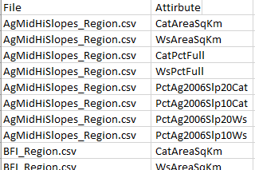
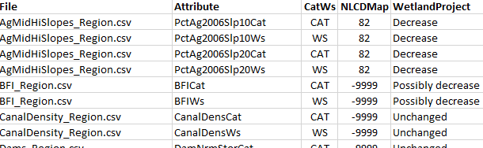
Data Prep: 2
Generate StreamCat attribute list: Create a CSV file listing all the attributes included in the Stream Cat data alongside the file in which they occur. This is used in later scripts to extract specific attributes from the proper file.
Set additional attribute filters: Manually pivot the list and add columns indicating whether the attribute is for the catchment (CAT) or entire watershed area (WS). Also indicate the NLCD class aligned with the attribute (or -9999 if none).
C:\Workspace\GeoWET\Data\
StreamCat\StreamCatInfo.csv
C:\Workspace\GeoWET\Data\
StreamCat\StreamCatInfo.xlsx
Notes:
The additional attribute filters are used in modeling changes in specific StreamCat attributes associated with project changes. This example shows the listings associated with wetland increase. The 1st four lines indicate that Ag in MidHiSlopes will potentially decrease, e.g. if a proposed wetland replaces ag in those areas.

Slide 10

Data Prep: 3
Create table of indicator species per ecoregion: This file is read by scripts to determine which species require MaxEnt Species With Data (SWD) files are created for various scenarios.
CommonName | ScientificName | MACP | PIEDMONT | BLUERIDGE | SE_PLAINS
American Eel | Anguilla_rostrata | 1 |  |  | 1
Bluehead Chub | Nocomis_leptocephalus |  | 1
Bluespotted Sunfish | Enneacanthus_gloriosus | 1 |  |  | 1
Chainback Darter/Piedmont Darter | Percina_nevisense |  | 1
Creek Chubsucker/Spotted Sucker | Erimyzon_oblongus | 1 |  |  | 1
Dusky Shiner/Swallowtail Shiner/Ironcolor Shiner/Highfin Shiner | Notropis_cummingsae | 1 |  |  | 1
Eastern Mudminnow | Umbra_pygmaea | 1 |  |  | 1
Fantail Darter/Carolina Fantail Darter | Etheostoma_flabellare |  | 1
Greenfin Darter/Redline Darter | Etheostoma_chlorobranchium |  |  | 1
Highfin Shiner | Notropis_altipinnis |  | 1
Kanawha Darter/Swannanoa Darter | Etheostoma_kanawhae |  |  | 1
Longnose Dace | Rhinichthys_cataractae |  |  | 1
Margined Madtom | Noturus_insignis |  | 1
Mottled Sculpin (where native) | Cottus_bairdi |  |  | 1
Mountain Brook Lamprey | Ichthyomyzon_greeleyi |  |  | 1
Mud Sunfish | Acantharchus_pomotis | 1 |  |  | 1
Northern Hog Sucker (where native) | Hypentelium_nigricans |  |  | 1
Notchlip Redhorse | Moxostoma_collapsum |  | 1
Pirate Perch | Aphredoderus_sayanus | 1 | 1 |  | 1
Rainbow Trout | Oncorhynchus_mykiss |  |  | 1
Redbreast Sunfish | Lepomis_auritus |  | 1
Redfin Pickerel | Esox_americanus | 1 |  |  | 1
Redlip Shiner (where native)/Greenhead Shiner/Piedmont Shiner | Notropis_chiliticus |  | 1
River Chub/Bluehead Chub/Bigmouth Chub | Nocomis_micropogon |  |  | 1
Rosyside Dace | Clinostomus_funduloides |  | 1
Tadpole Madtom | Noturus_gyrinus | 1 |  |  | 1
Tennessee Shiner (where native)/New River Shiner | Notropis_leuciodus |  |  | 1
Tessellated Darter/Johnny Darter | Etheostoma_olmstedi | 1 | 1 |  | 1
Warpaint Shiner (where native) | Luxilus_coccogenis |  |  | 1
Whitemouth Shiner/Swallowtail Shiner (where native) | Notropis_alborus |  | 1
AquaticSpeciesList.xlsx
Notes:
The AQUATIC_CreateAllSpeciesSWDFiles.py script combines script presence absence data with catchment attributes to create a MaxEnt S

Slide 11
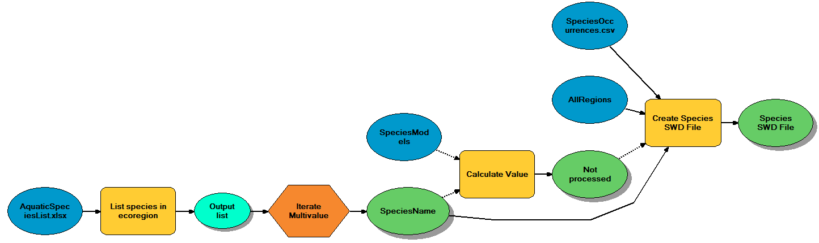
Data Prep: 4
Create MaxEnt Species With Data (SWD) files for all indicator species: This file is read by scripts to determine which species require MaxEnt Species With Data (SWD) files are created for various scenarios.
Iterates through all species listed in the AquaticSpeciesList.xlsx file
For each species:
Identifies HUC8s in which species occurs
Extracts catchments in those HUC8s
Removes catchments with missing data and no known occurrences
Removes attributes with missing data and known occurrences
Removes attributes not correlated with species occurrence
Removes cross correlated attributes with lower coefficient
Formats output in Maxent SWD format
Writes metadata file listing all catchment/attribute removals
Notes:
The output is a set of files in the SpeciesModels folder.
These files drive the Maxent analysis for all species

Slide 12
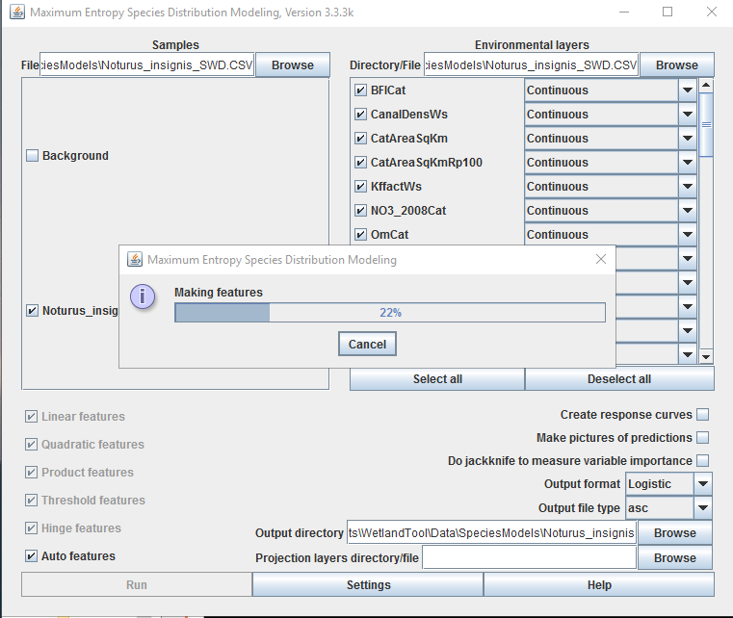
Data Prep: 5
Run MaxEnt base models: This file is read by scripts to determine which species require MaxEnt Species With Data (SWD) files are created for various scenarios.
Notes:
The output is a set of files in the SpeciesModels folder.
These files drive the Maxent analysis for all species

Slide 13
Aq. Species Presences CSV file
Stream Cat
CSV files
Stream Cat
CSV files
Stream Cat
CSV files
1
Identifies the HUC8s in which the species was found and extracts all StreamCat catchment records within them.
Removes any records with missing data where the species was not found and then any attributes with no data where the species was found.
Removes any attributes with no significant correlation with presence/absence (p > 0.05). Then identifies cross-correlated attributes pairs (r > 0.75) and removes the one with the least correlation with presence/absence.
Formats columns and column names to suit the MaxEnt species with data (SWD) format.
Scenario
GIS Tool
2
Extract Species Data & create MaxEnt SWD File
1
Modified
Stream Cat
CSV files
2
Allows user to draw a shape on a map reflecting a change in land cover type.
The user also designates the analysis extent for projecting uplift. This is usually the HUC 6 in which the modification occurs.
Based on this change, adjusts values in appropriate StreamCat attribute values for affected records.
Create Alternate SWD
Analysis Extent
3
Entire state
3
Converts each set of StreamCat within the analysis extent (e.g. HUC 6) into its own Maxent SWD files that can be used as MaxEnt projection scenarios.
Maxent SWD file
Maxent Projection SWD files
MaxEnt
4
Listing of each catchment and the estimated percent likelihood of finding the species there based on current conditions (unmodified StreamCat values).
4
5
Current Conditions
Scenario Conditions
5
Listing of each catchment and the estimated percent likelihood of finding the species there based on altered conditions (modified StreamCat values).
Notes:
Aquatic habitat uplift:
Step 1, accomplished by the CreateSpeciesSWDFile.py script or the <Create Species SWD File> tool, creates the generic/state-wide SWD file used to train the MaxEnt model.
Step 3, is accomplished by the CreateAlternateSWD.py script or the <Create Project SWD> tool, alters StreamCat attribute values associated with the NLCD changes. Which attributes re changed and how is laid out in the StreamCatInfo.xls file.

Slide 14
Get list of stream cat files that will be affected
Extract stream cat records for HUC 8 → dataDF
Update catchment records
Identify land cover change underneath project
Decrease values in catchment records of dataDF
Update watershed records
Identify catchments downstream of project catchment
Update attribute records
Notes:
GIS tool to create a modified SWD file for the HUC8

Slide 15
Create Alternate SWD File
Inputs:
Project shapefile: boundary of project
Project type: wetland or forest
Catchment data folder: containing StreamCat CSV files
Fieldmap.xlsx file: see description
NLCD raster: to determine current land cover types
NHD Elev_cm raster: to compute slopes
NHD Flowlines: to compute buffer area
NHD Catchment raster: to identify project catchments
NHD HUC12 features: to identify project HUC8
Workflow:
Compute the land cover changes from the project
Net loss of NLCD cover types
Net loss of NLCD cover types in riparian zone
Net loss of NLCD cover types in mid-slope areas
Net loss of NLCD cover types in high-slope areas
Identify the NHD catchment and HUC8 in which the project occurs
Extract the NHD Catchment raster by the project polygon
Clip the HUC12 feature with the project polygon
Create a list of the StreamCat CSV files to add to the output SWD
Use the FieldMappings table to identify those CSV files with attributes that will change with the project, i.e., those linked to land cover change.
Loop through each StreamCat CSV file…

Slide 16
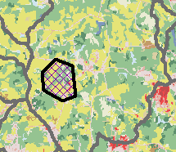
1. Identify the land cover areas coinciding with the project boundary
Km2 within | 21 | 22 | 23 | 41 | 42 | 82 | 90
Catchment | -0.4 | -1.6 | -0.2 | -2.1 | -1.2 | -5.2 | +3.1
Buffer | 0 | 0 | 0 | 0 | 0 | 0 | 0
Mid-slope | 0 | 0 | 0 | 0 | 0 | 0 | 0
High-slope | 0.2 | 0.9 | 1.2 | 0 | 0 | 0 | 0
Proposed Wetland
Notes:
If models were available to translate the effects on other attributes, e.g. flow velocity, that could be added fairly easily.

Slide 17
2. Define the scale of the project: HUC 8 in which the project occurs
Or: The catchment and all downstream catchments.
3. Select StreamCat features for those catchments
4. Update NLCD related attributes
5. Merge all stream cat records into a new projection file.
Notes:
If models were available to translate the effects on other attributes, e.g. flow velocity, that could be added fairly easily.

