Slide 1
INVENTORY MANAGEMENT SYSTEM
QA ACADEMY
JOHN POOLER PEREA

Slide 2
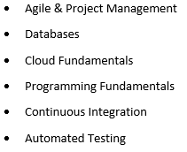
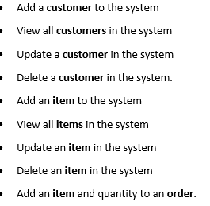
PDS - Project Design Specification
Core principles introduced
Objectives
IMS Functionality
Application using java which interacts with a Managed Database.
CI Pipeline that can automate the building and deployment of your artifact

Slide 3
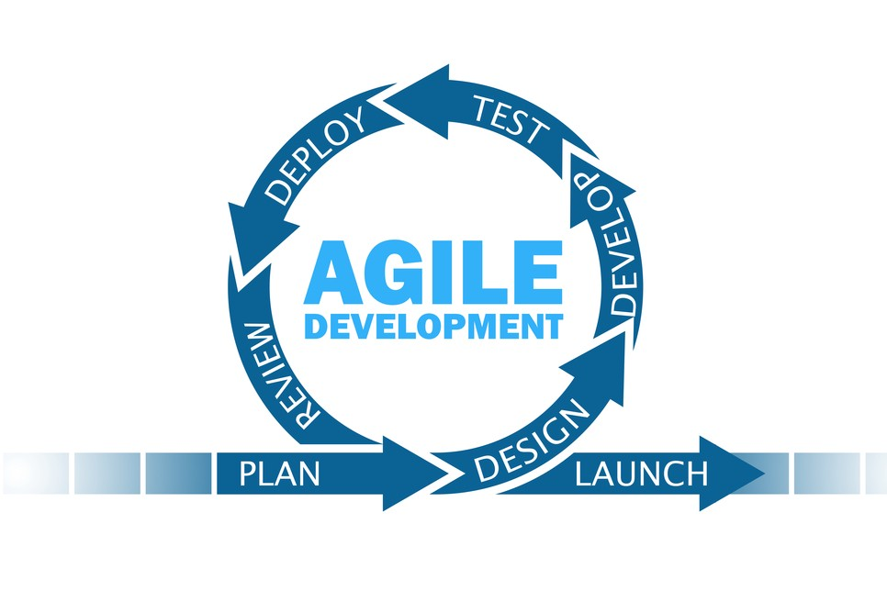
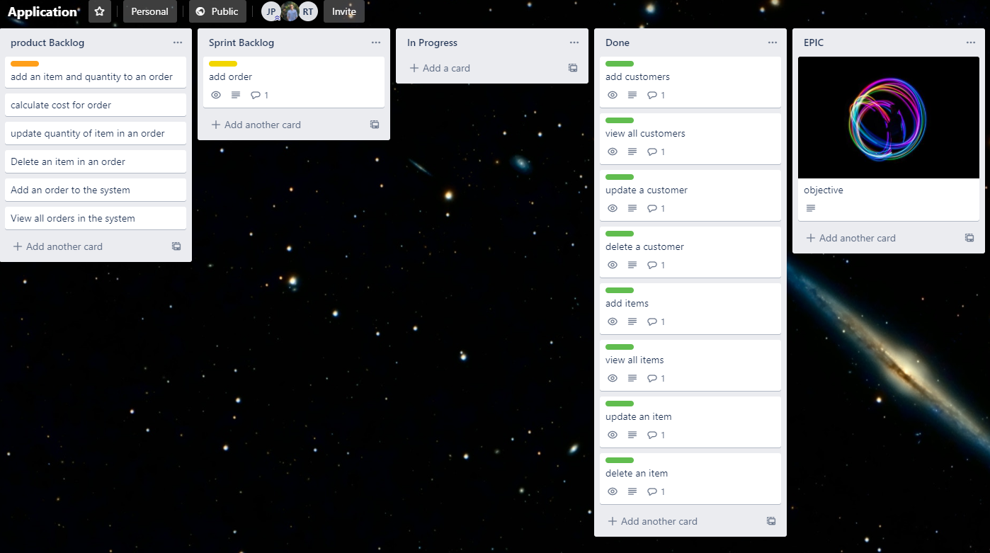
Project Management
AGILE -
Planning-
Designing-
Developing-
Amending-
Testing-
Deploying-
Reviewing-
Launching-
Documenting-
Trello boards (kanban)
Story points

Slide 4





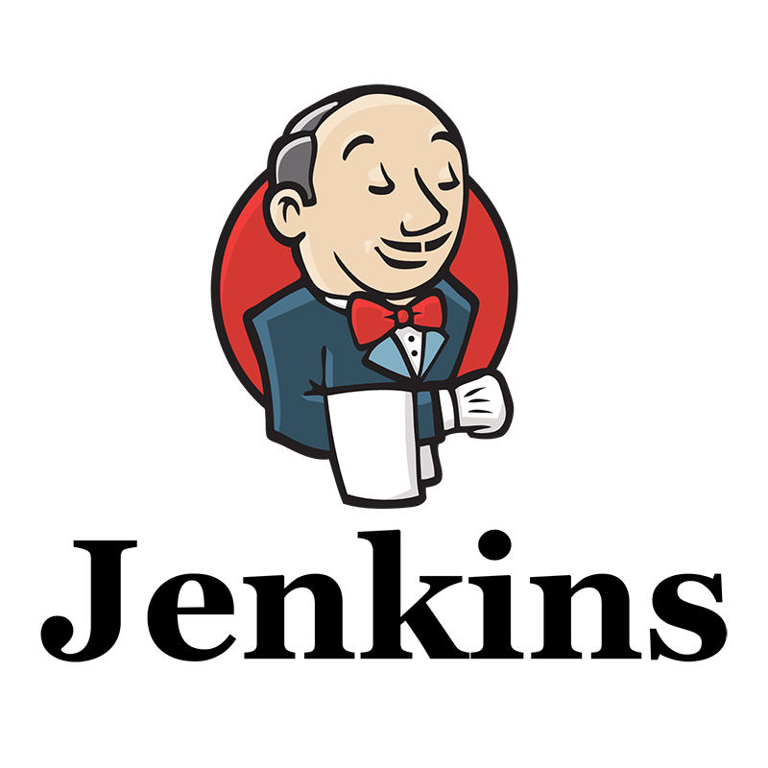


1. Tools
GCP - Google Cloud Platform VM running instance
GitHub Version control
Jenkins CI server
Sonarqube - code quality (bugs, code smells, security vulnerability, coverage)
Maven - Build Management tool based on POM.xml

Slide 5
2.Additional tools
Junit - code testing framework
Nexus Artifact Repository manager, manages dependencies for ease of Jar manipulation.
Java programming language
Eclipse IDE

Slide 6
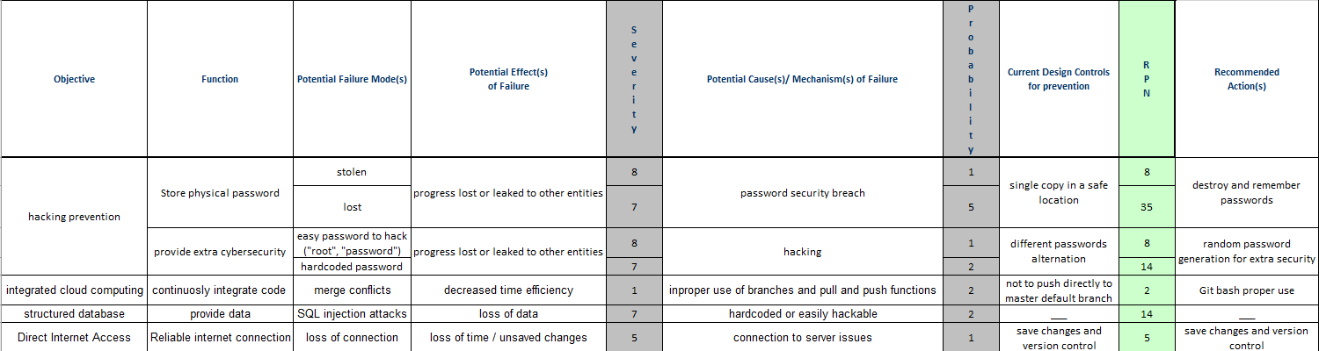
Risk analysis

Slide 7
Structured Query Language (SQL)
Creating and managing databases (cloud hosted)
INSERT INTO customer VALUES (1, 'Mateu');
INSERT INTO customer VALUES (2, 'Joan');
INSERT INTO customer VALUES (3, 'LLuc');
UPDATE customer SET name = 'johnny' WHERE id = 2;
DELETE FROM customer WHERE id = 12;
SELECT* FROM customer;
DDL & DML

Slide 8
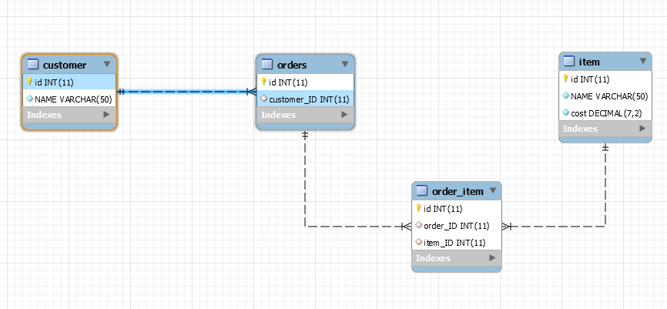
Entity Relationship Diagram

Slide 9
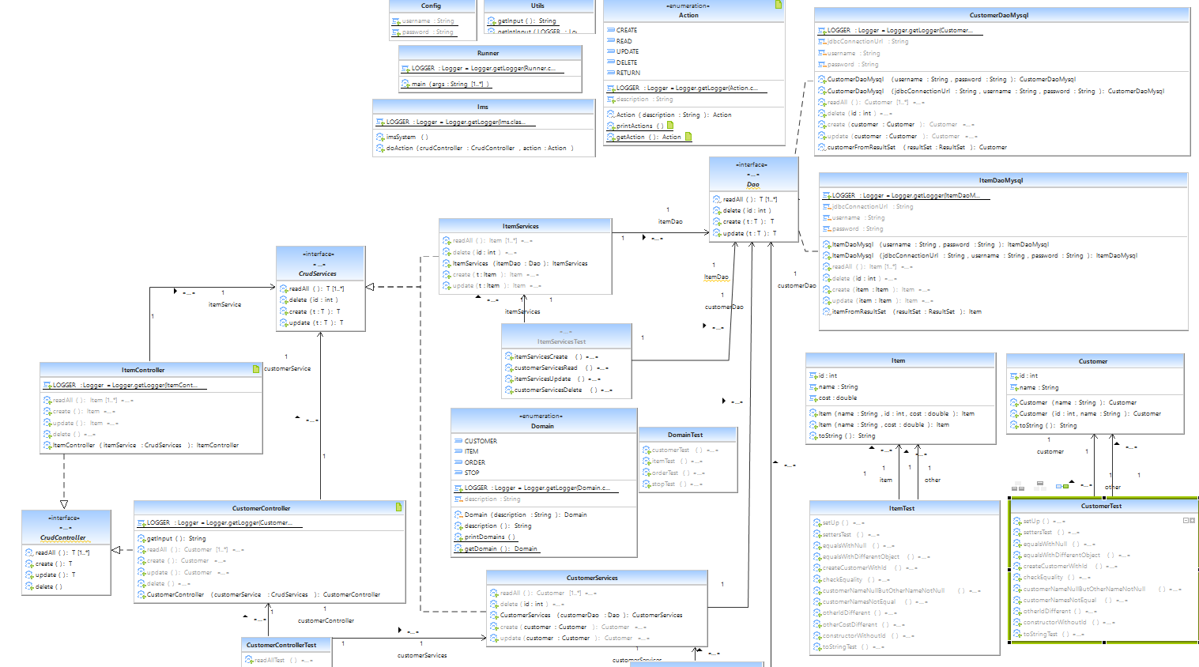
UML - Unified Modelling Language
Modelling language to visualize the design of a system

Slide 10
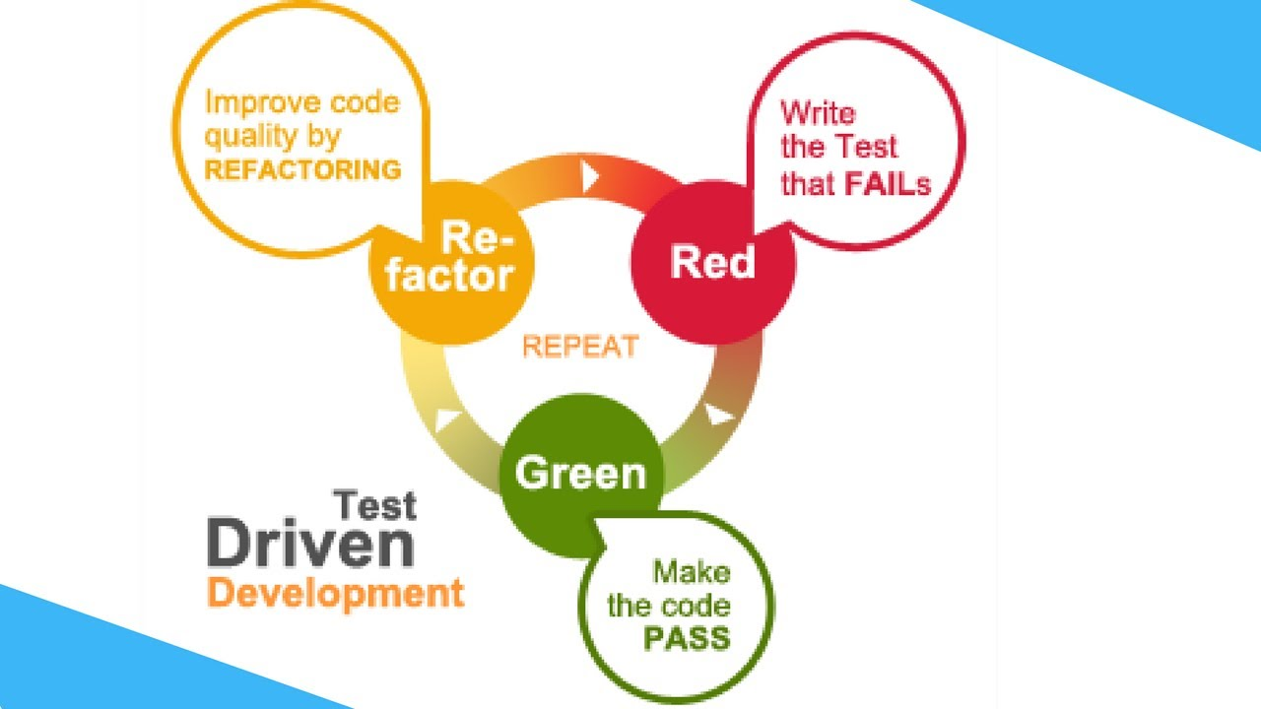
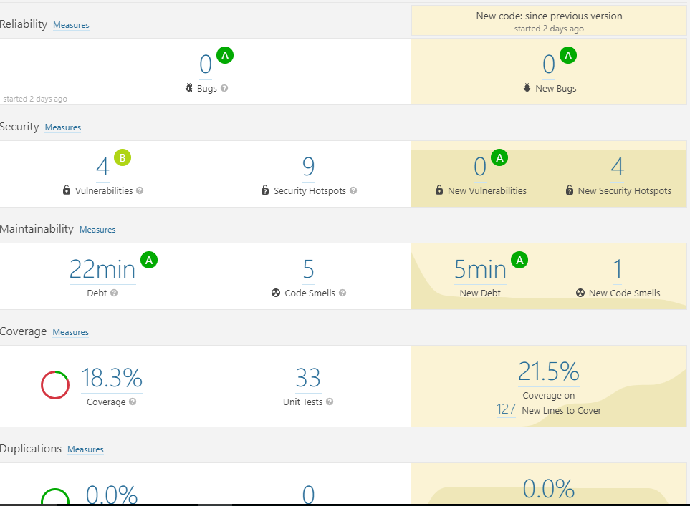
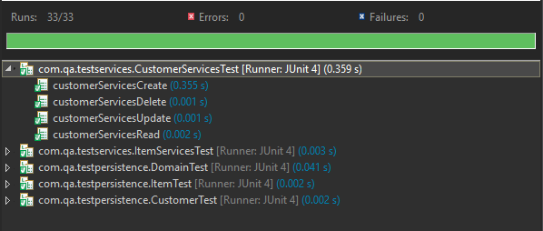
Testing - Unit and integration testing
Coverage

Slide 11
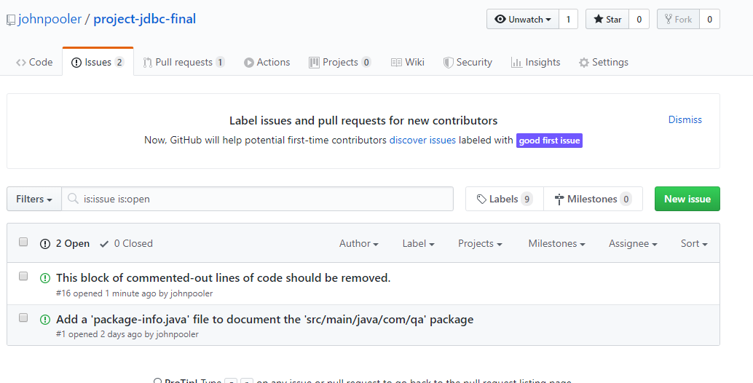
Issues

Slide 12
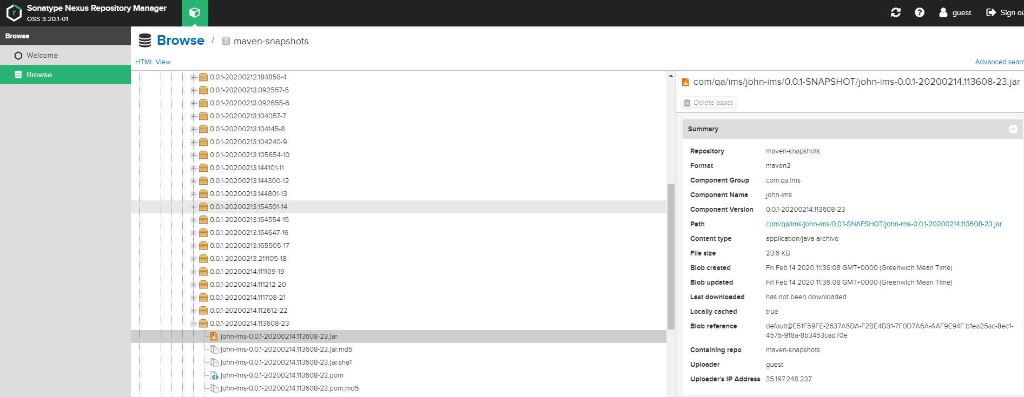
SonaType Nexus Repository Manager- .Jar

Slide 13
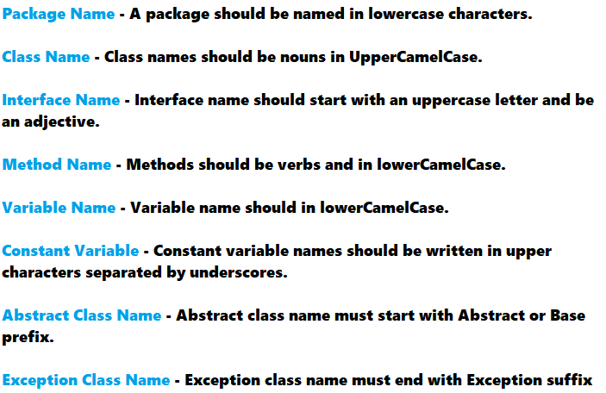
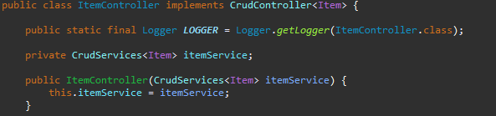
CODE and best practices

