Slide 1

Self Healing In Smart Grid
John Pranoy
15241A0257

Slide 2
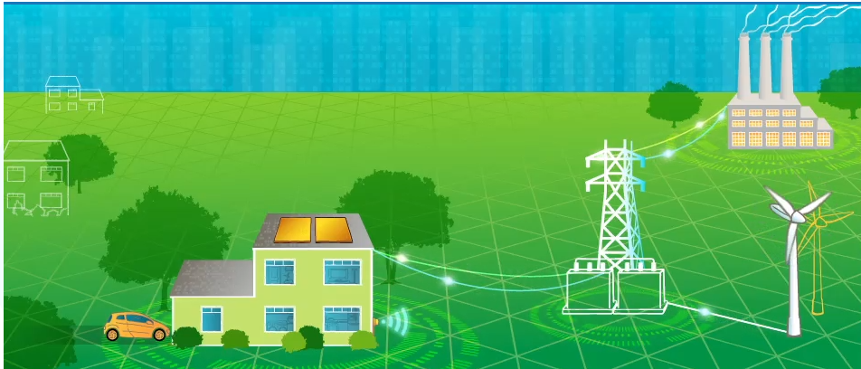
Abstract
Complex Networks
Difficult to find the fault
Time Consuming
So we need to go for Smart Grid

Slide 3
What is Smart Gird?
Smart Grid is simply a communications system overlay on the existing electrical grid to make the electrical grid more controllable and much more efficient in the delivery of energy. The communications systems will be connected to strategically placed sensors throughout all four segments of the electrical grid: Generation, Transmission, Distribution and Consumers

Slide 4
A Smart Grid is modernized electrical grid that uses analog or digital information about the behaviors of suppliers and consumers in an automated fashion to improve the efficiency, reliability, economics and sustainability of the production and distribution of electricity. Electric power conditioning and control of the production and distribution of electricity are important aspects of the smart grid.

Slide 5
Benefits of Smart Grid
More efficient transmission of electricity
Quicker restoration of electricity after power disturbances
Reduced operations and management costs for utilities, and ultimately lower power costs for consumers
Reduced peak demand, which will also help lower electricity rates
Increased integration of large-scale renewable energy systems
Better integration of customer-owner power generation systems, including renewable energy systems
Improved security

Slide 6
Self- Healing
The Self Healing Grid is a system comprised of sensors, automated controls, and advanced software that utilizes real-time distribution data to detect and isolate faults and to reconfigure the distribution network to minimize the customers impacted.
Notes:
Reconfiguring the switches and reclosers installed on the distribution feeder to quickly isolate the faulted section of the feeder and re-establish service to as many customers as possible from alternate sources/feeders.

Slide 7
Uses of Self-Healing
Makes necessary adjustments to restore the system without human intervention
Less number of people are affected
Fault can be foundout quickly and easily

Slide 8
Thank You

