Slide 1

71. Using a systems model approach to assess the potential effect of changes in gene expression in adipose tissue of dairy cattle on production and reproductive efficiency
Shannon L. Shields and John P. McNamara
(collaborators Juan Loor, UIUC and Jennifer Thompson, MTSU
This project was partially supported by National Research Initiative Competitive Grant no. 2007-35206-17841 from the USDA Cooperative State Research, Education, and Extension Service. This project was conducted in conjunction with Regional Research Project NC 1040 Metabolic Relationships in Supply of Nutrients for Lactating Cows.

Slide 2
Animal Efficiencies, Metabolic Control
“Maximum observed efficiencies are sometimes quite comparable to theoretical efficiencies. On the other hand, observed efficiencies considerably below theoretical are also observed. This variation in observed efficiencies raises two
important questions:
“(1) Could we learn to identify animals that are capable of attaining maximum efficiencies and based on genetic selection improve the average efficiency of animal production?
(2) “If we knew exactly what types of unfortunate metabolic decisions the less efficient animals were making, could we
manipulate the metabolism of those animals such that their efficiencies would approach those of the best animals?”
Baldwin et al. 1980 JDS

Slide 3
Feed Conversion Efficiency
1968- Baldwin -- at 4.8, 3.0, and 3.5 % lactose, protein and fat, mammary efficiency is 83 %
Post ruminal overall metabolic efficiency is:
? (65? 35?, ??)
Where will improvement come from?

Slide 4
Objectives
Using a systems approach to investigate causes of among animal variation with a herd
Running a mechanistic bio-mathematical modelling experiment focussed on gene expression and metabolic control in adipose tissue (for now)
Adipose tissue is an important control integrator, accepting and transmitting information through the system

Slide 5
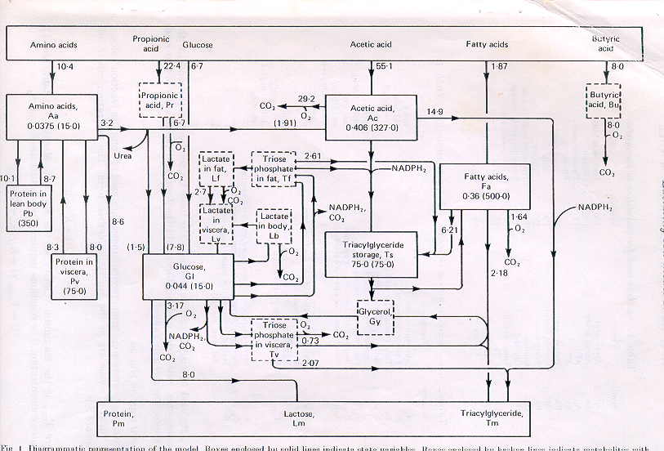
Metabolic Network--Molly
TSHRSP14
ACACA
FASN
BR2B
PLIN, CAV
ATGL, HSL

Slide 6
Metabolic Control
AcTsF (lipogenesis) = VAcTs / (1.0 + (KAcTsF /cAc) + K1AcTs/(Ahor*cGl))
TsFaF (Lipolysis)= VTsFaF * CHOR1 /(1.0+(cFa/K1TsFa)**EXP10 +
(KTsFaF/cTs)**THETA1)
Genomics, transcriptomics, post-translational control =
Either Vmax, Ks, or both, change.

Slide 7
Key control elements in adipose tissue and maintenance functions
Vmax for lipolysis | VTSFAF
Vmax for esterification | VFATSF
Ks for esterification | KFATSF
Ks for lipogenesis 1 | K1VACT
Ks for lipogenesis 2 | K2VACT
Ks for lipogenesis 3 | KACTSF
visceral maintenance | KNAV
body tissue (muscle) | KNAB
adipose maintenance | KNAF

Slide 8
Model experiment
Using observed data on cows in early lactation at the WSU KDC herd:
DMI, feed composition
Milk production and component production
Body fat content

Slide 9
Model experiment
Using observed data on cows in early lactation at the WSU KDC herd:
Rates of lipogenesis, esterification and lipolysis
Amounts and changes in mRNA transcripts
(THRSP14, ACACA, FASN, B2ADR, PLIN, CAV1,2, ATGL, LIPE)
Altered each key controller by :
Default
½ default
2x default

Slide 10
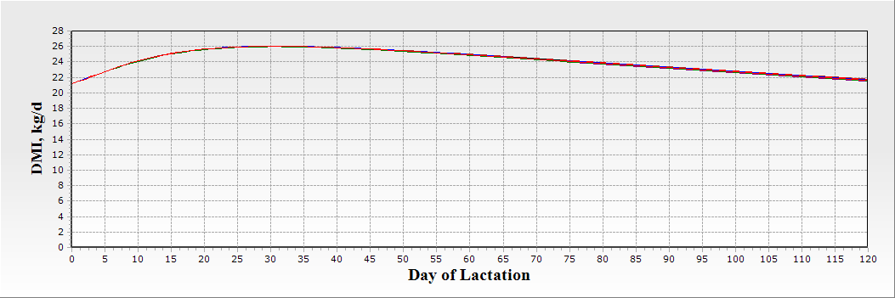
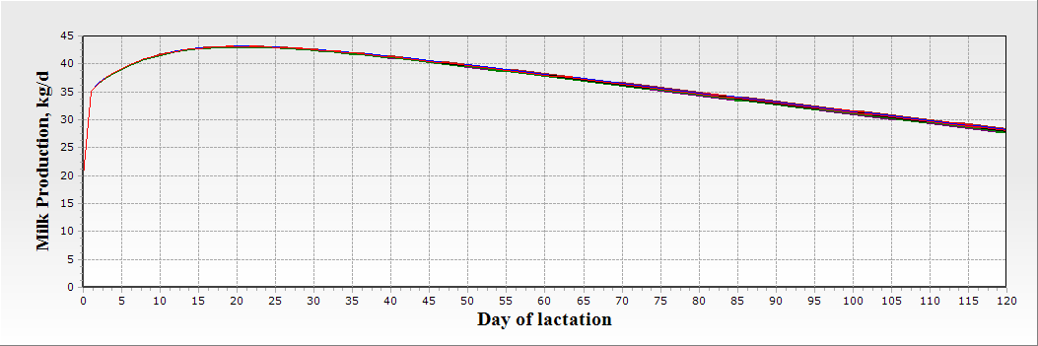
Changing AT controllers does not affect milk producttion or feed intake

Slide 13
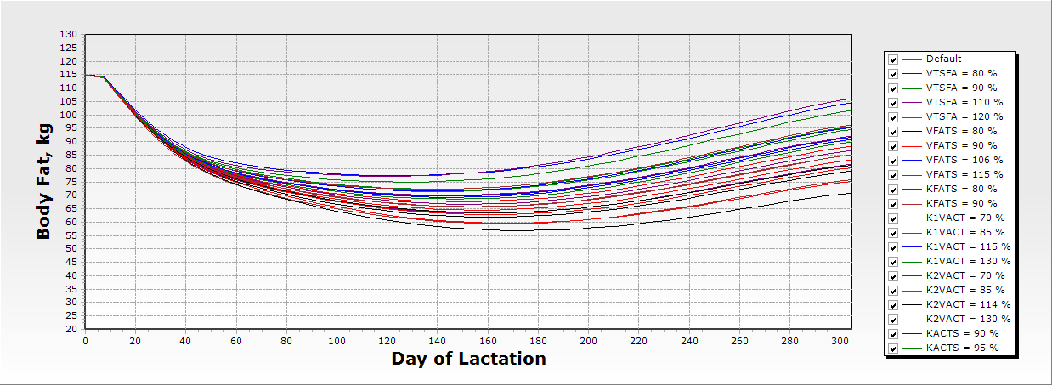
Variation in Adipose Metabolism
Altering genotype/phenotype of starting conditions of Vmax or Ks for lipogenesis (ACT, ACTS); esterification (FATS) and lipolysis (TSFA)

Slide 14
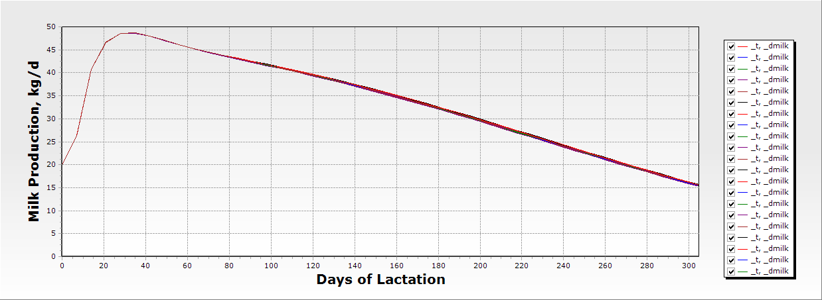
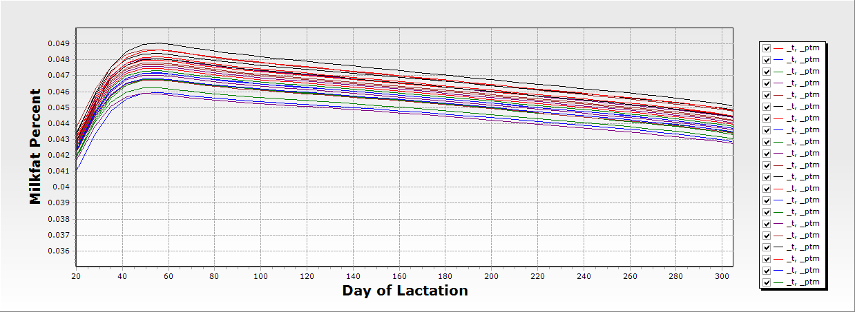
Variation in Adipose Metabolism
In this scenario,
At the same feed/
Energy intake
Altering genotype/phenotype of starting conditions of Vmax or Ks for lipogenesis (ACT, ACTS); esterification (FATS) and lipolysis (TSFA)

Slide 15
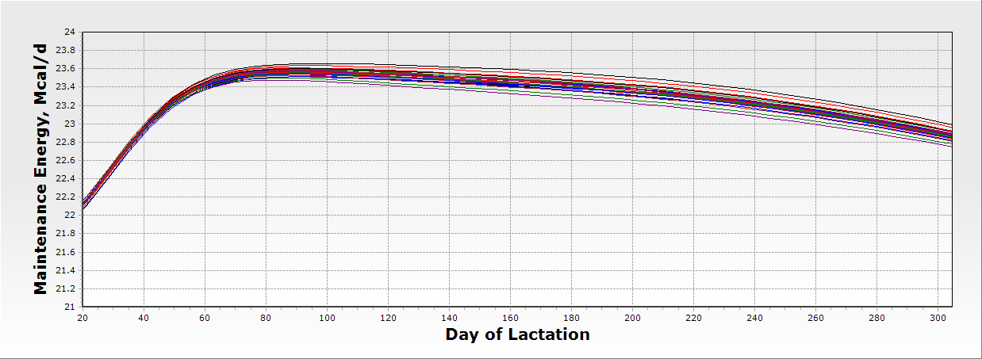
Variation in Energy Metabolism
“The system” can be significantly altered, throughout, by a single key
metabolic control element.

Slide 16
Systems Biology Moving Forward
“The system” can be significantly altered, throughout, by a single key metabolic control element.
Data from ongoing genotype/phenotype studies will need to be analyzed, interpreted and integrated into known flux control models.

