Slide 1
PRODUCTION VS. REPRODUCTION: FINAL WORD--or--Why we really need to move to a fully Systems Biology approach to remain viable and provide quality human food.
John P McNamara
Emeritus Professor of Animal Sciences
With D. Smith, T. Smith, K. Parmley, J. Sage, M. Woodman, G.J. Phillips, J. Sumner-Thomson, J. Vierck, B. Becker-Khaleel
Also thanks to Lee Baldwin, Juan Loor
This project was partially supported by National Research Initiative Competitive Grant no. 2007-35206-17841 from the USDA Cooperative State Research, Education, and Extension Service; NIH RD XXXX; NPPC, Pork Board; Kemin Industries; Church & Dwight, ADM Alliance, Lohmann Animal Health. This project was conducted in conjunction with Regional Research Project NC 185/1009/1040/2040 “Metabolic Relationships in Supply of Nutrients for Lactating Cows.”

Slide 2
Why?
“There is general agreement among most informed authors that products of animal agriculture will continue to contribute to the world food supply. However, the key challenge of ascertaining how much animals should contribute has not been resolved.”
Baldwin, 1995

Slide 3
Baldwin, 1995:
“Our inability to undertake quantitative evaluations of impacts of competing human nutrition strategies on human food availability is due in large part to the fact that current plant and animal production models are normally restricted to single species and have not been interfaced.”

Slide 4
Baldwin, 1995
“This is a long-term goal that will require the availability of advanced dynamic, mechanistic models of ruminant digestion and metabolism…”

Slide 5
Animal Efficiencies
“Maximum observed efficiencies are sometimes quite comparable to theoretical efficiencies. On the other hand, observed efficiencies considerably below theoretical are also observed. This variation in observed efficiencies raises two
important questions:
“(1) Could we learn to identify animals that are capable of attaining maximum efficiencies and based on genetic selection improve the average efficiency of animal production?
(2) “If we knew exactly what types of unfortunate metabolic decisions the less efficient animals were making, could we manipulate the metabolism of those animals such that their efficiencies would approach those of the best animals?”
Baldwin et al. 1980 JDS

Slide 6
Systems Biology Animal Sciences
Biological Necessity
(Scientific Necessity)
Technical Possibilities
Funding Possibilities
Cows, Pigs, etc. are biological systems of integrated processes and should therefore be studied as such. (The cow is not just a rumen and mammary gland).
Small scale, single organ/cell experiments are appropriate but ONLY in the explicit context of how they contribute to the system.
There is little to no limit of technology to study complex systems efficiently.
There is already a tremendous amount of knowledge available and young scientists MUST be made aware of this.
Funding should be only for integrated projects (even though smaller scale research can be contained in this.

Slide 7
Purposes/Messages
Systems Biology is not new and not separate from “animal sciences research.”
Breakdown disciplinary and other (financial /philosophical/political) boundaries to improve scientific research.

Slide 8
Examples
Using Molly Model as a framework for basic research on adipose tissue as an essential component of dairy cattle efficiency.
Development of a next generation adipose tissue metabolism, eventually to be integrated with others (as Baldwin et al. started).
Development of a first integrated model of genetic, nutritional and physiological control of reproductive processes.

Slide 9
Figure 1. Conceptual flow of genetic and nutritionaal mechanisms of control of flux. The asterisk indicates states (proteins, nutrients) that are genetically controlled and may have a measurable heritability. Each state (box) and rate (arrow) can be measured to determine appropriate parameters.
DNA transcription site *
Receptor*
Nucleotides
Hormone* or
Nutrient
cAMP
mRNA
*K₁
Substrate
Amino acids
Initial substrate(s)
enzyme
>>> Pathway >>>
V_{m}, K_{s}*
*K2
product
End Product
<<< Pathway <<<

Slide 10
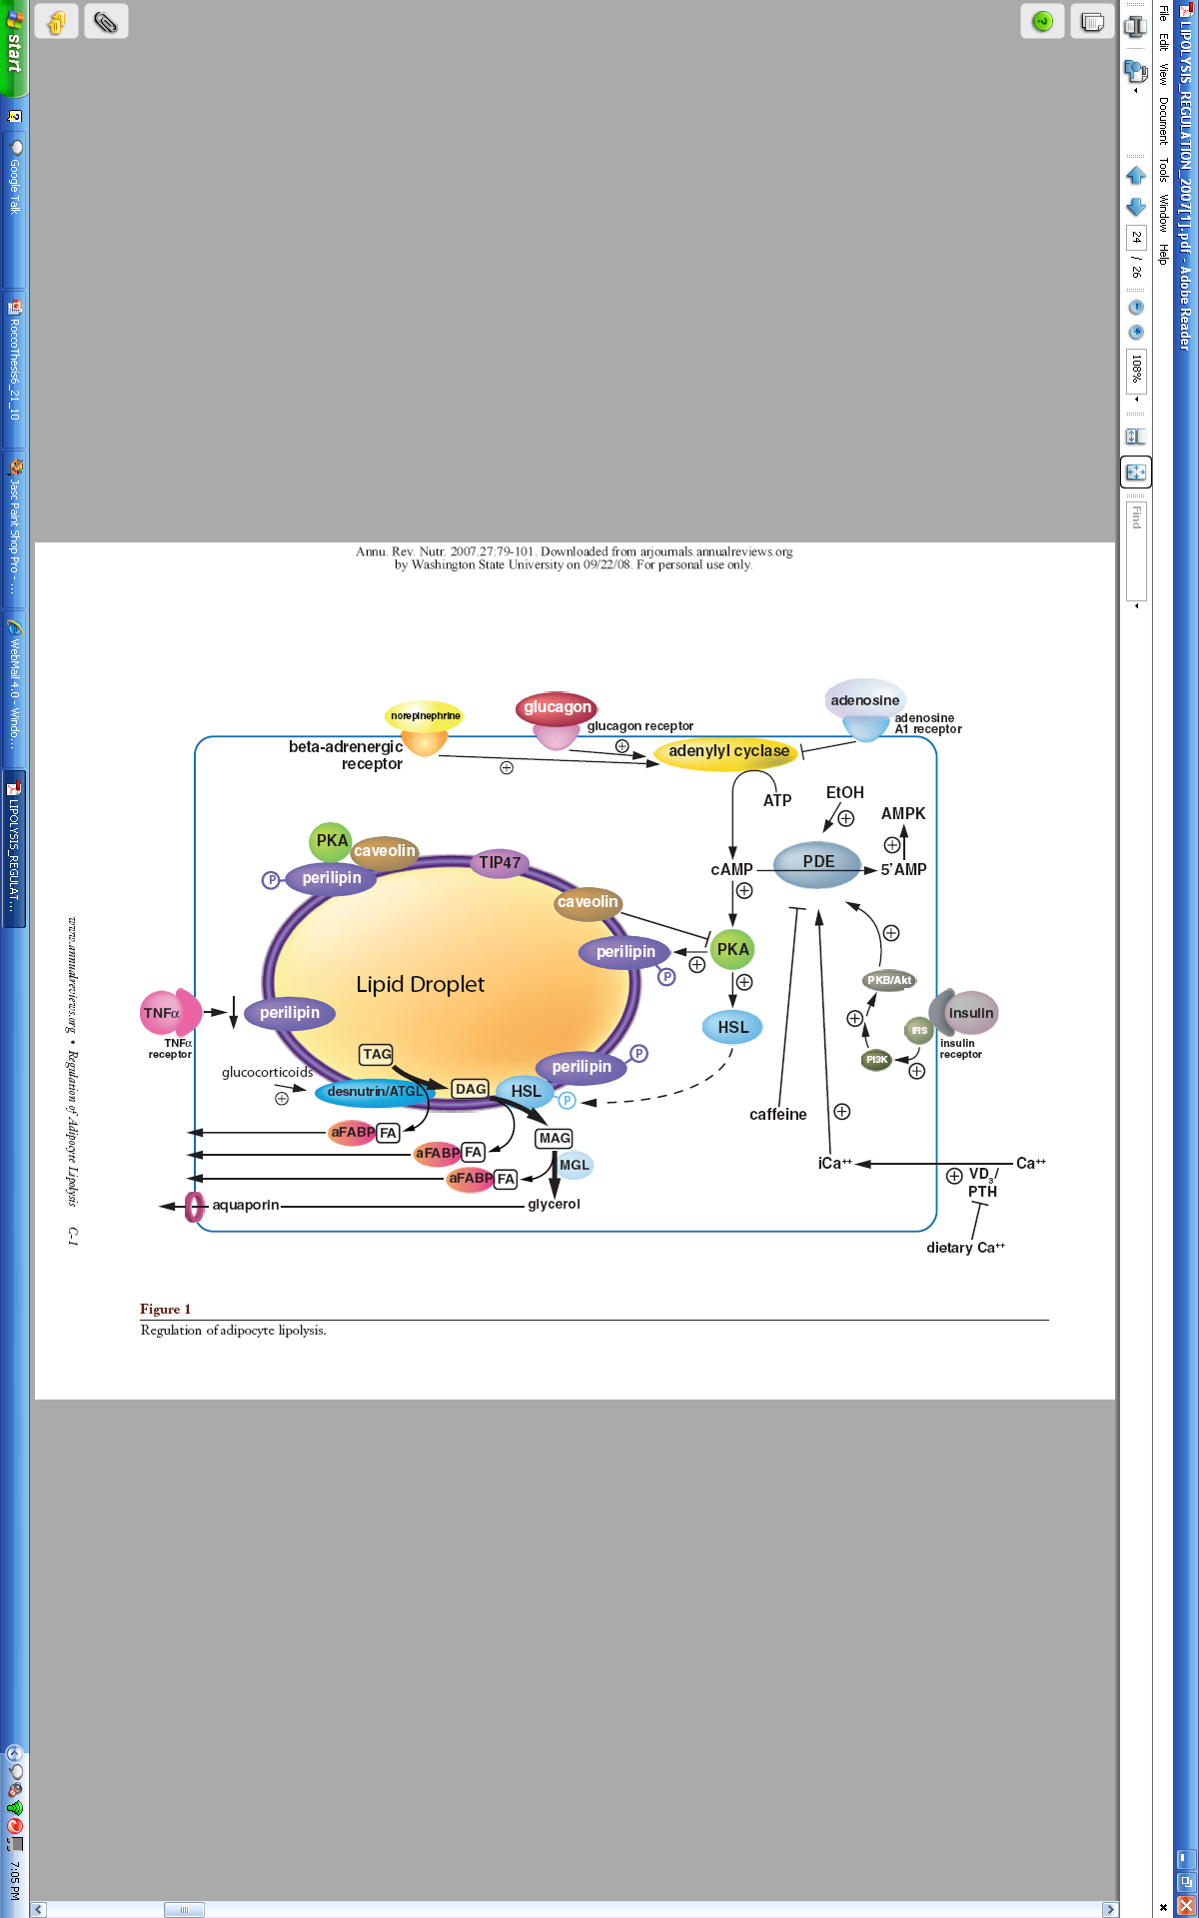
Adipocyte Metabolism
Ac
FFA
glycerol
Duncan et al., 2007. (Adapted by Shawnese Rocco)

Slide 11
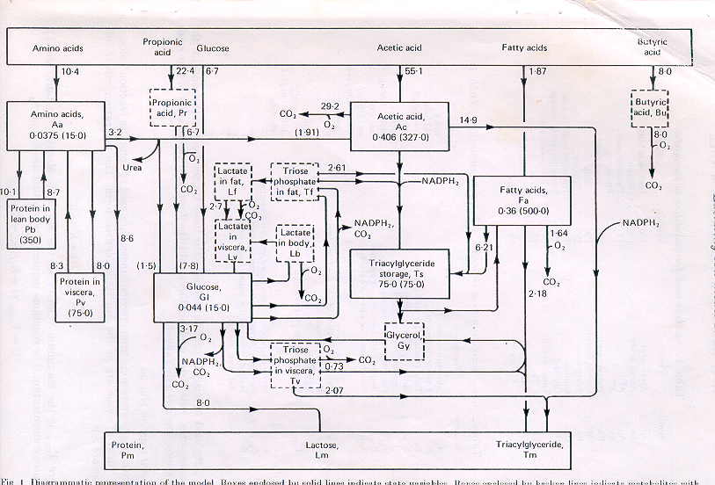
Metabolic Network--Molly
TSHRSP14
ACACA
FASN
BR2B
PLIN, CAV
ATGL, HSL

Slide 12
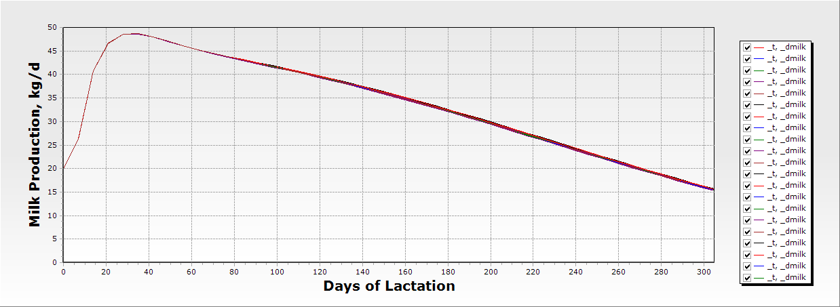
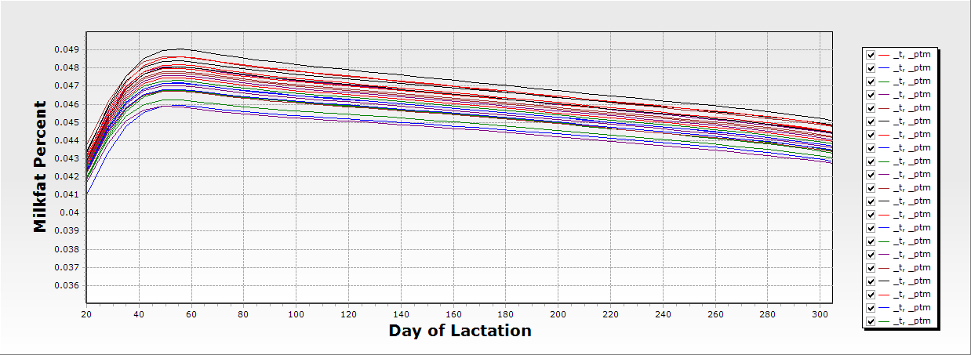
Variation in Adipose Metabolism
In this scenario,
At the same feed/
Energy intake
Altering genotype/phenotype of starting conditions of Vmax or Ks for lipogenesis (ACT, ACTS); esterification (FATS) and lipolysis (TSFA)

Slide 15
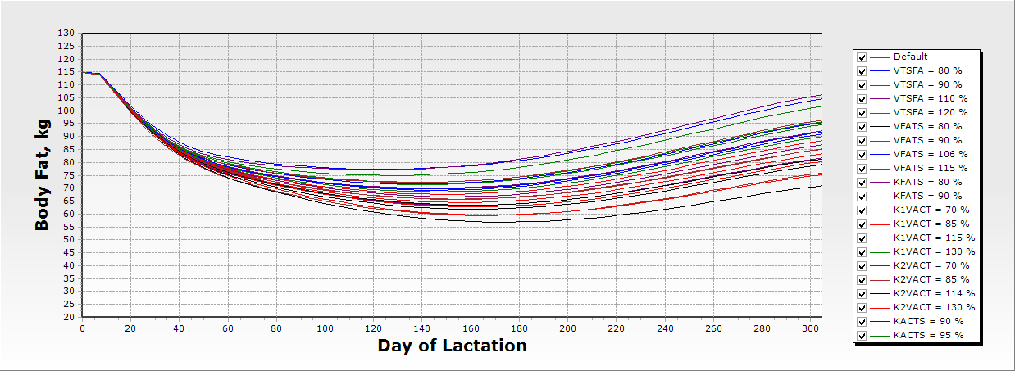
Variation in Adipose Metabolism Effect on body fat
Altering genotype/phenotype of starting conditions of Vmax or Ks for lipogenesis (ACT, ACTS); esterification (FATS) and lipolysis (TSFA). “The system” can be significantly altered, throughout, by a single key metabolic control element.

Slide 16
Jenny—the First Bio-Mathematical Model of Nutrient Use and Reproduction in Dairy Cattle
Nutritional Inputs
Glucose
TAG
NEFA
FA isomers,
Linoleic, CLA
Acetate
Amino acids
Molly Model
Reproduction
Model
Omega-3 Classes
Omega-6 Classes
Endocrine
Signals
In Molly
Lactation Hormone
Cholesterol?
Anabolic Hormone
(Affects all organs)
Adipose
Liver
Muscle
Mammary Gland
Stomach
Catabolic Hormone
(Affects all organs)
SomStat
(-)
Endocrine
Controllers
TRH
Hypothalamus
Pituitary
GnRH
Dopamine
Ant
Post
Ghrelin
Leptin
IGF-1
(+)
(-)
(-)
prolactin
FSH
LH
Oxytocin
GH
(+)
Estrogen
Progesterone
Temperature
Ovary
Reproductive
Organs &
Processes
Follicle
C.L
pH ?
NH3?
Developing Follicles
Ovulated Egg
Fertilized egg
Developing embryo
Embryonic Death
Uterus
Outputs
Placenta
Calf
Notes:
16

Slide 17
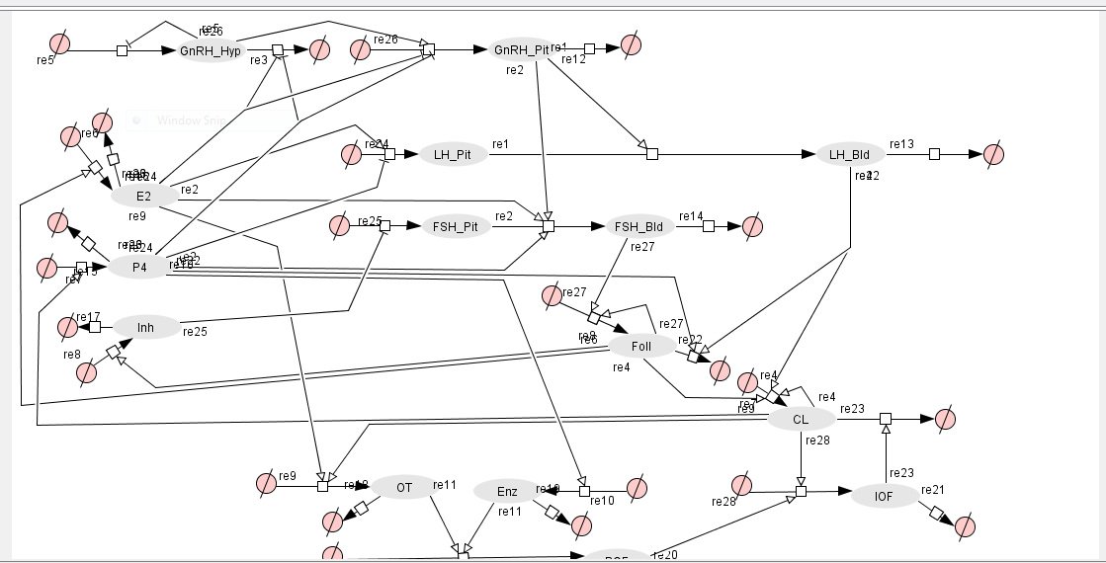
Reproduction Model Stötzel et al., 2011
_
Metabolic Rate
(ATP to ADP)
_
+
IGF-1
Notes:
There has been a tremendous amount of research done, and what we know, we can model… For example we know that glucose, GH, and IGF1 affect rates of FSH, LH and follicular growth.
We also know that glucose, energy balance and body fat affects days to first estrous, and feed intake and milk production affect circulating steroid concentrations.
Glucose, energy balance, and body fat affects days to first estrous.
Glucose, IGF-1, and growth hormone affect rates of follicle stimulating hormone, luteinizing hormone and follicular growth.
Feed intake and milk production affect steroid concentrations

Slide 18
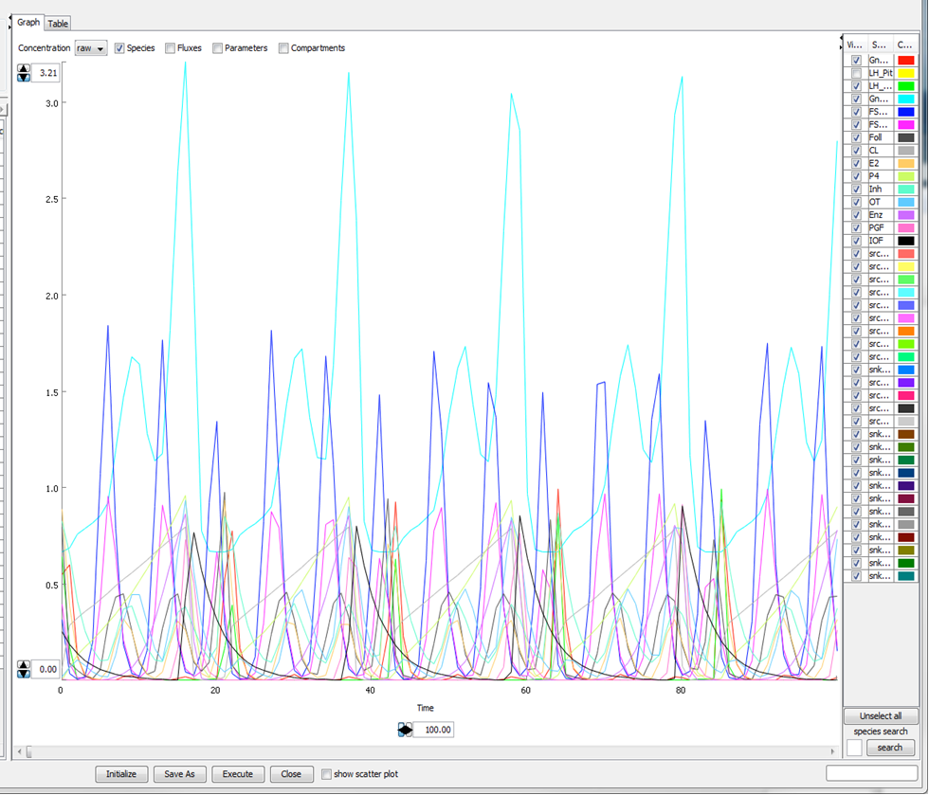
Stötzel et al., 2011
GnRH
FSH
P4
Notes:
Here is the output from the Stotzel Reproduction model here we have the relative values of the different hormones through multiple cycles. Although these relative values are not the actual concentrations of hormones these relative values do signify the concentration as they all proceed through multiple cycles

Slide 19
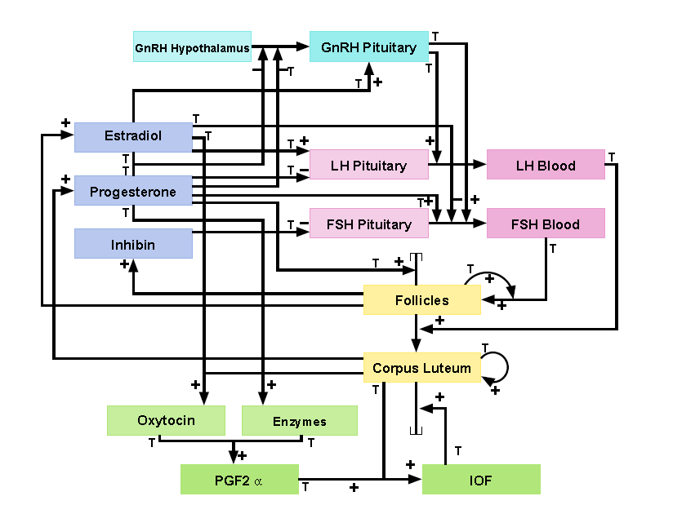
Integrated Models Presently
Glucose / Energy balance
+
-
Metabolic Clearance Rate
+
-
+
IGF-1
FIX THIS
Stötzel et al., 2011
Notes:
Now, we are able to specificallly integrate the two systems, adding key nutritional drivers into this model.
At this point I am only going to focus on glucose and energy balance and the effect it has on reproductive processes. And metabolic clearance rate and the effect it has on clearance of E2 and P4 and increases in IGF-1 and the effect it has on follicular growth.

Slide 20
Reproductive Problems
Delayed timing or decreased strength of ovarian cycling (Hypothalamic-Pituitary-Ovarian Axis).
Reductions in circulating steroid concentrations.
Less visible signs of estrus
Potential for increased embryonic mortality.
Notes:
Some of the problems include a decrease in ovarian cycling or delay in timing via the hypothalamic pituitary ovarian axis, reductions in circulating steroid concentrations of progesterone and estrogen. A decrease in estrogen can lead to less visible signs of estrus while a decrease in progesterone may lead to increased embryonic mortality. There can also be variation in uterine biology, eg. pH, leading to decreased embryo survival.

Slide 21
Connections between nutrition and reproduction
Nutritional status is a key factor influencing reproduction.
Nutrition correlated with and/ or directly a driving function of:
hypothalamus-pituitary-ovarian axis to control follicular growth and CL competence.
embryo survival.
Generally, anabolic functions affect follicular growth and overall metabolic rate affect steroid degradation.
Notes:
What are the connections between nutrition and reproduction?
Nutrition clearly is a key factor influencing reproduction, and there are multiple mechanistic connections.
It has been correlated with ovarian activity via the Hypothalamus pituitary ovarian axis.
In addition, metabolic rate (a function of both milk yield and feed intake) affects steroid clearance, affecting cyclicity and likely reducing embryonic survival.
Follicular growth is a function of anabolism, while steroid clearance is a function of catabolism.

Slide 22
Follicular Diameter after Parturition
Kawashima et al., 2007
Notes:
In this graph the follicular diameter is indicated on the left and the days after parturition on the x axis. The red is defined as Ovulatory dairy cows and the blue as anovulatory dairy cows. As days after parturition increases the follicular diameter increases in both ovulatory and anovulatory cows. The ovulatory cows have a greater follicular diameter compared to the anovulatory

Slide 23
IGF-1 concentration after parturition
Kawashima et al., 2007
Notes:
Similar to the previous graph IGF-1 is indicated on the left y axis and days after parturition is on the x axis. Ovulatory is defined in the red and anovulatory is defined in the blue the IGF concentrations are high and then decrease but then start to increase in both anovulatory and ovulatory and the ovulatory cows have higher concentrations of IGF as days after parturition increase.

Slide 24
Difference Between Anovulatory and Ovulatory Cows
Kawashima et al., 2007

Slide 25
Modeling Hypothesis
A dynamic, mechanistic, deterministic systems model of nutritional and reproductive processes can be used to
More efficiently and explicitly describe the control of reproductive processes
Test complex hypotheses to improve the understanding of effects of nutrition on reproductive efficiency.
Notes:
My hypothesis is that I can take a model of nutrition and integrate it with a model of reproductive process to more efficiently describe the control of reproductive process driven by nutritional mechanisms.

Slide 26
Objective
Integrate two existing mechanistic, dynamic models of nutritional and reproductive processes in the dairy cow.
The nutritional model “Molly”, Baldwin et al., 1995 and the reproduction model “BoviCycle”, Stötzel et al., 2011.
Notes:
My objective is to integrate 2 dynamic, mechanistic models of nutritional and reproductive processes in order to develoop on systems model to help study nutritional affects on reproduction.

Slide 27
Relationship between metabolic hormones and follicular growth
IGF-1 is changed by feed intake and is susceptible to endocrine and metabolic status (Lucy et al., 1992).
Liver derived IGF-1 regulates final maturation of dominant follicle (Beam and Butler, 1998).
Insulin like growth factor (IGF -1) is a regulatory factor in follicular growth (Kawashima et al., 2007).
Notes:
These recent studies provided data appropriate to construct a potentially useful equation. The results from the Kawashima study supports the concept that IGF 1 represents a metabolic signal for the resumption of ovarian activity in high producing dairy cows.

Slide 28
IGF-1 with Follicular Growth Equations
follicular_growth ƒ (follicular_rate_constant = hp_fsh_mod + (follicular_ rate_factor_ IGF_1(0.001833) * (IGF_1 - average_IGF_1)))
Shannon Shields: McNamara and Shields, Animal Frontiers; 2013
Notes:
To come up with this equation I calculated an average IGF 1 and an average follicular diameter between ovulatory and anovulatory cows. After calculating that. For every 20ng/ml increase in IGF 1 there is an increase in 1mm in follicular diameter. I then had to adjust the follicular diameter into the relative values that this model was using and came up with the equation 0.001833. Calling this my follicular rate factor I can then place this into the synthesis part of the equation and change it depending on the amount of IGF 1.

Slide 29
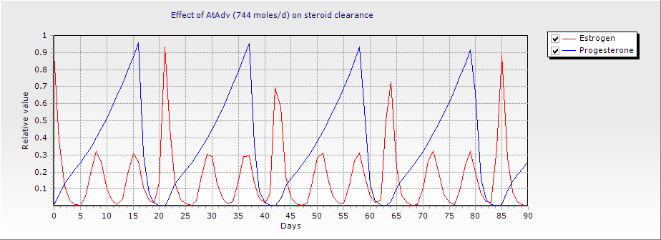
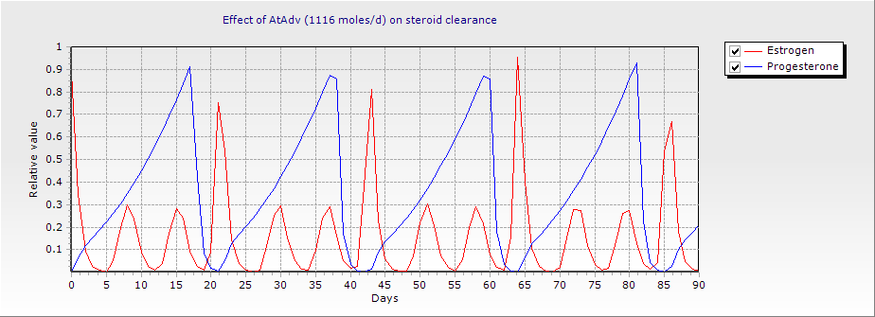
Model Experimental Results: Metabolic Rate of E2 and P4
Notes:
We can now use the data reported by Sangsritavong et al., in the integrated model. Shown here as feed intake is increased there is a decrease in P4 and E2 concentrations when AtAdv is changed in the parameters from 744 moles/d (average AtAdv) to 1116 moles/d.

Slide 30
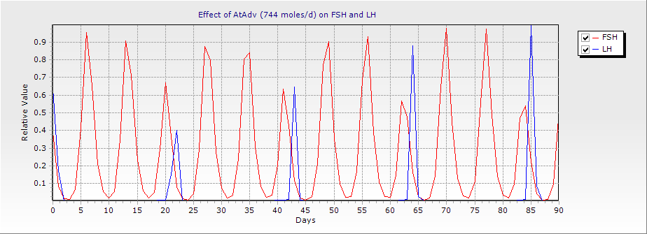
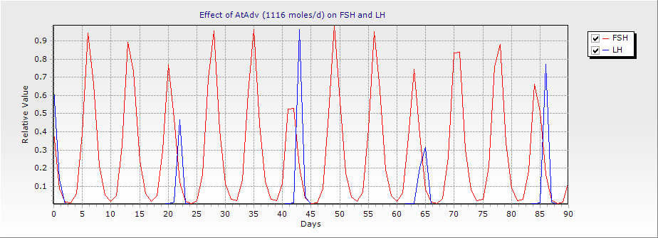
Model Experimental Results: Metabolic Rate of FSH and LH

Slide 31
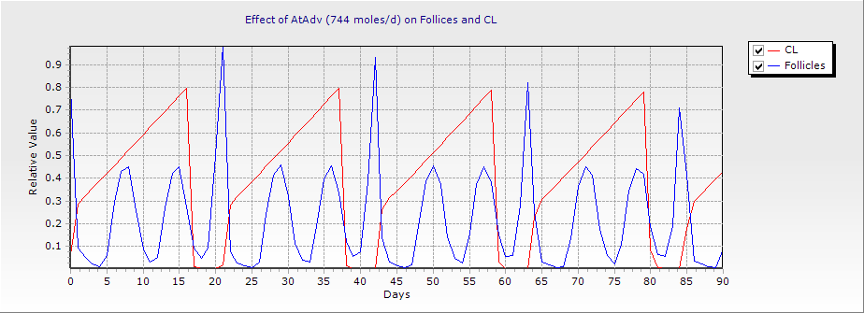
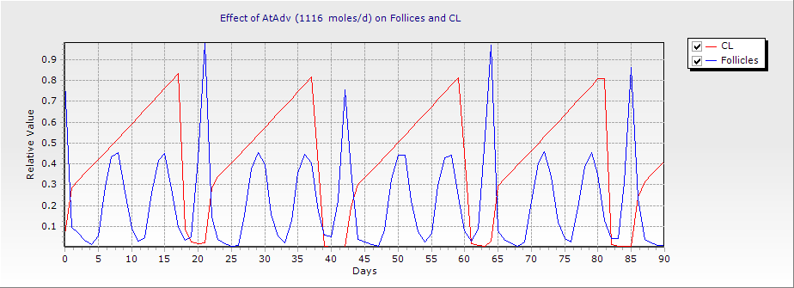
Model Experimental Results: Metabolic Rate of Follicles and CL

Slide 32
IGF-1 Equations
CONSTANT average_IGF_1 = 86.4
CONSTANT IGF_1 = 86.4
follicular_rate_factor_IGF_1 = 0.001833
follicular_rate_constant = hp_fsh_mod + (follicular_rate_factor_IGF_1 * (IGF_1 - average_IGF_1))
f(7) = follicular_rate_constant - (hp_p4_2 +hp_lh) * y(7)
y(7) = integ(f(7),fic(7))

Slide 33
Follicular Growth Equations
hp_lh = Par(47) * y_lh**2 / (Par(48)**2 + y_lh**2)
hp_p4_2 = Par(45) * y_p4**5 / (Par(46)**5 + y_p4**5)
hm_foll = (Par(43)**2)/(Par(43)**2+y(7)**2)
hp_fsh_mod = Par(41) * y_fsh**2 / ((Par(42)*hm_foll) **2+y_fsh**2)
f(7) = hp_fsh_mod - (hp_p4_2 +hp_lh) * y(7)
y(7) = integ(f(7),fic(7))
Notes:
Moving from the available data to the existing model…..
F(7) is the follicles.

Slide 34
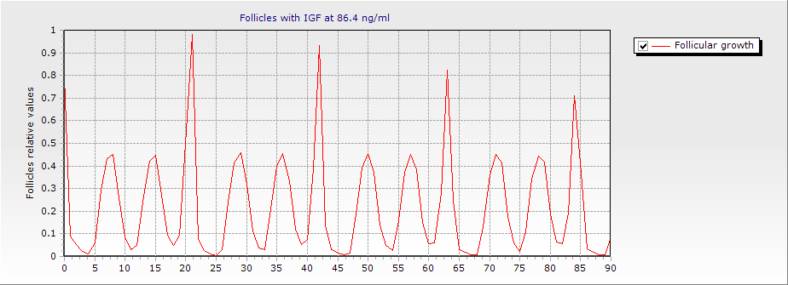

Model Experimental Results: IGF-1 and follicular growth

Slide 35
Effect of amount of body fat (WTF) at 21 DIM on initiation of cycling, hormonal concentrations and day of peak hormonal concentration.
WTF | Start of Cycling (DIM) | FSH | FSH Day of Peak | Estrogen | Estrogen Day of Peak | Progesterone | Progesterone Day of Peak
50 | 30 | 4.78 | 51 | 129.30 | 30 | 113.17 | 41
100 | 22 | 4.67 | 43 | 153.76 | 22 | 113.03 | 31
125 | 19 | 4.84 | 40 | 117.54 | 19 | 113.20 | 34
150 | 19 | 4.78 | 36 | 128.56 | 19 | 113.17 | 30
175 | 19 | 4.72 | 32 | 140.34 | 19 | 112.94 | 26
200 | 19 | 4.67 | 28 | 152.91 | 19 | 113.00 | 22

Slide 36
Energy metabolism affects steroid clearance
Liver blood flow and steroid clearance are elevated by feed intake and overall metabolic rate (support of milk production).
Decrease in reproductive efficiency may is a partial function of decreased circulating steroid concentrations (Sangsritavong et al., 2002).
Notes:
Moving from anabolic content to catabolic content…..
The liver is the major site of P4 and E2 metabolism, it would make sense that an increase in feed intake in lactating dairy cows will increase metabolism of progesterone and estrogen.
Progesterone, also known as the pregnancy hormone, levels must be maintained at a certain level in order for a successful pregnancy and estrogen is important in estrus indication. If any of these levels of steroid hormones is decreased that may lead to a decrease in reproductive efficiency.
The results from this study showed that there is an increase in MCR of both P4 and E2 in response to feeding, which also appears to be related to acute changes in Liver blood flow.

Slide 37
Energy Metabolism
Formation of ADP in the visceral tissue
AtAdV = basalV + AtAdV1 + AtAdV2 + AtAdV3 + AtAdV4 + AtAdV5+ AtAdV6+ AtAdV7 + AtAdV8 + AtAdV9 + AtAd10 +AtAd11 +AtAd12 + AtAd13 + AtAd14 + AtAd15 +Atad16
For example
AtAdV3 = AaPvV * AaPxAD visceral protein synthesis
AtAdV4 = AaPmV * AaPxAD milk protein synthesis
AtAdV5 = GlLmV * GlLmAD milk lactose synthesis
AtAdV6 = GlHyV * GlHyAD glucose intermediary metabolism
Notes:
In the nutritional model energy metabolism is expressed as AtAdV and represents the sum of all metabolic transactions occuring in the visceral tissue for milk production. Here in the visceral tissue the individual AtAdV’s are for energy used to make fat, acetate, amino acids, glucose, lactose in milk production.

Slide 38
Effect of milk Production on AtAdv
Notes:
From the nutritional model I created this graph to look at the effects of milk production on AtAdv. AtAdv is indicated on the left axis and milk production on the bottom axis. As milk production increases the AtAdv increases.

Slide 39
Effect of Feed Intake on AtAdv
Notes:
Next I did the same with feed intake and the effect on AtAdv similar to the last graph AtAdv is on the left axis and feed intake is on the bottom. As feed intake increases AtAdv increases. From these last two graphs I was able to calculate an average AtAdv value when there is an average feed intake and average milk production

Slide 43
Metabolic Clearance Rate Progesterone
Metabolic Clearance Rate can be controlled by feed intake:
CONSTANT avg_ATADV = 743.89
CONSTANT AtAdv = 743.89
CONSTANT metab_rate_degradation_factor_P4 = 0.0005669
deg_const_P4 = Par(72) + (metab_rate_degradation_factor_P4 * (AtAdV-avg_ATADV))
Notes:
Nutritional status effects the degradation of progesterone. There are several mechanism , however, for now we have reduced them to glucose flux.
The higher the feed intake the higher the liver blood flow, therefore a higher clearance rate of progesterone

Slide 44
Progesterone Equation
F(10) = Par(71) * y_cl**2 – (deg_const_P4 * y(10))
Y(10) = integ (f(10), fic (10))

Slide 45
Metabolic Clearance Rate Estrogen
Metabolic Clearance Rate can be controlled by feed intake:
CONSTANT metab_rate_degradation_factor_E2 = 0.00034
deg_const_E2 = Par(77) + (metab_rate_degradation_factor_E2 * (AtAdV-avg_ATADV))
Notes:
Nutritional status effects the degradation of progesterone. There are several mechanism , however, for now we have reduced them to glucose flux.
The higher the feed intake the higher the liver blood flow, therefore a higher clearance rate of progesterone

Slide 46
Estrogen Equation
f(11)= Par(76)*y_fol**2 - (deg_const_E2 * y(11))
Y(11) = integ (f(11), fic (11))

Slide 47
Estrogen Equation
Original equation:
f (11) = Par(76)*y_fol**2 – (par (76) * y(11))
New equation:
f(11)= Par(76)*y_fol**2 - (deg_const_E2 * y(11))
Y(11) = integ (f(11), fic (11))
Notes:
Similar to the progesterone equations. This is the original and new equations that have been replaced in the model. Nutritional status effects the degradation of estrogen.
F(11) = estrogen concentration. Synthesis - Degradation

Slide 48
Metabolic Clearance Rate Estrogen
Estrogen degradation ƒ (deg_const_E2 = estrogen degradation factor (0.00034) + (metab_rate_degradation_factor_E2 *
(AtAdV - avg_AtAdV)))

Slide 49
Progesterone Equation
Original equation:
f (10) = Par (71) * y_cl**2 – Par (72) * y(10)
New equation:
f(10) = Par(71) * y_cl**2 – (deg_const_P4 * y(10))
y(10) = integ (f(10), fic (10))
Notes:
This is the original and new equations that have been replaced in the model. Nutritional status effects the degradation of progesterone.
F(10) is equal to the concentration of P4. Synthesis – degradation.

Slide 50
Metabolic Clearance Rate Progesterone
Progesterone degradation ƒ 0.0005669 (deg_const_P4 = progesterone degradation factor (0.0005669) + (metab_rate_degradation_factor_P4 *
(AtAdV -avg_ATADV))
Notes:
Nutritional status effects the degradation of progesterone. There are several mechanism , however, for now we have reduced them to AtAdv.
The higher the feed intake the higher the liver blood flow, the higher the AtAdv therefore a higher clearance rate of progesterone

Slide 51
Model Experiment: range of IGF-1 metabolic rate
AtAdv, m/d | IGFI, ug/L
1090 | 86.4
1090 | 96.4
1090 | 106.4
1278 | 86.4
1278 | 96.4
1278 | 106.4
1370 | 86.4
1370 | 96.4
1370 | 106.4
1426 | 86.4
1426 | 96.4
1426 | 106.4
Simulations were run through a range of 20 to 27 kg/d DMI and milk production of 32 to 55 kg/d through 120 DIM to provide a range of anabolic (IGF1) and catabolic (AtAdv) situations.
Notes:
Here is the output from the model simulation. The first graph represents the follicular growth when IGF 1 is at an average level while the bottom graph represents the follicular growth when IGF is increased to 106.4 ng/ml. The numbers on the left again are the relative values while the bottom axis represents time in days through four cycles. You can see that an increase in IGF 1 has created a growth in the follicles.
There is an aproximately a 1mm change in follicular diameter for each 20 ng/ml increase in IGF-1

Slide 54
But what about ON THE FARM?
What has happened to Estrus DR, CR, PR on the farm?
Why?
Did changes in your diet really change PR?
Has the pharmaceutical approach (Technological Approach) to reproduction improved: EDR, CR, PR?

Slide 55
But? But?
High producing cows don’t reproduce
High production means low fertility
We need to get used to a longer calving interval
Reproduction has a low heritability?
(you want 5 % with that? Or 1 %? Or 20 %)
We need science and practice
Look at data, not dogma

Slide 56
Systems Biology Moving Forward
“The system” can be significantly altered, throughout, by a single key metabolic control element.
Data from ongoing genotype/phenotype studies will need to be analyzed, interpreted and integrated into known flux control models.
All processes in the cow (etc.) are connected and should be studied as such (yes, that means longer, more complex, more expensive and team-run experiments).

Slide 57
And, Finally a little “Trans-Tas’ Wisdom John Black, formerly CSIRO
“There has been a tendency to apply excessively simple economic and applied mathematics to complicated biological problems, and, in the process, lose the richness that’s implicit in the biology. And, the potential economic gains that are available if the richness is taken into account are lost too.”

