Slide 1
CHANGES IN LIPID mrna expression throughout lactation or, what can we learn from fat?
John P McNamara
Washington State University

Slide 2
Why?
“There is general agreement among most informed authors that products of animal agriculture will continue to contribute to the world food supply. However, the key challenge of ascertaining how much animals should contribute has not been resolved.”
Baldwin, 1995

Slide 3
Baldwin, 1995:
“Our inability to undertake quantitative evaluations of impacts of competing human nutrition strategies on human food availability is due in large part to the fact that current plant and animal production models are normally restricted to single species and have not been interfaced.”

Slide 4
Baldwin, 1995
“This is a long-term goal that will require the availability of advanced dynamic, mechanistic models of ruminant digestion and metabolism…”

Slide 5
Animal Efficiencies
“Maximum observed efficiencies are sometimes quite comparable to theoretical efficiencies. On the other hand, observed efficiencies considerably below theoretical are also observed. This variation in observed efficiencies raises two
important questions:
“(1) Could we learn to identify animals that are capable of attaining maximum efficiencies and based on genetic selection improve the average efficiency of animal production?
(2) “If we knew exactly what types of unfortunate metabolic decisions the less efficient animals were making, could we manipulate the metabolism of those animals such that their efficiencies would approach those of the best animals?”
Baldwin et al. 1980 JDS

Slide 6
Systems Biology Animal Sciences
Biological Necessity
(Scientific Necessity)
Technical Possibilities
Funding Possibilities
Cows, Pigs, etc. are biological systems of integrated processes and should therefore be studied as such. (The cow is not just a rumen and mammary gland).
Small scale, single organ/cell experiments are appropriate but ONLY in the explicit context of how they contribute to the system.
There is little to no limit of technology to study complex systems efficiently.
There is already a tremendous amount of knowledge available and young scientists MUST be made aware of this.
Funding should be only for integrated projects (even though smaller scale research can be contained in this.

Slide 7
Purposes/Messages
Systems Biology is not new and not separate from “animal sciences research.”
Breakdown disciplinary and other (financial /philosophical/political) boundaries to improve scientific research.

Slide 8
Examples
Using Molly Model as a framework for basic research on adipose tissue as an essential component of dairy cattle efficiency.
Development of a next generation adipose tissue metabolism, eventually to be integrated with others (as Baldwin et al. started).
Development of a first integrated model of genetic, nutritional and physiological control of reproductive processes.

Slide 9
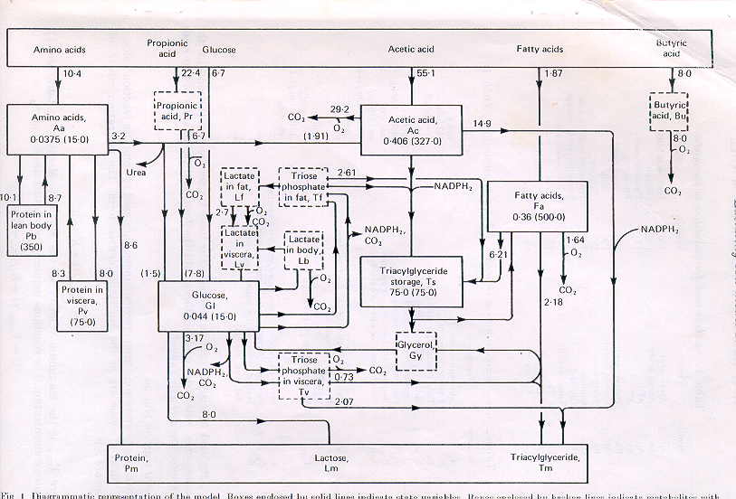
Molly Model; Baldwin et al., J. Dairy Res, 1987

Slide 10
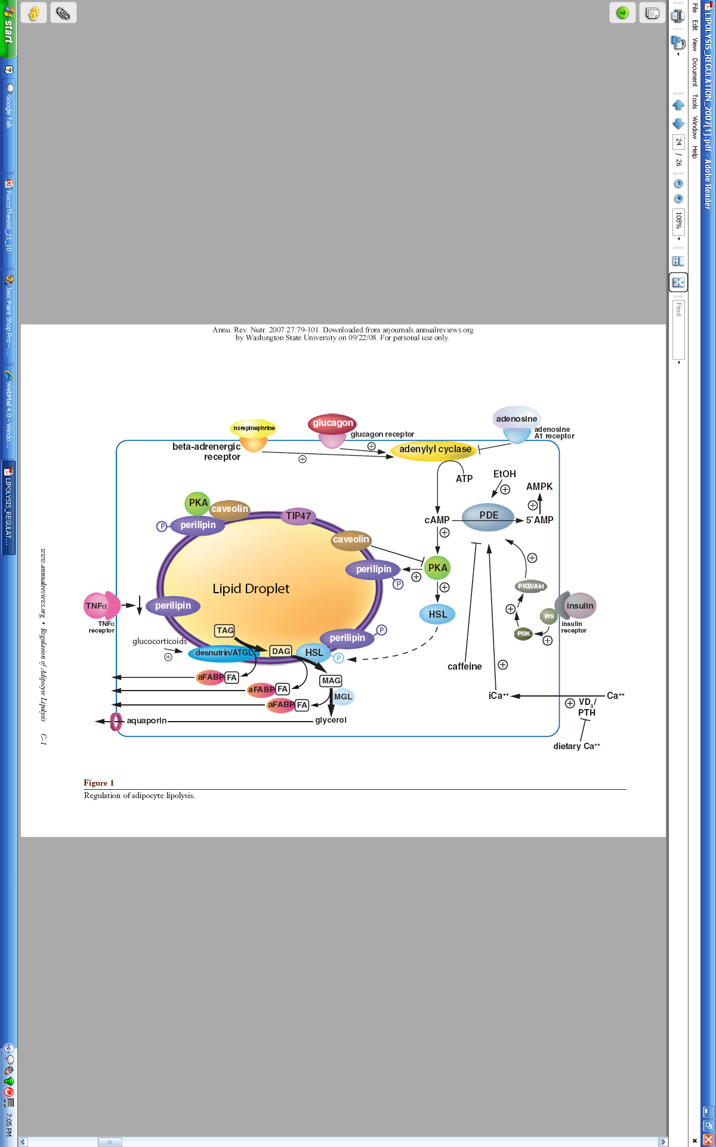
Adipocyte Metabolism
Ac
FFA
glycerol
Duncan et al., 2007. (Adapted by Shawnese Rocco)

Slide 11
Figure 1. Conceptual flow of genetic and nutritionaal mechanisms of control of flux. The asterisk indicates states (proteins, nutrients) that are genetically controlled and may have a measurable heritability. Each state (box) and rate (arrow) can be measured to determine appropriate parameters.
DNA transcription site *
Receptor*
Nucleotides
Hormone* or
Nutrient
cAMP
mRNA
*K₁
Substrate
Amino acids
Initial substrate(s)
enzyme
>>> Pathway >>>
V_{m}, K_{s}*
*K2
product
End Product
<<< Pathway <<<

Slide 12
Adipose Research Track
McNamara, J. P. and J. K. Hillers. 1986. Regulation of bovine adipose tissue metabolism during lactation 1. Lipid synthesis in response to both increased milk production and decreased energy intake. J. Dairy Sci. 69:3032-3041.
McNamara, J. P. and J. K. Hillers. 1986. Regulation of bovine adipose tissue metabolism during lactation 2. Lipolysis response to milk production and energy intake. J. Dairy Sci. 69:3042-3050.
McNamara, J. P., D. C. McFarland and S. Bai. 1987. Regulation of bovine adipose tissue metabolism during lactation 3. Adaptations of hormone sensitive lipase and lipoprotein lipase. J. Dairy Sci. 70:1377-1384.
McNamara, J. P. 1988. Regulation of bovine adipose tissue metabolism during lactation 4. Dose-responsiveness to epinephrine as altered by stage of lactation. J. Dairy Sci. 71:643-649.
McNamara, J. P. and J. K. Hillers. 1989. Regulation of bovine adipose tissue metabolism during lactation 5. Relationships of lipid synthesis and lipolysis with energy intake and utilization. J. Dairy Sci., 72:407-418.
Smith, D. J. and J. P. McNamara. 1989. Lipolytic response of bovine adipose tissue to alpha and beta adrenergic agents during pregnancy and lactation. Gen. Pharm., 20:369-374.
Smith, T. R. and J. P. McNamara. 1990. Regulation of bovine adipose tissue metabolism during lactation 6. Cellularity and hormone sensitive lipase activity as affected by genetic merit and energy intake. J. Dairy Sci. 73:772-782.
Rocco, S.M. and J. P. McNamara. 2013. Regulation of bovine adipose tissue metabolism during lactation. 7. Metabolism and gene expression as a function of genetic merit and dietary energy intake. J. Dairy Sci. 96:3108-3119.

Slide 13
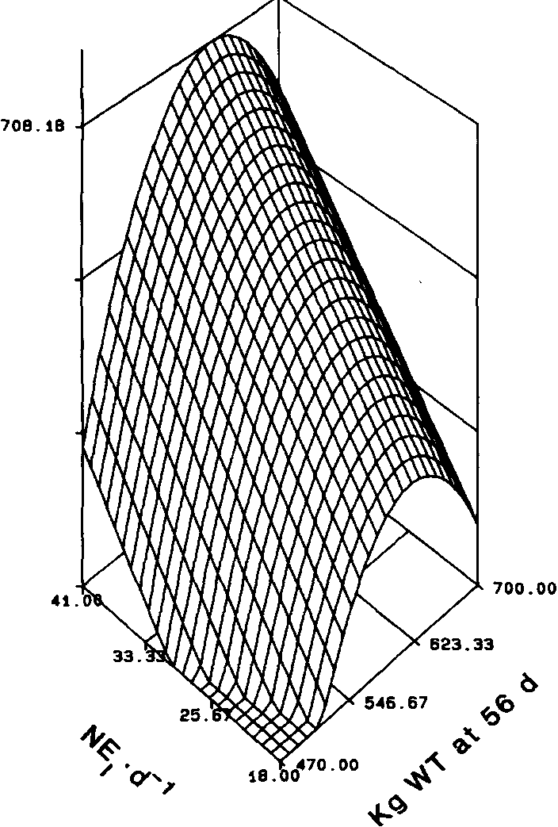
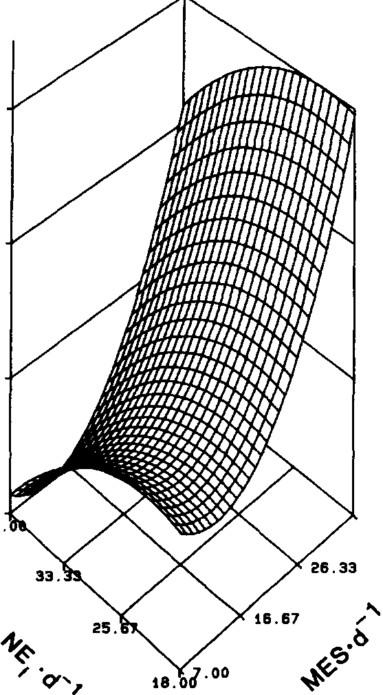
Connection between adipose tissue and whole animal flux
Esterification (TAG synthesis)
NE stimulated Lipolysis

Slide 14
Table 6. Changes in metabolic control element genes in adipose tissue of dairy cattle
from 30 d prepartum to 14 d postpartum.
______________________________________________________________________
%
Gene Name -30 14 Change SEM P, Pre vs Post¹
Genes coding for anabolic control
PPARG2* (534)544 (475) 237 (-11) -46.6 % 68.7 0.00
SREBP 142 106 -25.1% 8.7 0.032
GLUT1 176 75 -57.3% 24.9 0.004
TSH SP 14 3495 2418 -30.8% 258.0 0.050
LPL 4621 2384 -48.4% 355.6 0.002
ACACA1 196 77 -60.6% 25.4 0.001
ACACA 265 96 -63.9% 29.7 0.002
ATP Citrate Lyase 394 323 -18.1% 24.8 0.094
GLUT4 62 44 -29.4% 4.7 0.018
Affymetrix Bovine Gene Array, signal strength norm = 125

Slide 15
Changes in gene transcription in adipose tissue in early lactation
Genes coding for lipolytic enzymes
- 30 d 14 DIM % change SEM P value
Ca chan A1F 4 18 338.5% 8.2 0.218
B2 AR 147 223 52.0% 13.0 0.002
PKC rec 4998 5504 10.1% 128.4 0.008
HSL mRNA 236 290 23.0% 42.3 0.167
Caveolin-2 1089 725 -33.4% 74.0 0.010
Caveolin-1 3773 2993 -20.7% 139.0 0.020

Slide 16
Transcriptional regulation to integrate system control
Table 7. Linear regression of the mean change from 30 d prepartum to 14 DIM in transcription signal in subcutaneous adipose tissue with mean milk production for the first 60 DIM in first lactation Holsteins.
Gene of Interest Intercept Slope RSQ
Milk, kg/d
Anabolic Processes
AcCoA 1 57.5 -0.064 0.176
ATP Citrate Lyase 61.8 -0.045 0.260
GLUT 4 61.7 -0.180 0.168
Catabolic Processes AT Anabolic primary function of ABSE
HSL 66.2 0.577 0.374
B2 AR 56.9 0.106 0.301
AT Catabolic more function of Genetics, also diet

Slide 17
Glucose
*
Glucose
-
NEFA
SNS-norepinephrine
Insulin
Insulin
Catecholamines.
Catecholamines
β-adrenergic receptor
Adenylyl cyclase
Adipose tissue
ATP
AMPK
cAMP
PDE
5’AMP
AMP/ATP
AMP/ATP
PKA
Akt
insulin
caveolin
PKA
INSR
-
perilipin
TF activation
PPARG, SREBF1 etc.
P
caveolin
IRS
*
TF activation
PPARG, SREBF1 etc.
perilipin
NEFA
Lipid droplet
P
PI3K
Lipogenic enzymes
FASN, DGAT1 etc.
Lipogenic enzymes
FASN, DGAT1 etc.
LIPE
perilipin
TAG
perilipin
DAG
LIPE
P
PNPLA2
P
Lipogenesis
PNPLA2
FA
MAG
ABHD5
FA
MGLL
PNPLA2
Lipolysis
FA
ABHD5
HGM
LGM
glycerol
HGM
LGM
Lipogenesis
*
NEFA
Before parturition
After parturition
Notes:
We measured gene expression of proteins that are in pink color. Gene expression, significantly different by interaction (genetics x day), are shown in dotted circles dotted line and dotted arrow. All the other genes did not show interaction effect.

Slide 18
Metabolic Network--Molly
TSHRSP14
ACACA
FASN
BR2B
PLIN, CAV
ATGL, HSL

Slide 19
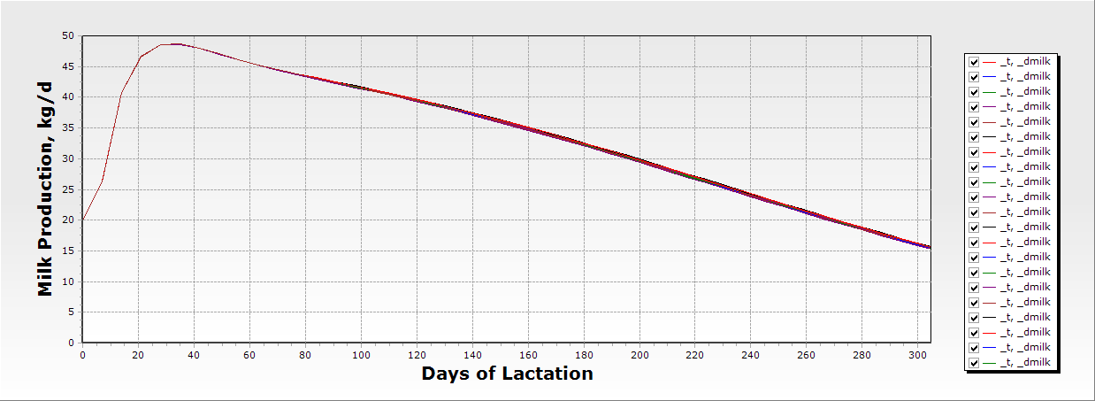
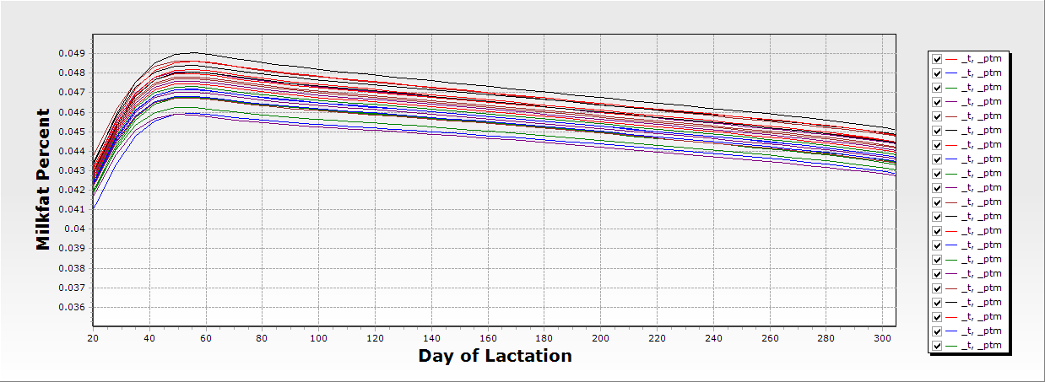
Variation in Adipose Metabolism
In this scenario,
At the same feed/
Energy intake
Altering genotype/phenotype of starting conditions of Vmax or Ks for lipogenesis (ACT, ACTS); esterification (FATS) and lipolysis (TSFA)

Slide 22
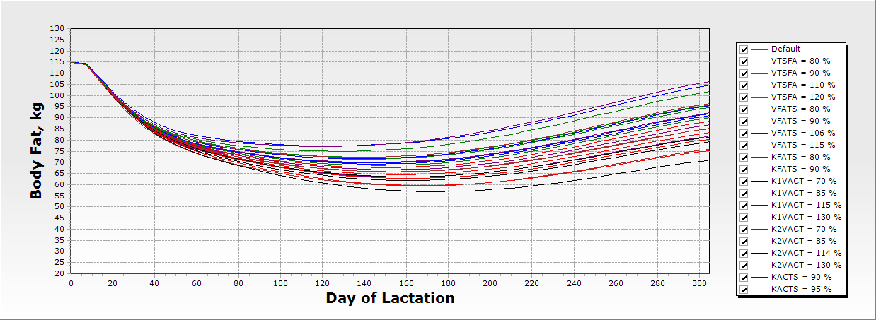
Variation in Adipose Metabolism Effect on body fat
Altering genotype/phenotype of starting conditions of Vmax or Ks for lipogenesis (ACT, ACTS); esterification (FATS) and lipolysis (TSFA). “The system” can be significantly altered, throughout, by a single key metabolic control element.

Slide 23
Segue to:
First Generation Model of Adipose Tissue Metabolic Control
Thanks to Korinna Huber, Helga Sauerwein, and Bonn University; UVM Hannover

Slide 24
Figure 1. Conceptual flow of genetic mechanisms of control of flux, involvement of gene transcription and environmental effects.
Receptor
DNA transcription site
Hormone or
Nutrient
cAMP
Nucleotides
mRNA
Initial substrate(s)
K₁
Substrate
Amino acids
>>> Pathway >>>
enzyme
V_{m}, K_{s}
K2
product
End Product
<<< Pathway <<<

Slide 25
Key Processes and Terms in Adipose Model
Table 3. Equation forms and parameter values in the model of metabolism in adipocytes of lactating dairy cattle.
_______________________________________________________________________
Reaction |  |  | Equation Type |  | Parameters |  | Parameter Values
 |  |  |  |  |  |  | (Molar)
Acetate Absorption |  |  | M-M |  | Ka, Vmax |  | 0.018 |  | 1.18
Butyrate Absorption |  |  | M-M |  | Ka, Vmax |  | 0.003 |  | 0.3
Fatty Acid Absorption |  |  | M-M |  | Ka, Vmax |  | 0.005 |  | 0.5
Glucose Absorption |  |  | M-M |  | Ka, Vmax |  | 0.003
Amino Acid Absorption |  |  | M-M |  | Ka, Vmax |  | 0.0025
Acetate Activation |  |  | MA |  | K |  | 1.0
Butyrate Activation |  |  | MA |  | K |  | 1.0
Fatty Acid Activation |  |  | MA |  | K |  | 1.0
Enzyme Synthesis |  |  | MA |  | K |  | 1.0
De Novo Lipogenesis |  |  | M-M |  | Ks, AcCoA; Vmax
TAG synthesis |  |  | M-M |  | Ks,FaAcylCoA;
 |  |  |  |  | Ks, glycerol, Vmax
TAG Lipolysis |  |  | M-M |  | Ks, TAG, Vmax

Slide 26
Key Equations In Adipose Model

Slide 27
Key Equations In Adipose Model

Slide 28
Esterification of fatty acids to TAG
TAG lipolysis and metabolism

Slide 29
Control of Triacylglycerol Synthesis by glucose and fatty acyl CoA

Slide 30
Regulation of lipolysis by fatty acyl CoA and norepinephrine

Slide 31
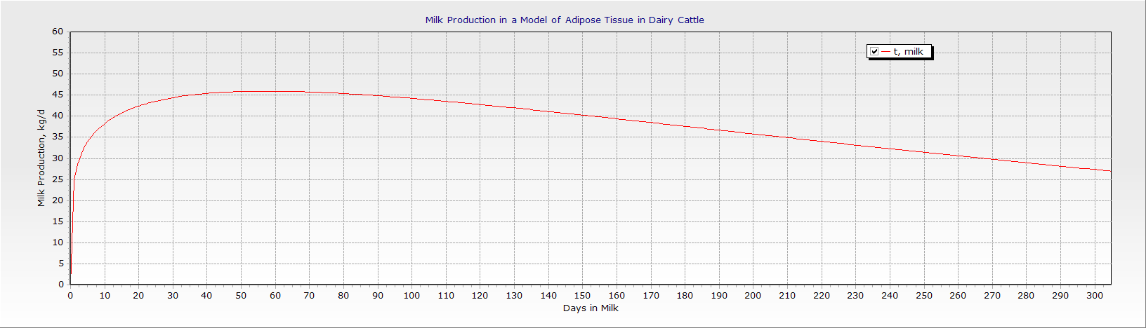
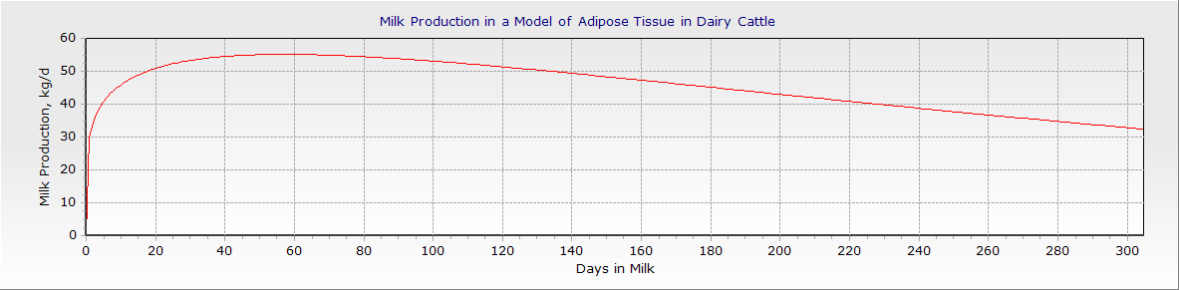
Milk Production, kg/d

Slide 32
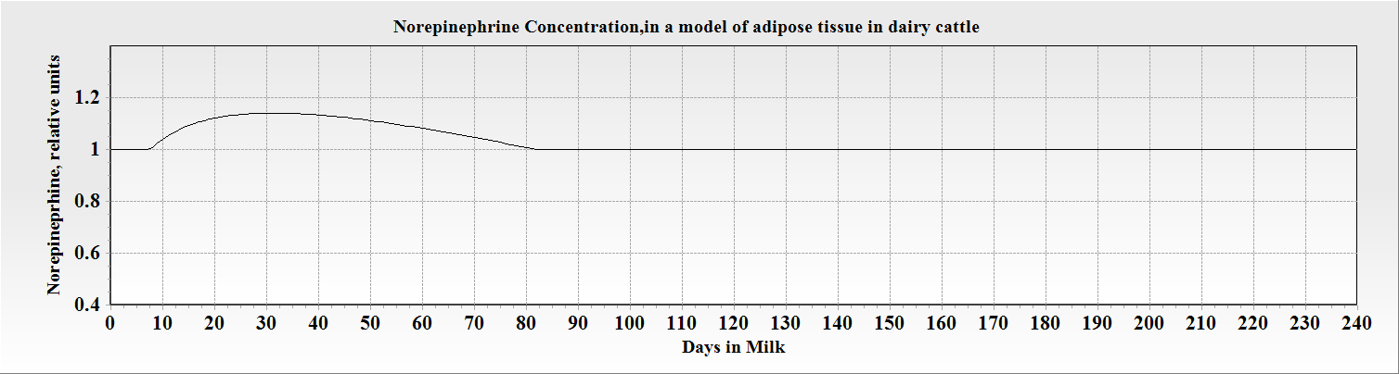
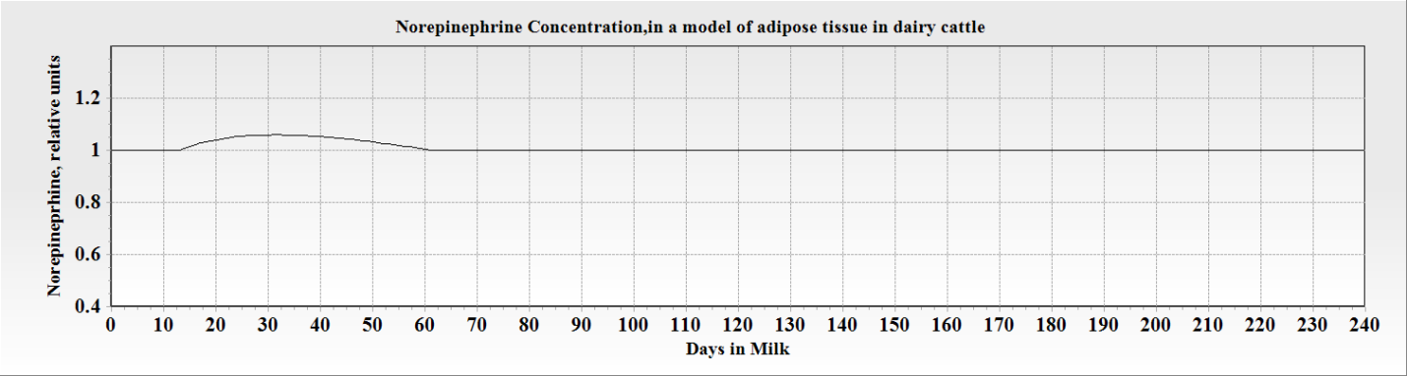
Norepinephrine concentrations (relative units ) as an effect of changing milk production from 39 to 29 kg/d during the first 240 d of lactation. This is in keeping with available data that SNS is related to milk production and that small changes in NE release can have a significant effect on metabolic flux.

Slide 33
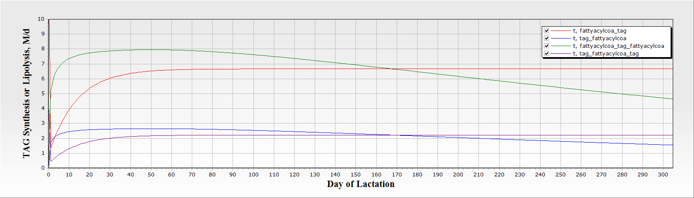
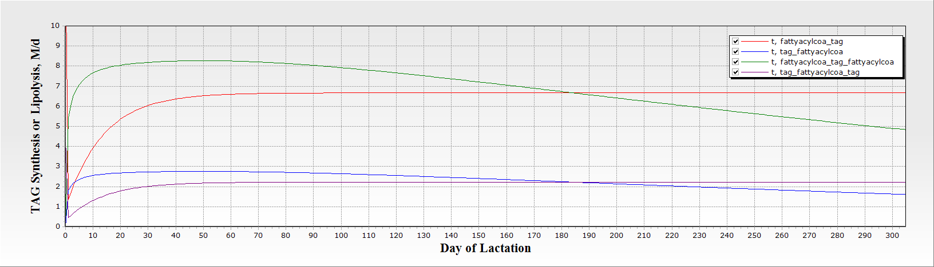
Change in TAG synthesis and Lipolysis
Synthesis (fattyacylcoa_tag) and lipolysis (fattyacylcoa_tag_fattyacylcoa) in a model of adipose tissue metabolism. Synthesis is a function of substrate and insulin; lipolysis is a function primarily of demand signaled by norepinephrine and modifications in the phosphorylation response.

Slide 34
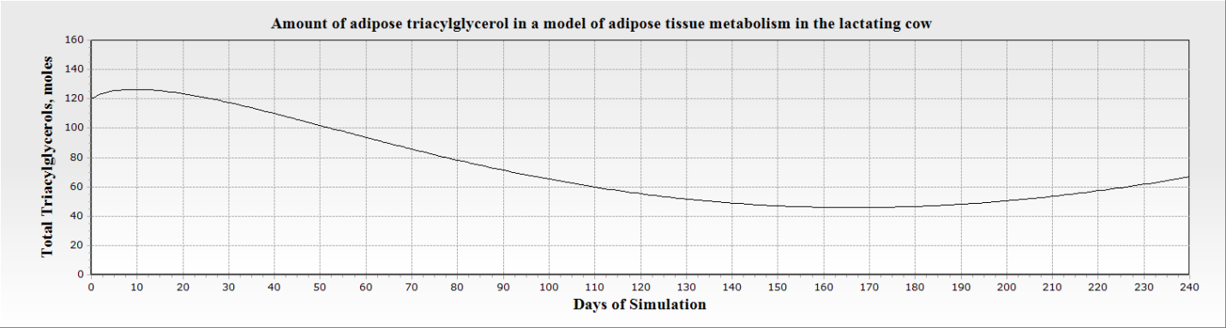
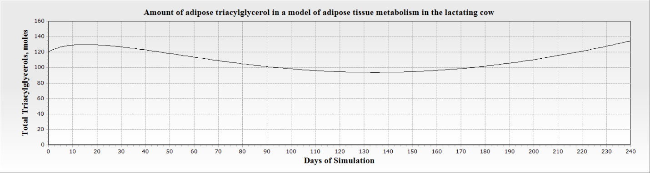
Amount of Triacylglycerol in a model of adipose tissue metabolism in dairy cattle. Upper panel is milk production at 39 kg/d; lower panel is milk at 29 kg/d.

Slide 35
The Future
The model behaves in a consistent fashion with changes in adipose tissue metabolism in lactation.
Key controllers are explicit in the model.
This provides a framework for expansion to include control systems including endocrine, neurocrine, gene transcription and post-translational modification.

Slide 36
But I’m a nutritionist…
I work in the real world
Day to day problems
Too much science
Too much math

Slide 37
Science is the real world
How did we get here?
25000 lbs/305 d; fat at 4 % SCC < 100 or 150?
Too much math?
IOFC
Pregnancy Rate
Profit
Long term ROI

