Slide 1
Stock forecasting Analysis
Top Secret
John Q. Li, Rakesh Chauhan, Bijan Marsh

Slide 2
Agenda
Data Storytelling
The stock investment Dataset
Statistical Analysis & Charts

Slide 3
Work we did
Stock Data Collection
Data Analysis using Python & Statistical Methods
Lots of Graphs and Plots
D3JS Visualization
Next steps would be more advanced analytics
Statistical &
Dynamic Visualization

Slide 4
Data Storytelling But
Don’t feel like to do it today.
Not going to do that
I want to make a sale today.
But
I don’t have much on me. besides I don’t seem to have anything with me to make an exchange with anyone today.
Ok. How about advertising? For what?
For me I want to do an advertisement for myself today.
So once I sold myself, I no longer need to deal with my ridiculous wife any more.

Slide 5
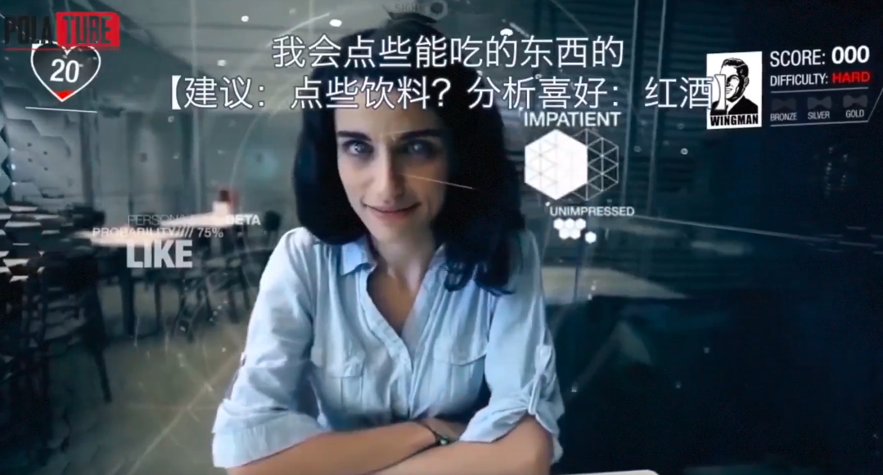
concept introduce
What is the future have but I don’t have at present. What am I current facing
Reality: back from the future is too risky and costly
Alternative: Dark technology, AI
Video “AI Glasses”
https://www.youtube.com/watch?v=L6f-cG230P4
My life will be: machine learning glasses guide and prepare me for any unexpected situation. But I am afraid. what if I live without it.

Slide 6
The stock investment!!!
What you know about the stock analysis? Any personal experience
What info come with the stock before purchasing.
What kind information can help you succeed but not offered to you?
How to find them out?
Asymmetric information
Example of a good stock analysis platform?
Is it user friendly?
Do you know how to use it?
What can be improved?
is the info enough for you to make a successful investment?
Does other people knows something that you don’t know? Will cause you hesitated to invest.
you still don’t have significant confidence to ensure that the stock price will bring you fortune

Slide 7
Analysis purpose and expectation
What keep you away from stock investment?
Lack of experience & confidence, Uncertain the risks.
Lack of expertise domain knowledge.
what can our study provide?
Generate future prediction to Reduce the investment risk
What you need to do? Using the magic spell
“Magical data John, preparing me for my decision please.”
to seek me out
Visualization works because neurons in our brains transmits information, interpret imagery as equivalent to a real-life action … - from huffpost.com

Slide 8
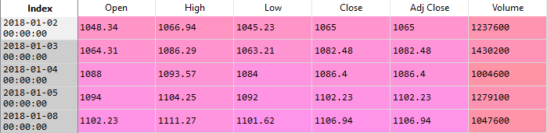
As an magical data analyst you have to feed me with Data…
What the original dataset looks like
what the attributes are?
Do those attributes offer enough information for us to analysis?
What is the limitation of our dataset.

Slide 9
Dataset description
Basic Statistics regard to the datasets
Does those attributes means anything?
[*********************GOOGLE Stock 100%***********************] 1 of 1 completed
Open High Low Close Adj Close Volume
count 481.000000 481.000000 481.000000 481.000000 481.000000 4.810000e+02
mean 195.010727 196.909668 193.235717 195.132266 192.372161 3.117239e+07
std 25.388137 25.433350 25.336855 25.483966 26.136655 1.325359e+07
min 143.979996 145.720001 142.000000 142.190002 140.085220 1.136200e+07
25% 175.029999 176.190002 173.850006 175.029999 171.800674 2.169530e+07
50% 191.509995 192.470001 189.929993 191.240005 187.721039 2.783540e+07
75% 210.880005 213.649994 209.229996 210.360001 208.563843 3.666000e+07
max 267.899994 268.000000 265.390015 267.839996 267.839996 9.624670e+07

Slide 10
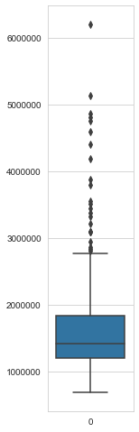
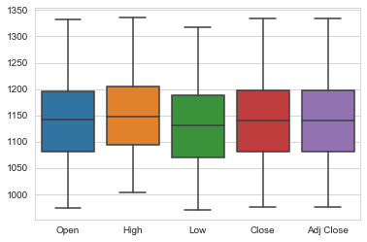
Charts from data statistics
￼
Volume

Slide 11
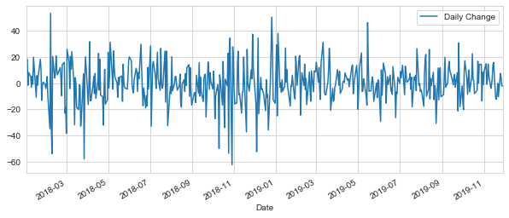
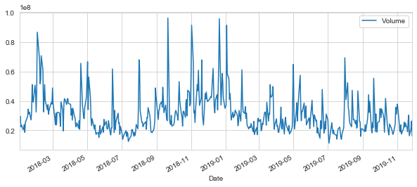
Hypothese: correlation between
Daily Change=Close-Open

Slide 12
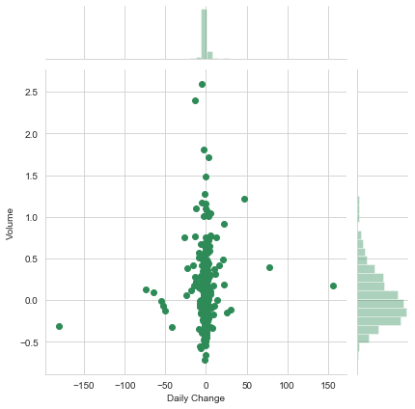
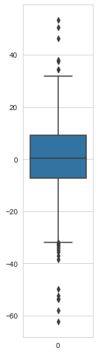
Get more info from data
Daily Change=Close-Open
(Chi-Squared Test)
H0: the two samples are independent.
H1: there is a dependency between the samples.
CI : 0.05
there is no sufficient evidence to prove there is dependency between samples

Slide 13
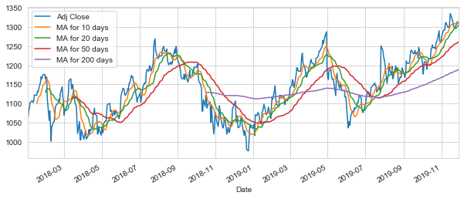
GOOG averages

Slide 14
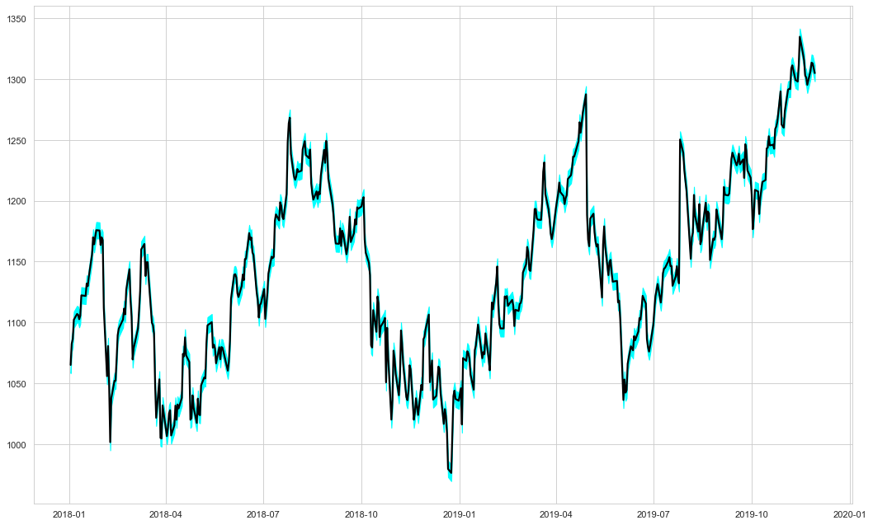
Standard Error

Slide 15
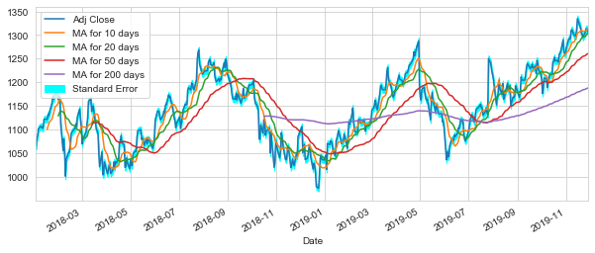

Slide 16
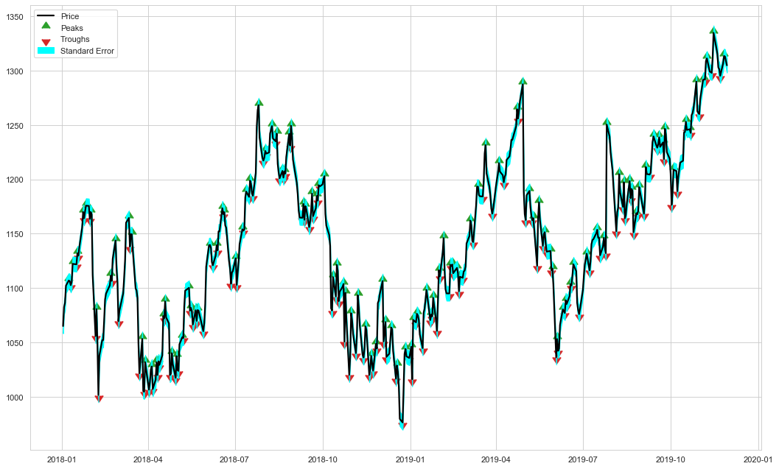

Slide 17
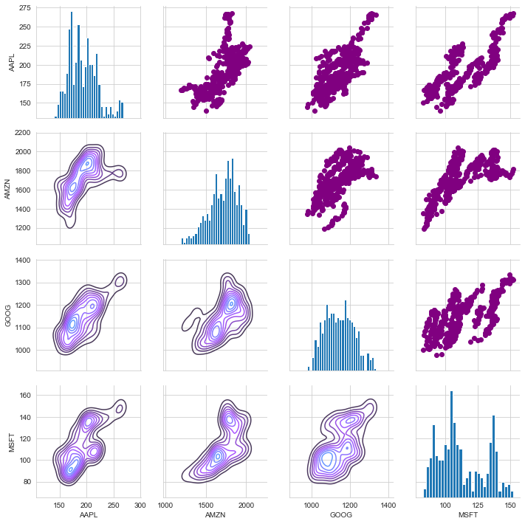
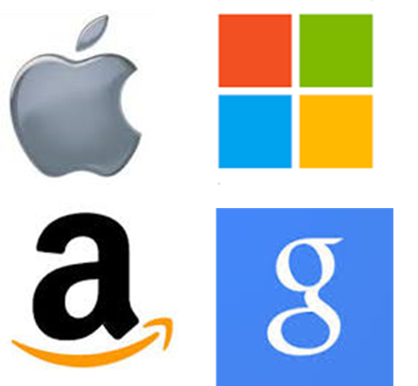
Fundamental Analysis

Slide 18
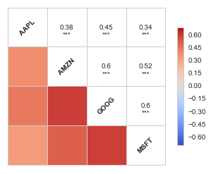
Tech company stocks correlation (Pearson’s correlation coefficient)
 | Coefficient, r
Strength of Association | Positive | Negative
Small | .1 to .3 | -0.1 to -0.3
Medium | .3 to .5 | -0.3 to -0.5
Large | .5 to 1.0 | -0.5 to -1.0

Slide 19
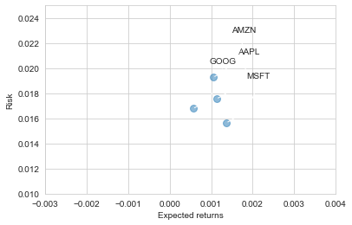
Risk comparison

Slide 20
“Magical data John, preparing me for my decision please.”
Now I have the data. Hey, hands off me! I don’t have your fortune on me！！！
You have to use the magical spell…
“Magical data John, preparing me for my decision please.”
Keep doing what you are doing right now…
“Magical data John, preparing me for my decision please.”
“Magical data John, preparing me for my decision please.”
“Magical data John, preparing me for my decision please.”...
Don’t beat me, the magic take times, a few days. You have to be patient. Otherwise the magic will not work...

Slide 21
Meanwhile magic happening In a dark room in front of a laptop The magic abstract
Top Secret
Data driven decision making is key to our bright future
Our purpose to Forecast future so we could make fortune with less risks
in order to do that we have to do an ETL data analysis Project
In the dark room, with my swelling eyes and drowsy lips,
I was hardly awake...
Data⇒ extraction... formation...cleansing….
normalization...transfer...load…
⇒ Visualization
Interpret Results
price prediction accuracy tuning & risk analysis
extraction...formation...cleansing….
normalization...Standardize...transfering...loading…

Slide 22
Advertising: Who are we? and what we are becoming?
Wait…
What am I talking about? I am suppose to sale myself.
Who am I? and what I am becoming?
We r 30’sh years old data scientists intend to be. Always nervous talking in front of people. Have low EQ and IQ. But We have a superpower about using data to assist decision making on anything, literally anything. -Just like the AI glasses in the clip.
offer me data the more the better, So you can earn milk no I mean fortune…
Don’t roll your eyes at me!
I can prove it…

Slide 23
Bored long enough? Where is the future We promised?
Linear Regression
k-Nearest Neighbors
Auto ARIMA
Prophet
Long Short Term Memory (LSTM)

Slide 24
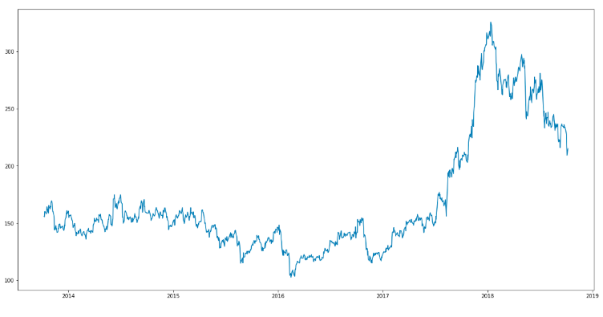
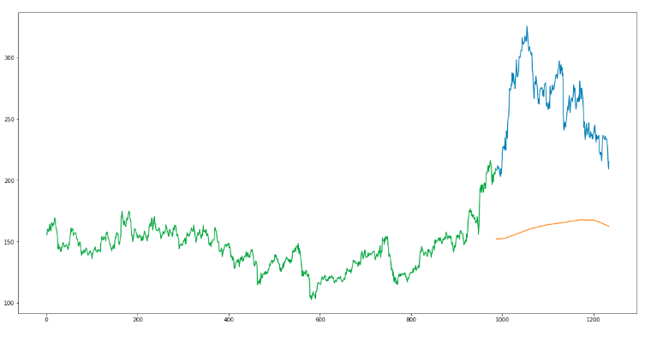
🡸What we have.
Our Prediction🡺
Don’t throw eggs at me!

Slide 25
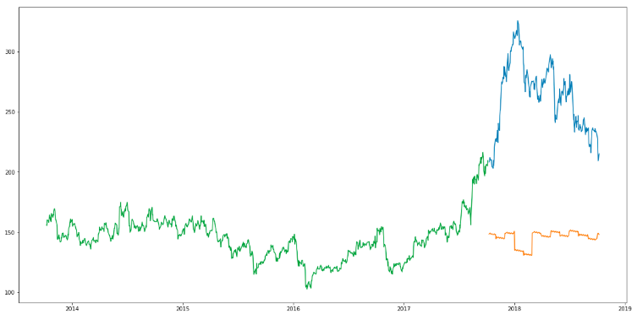
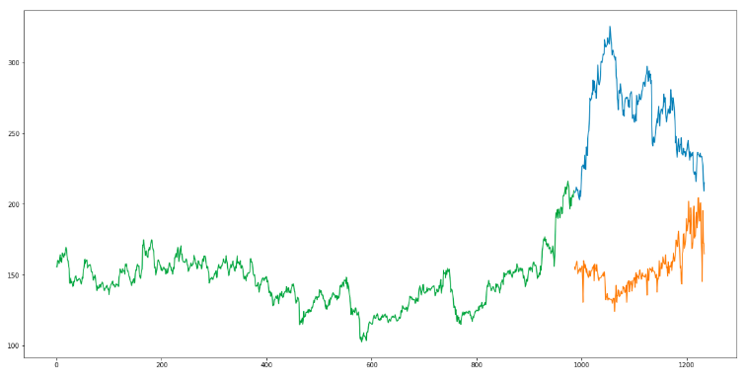
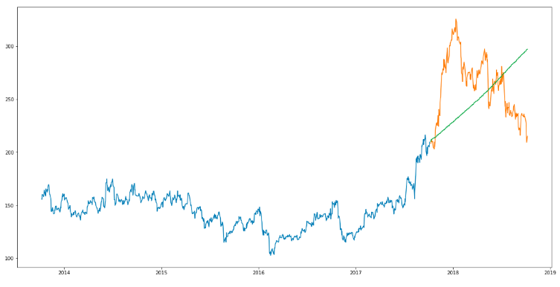
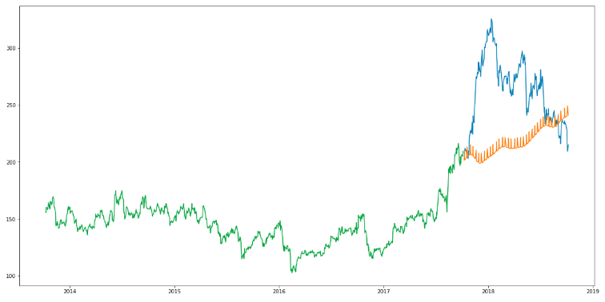
I start to become excited… How about you?

Slide 26
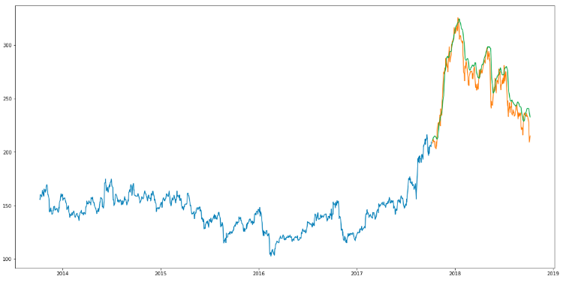
Are you high?

Slide 27
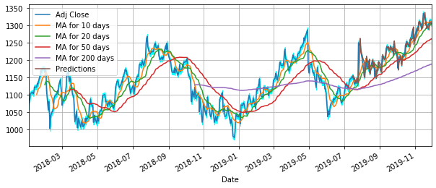
Google stock prediction result

Slide 28
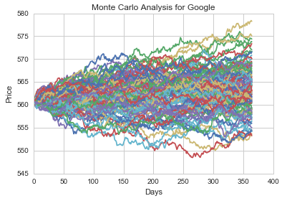
Risk Analysis

Slide 29
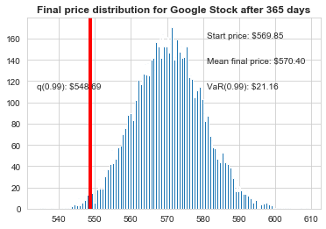
Z test

Slide 30
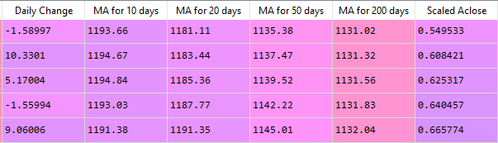
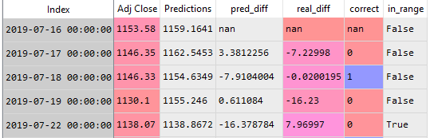

data ⇒ more data...
Holy crap!
Hold on, I thought I just spend days finished the analysis without a good sleep. but now there are even more data been generated… this is endless
No more magic spells... Please!!!
I won’t do it anymore.
Please let me go.
I think data scientist position is no longer suitable for me. I am too lazy.

Slide 31
Future work & Who we are
The stock forecasting can be more accurate by neural network models tuning and mathematical algorithms improving.
Models combination is one way to result better prediction accuracy.
Generative Adversarial Network (GAN) with LSTM
We are data scientists who can using data to reduce your decision risk and cost positively guide your life decisions.
Remember, We are one magic spell away.
“Magical data John, preparing me for my decision please.”

Slide 32
References
Stock Prices Prediction Using Machine Learning and Deep Learning Techniques
https://www.analyticsvidhya.com/blog/2018/10/predicting-stock-price-machine-learningnd-deep-learning-techniques-python/
Using the latest advancements in deep learning to predict stock price movements
https://towardsdatascience.com/aifortrading-2edd6fac689d
Time Series Prediction with LSTM Recurrent Neural Networks in Python with Keras
https://machinelearningmastery.com/time-series-prediction-lstm-recurrent-neural-networks-python-keras/
Stock Analysis in Python
https://towardsdatascience.com/stock-analysis-in-python-a0054e2c1a4c
Stock Prediction in Python
https://towardsdatascience.com/stock-prediction-in-python-b66555171a2

