Slide 1
Mammoth snow depth
A Time Series Analysis
John Rapp Farnes

Slide 2
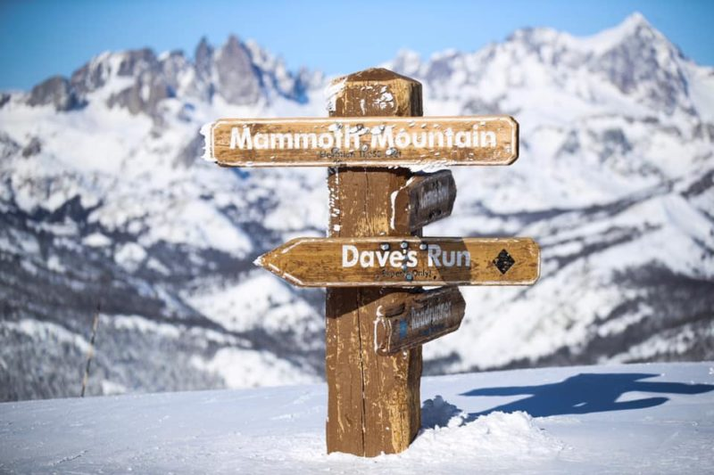
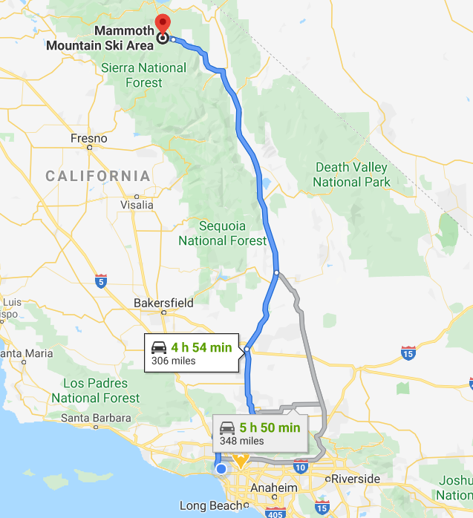
Mammouth mountain

Slide 3
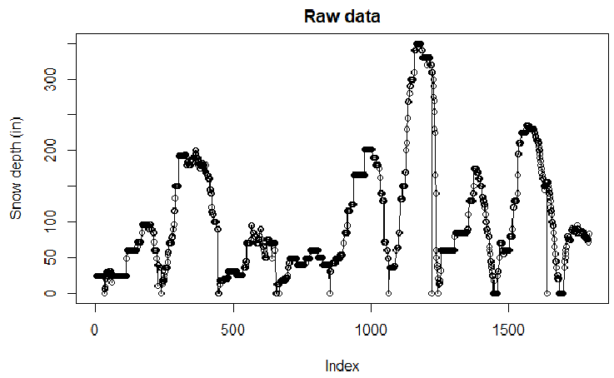
Dataset
Snow depth data from Mammoth website (Main lodge)
Collected by https://www.onthesnow.com/california/mammoth-mountain-ski-area/historical-snowfall.html
Problem with missing data
During off season and missing measurements

Slide 4
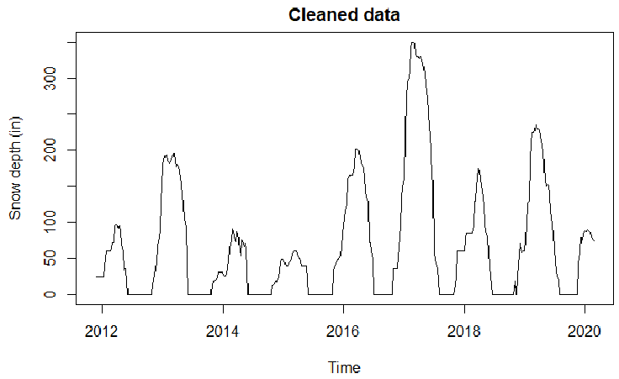
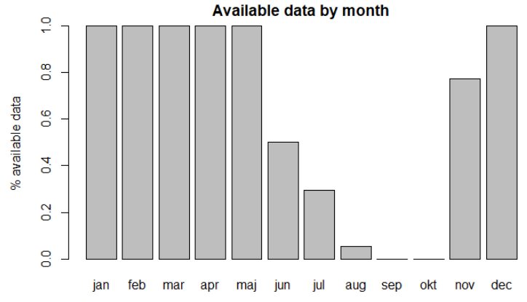
Data cleaning
Weekly average
Fill 0s in missing values

Slide 5
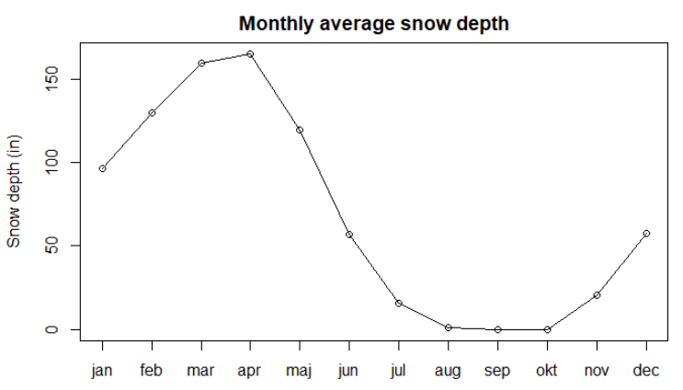
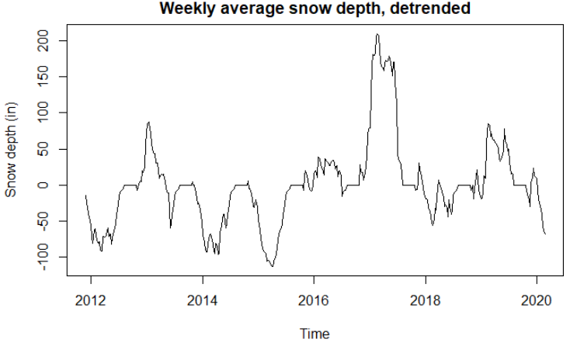
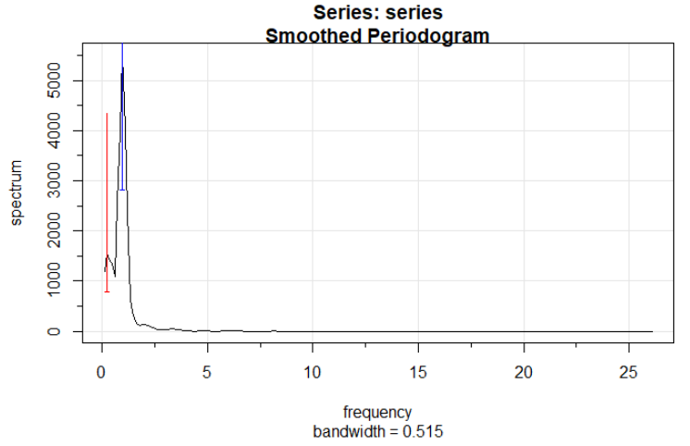
Detrending
Clear and obvious yearly trend (additional 4 year trend)
Detrend as depth – weekly_average(depth)

Slide 6
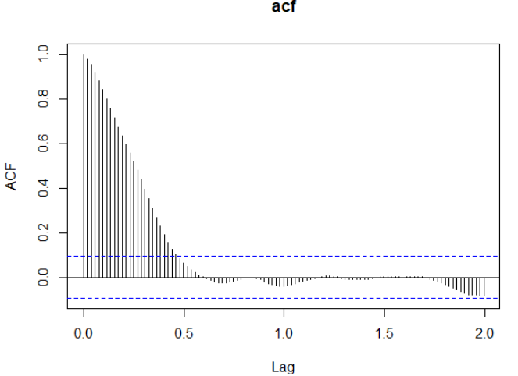
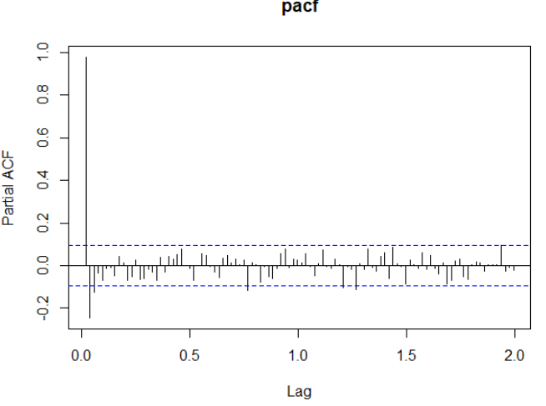
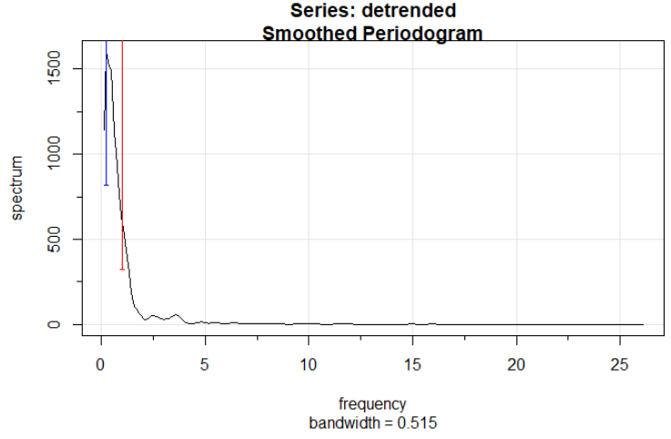
Detrended series properties
Looks like AR(1)
No yearly peak in periodogram

Slide 7
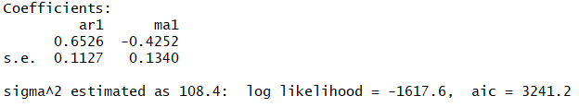
Model fitting
Best model ARMA(1,1,1) according to AIC
All terms significant
High sigma^2 estimate: 108.4

Slide 8
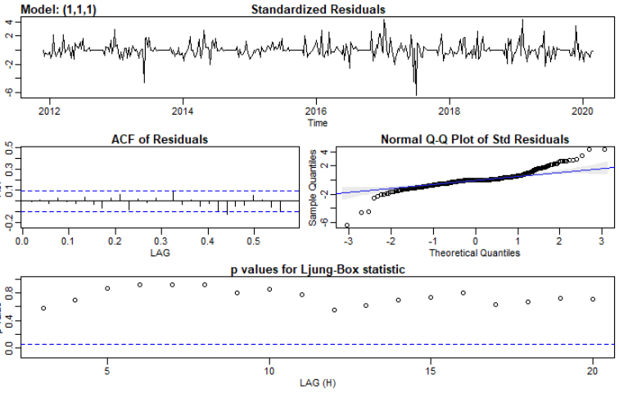
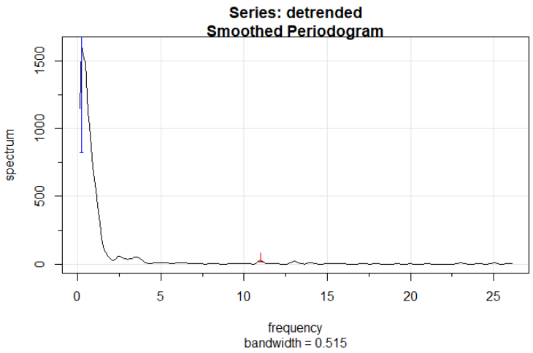
Residuals and smoothness
Residuals doesn’t meet assumptions
Big non-normal residuals
ACF and Ljung-Box OK
Low frequency variance
Smooth, however big jumps

Slide 9
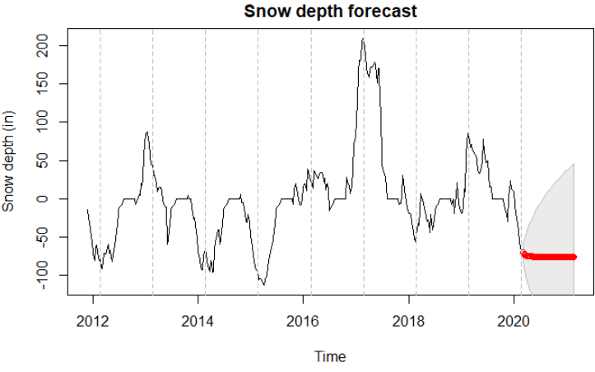
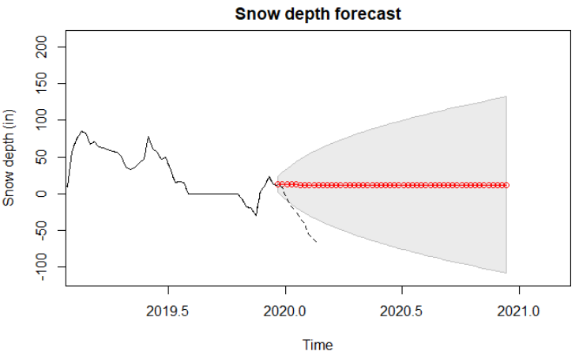
Prediction
Predicting snow depth continue according to seasonal trend
Big standard errors, not predicting last 5 weeks

Slide 10
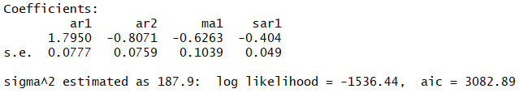
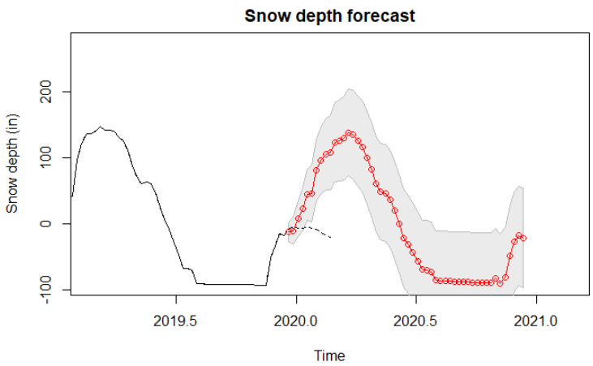
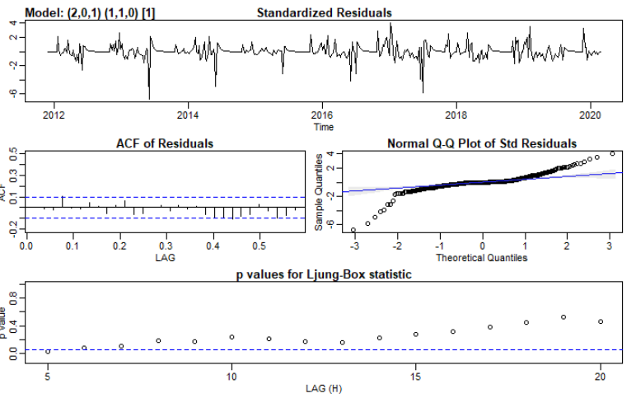
Prediction different model
Linear detrending, ARMA(2,0,1)x(1,1,0)[52]
Better Ljung-Box and residual ACF, high variance
Predicts snow will increase

Slide 11
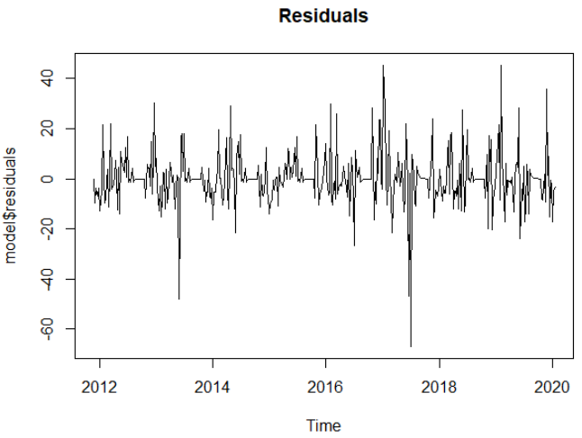
Next steps
More transformations on data
E.g. log, removing trend
Other weather predicting features
E.g. radar, temperature
Other models
GARCH, varying variance?

Slide 12
Questions?

