Slide 1
Mammoth snow depth
A Time Series Analysis
John Rapp Farnes

Slide 2
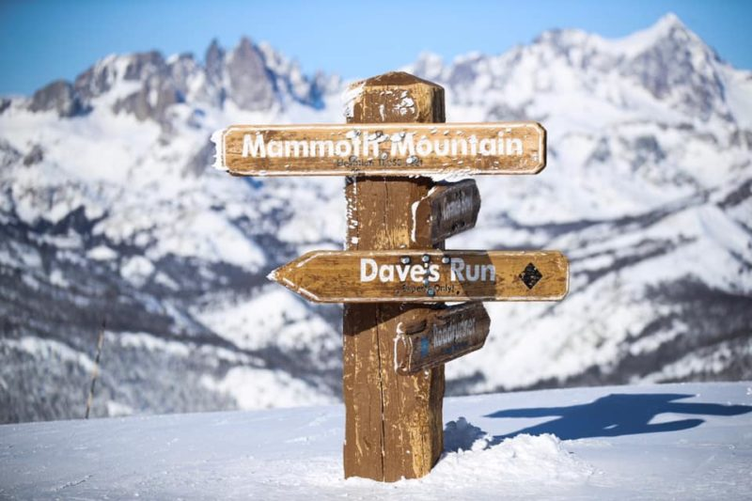
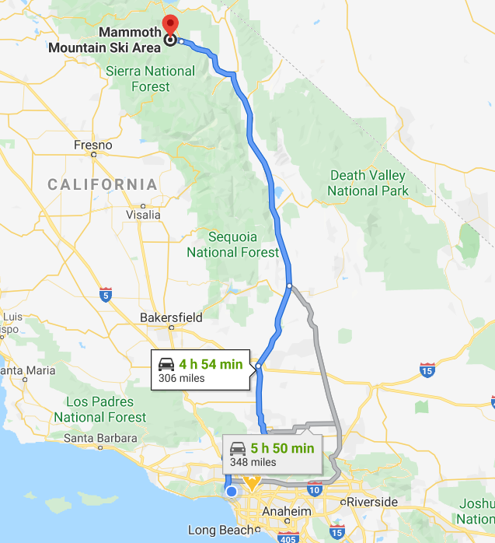
Mammouth mountain

Slide 3
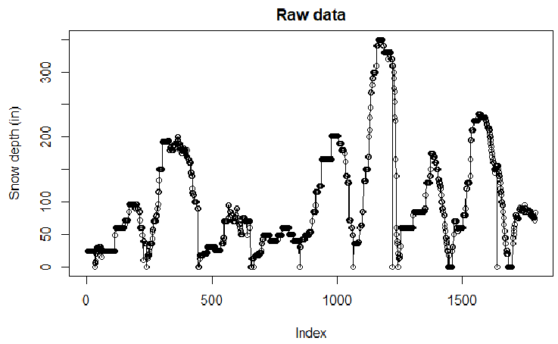
Dataset
Snow depth data from Mammoth website (Main lodge)
Collected by https://www.onthesnow.com/california/mammoth-mountain-ski-area/historical-snowfall.html 431 weeks, 8 years
Problem with missing data
During off season and missing measurements

Slide 4
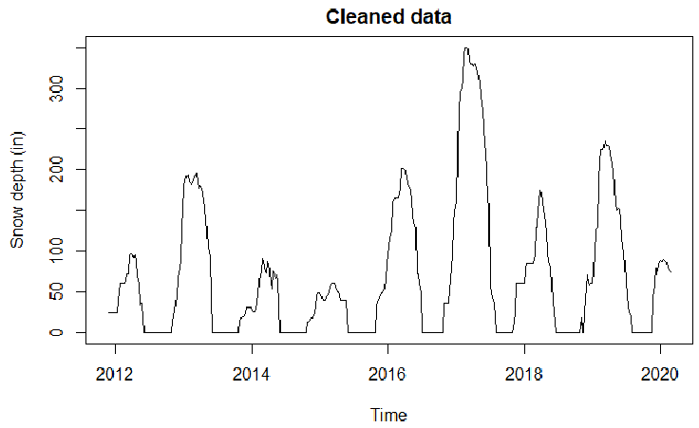
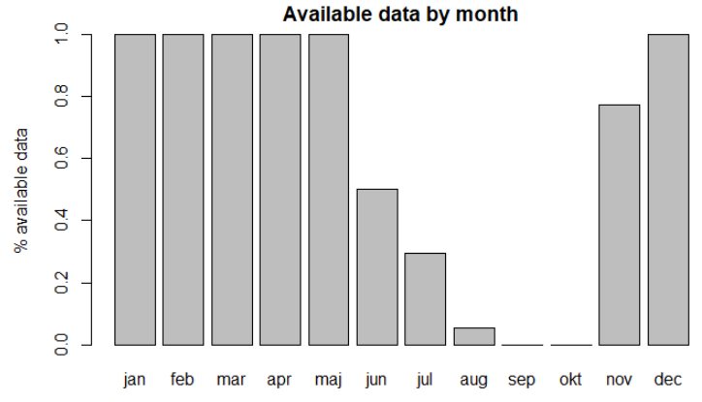
Data cleaning
Weekly average
Fill 0s in missing values

Slide 5
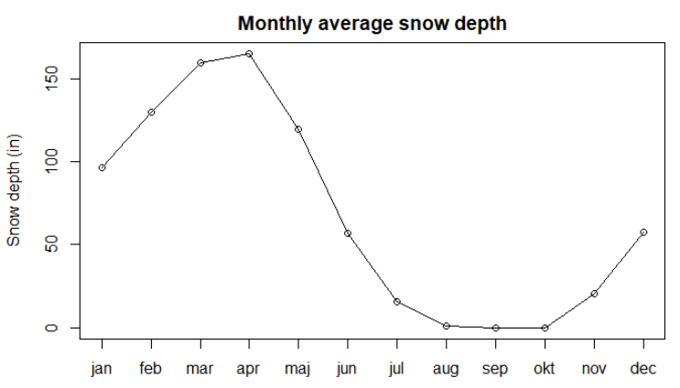
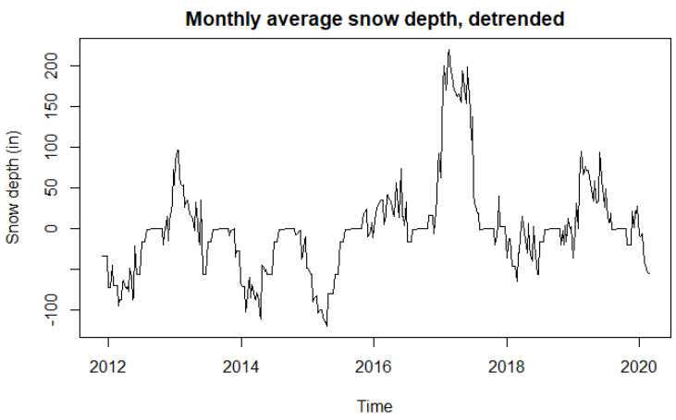
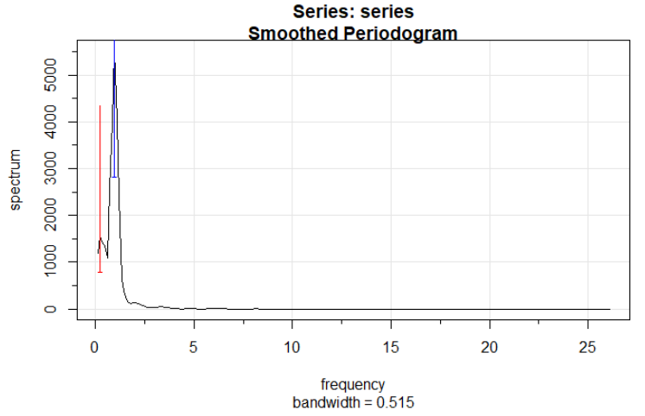
Detrending
Clear and obvious yearly trend (additional 4 year trend)
Detrend as depth – weekly_average(depth)

Slide 6
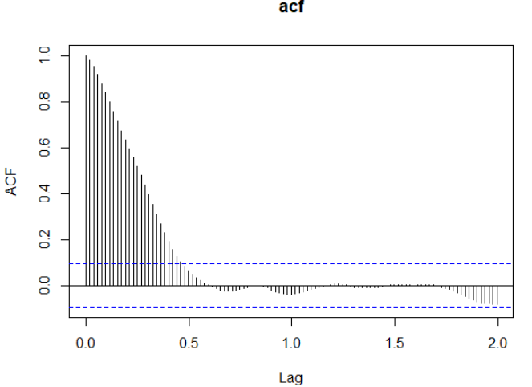
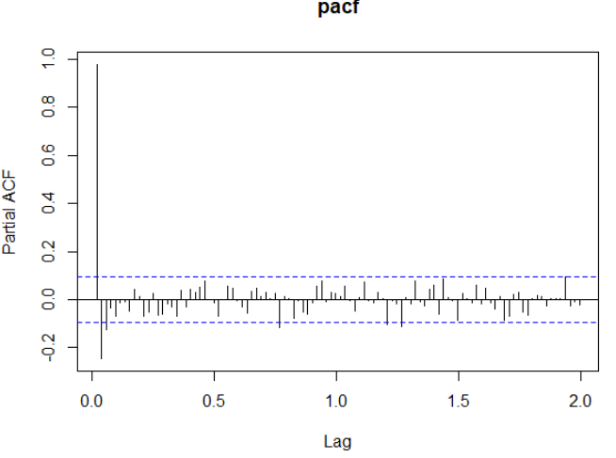
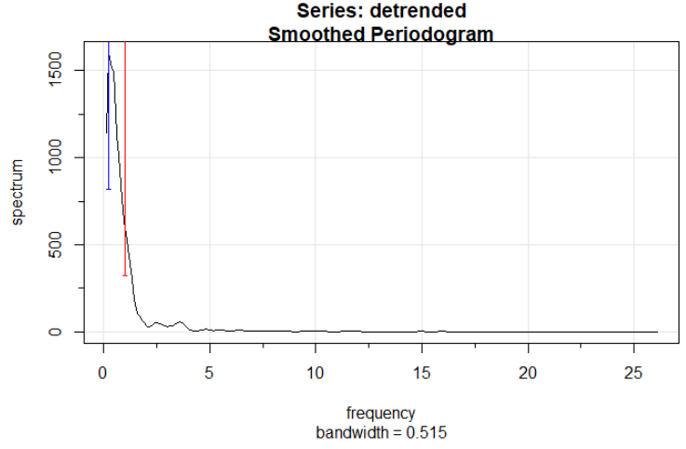
Detrended series properties
Looks like AR(1)
No yearly peak in periodogram

Slide 7
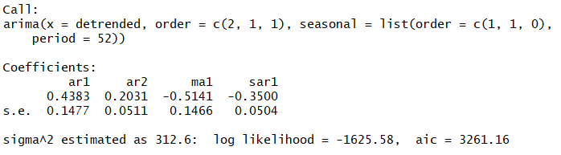
Model fitting
Best model ARMA(2,1,2)X(1,1,0)[52] according to AIC measurement
All terms significant
Very high sigma^2 estimate: 312

Slide 8
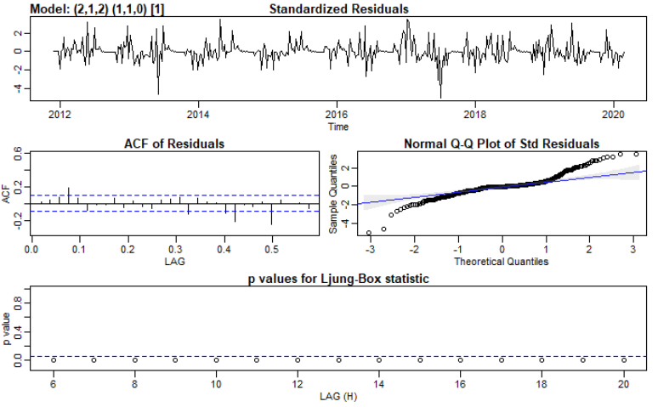
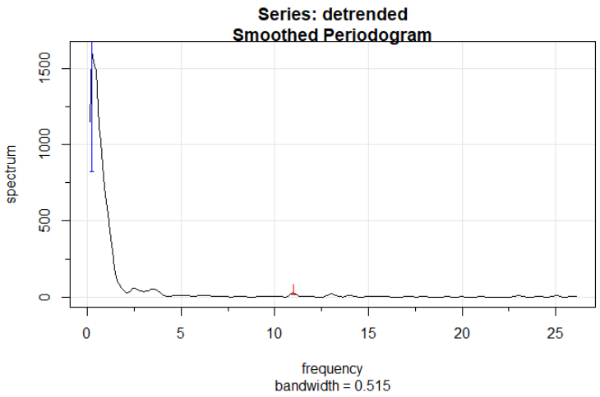
Residuals and smoothness
Residuals doesn’t meet assumptions
Big residuals big snow falls?
Standard error higher than estimate
Low frequency variance
Smooth, however big jumps

Slide 9
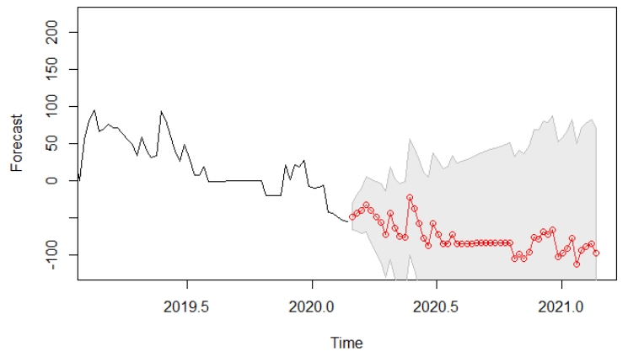
Prediction
Predicting snow depth decrease compared to average
High error, higher than reported

Slide 10
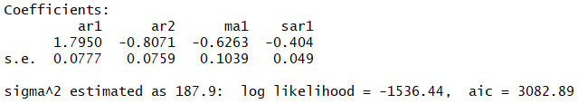
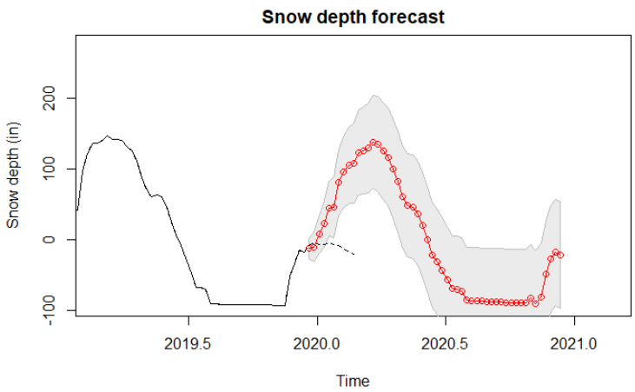
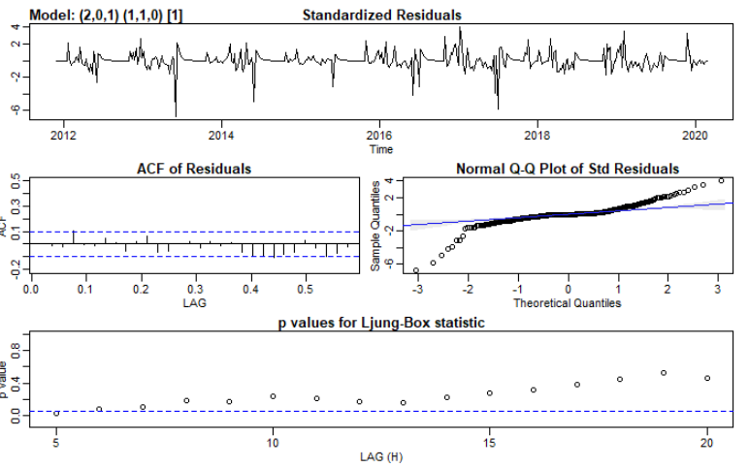
Prediction different model
Linear detrending, ARMA(2,0,1)x(1,1,0)[52]
Better Ljung-Box and residual ACF
Predicts snow will increase

Slide 11
Next steps
More transformations on data
E.g. log
Other weather predicting features
Other models?
GARCH?

Slide 12
Questions?

