Slide 1
InterHavoc
Notes:
Introductions - <30s. Greet the class, name ourselves, name the game.

Slide 2
Project Idea
First Person Shooter
Roguelike
Set on an abandoned outpost
Simple AI enemies
Procedural level generation
Notes:
Project Idea - ~1min. Describe the game from a player perspective; what genre is it? What will the player do and encounter? How long is it?

Slide 3
Simple AI - Making Enemies
Enemy properties
Spawn points
Pathfinding
Notes:
Intermediate topic plan – 30-60s. Name and explain our pick (simple AI iirc)

Slide 4
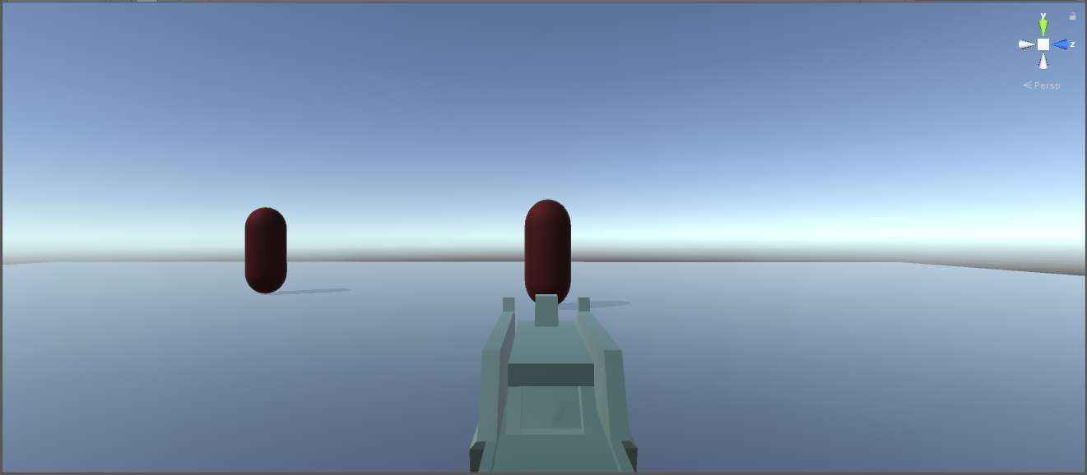
Simple AI - Beginnings
Enemies have health
Will aim at the player
Will add basic walk-towards-player
Will follow player through level (pathfinding)
Notes:
Intermediate progress – 30-60s. What we have currently towards our topic.
Will take a crack at getting targets to aim and shoot, and report on it here.

Slide 5
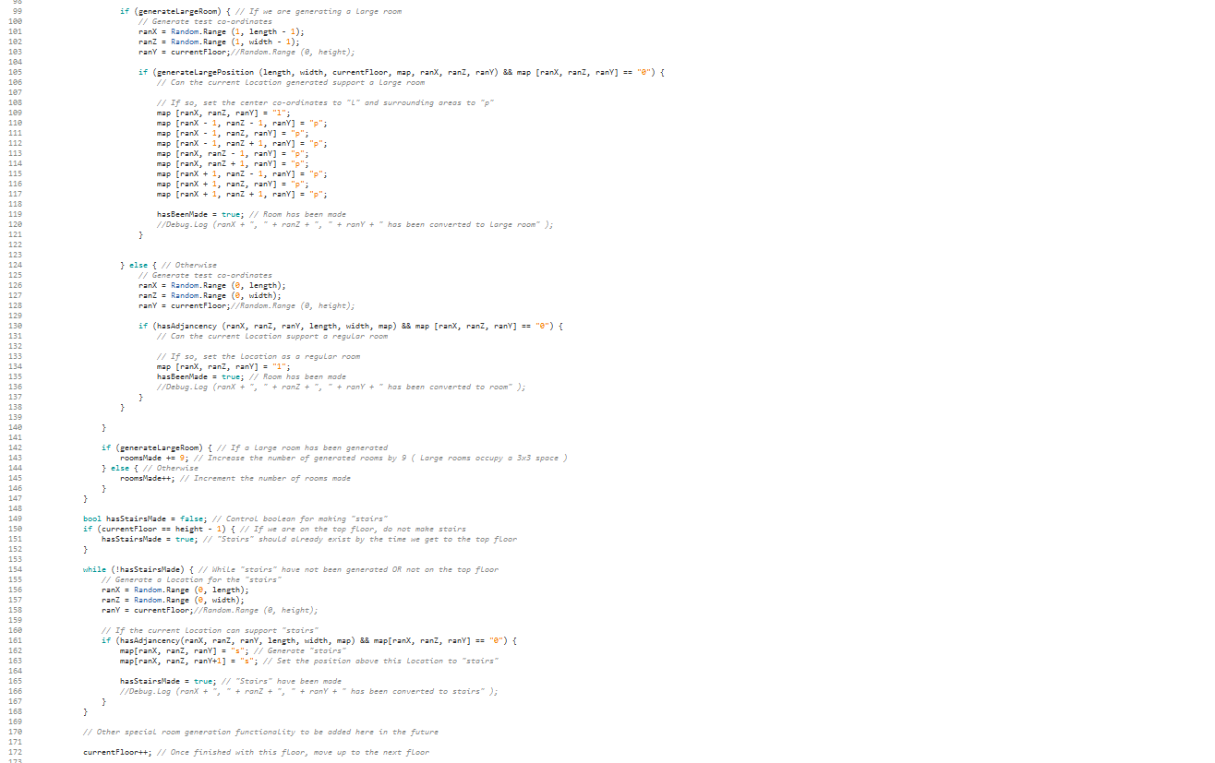
Introduction to Substantial Procedural Content Generation
Procedurally Generated Levels
… in 3 dimensions!
Rooms in Levels contain Loot and Enemies
Notes:
Advanced topic plan – 30-60s. Name and explain our pick (procedurally generated levels), and what we want(ed) our procedural generation to do.

Slide 6
Procedural Generation Research
Rogue (1980) relied heavily on procedural generation
New content made on the fly
Can have varying degrees of complexity
Notes:
Advanced topic – 30-60s. What we researched on procedural generation methods.

Slide 7
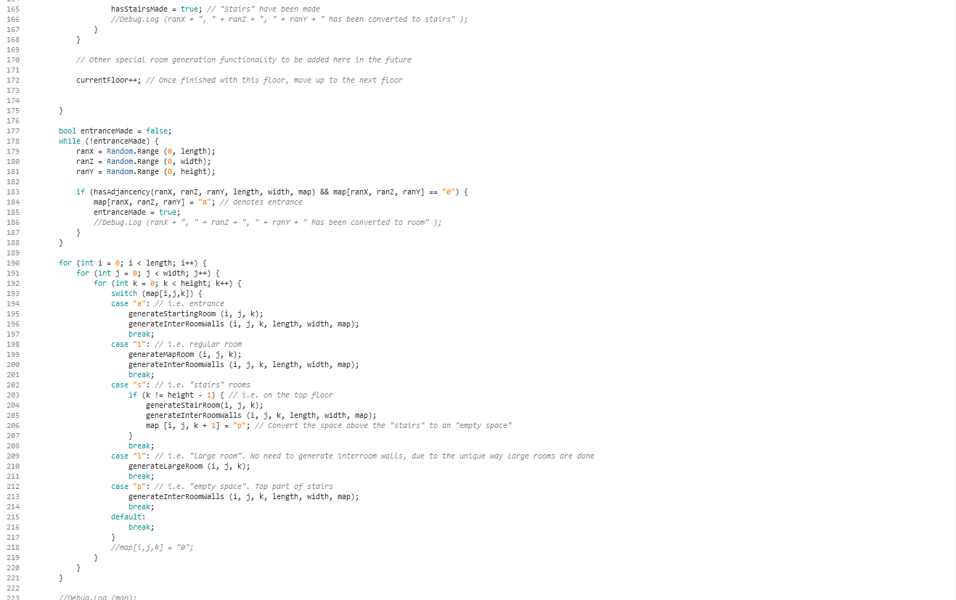
Procedural Level Generation - Features
Map
Rooms
“Stairs”
Large Rooms
Entrances
To Come
Objectives
Boss Room
Notes:
Advanced topic research – 1min+. What we have so far (extended to explain the current working iteration.

Slide 8
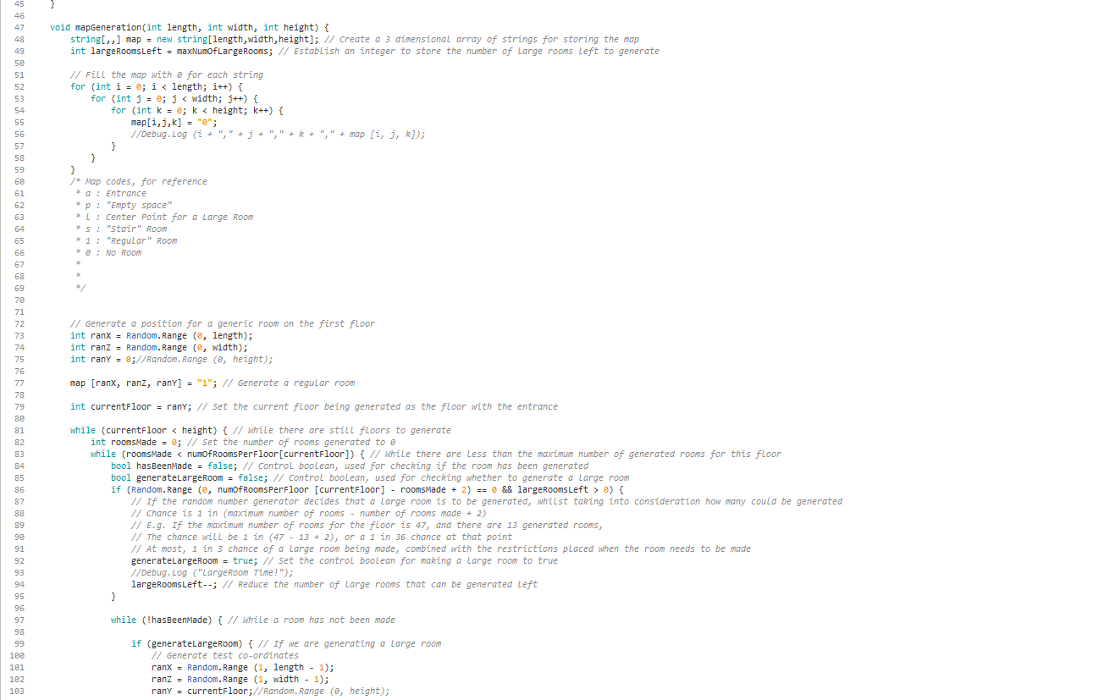
Map Generation
3 Dimensional Array of Strings
Generate Position with Horizontal Adjacency
Stairs + empty space above

Slide 9
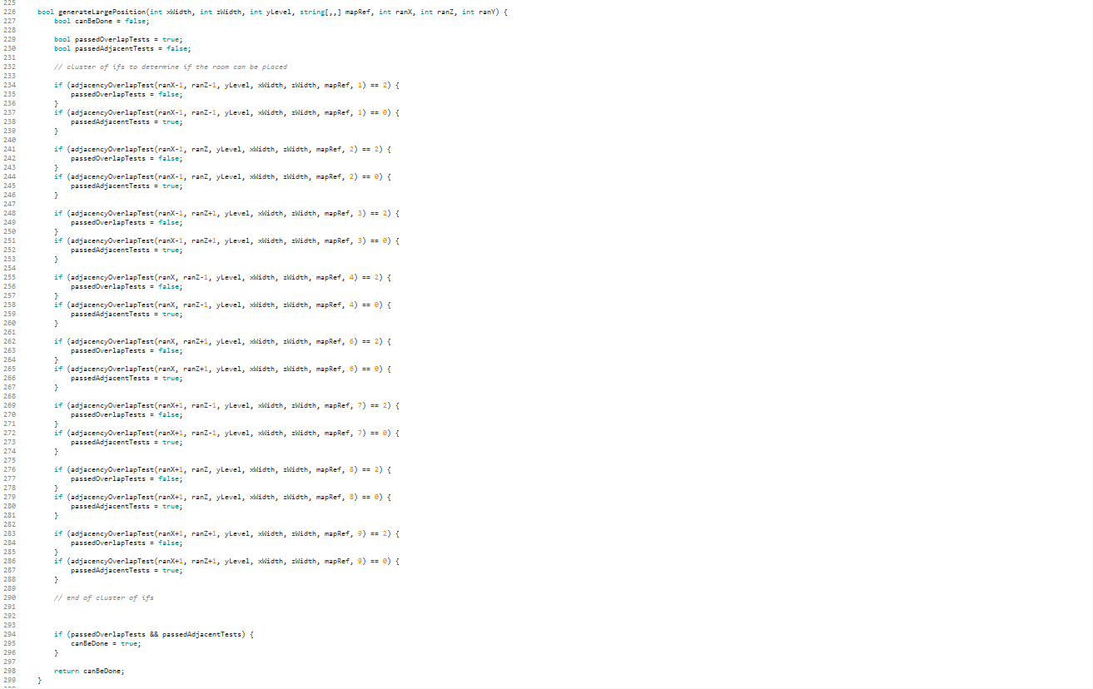
How Large Rooms Work
Generate Position
Overlap/Adjacency Tests
Update Map

Slide 10
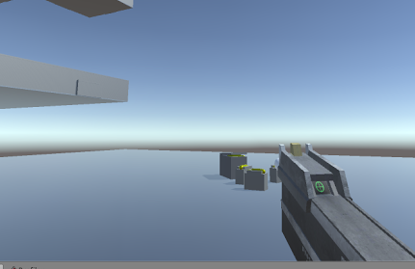
User feedback
Create direct feedback when player shoot
Gun recoil
Sound feedback
Animation

Slide 11
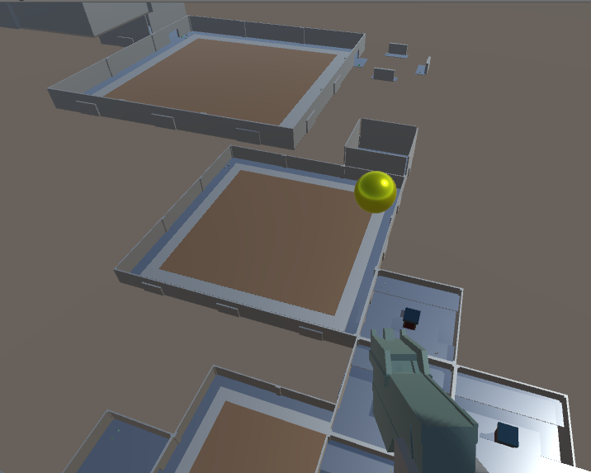
Overall Progress
Procedural level generation
Turret-like enemy
Basic movement
Solid framework to build on
Notes:
Overall Progress - ~1min. What we have right now when we launch the game

Slide 12
Future Goals
Added scenes and room permutations
Mobile enemies (pathfinding AI)
Improved movement code
Sound additions (refined triggers)
Level objective
Notes:
Future goals - ~1min. What we’ll work toward, and how we may approach the tasks.
@ Friends, feel free to add

Slide 13
Questions?
Notes:
Q&A + outro - remaining time – take questions from class (and more likely Dr Raffe), and give the class our regards

